Slide 1


感恩遇见，相互成就，本课件资料仅供您个人参考、教学使用，严禁自行在网络传播，违者依知识产权法追究法律责任。
更多教学资源请关注
公众号：溯恩英语
知识产权声明

Slide 2
活用教材词汇，靶向高考写作
M6U4单词拓展
浙江省嵊州市高级中学：尹 娟

Slide 3

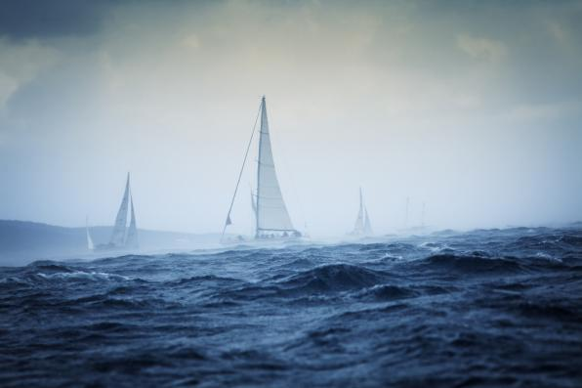
1. adversity/ ədˈvɜːsəti / n. 逆境;厄运;(经济方面的)窘境; (常作-ties)灾祸;灾难;不幸
1.尽管面临了许多逆境，她从未放弃，并成功取得了事业上的成就。（应、续）
2.苦尽甘来.----莎士比亚（应、续）
3.岁寒知松柏,逆境显美德。（应、续）
4.在逆境中，我们要学会调整心态，积极面对困难，努力寻找解决问题的办法。（应、续）
5. 有充分准备的人,在逆境中充满希望,在顺境中不忘担忧。（应、续）
Despite facing numerous adversities, she never gave up and managed to achieve success in her career.
Sweet are the uses of adversity. ---William Shakespeare
Adversity reveals virtue.
In adversity, we should learn to adjust our mentality, actively face difficulties, and strive to find solutions to problems.
A well-prepared mind hopes in adversity and fears in prosperity.

Slide 4



2.wage /weɪdʒ/ vi. 进行；发动；从事 vt. 开展；进行 n. 工资；报偿；代价
1. 最低工资; 平均工资; 工资水准，薪金标准，工资收入;
最低生活工资; 计时工资，按时计酬; 冻结工资; 效率工资（续）
2. 他的工资足够他舒适地生活。（续）
3. 但是我们知道如何获得战斗的胜利。（应、续）
4. 政府誓言向污染宣战。（应）
minimum wage; average wage; wage level；wage income;
living wage; hourly wage; freeze wages；efficiency wage
His wage is sufficient for him to live comfortably.
But we know how to wage this fight.
4. The government vowed to wage war on pollution.

Slide 5
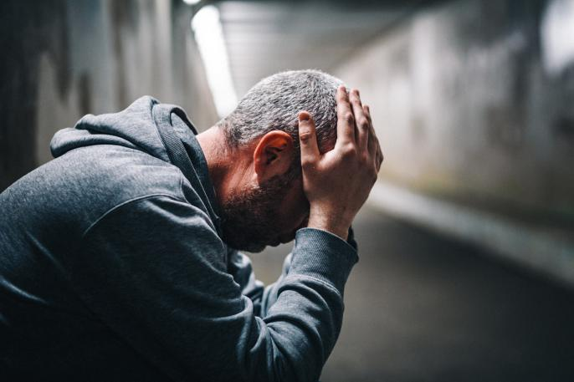

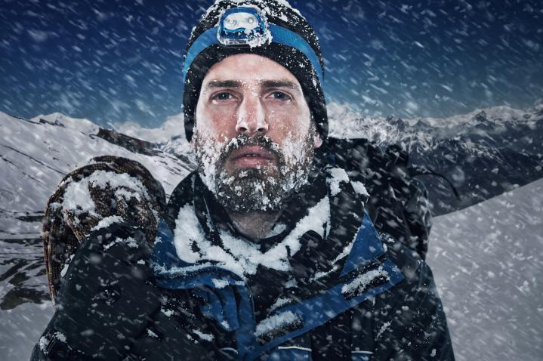
3.bitter/ˈbɪtə(r)/ adj.严寒的；激烈而不愉快的；味苦的
1. 痛苦的失望（续） 2. 人生的辛酸（续） 3. 极其寒冷地夜晚（续） 4. 看到痛苦中的甘甜（续） 5. 苦乐参半的回忆（应、续） 6. 难以接受的真相；让人难以忍受的悲伤（续） 7. 一个严冬的傍晚（续） 8. 从北方吹来的寒风（续） 9. 自责的悔恨泪水（续） 10. 人世间的悲欢（续） 11. 痛苦地流泪水（续）
1. a bitter disappointment
2. the bitter taste of life
3. a bitter cold night
4. take the bitter with the sweet
5. bitter-sweet memories
6. the bitter truth; bitter sorrow
7. a bitter winter's eve
8. a bitter wind blew from the north
9. the bitter tears of self-reproach
10. the sweets and bitters of life
11. cried bitter tears

Slide 6

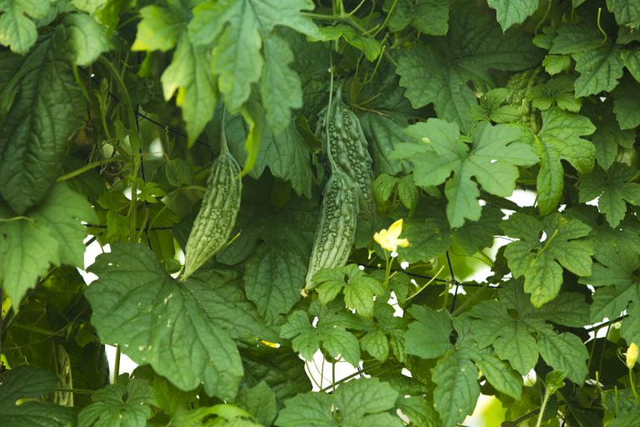
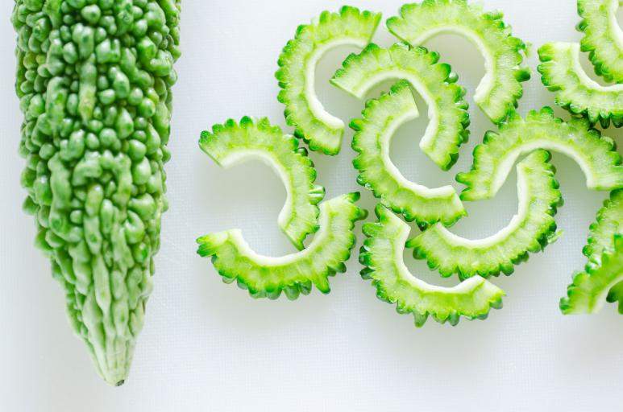
3.bitter/ˈbɪtə(r)/ adj.严寒的；激烈而不愉快的；味苦的
12. 罗恩露出一个满意的微笑，“他嫉妒啊。”（续）
13. 那里的植株会非常矮，而且非常苦。（续）
Ron gave a satisfied smile. “He’s bitter.”
There the plant is very short and really quite bitter!

Slide 7



4. expedition/ˌekspəˈdɪʃn/ n.探险；远征；探险队
1. 一次寻找长江源头的探险（应、续）
2. 穿越森林的探险充满着艰辛和危险。（应、续）
an expedition to find the beginning of the Changjiang River
The expedition through the jungle was fraught with difficulty and danger.

Slide 8


5. endurance/ ɪnˈdjʊərəns / n.忍耐力；耐久力
1. vt.忍耐；忍受；持续；持久
2. adj. 持久的；耐久的
3. 通过努力工作和坚持，我们将会完成这项方案。（应、续）
4.坚持不懈是增强体力、耐力和毅力的关键。（应、续）
5.这项练习将明显增强力量和耐力。（应、续）
endure
enduring
Through hard work and endurance, we will complete this project.
4. Consistency is the key to getting stronger and building endurance and stamina.
5. The exercise obviously will improve strength and endurance.

Slide 9

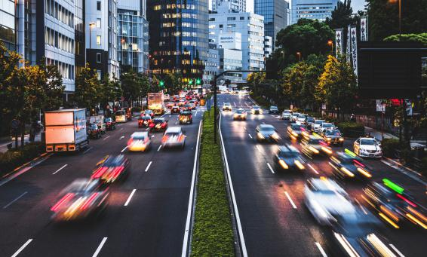
6. vigour(NAmE vigor) /ˈvɪɡə(r) / n.精力；力量；活力
1. adj. 有力的；精力充沛的
2. 给这个运动注入新的生命力（应、续）
3. 它可以有助于确保整个人口的神志、活力和快乐。（应）
4. 第二天我精神抖擞地回归到实验助手角色。（续）
5. 只有这样做，我们才能使的国家保持生机和活力。（应）
vigorous
infused new vigor into the movement.
It can help to ensure the sanity, vigor and happiness of a whole population.
The next day I returned to my role as lab assistant with renewed vigor.
Only by doing so can we maintain the vigor and vitality of our nation.

Slide 10


7. turn sb. down 拒绝(某人)
减小，关小，调低
出现；到场；开大；调高音量
转身
证明是；结果是
转向；求助于；查阅
翻转；移交
打开/关闭(开关)
上交
变成
turn sb. down
turn up
turn around/round
turn out...
turn to...
turn over
turn on/off
turn in
turn into

Slide 11


7. turn sb. down 拒绝(某人)
1. 她为什么谢绝你的邀请？（应、续）
2. 我感谢他的好意，但拒绝了他。（续）
Why did she turn down your invitation?
I thanked him for the offer but turned it down.

Slide 12


8. qualified/ˈkwɒlɪfaɪd/ adj.符合资格；具备……的知识(或技能、学历等)
vt. 取得资格(或学历);合格;使合格;使具备资格
n．资格；资历；资格证
1. 我们都认为他是一名合格的教师。（应）
2. 我想我很适合这里的会计职位。（应）
3. 我确信我自己胜任该职位。（应）
qualify
qualification
We all account him a qualified teacher.
I think I'm well qualified for the accountant position here.
I am sure that I am qualified for it.

Slide 13


9. enthusiastic /ɪnˌθju:ziˈæstɪk/ adj.热情的；热心的
热情；对…热心 adv.热情地 n. 热情；热心 1. 她看上去热情且能干。（应、续）
2. 热烈的掌声使他获得了信心。（应、续）
3. 他的演讲博得了一阵又一阵的热烈掌声。（应、续）
4. 这个职位对那些有雄心并且富于热情的人来说是理想的选择。（应、续）
be enthusiastic about
enthusiastically
enthusiasm
she looked enthusiastic and capable.
He drew reassurance from the enthusiastic applause.
His speech won round after round of enthusiastic applause.
This position is ideal for an ambitious and enthusiastic person.

Slide 14

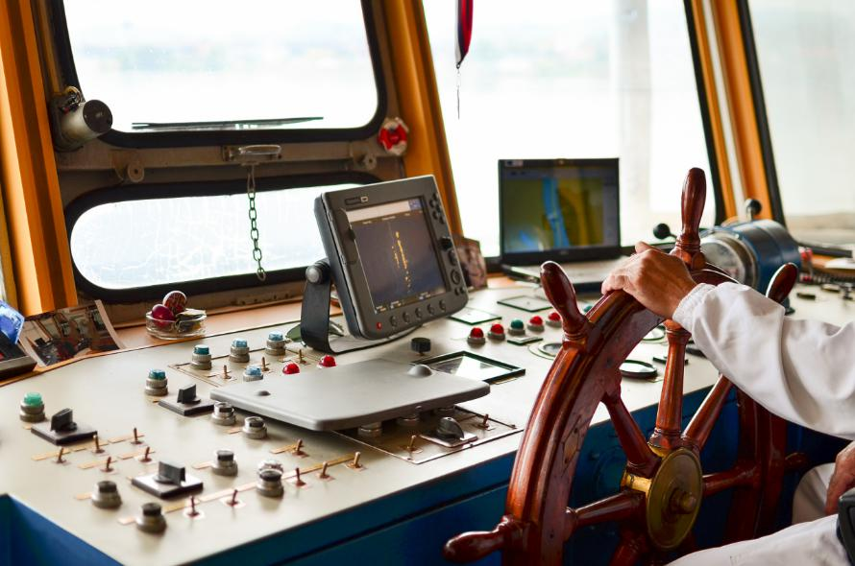
10. aboard / əˈbɔ:d/ adv.& prep.上(船、飞机、公共汽车等)
1. 等他们全都上车了，我们都含笑点头。（应、续）
2. 他已经登机了。（应、续）
3. 视听展览让参观者得以了解在航行中的船上生活是什么样子。（应、续）
When they are all aboard, we chuckle and nod.
He was already aboard the plane.
An audio-visual display gives visitors an idea of what life was like aboard a sailing ship.

Slide 15


11. assign /əˈsaɪn / vt.分派；布置；分配
指派某人做某事 将……分配给…… 被派遣到某地 指派某人 n．分派；布置；分配 1. 老师会给孩子们布置一个题目，让他们在周末写。（应、续）
2. 班长被分派作会议记录。（应、续）
assign sb.to do sth.
assign sth.to sb./assign sb.sth.
be assigned someplace
be assigned sb.
assignment
The teacher will assign a topic to children that they would write about during weekends.
The monitor was assigned to take notes for the meeting.

Slide 16
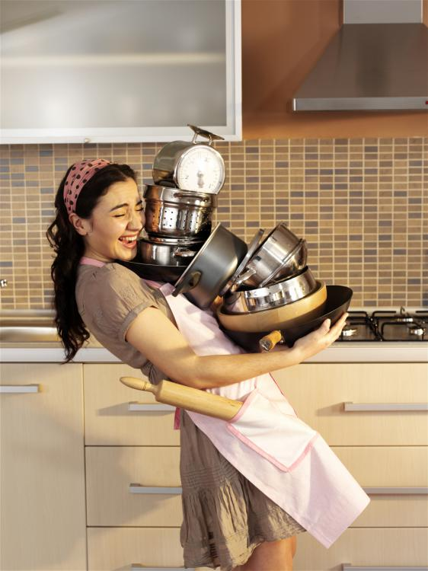

11. assign /əˈsaɪn / vt.分派；布置；分配
3. 于是我主动请缨，我住的这段期间，厨房的琐事全交给我好了。（应、续）
4. 当然，不应布置学生在没有昂贵设备的情况下无法完成的家庭作业。（应）
5. 今天上课时，老师给我们分配了阅读小组。（应、续）
So I requested that I be assigned kitchen detail for the duration of my stay.
Certainly, no homework should be assigned that students cannot do without expensive equipment.
Today at school we got assigned to reading groups.

Slide 17
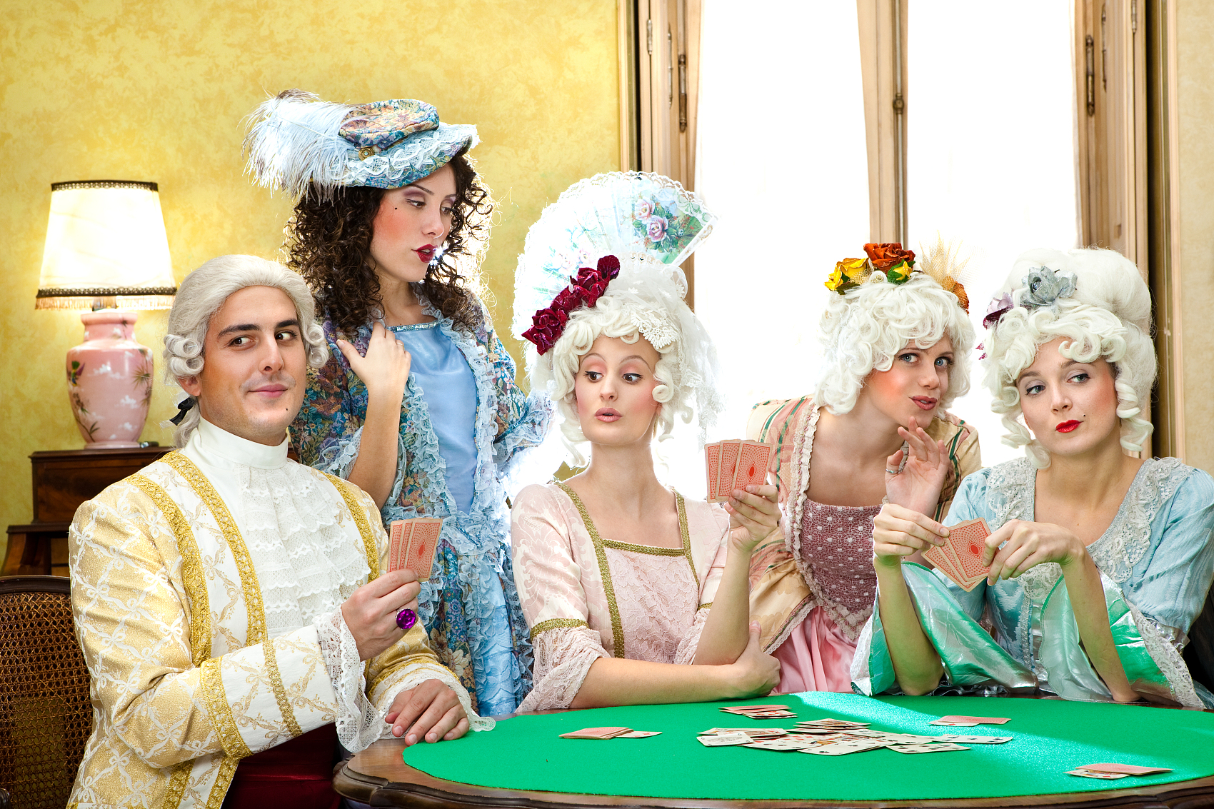

12.envy /ˈenvi/ n.&vt.羡慕；妒忌
adj.嫉妒的 羡慕/妒忌某人有某物 羡慕/妒忌某人做某事 对……忌妒 出于忌妒 妒忌(常作状语) 成为/是……妒忌或羡慕的对象
envious
envy sb.(for) sth.
envy sb.doing sth.
feel envy at ...
out of envy
with envy
become/be the envy of ...

Slide 18
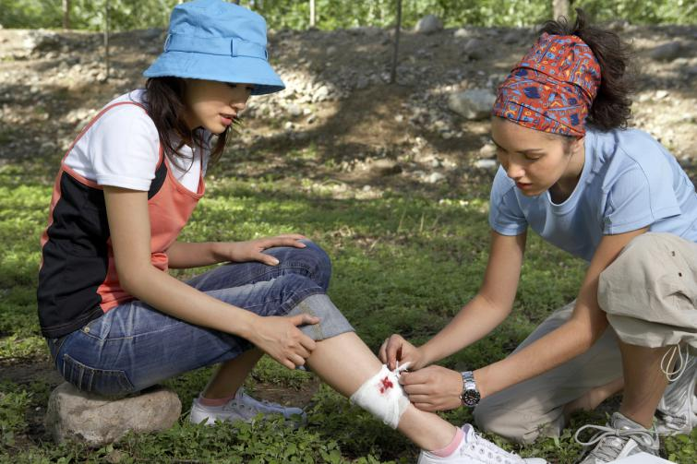

12.envy /ˈenvi/ n.&vt.羡慕；妒忌
1. 我真羡慕你有这样一位知心朋友，愿意与你同甘共苦。（应、续）
2. 我并不羡慕你在这种坏天气去旅行。（续）
3. 他们纯粹出于忌妒才说你这些不友善的话。（续）
4. 所有邻居都羡慕他们的花园。（续）
I envy you having such a close friend, who would like to share happiness and sorrow with you.
I don't feel envy at your journey in this bad weather.
They only said such unkind words about you out of envy.
Their beautiful garden is the envy of all the neighbors.

Slide 19


13.crush/krʌʃ / vt.毁坏；压坏；压碎 n.拥挤的人群
1. 列车上这么拥挤我几乎透不过气来。（续）
2. 那些没有被摧毁的人都变得更为强大。
（应、续）
There was such a crush on the train that I could hardly breathe.
People who were not crushed ended up being stronger.

Slide 20


14. sink /sɪŋk / vi.沉没;下沉；下降 vt.使下沉；使沉没n. 水池，水槽
sink into a deep sleep
沉沉入睡
1. 她的声音越来越低。（续）
2. 她退了回去, 不愿看着父亲发火。（续）
3. 太阳正在西下。（续）
4. 莎拉忙着把咖啡杯拿到洗碗槽那里。（续）
5. 他陷入沉思。（续）
Her voice had sunk even lower as she went on.
She sank back, unwilling to face her father's anger.
The sun was sinking in the west.
Sarah occupied herself taking the coffee cups over to the sink.
He was sunk in deep thought.

Slide 21

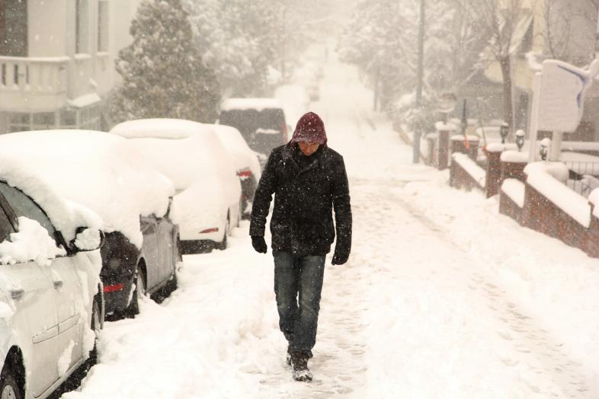
15.abandon/əˈbændən/ vt.舍弃；抛弃；放弃
1. 不要悲观失望。（应、续）
2. 因为下雨比赛停止了。（应、续）
3. 我们应该摒弃人们对心理问题的偏见。（应）
4. 我们正在快速下沉，船长下令弃船。（续）
5.大雪迫使许多驾驶者弃车步行。（续）
Do not abandon yourself to despair.
They abandoned the game because of rain.
We should abandon the prejudice against mental problems.
We were sinking fast, and the captain gave the order to abandon the ship.
Snow forced many drivers to abandon their vehicles.

Slide 22
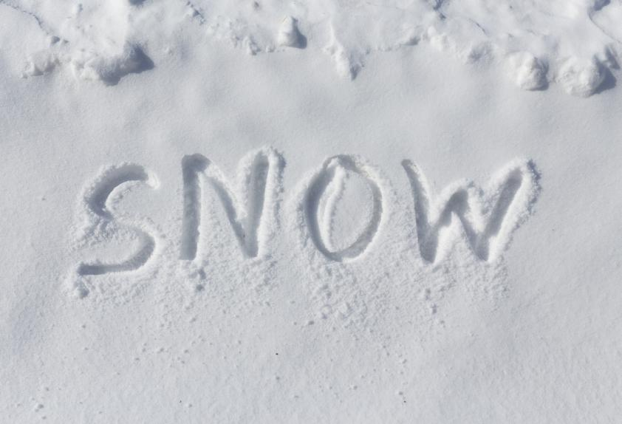

16. blanket /ˈblæŋkɪt/ n.毯子adj. 适用于任何情况的；总括的，综合的v. 以厚层覆盖
一层厚厚的雪
全面禁止香烟广告
1. 雪覆盖了地面。（应、续）
2. 她使劲抖动毯子以抖掉尘土。（续）
a thick blanket of snow
blanket ban on tobacco advertising
The snow blanketed the ground.
She shook the blankets vigorously to get rid of the dust.

Slide 23
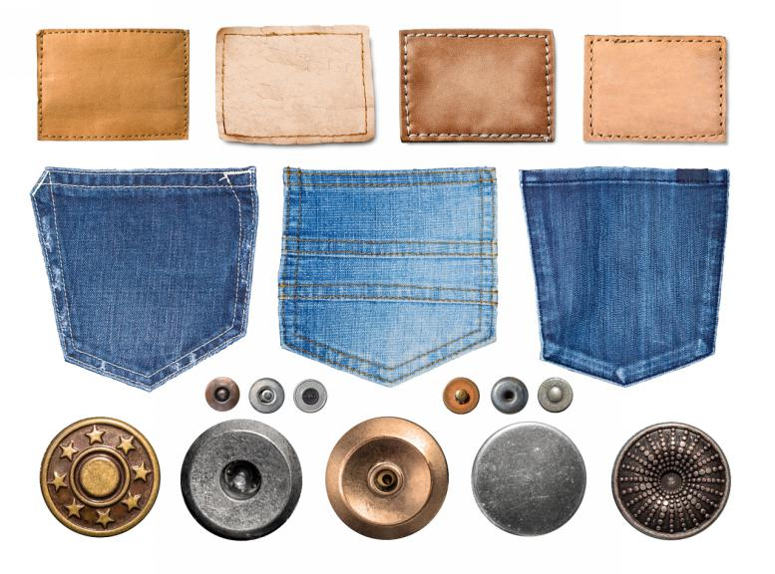
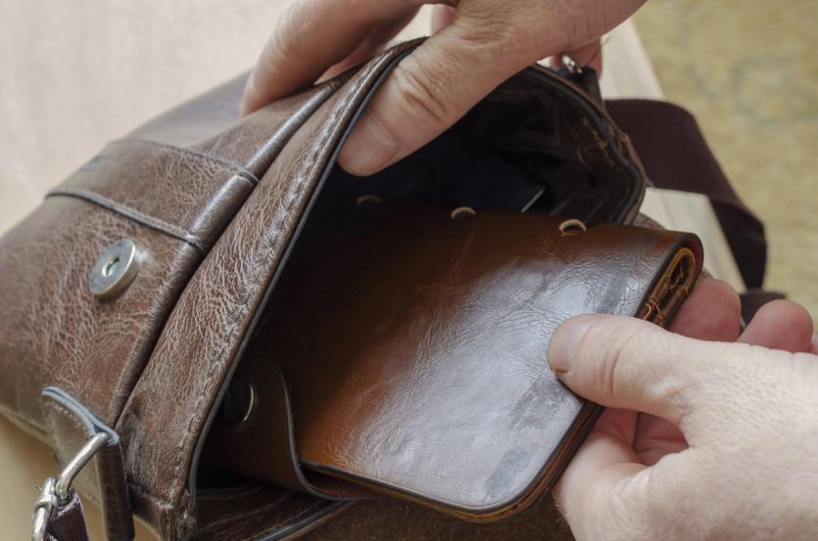
17. belongings/bɪˈlɒŋɪŋz / n. [pl.]财物；动产; 家眷；亲属；亲戚
n. 附属品，附件；属性
vi. 属于；是…的成员,应被放在，应归入,适应，合得来
1. 我把几件私人物品装进包中。（续）
2. 他仔细翻看了她的东西，希望找到一些情报。（续）
belonging
belong
I put a few personal belongings in a bag.
He looked through her belongings in the hope of coming across some information.

Slide 24


18. miserable/ˈmɪzrəbl / adj.痛苦的；令人难受的
令人非常难受的气候
1. 他们假期开始时天气很不好。（应、续）
2. 我们回到家后，我控制不住自己，让母亲看出了我有多痛苦。（续）
a miserable climate
They started their holiday on a miserable day.
And when we arrived home, I could not help showing my mother how very miserable I was.

Slide 25


19. decent /ˈdiːsnt/ adj.相当不错的；正派的；得体的
高雅的谈吐和行为 一份相当不错的薪水 1. 你真是太好了（应、续）。
2. 他挣一份很不错的工资。（续）
3. 这些措施还不错，但还远远不够。（应、续）
decent language and decent behaviour
a decent salary
That's awfully decent of you.
He earns a decent wage
These are decent measures—but nowhere near enough.

Slide 26


20. cosy/ˈkəʊzi / adj.温馨的；舒适的
1. 这是一个人们都很友善的温馨的乡镇。（应、续）
2. 我们在炉火旁聊天度过了一个舒适的晚上。（应、续）
3. 摇曳的灯光给房间一种温暖而有人气的感觉（续）
4. 床上温暖而又舒适， 西蒙简直不想下床了。（续）
It’s a cosy rural town populated with friendly folk.
We spent a cosy evening chatting by the fire.
The flickering lamp gave the room a cosy lived-in air.
It was so warm and cosy in bed that Simon didn't want to get out.

Slide 27



21. selfish/ˈselfɪʃ/ adj.自私的
adj. 无私的, 忘我的
1. 我想道歉 因为我太过自私。（应、续）
2. 努力追求快乐算不上是自私。（应、续）
3. 我们对你们及时而无私的援助真是感激不尽。（应、续）
selfless
I want to apologize for being selfish.
It is not selfish to strive for happiness.
We cannot be thankful enough to you for your timely and selfless help.

Slide 28



22.good/bad-tempered adj.脾气好的/坏的
1. 他表面脾气暴躁，实则菩萨心肠。（续）
2. 她的同学都非常喜欢她，因为她脾气好，具备很容易讨人喜欢的艺术才能。（应、续）
He seems bad-tempered, but he's very soft-hearted underneath.
She was a great favorite with her mates, being good–tempered and possessing the happy art of pleasing without effort.

Slide 29


23.genuine/ˈdʒenjuɪn/ adj.真正的；真诚的；可信赖的
1. 她看起来很真诚，也很优雅。（应、续）
2. 选择坦率真诚的人做朋友。（应、续）
3. 给予真诚的微笑，使用令人舒适的肢体语言。（应、续）
She seemed so genuine and so refined.
Pick friends who are genuine and sincere.
Give genuine smiles and use welcoming body language.

Slide 30
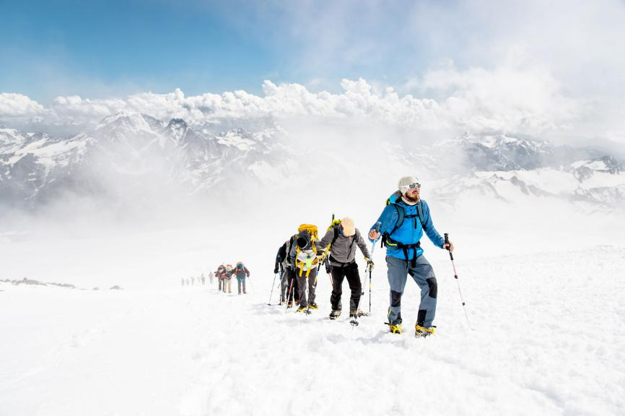

24. perseverance/ˌpɜːsəˈvɪərəns / n.毅力；韧性；不屈不挠的精神
1. 忍耐是成功的重要条件。（应、续）
2. 毅力加上精力是人生成功的要素。（应、续）
3. 努力、决心、坚持就是成功三秘诀。（应、续）
Perseverance is vital to success.
Perseverance combined with energy is necessary to success in life.
Hard work, determination, and perseverance always win out.

Slide 31


24. perseverance/ˌpɜːsəˈvɪərəns / n.毅力；韧性；不屈不挠的精神
4. 他从末停止努力，表现出了极大的毅力。（应、续）
5. 他能赢得那样的比赛证明了他的毅力。（应、续）
6. 要更上一层楼，唯一的途径就是艰苦奋斗，不屈不挠。（应、续）
He has never stopped trying and showed great perseverance.
For him to win the game like that is a testament to his perseverance.
The only way to improve is through hard work and dogged perseverance.

Slide 32



25. persevere/ ˌpɜːsɪˈvɪə(r)/ vi.坚持；孜孜以求
1. 尽管他身体不好, 他仍孜孜不倦地学习。（应、续）
2. 接受挫败并学会坚持，不畏风险地追求你的梦想。（应、续）
3. 这样，你就可以激励自己努力工作，在失败中坚持下去。（应、续）
4. 在他们的支持下，你可以在困难中坚持，直面令人生畏的障碍，实现你一生的梦想。（应、续）
Although he is in poor health, he still perseveres in his studies.
Accept disappointment and learn to persevere, to pursue your dreams despite pitfalls.
And that way, you can motivate yourself to work hard and persevere through failure.
With their support, you can persevere through rough patches, face intimidating obstacles, and achieve your lifelong dreams.

Slide 33



26.resolve / rɪˈzɒlv/ vi.&vt.决定；决心；解决(问题或困难) n.决心；坚定的信念
resolution/ˌrezəˈluːʃn /
n.决议；解决；坚定
1. 我决定学英语。（应、续）
2. 他承诺：“所有的担忧都会得到解决。”（续）
3. 他的决心开始动摇了。（续）
4. 那景象似乎坚定了他的决心，他点了点头。（续）
I resolve to study English.
He promised, " All worries will be resolved" .
His resolve began to waver.
The sight seemed to strengthen his resolve, and he nodded.

Slide 34
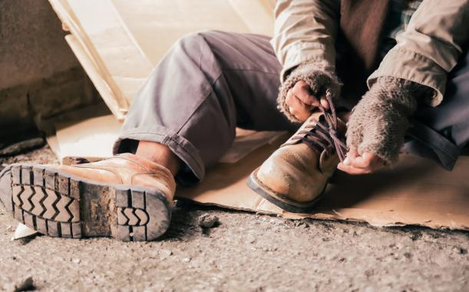


27. cruel/ˈkruːəl/ adj.残酷的；残忍的；冷酷的
1. 命运给他以惨痛的打击。（续）
2. 漫长的严冬终于结束, 随之而来的是温暖的春天。（应、续）
3. 或许你认为这很残酷，但是，有些人会称这是爱，严厉的爱！（续）
Fate dealt him a cruel blow.
The long cruel winter came to an end at last, yielding to a gentle warm spring.
Maybe you'd call it cruel but others would call it love, tough love!

Slide 35

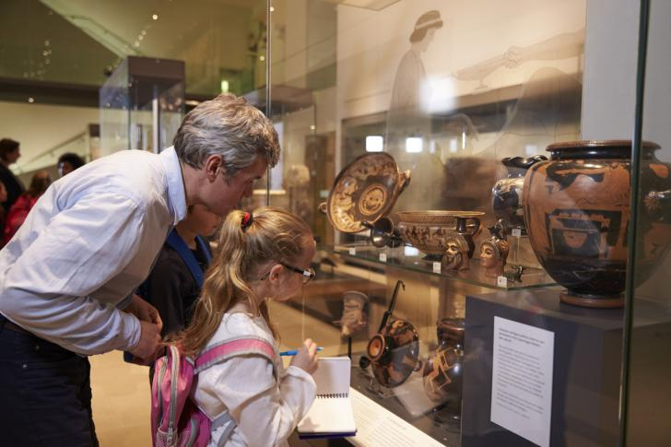
28. thorough/ˈθʌrə / adj.深入的；彻底的；细致的
1. 他在雷雨中浑身湿透了。（应、续）
2. 你应该对某一题目有深刻的了解。（应、续）
3. 请把房间彻底打扫一下。（应、续）
4. 博物馆的收藏尽量做到既彻底又令人惊讶。（应、续）
He got a thorough wet in a thunderstorm.
You are supposed to have a thorough grasp of a subject.
Give the room a thorough clean please.
The museum's collection manages to be both thorough and surprising.

Slide 36

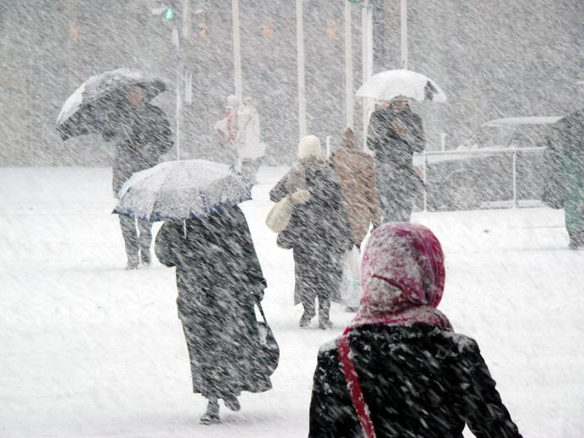
29. unfortunately/ ʌnˈfɔːtʃənətli/ adv.不幸地；遗憾地
fortunately/ˈfɔːtʃənətli/
adv.幸运地
1. 不幸的是乔治今天不能来了,故而我很荣幸能替他领奖。
（应、续）
2. 很好的点子，可惜并没有成功。（应、续）
3. 不幸的是，这些暴风雪带来了严重的后果。（应、续）
Unfortunately, George cannot be with us today so I am pleased to accept this award on his behalf.
A good idea, unfortunately it doesn't work.
And unfortunately, those storms came with consequences.

Slide 37
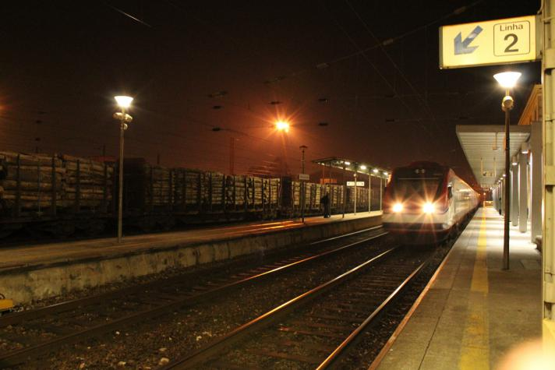

29. unfortunately/ ʌnˈfɔːtʃənətli/ adv.不幸地；遗憾地
4. 我到达火车站时已经迟了, 但是幸亏火车也误了点。
（应、续）
5. 幸好,风浪使船只受到的损坏较轻。（续）
6. 幸运的是，她一认识到自己冒犯了他们就知趣地道了歉。 （续）
I was late in getting to the station, but fortunately for me, the train was late too.
Fortunately,the stormy waves caused trifling damage to the boat.
Fortunately, she had the grace to apologize as soon as she realized she had offended them.

Slide 38
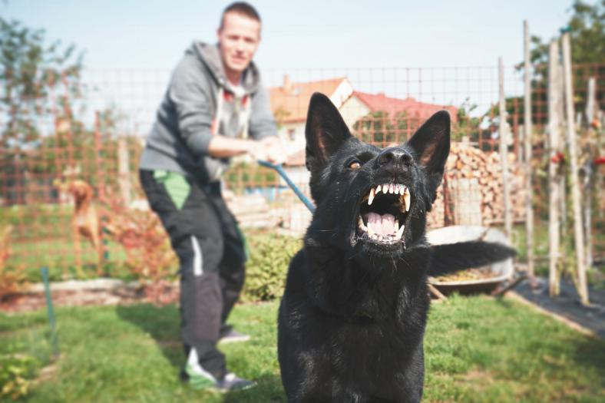

30. bark/ bɑːk/ vi.&n.(狗)吠叫；吠叫声;大声喊出
1. 这只狗对陌生人吠叫。（续）
2. 她呵呵大笑。（续）
3. 狗很吵，几乎所有的狗都对陌生人狂吠，有些狗吠声特别大。（续）
4. 那军官大声发出命令。（续）
The dog barks at strangers.
She barked with laughter.
Dogs are noisy. Nearly all dogs bark at strangers. Some dogs bark more loudly than others.
The officer barked out an order.

Slide 39


31. bat /bæt/ n.球拍；蝙蝠 vi.&vt.用球板击球；挥打；拍打
充分考虑一个主意（应、续）
眨动眼睫毛（续）
草草撰写演讲稿；赶写一首舞曲（应、续）
1. 不戴眼镜我简直跟瞎子一样。（续）
2. 等到最后再挥棒。（应、续）
bat an idea around
bat one's eyelashes
bat out a speech; bat out dance music.
I’m as blind as a bat without my glasses.
Wait unit the last minute and swing the bat.

Slide 40

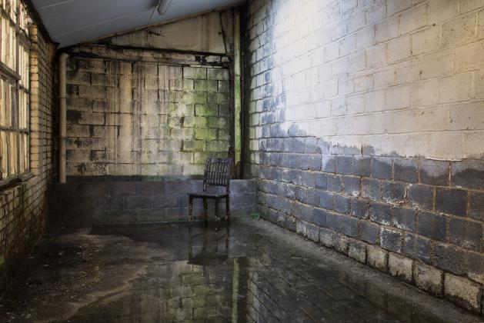

32. damp/dæmp/ adj.潮湿的；湿气重的
湿而阴郁的天（应、续）
1. 地下室很潮湿。（续）
2. 他们在湿冷的雾天直哆嗦。（续）
3. 他走了十英里路，到家时浑身湿透，疲惫不堪。（应、续）
a damp, gloomy day
It is rather damp in the basement.
They shivered in the damp foggy cold.
He reached home damp and weary enough after his ten-mile walk.

Slide 41


33. recreation/ˌrekriˈeɪʃn / n.娱乐；消遣；游戏
1. 唯一的消遣方式是体育运动。（应、续）
2. 这儿可以进行各种形式的娱乐活动。（应、续）
3. 在体育馆的旁边，是休闲娱乐中心，学生可以在这里下棋和跳舞。（应、续）
4. 因为这两个原因，我最喜欢的娱乐活动是在公园里遛狗。（应、续）
The only form of recreation they had was sports.
There's lots of opportunity to exercise and do various forms of recreation.
Next to it, there is a recreation centre where students play chess and dance.
For these two reasons, my favorite recreation activity is walking my dog in the park.

Slide 42
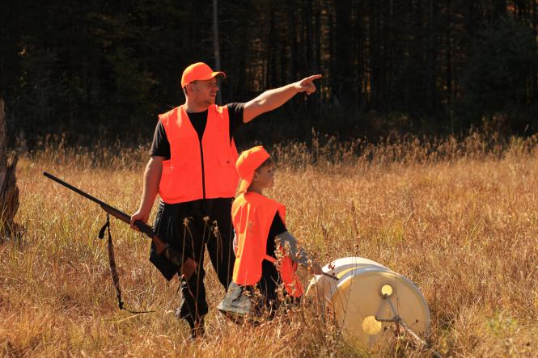

34. guidance/ˈɡaɪdns / n.指导；引导；导航
在…的指引下 1. 在一位有经验的猎人的带领下,我们很容易地从悬崖边上爬下了山。（应、续）
2. 这给学习者以自主学习方面的指导。（应、续）
3. 他在生活中和工作中都对我进行指导。（应、续）
4. 如果需要指导，尽可找我们。（应、续）
under the guidance of
Under the guidance of the experienced hunter, we easily climbed down the side of the cliff.
This gives learners guidance in their self-directed learning.
He's given me guidance both personal and professional.
So please know we are a resource if you need any guidance.

Slide 43


35. advertise /ˈædvətaɪz / vt.&vi.公布；宣传；做广告
1. 我们通过报纸宣传。（应、续）
2. 公司登广告招聘一名新秘书。（应、续）
3. 他们为即将举办的音乐会作广告。（应、续）
4. 梅里尔咳了咳，想让大家注意到她在场。（续）
We advertised through the press.
The company advertised for a new secretary.
They advertise a forthcoming concert.
Meryl coughed briefly to advertise her presence.

Slide 44


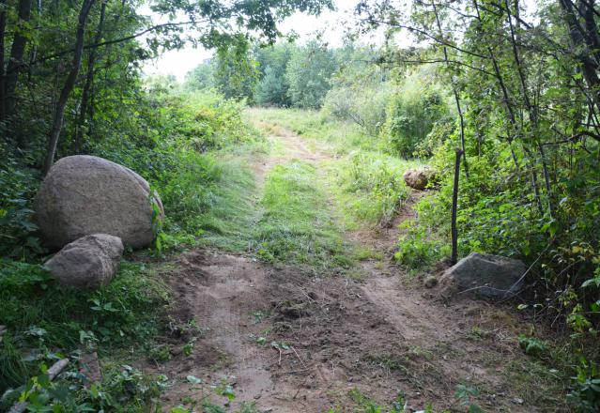
36. rough/ rʌf / adj.汹涌的；粗糙的；粗略的
1. 小船在汹涌的湖面上下摆动。（续）
2. 那些探险者进入丛林后, 不得不过着艰苦的生活。（续）
3. 一辆警车在通向村庄的高低不平的小路上颠簸地行进。（续）
The small boat was bobbing on the rough water of the lake.
The explorers had to rough it when they got into the jungle.
A police car jogged along on the rough path to the village.

Slide 45

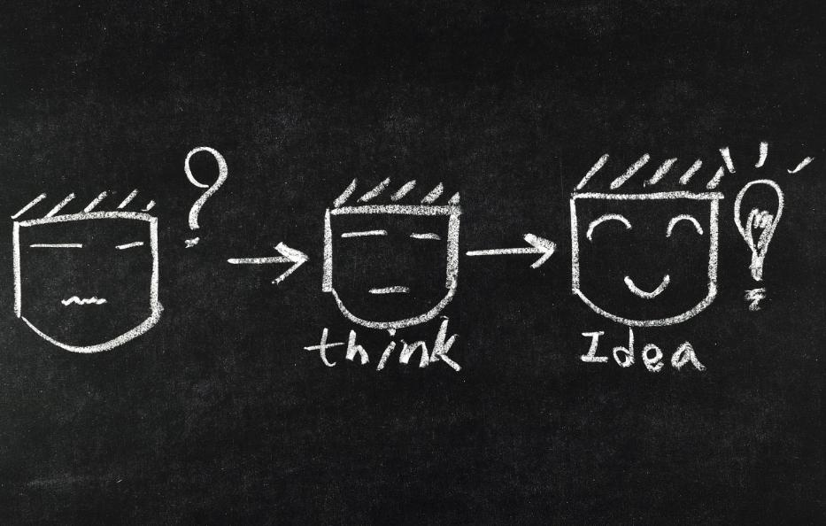
36. rough/ rʌf / adj.汹涌的；粗糙的；粗略的
4. 风浪里试舵手,困难中识英雄。（应、续）
5. 他既无工作又无钱, 只好在野外露宿数月。（续）
6. 这只是初步想法, 以后我将详加说明。（应、续）
A helmsman is tested in a rough sea; a hero is distinguished in difficult circumstances.
Jobless and penniless, he had to sleep rough in the fields for several months.
This is only a rough idea; I'll go into top particulars later on.

Slide 46



37. loyal/ˈlɔɪəl/ adj.忠诚的；忠实的
n. 忠诚；忠实
1. 我们必须忠于祖国。（应、续）
2. 她很忠诚，完全值得信赖。（应、续）
3. 这家显赫的老旅店拥有忠实但颇多要求的顾客。（应、续）
4. 如果善待动物，它们会保持对人类的忠心。（应、续）
loyalty
We must be loyal to our motherland.
She is loyal and totally dependable.
The grand old hotel has loyal but demanding customers.
The animals will remain loyal to humans if treated well.

Slide 47


38. candidate/ˈkændɪdət / n.候选人；应试者
1. 该求职者的经历和这项工作很相称。（应、续）
2. 校长鼓励参加全国数学竞赛的选手们争取最好的成绩。（应、续）
3. 看了你的简历，我们认为你是一位不错的人选。（应、续）
The candidate's experience is relevant to the job.
The headmaster encouraged the candidates for the national maths competition to strive for the best results.
We looked into your resume and thought you might be a good candidate.

Slide 48
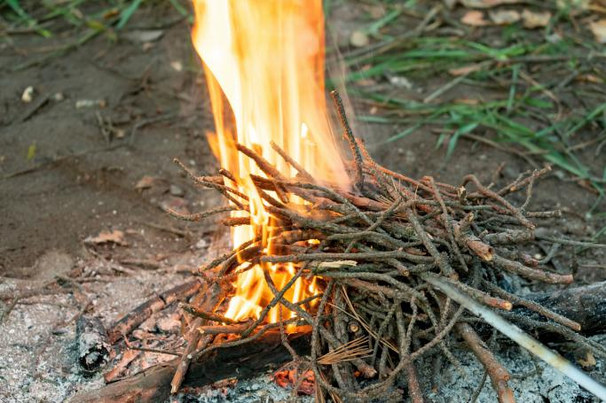
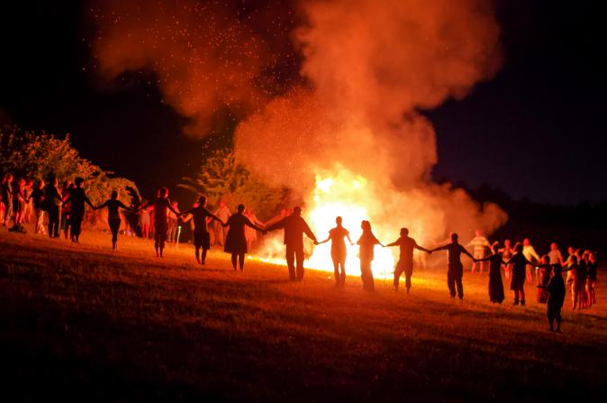
39. make（a）fire 生火
1. 咱们找些树枝来生火吧。（续）
2. 我们常在灌木丛中生起一堆火。（续）
3. 他找了些木头，生起了火，开始做早饭。（续）
4. 他们在沙滩上生火并围着火跳舞。（应、续）
Let's find some sticks to make a fire.
Often we would make a fire in the bushes.
He found wood to make a fire, and prepared breakfast.
They made their fire on the sand and danced round it.

Slide 49
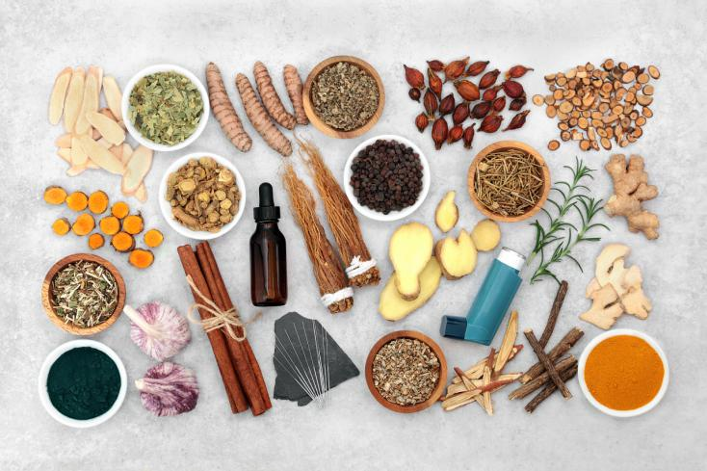

40. give off 放出(热、光、气味或气体)
向某人投降/屈服/让步 分配；分发；用光；筋疲力尽 放弃；认输 屈服；投降；让步；上交 泄露；赠送 1. 这些中草药散发出一种独特的气味。（应、续） 2. 你可以试试发出信号。（应、续）
give in to sb.
give out
give up
give in
give away
These Chinese herbal medicine gives off a unique smell.
You can try to give off signals.

Slide 50


41. episode/ˈepɪsəʊd/ n.(人生的)一段经历；(小说的)片段；插曲
1. 这段经历至今仍深深地铭刻在我的心中。（应、续）
2. 这段小插曲令所有有关人员都感到非常尴尬。 （应、续）
3. 欢迎来到本周的图书谈话节目。（应、续）
This episode remains sharply engraved on my mind.
The episode was a huge embarrassment for all concerned.
Welcome to this week's episode of book talk.

Slide 51


42. commitment/kəˈmɪtmənt / n.承诺；保证；奉献
vt. 承诺；保证（某个人；机构等）；vi. 忠于；全心全意投入 adj. 尽心尽力的；坚定的；坚信的 1. 此刻我不能作出这样的承诺。（续）
2. 必须投入大量的时间和金钱。（应、续） 3. 感谢你们的付出。（应、续）
4. 但这并不减少我们的承诺，而是使之更加坚定。（应、续）
commit
committed
I cannot make such a commitment at the moment.
There must be a major commitment of money and time.
Thank you for making this commitment.
But that does not weaken our commitment; it only reinforces it.

Slide 52


43. motive/ˈməʊtɪv/ n.动机；原因；目的
vt. 成为......的动机；激发；激励 adj. 积极的；主动的 n. 动力；积极性；动机 1. 这些措施有几个积极的动机。（应、续）
2. 当然，目前我们还不知道他的动机。（续）
motivate
motivated
motivation
Such measures have a couple of uplifting motives.
Of course, we still don't know his motive.

Slide 53
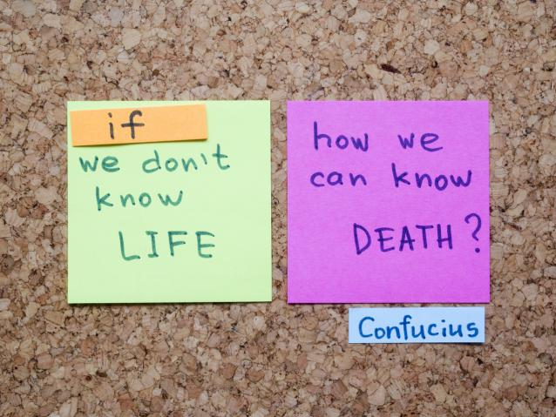
44. Confucianism/ kənˈfjuːʃənɪzm / n.孔子学说；儒家(学说)
adj. 儒家的；儒学的；孔子学说的 n. 孔子 1. 儒家思想也深深地影响了中国的艺术、文学和文化表达。（应）
2. 儒家和道家都强调同情的重要性。（应、续）
3. 儒家思想是中国最大的思想流派，也是中国古代的主流意识。（应、续）
4. 多亏了这位学者，我们才有机会欣赏五大儒学经典著作之一的《尚书》。（应）
Confucian
Confucius
Confucianism also deeply influenced Chinese art, literature, and cultural expression.
Confucianism and Taoism both stress the importance of compassion.
Confucianism is the largest Chinese school of thoughts, and the mainstream consciousness of the ancient China.
Thanks to this scholar, we have the chance to enjoy the great book, Shangshu, one of the "five classics" of Confucianism.

Slide 54
Thank You!

