Slide 1


感恩遇见，相互成就，本课件资料仅供您个人参考、教学使用，严禁自行在网络传播，违者依知识产权法追究法律责任。
更多教学资源请关注
公众号：溯恩英语
知识产权声明

Slide 2
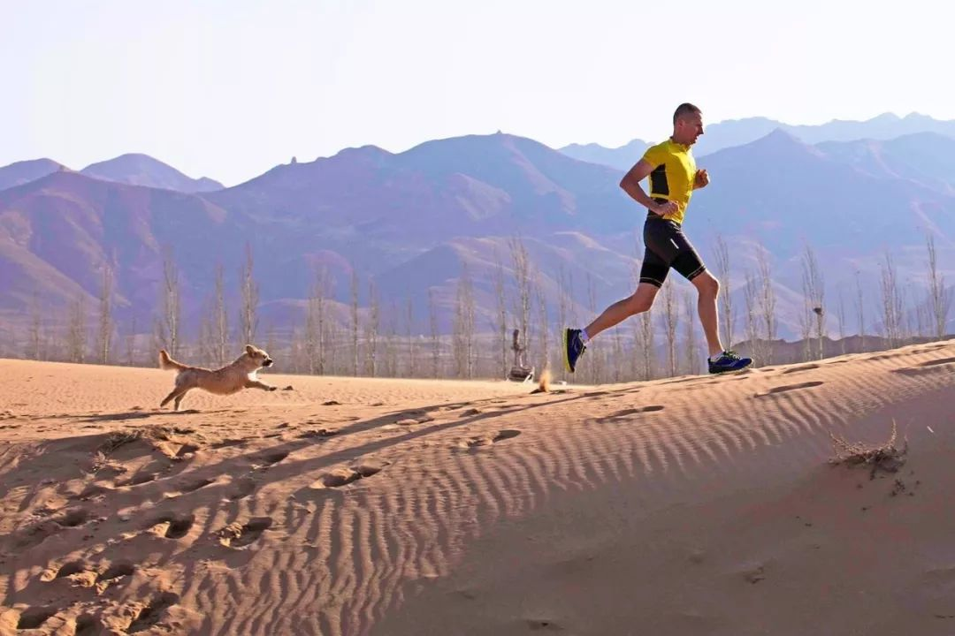


Slide 3
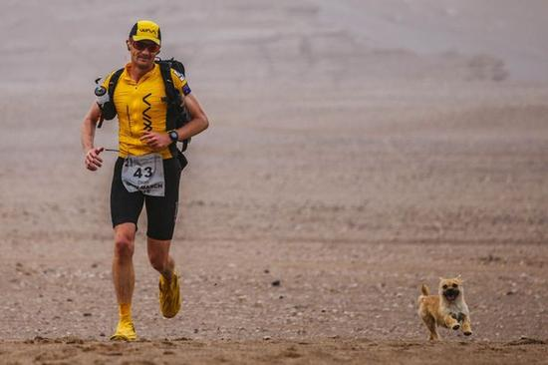
人狗奇缘

Slide 4
原文复现
Dion was having a running race. This race would stretch in six stages over seven days and cover almost 155 miles. Gobi, a little she-dog happened to join him. It was their third day.
The sky was clear, the weather was warm; the ground was firm beneath Gobi's feet. From time to time, Dion would look over at her and smile. The warmth of that smile was even brighter than the sun beating down on them, but in a good way. It filled Gobi up.

Slide 5
As they progressed, a broad river popped into their sight, lying right in front. Dion had no idea how deep it was, but the race markers led right across, so he had to assume he'd be able to make it across as well.
Taking a deep breath, he took a careful step into the water. It was surprisingly cold considering how warm the day was, and he sank down up to his waist, but that was it. At least the riverbed seemed solid. He could make his way across, he just had to go slowly. One wrong step and he'd get completely wet. Plus, he could hurt himself since he couldn't see where he was putting his feet. This was going to take a while.

Slide 6
Gobi watched as the man jumped into the water. She wagged her tail, but he didn't look her way. He was clearly busy concentrating. She sat down just before the water and watched. Surely, he would turn around and notice that she wasn't with him. But several minutes passed, and he got farther and farther away.
Finally, Gobi couldn't take it any longer. She began anxiously running up and down the riverbank. Was the man going to leave her?

Slide 7
At the sound of her bark, Dion stopped. He always made a point of facing forward, always forward, during a race. But this time he did glance back. Gobi was sitting at the river's edge, barking fiercely. There was no way the little dog could cross that on her own. These days, he'd fed her, given her water, and named her. He had to admit that he liked having her with him. She lifted his spirits.

Slide 8
Read for details
Dion was having a running race. This race would stretch in six stages over seven days and cover almost 155 miles. Gobi, a little she-dog happened to join him. It was their third day.
The sky was clear, the weather was warm; the ground was firm beneath Gobi's feet. From time to time, Dion would look over at her and smile. The warmth of that smile was even brighter than the sun beating down on them, but in a good way. It filled Gobi up.
Q1: What was Dion doing? What was Gobi?
Q2: How did Dion and Gobi get alone?

Slide 9
Read for details
As they progressed, a broad river popped into their sight, lying right in front. Dion had no idea how deep it was, but the race markers led right across, so he had to assume he'd be able to make it across as well.
Taking a deep breath, he took a careful step into the water. It was surprisingly cold considering how warm the day was, and he sank down up to his waist, but that was it. At least the riverbed seemed solid. He could make his way across, he just had to go slowly. One wrong step and he'd get completely wet. Plus, he could hurt himself since he couldn't see where he was putting his feet. This was going to take a while.
Q3: What was Dion’s task?
Q4: How was the water? How did Dion handle his task?

Slide 10
Read for details
Gobi watched as the man jumped into the water. She wagged her tail, but he didn't look her way. He was clearly busy concentrating. She sat down just before the water and watched. Surely, he would turn around and notice that she wasn't with him. But several minutes passed, and he got farther and farther away.
Finally, Gobi couldn't take it any longer. She began anxiously running up and down the riverbank. Was the man going to leave her?
Q5: What happened?
Q6: How did Gobi react?

Slide 11
Read for details
At the sound of her bark, Dion stopped. He always made a point of facing forward, always forward, during a race. But this time he did glance back. Gobi was sitting at the river's edge, barking fiercely. There was no way the little dog could cross that on her own. These days, he'd fed her, given her water, and named her. He had to admit that he liked having her with him. She lifted his spirits.
Q7: Can you use some words to describe the relationship between Dion and Gobi?

Slide 12
Read for cues
Dion was having a running race. This race would stretch in six stages over seven days and cover almost 155 miles. Gobi, a little she-dog happened to join him. It was their third day.
The sky was clear, the weather was warm; the ground was firm beneath Gobi's feet. From time to time, Dion would look over at her and smile. The warmth of that smile was even brighter than the sun beating down on them, but in a good way. It filled Gobi up.
Cue1：Dion finished his 155-miles race on the seventh day.
Cue2: Cold and wet, Dion and Gobi dried up and warmed up as the sun beat down on them.

Slide 13
Read for cues
As they progressed, a broad river popped into their sight, lying right in front. Dion had no idea how deep it was, but the race markers led right across, so he had to assume he'd be able to make it across as well.
Taking a deep breath, he took a careful step into the water. It was surprisingly cold considering how warm the day was, and he sank down up to his waist, but that was it. At least the riverbed seemed solid. He could make his way across, he just had to go slowly. One wrong step and he'd get completely wet. Plus, he could hurt himself since he couldn't see where he was putting his feet. This was going to take a while.
Cue3：Dion jumped into the water again with great caution .
Cue4: The freezing cold river water panicked Gobi.
Cue5: But this time the riverbed became muddy. (可以与第二段所给首句呼应）
Cue6: Unfortunately, something sharp in the riverbed hurt his feet.

Slide 14
Read for cues
Gobi watched as the man jumped into the water. She wagged her tail, but he didn't look her way. He was clearly busy concentrating. She sat down just before the water and watched. Surely, he would turn around and notice that she wasn't with him. But several minutes passed, and he got farther and farther away.
Finally, Gobi couldn't take it any longer. She began anxiously running up and down the riverbank. Was the man going to leave her?
Cue7：Dion would never leave Gobi. The bond between them got closer and closer beyond imagination.// became inseparable and tight.

Slide 15
Read for cues
At the sound of her bark, Dion stopped. He always made a point of facing forward, always forward, during a race. But this time he did glance back. Gobi was sitting at the river's edge, barking fiercely. There was no way the little dog could cross that on her own. These days, he'd fed her, given her water, and named her. He had to admit that he liked having her with him. She lifted his spirits.
Cue8：Dion walked back/ returned to Gobi to take her away with him .
Cue9: （再次过河把和对岸的Gobi 带走，Dion其实过了三次河）Wet , cold , exhausted and starving as Dion was, he breathed a sigh of relief, knowing that he would have Gobi with him again.
Cue10: (结合常识，沙漠跑七天，要露天住宿，想象夜晚小狗陪Dion的场景） Gobi would snuggle around him when he camped alone under the starry night sky. Gobi would inspire him to move on and on when he almost lost heart. (排比手法）

Slide 16
定两段情节—首段
Para1. Right now, listening to her barking as he left her behind nearly broke his heart.
Para2. This became tougher for Dion to cross the broad river.
首段情节：原文本最后一段表明Dion已经过河，Gobi 则在河的对岸；所给第二段首句Dion再次过河，提示首段情节为回到Gobi 所在的河畔并带上Gobi ，再次过河。可描写重聚的场景；且根据This became tougher for Dion…要在首段设置一个过河的障碍如：The riverbed suddenly became muddy and sticky. 再如：The cold water panicked Gobi, who suddenly jumped out of his arms, trying to get back.

Slide 17
定两段情节—二段
Para1. Right now, listening to her barking as he left her behind nearly broke his heart.
Para2. This became tougher for Dion to cross the broad river.
二段情节：思路1：结合所给首句，Dion 首先要再次顺利过河，如 Gobi 最终很镇定很配合；两次过河消耗Dion 不少体力，又湿又冷又累又饿，但是 心里满是重聚的快乐。 此外，可以涌现一下三天来与Gobi 有关的美好回忆。Dion继续比赛，和Gobi一起顺利抵达终点。思路2：结合原文的he could hurt himself since he couldn‘t see where he was putting his feet. 可以在第二段增加一个脚受伤的情节，让过河变得难上加难。

Slide 18
定四句之首段首句
At the sound of her bark, Dion stopped. He always made a point of facing forward, always forward, during a race. But this time he did glance back. Gobi was sitting at the river's edge, barking fiercely. There was no way the little dog could cross that on her own. These days, he'd fed her, given her water, and named her. He had to admit that he liked having her with him. She lifted his spirits.
Para1. Right now, listening to her barking as he left her behind nearly broke his heart. （故事角色：Dion ；小狗 Gobi）
首句1：(描写Dion矛盾的心理活动）Dion wanted to speed up but abandoning/ deserting Gobi put him into a dilemma. Who would cheer him up when he was down with the scorching sun?
首句2： （所给第一段的首句展示的是听觉造成Dion心痛的情感体验；心理活动也可以加强Dion的痛苦情感，以加强人与狗之间不可割舍的情谊）The thought of running the remaining race without Gobi flashed across his mind, which pained him.

Slide 19
定四句之首段尾句
Para1. Right now, listening to her barking as he left her behind nearly broke his heart.
尾句1：(冰冷的河水使Gobi惊慌失措，增加Dion过河难度） What he never expected was that the freezing/ biting cold river water panicked Gobi, struggling in water and wetting Dion.
尾句2：（依据原文the riverbed seemed solid 进行反向设计）While Dion was carrying Gobi toward the opposite riverbank, the riverbed suddenly became muddy and soft.
Para2. This became tougher for Dion to cross the broad river.

Slide 20
定四句之二段首句
Para2. This became tougher for Dion to cross the broad river.
二段首句：（根据原文最后一段以及所给首段情节设定，推知，此时，Dion 与Gobi一起在河水中。那么Dion 与Gobi 会有互动）
二段首句1： （以Dion为叙事对象，主位推进叙述方式）Petting Gobi’s back gently, Dion soothed his nervous companion.
二段首句2：（描写Dion 所见与所说） Looking into Gobi’s eyes, Dion reassured her/ consoled her, saying , “ Trust me and we’ll be safe.”

Slide 21
定四句之二段尾句
Para2. This became tougher for Dion to cross the broad river.
二段尾句：（根据原文最后一段提供的故事背景: Dion 参加了为期七天的长跑，结尾拉长故事的时间线到比赛结束。）
二段尾句1： （以Dion为叙事对象，主位推进叙述方式）Time ticking by, the race eventually came to an end. Gobi, despite the harsh conditions in the wild, crossed the finishing line together with Dion. What delighted Gobi most was that she was awarded with a specially- designed medal for her unique bravery and perseverance shown in the seven-day race.

Slide 22
定四句之二段尾句
Para2. This became tougher for Dion to cross the broad river.
二段尾句2：（以过河为继续越野赛跑的时间点，展望未来赛程：有了Gobi的陪伴与鼓舞，Dion 一定会征服比赛中出现的困难） Along/ Together with his loyal/ devoted pal/ fellow/partner/ companion, Dion would conquer the rest race in the following days.
// Dion would overcome every new obstacle in his remaining race.

Slide 23
第一段行文逻辑：
Para1. Right now, listening to her barking as he left her behind nearly broke his heart.
（心理活动也可以加强Dion的痛苦情感，以加强人与狗之间不可割舍的情谊）The thought of running the remaining race without Gobi flashed across his mind, which pained him.
（以Dion为叙事对象，主位推进法：Dion下定决心返回对岸）Though going back to Gobi across the river would slow him down, Dion made a resolution to take Gobi back.
（Dion主位推进法：夸张的手法）After what seemed like centuries, Dion made it back to Gobi.
(以小狗Gobi为叙事对象：见到Dion时的兴奋之情）Seeing Dion getting closer and closer, Gobi wagged her tail, barking like crazy.

Slide 24
第一段行文逻辑：
5. （Gobi 为叙事对象，Dion 一上岸就迫不及待投入Dion的怀抱，结合一下狗狗的舔的动作，表现人狗之间深情厚谊）No sooner had Dion risen from the river than Gobi threw herself into his arms, licking his face excitedly.
6.（Dion主位推进法，人狗相拥的场景）Trembling with cold, Dion hugged Gobi tightly, murmuring, “ Gobi, I just can’t leave you alone here. Then let’s cross the river together!”
7. （Dion主位推进法，再次进入河水，继续比赛赛程）With these words, Dion, once again, jumped into the river, carrying Gobi with him.
8. （结合二段所给的首句，设置一个过河的困难）What Dion never expected was that the freezing cold river water panicked Gobi, struggling in water and wetting him.

Slide 25
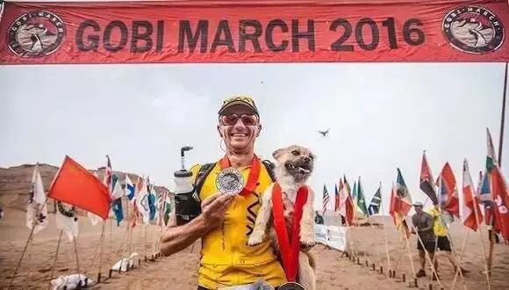
第一段行文逻辑：
Para2. This became tougher for Dion to cross the broad river.
（Dion主位推进：承接上文尾句小狗惊恐的反应，Dion 安抚）Patting Gobi’s back tenderly, Dion ultimately calmed the poor creature down.
（加入外部环境，进行对比写作）Though the sun was shining brightly over their head, the biting cold water almost numbed Dion .
（根据原文he could hurt himself since he couldn‘t see where he was putting his feet. 进行创作性写作）What made matters worse was that a sharp stone in the river bed hurt his left foot , which was literally a disaster!
（ Dion主位推进：克服重重困难，终于上岸）Anyhow, Dion managed to get ashore with the she-dog. Crossing the river slowed Dion down, but never did he regret his decision.

Slide 26
第二段行文逻辑：
5. （ Dion主位推进： 上岸后Dion状态的描述，心里活动的描述）Wet, cold, exhausted and starving as Dion was , Dion breathed a sigh of relief, knowing that he would have Gobi with him again.
6. （以Gobi 为 叙事对象，继续推进狗狗在后来的赛程中勇敢的表现）Amazingly, despite the scorching / beating sun and blinding sandstorms, Gobi ultimately/ eventually crossed the finishing line together with Dion.
7. （Gobi主位推进，加上拟人的手法+赛事结束颁奖的场景）Never in Gobi’s wildest dream had she imagined that she was awarded with a specially- designed medal for her unique bravery and remarkable perseverance.

Slide 27
下水作文：
Para1. Right now, listening to her barking as he left her behind nearly broke his heart. The thought of running the remaining race without Gobi flashed across his mind, which pained him. Though going back to Gobi across the river would slow him down, Dion made a resolution to take Gobi back. After what seemed like centuries, Dion made it back to Gobi. Seeing Dion getting closer and closer, Gobi wagged her tail, barking like crazy. No sooner had Dion risen from the river than Gobi threw herself into his arms, licking his face excitedly. Trembling with cold, Dion hugged Gobi tightly, murmuring, “ Gobi, I just can’t leave you alone here. Then let’s cross the river together!” With these words, Dion, once again, jumped into the river, carrying Gobi with him. What Dion never expected was that the freezing cold river water panicked Gobi, struggling in water and wetting him.

Slide 28
二段版本1：
Para2. This became tougher for Dion to cross the broad river. Patting Gobi’s back tenderly, Dion ultimately calmed the poor creature down. Though the sun was shining brightly over their head, the biting cold water almost numbed Dion .What made matters worse was that a sharp stone in the river bed hurt his left feet , which was literally a disaster! Anyhow, Dion managed to get ashore with the she-dog. Crossing the river slowed Dion down, but never did he regret his decision. Wet, cold, exhausted and starving as Dion was , Dion breathed a sigh of relief, knowing that he would have Gobi with him again. Amazingly, despite the scorching / beating sun and blinding sandstorms, Gobi ultimately/ eventually crossed the finishing line together with Dion. Never in Gobi’s wildest dream had she imagined that she was awarded with a specially- designed medal for her unique bravery and remarkable perseverance.

Slide 29
二段版本2：
Para2. This became tougher for Dion to cross the broad river. Looking into Gobi’s alarmed/ panicked eyes, Dion consoled her gently, “ Trust me!” All of a sudden, Gobi calmed down and stayed still as if Dion’s words cast a spell on her. Thankfully, due to Gobi’s perfect cooperation, walking in the water with Gobi in his arms became less challenging. He was wet, cold, exhausted and starving, but all his efforts paid off. The reunion with Gobi filled Dion’s heart with delight. Looking back on the past three days, he came to realize it was Gobi’s company that lighted up his boring and demanding race. When he camped alone under the starry sky, Gobi would snuggle around him. When he dragged his two heavy legs in the gobi desert, Gobi followed behind as if pushing him to move on and on. Along with his loyal/ devoted pal/ fellow/partner, Dion was convinced that he would conquer the rest race in the following days.

Slide 30
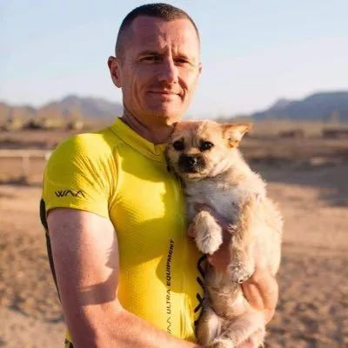
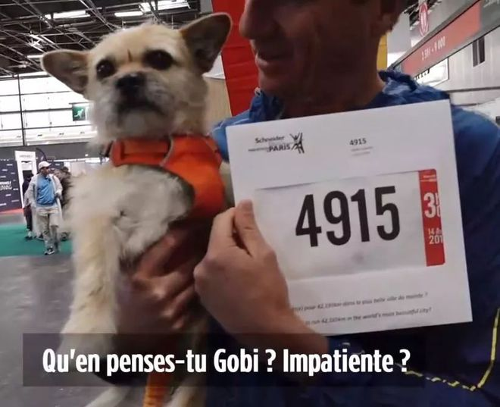
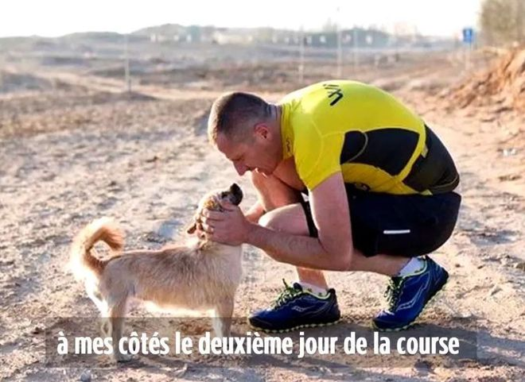

Slide 31
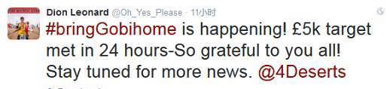
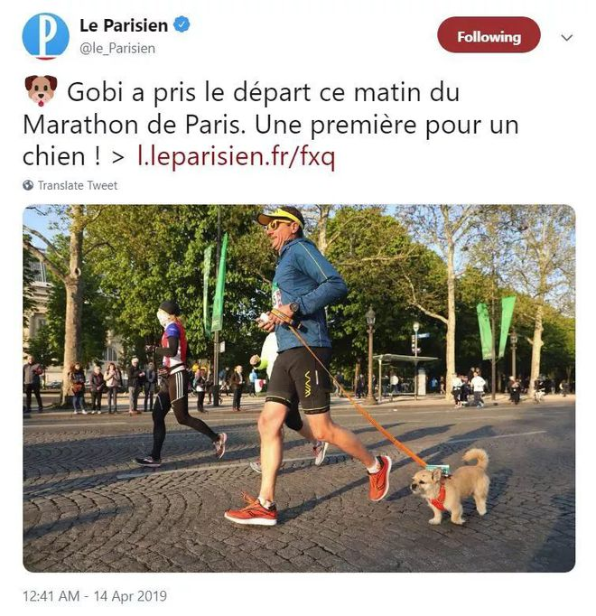
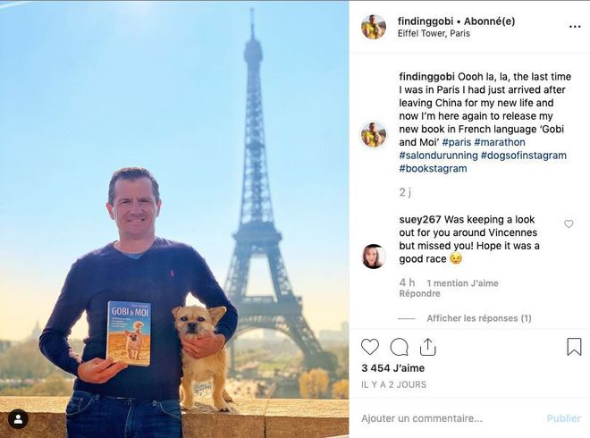
A book titled GOBI & MOI was published

Slide 32
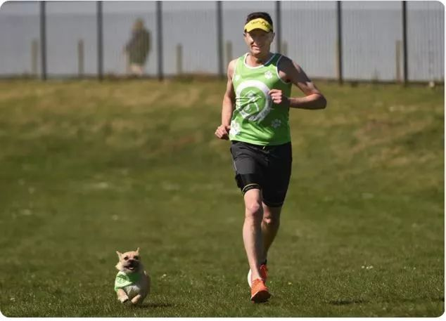
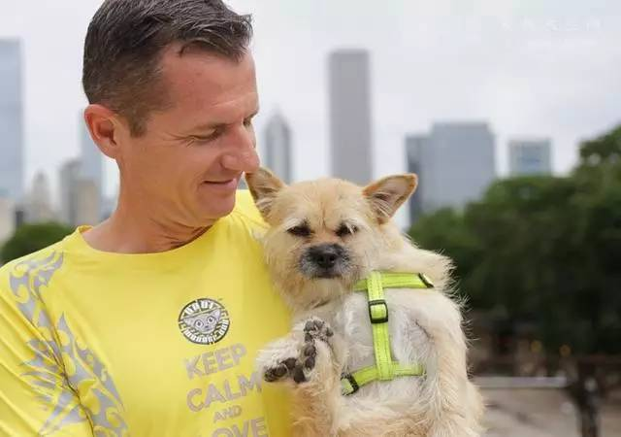
The unconditional love and loyalty a dog offers is a reminder of the true value of companionship.

Slide 33
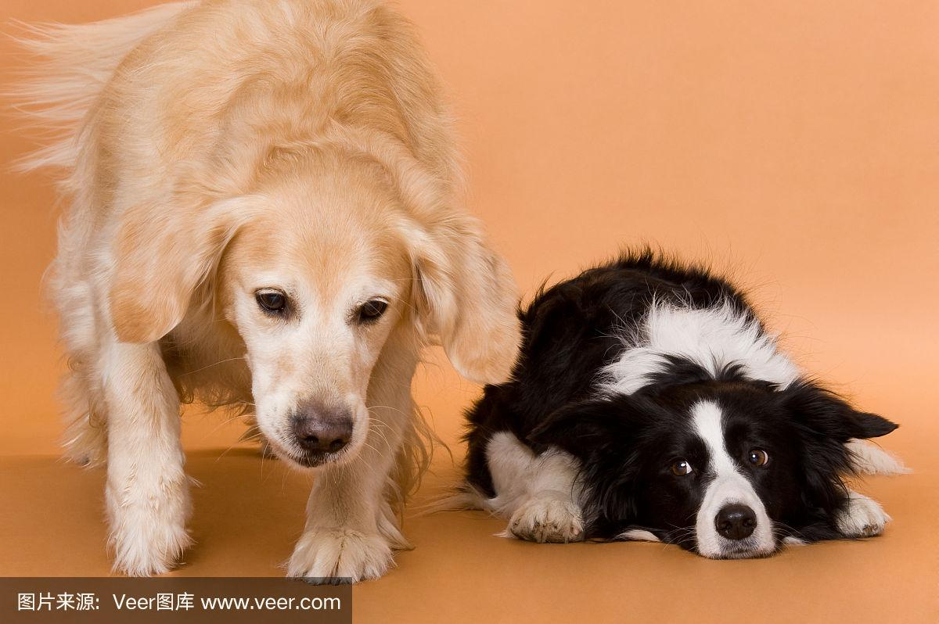
考过的与狗有关的真题以及模拟题
2020年1月浙江省首考：
波比的小狗 （描写狗与狗之间的，人与狗之间的美好情谊）
2023年12月浙江省四校联考：
小黑狗洗澡历险记 （描写作者小时候给狗洗澡时发生的趣事）
20232-2023 学年长沙市第一中学高二第二学期期中考试
狗狗救主历险记
（退休老人冬日野外狩猎遇险，狗狗求助路边卡车司机助老人脱困）

Slide 34
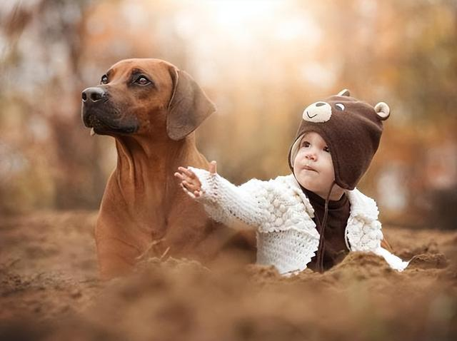
人与狗的三个续写套路：
可爱的狗狗： 陪伴、相处和谐、待人忠诚；
凶猛的狗狗： 难忘的可怕的经历，如何脱困，对救助之人感恩；
可怜的流浪狗：人如何救助流浪狗，珍爱生命，人与动物和谐相处

Slide 35
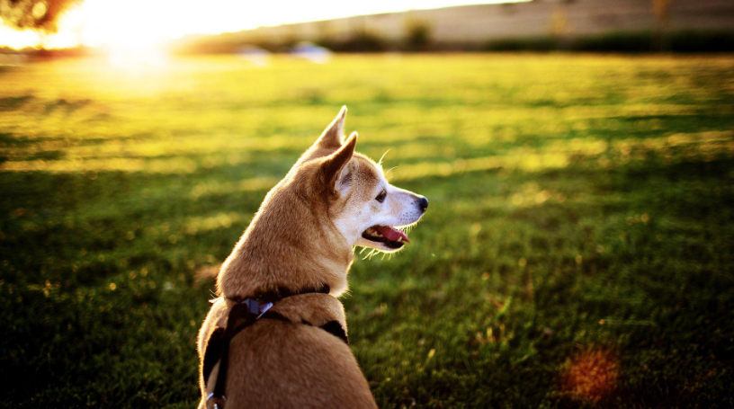
动物类描写可以考虑拟人的写作手法
狗的动作描写：
Gobi ran up and down the river bank, barking crazily.
No sooner had Dion set his foot on the land than Gobi threw herself into his arm, licking his face excitedly.
The puppy stared at his new master, wagging his tail excitedly
as if showing his warmest welcome to his coming back home.

