Slide 1


感恩遇见，相互成就，本课件资料仅供您个人参考、教学使用，严禁自行在网络传播，违者依知识产权法追究法律责任。
更多教学资源请关注
公众号：溯恩英语
知识产权声明

Slide 2



Lead-in
1.Have you ever drunk the following beverages ？
2.Who founded Wahaha ？

Slide 3
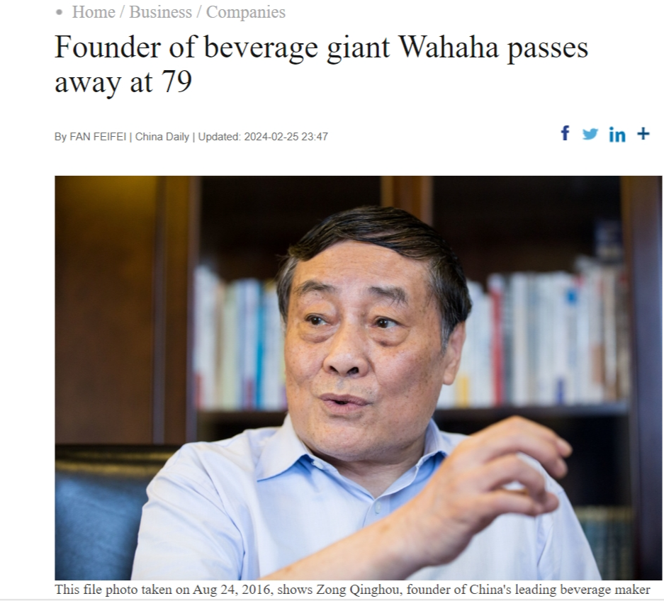
Before Reading
Part 1 Reading
According to the following title , what questions
do you want to ask about Zong Qinghou?

Slide 4
Before Reading
Part 1 Reading
Possible questions asked by students:
1. What was the main reason for his success ?
2. What’s his early life experiences and careers?
3. What achievements did he get?
4.What’s the main products of Wahaha?
5.What impact did Zong Qinghou have ?
6. What ’s his personality?

Slide 5
Zong Qinghou, the founder and chairman of Hangzhou Wahaha Group, China's leading beverage manufacturer, passed away on Sunday at the age of 79.
As one of the most respected representatives of China's first generation of entrepreneurs since the country embarked on reform and opening-up in 1978, Zong's down-to-earth style and innovative spirit greatly impressed the public.
Experts said Zong's rags-to-riches life story will surely inspire more Chinese entrepreneurs to focus on the real economy and run their businesses in a realistic and steady manner.
Born in 1945 in Suqian, Jiangsu province, Zong took over a small grocery store at a school in Hangzhou, Zhejiang province, in 1987, and worked as a distributor of soft drinks and popsicles for children.In 1989, he founded Hangzhou Wahaha Nutritional Food Factory, which became Hangzhou Wahaha Group two years later after the acquisition of a local canned food factory on the verge of bankruptcy.In 1996, Zong launched Wahaha AD calcium milk, which became a great hit with Chinese consumers.
The company's products now cover more than 200 categories, including purified water, milk and yogurt drinks, carbonated drinks, fruit and vegetable juice, tea and coffee drinks, with its sales revenue reaching 51.2 billion yuan ($7.1 billion) in 2022. It has nearly 30,000 employees and 81 production bases nationwide.As one of the most iconic figures in Chinese business history, Zong was ranked as the country's richest person in 2010, 2012 and 2013 by business magazine Forbes.
However, Zong led a simple and saving life. He lived economically, and it was common to see him dressed in a white shirt and black cloth shoes.He once said, "I am an ordinary person, but luckily I was born in such an era." He said that Wahaha would not exist without reform and opening-up.
Moreover, Zong attached great importance to technological innovation, which was conducive to ensuring the quality and diversity of Wahaha's products in a highly competitive market, and providing strong driving to the company's sustainable growth.
An extract from CGTN

Slide 6
While Reading
Part 1 Reading
Find the answers from the passage asked by you ?
1. What was the main reason for his success ?
2. What’s his early life experiences and careers?
3. What achievements did he get?
4.What’s the main products of Wahaha?
5.What impact did Zong Qinghou have ?
6. What ’s his personality?

Slide 7
Language Focus
Part 1 Reading
1.Underline the useful expressions to describe his life and career.
(1) As one of the most respected representatives,he.......
(2) Born in,....., he took over.....,worked as........,founded......,and lauched....
(3) However, he led a ...... life
(4) ....... would not exist without ......
(5) ...... greatly impressed the public.
2.Retell a brief story about his life and career in pairs,and share with the whole class.
Pair Work
3.Rewrite the following two sentences (It is ......that 强调句)
①Zong's down-to-earth style and innovative spirit greatly impressed the public.
__________________________________________________________________________
②Zong's rags-to-riches life story will surely inspire more Chinese entrepreneurs to focus on the real economy and run their businesses in a realistic and steady manner.
______________________________________________________________________________________________________________________________________________________
It was Zong's down-to-earth style and innovative spirit that impressed the public.
It is Zong's rags-to-riches life story that will inspire more Chinese entrepreneurs to focus on the real economy and run their businesses in a realistic and steady manner.

Slide 8
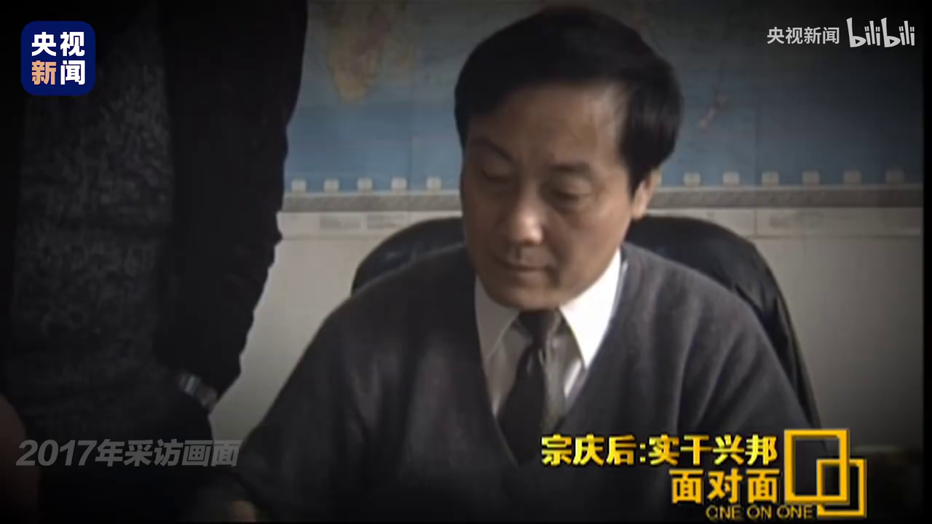
Post Reading
Part 1 Reading
1.If you were a successful entrepreneur, what would you do to make contributions to our society?
2. What can we learn from him?

Slide 9
How to introduce a person
Part 2 Writing
【亮点词汇短语】
①影响：influence/impact
②人物：figure
③显著的：remarkable / outstanding
④决定： be determined to do
⑤不管，不顾：regardless of
⑥坚守岗位：stick to one's post
⑦面对……：be faced with
⑧致力于做某事： devote oneself to
⑨对什么做出重大贡献：make great contributions to
⑩得到好结果：pay off
【常用句型】
1. He sets a good example to all younger generations.
2. The public speak / think highly of him.
3. He is honored as the most extraordinary..... home and abroad.
4. She is not only gifted but also diligent.
5. To devote herself to our China, she came back this year without any hesitation.
6. When it comes to the role model around me, it’s nobody but....

Slide 10
高考链接 人物介绍类应用文
【2020年全国Ⅰ卷】你校正在组织英语作文比赛。请以身边值得尊敬和爱戴的人为题，写一篇短文参赛，内容包括：
1. 人物简介；
2. 尊敬和爱戴的原因。
Part 2 Writing
The person I resprect
In my circle, a figure stands out as a beacon of respect and admiration: my neighbor, Uncle Li. He is a volunteer gate guard who played a key role in our community during the COVID-19 pandemic. His primary responsibility was to measure the body temperature of all residents and check their passes for entry and exit, ensuring the safety of our neighborhood.
Uncle Li's commitment to his duty was unwavering, regardless of the personal risk of infection. He was a constant presence, even in the most adverse weather conditions, never allowing anyone to bypass the checks. His dedication to the cause of epidemic prevention and control was instrumental in maintaining the health and well-being of our community.
The respect I have for Uncle Li is not only because of his actions during the pandemic but also for the selfless spirit he embodies. It is Uncle Li's service that reminds us of the importance of community and the power of individual actions in times of crisis. His story is a reminder that respect is earned through consistent acts of kindness and responsibility, and he is truly deserving of our admiration and gratitude.
注意：绿色部分是人物品质，红色部分是句型

Slide 11
( 2023年全国甲卷)
你们学校正举办主题为“用英文讲中国故事”的征文活动。请你以一位中国历史人物为题写一篇短文投稿，内容包括：
1. 人物简介及事迹；
2. 意义或启示。
注意：绿色部分是人物品质，红色部分是句型
Part 2 Writing
The Historical Figure in China
Countless figures made huge contribution to Chinese history and formed the prosperous Chinese culture. Li Shizhen, an expert on herbs from Ming Dynasty, is an outstanding example.
Keen on herbs, Li committed himself to fostering traditional Chinese medicine career. Spending a total of 27 years, Li put his academic knowledge into practice, correcting mistakes in former books and collecting his researching fruits to a book entitled Bencao Gangmu, who is regarded as a pioneer and director to later generations.
It’s Li’s extensive reading and continuous efforts that shaped his success. His invaluable contributions and achievements sparked advancements in the fields of traditional Chinese medicine and culture,which also inspire us to develop China’s promising culture. It is high time that we learned from historical figures like Li Shizhen, passed on their stories and spread their spirits.

Slide 12
应用文写作
假如你是李华，你的笔友John对中国的企业家非常感兴趣，请你以宗庆后为题写一篇文章，回信给John，内容包括：
1. 人物简介
2. 启示或影响
词数100左右； 可以适当增加细节，以使行文连贯。

Slide 13
Dear John,
I'm delighted to hear about your interest in Chinese entrepreneurs. There's one figure who stands out for me, Zong Qinghou, the founder of Wahaha Group. Born in 1945, Zong started with a small grocery store and, through strong determination and business talent, transformed it into China's leading beverage company.
Zong's story is a will to resilience and innovation,whose focus on quality and his willingness to embrace challenges have not only made Wahaha a household name but also inspired me to pursue excellence with integrity.It was his generous efforts, especially in education and poverty alleviation that demonstrate a commitment to giving back to society.
Zong's journey teaches us that without hard work and a heart for social good, one couldn’t achieve great heights while making a positive impact. His life serves as a powerful reminder that success is not just about personal gain but also about contributing to the common good.
I hope this insight into Zong Qinghou's life inspires you as much as it has me.
Best regards,
Li Hua

Slide 14


