Slide 1


感恩遇见，相互成就，本课件资料仅供您个人参考、教学使用，严禁自行在网络传播，违者依知识产权法追究法律责任。
更多教学资源请关注
公众号：溯恩高中英语
知识产权声明

Slide 2

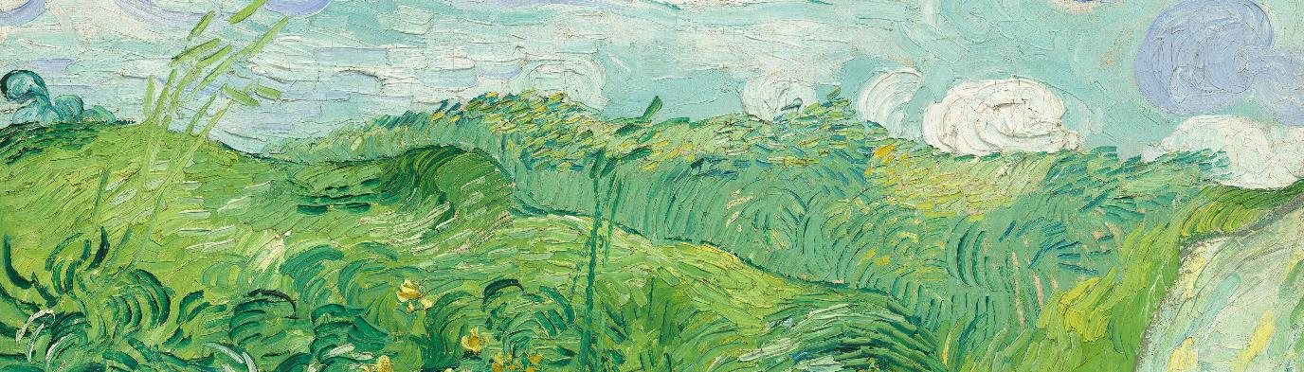
高三新阵地联盟
2024.02
阅 读 理 解 解 析
Fay

Slide 3
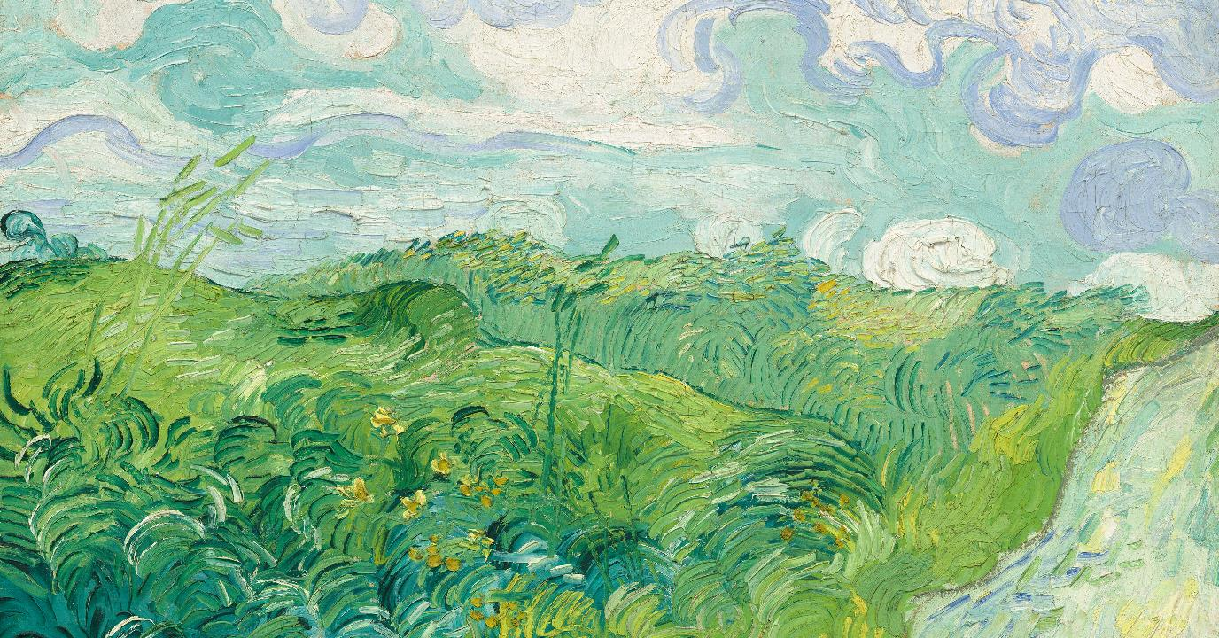
阅 读 理 解
comprehension

Slide 4





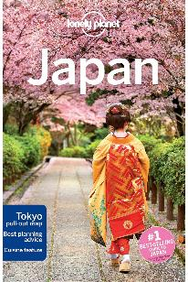
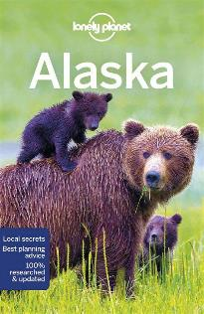
23.Where is the passage probably taken from?
A. Reader's Digest.
B. Science Bulletin
C. The Lonely Planet.
D. The New York Times.

Slide 5
A
Your adventures start here! Plan to broaden your horizons with these escapes closer to home.
Discover Bangladesh
We are specialists in tours of Bangladesh, a beautiful country still relatively untouched by tourism. Our 27-day tour package visits the very best sights and attractions in the country for just ￡2,130 per person. There is a maximum of six people in each group. Single supplements are also available: join any of our scheduled tours and reduce your cost. Read travelers' recent experiences on our website and discover how good we are! Email:hasan@nijhoom. com for more details.
21.According to the first advertisement, which of the following statements is true?
A. Travellers have to book the tour package with friends.
B. Travellers can find other travelers' feedback on the trip online.
C. Travellers are forbidden to touch living species along the journey.
D. Travellers can get discounts if they book the tour package as a group

Slide 6

Incredible Japan
Enjoy the wonders of Japan on a unique trip full of exciting discoveries. Explore vibrant Tokyo with its energetic city life and relax in peaceful Kyoto surrounded by tranquil temples. In spring, gaze upon graceful Mt Fuji as you sit among delicate cherry blossom or find yourself captivated by the breath-taking gold landscape on an autumn adventure. No trip is complete without sampling a variety of some of the world's best cuisine, from delicious fresh sushi to crispy tempura. Fully Escorted Tours to Japan from￡3,690.
Wendy Wu Tours wendywutours.co.uk T:0808 278 1657
Challenge yourself in Europe
From reaching the highest mountain sleeping spots on hut-to-hut journey in the Alps to enjoying a week discovering the Italian Lakes with a spectacular Alpine rail journey included, at KE, we have been creating small-group walking, hiking and cycling holidays throughout Europe for over 20 years. Reserve your place on a 2024 adventure now from just ￡2000.
KE Adventure Travel keadventure.com T:017687 73966
词 块 整 理
22. If you enjoy exploring food and trains , which travel agencies will you contact?
A.KE Adventure Travel& Nijhoom Tours.
B. American Adventures& Wendy Wu Tours
C. American Adventures& Nijhoom Tours.
D. KE Adventure Travel & Wendy Wu Tours
Broaden one’s horizons开阔视野
One-of-a-kind destinations独一无二
Find oneself captivated by被迷住
Sample world’s best cuisine品尝佳肴
Get discounts打折

Slide 7
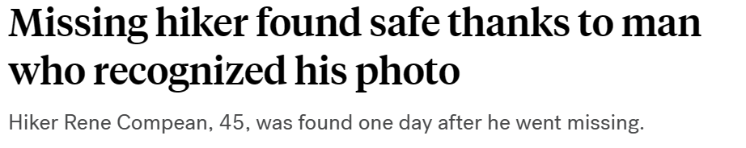

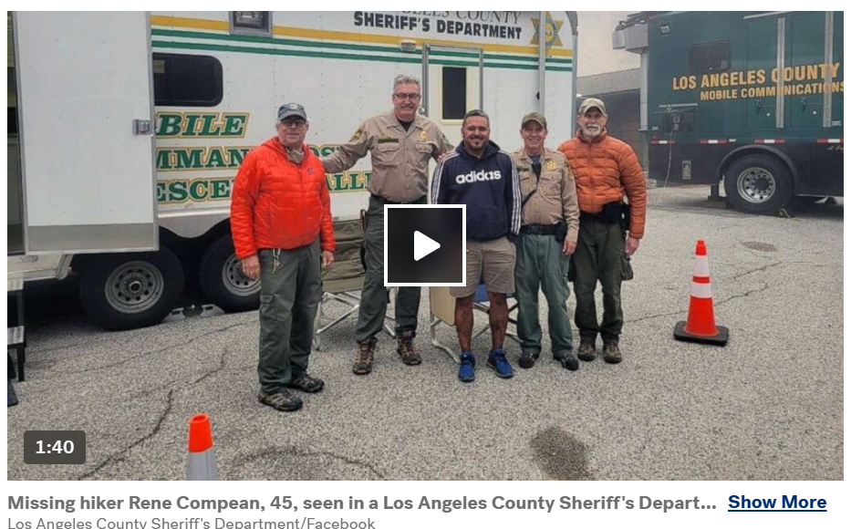


失踪徒步者安，
归功识别照片者也

Slide 8

B
Rene Compean was no stranger to Angeles National Forest. But after venturing along a new path last April, the 45-year-old mechanic was lost.
As the day faded into dusk, following several hours of aimless roaming, his concern turned to fear. no flashlight, only a liter of water and a power bar in his backpack, and less than ten percent battery remaining on his cell phone, Compean was unprepared for anything more than the two-hour trek he'd planned. Compean climbed to a spot, some 7,000 feet above sea level, where he found at least one bar of signal. "SOS. My phone is going to die. I'm lost." He texted a friend, attaching a photo showing where he was. All Compean could do then was wait and hope. But he wouldn't sleep. After spotting two mountain lions and a bear, he spent the night on high alert.
24. What can we learn about Rene Compean from the second paragraph?
Fierce animals attacked him.
Being alone made him unable to fall asleep.
His dead cell phone isolated him from the outside.
Insufficient preparation transformed his worry into fear.

Slide 9
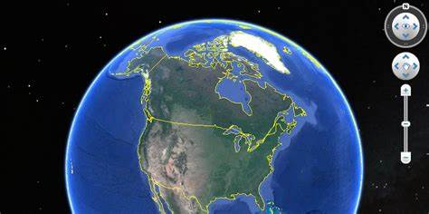
Sixty miles away in Ventura County, The sheriff's search-and-rescue teams had spent the previous night unsuccessfully looking for Compean, so they released the photo to the public, hoping someone might know the location.
Ben Kuo, then 47, has an unusual hobby to identify where movie scenes or television shows were filmed. When he saw the blurry image of Compean's legs surrounded by an endless landscape of rocks and vegetation, he instinctively pulled up a satellite map on his laptop. Then he narrowed his search to the surrounding area. The first thing he noticed in Compean's photo were patches of greenery. After comparing it to the satellite map, Kuo realized something: "He's got to be on the south side because there's not really any green valleys on the north side.“
That finding tightened his search, leading him to an area that resembled the landscape in the image. The final step was cross-referencing the original photo with 3-D images of the area from Google Earth. The locations matched!
The steps
(procedure)
take moving pictures
Be similar to
The result
25. Ben Kuo was able to help because of_______________________.
his photo reading ability.
his sense of responsibility.
his professional experience.
His familiarity with the area
26. Which of the following can best describe Ben Kuo?
Timid and smart. 胆怯而聪明
Daring and expert. 大胆而专业
Observant and swiftly-acting 观察力强，行动迅速
Sharp-eyed and widely-interested.眼光敏锐，兴趣广泛
familiarity: n.精通，通晓；熟悉，亲切感

Slide 10
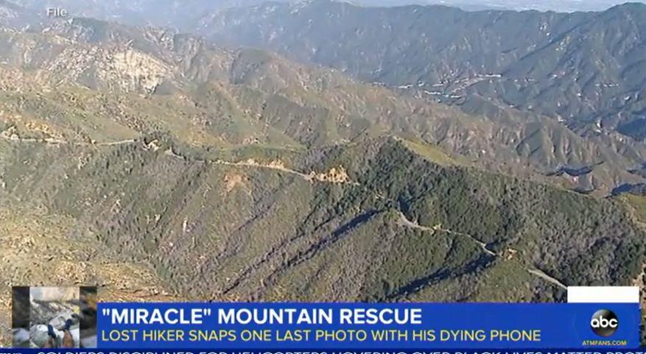
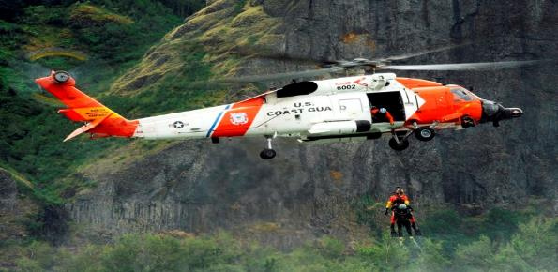
Soon, a search-and-rescue team helicopter was in the air, hovering above Compean. After spending 27 hours alone in the wildness, Compean cried, “I'm safe." Compean's story probably would have ended very differently had a total stranger with strong satellite skills and a sharp eye for detail not taken action.
词 块 整 理
27. What can be the best title for the text?
Screen Saver: No Useless Knowledge.
Lost Hiker: Boldness Deserved.
Nature Lover: Adventure Failed.
Hiking Goer: Narrow Escape.
Fade into dusk消失在暮色中
A power bar电源条
The phone goes to die手机没电
On high alert在高戒备状态
Pull up 核对；停车
Search-and rescue team搜救队
The blurry image模糊图像
Patches of greenery成片的绿色植物
Narrow his search缩小搜索范围
Tighten his search加强搜索
Cross-referencing相互参照，交叉引用
In the wildness在荒野
Would have done本来会…
Insufficient preparation准备不足

Slide 11

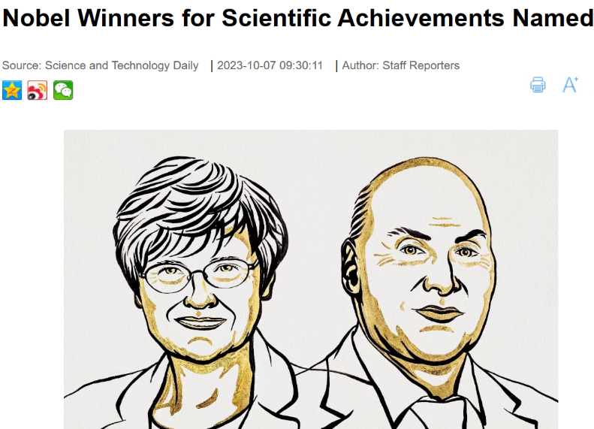
Twenty-two years ago, I won a Nobel Prize, together with Tim and Leland Hartwell, for our work on how cells control their division.
The prize changed our lives. Suddenly you become a public figure being asked to do all sorts of things: to give lectures, quite often on topics you know little about; to sit on committees and reviews you are not always well qualified to be on; to visit countries you have barely heard of. It is like having a whole new extra job, with upwards of 500 requests a year.
28. What is the author's purpose in writing paragraph 2?
To share his pride in winning a Nobel.
To express his regret at the changing of life.
To show his self confidence in handling the extra jobs.
To display his overburdened tasks after winning a Nobel.
to load with excessive weight, work, etc

Slide 12

A recent study suggests that in general the extra commitments that Nobel winners take on result in fewer papers after their awards. There may be some truth to this given the extra demands on one's time, but of course prestigious awards also allow new projects and research to be undertaken.
What effects did the Nobel Prize have on my subsequent carer and work? It has certainly helped me to get scientific leadership positions. Within a year of getting the prize I was offered and accepted the presidency of Rockefeller University in New York. Having the prize also helps to get things done. For example, I have been involved in the merging of two separate cancer research charities to form Cancer Research UK. And it has helped me support causes I care deeply about. I became an ambassador for Ukraine education and science to help raise money for schools in that shattered country. Moreover, having a Nobel does help attract high-quality research colleagues. I have just started three excellent new PhD students. It is a privilege for me to be able to pursue curiosity-driven research at this late stage of my career
29. What does the underlined word "merging" in paragraph 4 mean?
A. Competition. B. Comparison. C. Combination D. Construction
我参与了两个独立的癌症研究慈善机构的_____，建立了英国癌症研究中心。

Slide 13

What effects did the Nobel Prize have on my subsequent carer and work? It has certainly helped me to get scientific leadership positions. Within a year of getting the prize I was offered and accepted the presidency of Rockefeller University in New York. Having the prize also helps to get things done. For example, I have been involved in the merging of two separate cancer research charities to form Cancer Research UK. And it has helped me support causes I care deeply about. I became an ambassador for Ukraine education and science to help raise money for schools in that shattered country. Moreover, having a Nobel does help attract high-quality research colleagues. I have just started three excellent new PhD students. It is a privilege for me to be able to pursue curiosity-driven research at this late stage of my career.
a special right or advantage
30. What is paragraph 4 mainly about?
The special privileges the Nobel winner has.
The positive impacts the Nobel Prize generates.
The great contributions the Nobel winner makes.
The scientific leadership the Nobel Prize provides.

Slide 14
However, one thing I am glad to say that the Nobel Prize did not influence was peer review from my fellow scientists, assessing the suitability of my own research for publication, and my grant applications for funding. My rejection rates have remained essentially the same before and after the prize. And that, of course, is exactly how it should be.
词 块 整 理
31. What message does the author mainly want to convey in the last paragraph?
The spirit of science lies in seeking facts and truth.
Winning a Nobel Prize has an impact on peer review.
Extra commitments make Nobel winners less productive.
The approval a Nobel winner receives is equal to rejection
A public figure 公众人物
Be well qualified to 能胜任做..
Upwards of 至少
Take on 承担
Be some truth to对…说些实话
Assess the suitability评估适用性
Peer review同行评审
Grant applications拨款申请
Rejection rates某项申请或请求被拒绝的比率
Generate the positive impacts产生积极影响
Seek facts and truth 寻求事实与真理
然而，有一件事我很高兴地说，诺贝尔奖没有影响到我的同行科学家的同行评议，评估我自己的研究是否适合发表，以及我的资助申请。获奖前后，我的拒稿率基本保持不变。当然，这正是它应该有的样子。
What should science be like?

Slide 15
Twenty-two years ago, I won a Nobel Prize, together with Tim and Leland Hartwell, for our work on how cells control their division.
The prize changed our lives. Suddenly you become a public figure being asked to do all sorts of things: to give lectures, quite often on topics you know little about; to sit on committees and reviews you are not always well qualified to be on; to visit countries you have barely heard of. It is like having a whole new extra job, with upwards of 500 requests a year.
A recent study suggests that in general the extra commitments that Nobel winners take on result in fewer papers after their awards. There may be some truth to this given the extra demands on one's time, but of course prestigious awards also allow new projects and research to be undertaken.
What effects did the Nobel Prize have on my subsequent carer and work? It has certainly helped me to get scientific leadership positions. Within a year of getting the prize I was offered and accepted the presidency of Rockefeller University in New York. Having the prize also helps to get things done. For example, I have been involved in the merging of two separate cancer research charities to form Cancer Research UK. And it has helped me support causes I care deeply about. I became an ambassador for Ukraine education and science to help raise money for schools in that shattered country. Moreover, having a Nobel does help attract high-quality research colleagues. I have just started three excellent new PhD students. It is a privilege for me to be able to pursue curiosity-driven research at this late stage of my career
However, one thing I am glad to say that the Nobel Prize did not influence was peer review from my fellow scientists, assessing the suitability of my own research for publication, and my grant applications for funding. My rejection rates have remained essentially the same before and after the prize. And that, of course, is exactly how it should be.
The cause
The negative effect
Focusing on text structure
h e l ps
discourse comprehension
The positive impact
The conclusion

Slide 16
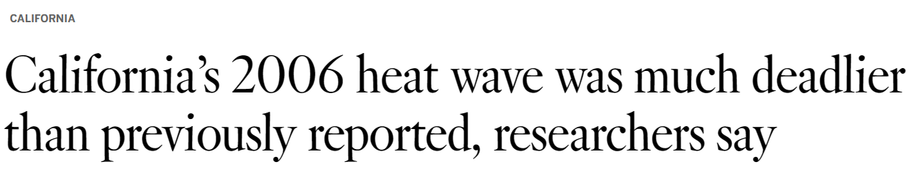
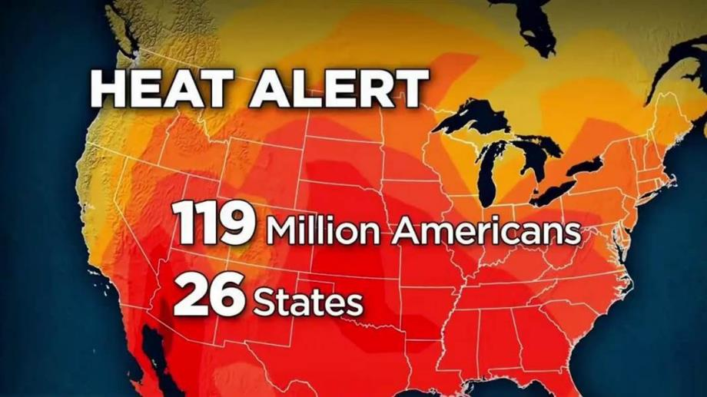


Slide 17
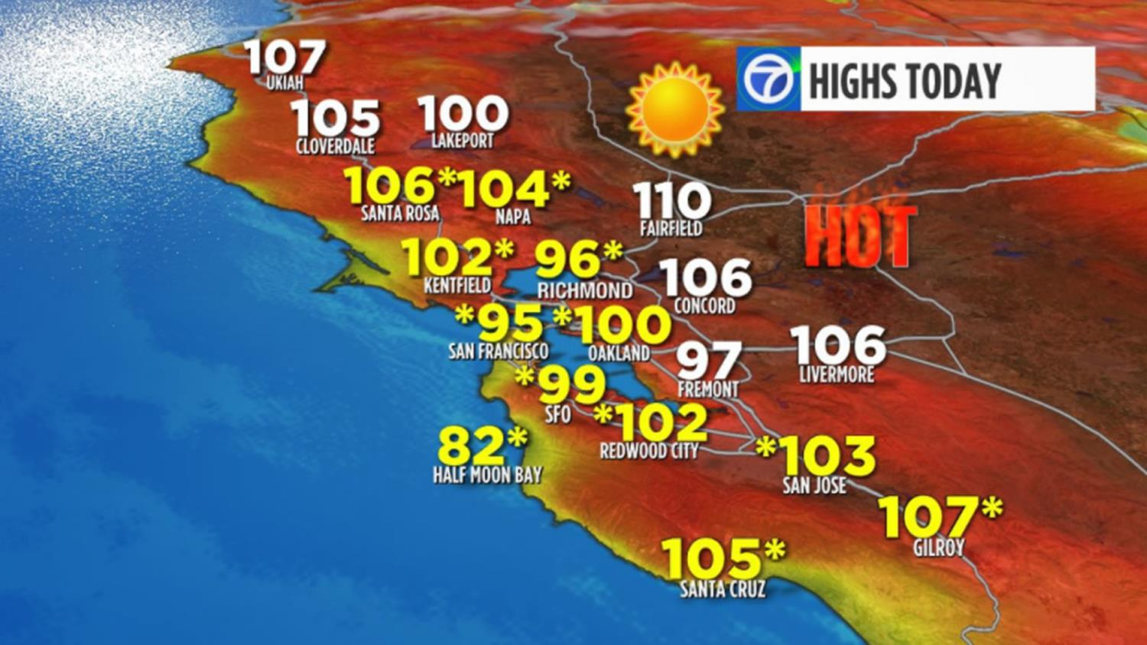
When a severe heat wave covered California in July 2006, it killed an estimated 650 people. But it may be tough to recall because heat waves don't typically have names. They are already the deadliest weather-related danger, yet they remain invisible killers that few people take seriously. What if the most life-threatening heat waves did have names?
32. Why does the author mention the severe heat wave that covered California in July 2006?
To clarify the severity of heat waves.
To remind people of the tough heat wave.
To introduce the topic of naming heat waves.
To show people’s ignorance of the heat wave.

Slide 18
This summer, as many experience high temperatures fueled by greenhouse gas pollution and EI Niño, there has been new openness to the idea of naming heat waves. People in Southern Europe have dubbed the July heat wave Cerberus. The results of a survey of more than 2,000 people found that people who knew the heat wave was named Cerberus were also more likely to take actions to stay safe, including drinking more water, spending more time indoors and warning others about the risk.
Though more research is needed, this suggests that naming heat waves, combined with stronger messaging, can not only help change people's perception of the risk, but prompt them to take protective action. It would be more effective to broadcast that Heat Wave Zoe, a dangerous Category 3 event, will start tomorrow and here's what you can do to protect yourself, your neighbors and co-workers. Names, after all, are easier to remember than numbers or weather forecasts.
33. What can we learn from paragraph 2 and 3?
Due to its effectiveness, naming waves is a must.
There exist benefits of categorizing and naming heat waves.
Naming heat waves can change people's perception of the risk.
Naming heat waves can urge people to take prompt action to protect themselves.

Slide 19

But the World Meteorological(气象学的)Organization opposes naming heat waves on the grounds that it would confuse and distract the public. And the National Weather Service has no plans to rank or name heat waves either, saying that heat and its health impacts vary so dramatically across different regions and seasons that even coming up with a standard definition of a heat wave is impossible.
34. Why does the National Weather Service have no plans to name heat waves?
A. It will confuse and distract the public.
B. It is inappropriate for naming heat waves.
C. It is difficult to distinguish and predict heat waves.
D. It is unlikely to put forward a standard definition for heat waves
但世界气象（气象学）组织反对命名热浪，理由是这会混淆和分散公众的注意力。美国国家气象局也没有计划对热浪进行排名或命名，称高温及其对健康的影响在不同地区和季节之间差异如此之大，以至于甚至不可能提出热浪的标准定义。

Slide 20
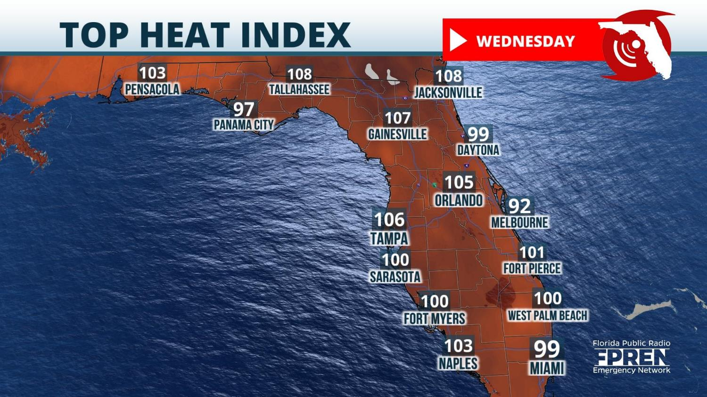
There's nothing to lose by trying out a pilot program to name the most dangerous heat waves. It's pretty clear the current approach to these disasters is falling far short of what's necessary to protect lives. We need other ways to call attention to it and warn the public of the danger. It's hard to make progress fighting an enemy with no name.
35. What is the author's attitude to naming heat waves?
A. Approving. B. Indifferent. C. Doubtful. D. Opposed.
词 块 整 理
Invisible killers隐形杀手
Take seriously认真对待
Life-threatening heat危及生命的热度
Take protective action采取保护措施
Take prompt action迅速采取行动
On the grounds that…因为，由于
Come up with提出
Fall far short of远远不及，远低于
Call attention to引起注意

Slide 21
The introduction
When a severe heat wave covered California in July 2006, it killed an estimated 650 people. But it may be tough to recall because heat waves don't typically have names. They are already the deadliest weather-related danger, yet they remain invisible killers that few people take seriously. What if the most life-threatening heat waves did have names?
This summer, as many experience high temperatures fueled by greenhouse gas pollution and EI Niño, there has been new openness to the idea of naming heat waves. People in Southern Europe have dubbed the July heat wave Cerberus. The results of a survey of more than 2,000 people found that people who knew the heat wave was named Cerberus were also more likely to take actions to stay safe, including drinking more water, spending more time indoors and warning others about the risk.
Though more research is needed, this suggests that naming heat waves, combined with stronger messaging, can not only help change people's perception of the risk, but prompt them to take protective action. It would be more effective to broadcast that Heat Wave Zoe, a dangerous Category 3 event, will start tomorrow and here's what you can do to protect yourself, your neighbors and co-workers. Names, after all, are easier to remember than numbers or weather forecasts.
But the World Meteorological(气象学的)Organization opposes naming heat waves on the grounds that it would confuse and distract the public. And the National Weather Service has no plans to rank or name heat waves either, saying that heat and its health impacts vary so dramatically across different regions and seasons that even coming up with a standard definition of a heat wave is impossible.
There's nothing to lose by trying out a pilot program to name the most dangerous heat waves. It's pretty clear the current approach to these disasters is falling far short of what's necessary to protect lives. We need other ways to call attention to it and warn the public of the danger. It's hard to make progress fighting an enemy with no name.
An example
Advantages
Disadvantages
The author’s stand

Slide 22
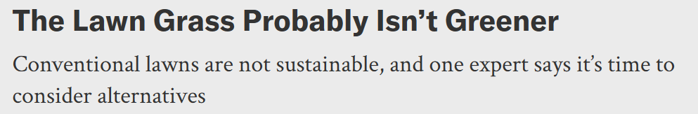
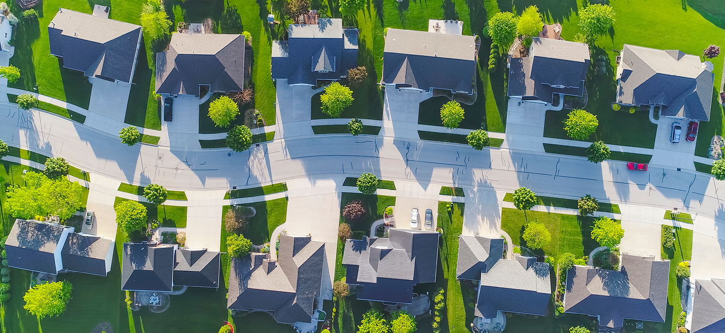

Slide 23
Cruise through many neighborhoods or parks around the world, and you will find no shortage of well-mowed expanses of grass. Lawns(草坪)do look attractive._36_ Additionally, they can require environmentally questionable practices to maintain. Researchers and landscape architects are increasingly considering alternatives that are more sustainable, demand fewer resources and help people connect more intimately with nature. Here follows an edited excerpt of the conversation between researchers Maria Ignatieva and Marcus Hedblom.
Why did lawns become so popular?_37_ They were like a special frontier that separated cities and towns from the wilderness. A lawn was always a symbol of how a civilized society should be. That's why it was so powerful. And of course, they are also important for recreation.
What environmental problems are lawns causing?
Lawns are homogenizing the environment, not only in terms of biodiversity but also visually. You compare countries' and cities' urban landscapes around the world, and they look exactly the same. _38_ Mowers burn fossil fuels and emit gases that heat up the atmosphere.
__39__
You have to find your own local solution. We can take inspiration from the natural plant communities around us. In suburban and rural areas, that might mean having a meadow or prairie. In other places, it…
How can we persuade people to adopt these alternatives?
When people see them, they appreciate them and like them. _40_ We also have to try to change the minds of decision makers, including politicians. We need to show the public there are different ways of handling our urban environment and making it better.
36.Adversative relation转折: E However, they choke out biodiversity.
扼杀生物多样性
37.Causal relation因果+总起: F Lawns came to be seen as a symbol of civilization and a way of life.
38.承上启下，点明问题
B Lawn upkeep takes resources, fertilizer and pesticide that enter groundwater and runoff water.
维修草坪
39.B What are these alternatives?同义替换，总结下文
40. A So it is all about education.用education回答HOW 并总结下文具体的方法

Slide 24
重 点 词 汇
comprehension

Slide 25
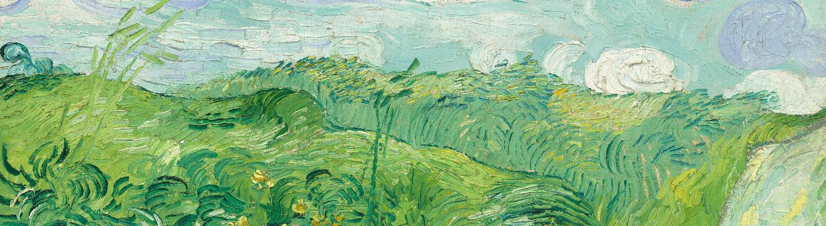



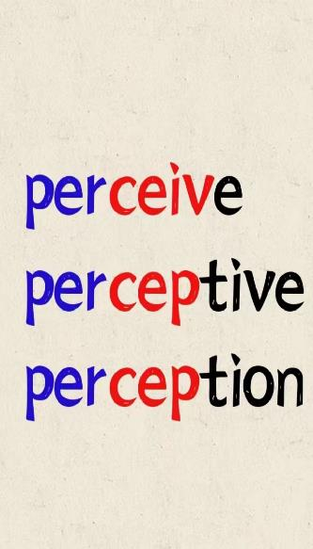

部分生词
熟词生义
词形变化
Captivate
Venture
Alert
Resemble
Hover
Timid
Undertake
Overburden
Dub
Distract
Oppose
Categorize
Sample
Reserve
Film
Narrow
Tighten
Generate
Fuel
Prompt
Specialize
Blurry
Greenery
Familiarity
Insufficient
Daring
Observant
Boldness
Division
Presidency
Suitability
Rejection
Productive
Invisible
Openness
Perception
Protective
Dramatically
Severity
Ignorance
Effectiveness
Inappropriate

Slide 26
好 句 摘 录
来探索生机勃勃的东京及其充满活力的城市生活，在宁静的京都放松身心，周围环绕着静谧的寺庙。在春天，当您坐在娇嫩的樱花中时，凝视着优雅的富士山，或者在秋季冒险中被令人叹为观止的金色景观所吸引。
Grand American Adventures 专门从事前往美洲的小团体探险之旅，拥有无与伦比的知识和经验。
漫无目的地漫游了几个小时后，随着白昼逐渐消失在黄昏中，他的担忧变成了恐惧。没有手电筒，背包里只有一升水和一根能量棒，手机里只剩下不到百分之十的电池电量，除了他计划的两小时跋涉之外，Compean对任何事情都没有准备。（场景描写）
当他看到Compean的双腿被一望无际的岩石和植被景观所包围的模糊图像时，他本能地在笔记本电脑上调出了卫星地图。然后，他将搜索范围缩小到周边地区。......位置匹配！（过程描写，长短句结合）
这表明，命名热浪，结合更强的信息传递，不仅可以帮助改变人们对风险的看法，而且可以促使他们采取保护措施。
很明显，目前应对这些灾难的方法远远达不到保护生命所需的水平。
Explore vibrant Tokyo with its energetic city life and relax in peaceful Kyoto surrounded by tranquil temples. In spring, gaze upon graceful Mt Fuji as you sit among delicate cherry blossom or find yourself captivated by the breath-taking gold landscape on an autumn adventure.
Grand American Adventures specializes in small-group adventure tours to the Americas, with unrivalled knowledge and experience.
As the day faded into dusk, following several hours of aimless roaming, his concern turned to fear. With no flashlight, only a liter of water and a power bar in his backpack, and less than ten percent battery remaining on his cell phone, Compean was unprepared for anything more than the two-hour trek he'd planned.
When he saw the blurry image of Compean's legs surrounded by an endless landscape of rocks and vegetation, he instinctively pulled up a satellite map on his laptop. Then he narrowed his search to the surrounding area. ……The locations matched!
This suggests that naming heat waves, combined with stronger messaging, can not only help change people's perception of the risk, but prompt them to take protective action.
It's pretty clear the current approach to these disasters is falling far short of what's necessary to protect lives.

Slide 27
Don’t stop.
Don’t hide.
Follow the light and you’ll find tomorrow!
THANK YOU
FAY

