Slide 1


感恩遇见，相互成就，本课件资料仅供您个人参考、教学使用，严禁自行在网络传播，违者依知识产权法追究法律责任。
更多教学资源请关注
公众号：溯恩英语
知识产权声明

Slide 2
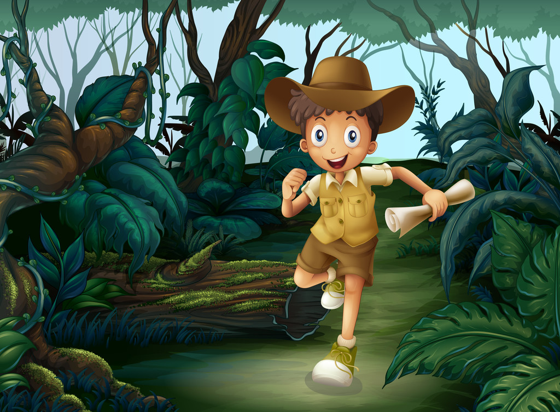
心
援
惊
救

Slide 3


原文本
I worked at a local station of the Berlin fire department. We got an alert(警报) around 8:25 pm that Friday and rushed to the fire engine, where the printout from the dispatcher(调度员) said there was a nine-year-old boy locked in a safe.
I asked myself: if it were a safe, would it be airtight? I was aware that it might already be too late by the time we arrived. I had to plan for a bad outcome. On the other hand, if we were in time, how long would it take us to open the safe? I knew it would be an incredibly difficult task. It’s what safes are designed for―not to be opened.
It took less than five minutes to reach the property. When I saw a woman crying on the street, I knew the situation was serious. She was the boy’s mother and she led us into the basement. She told us the boy was alive and we started talking to him; he was very calm. We asked how it had happened: during a game of hide and seek with his five-year-old brother, he had thought the safe would be a good place to hide.
The boy’s parents had got the house from his mother’s father. The unlocked safe had been there when they moved in and was in an area they didn’t use much. The boy’s little brother had shut the safe, then, when he couldn’t open it again. The only person who knew the combination was the boy’s late grandfather.
From the outset, the biggest priority was getting oxygen to the boy. We got oxygen from the hospital. The boy said that he could feel a thin stream of air. I asked his parents if anyone had opened the safe before and they said no. So we had to guess a six-digit code(密码). We started typing them in―but we had to wait 10 minutes between each attempt before we could try again. So quickly we tried them all. No luck.

Slide 4
I worked at a local station of the Berlin fire department. We got an alert(警报) around 8:25 pm that Friday and rushed to the fire engine, where the printout from the dispatcher(调度员) said there was a nine-year-old boy locked in a safe.
main idea
消防员我接到警报—9岁男孩被锁在保险箱中

Slide 5
I asked myself: if it were a safe, would it be airtight? I was aware that it might already be too late by the time we arrived. I had to plan for a bad outcome. On the other hand, if we were in time, how long would it take us to open the safe? I knew it would be an incredibly difficult task. It’s what safes are designed for―not to be opened.
main idea
接警后我的心理活动---任务很棘手

Slide 6
It took less than five minutes to reach the property. When I saw a woman crying on the street, I knew the situation was serious. She was the boy’s mother and she led us into the basement. She told us the boy was alive and we started talking to him; he was very calm. We asked how it had happened: during a game of hide and seek with his five-year-old brother, he had thought the safe would be a good place to hide.
main idea
我们火速赶到现场---得知男孩为什么会被锁在保险箱

Slide 7
The boy’s parents had got the house from his mother’s father. The unlocked safe had been there when they moved in and was in an area they didn’t use much. The boy’s little brother had shut the safe, then, when he couldn’t open it again. The only person who knew the combination was the boy’s late grandfather.
main idea
无人知道保险箱的密码

Slide 8
From the outset, the biggest priority was getting oxygen to the boy. We got oxygen from the hospital. The boy said that he could feel a thin stream of air. I asked his parents if anyone had opened the safe before and they said no. So we had to guess a six-digit code(密码). We started typing them in―but we had to wait 10 minutes between each attempt before we could try again. So quickly we tried them all. No luck.
main idea
消防工作人员开始救援---
先给保险箱输送氧气；同时在猜测保险箱的密码；

Slide 9
原文伏笔 | 续写回扣
I worked at a local station of the Berlin fire department. We got an alert(警报) around 8:25 pm that Friday and rushed to the fire engine, where the printout from the dispatcher(调度员) said there was a nine-year-old boy locked in a safe. | 1. The job of being a firefighter infused my heart with a strong sense of mission. I eventually realized the significance of timely rescue---to help those in need and to save those in danger. 2. The boy locked in the safe would be saved, safe and sound/ unharmed.

Slide 10
原文伏笔 | 续写回扣
I knew it would be an incredibly difficult task. It’s what safes are designed for―not to be opened. | 3.Incredibly difficult task it was, we opened the safe without doing harm to the boy as well as the safe. We felt as if we were all blessed by the mighty God.

Slide 11
原文伏笔 | 续写回扣
We asked how it had happened: during a game of hide and seek with his five-year-old brother, he had thought the safe would be a good place to hide. | 4. After being rescued from the safe, the 9-year-old boy told us that the safe would never be a good place to hide, for which we burst out laughing To be honest, his unusual humor and calmness really impressed us.
We started typing them in―but we had to wait 10 minutes between each attempt before we could try again. So quickly we tried them all. No luck. | 5.Magically, the final attempt worked.

Slide 12
记叙文六要素 | 本文六要素具象化
who
where
When
The cause
The process
The result
I, two boys, the mother , my workmate
in the basement
around 8:25 pm that Friday
I got an alert– a boy was locked in a safe
We got to the spot immediately and began to carry out the rescue.
Predict: the boy would be saved!

Slide 13
段落的平行关系可以为续写内容的设计提供很好的内容衔接与结构衔接。
所给的两个段落之间的平行关系意味着原文的第一段或最后一段都可以视为平行内容，以此来设计各段的情节和设计句群。
From the outset, the biggest priority was getting oxygen to the boy. We got oxygen from the hospital. The boy said that he could feel a thin stream of air. I asked his parents if anyone had opened the safe before and they said no. So we had to guess a six-digit code(密码). We started typing them in―but we had to wait 10 minutes between each attempt before we could try again. So quickly we tried them all. No luck.
Para1： We were fully prepared at this point to open the safe by force, starting with a drill.
分析：男孩有了可以供呼吸的氧气，说明暂时生命无虞。但是密码尝试很费时，结合第一段所给句 by force , drill (钻子），第一段开始用钻子来钻孔打洞，
为第二段开一个切口做好前期准备工作。

Slide 14
I worked at a local station of the Berlin fire department. We got an alert(警报) around 8:25 pm that Friday and rushed to the fire engine, where the printout from the dispatcher(调度员) said there was a nine-year-old boy locked in a safe.
Para1： We were fully prepared at this point to open the safe by force, starting with a drill.
Para2: Then, just as we started to make the first cut, my workmate typed in the correct code.
原文第一段交代警情，最后一段一定时警情消除，众人如释重负，兄弟俩的兄弟情，消防员的职业价值等等。要让续写有高度，立意角度也不妨多思考思考。当然仅仅留在脱险角度也未尝不可，但有思想深度的续写结尾一定会受到阅卷老师的青睐。如浙江高考真题2020年7月 《突遇北极熊》，考生上升到为什么北极熊频频袭击人类，引发对北极熊生存挑战的担忧和思考。这样习作会打动阅卷老师。

Slide 15
内容上句间或段间衔接
1. 平行衔接 （叙事对象一致+ 同一个角色的各种动作，情感体验等）
2. 交叉衔接 (叙事对象交叉+原故事出现的可以出场的角色言行与情感）
Para1： We were fully prepared at this point to open the safe by force, starting with a drill.
首句叙事角度： We
We frowned our eyebrows, checking the safe with serious faces.
Faced with such a challenging mission, we tried to keep calm and carried out the rescue in an organized way.

Slide 16
内容上句间或段间衔接
1. 平行衔接 （叙事对象一致+ 同一个角色的各种动作，情感体验等）
2. 交叉衔接 (叙事对象交叉+原故事出现的可以出场的角色言行与情感）
Para1： We were fully prepared at this point to open the safe by force, starting with a drill.
首句叙事角度： the safe
The safe was like a nut hard to crack.
The safe stood still in the basement as if teasing us for being at our wit’s end.

Slide 17
内容上句间或段间衔接
1. 平行衔接 （叙事对象一致+ 同一个角色的各种动作，情感体验等）
2. 交叉衔接 (叙事对象交叉+原故事出现的可以出场的角色言行与情感）
Para1： We were fully prepared at this point to open the safe by force, starting with a drill.
首句叙事角度： a drill
The drill seemed too heavy for me to lift.
The drill suddenly began to roar in the silent basement as I switched it on .

Slide 18
内容上句间或段间衔接
1. 平行衔接 （叙事对象一致+ 同一个角色的各种动作，情感体验等）
2. 交叉衔接 (叙事对象交叉+原故事出现的可以出场的角色言行与情感）
Para1： We were fully prepared at this point to open the safe by force, starting with a drill.
Para2: Then, just as we started to make the first cut, my workmate typed in the correct code.
Para1尾句叙事角度： the safe
The safe made some terrible noises when we were drilling, focused and concerned.

Slide 19
内容上句间或段间衔接
1. 平行衔接 （叙事对象一致+ 同一个角色的各种动作，情感体验等）
2. 交叉衔接 (叙事对象交叉+原故事出现的可以出场的角色言行与情感）
Para1： We were fully prepared at this point to open the safe by force, starting with a drill.
Para2: Then, just as we started to make the first cut, my workmate typed in the correct code.
Para1尾句叙事角度： drill + my workmate
As the drill did its drilling work, my workmate still kept trying any possible code.

Slide 20
内容上句间或段间衔接
1. 平行衔接 （叙事对象一致+ 同一个角色的各种动作，情感体验等）
2. 交叉衔接 (叙事对象交叉+原故事出现的可以出场的角色言行与情感）
Para2: Then, just as we started to make the first cut, my workmate typed in the correct code.
Para2首句叙事角度： we
We cheered at the good news , with the tension replaced with hope and relief.

Slide 21
内容上句间或段间衔接
1. 平行衔接 （叙事对象一致+ 同一个角色的各种动作，情感体验等）
2. 交叉衔接 (叙事对象交叉+原故事出现的可以出场的角色言行与情感）
Para2: Then, just as we started to make the first cut, my workmate typed in the correct code.
Para2首句叙事角度： my workmate
My workmate breathed a sigh of relief, beads of sweat popping up on his nose tip.

Slide 22
内容上句间或段间衔接
1. 平行衔接 （叙事对象一致+ 同一个角色的各种动作，情感体验等）
2. 交叉衔接 (叙事对象交叉+原故事出现的可以出场的角色言行与情感）
Para2: Then, just as we started to make the first cut, my workmate typed in the correct code.
Para2尾句叙事角度： we
Seeing the two young brother reunite together, we were overcome with a flood of joy mingled with pride.

Slide 23
内容上句间或段间衔接
1. 平行衔接 （叙事对象一致+ 同一个角色的各种动作，情感体验等）
2. 交叉衔接 (叙事对象交叉+原故事出现的可以出场的角色言行与情感）
Para2: Then, just as we started to make the first cut, my workmate typed in the correct code.
Para2尾句叙事角度： 结合平行段落第一段的叙事角度 I +时间
联想：接到新的警情，深夜继续履行职责，守一方百姓安宁。
Glancing at my watch, I noticed it was 9:00 p.m.. Thanks to our timely emergency response, we stopped a disaster and guarded the family’s well-being. For the first time, I took pride in what I did. We were assigned another alert--- a big fire broke out in the center of Berlin before we could say goodbye to the happy family.

Slide 24
习作欣赏
Para1： We were fully prepared at this point to open the safe by force, starting with a drill. Faced with such a challenging mission, we tried to keep calm and carried out the rescue in an organized way. Never in my wildest dream had I imagined that such a terrible accident happened to the boy. Thankfully, his calmness provided me with strong confidence --- we would get him out of the safe, safe and sound! My palms sweating, I held the drill tight, my eyes focused on the safe door. When I stopped drilling , I would put my ear close to the safe to make sure the boy was fine. As the drill did its drilling work, my workmate still kept trying any possible code.

Slide 25
习作欣赏
Para2: Then, just as we started to make the first cut, my workmate typed in the correct code. We cheered at the good news , with the tension replaced with hope and relief. As the door opened, we saw the boy curling up in the safe like a poor puppy. But he was alive! His mother rushed to carry him in her arms, tearful and choking with excitement. Glancing at my watch, I noticed it was 9:00 p.m.. It was only 35 minutes since we got the alert. Thanks to our timely emergency response, we stopped a disaster and guarded the family’s well-being. Now the grateful parents hugged their two sons tightly. For the first time, I took pride in what I did. We were assigned another alert--- a big fire broke out in the center of Berlin before we could say goodbye to the happy family.

Slide 26
习作欣赏
Para2: Then, just as we started to make the first cut, my workmate typed in the correct code. We cheered at the good news , with the tension replaced with hope and relief. As the door opened, we saw the boy curling up in the safe like a poor puppy. But he was alive! His mother rushed to carry him in her arms, tearful and choking with excitement. Thanks to our timely emergency response, we stopped a disaster and guarded the family’s well-being. Now the grateful parents hugged their two sons tightly. The job of being a firefighter infused my heart with a strong sense of mission. I eventually realized the significance of timely rescue---to help those in need and to save those in danger. (有升华的结尾比较有意境）

Slide 27
提醒：句子离不开主语，主语的选择就是叙事的角度。
每段的句子量基本保持6-8句之间，句式丰富多样，巧用平行叙事人称的方式或交叉式的叙事人称方式，让叙事角度多变，不同的叙事模式可以按需切换。如此，续写的内容不会出现句子单一。加上对原文伏笔和故事内容的剖析，巧用伏笔，进行呼应。

