Slide 1

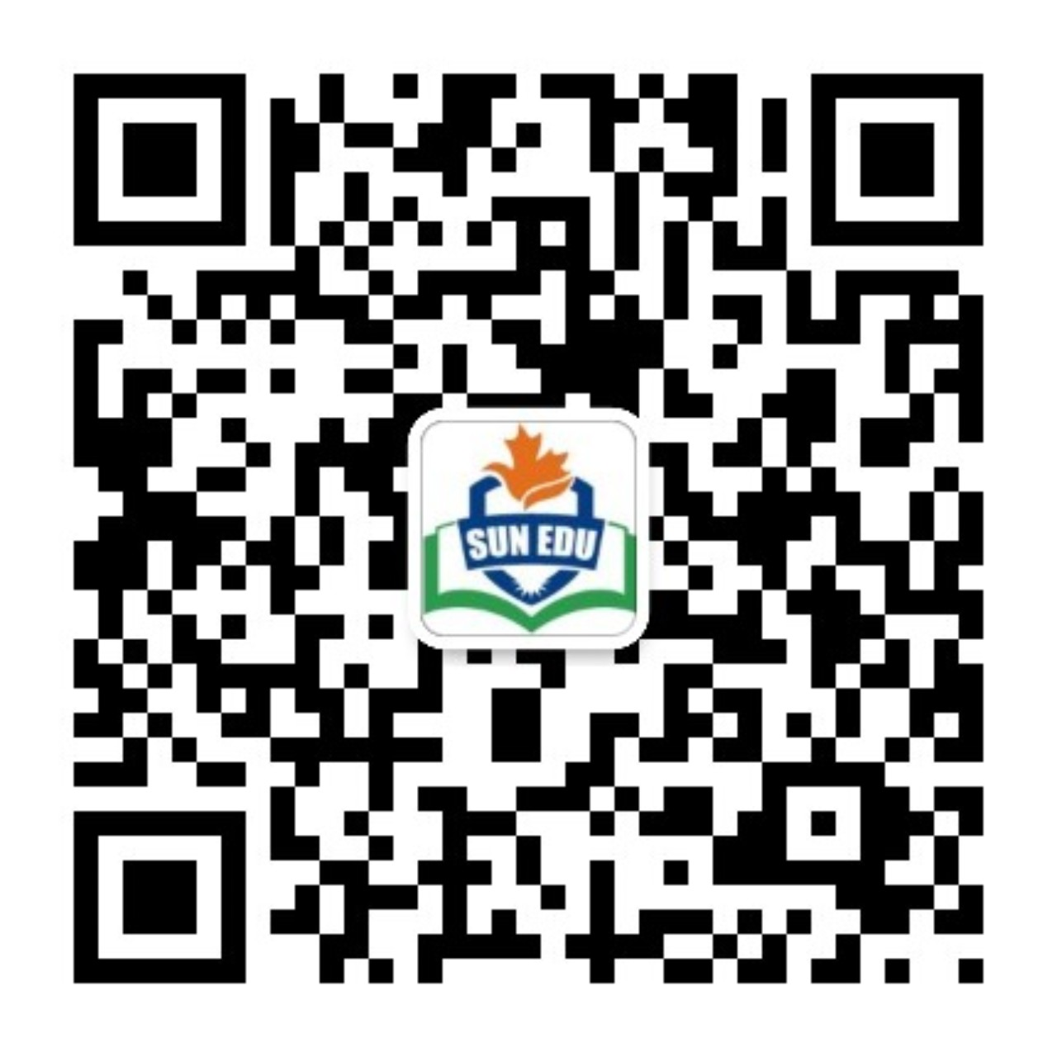
感恩遇见，相互成就，本课件资料仅供您个人参考、教学使用，严禁自行在网络传播，违者依知识产权法追究法律责任。
更多教学资源请关注
公众号：溯恩英语
知识产权声明

Slide 2
By Yushen
MUTUAL ASSISTANCE AND CARE
互助互爱
倡议信
2024新阵地联盟高三联考

Slide 3
By Yushen
目录
01
审题
评价
03
02
建构
迁移
04

Slide 4
By Yushen
PART 01
审题

Slide 5

By Yushen
01
文本呈现
假如你是某学生会主席李华, 为了迎接国际志愿者日(International Volunteer Day)的到来, 请你以学生会的名义向全校师生写一封英文倡议信，号召参加主题为“互助， 互爱”(mutual assistance andcare) 的志愿者活动。
内容包括：
1. 倡议目的;
2. 活动内容;
3. 呼吁参加。
注意：
1. 写作词数应为 80个左右；
2. 请按如下格式在答题纸的相应位置作答。
Dear teachers and schoolmates,
The Students’ Union

Slide 6

By Yushen
01
要素归纳
倡议书
体裁：
时态：
人称：
语气：
交际对象：
主题语境：
谋篇布局：
一般现在、将来时
第一、二人称
informal
全体师生
人与自我。主题群为做人与做事，主题语境内容要求公民义务与社会责任。
人与社会。主题群为社会服务与人际沟通。主题语境内容要求公益事业与志愿服务
首段：背景介绍+发出活动倡议
中段：具体介绍活动内容+意义
尾段：再次发出活动倡议

Slide 7
By Yushen
PART 02
建构

Slide 8

By Yushen
篇章建构
02
首段：背景介绍+发出活动倡议
中段：具体介绍活动内容+意义
尾段：再次发出活动倡议

Slide 9

By Yushen
首段
2.1
首段
1.With the International Volunteer Day in full swing, I am thrilled to appeal to you to participate in volunteer activities on the theme of mutual assistance and care organized by our school, which embody humanistic values.
2.As the International Volunteer Day approaches, I am excited to notify you of several pertinent volunteer activities organized by our school, which reflect the essential value of humanity.
3. I, President of the Students’ Union, am more than/exceedingly delighted to share with you the news about the upcoming International Volunteer Day, emphasizing the importance of mutual assistance and care. In preparation for this day, our school will be organizing volunteer activities aimed at embracing and showcasing core values of contribution and humanity.
背景介绍+发出活动号召
Q1:如何阐释背景？
Q2: 号召某人做某事
with sth approaching
with sth around the corner
with sth drawing near
with sth in full swing
call on somebody to do sth
appeal to somebody to do sth
advocate doing sth

Slide 10
By Yushen
中段
2.2
What可以写哪些活动？Why为什么？
Element 1: What
Activity1: beautify campus activities
Activity2: Volunteer at Nursing Home
Activity3: assistance in charity activities
Element 2: Why
: Students are required to plant trees and beautify the wall, through which they will realize the meaning of mtual assistance.
: Students come to know how to assist nearby people, realizing the significance of mutual care.
: Students can know their deeds and also make a difference to the people in the distant area.
MUTUAL ASSISTANCE AND CARE

Slide 11
By Yushen
中段
2.2
具体活动介绍
Q3: What？哪些活动？
Q4: How?要点怎么衔接？
中段
1.The relevant activities commence with beautifying campus activities. A variety of activities will be organized, including planting trees, and decorating the initially dull walls.
2. What follows next is volunteering at the nursing home. During the stay, we are designed to conduct several interactive games with the elderly, which involve assisting them in handling daily chores and teaching them basic computer skills.
3. Subsequent to it, concerning the assistance for disaster-stricken areas, a series of charity contributions are scheduled by our school, such as contributing second-hand reference books and high-quality stationery. What we are supposed to do is cleaning and packing the donations for the people in need.
校内：校园美化
社会：敬老院
社会：捐献活动辅助工作
活动一：commence with/kick off with
活动二：subsequent to it, subsequently
活动三：what follows next is
首先：Initially/ To start with/ To begin with
其次；Moreover, furthermore, moreover, apart form it, aside from it, additionally, in addition,
最后：Eventually，last but not least, ultimately

Slide 12
By Yushen
尾段
2.3
尾段
1. It’s high time that we took action to attend the volunteer activities. With joint efforts, we are bound to establish a more harmonious society.
2. What you do definitely/absolutely renders a great deal to those in need. Let’s join hands and take immediate action.
3. It is every bit of what you do that truly counts/matters. Let us work together to make a positive difference to those around us and contribute to a better world for all.
号召师生参加
Q5:可以采用哪些句式发出号召？
1. It is high time that we should act/acted to do sth.
2. With our joint efforts,....
3. Let’s join our hands and take immediate action.

Slide 13
By Yushen
下水作文
2.4
Dear teachers and schoolmates,
With the International Volunteer Day in full swing, I am thrilled to appeal to you to participate in volunteer activities on the theme of mutual assistance and care organized by our school, which embody humanistic principles .
The relevant activities commence with beautifying campus activities.Varieties of activities will be organized, including planting trees together, and decorating the initially dull walls, from which we can fully realize the importance of mutual assistance. What follows next is working for the nursing home. During the stay, we are designed to engage them in several interactive games, which involves assisting the elderly in handling daily chores and teaching them to obtain basic computer skills. Subsequent to it, concerning the assistance for disaster-stricken areas, a series of charity contributions are scheduled by our school, such as contributing second-hand reference books and high-quality stationery. What we are supposed to do is cleaning and packing the donations for the people in need. It is worth mentioning that we can exert enough attention to the left-behind children in our daily activities. Personally, all the above volunteer activities are bound to render us rewarding experiences.
It is every bit of what you do that truly counts/matters. Let us work together to make a positive difference to those around us and contribute to a better world for all.
The Students’ Union

Slide 14
By Yushen
PART 03
评价

Slide 15
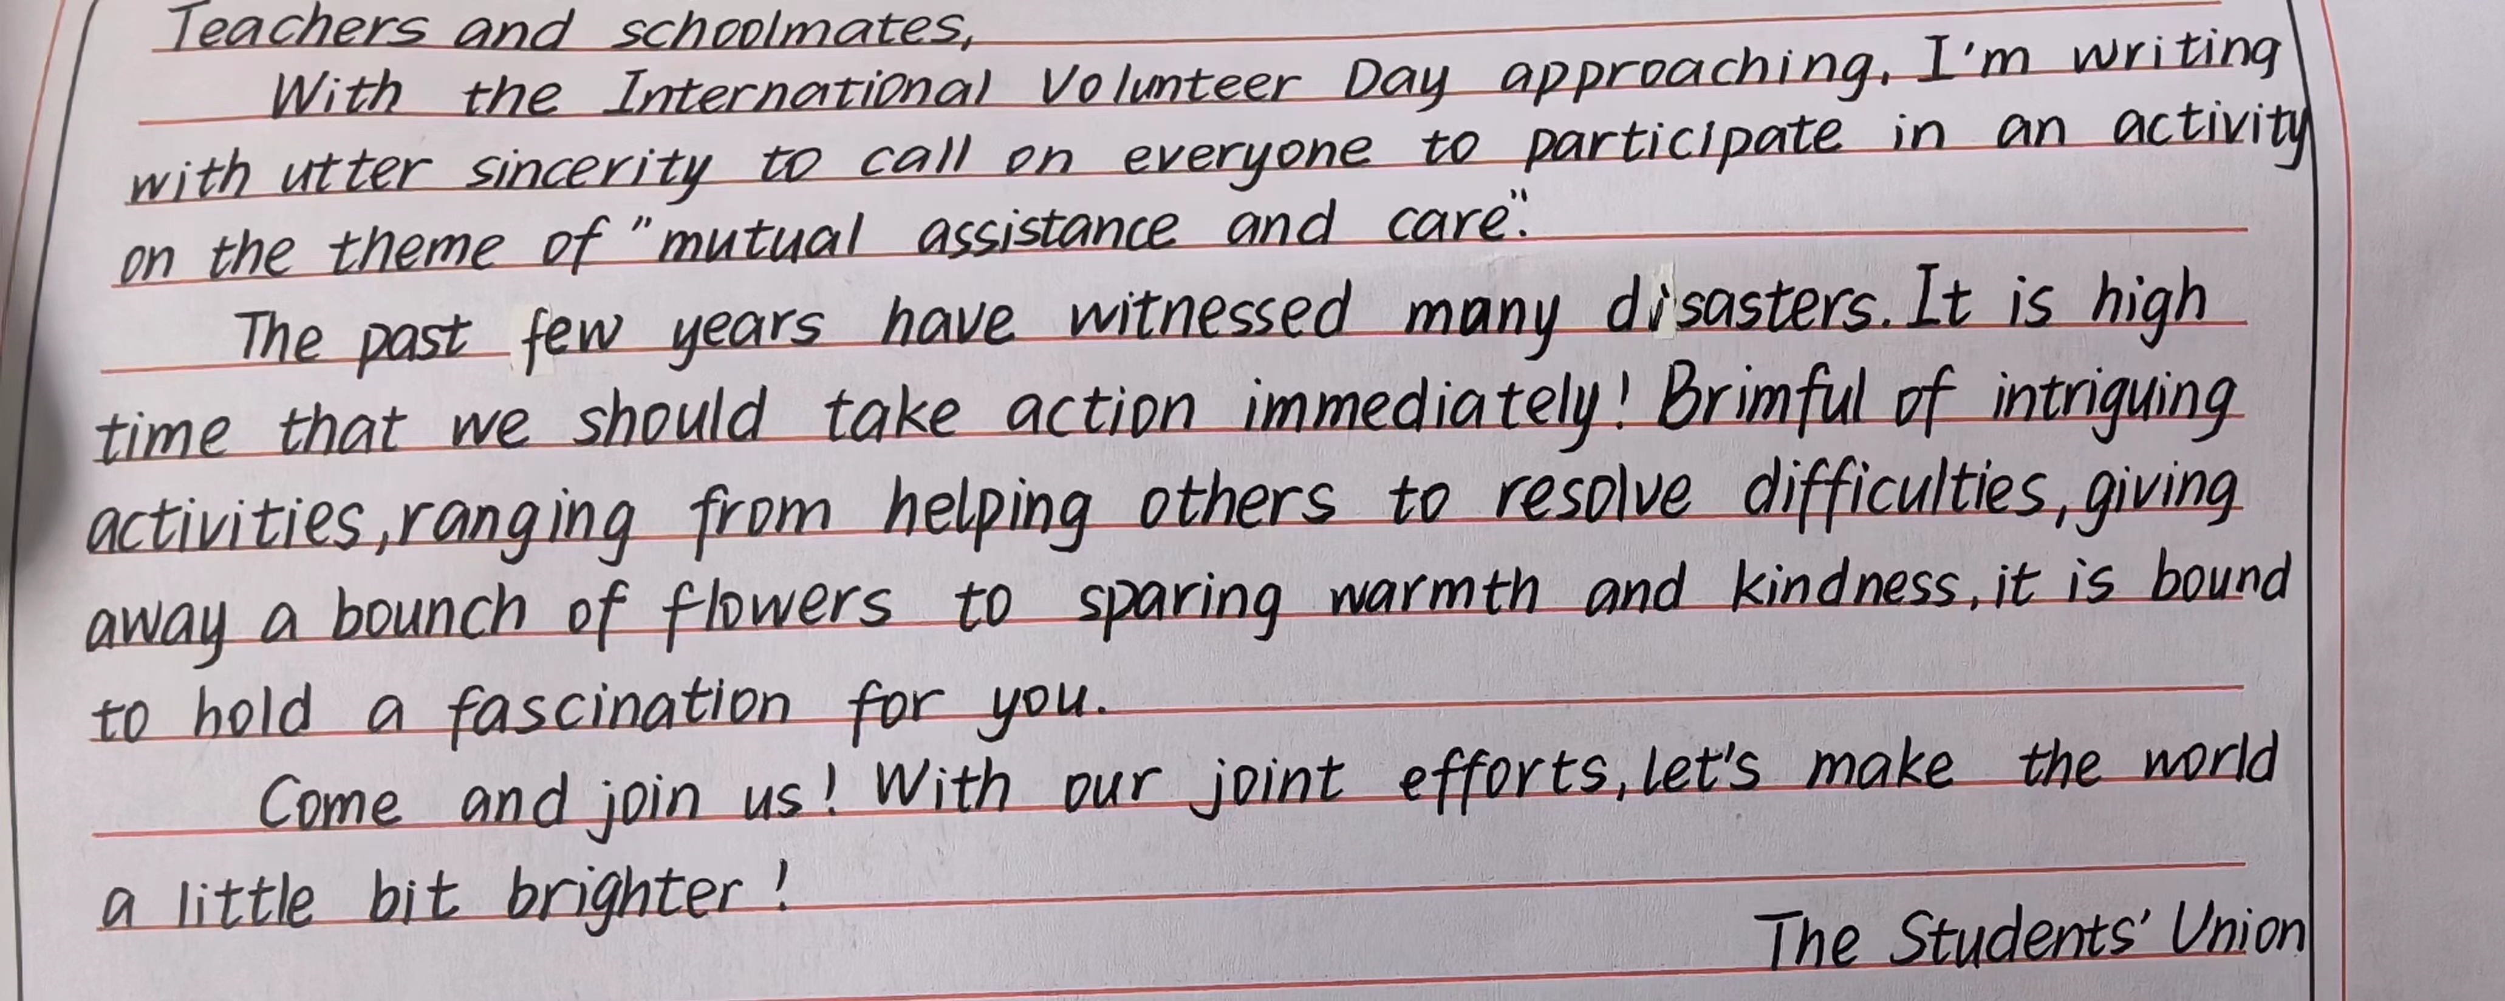

By Yushen
03
学生习作评价
内容：
三段要点齐全，语言表达流畅
结构：
句子间衔接合理
语言：
使用了with的复合结构；无灵主语句；非谓语，语言表达丰富、形式多样
不足：
中间段的活动可以具体展开，少量语法、拼写错误

Slide 16
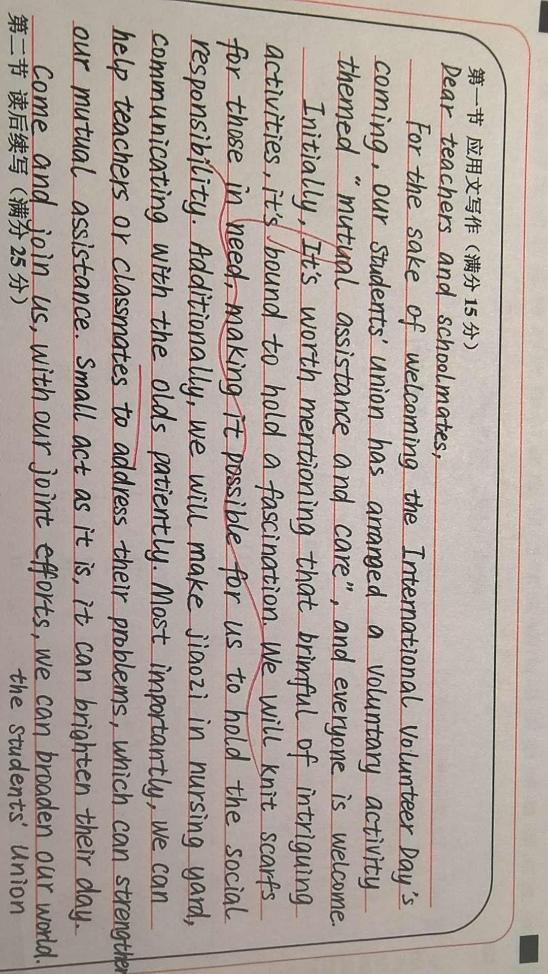
By Yushen
03
学生习作评价
内容：
三段要点齐全，语言表达流畅；中间段落活动丰富，展开具体
结构：
句子间衔接合理，上下文衔接自然
语言：
使用了非谓语，非限制性定语从句，it做形式主语，语言表达丰富、形式多样
不足：
拼写细节，专有名词的积累：the elderly（老人）； the nursing home（养老院）

Slide 17
By Yushen
PART 04
迁移

Slide 18

By Yushen
迁移
04
（2023.3 福建模拟）假定你是李华，上周日你校举办了以“The Power of Voluntary Work”为主题的演讲比赛。请你为校英文报写一篇报道，内容包括：1.参加人员；2.比赛过程；3.活动反响。

Slide 19
By Yushen
迁移作文
04
The Power of Voluntary Work
Targeted at provoking students’ awareness of dedication to assisting others, a speech competition with the title of “the power of voluntary work” was held as scheduled in our school last Sunday.
After several rounds of fierce competition, 10 finalists gained access to the final . At the very start, the opening speech was delivered by the principal, who laid emphasis on the core value of volunteer work. Subsequent to it, each contestant was required to deliver a pertinent speech within 5 minutes, embodying the essence of volunteer work. Eventually, centered on their immediate performance and the content, 3 students were awarded certifications in recognition of their distinguished performance.
Thunderous applause marked the end of the competition. Not only could it ignite students’ zest for volunteering, but it could shed light on the significance of individual’s deeds, which would contribute to the improvement of the society.

Slide 20
By Yushen
语料整理
04
1)告知相关信息:notify/inform you of pertinent information=render you some relevant information
2)目的是/旨在:be aimed at doing/aim to do=with the aim/intention of …=with the purpose of=in a bid to do
3)活动由…开始:sth commences with/ kicks off with
4) 紧接着是:Subsequent to it=What follows next is…=Subsequently,
5) 激发兴趣：provoke/arouse/ignite/kindle students’ interest in
6)唤起热爱：provoke/arouse/ignite/kindle students’ enthusiasm/passion/zest/appetite for...
7)使…了解：…shed/cast light on …give students a deeper insight into …/ offer students a vivid portrait of …

Slide 21
By Yushen
MUTUAL ASSISTANCE AND CARE
Thanks for your attention!

