Slide 1


感恩遇见，相互成就，本课件资料仅供您个人参考、教学使用，严禁自行在网络传播，违者依知识产权法追究法律责任。
更多教学资源请关注
公众号：溯恩英语
知识产权声明

Slide 2
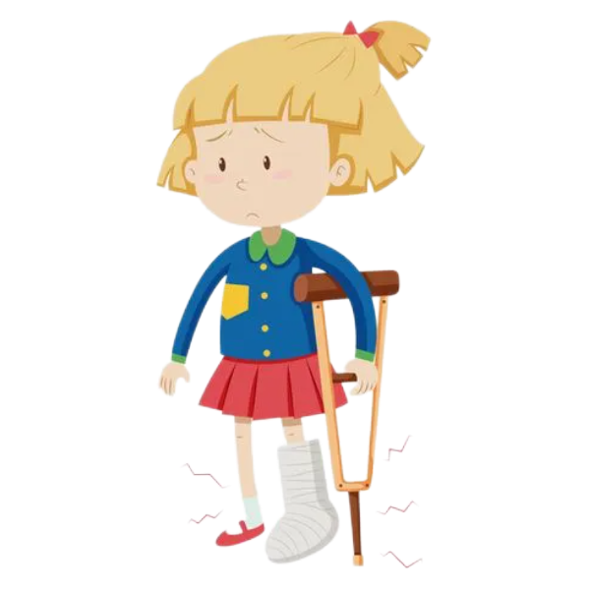
Plot Development Strategy 读后续写情节推进策略
——以2023年深圳一模为例
余杭第一中学 董钶梦

Slide 3

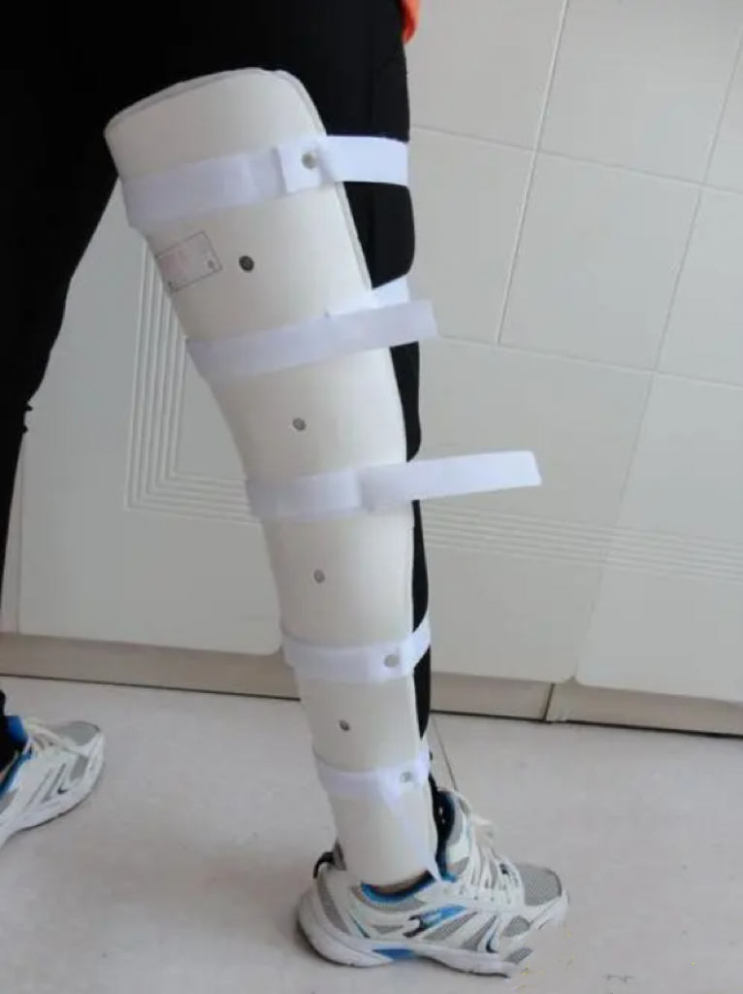
Step1 Warming up
What’s the function?
Who needs it?
If you have to wear it to school, how would you feel?

Slide 4
Step2 Study the given story
Task1 Read for the basic information
1. Time
2. Place
3. Character
(age, physical description, personality, relationship)
4. Plot
5. Theme

Slide 5
Today was Community Service Day at school. Maya’s class was going to make cards for the seniors living in a nursing home. It was also the first day Maya would be wearing her leg brace (腿支架) to school, which was designed to help her walk more steadily and smoothly.
It was a cold autumn morning, Maya looked down, feeling embarrassed. To make it lovelier, she had delicately decorated the brace with pretty butterfly patterns. Still, she was unsure about others’ reaction. All morning at school, kids kept glancing at her brace. To her relief, they didn’t say anything.
In the classroom, Maya was drawing little green buds (芽) and pretty flowers when her friend Samir came over and sat by her. She felt his eyes fixed on her brace and heard him asking, “What’s that for?” Not knowing what to say, Maya pretended she didn’t hear him. After a few seconds of awkwardness, she glanced back at him, and found that he looked a little sad.
After lunch, the class set off. The nursing home was on a small hill and all of them walked there happily along the path. Maya found that the brace did make it easier for her to walk up.
Maya and Samir were paired up with a lady who was 83 years old. There at the end of the hall in a wheelchair, with a big smile on her face, sat the lady, wearing a pink coat, with red lipstick and beautiful earrings. She looked bright and full of life. Moving flexibly and fast towards Maya and Samir, she greeted first. “I’m Joan, ” she said cheerfully, “Glad to meet you. ”
Maya and Samir handed her the cards they made. Joan looked at Samir’s card carefully and spoke with admiration, “You’ve written a poem! That’s so artistic!” Samir’s face reddened with shyness. Then Joan turned to Maya’s picture. “The first flowers of spring!” she cried in delight. “You really have a gift for using colour!” she said. Clearly, Joan’s praise added great power into Maya.
注意:1.续写词数应为150左右; 2.请按如下格式在答题卡的相应位置作答。
In a sudden wave of bravery, Maya asked, “What’s it like being in a wheelchair?”
Deeply impressed by Joan, Maya offered to sit beside Samir on the bus ride back home.
student
wear a leg brace
sensitive
Maya wore her leg brace to school for the first time.
Samir asked about the brace and Maya kept silent.
student
caring
easy to get shy
They met Joan at the nursing home.
83
sit in a wheelchair
fashionable
optimistic
They gave Joan cards and
Joan encouraged them.
Theme：
accept and love yourself

Slide 6
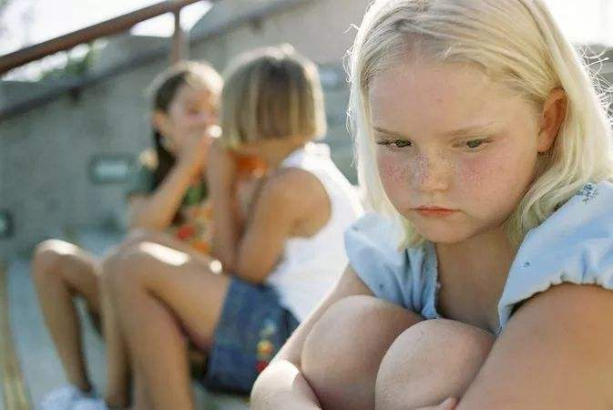
Task2 Read for feelings
Today was Community Service Day at school. Maya’s class was going to make cards for the seniors living in a nursing home. It was also the first day Maya would be wearing her leg brace (腿支架) to school, which was designed to help her walk more steadily and smoothly.
It was a cold autumn morning, Maya looked down, feeling embarrassed. To make it lovelier, she had delicately decorated the brace with pretty butterfly patterns. Still, she was unsure about others’ reaction. All morning at school, kids kept glancing at her brace. To her relief, they didn’t say anything.
In the classroom, Maya was drawing little green buds (芽) and pretty flowers when her friend Samir came over and sat by her. She felt his eyes fixed on her brace and heard him asking, “What’s that for?” Not knowing what to say, Maya pretended she didn’t hear him. After a few seconds of awkwardness, she glanced back at him, and found that he looked a little sad.
After lunch, the class set off. The nursing home was on a small hill and all of them walked there happily along the path. Maya found that the brace did make it easier for her to walk up.
Maya and Samir were paired up with a lady who was 83 years old. There at the end of the hall in a wheelchair, with a big smile on her face, sat the lady, wearing a pink coat, with red lipstick and beautiful earrings. She looked bright and full of life. Moving flexibly and fast towards Maya and Samir, she greeted first. “I’m Joan, ” she said cheerfully, “Glad to meet you. ”
Maya and Samir handed her the cards they made. Joan looked at Samir’s card carefully and spoke with admiration, “You’ve written a poem! That’s so artistic!” Samir’s face reddened with shyness. Then Joan turned to Maya’s picture. “The first flowers of spring!” she cried in delight. “You really have a gift for using colour!” she said. Clearly, Joan’s praise added great power into Maya.
注意:1.续写词数应为150左右; 2.请按如下格式在答题卡的相应位置作答。
In a sudden wave of bravery, Maya asked, “What’s it like being in a wheelchair?”
Deeply impressed by Joan, Maya offered to sit beside Samir on the bus ride back home.

Slide 7
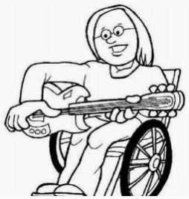
Task3 Read for tips
Para5 ①Maya and Samir were paired up with a lady who was 83 years old. ②There at the end of the hall in a wheelchair, with a big smile on her face, sat the lady, wearing a pink coat, with red lipstick and beautiful earrings. ③She looked bright and full of life. ④Moving flexibly and fast towards Maya and Samir, she greeted first. ⑤“I’m Joan, ” she said cheerfully, “Glad to meet you. ”
Para6 ①Maya and Samir handed her the cards they made. ②Joan looked at Samir’s card carefully and spoke with admiration, “You’ve written a poem! That’s so artistic!” ③Samir’s face reddened with shyness. ④Then Joan turned to Maya’s picture. ⑤“The first flowers of spring!” she cried in delight. ⑦“You really have a gift for using colour!” she said. ⑧Clearly, Joan’s praise added great power into Maya.
Time and Place
Cohesion with the first sentence
Reaction of characters
Transition
That’s how para5&6 developed!

Slide 8
Task3 Read for tips
Para5 ①Maya and Samir were paired up with a lady who was 83 years old. ②There at the end of the hall in a wheelchair, with a big smile on her face, sat the lady, wearing a pink coat, with red lipstick and beautiful earrings. ③She looked bright and full of life. ④Moving flexibly and fast towards Maya and Samir, she greeted first. ⑤“I’m Joan, ” she said cheerfully, “Glad to meet you. ”
Time and Place
Time: after lunch
Place: S2-- ②There at the end of the hall in a wheelchair
Cohesion with the first sentence
S1&S2:
①Maya and Samir were paired up with a lady ...②There at the end of the hall...sat the lady...

Slide 9
Task3 Read for tips
Para5 ①Maya and Samir were paired up with a lady who was 83 years old. ②There at the end of the hall in a wheelchair, with a big smile on her face, sat the lady, wearing a pink coat, with red lipstick and beautiful earrings. ③She looked bright and full of life. ④Moving flexibly and fast towards Maya and Samir, she greeted first. ⑤“I’m Joan, ” she said cheerfully, “Glad to meet you. ”
S1&S4&S5:
①Maya and Samir were paired up with a lady ... ④Moving...towards Maya and Samir, she greeted first. ⑤“I’m Joan, ” she said cheerfully, “Glad to meet you. ”
Reaction of characters
S5 & the 1st sentence of Para6:
⑤“I’m Joan, ” she said cheerfully, “Glad to meet you. ”
Maya and Samir handed her the cards they made.
Transition

Slide 10
Task3 Read for tips
Para6 ①Maya and Samir handed her the cards they made. ②Joan looked at Samir’s card carefully and spoke with admiration, “You’ve written a poem! That’s so artistic!” ③Samir’s face reddened with shyness. ④Then Joan turned to Maya’s picture. ⑤“The first flowers of spring!” she cried in delight. ⑦“You really have a gift for using colour!” she said. ⑧Clearly, Joan’s praise added great power into Maya.
Time and Place
the same as Para5
Cohesion with the first sentence
S1&S2:
①Maya and Samir handed her the cards they made. ②Joan looked at Samir’s card carefully and spoke with admiration,...

Slide 11
Task3 Read for tips
Para6 ①Maya and Samir handed her the cards they made. ②Joan looked at Samir’s card carefully and spoke with admiration, “You’ve written a poem! That’s so artistic!” ③Samir’s face reddened with shyness. ④Then Joan turned to Maya’s picture. ⑤“The first flowers of spring!” she cried in delight. ⑦“You really have a gift for using colour!” she said. ⑧Clearly, Joan’s praise added great power into Maya.
Reaction of characters
S1&S2&S3&S4
①Maya and Samir handed her the cards... ②Joan looked at Samir’s card ... ③Samir’s face reddened with shyness. ④Then Joan turned to Maya’s picture.
Transition
S7 & the 1st sentence of Para7:
⑧Clearly, Joan’s praise added great power into Maya.
In a sudden wave of bravery, Maya asked, “ What’s it like being in a wheelchair?”

Slide 12
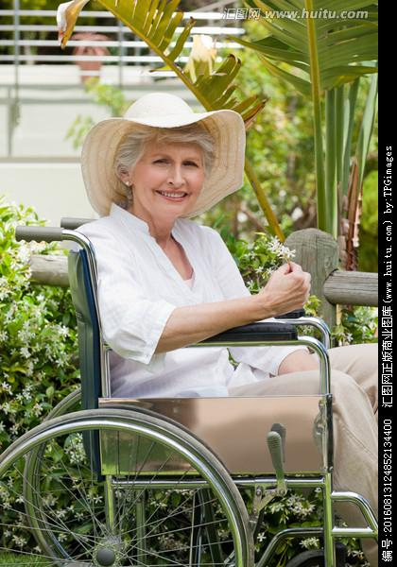

Step3 Frame your plot
Task 4 Outline your plot
Para 1
In a sudden wave of bravery, Maya asked, “ What’s it like being in a wheelchair?”
3 to 4 actions (who did what)
include the change of Maya’s feeling
Time and Place
Cohesion with the first sentence
Reaction of characters
Transition
Para 2
Deeply impressed by Joan, Maya offered to sit behind Samir on the bus ride home.

Slide 13
Step3 Frame your plot
Task 4 Outline your plot
Para 1
In a sudden wave of bravery, Maya asked, “ What’s it like being in a wheelchair?”
3 to 4 actions (who did what)
include the change of Maya’s feeling
Time and Place
What’s the time and place of this paragraph?

Slide 14
Step3 Frame your plot
Task 4 Outline your plot
Para 1
In a sudden wave of bravery, Maya asked, “ What’s it like being in a wheelchair?”
3 to 4 actions (who did what)
include the change of Maya’s feeling
Cohesion with the first sentence
After Maya asked such a question, what was Joan’s reaction? What would she do? How would she feel?

Slide 15
Step3 Frame your plot
Task 4 Outline your plot
Para 1
In a sudden wave of bravery, Maya asked, “ What’s it like being in a wheelchair?”
3 to 4 actions (who did what)
include the change of Maya’s feeling
Reaction of characters
Based on Joan’s reaction, what would Maya do? How would she feel?

Slide 16
Step3 Frame your plot
Task 4 Outline your plot
Para 1
In a sudden wave of bravery, Maya asked, “ What’s it like being in a wheelchair?”
3 to 4 actions (who did what)
include the change of Maya’s feeling
Transition
How to make a resonable transition?
Para 2
Deeply impressed by Joan, Maya offered to sit behind Samir on the bus ride home.

Slide 17
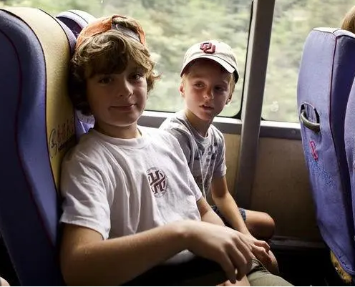
Step3 Frame your plot
Task 4 Outline your plot
Para 2
Deeply impressed by Joan, Maya offered to sit behind Samir on the bus ride home.
3 to 4 actions (who did what)
include the change of Maya’s feeling
Time and Place
Cohesion with the first sentence
Reaction of characters
Theme

Slide 18
Step3 Frame your plot
Task 4 Outline your plot
Para 2
Deeply impressed by Joan, Maya offered to sit behind Samir on the bus ride home.
3 to 4 actions (who did what)
include the change of Maya’s feeling
Time and Place
What’s the time and place of this paragraph?

Slide 19
Step3 Frame your plot
Task 4 Outline your plot
Para 2
Deeply impressed by Joan, Maya offered to sit behind Samir on the bus ride home.
3 to 4 actions (who did what)
include the change of Maya’s feeling
Cohesion with the first sentence
After Maya sit behind Samir, what would she do? How would she feel?

Slide 20
Step3 Frame your plot
Task 4 Outline your plot
Para 2
Deeply impressed by Joan, Maya offered to sit behind Samir on the bus ride home.
3 to 4 actions (who did what)
include the change of Maya’s feeling
Reaction of characters
Based on Maya’s reaction, what would Samir do? How would he feel?

Slide 21
Step3 Frame your plot
Task 4 Outline your plot
Para 2
Deeply impressed by Joan, Maya offered to sit behind Samir on the bus ride home.
3 to 4 actions (who did what)
include the change of Maya’s feeling
Theme
How to end the story in a reasonable way? What’s the theme of the story?

Slide 22
Step4 Evaluate your plot
Task5 Evaluate your partner’s plot.
Is the time and place correct?
Does your plot include the cohesion with the first sentence?
Does your plot include the reaction of characters?
Does your plot include the transition between the 1st and 2nd paragraph?
Does your plot include the theme at the end?

Slide 23
In a sudden wave of bravery, Maya asked, “What’s it like being in a wheelchair?” “It helps me get around,” Joan said simply. Then, grinning, she added, “You’d be surprised at how fast I can go in this thing!” Right then, she moved the wheelchair across the room, turning around, back and forth. And what surprised Maya most was that she didn’t detect any pity or embarrassment from her. Then Maya looked up and found Joan was smiling, eyes purposefully resting on her brace. It was then that a spark of power was lit up deep inside Maya. That afternoon, the three of them had a pleasant talk over lots of things until it was dusk.
Deeply impressed by Joan, Maya offered to sit beside Samir on the bus ride back home. “Joan is great. I like her.” Samir admired. Maya nodded, lost in thought. With Joan’s wheelchair and smile in mind, she summoned up her courage and said, “The brace keeps my toe up so I can walk better.” “Really?” Samir looked amazed, reached out and touched it gently. “That’s super cool!” His words were so sincere that Maya felt warm and moved. It was a reaction that she expected deep inside her heart. Though it was autumn outside, it felt like spring for Maya. A little green bud was bursting ——she and her brace looked cool, beautiful and dynamic in her and others’ eyes.
Cohesion with the first sentence
Reaction of characters
Transition
Time and place
Cohesion with the first sentence
Reaction of characters
Theme

Slide 24
Step5 Assignment
Revise your own plot based on those 4 aspects.

Slide 25
Thank you!

