Slide 1


感恩遇见，相互成就，本课件资料仅供您个人参考、教学使用，严禁自行在网络传播，违者依知识产权法追究法律责任。
更多教学资源请关注
公众号：溯恩英语
知识产权声明

Slide 2
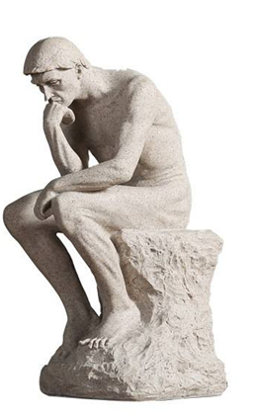
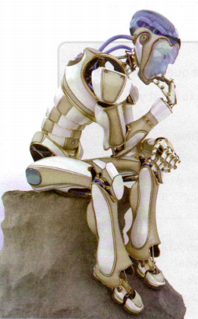
AI AND HUMAN BEINGS
人教版选择性必二
Unit1 Workbook Reading and Writing

Slide 3

Teaching Objectives
Practice reading skills.
Broaden student’s horizons by allowing them to reflect upon the relationship between humans and intelligent machines.
Discuss the benefits and problems of AI bring us.
Be capable to write an essay about the impact of the technology on people’s lives.

Slide 4
Lead-in
Do you think it is possible to make the robot or AI think like humans?

Slide 5
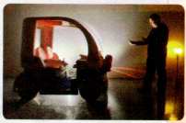
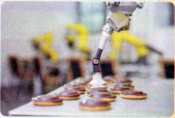
Free Talk
Describe the pictures beside the passages and state the value of using them.
a self-driving car
a robot arm making biscuits

Slide 6

Comprehending
Activity 1
Skim the passage and complete the following sentence.
√
Activity 2
Match the paragraph with its main idea.
Para. 1
Introduce the topic:
whether machines can think like humans?
Para. 2
Summary and interactions with readers for their perspectives
Para. 3
The application of AI currently
Para. 4
What people hope the AI can do in the future
Para. 5
People’s concerns about AI

Slide 7
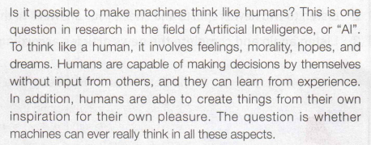
Intensive reading
Para. 1
1. According to paragraph one, what are the things that humans have the capability to do but the machines or AI don’t?
2. Why does the author put forward a question at the beginning of this passage?
Arouse reader’s interest and introduce the topic.

Slide 8

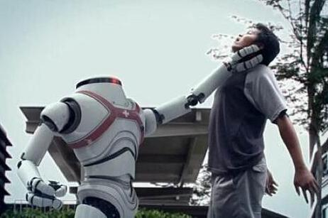
Para. 2
1.When it comes to a mighty computer, why do some people get frightened?
2.Do you think AI will be applied to take the place of humans?
Because they think the computer might have the power to make decisions for their own sake, for example, to wipe out the humans and dominate the Earth by themselves instead.

Slide 9
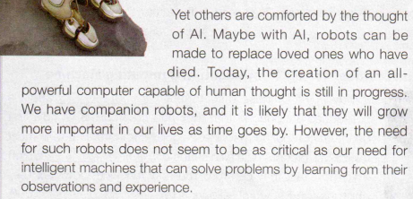
1.What benefits of AI or intelligent machines are mentioned in this paragraph?
2.Do you think companion robots are essential for people’s daily life according to this paragraph?
Para. 3
Companion robots can offer comforts, which are likely to become increasingly important.
It has started and is still continuing.

Slide 10

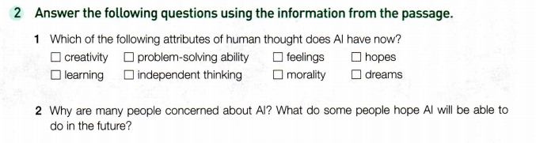
Activity 3
Finish the exercise on page 65.
√
√
The idea of a computer that is all powerful and can think and make decisions for itself terrifies many people. Many people are also concerned that AI will be used to replace humans. On the other hand, some people hope that in the future robots can be made to replace loved ones who have died.

Slide 11
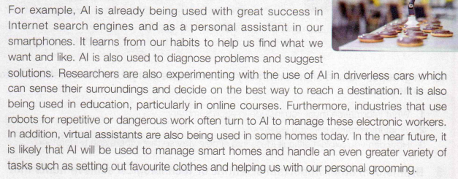
Para. 4
How does the author develop this paragraph?
What are exactly the applications of AI according to the text?
Among them, which one do you think is the most worthwhile and why?
By giving examples.

Slide 12

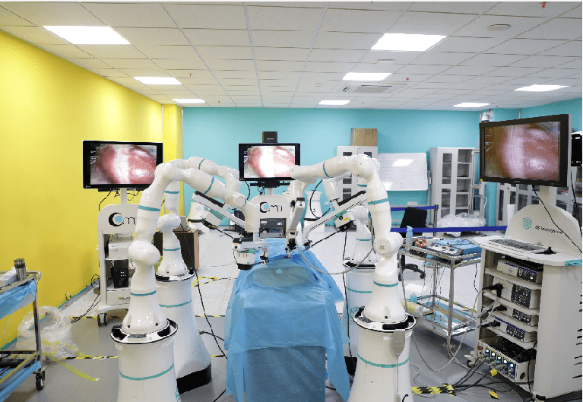
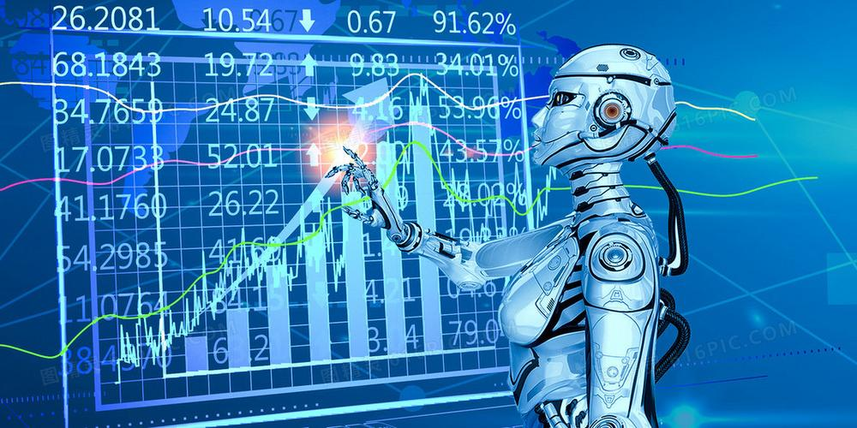
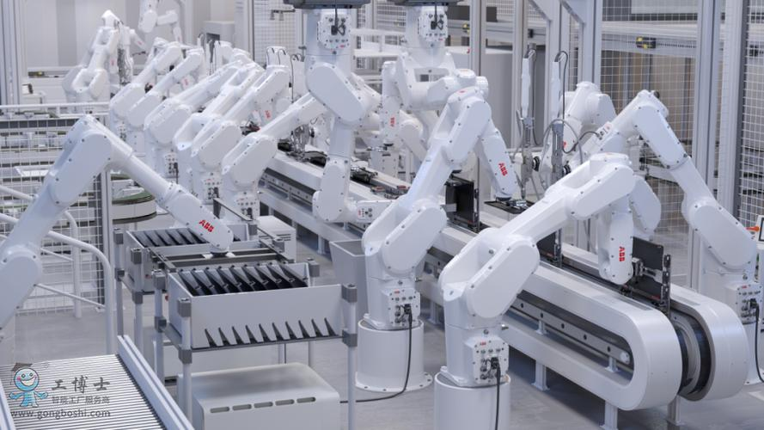
Para. 5
As far as you know, which aspects are the AI superior to humans?
In processing information, it can analyze data much faster.
In manufacture (批量生产工业), it has higher efficiency.
In medical industry, it can detect disease early and develop personalized treatment plans for patients
…

Slide 13
Discussion
What do you think AI will do in the future?
What possible benefits or problems will AI bring us?
Suggested answer:
AI will be able to run most of the high-tech systems we have in the world, and even many household machines will use AI.
Suggested answer:
A possible benefit will be that we will have more time for leisure. A possible problem might be a loss of control over many things in life, where an AI machine will be dictating to use what we want.

Slide 14
Writing
1. In groups, talk about your average day form morning until night. Fill in the table below with your notes.
I use my computer, smart phone, and tablet.
What technology do you use every day?
What technology affects you in your daily life, either in a good way or bad way?
My computer is completely necessary for my life and studies. My smart phone can be a problem at times, as I keep getting interrupted with unnecessary text messages, and I end up spending too much time on social media.
Which of this technology is old(e.g.,the microwave oven) and which is new old(e.g.,the smartphone)?
The only old technology that I really use is a coffee maker . Everything else is fairly new.
What would your daily life be like without this technology?
I could not survive without my computer.

Slide 15
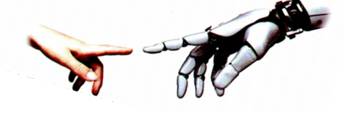
2. Choose one kind of technology from your discussion and use your notes to write an essay about its impact on your daily life. You can start your essay like this:
Sample writing
Every day, I use all kinds of technology. I begin my day by heating my breakfast in the microwave oven. It’s easy and convenient. Then I turn on the radio to listen to the news while eating breakfast. I go to school by bus. My school day is mostly low tech. However, when I get home I am back on the computer again doing my homework. My friends always contact me after school by smartphone—they either call or text. After I finish my homework, I watch TV, tablet in hand. I use the tablet for social media during TV commercials. Some of the new and old technology I use is nice, while some is essential. It seems impossible to live nowadays without some technology in our lives.

Slide 16
Deep Thinking
In the future, what jobs are not likely to be replaced by AI and why?
On the one hand , AI is expert in the jobs whose work is highly repetitive with a fixed working environment or condition.
On the other hand, they are not adept at the jobs which need creative thinking, interpersonal skills, empathy, teamwork spirit, emotional experience, critical thinking, and complex problem solving ability etc.
Therefore, AI researchers, engineers, novelists, lawyers, artists, leaders and teachers are the jobs which are impossible to be completely replaced by AI.

Slide 17
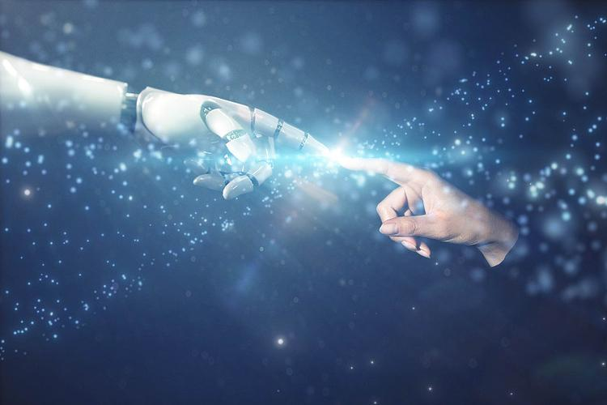
Whether technology is a curse or a blessing depends on how we use it.

