Slide 1


感恩遇见，相互成就，本课件资料仅供您个人参考、教学使用，严禁自行在网络传播，违者依知识产权法追究法律责任。
更多教学资源请关注
公众号：溯恩英语
知识产权声明

Slide 2

漫长的重逢

Slide 3
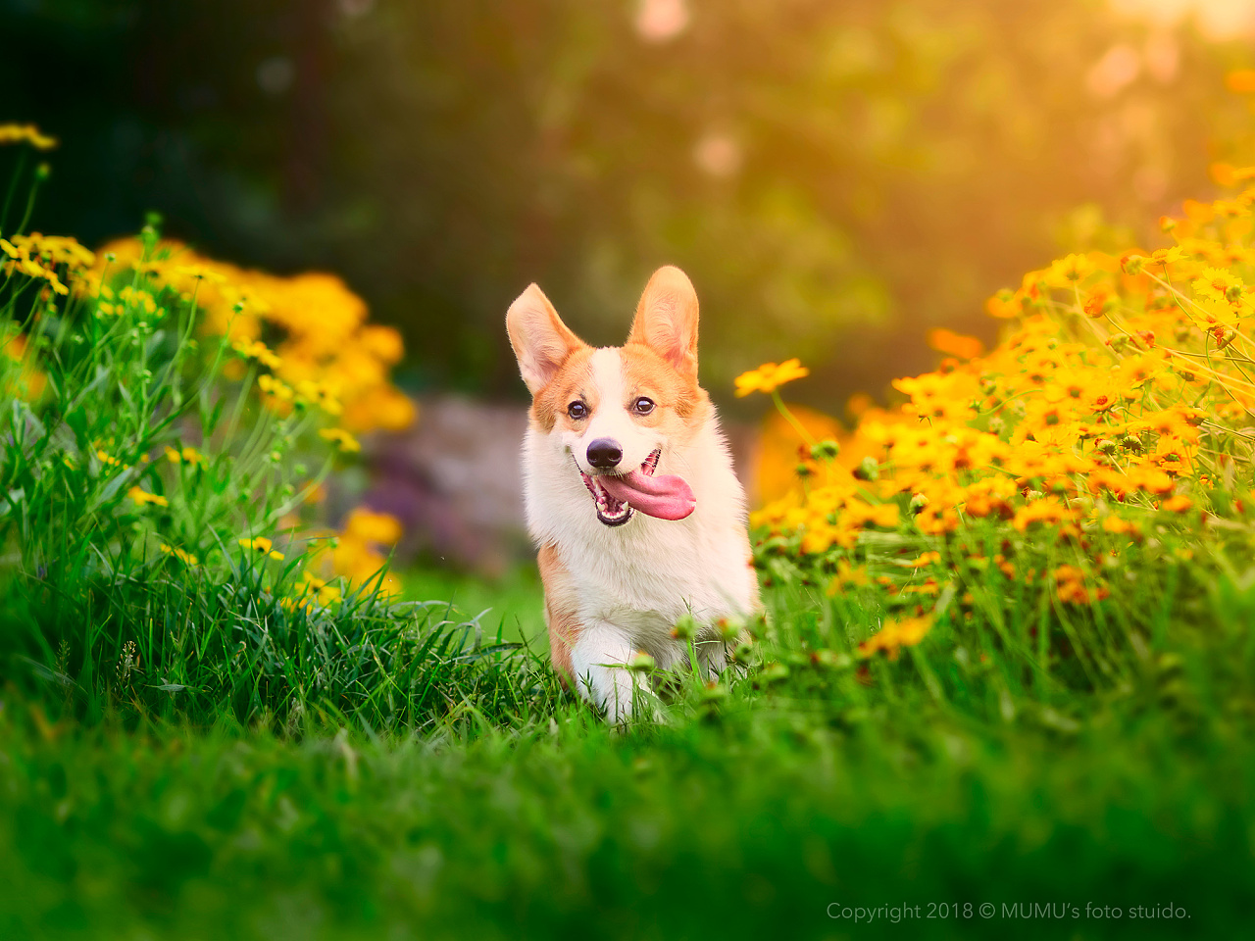

文本呈现
My family moved from Toowoomba, Canada to London in 1950. My mother was in great pain from the 1950s epidemic of polio(小儿麻痹症).She wished to visit specialists in London. The day before we boarded the ship, Father bade a tender farewell to his five-year-old “friend” at the dock(码头),an Australian cattle dog, Spider, who was loved by us all. Father's friend Sandy was to be his guardian while we were overseas.
Six weeks later, a letter arrived from Sandy, giving my father the news that Spider had run away just two weeks after we had sailed. I will always remember my father's face crumbling and his eyes glistening as he read the letter. We tried to comfort him, knowing in our hearts how useless this was. Sandy has advertised constantly on ABC radio and other local newspapers. Despite some “sightings” in the dock at first, the dog was never found later. It seems Spider decided to search for us elsewhere.
We sailed back two years later and re-established our home in Toowoomba. My father immediately began his own searching for Spider. Several months passed but there was still no news concerning Spider. The dog was gone, possibly shot or dead from starvation or exhaustion.
One cold morning eight months after our return, my father had a call from an old lady who said she was putting food out "for a very old dog". In the night the food disappeared. This had been going on for a few weeks. That was enough for my father to interrupt my homework and we set off immediately. When we arrived at the old lady's house, she invited us into an old bush. Sadly, she then told us that the "dingo dog” hadn't been around for a few days. My father had a strange look in his eye. He put two fingers to his lips and did his special whistle(口哨)for Spider.

Slide 4
Read for main ideas for each paragraph
My family moved from Toowoomba, Canada to London in 1950. My mother was in great pain from the 1950s epidemic of polio(小儿麻痹症).She wished to visit specialists in London. The day before we boarded the ship, Father bade a tender farewell to his five-year-old “friend” at the dock(码头),an Australian cattle dog, Spider, who was loved by us all. Father's friend Sandy was to be his guardian while we were overseas.
Main idea
Spider was left with Sandy while our family were overseas.

Slide 5
Six weeks later, a letter arrived from Sandy, giving my father the news that Spider had run away just two weeks after we had sailed. I will always remember my father's face crumbling and his eyes glistening as he read the letter. We tried to comfort him, knowing in our hearts how useless this was. Sandy has advertised constantly on ABC radio and other local newspapers. Despite some “sightings” in the dock at first, the dog was never found later. It seems Spider decided to search for us elsewhere.
Main idea
Spider was missing.

Slide 6
We sailed back two years later and re-established our home in Toowoomba. My father immediately began his own searching for Spider. Several months passed but there was still no news concerning Spider. The dog was gone, possibly shot or dead from starvation or exhaustion.
Main idea
After two years, Spider was still nowhere to be found.

Slide 7
One cold morning eight months after our return, my father had a call from an old lady who said she was putting food out "for a very old dog". In the night the food disappeared. This had been going on for a few weeks. That was enough for my father to interrupt my homework and we set off immediately. When we arrived at the old lady's house, she invited us into an old bush. Sadly, she then told us that the "dingo dog” hadn't been around for a few days. My father had a strange look in his eye. He put two fingers to his lips and did his special whistle(口哨)for Spider.
Main idea
Spider was spotted by an old lady and we set off to look for it.

Slide 8
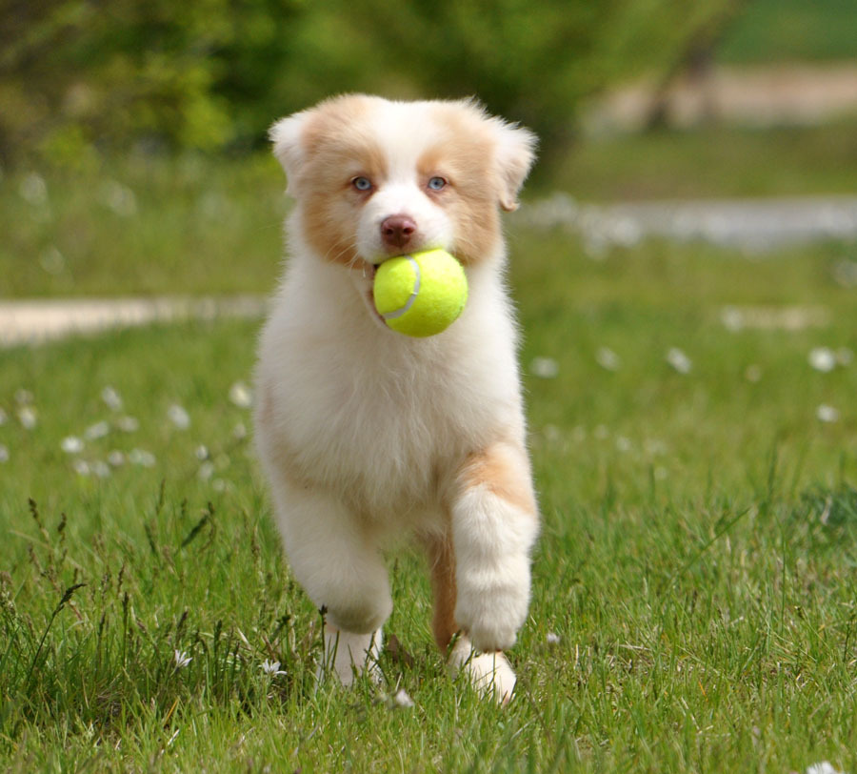
Read for clues
The day before we boarded the ship, Father bade a tender farewell to his five-year-old “friend” at the dock(码头),an Australian cattle dog, Spider, who was loved by us all. .
clues
echoes
1. Spider would never bid a farewell to my father again. Wherever Father went, he would just follow his steps, as if fearing another long separation.

Slide 9
I will always remember my father's face crumbling and his eyes glistening as he read the letter. ……. Despite some “sightings” in the dock at first, the dog was never found later. It seems Spider decided to search for us elsewhere.
clues
echoes
2. My father’s face lit up and his eyes glistened as Spider jumped into his arms, licking his face excitedly.
3. After such a long search, we found Spider ultimately and brought it back home.

Slide 10
Read for clues
Several months passed but there was still no news concerning Spider. The dog was gone, possibly shot or dead from starvation or exhaustion.
clues
echoes
4. The story of our reunion with Spider was covered by the local newspaper, which struck a chord with many pet owners.

Slide 11
Read for clues
The day before we boarded the ship, Father bade a tender farewell to his five-year-old “friend” at the dock(码头),an Australian cattle dog, Spider, who was loved by us all. .
clues
echoes
5. Spider would never bid a farewell to my father again. Wherever Father went, he followed his steps.

Slide 12
Analysis about characters and plot of the text
人物： 狗Spider ; my father, I , (my mother 只有在第一段提到，而且与狗的关系只字未提，可见my mother 可写可不写。）
地点：the dock, Toowoomba, Canada (London 对于设计续写情节是个没有用的地点，母亲看病的城市）
时间： 1950- 六周后-两年—八个月—暗示Spider 在外独自流浪了近三年，但还是顽强地活了下来。
主题：①忠诚，顽强的狗是我们完整的家庭的重要一份子！
② 通过the old lady 对Spider 表现出来的善意，我们一家人传承这种善意，把对Spider 的爱惠及其他流浪狗。

Slide 13
Read for plot design based on the two given sentences
Para 1: Suddenly there was a bark in the bush.
Para 2: From then on, Spider and my father would hang out at the dock.
根据尾段以及 首段所给句的 a bark + 二段所给句中 Spider ，即可判断第一段的内容设计一定是围绕着找到了狗.结合尾段去找狗的人物是 我以及我父亲，地点是 bush ， 一个老太太提供的信息。加上Spider 在外流浪多年，非常像Dingo dog (野狗），可以描写一下落魄的外表。

Slide 14
Read for plot design based on the two given sentences
Para 2: From then on, Spider and my father would hang out at the dock.
二段设计的情节应该是Spider与家人团聚后的幸福生活日常。如果要更有趣些，设计一个情节：动人的故事总会流传，然后被当地媒体报道，考虑到1950那个年代，采用当地报社报道会比较合理，引起共鸣，甚至Spider 成了社区名人。但我们高兴的点是在于Spider 的回归让我们家再一次完整！

Slide 15
Read for plot design based on the two given sentences
Para 2: From then on, Spider and my father would hang out at the dock.
二段设计的情节还可以结合Spider 历经近三年的在外流浪而幸存的经历，把陌生人其中包括the old lady 对流浪狗的善进行发散性思维。爱可以传递给别的流浪狗！这样的结尾会有思想深度！！！（考生优秀范文会在此课件结尾呈现）

Slide 16
Design four key sentences for each paragraph
Para 1: Suddenly there was a bark in the bush.
Para 2: From then on, Spider and my father would hang out at the dock.
首句1：What shocked us was that the bark sounded so familiar to us.
首句2： The dense bush looked tough to go through, but apparently it offered an ideal shelter for the “dingo dog”.

Slide 17
Design four key sentences for each paragraph
Para 1: Suddenly there was a bark in the bush.
Para 2: From then on, Spider and my father would hang out at the dock.
尾句1： With our family’s delicate care and professional medical treatment, it didn’t take a long time before Spider recovered, as energetic as before.
尾句2： After what seemed like centuries of search, we ultimately found Spider and brought it back home.

Slide 18
Design four key sentences for each paragraph
Para 2: From then on, Spider and my father would hang out at the dock.
首句1： Together, they would wander along the edge of the dock in the golden morning sunshine or in the glow of sunset, enjoying each other's company.
首句2： The dock not only witnessed their previous departure but also their present mutual company.

Slide 19
Design four key sentences for each paragraph
Para 2: From then on, Spider and my father would hang out at the dock.
尾句1： Separated from home for nearly three years, Spider eventually reunited with our family.
尾句2： After what seemed like centuries of search, we ultimately found Spider and brought it back home.

Slide 20
Textual logic between each sentence in Para1.
Para 1: Suddenly there was a bark in the bush.
(呼应bark) What shocked us was that the bark sounded so familiar to us.
2. (描写父亲和我的感受：）My father and I just couldn't believe our ears.
3. (写心理活动:忐忑的猜测）Could it be Spider? Could Spider be still alive after all that long time?

Slide 21
Textual logic between each sentence in Para1.
4. （激动的心情）My heart almost pounded out of my chest as we followed the bark, pushing through the thick bush.
5.（描写流浪在外多年的狗 的惨状）And then, a weathered, skinny and weary-looking dog came into our sight.

Slide 22
Textual logic between each sentence in Para1.
6. （父亲喜悦的泪水）Tears of joy welled up in my father's eyes as he called out Spider's name, choking with emotions.
6. （或者回扣第二段父亲得知spider 逃跑的消息父亲的神态描写，进行反向创作）My father’s face lit up and his eyes glistened as Spider jumped into his arms, licking his face excitedly.

Slide 23
Textual logic between each sentence in Para1.
7. （离家近三年，Spider 与我们家人团圆）Separated from home for nearly three years, Spider eventually reunited with our family.
7. (或者回扣原文中提到的数年来的寻找，终于找到了Spider)After what seemed like centuries of search, we ultimately found Spider and brought it back home.
8. （精心照顾，Spider 又像从前一样精力充沛）With our family’s delicate care and professional medical treatment, it didn’t take a long time before Spider fully recovered, as energetic as before.

Slide 24
Textual logic between each sentence in Para2.
Para 2: From then on, Spider and my father would hang out at the dock.
1. （描写Spider and my father 清晨或黄昏漫步日常）Together, they would wander along the edge of the dock in the golden morning sunshine or in the glow of sunset, enjoying each other's company.
2. (描写欢乐的Spider) Spider would follow my father, wagging his tail cheerfully all the time.

Slide 25
Textual logic between each sentence in Para2.
3. ( 人与狗之间的深厚纽带令我们感动不已）The bond between them seemed to transcend time and distance, which moved us all.
4. （我的看法是狗狗害怕再次漫长的分离） I think Spider would never bid a farewell to my father again, as if fearing another long separation.
5. （动人的故事广为人知，引起共鸣）Somehow, the amazing story of Spider got around and it was covered by a local newspaper, which struck a chord with many pet owners.

Slide 26
Textual logic between each sentence in Para2.
6. （因为媒体报道，Spider 一鸣惊人）What Spider never expected was that he now became a celebrity in Toowoomba !
7. （具体表现为络绎不绝的游客来到Toowoomba一睹Spider 风采） Floods of visitors from near and far came to Toowoomba to see Spider ，asking to take pictures with him !

Slide 27
Textual logic between each sentence in Para2.
8. (但是我们最快乐的事是阖家团圆）But much to our delight, despite years of living/wandering/being homeless in the wild alone, Spider survived and found his way back to us, and our family was whole once more!

Slide 28
习作欣赏
Para 1: Suddenly there was a bark in the bush. What shocked us was that the bark sounded so familiar to us. My father and I just couldn't believe our ears. Could it be Spider? Could Spider be still alive after all that long time? My heart almost pounded out of my chest as we followed the bark, pushing through the thick bush. And then, a weathered, skinny and weary-looking dog came into our sight. My father’s face lit up and his eyes glistened as Spider jumped into his arms, licking his face excitedly. Separated from home for nearly three years, Spider eventually reunited with our family. With our family’s delicate care and professional medical treatment, it didn’t take a long time before Spider fully recovered, as energetic as before.

Slide 29
Para 2: From then on, Spider and my father would hang out at the dock.Together, they would wander along the edge of the dock in the golden morning sunshine or in the glow of sunset, enjoying each other's company. Spider would follow my father, wagging his tail cheerfully all the time. The bond between them seemed to transcend time and distance, which moved us all. Somehow, the amazing story of Spider got around and it was covered by a local newspaper, which struck a chord with many pet owners. What Spider never expected was that he now became a celebrity in Toowoomba ! Floods of visitors from near and far came Toowoomba to see Spider ，asking to take pictures with him !But much to our delight, despite years of living in the wild alone, Spider survived and found his way back to us, and our family was whole once more!

Slide 30

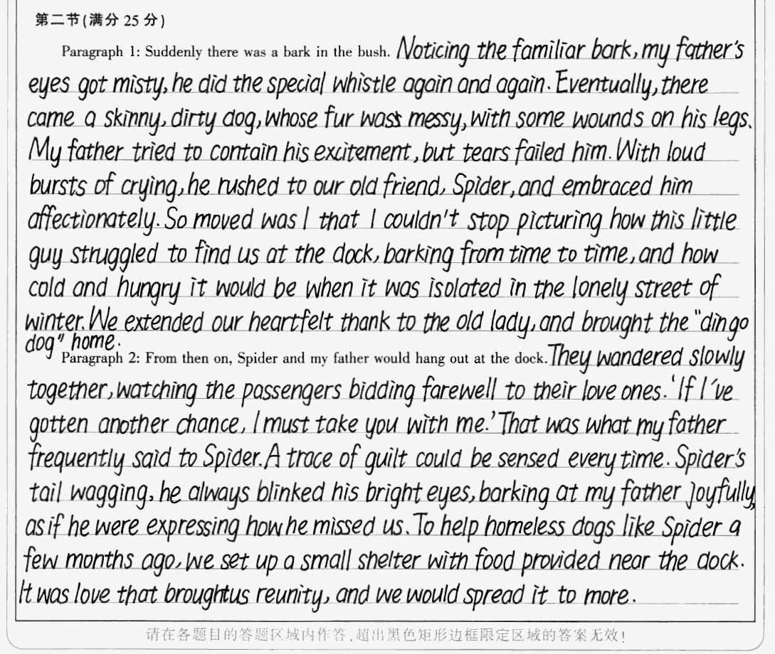
学生习作欣赏
习作点评：
该生语言功底扎实，叙事能力卓越，设计情节老练，思维活跃且有深度，尤其是有感于老太太对流浪狗的友善最终在码头设立一个狗狗的shelter， 让更多的善继续传递下去。

Slide 32
关于狗的语料 请参考已发表的 人狗奇缘

