Slide 1


感恩遇见，相互成就，本课件资料仅供您个人参考、教学使用，严禁自行在网络传播，违者依知识产权法追究法律责任。
更多教学资源请关注
公众号：溯恩英语
知识产权声明

Slide 2

2024年3月
强基联盟高三试题讲评
浙江省海亮高级中学 陈虹

Slide 3

CONTENTS
题型概况
阅读理解
完形填空
语法填空

Slide 4

01
题型概况

Slide 5
题型 | 话题 | 体裁 | 词数
阅读A | 人与社会:An introduction of the Ynez Library | 应用文 | 144
阅读B | 人与社会:The founding of a basketball team | 记叙文 | 269
阅读C | 人与自然：A new research about the microscopic plastic particles | 说明文 | 298
阅读D | 人与自我 The author’s idea of rational abandonment | 议论文 | 287
七选五 | 人与自我 The right stratege to deal with procrastination | 说明文 | 232
完型填空 | 人与社会 My Autistic daughter | 记叙文 | 221
语法填空 | 人与社会 This winter’s tourism fever | 说明文 | 168

Slide 6
02
阅读理解

Slide 7

A 篇
An introduction of the Ynez Library
本文是Ynez图书馆的介绍。阐述了图书馆的使命和核心价值观及为访客提供的不同服务和活动，并说明了怎样接触特殊收藏。

Slide 8



A 篇
21.What does Ynez Library highlight in the first paragraph? A.Its new changes. B.Its main values. C.Its best achievements. D.Its working principles.
第一段“At its core,our mission for nearly four centuries has been to advance the learning, research, and pursuit of truth, Our efforts are motivated and powered by working collaboratively, embracing diverse perspectives, championing access, aiming for the extraordinary,and always leading with curiosity.”
核心价值观
Tip: 对段落中的细节要进行综合分析

Slide 9
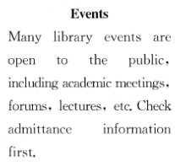

A 篇
22.Which part should a person click on if he plans to attend a scientist's speech?
A.Visitors. B.Exhibits. C.Tours. D.Events.
Tip: 应用文的阅读可以通过扫读的方式，节约时间并准确定位

Slide 10
A 篇
23.How can a researcher find the special holdings quickly in the library?
A.By paying a special fee. B.By visiting main libraries.
C.By locating them online. D.By appointing a librarian.
SPECIAL COLLECTIONS
.....
◎Different libraries have different holdings,so you may want to start by using our search tools to find materials relevant to your research.
use ...search... to find=locte... on line
Tip：细节题要关注同义词转换

Slide 11
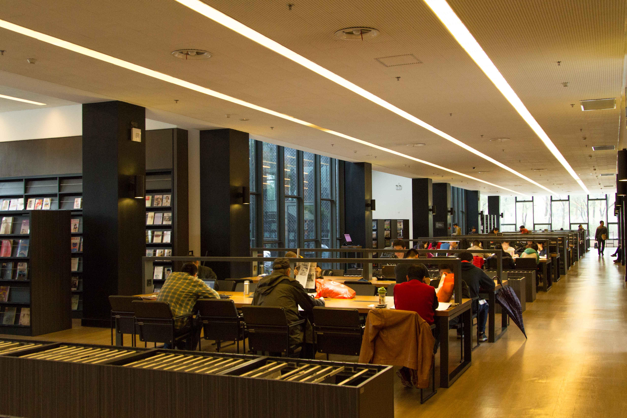
语料积累
阐述活动或组织主旨的语料
At its core,our mission for nearly four centuries has been to advance the learning,research,and pursuit of truth.Our efforts are motivated and powered by working collaboratively,embracing diverse perspectives,championing access,aiming for the extraordinary,and always leading with curiosity. 近四个世纪以来，我们的核心使命一直是推动学习、研究和追求真理。我们努力的动力和力量来自于合作，拥抱不同的观点，支持访问，以非凡为目标，并始终以好奇心为导向。
对活动或组织进行介绍的语料
champions of curiosity 好奇心的捍卫者 open to the public 向公众开放 admittance information 导纳信息
关于活动参与者行为的语料
accessing their special collection items 访问他们的特殊收藏项目 using our search tools 使用我们的搜索工具

Slide 12
长难句分析
Our efforts are motivated and powered by working collaboratively,embracing diverse perspectives,championing access,aiming for the extraordinary,and always leading with curiosity.
主语
谓语（被动语态）
状语
我们努力的动力和力量来自于合作，拥抱不同的观点，支持访问，以非凡为目标，并始终以好奇心为导向。
Tip:在长难句中“and”扮演着很重要的角色，搞清楚“and”连接的对象是分析长难句句子结构的关键

Slide 13
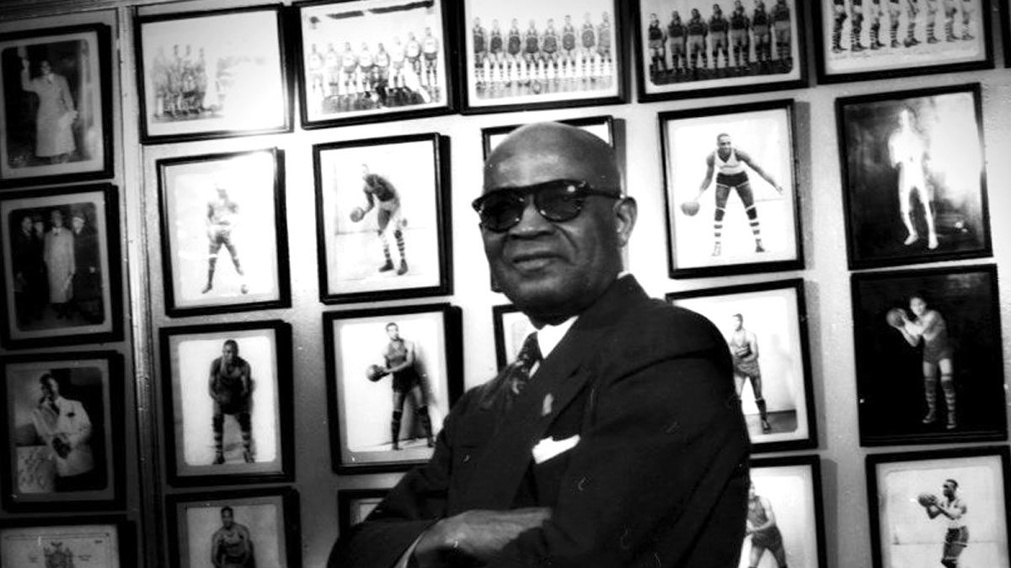
B 篇
The founding of a basketball team
本文是关于 Bob Douglas 创立篮球队并为纽约市的黑人运动员提供更多机会的故事。他和他的队伍在面对困难时坚持不懈,并取得了显著的成就,尽管最终球队在 1949 年解散，但他们对黑人运动员在篮球领域的贡献被人们所记住。

Slide 14
背景资料
Bob Douglas, known as the "Father of Black Professional Basketball," established the Rens in the 1920s. The Rens were one of the first all-black professional basketball teams in the United States during a time when racial segregation（种族隔离） was prevalent（盛行的） in sports.
Under Douglas' leadership, the Rens achieved remarkable success and became a dominant force in basketball. They won the first World Professional Basketball Tournament in 1939, solidifying their reputation as one of the best teams of their era. The Rens played a significant role in breaking down racial barriers in basketball and showcasing the talent and skill of African American players.
Bob Douglas' vision and dedication to providing opportunities for black basketball players paved the way for integration（整合） in the sport and opened doors for future generations of athletes. The New York Renaissance and Bob Douglas's legacy remain an important part of basketball history, highlighting the resilience and excellence of African American athletes in the face of adversity.

Slide 15
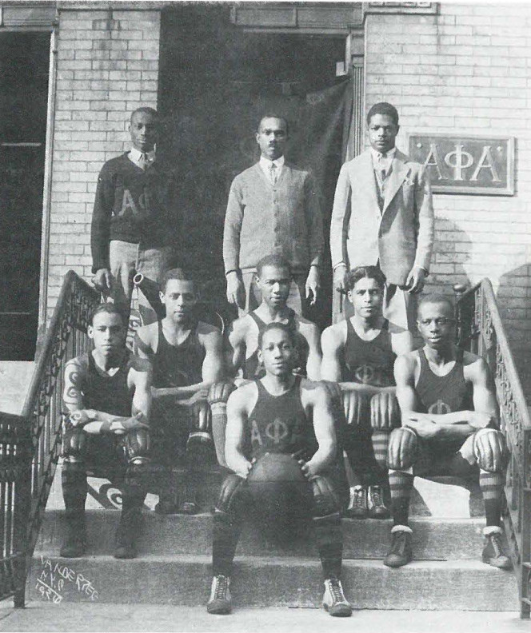
B 篇
24.What inspired Douglas to establish a basketball team? A.His desire to show his athletic strength.
B.A motivation to learn Black culture. C.His intention to earn a good income.
D.An experience to a basketball court.
第一段“Later，a co-worker took him to visit a basketball court，and he was amazed by the athletic prowess on display. At that moment, Douglas who had enjoyed playing sports as a child, was determined to create a basketball team..
be amazed by +be determined to = be inspired to do
后来，一位同事带他去了一个篮球场，他对所展示的运动能力感到惊讶。在那一刻，小时候喜欢参加体育运动的道格拉斯决心创建一支篮球队，为纽约市的黑人运动员提供更多的机会。

Slide 16
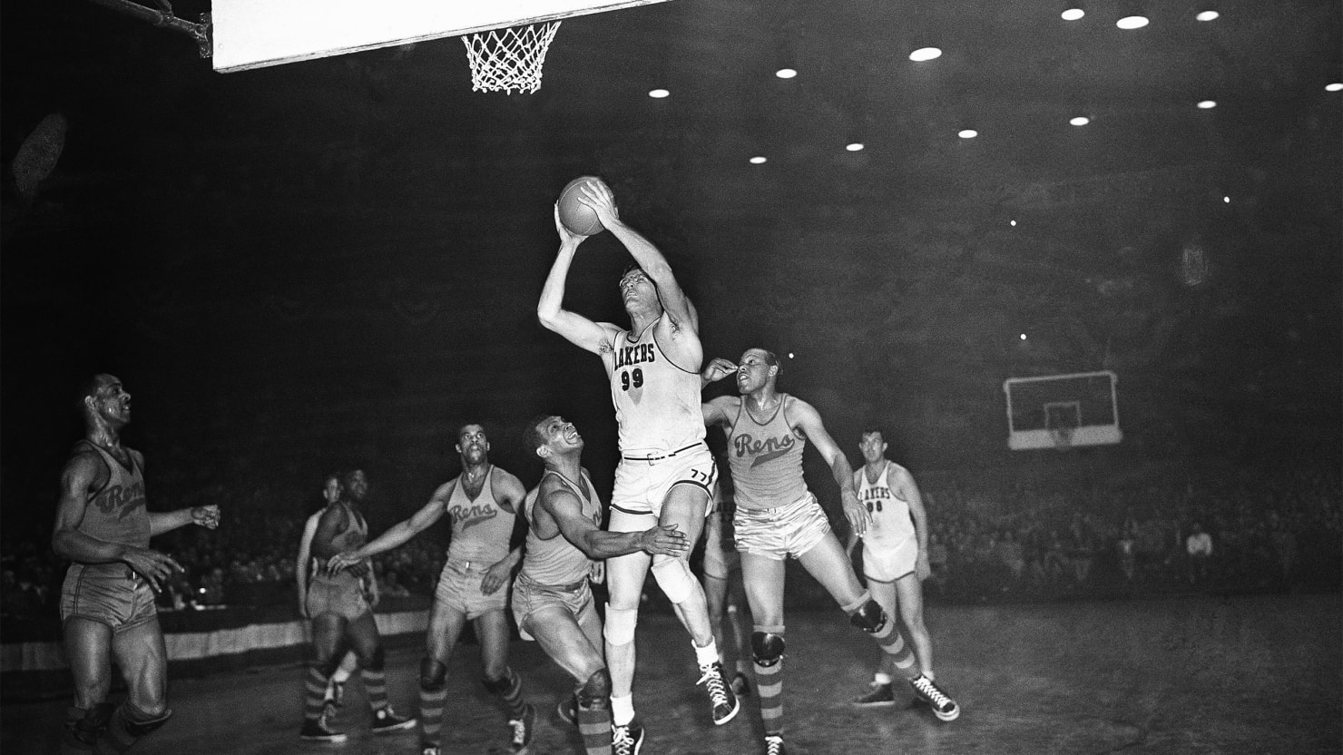
小知识：pack the house吸引大量观众或观众到场。
这个短语的来源可以追溯到剧院、演出或体育比赛等活动，当主办方或表演者成功地吸引了足够多的观众填满场馆时，就可以说他们“packed the house”。“Pack the house” 这个短语中的“pack” 意为“填满”或“挤满”，而“house” 在这里指的是“房子”或“场馆”，表示将场馆填满观众。这个短语常用于描述一个活动或表演非常受欢迎，吸引了众多观众到场，使场馆充满热闹的氛围。因此，当人们说某个活动或表演“packed the house” 时，意思是这个活动或表演吸引了大量观众，场馆座无虚席，通常是一个成功的、受欢迎的表现。
B 篇
25.Why did the Rens tour the country playing basketball?
A.To solve financial problems. B.To improve basketball skills.
C.To fight for accommodation. D.To play with excellent players.
第三段“...so Douglas had to pack the house to generate profits and keep his team alive. They traveled the country playing any opponent that would agree to schedule them...”
通过travel the country定位第三段，该句中的generate profits可知应选A项。

Slide 17
B 篇
26.How did the Rens help change the game of basketball?
A.Making competition rules.
B.Speeding up the game.
C.Defeating the professional team.
D.Creating an unbroken record.
第四段“They helped change the game of basketball by focusing on quick passing, which let the players move faster, play a more fluid game..."
focusing on quick passing, which let the players move faster, play a more fluid game..."
加速比赛流程
Tip：通过关键词定位信息

Slide 18
B 篇 篇
27.What can we learn from the story?
A.A winner is one with a willing heart. B.A high reputation will work wonders.
C.Success makes personal desires satisfied. D.A man owes success to the team support.
结合整篇文章,尤其是最后一段“No matter the obstacle，the Rens just kept strict practicing... ensuring that although the Rens aren't a household name, their story will never be forgotten."
Tip：主旨题需要仔细分析选择项的含义，要有全局意识

Slide 19

语料积累
与运动相关的语料
与个人行为相关的语料
athletic prowess：运动能力
pack the house 吸引观众
play the opponent 与对手比赛
quick passing 快速传球
the dominant team 占优势的队伍
the 1932-33 season 1932-33年赛季
88 straight games 88场连胜
a household name 一个家喻户晓的名字
generate profits 盈利 schedule them 安排他们 shock the world 让世界震惊 be recognized for 因为…获得认可

Slide 20
长难句分析
非谓语动词，逻辑主语是Douglas
插入语（定语，修饰前面的owner
When asking a ballroom owner,William Roach,for permission to use one of the dance floors,Douglas was replied with"you guys will break up my place".
主语
谓语（被动语态）
状语
当向舞厅老板威廉·罗奇请求允许使用其中一个舞池时，道格拉斯回答说：“你们会破坏我的住处的。”
Tip:在长难句中非谓语动词是影响理解的一个关键点，要准确地找到逻辑主语，判断与逻辑主语之间的关系。

Slide 21

C 篇
A new research about the microscopic plastic particles
本文主要介绍了一项新的研究揭示微塑料和纳米塑料对人体健康的潜在影响

Slide 22
第三段"...the major concern here is that these plastic particles contain chemicals that can interrupt our body's natural release of hormones, potentially increasing our risk of reproductive disorders and certain cancers.”
C 篇
28.What is the primary focus of the new research? A.The presence of plastic particles.
B.The use of plastic in everyday products. C.The detection methods for microplastics.
D.The potential risks of nanoplastics to human.
Tip：通过地点副词定位信息

Slide 23
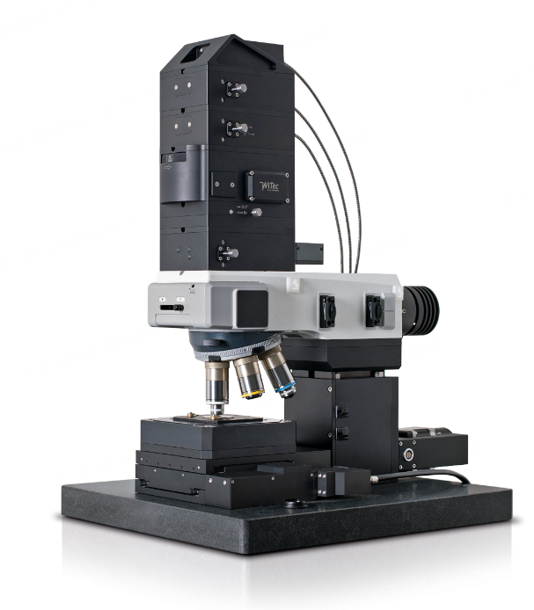
C 篇
29.What is the advantage of Raman microscopy?
A.Finding the source of plastic particles.
B.Helping to cure the deadly flu virus.
C.Detecting the smaller plastic particles.
D.Improving the quality of bottled water..
第五段“Using Raman microscopy，capable of detecting particles down to the size of a flu virus..”

Slide 24

C 篇
30.Why will the team expand their research into tap water? A.To focus on areas with higher plastic pollution.
B.To be aware of the dangerous particles in daily life. C.To further measure the types of particles in tap water. D.To detect the smaller plastic particles in industrial areas.
小知识：饮用水的几种类型
Tap water 自来水
Bottled water（瓶装水）
Mineral water（矿泉水）
Spring water（泉水）
Distilled water（蒸馏水）
Purified water（纯净水）
倒数第二句“His team hopes to expand their research into tap water and other water sources to better inform our exposure to these potentially dangerous particles.”
inform....dangerous particles=be aware of the dangerous particles

Slide 25


C 篇
31.What is Qian's attitude towards his research? A.Skeptical.
B.Objective.
C.Conservative.
D.Positive.
Tip：观点态度题要注意说话者的情感色彩和语气语调
最后一段中 Qian 的话“It is not totally unexpected to find so much of this stuff," “The idea is that the smaller things get, the more of them I reveal,"

Slide 26
语料积累
微塑料和纳米塑料对人体危害相关语料
pass through our intestines and lungs into our bloodstreams 通过我们的肠道和肺部进入我们的血液
interrupt our body's natural release of hormones 干扰我们身体自然释放的荷尔蒙
increase our risk of reproductive disorders and certain cancers 增加我们患生殖障碍和某些癌症的风险
研究过程相关语料
previous estimates 先前的估计
an understatement 低估
the idea of eating plastic is unsettling in itself 吃塑料的想法本身就令人不安
the major concern 主要问题是
be detectable 可检测的
It is not totally unexpected to find…. 找到....并不完全出乎意料

Slide 27
长难句分析
非谓语动词作状语
Using Raman microscopy(显微镜学),capable of detecting particles down to the size of a flu virus,the team measured an average of 240,000 particles of plastic per liter of bottled water,90 percent of which were nanoplastics,a revelation 10 to 100 times larger than previous estimates.
主语
谓语
宾语
非限定性定语从句
使用拉曼显微镜，能够检测到流感病毒大小的颗粒，平均每升瓶装水测量了24万粒塑料颗粒，其中90%是纳米塑料，这比之前的估计大10到100倍。
Tip:在长难句的句子翻译中非限定性定语从句单独进行翻译，不用放到先行词前。

Slide 28
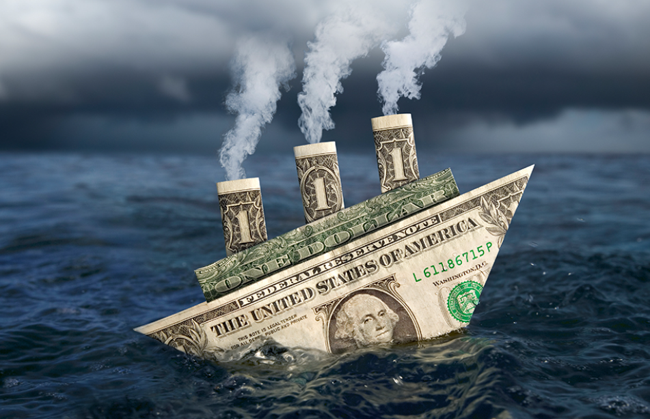
D 篇
The author’s idea of the sunk cost dilemma
本文主要讨论了在决策时如何理性地考虑放弃,而不是盲目地坚持。作者通过个人经历和身边的例子,讨论了沉没成本谬误对决策的影响,并强调了决策时应当关注未来的收益而非过去的投入。

Slide 29
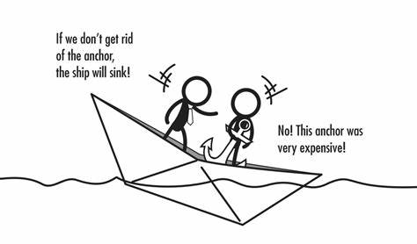
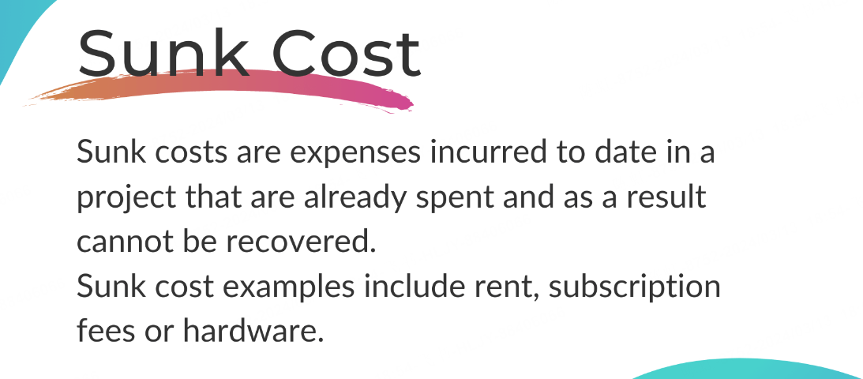
D 篇
32.Why does the author introduce a distance runner's image at first?
A.To make a contrast. B.To give a definition.
C.To draw a conclusion. D.To illustrate a theory
作者引用跑步者的形象并提出“坚持到底”的信息是为了与文章中讨论的主题形成对比,即有时放弃是更合理的选择。
小知识："sunk cost"这个术语第一次被用来表达已经发生且不可收回的成本是在19世纪的经济学中。具体来说，这个概念最早出现在19世纪的法国经济学家弗雷德里克·巴斯夏（Frédéric Bastiat）的著作中。弗雷德里克·巴斯夏在他的著作中讨论了不应该考虑已经发生的成本，而应该重点关注将来的成本和收益。这一概念后来被进一步发展和应用于现代经济学和商业管理领域中，成为了一个重要的决策分析原则。
Tip：出现在段中的例子通常是为了说明或佐证该段的主旨。第一段中的例子一定与全文的主题相关，引出话题而用的。

Slide 30
33.What is the common characteristic of a rational decision maker?
A.Following suit as most people.
B.Taking elementary education.
C.Valuing the development in future.
D.Over looking past investments.
D 篇
第三段“A rational(理性的) decision maker is not ruled by past investments，but weighs future outcomes."
小知识："weigh"在表示权衡或考虑时通常用于以下结构：
1. Weigh something against something else
- 表示将某事物与另一事物进行权衡或比较。
例如：We need to weigh the benefits of investing in new technology against the costs.
2. Weigh the pros and cons
- 表示权衡利弊。
例如：Before making a decision, it's important to weigh the pros and cons of each option.
3. Weigh the options
- 表示认真考虑各种选择。
例如：She took her time to weigh the options before deciding on a course of action.
4. Weigh the risks
- 表示评估风险。
例如：Before starting a new business, it's important to weigh the risks involved.
weigh future outcome:权衡未来的结果

Slide 31
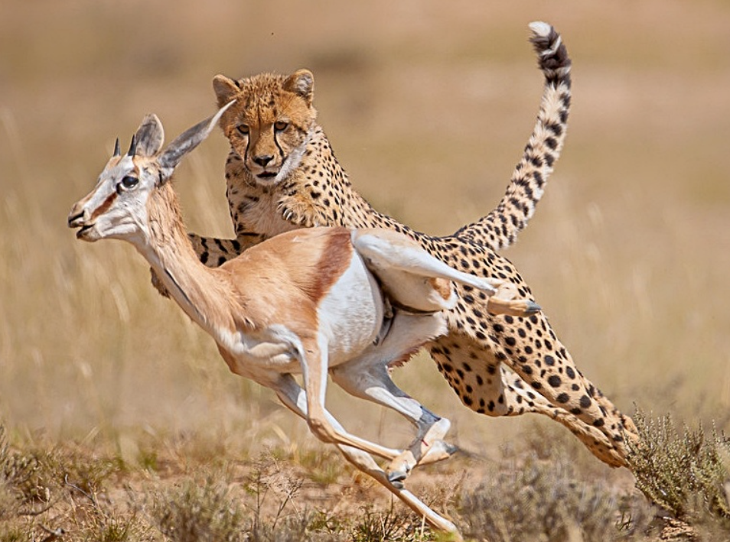
D 篇
34.What does the underlined idiom“fallen prey to”mean in the last paragraph?
A.Get benefits from. B.Be harmed by
C.Be interested in. D.Get rid of.
小知识： “fallen prey to” 意为“受到…的损害或攻击”，通常用来描述一个人或事物成为某种负面情况或问题的受害者。这个习语的由来可以追溯到狩猎和捕食的动物行为。在自然界中，猎食者会寻找弱小、易捕捉的猎物作为食物，这些猎物被称为“猎物”（prey）。当一个动物“fallen prey to”另一个动物时，意味着它成为了另一个动物的捕食对象。
这种自然界中的行为被引申为人类社会中各种负面情况的描述，比如被欺骗、受骗、受害等。因此，“fallen prey to”这个习语也被用来描述人们或事物受到一些不良影响或危害。通过这个习语，人们可以生动地表达某人或某事成为不利情况的牺牲品或受害者的含义。
属于该段的主题句。根据下文“I wear clothes I dislike simply because I spent money on them”“Unhealthy relationships last be- cause of the invested time”表明“fall prey to”指的是受到某种事情的不良影响
Tip：划线单词的意思不仅要分析所在的这句话，还要结合所在段落的主旨

Slide 32

D 篇
35.Which is the best title of the text?
A.Perseverance is a virtue
B.The chosen path is the toughest
C.Cut your losses for your winners
D.Walking away means losing all
全文通过作者个人的例子以及对沉没成本谬误的讨论,指出了在合适的时候割舍损失的智慧,而不是盲目坚持。因此,C 项“及时割舍损失是明智的”最能概括文章的中心思想。
Tip：文章标题题既要注意文章大意还要关注文体

Slide 33

语料积累
描述个人行为的语料
“坚持”的不同表达方法
come across an image 偶遇一副图片
inquire further about 进一步询问关于…
hear back from another school 收到另一所学校的回复
sink into 陷入
persevere at all costs 不惜任何代价坚持
stay committed to 坚持

Slide 34
长难句分析
.Despite the new offer,I stayed committed to SUU,believing that switching schools,even if it meant acknowledging the “wasted”$100,would have been the wiser financial choice.
状语
主语
谓语
宾语
主语
宾语从句
状语
谓语
表语
尽管有了新的录取邀请，并且相信转学，即使这意味着承认“浪费”了100美元，会是更明智的财务选择，但我仍然致力于SUU，。
Tip:在复合句要理清各个从句所做的成分以及从句内的句子结构。

Slide 35

七选五
The right stratege to deal with procrastination
本文主要讨论了拖延是情绪管理的失误,以及如何应对拖延提出了认识到拖延、了解自己的情绪、合理安排任务和适时奖励自己等策略。

Slide 36
We all do procrastination(拖延).No matter how well-organized you are,chances are that you have found yourself wasting hours on small pursuits when you should have been spending that time on school-related projects. 36 However,do they really work?
解析：该句的位置在说明文的第一段，是在介绍话题，根据下文“However,do they really work?”可知此处的“they”指代G项中的 “many ways”
A.Learn from negative thoughts. B.What's more,reward yourself after the task. C.It means a mismanagement of your emotions. D.Procrastination frequently happens in daily life. E.Therefore,we need to figure out its internal roots. F.If the task is easy to handle,we can do it as soon as possible. G.Fortunately,you will find many ways to deal with procrastination online.

Slide 37

Knee-jerk reaction and recommendations to procrastination can focus on making lists, downloading apps,setting timers,etc.If simply making a list could solve the problem of procrastination,then there wouldn't be so many articles on it or conversations about it with doctors. 37
When we look at a task,such as doing homework or preparing a presentation,we do an internal assessment. 38 If not,our brain center responds by telling our body to avoid the situation causing us anxiety.In this way,procrastination will provide us with a circle-stressful task, perceived threat,but once the task is finished,you will feel better.This is a short-term solution in fact.Then,ultimately we want to finish a work and feel good,what can we do?
小知识：“Knee-jerk reaction”是一个英语习语，指的是一种反应迅速、自动且缺乏深思熟虑的反应。这个短语来源于医学上的“膝反射”，即当膝盖被轻轻敲击时，大脑会自动发送信号使膝盖肌肉收缩。在日常用语中，“knee-jerk reaction”用来形容人们反应过于迅速，缺乏充分思考或理性的情况，通常在情绪高涨或紧急情况下出现。这种反应可能是出于习惯、情绪冲动或缺乏深思熟虑。
解析：承上启下。根据上文这样的方法不对，需要另外寻求方法，联系下文 ，进行内部评估。可知应是E项，找出“internal roots”.
E.Therefore,we need to figure out its internal roots. F.If the task is easy to handle,we can do it as soon as possible.

Slide 38
Knee-jerk reaction and recommendations to procrastination can focus on making lists, downloading apps,setting timers,etc.If simply making a list could solve the problem of procrastination,then there wouldn't be so many articles on it or conversations about it with doctors. 37
When we look at a task,such as doing homework or preparing a presentation,we do an internal assessment. 38 If not,our brain center responds by telling our body to avoid the situation causing us anxiety.In this way,procrastination will provide us with a circle-stressful task, perceived threat,but once the task is finished,you will feel better.This is a short-term solution in fact.Then,ultimately we want to finish a work and feel good,what can we do?
解析：与后文的“if not”成对比关系，所以F项“if ...”是正确选项
E.Therefore,we need to figure out its internal roots. F.If the task is easy to handle,we can do it as soon as possible.

Slide 39
39 That's because we live in a busy world where tasks will roll your way.Be aware that you are procrastinating and don't pile up the act of procrastination with the act of self-deception(欺骗). Know yourself and your moods.Scheduling tasks during times of high energy will help us be most productive and lessen the opportunity for procrastination. 40 If you are motivated by funny stickers on your papers,then you should pair the rewarding activity with the task you have been procrastinating.
解析：可以看出作者在讨论拖延在日常生活中经常发生的情况这与D项“拖延在日常生活中经常发生”符合
A.Learn from negative thoughts.
B.What's more,reward yourself after the task.
C.It means a mismanagement of your emotions.
D.Procrastination frequently happens in daily life.

Slide 40
解析：承上启下。上文的“high energy”和下文的“ motivated by funny stickers”，可知是在强调任务完成后的奖励对拖延的作用，与B项符合
39 That's because we live in a busy world where tasks will roll your way.Be aware that you are procrastinating and don't pile up the act of procrastination with the act of self-deception(欺骗). Know yourself and your moods.Scheduling tasks during times of high energy will help us be most productive and lessen the opportunity for procrastination. 40 If you are motivated by funny stickers on your papers,then you should pair the rewarding activity with the task you have been procrastinating.
A.Learn from negative thoughts.
B.What's more,reward yourself after the task.
C.It means a mismanagement of your emotions.
D.Procrastination frequently happens in daily life.

Slide 41
语料积累
与拖延症的危害相关的语料
No matter how well-organized you are,chances are that you have found yourself wasting hours on small pursuits when you should have been spending that time on school-related projects.
无论你多么有条理，你都有可能发现自己把时间浪费在了一些小事上，而这些时间本应该花在学校相关的项目上。
a circle-stressful task 一个充满压力的任务
perceived threat 感知威胁
采取行动相关的语料
do an internal assessment 做内部评估
lessen the opportunity 减少机会

Slide 42
长难句分析
No matter how well-organized you are,chances are that you have found yourself wasting hours on small pursuits when you should have been spending that time on school-related projects.
状语
主语
谓语
主语
谓语
宾语
宾补
表语从句
状语从句
无论你多么有条理，你都有可能发现自己把时间浪费在了一些小事上，而这些时间本应该花在学校相关的项目上。

Slide 43
03
完形填空

Slide 44

My Autistic daughter
文章讲述了作者作为一名母亲" 观察自己患有自闭症的女儿杰西卡与陌生人交流的情景。尽管担心女儿可能会打扰到他人，但作者感到欣慰的是，人们对待她的女儿总是很耐心， 给予她平等的对待。这不仅让女儿感到高兴， 也让作者对未来充满了希望。

Slide 45
“What's your name?”My fifteen-year-old daughter,Jessica,asked a stranger on the street.Her eyes sparkled with 41 and her face wore a broad smile.I wish she could make it because she has a disability with autistic(自闭症的).I stood nearby,waiting 42 for any potential result.
To be honest,the 43 nature of hers is a result of her disability. Ever since Jessica was real young,she had 44 right up to strangers on the street and 45 a conversation, never expecting to be refused.Children with autism don't relate well to others.As her mum, my thoughts are 46 .On one hand,I tried my best to prevent her from 47 others.On the other hand,I don't want her to be discouraged. Happily,when Jessica talks with someone,it always 48 me that people patiently answer her,although they must sense she's a bit different.
41.A.shock B.depression C.admiration D.excitement
42.A.politely B.tensely C.gracefully D.gratefully
43.A.sociable B.careful C.independent D.ambitious
44.A.marched B.received C.reminded D.covered
45.A.checked in B.put down C.struck up D.broke out
46.A.suspicious B.sharp C.conflicting D.convincing
47.A.excusing B.disturbing C.persuading D.threatening
48.A.surprises B.benefits C.frightens D.confuses

Slide 46
What about this time?Would this man respond kindly or just 49 _her and walk away? A few minutes later,Jessica skipped to me.Obviously,it was a successful 50 .Jessica shared with me the 51 they had talked about,which would certainly 52 my daughter's day.The man just treated her like an ordinary girl,nothing special from others.
As we continued on our way,I felt a renewed sense full of 53 for the future.Despite my daughter's problem,an equal 54 the kind people gave her created a moment of 55 interaction.
49.A.test B.ignore C.calm D.bother
50.A.examination B.explanation C.excuse D.exchange
51.A.content B.collection C.complaint D.material
52.A.declare B.describe C.ruin D.brighten
53.A.patience B.hope C.worry D.company
54.A.operation B.right C.treatment D.comment
55.A.sincere B.humorous C.modest D.accurate
解题策略：注意记叙文的情感线，关注前后文之间的联系

Slide 47

语料积累
描写开心的语料
Her eyes sparkled with excitement and her face wore a broad smile.
她的眼睛里闪烁着兴奋的光芒，脸上带着灿烂的笑容。
brighten my daughter's day 点亮了我女儿的生活
a renewed sense full of hope for the future 一种对未来充满了希望的新感觉
描写人物动作的语料
march right up to 直接走到
skip to me 向我蹦蹦跳跳地走过来

Slide 48
长难句分析
小知识：“strike” 的主要含义可能包括：
打击、攻击：例如，“strike back”（反击）、“strike out”（击中、打击）等。
罢工：例如，“go on strike”（罢工）、“call a strike”（宣布罢工）等。
敲击、敲响：例如，“strike a bell”（敲响钟铃）。
袭击、袭击：例如，“strike at”（袭击）、“air strike”（空袭）等。
达成、取得：例如，“strike a deal”（达成协议）、“strike a balance”（取得平衡）等。
映入（某人的）眼中：例如，“strike someone’s eyes”（映入某人的眼中）。
Ever since Jessica was real young,she had marched right up to strangers on the street and struck up a conversation, never expecting to be refused.
状语
谓语
主语
宾语
谓语
宾语
状语
自从杰西卡还很小的时候，她就径直走到街上的陌生人面前，开始交谈，从来没有想过会被拒绝。

Slide 49
04
语法填空

Slide 50
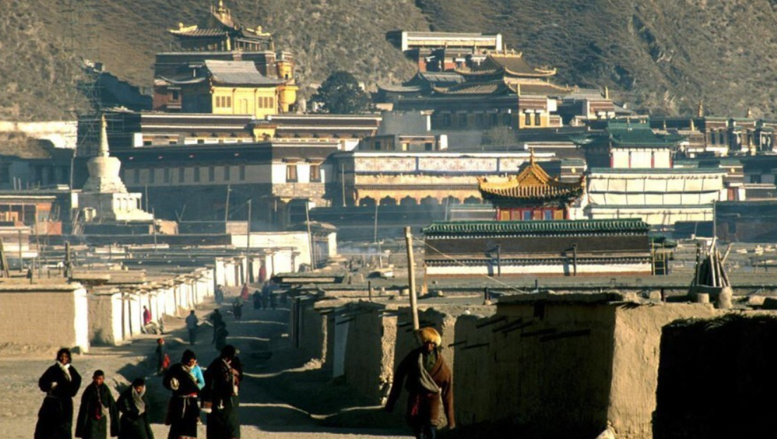
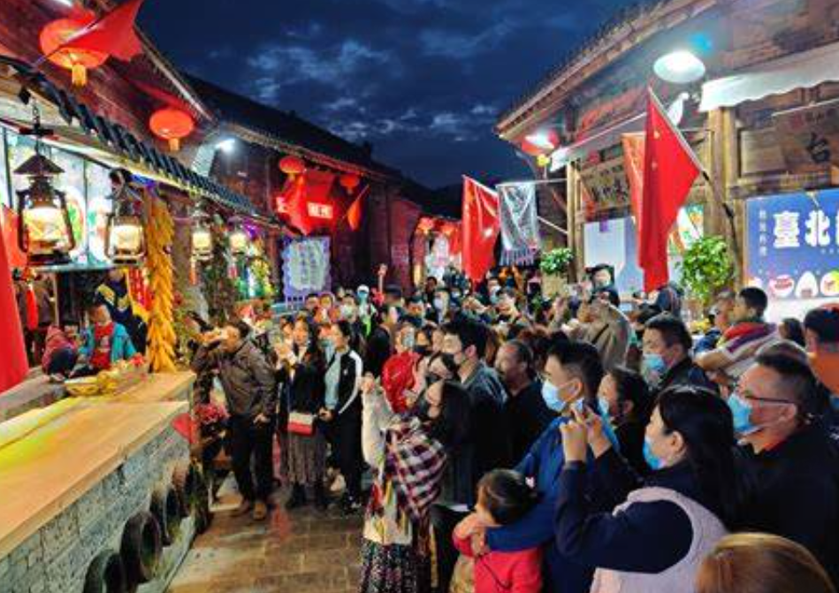
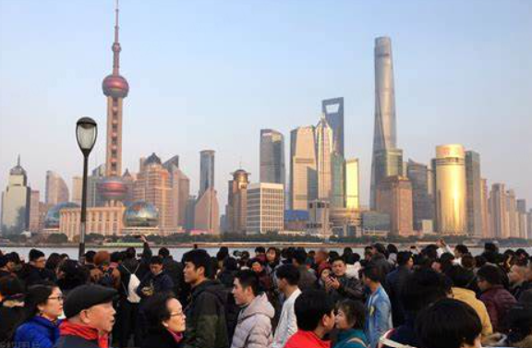
This winter’s tourism fever
本文讲述了中国东北哈尔滨市通过互联网引发的旅游热潮以及其他城市旅游当局的响应。文章突出了旅游宣传视频在吸引游客方面的成功，以及这一现象如何预示着中国旅游业的快速发展。

Slide 51
现在完成时的标志性词语：recently,ever,already,yet,so far,
The tourism phenomenon fueled by Harbin,in Northeast China's Heilongjiang Province, shows no sign of fading.Most recently,the ice city 56 (lead)to fierce competition among tourism authorities in several cities as they try to change the Internet potential 57 (engage)into real tourist footfall.More 58 (interest),the video of the leaders of local tourism dancing with performers has entertained millions of netizens(网民).
engage的常用词组：engage in（参与、从事）
engage with（与…交流、互动）
engage on（对…参与、讨论）
engage the audience（吸引观众）
has led/ has been leadiing
56. 谓语动词
engagement
57. 词性变化
interestingly
58. 词性变化

Slide 52
These diligent efforts made by Harbin 59 (attract)tourists to the city were joined by netizens across the country, 60 playfully discussed about the exceptional skills 61 (possess)by their own heads of tourism bureau,all to achieve similar success in their own cities.
to attract
59. 非谓语动词
who
60. 非限定性定语从句
possessed
61. 非谓语动词
哈尔滨市吸引游客的努力得到了全国网民的欢迎，他们开玩笑地讨论了自己旅游局局长的特殊技能，都是为了在自己的城市取得类似的成功。
长难句分析：这句话包含了一个主句和一个非限制性定语从句。
主句：“These diligent efforts made by Harbin to attract tourists to the city were joined by netizens across the country.”主语：“These diligent efforts ”，谓语：“were joined”（被…加入）宾语：“by netizens across the country”（被全国各地的网民）“ made by Harbin”非谓语动词做定语修饰主语“effort”，“ to attract tourists to the city ”目的状语，“across the country”是地点状语。
非限制性定语从句：
“who playfully discussed about the exceptional skills possessed by their own heads of tourism bureau, all to achieve similar success in their own cities”
引导词：“who”（指代 netizens）
主语：“who”（修饰 netizens）
谓语：“discussed about ”（讨论）
宾语：“the exceptional skills possessed by their own heads of tourism bureau”（关于他们自己的旅游局局长所拥有的出色技能）
状语：“playfully”（轻松愉快地）
目的状语：“all to achieve similar success in their own cities”（都是为了在自己的城市取得类似的成功）

Slide 53



Starting from January 9th,the official account of the Department of Tourism of Henan Province has seen 62 increase in the number of videos being posted, 63 more than 30 clips released per day.So the tourism authorities in Shanxi and Shandong provinces find 64 a must to promote their enriched tourism resources on social media.Winter,the traditional tourism off-season,draws new tourism fever, 65 (signal)the fast tourism development in China.
an
62. 冠词
with
63. 介词
it
64. 代词
signal(l)ing
65. 非谓语动词

Slide 54
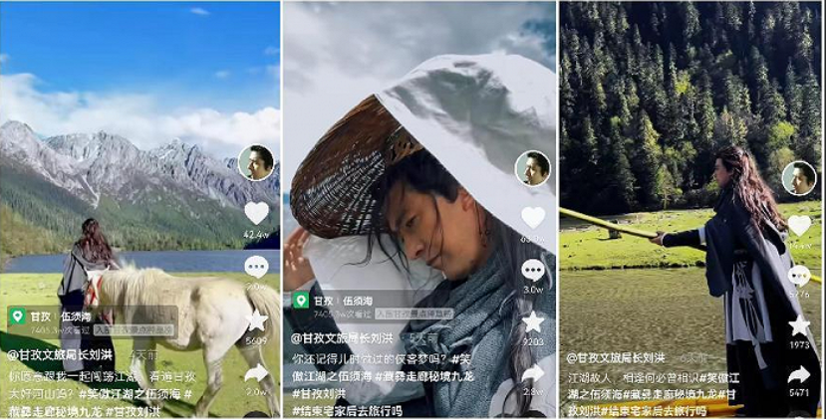
语料积累
旅游热相关的语料
The tourism phenomenon fueled by Harbin,in Northeast China's Heilongjiang Province, shows no sign of fading.
中国东北黑龙江省哈尔滨引发的旅游现象没有消退的迹象
fierce competition 激烈的竞争
change the Internet potential engagement into real tourist footfall
将互联网的潜在参与转变为真正的旅游足迹
网络相关的语料
the official account 官方账户
clip n. 片段

Slide 55
小知识：状语的类型
时间状语：表示动作或状态发生的时间。
例如：yesterday, last week, in the morning, at 3 o’clock, during the summer, etc.
地点状语：表示动作或状态发生的地点。
例如：at home, in the garden, on the table, under the tree, to the park, etc.
方式状语：表示动作发生的方式或方法。
例如：carefully, quickly, loudly, with enthusiasm, in a hurry, etc.
原因状语：表示引起动作或状态的原因。
例如：because of, due to, as a result of, owing to, etc.
目的状语：表示动作的目的或目标。
例如：to learn English, in order to pass the exam, so as to improve skills, etc.
条件状语：表示动作发生的条件。
例如：if it rains, unless you study hard, provided that you finish on time, etc.
比较状语：表示比较级或最高级。
例如：more than, less than, better than, the most beautiful, etc.
程度状语：表示动作或状态的程度。
例如：very, extremely, quite, too, so, etc.
频率状语：表示动作发生的频率。
例如：always, often, sometimes, rarely, never, etc.
伴随状语：表示动作发生时的伴随情况
例如：with，along with，together with，in addition to，etc
长难句分析
Starting from January 9th,the official account of the Department of Tourism of Henan Province has seen an increase in the number of videos being posted, with more than 30 clips released per day.
时间状语
主语
谓语
宾语
地点状语
伴随状语
从1月9日开始，河南省旅游部的官方账户上发布的视频数量有所增加，每天发布30多个视频片段。

Slide 56
Thanks!

