Slide 1


感恩遇见，相互成就，本课件资料仅供您个人参考、教学使用，严禁自行在网络传播，违者依知识产权法追究法律责任。
更多教学资源请关注
公众号：溯恩英语
知识产权声明

Slide 2
B5U5
Textbook P52
选修二unit5
教材答案和讲评

Slide 3
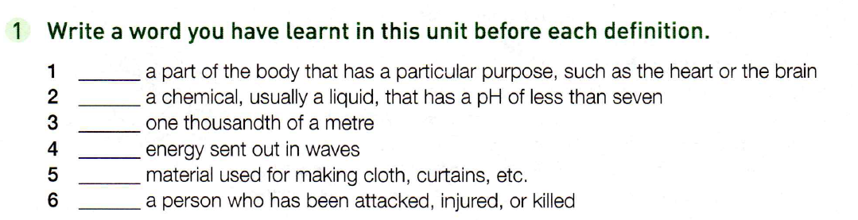
organ
acid
millimetre
radiation/rays
fabric
victim

Slide 4
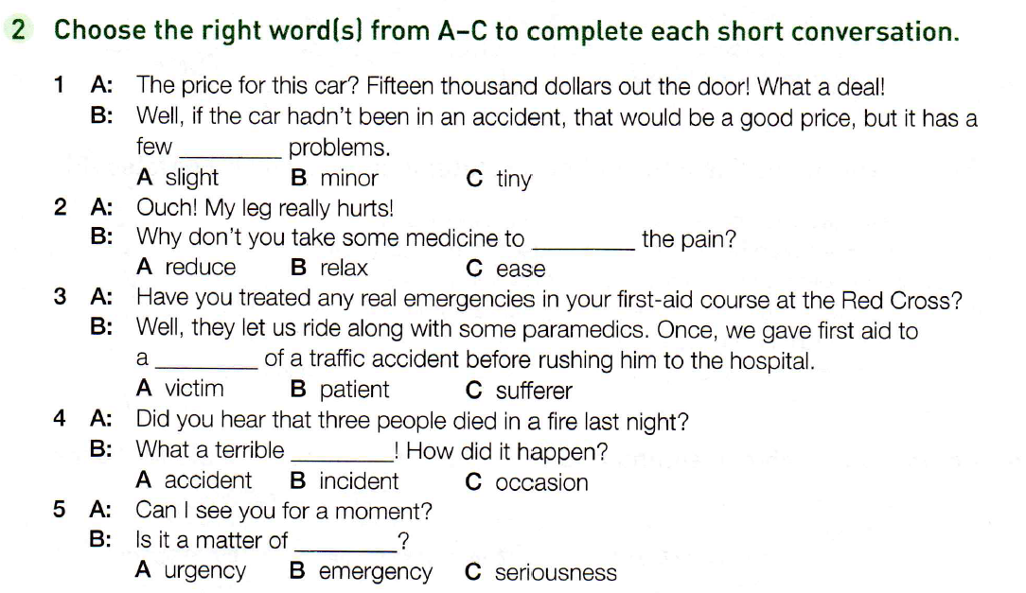
全包价/出门价
很划算/很便宜
A/B
A/C
A
A
A

Slide 5
3. sufferer n. a person who suffers, especially somebody who is suffering from a disease 患病者；受苦者；受难者
victim n. a person who has been attacked, injured or killed as the result of a crime, a disease, an accident, etc. 受害者；罹难者；罹病者；牺牲品
deal with/discuss
处理，讨论
下一章中对这一问题有更详尽的阐述。
The question is treated in more detail in the next chapter.
treatment n.
治疗，对待，处理
to give sb. medical care
医治；治疗
她因中暑而接受治疗。
She was treated for sunstroke.
treat
v. n.
to consider something in a particular way把…看作；把…视为
我决定把他的话当作戏言。
I decided to treat his remark as a joke.
我打算给自己买双新鞋。
I’m going to treat myself to a new pair of shoes.
招待；款待；请（客）买（可享受的东西）treat sb to sth.
treat n. 乐事，款待
Trick or treat.
不给糖就捣乱。
Let‘s go out for lunch—my treat
(= I will pay).

Slide 6
4. accident n. an unpleasant event, especially in a vehicle, that happens unexpectedly and causes injury or damage
（交通）事故；意外遭遇；不测事件
incident n. something that happens, especially something unusual or unpleasant
发生的事情（尤指不寻常的或讨厌的）
5. urgency n. the quality of needing to be dealt with or happen immediately 紧急，紧迫
a matter of urgency 紧急事项
emergency n. a sudden serious and dangerous event or situation that needs immediate action to deal with it突发事件；紧急情况
一个急救电话
一个紧急医疗情况
急救号码
应急服务
紧急会议
紧急迫降
an emergency call
a medical emergency
emergency numbers
emergency services
an emergency meeting
make an emergency landing

Slide 7
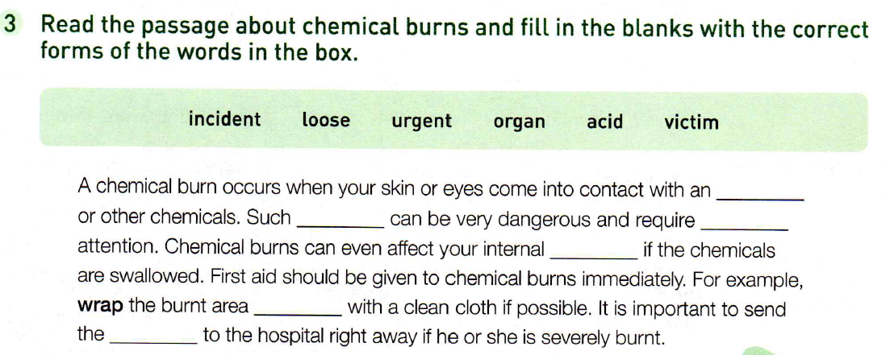
acid
incidents
urgent
organs
loosely
victim

Slide 8
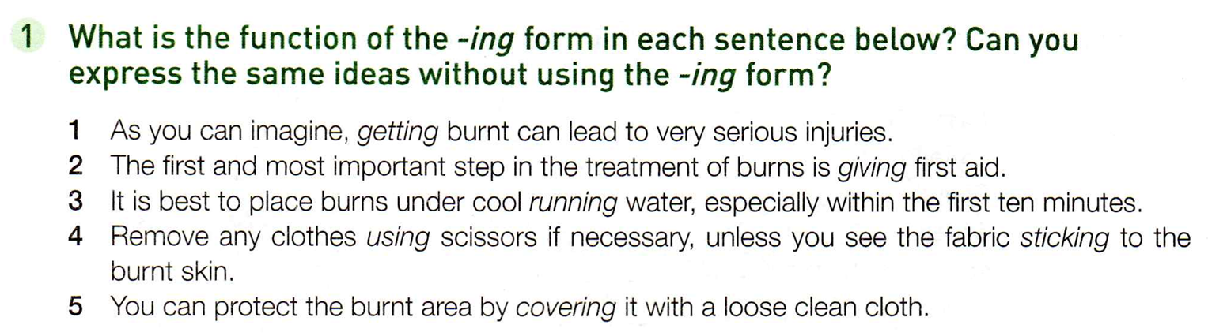
, if you get burnt, it can lead..
2. to give first aid
4. Use scissors to remove any clothes if necessary, unless you find that the fabric is sticking to the burnt skin.
3. It is best to run some cool water and place burns under it, especially within the first ten minutes.
5. To protect the burnt area, you can cover it with a loose clean cloth.

Slide 9
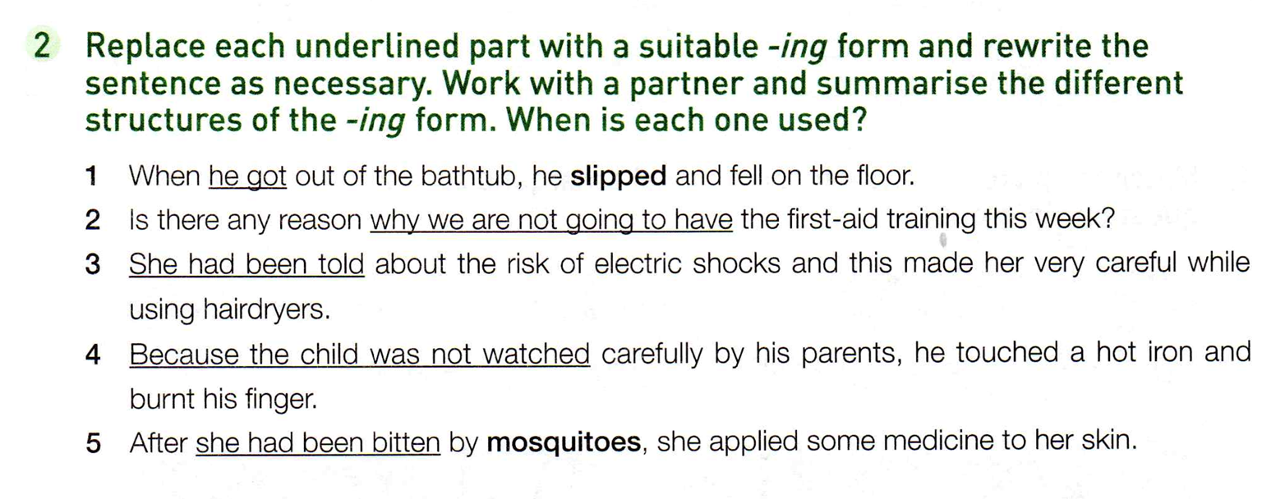
1. When getting
2. for not having
3. Having been told
4. Not being watched
一时的看护不到位
5. After being bitten
Having been bitten

Slide 10
Ex 3 on P53
What happened to Mrs Tayor?
/strəʊk/
n. 中风
She had a stroke when she was alone at home. She called for an ambulance and was saved in time.
The meeting has been delayed until 7 o’clock in the evening.
v. 延迟；推迟
delay … until…
delay doing sth.
He delayed ____________ (tell)her the news, waiting for the right moment.
telling
delay
v. n.
赶快将此事报告警方。
Report it to the police without delay
(= immediately).
n. without delay
=immediately

Slide 11
Mrs Taylor was an elderly woman ______ (live) alone. One day, she was in her living room cleaning the windows, when suddenly she could no longer feel the right side of her body. ________ (try) to walk to her sofa to sit down, she fell over onto the carpet. Then she realised that she could not get up, and that she was having trouble ____________ (breathe). Fortunately, she had her mobile phone with her, and she was able to reach it with her left hand while _______ (lie) on the floor. Her mobile phone ___________________ (already, set up) to call an emergency number at the push of a button, so it was easy to call for help.
living
Trying
breathing
lying
had already been set up

Slide 12
While attempting to talk to the operator, Mrs Tayor discovered that she could not speak. ___________ (not, hear) an answer, the operator knew that Mrs Tayor must be in trouble. Telling Mrs Tayor that everything would be OK, she immediately sent an ambulance. After _________ (arrive), the ambulance team quickly found Mrs Tayor and without delay gave he oxygen, put in an IV needle, and checked her vital signs. ___________________ (take) to the hospital and treated immediately, Mrs Tayor's health was in no great danger, though she had to stay in the hospital ward. After a week, her __________ (frighten) experience was over, and she was allowed to go home.
Not having heard
arriving
Having been taken
frightening

Slide 13
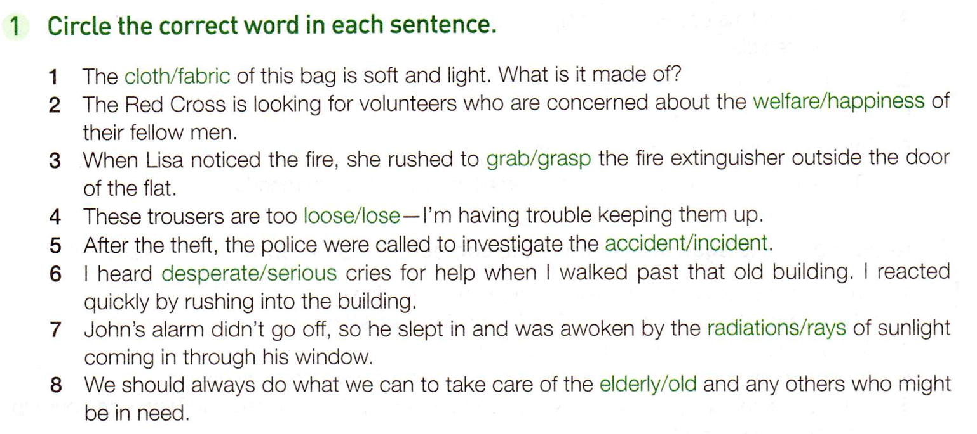
fabric
同胞
welfare
grab
loose
incident
desperate
rays
elderly

Slide 14
fabric n. 通常是指用于制作服装、窗帘、家具覆盖物等的织物。
cloth n. 常是指用于制作服装的料子
2. welfare n. the general health, happiness and safety of a person, an animal or a group（个体或群体的）幸福，福祉，安康
happiness n. the state of feeling or showing pleasure 幸福，幸运
grab v. to take or hold somebody/something with your hand suddenly or roughly
抓住；攫取
extinguisher /ɪkˈstɪŋɡwɪʃə(r)/ n. 灭火器
grasp v. to take a strong hold of somebody/something 抓紧；抓牢
4. keep trousers up 裤子往上提
ray n. a narrow line of light, heat or other energy
光线；（热或其他能量的）射线
radiation n. 辐射；powerful and very dangerous rays that are sent out from radioactive substances 放射线

Slide 15
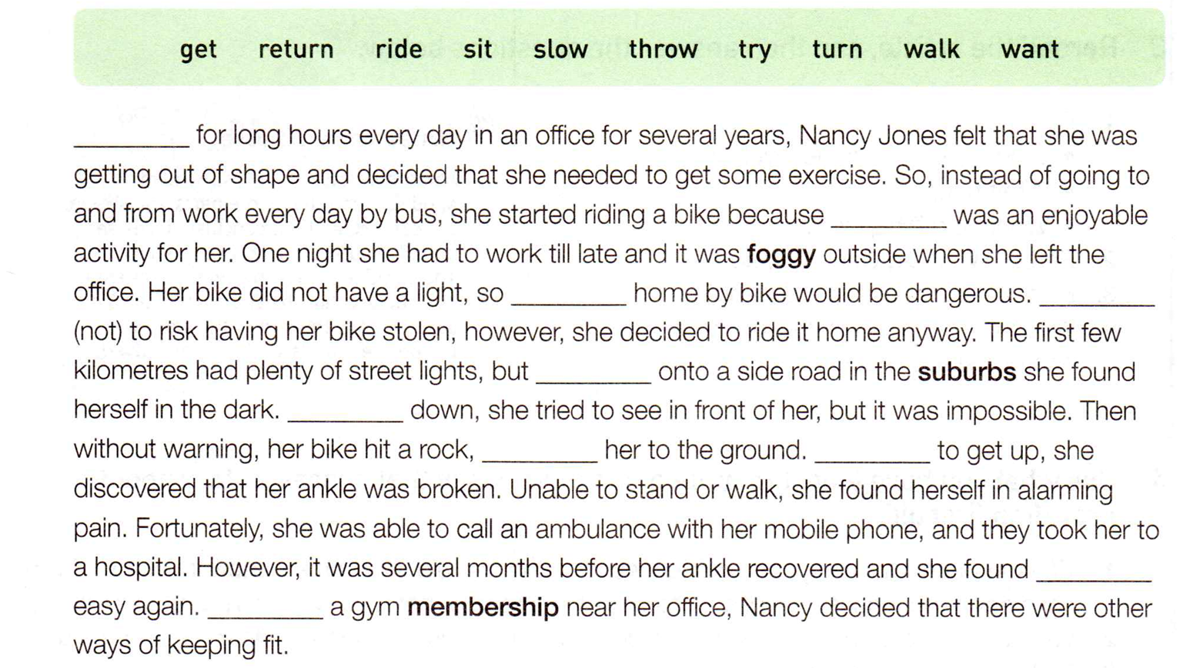
Having sat
riding
returning
Not wanting
turning
Slowing
throwing
Trying
walking
Getting

Slide 16
out of shape
(of a person人) not in good physical condition 身体不好；不健康
2) not having the normal shape 变形的；走样的
轮子已经扭曲变形了。
The wheel had been twisted out of shape.
2. 上下班 go to and from work
3. She found herself in ____________(alarm) pain.
alarming
极度痛苦
adj. causing worry and fear
使人惊恐的；令人惊慌的
stolen
4. Not wanting to risk ___________(have) her bike ___________(steal), however, she decided to ride it home anyway.
having

Slide 17
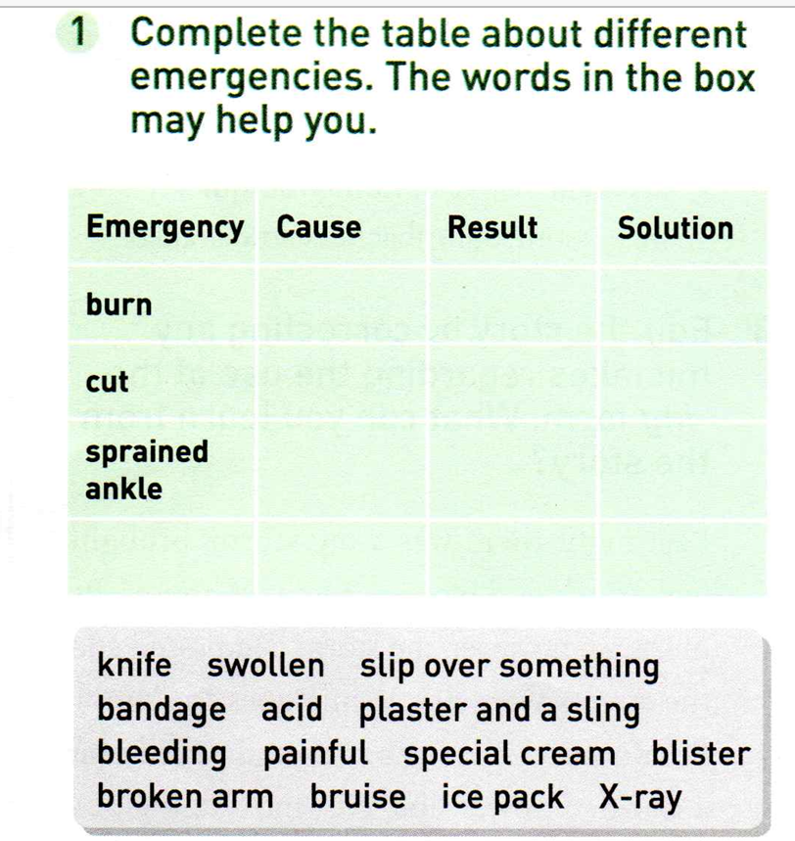
1. plaster /ˈplɑːstə(r)/ n. 膏药，护创胶布
2. sling /slɪŋ/ （悬吊受伤手臂的）悬带
3. bruise /bruːz/ n. 青肿；瘀伤
blister
special cream
acid
knife
bleeding
bandage
slip over
swollen
bruise
ice pack
x-ray
plaster and sling
broken arm
bike accident
painful

Slide 18
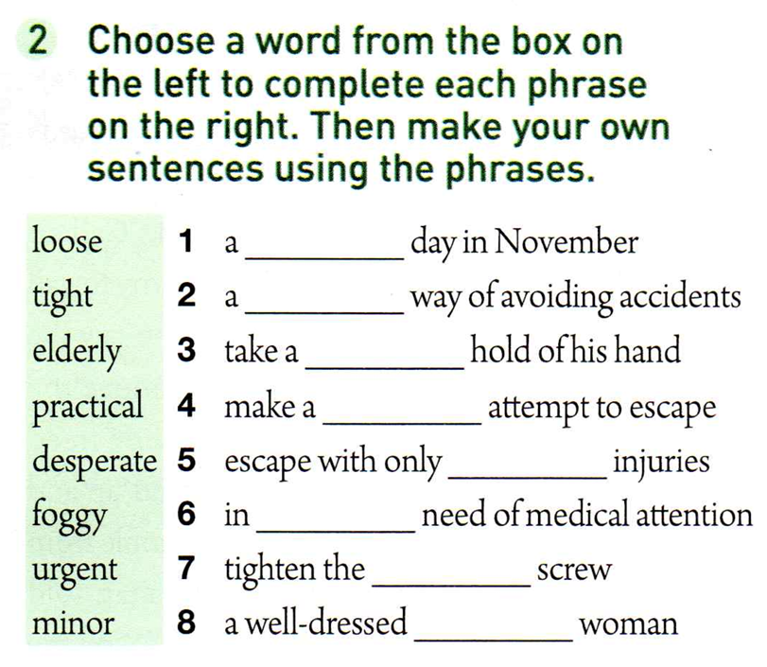
foggy
practical
Tight
desperate
minor
urgent
loose (screw 螺丝)
elderly

Slide 19
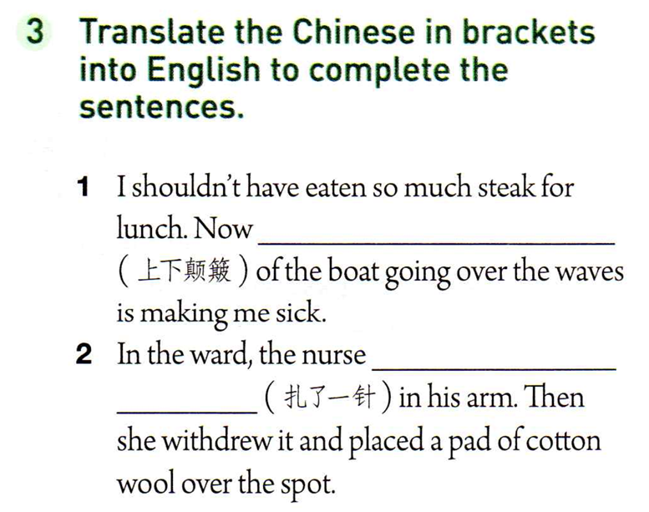
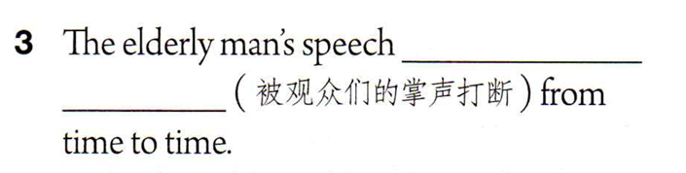
the up and down motion
stuck a needle
was interrupted by the audience’s clapping

Slide 20
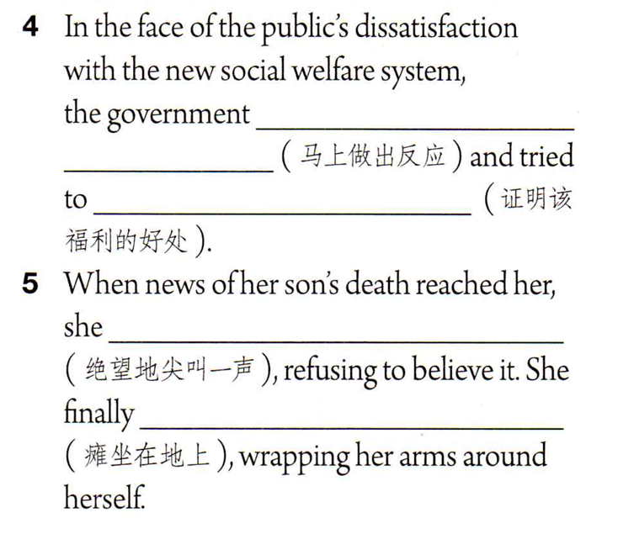
reacted immediately
justify the advantages of the welfare benefits
screamed in desperation
collapsed onto the ground

Slide 21
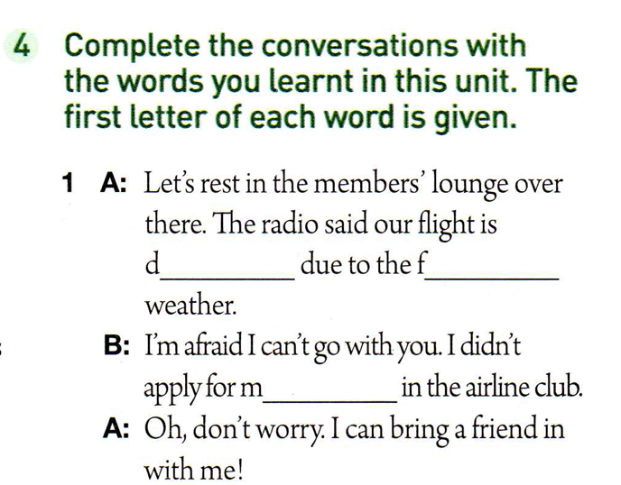
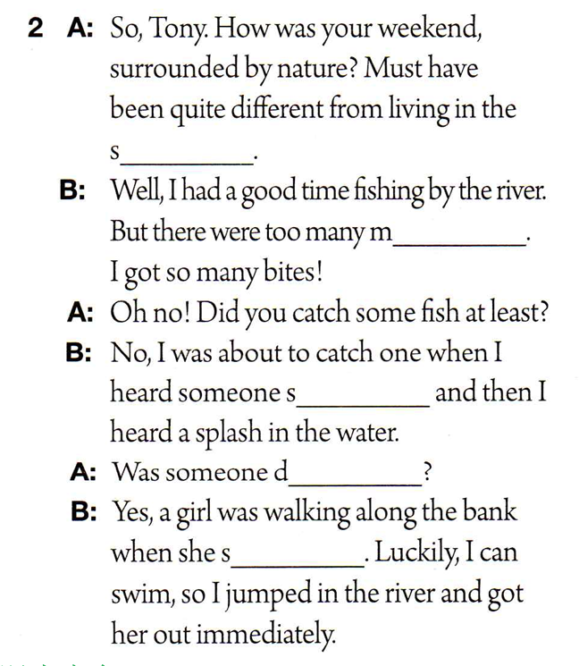
urbubs
osquitoes
elayed
oggy
cream(ing)
embership
rowning
lipped

Slide 22
Ex 2 on P 90
While waiting at a subway station, I saw a man lying on the street.
While having a bath, she saw water leaking over the sides of the tub.
Being driven from their homes, people were terrified by the hurricane.
I saw a snake moving fast through the grass.
Kathy looked at the old woman who fell down just in front of her, not knowing what to do.
Sobbing and wailing, the survivors were finally located by the search team.
Sitting on beach, Marty found the waves were huge.
After spending two hours in the waiting room, finally he heard his name being called.
Having been trained at the first-aid centre, he became more confident in helping people.
After having been seriously injured in a cycling accident last year, he is now afraid of riding too quickly on a bike.
分词短语作状语，逻辑主语是主句的主语

Slide 23
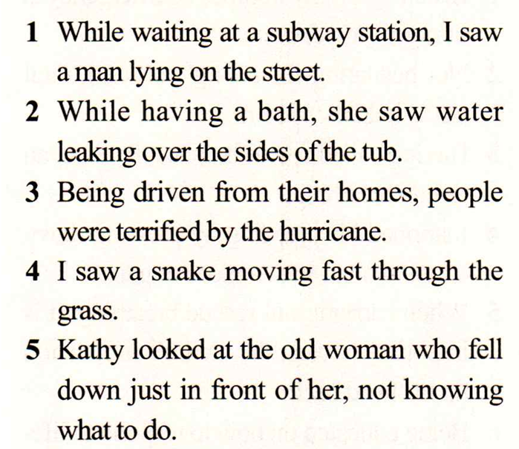
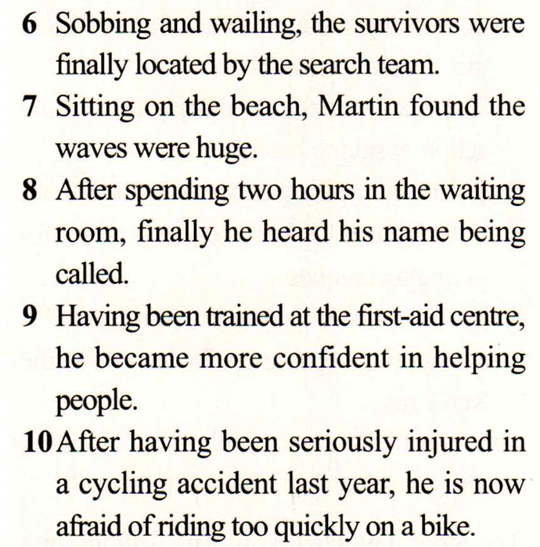
Ex 2 on P 90

Slide 24
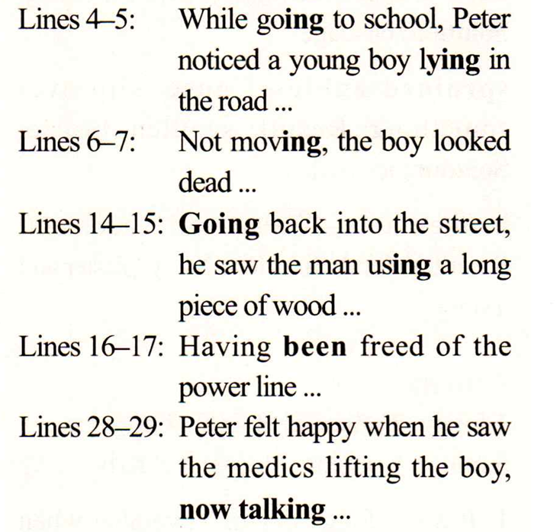

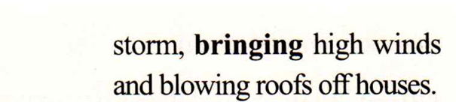
Ex 3 on P 90

