Slide 1


感恩遇见，相互成就，本课件资料仅供您个人参考、教学使用，严禁自行在网络传播，违者依知识产权法追究法律责任。
更多教学资源请关注
公众号：溯恩英语
知识产权声明

Slide 2
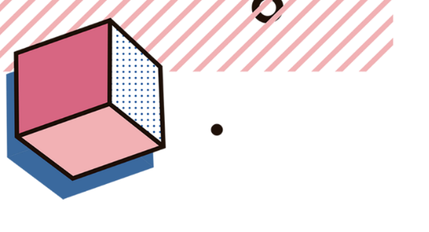

How to complete
a gap-filling task
based on cohesion theory
立足语篇
分析考纲
把握衔接
突破干扰
Lecturer: 谢耀玲

Slide 3



Activity 1
Learning Aims
In this class, you will be able to:
1. master the connection between logical structure and the content of the text as a whole and understand the relationship between sentences and paragraphs.
2. understand and apply “3-4-5”Strategy based on the theory of cohesion to finish the gap-filling task.
3. develop the ability of individual and cooperative work.
析考纲, 联语篇

Slide 4




Slide 5

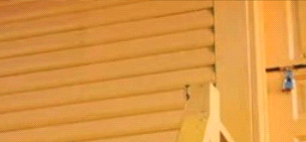
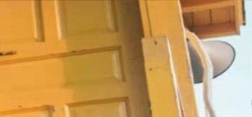

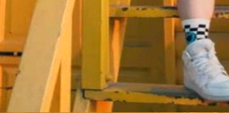



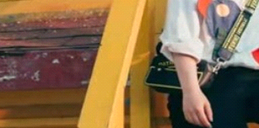







Lead-in Complete the puzzle
轮廓
内容
①
②
③ |  | ⑤
 | ④
拼图
B
A
Main clues
Detailed clues
①
七选五
C
D
E

Slide 6

Activity 1
What is the gap-filling task designed to a test?
析考纲, 联语篇

Slide 7


七选五命题分析：
题型: 高中英语阅读七选五题型给出一篇缺少5个句子的文章，对应有7个选项，要求同学们根据文章结构、内容，选出正确的句子，填入相应的空白处。
考点: 要求考生从整体上把握文章的逻辑结构和内容上的联系，理解句子之间、段落之间的关系，对诸如连贯性、一致性等语段特征有较强的意识和熟练的把握，并具备运用语法知识分析理解长难句的能力。此题型是对语言能力和阅读理解能力的综合测试。
设空特点：
段落小标题
段落主题句
段落内部或段落间过渡句，承上和启下
段首句
七选五
段落内部过渡句，承上和启下
找衔接词 逻辑关系
段中句
（并列、转折、因果、解释、递进等）
段落间过渡句
承上和启下
总结句
段尾句

Slide 8
分析2021-2023年新高考有关阅读七选五的考向分布。
年份 | 卷别 | 体裁 | 主题语境 | 段首题 | 段中题 | 段尾题
2023 | 新高考I卷 | 说明文 | 人与自我自我宽恕和增强自信 | 0 | 4 | 1
 | 新高考II卷 | 说明文 | 人与社会如何开始艺术之旅 | 1 | 3 | 1
2022 | 新高考I卷 | 说明文 | 人与社会体育与健康 | 0 | 4 | 1
 | 新高考II卷 | 说明文 | 人与自我写文章的技巧 | 1 | 4 | 0
2021 | 新高考I卷 | 记叙文 | 人与社会跨文化交流沟通 | 1 | 4 | 0
 | 新高考II卷 | 说明文 | 人与自我提高阅读速度的建议 | 1 | 2 | 2
02
稿定PPT
稿定PPT，海量素材持续更新，上千款模板选择总有一款适合你

Slide 9
考情分析
考点要求 | 考题统计 | 考情分析
段首句 | 3年4考 | 【命题规律】 根据新高考三年的考情分析，阅读七选五主要集中考查：文章的整体内容和结构以及上下文逻辑意义的理解和掌握。考试的呈现形式是段首句、段中句和段尾句，其中段中句是考查的重点，涉及逻辑关系和写作方法。 【命题预测】 2024年高考还会考查：以段首句、段中句和段尾句形式，考查文章的整体内容和结构以及上下文逻辑意义的理解。
段中句 | 3年21考
段尾句 | 3年5考
02
稿定PPT

Slide 10
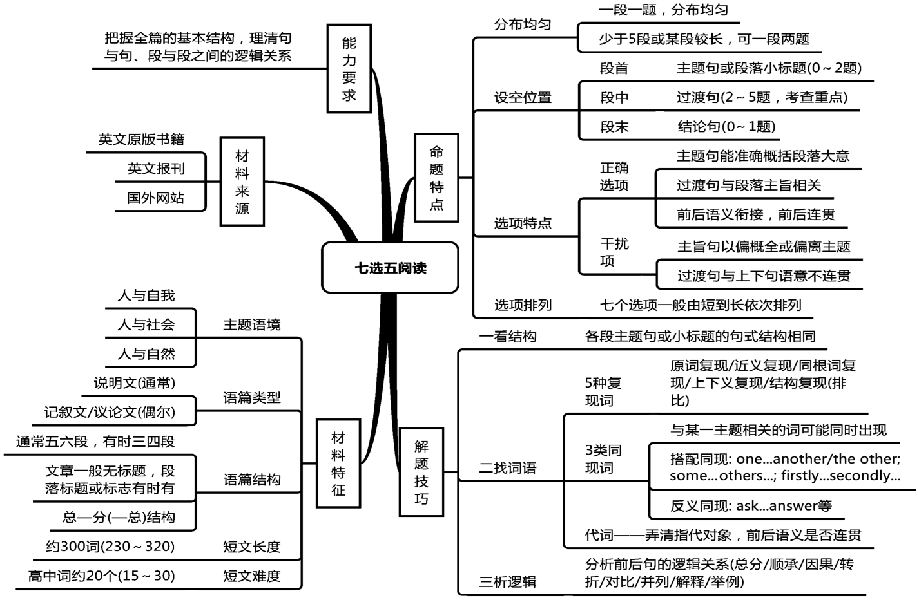
知识构建
02
稿定PPT
稿定PPT，海量素材持续更新，上千款模板选择总有一款适合你

Slide 11
考向1 考查段首句（2024年1月•浙江卷·节选）
___40____. A social connection is often a big part of learning. There are things you can do to ease this problem. Jessica Pink, an undergraduate student, suggests taking online courses with a friend, so you can motivate each other to stay on track. You can also find students on the class discussion board to organize a study group, or schedule in-person meetings with your professor to discuss course concepts.

Slide 12
A. But that doesn’t mean there aren’t deadlines.
B. Your motivation should be your main concern.
C. Do you know that online courses are also part of your education?
D. Professor Alex Davidson teaches the same course in person and online.
E. The chief complaint about online courses is that they lack human interaction.
F. If you take an online course, what can you do to ensure the best possible grade?
G. A survey found that 29 percent of college students registered for online courses.
02
稿定PPT
稿定PPT，海量素材持续更新，上千款模板选择总有一款适合你
技巧：同范畴词 complaint--problem；interaction--discussion +原词复现 online courses

Slide 13
考查段首句（2022•全国乙卷·节选）
___39____
Anniversaries and birthdays carry even more weight in long-distance friendships. Although technology might make day-to-day communication possible, extra effort goes a long way on special days. Simply keeping a diary that keeps track of friends’ birthdays and other important dates will make sure nothing slips by you.

Slide 14
A．Remember important dates
B．Compensate by writing letters
C．It is also helpful for you to be a friendship keeper
D．Try to find a time that works for both of you and stick to it
E．Friends need to talk about their preferred methods of communication
F．It is easy to have a sense of connectedness through social media
G．You may be the friend who left or the one who was left behind
02
稿定PPT
稿定PPT，海量素材持续更新，上千款模板选择总有一款适合你
技巧：小标题（言简意赅）+近义词复现 anniversaries & birthdays a time works/ --important dates
Notes:
小标题的特点：相比较承上启下，更多的应该是概括本段主旨以及和其余小标题的结构复现。（小标题和段首句还是有一定区别的）

Slide 15
考向2 考查段中（2023•新高考全国Ⅰ卷）
You could ask a friend or family member to help add to your list. ____39____ That way, you could exchange thoughts on what makes each of you special and the aspects of your personality that shine through. In fact, don’t wait until you’ve made a mistake to try this—it’s a great way to boost self-confidence at any time.

Slide 16
A. Little self-forgiveness also goes a long way.
B. Now list all the characteristics you like about yourself.
C. They might even like to have a go at doing the exercise.
D. It’s just as important to show yourself some forgiveness.
E. It doesn’t mean you have to ignore what’s happened or forget it.
F. Whatever it is, no matter how small it might seem, write it down.
G. Whatever the mistake, remember it isn’t a fixed aspect of your personality.
02
稿定PPT
稿定PPT，海量素材持续更新，上千款模板选择总有一款适合你
技巧：代词--代替前文提到的人或物，分为人称代词（they，it, she...）和指示代词(this, that, those, these)。

Slide 17
考向3 小标题 2024届山东省菏泽市高考一模英语试题
___18___
Your physical well-being significantly impacts your resilience. A health y body can cope better with stress and recover faster from illness or tiredness. Start to improve your health by integrating a simple exercise routine into your daily schedule, like a 30-minute stroll or a short yoga session. By taking care of yourself, you can boost your overall health and resilience and be fully ready to face life’s challenges.
Notes:
此题的设空不是段中句吗？能换个考小标题的题目吗？之前的段首句中就有一题啊

Slide 18
A. Prioritize physical health
B. Activate positive emotion
C. It’s important to have people you can trust.
D. It can be developed and enhanced over time.
E. Keep this list in a safe place and evaluate your progress regularly.
F. Experiment with different strategies to work through common problems.
G. It means the difference between handling pressure and losing your cool.
02
稿定PPT
稿定PPT，海量素材持续更新，上千款模板选择总有一款适合你
技巧：小标题（言简意赅）+原词复现 physical health

Slide 19
考向4 段尾句（2024·河南省郑州市高中毕业年级第一次质量预测节选）
Recently, a topic featuring “Graduates avoid sending resumes out of social anxiety disorder” received many comments on Sina Weibo. It seems that social anxiety disorder, also known as social phobia (恐惧症), is affecting many people’s lives. Over 80% of university students who took part in a survey tended to avoid social interaction due to an assumed social phobia. _________
For those who have a social phobia, everyday social situations cause strong fear beyond their control because they fear being watched or judged negatively by others.
在一项调查中，超过80%的大学生由于假定的社交恐惧症而倾向于避免社交互动

Slide 20
A．After all, they are not making you any better.
B．Understand it’s perfectly fine to make mistakes.
C．Here are some tips for overcoming a fear of social interaction.
D．But is avoiding social interaction equal to having a social phobia?
E．However, my attitude began to change when I met a senior journalist.
F．But if you only feel a bit uncomfortable, it might mean you are just shy.
G．Shy people avoid socializing because they take others’ opinions seriously.
02
稿定PPT
稿定PPT，海量素材持续更新，上千款模板选择总有一款适合你
技巧：但是，回避社交就等于患有社交恐惧症吗?
承接上文，并引出下文+原词复现 avoiding social interaction+social phobia

Slide 21
考向5 2024广东省一模 逻辑关系
Getting older means greater maturity and wisdom.36 In a society that is aging fast , it has become crucial to find ways to prevent related mental and emotional disorders. Music emerges as a promising tool for promoting well-being of the elderly.

Slide 22
A. Music can also open forgotten doors to our memories.
B. Recalling happy memories can lift our mood on a bad day.
C. Even passive music listening can help elderly adults think better.
D. This helps people feel better when they are depressed or anxious.
E. However, it often involves a series of physical and mental challenges.
F. The ability to form new memories is essential for processing information.
G. Thus, this accessible intervention should become a major policy priority for
healthy aging.
02
稿定PPT
稿定PPT，海量素材持续更新，上千款模板选择总有一款适合你
技巧：逻辑关系转折+近义词复现 physical and mental challenges-- mental and emotional disorders

Slide 23
连接词 Conjunction
表示转折关系的关联词
如 however, but, although, though, while, instead等
表示因果关系的关联词
如 because, so, therefore, hence, consequently, thus 等
表示解释关系的关联词
如 in other words，in fact, for example/instance, actually等
表示并列或递进关系的关联词
如 also, besides, what is more, in addition等
表示比较关系的关联词
如 similarly, like, likewise, in the same way, equally 等
表示对照关系的关联词
如on the contrary, by contrast, on the other hand等
表示总结关系的关联词
如all in all, altogether, overall, in short, to sum up等

Slide 24
Summarize“3 – 4 - 5”Strategy in gap filling：
3 三种 挖空句子及其功能：
4 四个解题步骤：
5 五个衔接密码：
段首句/小标题短小精悍
段中句
段末句
复读全文
概览全文
理解选项
仔细比对（运用衔接密码）
①复现（ 原词、同义词、近义词、反义词、派生词复现等）
⑤逻辑关系
④承上启下
② 指代
③ 概括归纳

Slide 25
拓展迁移

Slide 26
考查段首句（2024·广东省高三上学期12月联考节选）
____Spending time with people pursuing knowledge as intentionally as you are can encourage you to push through challenges to achieve your learning goals. And engaging with people who have different opinions and experiences can help keep your worldview flexible. Then you can continue to find new fields of knowledge to explore.

Slide 27
A．Surround yourself with fellow learners.
B．Encourage yourself to brave challenges.
C．Every kid’s favorite question is “Why? ”
D．You’re surrounded by opportunities to learn.
E．There’s no better or worse hobby or information to acquire.
F．Of course, scheduling learning isn’t just limited to the ways mentioned.
G．Adding a learning session to your timetable prevents you forgetting about it.
02
稿定PPT
稿定PPT，海量素材持续更新，上千款模板选择总有一款适合你
技巧：同范畴词learning goals--fellow learners和 engaging with people--surround yourself with fellow learners

Slide 28
（2024·高三第一次学业质量评价(T8联考)节选）
Have you ever caught a smell of something and been strongly reminded of a person or place? There seems to be a deep psychological link between smells and our memory. Some research even suggests that smells can influence our cognition(认知，感知). 36 Roja Dove, a perfumer,informed the BBC that when we are born,the olfactory bulb(嗅球), which is the area in our brain that processes smell, is empty, without pre-existing information or association.

Slide 29
A. Why do smells take us back?
B. So,don’t take your nose for granted.
C. How is the sense of smell connected to your brain?
D. Scents can revive memories that have been long forgotten.
E. We are not actively aware of them unless they are extremely strong.
F. This is especially true when it comes to the fragrance of essential oils.
G. Therefore, our responses to smells are learnt and highly individualized.
02
稿定PPT
稿定PPT，海量素材持续更新，上千款模板选择总有一款适合你
技巧：近义词 take us back--reminded of a person or place
+原词复现 smell

Slide 30
考查段中句（2024·广东省高三上学期12月联考节选）
Life’s rarely boring if you’re open to learning new things. No matter what you want to learn, the first step is noticing and seizing learning opportunities wherever you find them. Here are ways to develop the habit of learning.
Get curious and make friends with your inner child. ______This sense of curiosity is how you begin to learn, grow, and understand the world around you. As an adult, it’s important to stay curious to remain open to possibilities and opportunities by making a habit of asking questions.

Slide 31
A．Surround yourself with fellow learners.
B．Encourage yourself to brave challenges.
C．Every kid’s favorite question is “Why? ”
D．You’re surrounded by opportunities to learn.
E．There’s no better or worse hobby or information to acquire.
F．Of course, scheduling learning isn’t just limited to the ways mentioned.
G．Adding a learning session to your timetable prevents you forgetting about it.
02
稿定PPT
稿定PPT，海量素材持续更新，上千款模板选择总有一款适合你
技巧：近义词 kid--child +近义词get curious--why？

Slide 32
（2024·浙江省台州市高三上学期第一次教学质量评估节选）
Set actionable goals. It can be helpful to break down the feedback into specific, actionable goals. _____Set time to outline an action plan and timeline for each of these goals. With this, you can keep track of your progress and hold yourself accountable to your goals.
Though negative feedback may be disheartening, take the necessary steps to become an even better version of yourself.

Slide 33
A．Avoid reacting defensively.
B．Don’t take the feedback personally.
C．These can feel easier to work with and give you direction.
D．You don’t have to apply every piece of feedback you receive.
E．Negative feedback can sometimes make you feel like a failure.
F．It’s almost impossible to consistently do everything right all the time.
G．So instead of reacting negatively, thank those caring about you to give you honest feedback.
02
稿定PPT
稿定PPT，海量素材持续更新，上千款模板选择总有一款适合你
技巧：同范畴词 give you direction-- outline an action plan and timeline for each of these goals

Slide 34
（2024·浙江省Z20名校联盟第二次联考节选）
Get eight hours of sleep. “When you’re not rested, everything that happens in your life is a lot more stressful,” says Dr. Arya Sharma, a professor of medicine at the University of Alberta. If we don’t have enough sleep, our bodies also have more difficulty controlling blood pressure, inflammation and glucose levels. 37
如果我们睡眠不足，我们的身体也会更难控制血压、炎症和血糖水平。

Slide 35
A．Avoid polluted air.
B．Engage in indoor activities.
C．These factors can all have an impact on cardiovascular health.
D．Read the following tips to make your life filled with happiness.
E．Doing good for others helps your self-esteem and relieves stress.
F．It reduces stress and depression, and it may also serve as a mini-workout.
G．Actually, a small change in your everyday routine can potentially have a big impact.
02
稿定PPT
稿定PPT，海量素材持续更新，上千款模板选择总有一款适合你
技巧：指代关系 these factors--blood pressure, inflammation and glucose levels

Slide 36


Homework:
1. Draw a mind map about the strategies in completing gap-filling tests learned in this class.
2. Finish the gap-filling tests using these strategies.

Slide 37
2024届山东省日照市高考一模英语试题
阅读下面短文, 从短文后的选项中选出可以填入空白处的最佳选项, 选项中有两项为多余选项。
No matter how friendly your tone is or how honey sweet you are in a conversation, when you use one of these two words (or both) in your sentences, the message to your conversation companion is “You are wrong”. 16 They are “no” and “but”.
These words don’t say, “Let’s discuss this” or “I’d love to hear what you think about this” to people. They say, “You are wrong and I am right.” If your conversation companion is also eager to win at any cost, you will have a potential battle on your hands. The result? 17

Slide 38
Are you interested in a little test to see how competitive your co-workers are? Try this. For one week, keep a scorecard of how many times each person uses “no” or “but”. 18 And, if you explore a little deeper, you’ll see patterns emerge. For instance, some people use these words to gain power. You’ll see how much people hate it, consciously or not, and how it stifles(抑制)rather than opens up discussions.
19 Practically without even thinking, I keep count of their use of these two little words. It’s such an important indicator! If the numbers pile up in an initial meeting with a client, I’ll interrupt him or her and say, “We’ve been talking for almost an hour now, and do you realize that you have responded 17 times with either ‘no’ or ‘but’?” This is the moment when a serious talk about changing behavior begins.

Slide 39
If this is your interpersonal challenge, you can do this little test for yourself just as easily as you can to judge your co-workers. Stop trying to defend your position and start monitoring how many times you begin remarks with “no” or “but”. 20 For example That’s true, but...”. Another expression is “Yes, but...”.
A．I use this technique with my clients.
B．Why do people like to say these two words?
C．What are these conversation stopping words?
D．Nothing more can happen that will be productive.
E．It’s human nature to like being accepted and recognized.
F．You will be shocked at how frequently these words are used.
G．Pay close attention to when you use these words in sentences.
Answer:16．C 17．D 18．F 19．A 20．G

Slide 40
Thank you！

