Slide 1


感恩遇见，相互成就，本课件资料仅供您个人参考、教学使用，严禁自行在网络传播，违者依知识产权法追究法律责任。
更多教学资源请关注
公众号：溯恩英语
知识产权声明

Slide 2
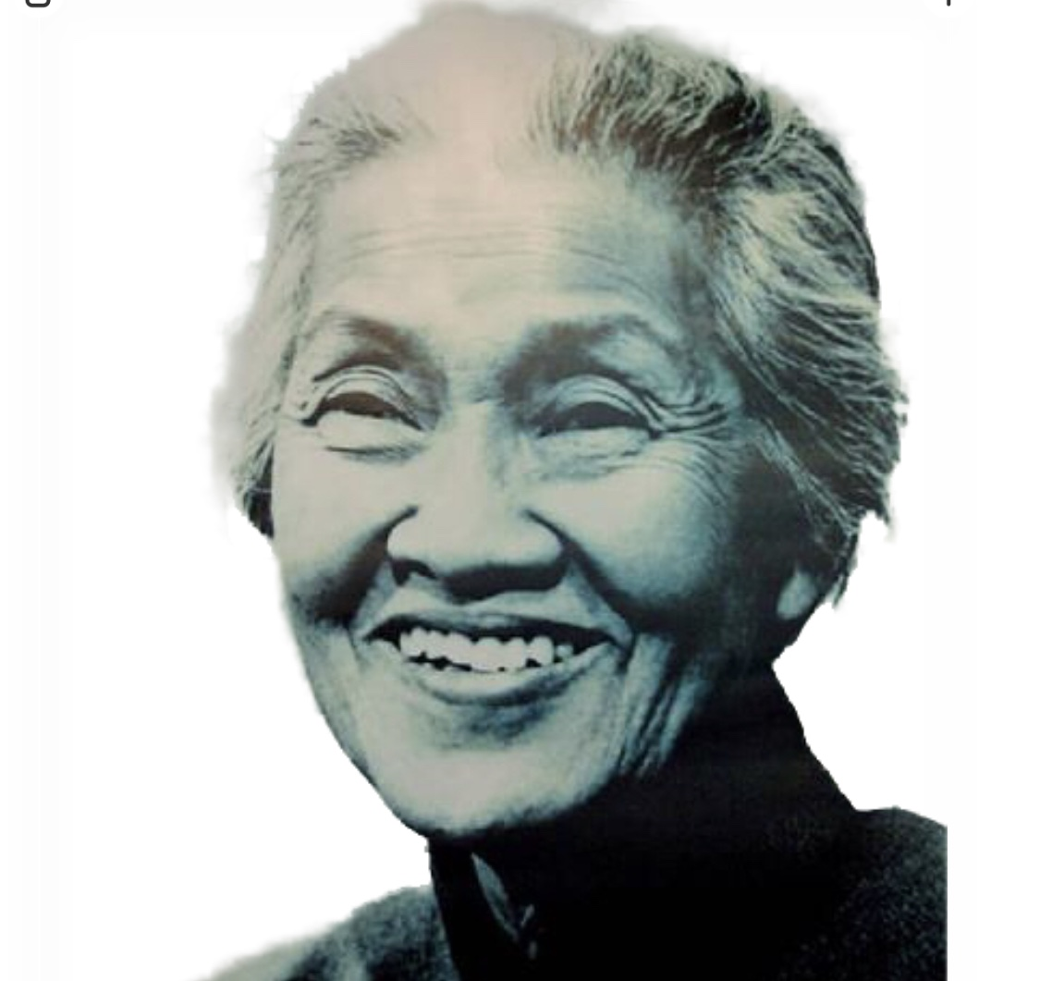
B3U2
Reading and thinking
含 workbook P67 近义词词汇辨析

Slide 3
Language study
I. Compare each pair of words (synonyms 同义词)

Slide 4
1. majority most
majority n. the largest part of a group of people or things 大多数
A majority of…
The majority of…
做主语时，谓语动词的人称和数有名词决定，名词为复数时，用复数，名词为单数时，可单可复。
1) A/The majority of workers now work five days a week.
2) The majority of the population in the country lives/live in the city.
the majority 单独使用，谓语动词可单可复
The majority is/are in favor of the plan.
most pron. adj.大多数, 大部分
most of the students
most students
most of them
the most +adj. 构成最高级

Slide 5
2. illustrate describe
illustrate v. to make the meaning of something clearer by using examples, pictures, etc.（用示例、图画等）说明，解释
Here's an example to illustrate what I mean.
这儿有个例子可以说明我的意思。
describe v. to say what somebody/something is like 描述；形容
They described for us exactly what happened.

Slide 6
3. reject, refuse
reject v. to refuse to accept or consider something
拒绝接受；不予考虑
to reject an argument/a plan
to reject an offer/a request/an application
All our suggestions were rejected out of hand.(不假思索)
我们所有的建议都被一口拒绝了。
refuse vi/vt . to say or show that you will not do something that somebody has asked you to do 拒绝；回绝
refuse (to do) sth.
Go on, ask her; she can hardly refuse.
去吧，去求她，她不大可能拒绝。
They simply refuse to give up.
…how could I refuse that trust, saying I’m cold ,hungry or tired?

Slide 7
4. harm; damage
harm 1) u.n damage or injury that is caused by a person or an event
伤害；损害 2) v.
do/cause harm to sb /sth.=do /cause damage to sb. /sth.
2) There is no harm in (somebody’s) doing something
| It does no harm (for somebody) to do something
used to tell somebody that something is a good idea and will not cause any problems 做某事没有什么坏处
He may say no, but there's no harm in asking.
他可能拒绝，但问一问也无妨。
damage u.n physical harm caused to something which makes it less attractive, useful or valuable（有形的）损坏，破坏，损失 2) v.
do /cause damage to sb./sth.
damages: an amount of money that a court decides should be paid to somebody by the person, company, etc. that has caused them harm or injury
（法院判定的）损害赔偿金

Slide 8
5. tend, intend
tend v.
tend to do something: to be likely to do something or to happen in a particular way because this is what often or usually happens 往往会；常常就
When I'm tired, I tend to make mistakes.我累了就容易出错。
2) tend (to) sb. to care for somebody/something 照料；照管；护理
Doctors and nurses tended (to) the injured.
intend v.
intend to do sth. to have a plan, result or purpose in your mind when you do something 打算；计划；想要
I never intended to hurt you.
2) be intended for sb.= be meant for… 打算供 ... 用； 想用于； 预定给
The chair is intended for you.

Slide 9
6. per, every
per prep. used to express the cost or amount of something for each person, number used, distance travelled, etc. 每；每一
Rooms cost £50 per person, per night.
房价每人每晚 50 英镑。
every adj. determiner ( 限定词)
1） used with singular nouns to refer to all the members of a group of things or people（与单数名词连用，指整体中的）每一个，每个
She knows every student in the school.
2） used to say how often something happens or is done
（表示发生的频率）每，每逢，每隔
The buses go every 10 minutes.
公共汽车每隔 10 分钟发一班车。

Slide 10
Underline the following phrases in the text Reading and thinking
carried her through a life of
hard choices
2. follow the traditional path of marriage
3. final goal
4. high tuition fees
5. would rather stay single
6. be hired as a resident physician
7. be named a chief resident physician
8. reject the offer
9. serve the women and children at home
10. be appointed director of…
1.帮助她度过充满艰难抉择的一生
2.跟随走上婚姻这一传统道路
3.归宿 （最终的决定）
4.高昂的学费
5.宁愿独身
6.被聘请为住院医师
7.被任命为住院主任医师
8.谢绝了邀请
9.服务祖国的妇女儿童
10.被任命为主任

Slide 11
11.开办了一家私人诊所
12.收取极低的费用
13.减免费用
14.提供医疗服务
15.起关键作用
16.随后的几十年间
17.担任重要职位
18.发表妇幼护理医学研究成果
19.对患者负责
20.万婴之母
11.open a private clinic
12. charge very low fees
13. reduce costs
14. provide medical care
15. play a key role
16. over the next several decades
17. hold many important positions
18. publish medical research on care for women and children
19. be responsible for the patients
20. mother of ten thousand babies

Slide 12
Para 1
1. To a person nothing is more precious than their life,..
nothing … more precious than…
(否定词和比较级连用)
An emphatic way to show life is the most precious.
To a person their life is the most precious.
2. …how could I refuse that trust, _________ (say) I’m cold, hungry, or tired？
saying
-ing短语做方式状语，补充说明拒绝的具体做法， 使得所要传达的思想更加具体。
她昨天创作 音乐作品到半夜。
She worked deep into the night, creating a musical composition.

Slide 13
3. These words of Dr Lin Qiaozhi give us a look into the heart of this amazing woman, and _________ carried her through a life of hard choices.
what
and连接名词短语 the heart of this amazing woman和相当于名词的名词性从句，连接词在从句中充当主语，用what
carry sb through
1) to help somebody to survive a difficult period
帮助…渡过难关
His determination carried him through the ordeal.
他靠坚强的信心渡过了难关。
2) to complete something successfully 成功完成；顺利实现
It's a difficult job but she's the person to carry it through.
这是一项艰巨的工作，但她这个人是能够顺利完成的。

Slide 14
Para 2
-ing短语表示原因
1…. her brother complained, ____________ (think) of the high tuition fees.
thinking
complain to sb about/of sth.
complain to sb that-clause
complaint n.
a letter of complaint
Some students complained to the teacher that there was too much homework.
Some students complained to the teacher _________ too much homework.
of/about

Slide 15
2. She responded. “I’d rather stay single to study all my life!”
respond
reply （口头或书面）回答，回应
She never responded to my letter.
2) react 作出反应；响应
How did they respond to the news?
response n.
未作回答 make no response
I’m writing a letter _____ response to your enquiry.
in
in response to sth.

Slide 16
Para 3
1. She immediately became the first woman ever __________ (hire) as a resident physician in the OB-GYN department of the PUMC Hospital.
to be hired
hire v. to give somebody a job 聘用；录用；雇用
名词被序数词修饰，用动词不定式短语做定语，此处表示被聘用，用to be hired
was named
chief
2. Within six months, she _________ (name) a ________ resident physician, a position that usually took four years to _________.
achieve
name sb (as)… v. to choose somebody for a job or position任命；委任
同位语， 后接定语从句，详细说明主任医师更多信息

Slide 17
Para 4
1. Dr Lin became the first Chinese woman ever _____________ (appoint) director of the OB-GYN department of the PUMC Hospital…
to be appointed
appoint sb (as)… v. to choose somebody for a job or position of responsibility 任命；委任
Para 5
In 1954, she __________ (elect) to the first National People’s Congress
was elected
elect v. to choose somebody to do a particular job by voting for them
选举；推选

Slide 18
Para 5
2. The new People’s Republic of China saw Dr Lin Qiaozhi playing a key role.
personification
拟人手法 “见证”
see, witness ,find
Dusk found a boy crying the street.
近十年来，电商平台迅猛发展。
The last decade saw the soaring growth of e-commerce.

Slide 19
3. staff: 集体名词 all the workers employed in an organization considered as a group全体职工（或雇员）
The staff are not very happy about the latest pay increase.

Slide 20
Para 6
as
1. …she was known _______ the “mother of ten thousand babies”,
_____________ (deliver) over 50, 000 babies in her lifetime.
having delivered
=because she had delivered… 现在分词的完成时表示发生在谓语动词之前的事情，作原因状语
savings
2…since she had no children of her own, she left her ___________ (save) to a kindergarten and a fund for new doctors.
savings: money that you have saved, especially in a bank, etc.
储蓄金；存款

Slide 21
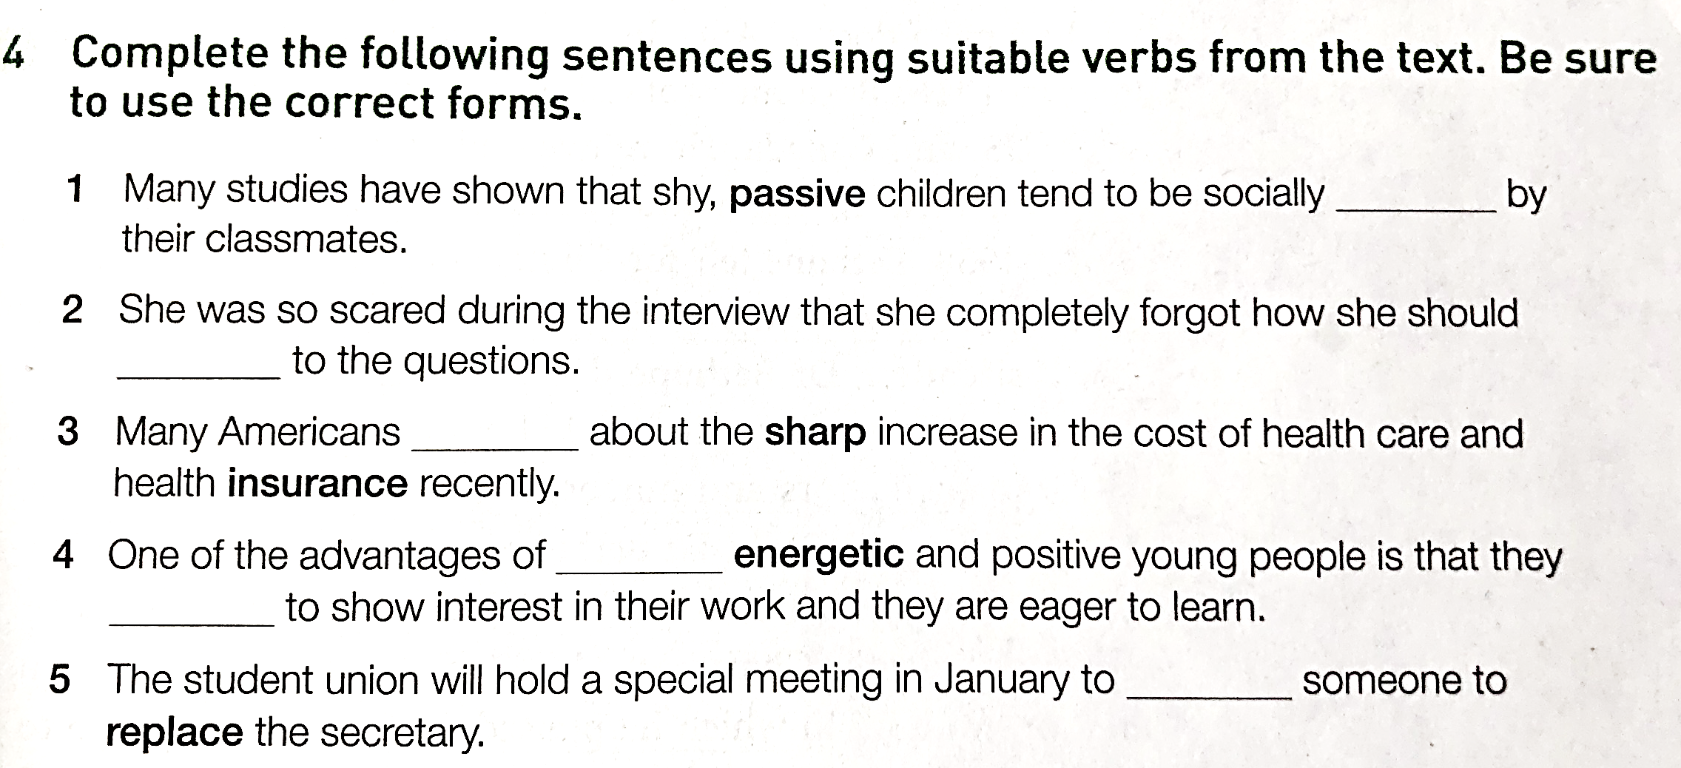
Post-reading
rejected
respond
complained
hiring
tend
hire/appoint

Slide 22
Ex 4 on P 17
3. Many Americans complained about the sharp increase in the cost of health care and health insurance recently.
sharp adj.
sudden and rapid, especially of a change in something
（变化）急剧的，骤然的
急剧上升: sharp rise/increase
急剧下降: sharp drop/decline
2) clear and definite 清楚明确的；清晰的；鲜明的
清晰的轮廓 a sharp outline
鲜明的对比 sharp contrast
3）quick to notice or understand things or to react敏锐的；灵敏的；敏捷的
敏锐的眼睛 sharp eyes,
聪颖的女孩 a girl of sharp intelligence

