Slide 1


感恩遇见，相互成就，本课件资料仅供您个人参考、教学使用，严禁自行在网络传播，违者依知识产权法追究法律责任。
更多教学资源请关注
公众号：溯恩英语
知识产权声明

Slide 2
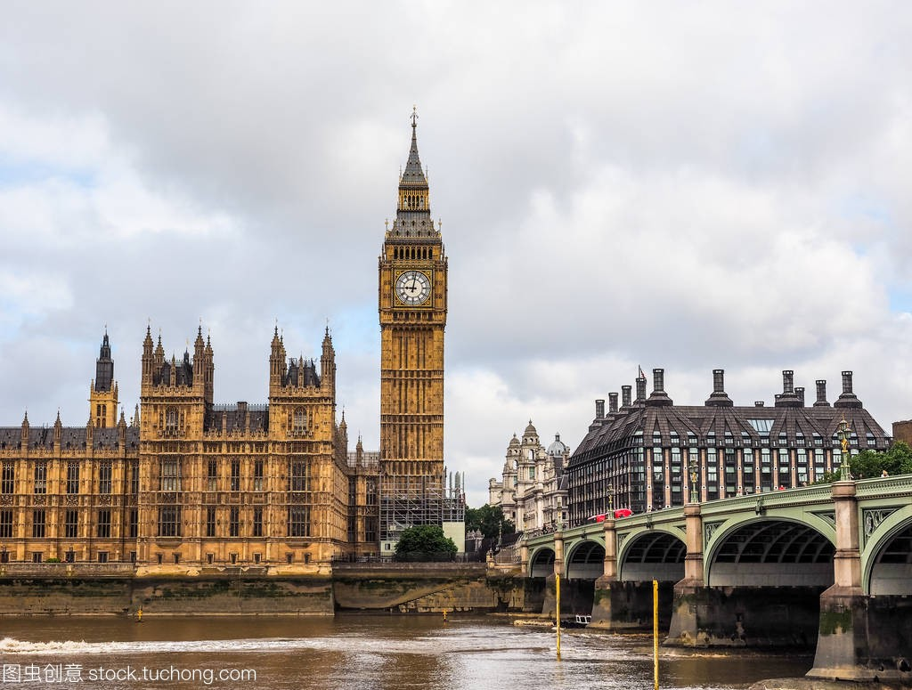
B2U4 Video Time
An Introduction to Historic London

Slide 3
Pre-watching
Word bank
1. blending n. mixture 混合
blend v. /blend/ to form a mixture with something（和某物）混合；融合
2. negotiate v. /nɪˈɡəʊʃieɪt/ to successfully get over or past a difficult part on a path or route
通过，越过（险要路段）
3. Parliament Building 议会大厦
4. core n. /kɔː(r)/ 核心
5. dock n. /dɒk/ a part of a port where ships are repaired, or where goods are put onto or taken off them 船坞；船埠；码头
6. imprisonment n. /ɪmˈprɪznmənt/ 监禁，关押
7. armoury n. /ˈɑːməri/ 军械库
8.royal n. /ˈrɔɪəl/ 皇家的；王室的
9. residence n. /ˈrezɪdəns/ a house, especially a large or impressive one
住所；住房；（尤指）宅第，豪宅
10. repository n. /rɪˈpɒzətri/ a place where something is stored in large quantities
仓库；贮藏室；存放处

Slide 4
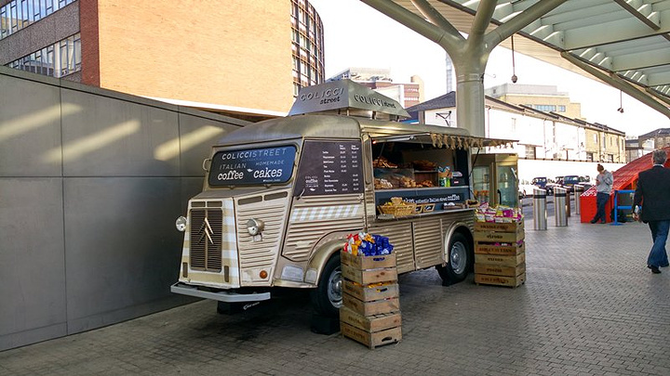
11. crown n. /kraʊn/ 王冠；皇冠
12. spectacular adj. /spekˈtækjələ(r)/ very impressive 壮观的；壮丽的；令人惊叹的
King’s Cross station 国王十字站 中转站
grab v. catch to take or hold somebody/something with your hand suddenly or roughly 抓住；攫取
14. Westminster Abbey 威斯敏斯特教堂
15. funeral n. /ˈfjuːnərəl/ 葬礼
16. coronation n. /ˌkɒrəˈneɪʃn/ 加冕；加冕典礼
17. sizeable adj. /ˈsaɪzəbl/ fairly large相当大的
18. ornamental /ˌɔːnəˈmentl/ 装饰性的
19. concentration n. a lot of something in one place
集中；聚集
20. unruffled adj. /ʌnˈrʌfld/ calm 平静的
21. hub n. （某地或活动的）中心，核心
22. monarch n. /ˈmɒnək/ 君主；帝王
monarchy 君主制；君主政体

Slide 5
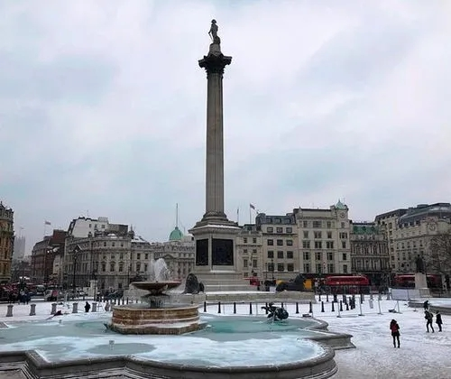
23. ascension n. /əˈsenʃn/ 登基
24. bland /blænd/ adj. with little colour, excitement or interest; without anything to attract attention 平淡的；乏味的
25. assemble v. /əˈsembl/ 聚集；集合
26. component n. /kəmˈpəʊnənt/ 组成部分
27. dominate v. /ˈdɒmɪneɪt/ 在…中具有最重要（或明显）的特色
28. rally n. /ˈræli/ 公众集会
29. address v. to make a formal speech to a group of people 演说；演讲
30. adjacent adj. /əˈdʒeɪsnt/ next to something 与…毗连的；邻近的
31. magnet n. /ˈmæɡnət/ 有吸引力的人（或地方、事物）
32. construct v. /kənˈstrʌkt/
to build or make something such as a road, building or machine
建筑；修建
33. devastate v. /ˈdevəsteɪt/
to completely destroy a place or an area 彻底破坏；摧毁；毁灭
34. pinnacle n. /ˈpɪnəkl/ （建筑物）尖顶
35. tracery n. /ˈtreɪsəri/ 花色窗棂
36. vitality n. /vaɪˈtæləti/ 生命力；活力；热情
Nelson’s Column

Slide 6
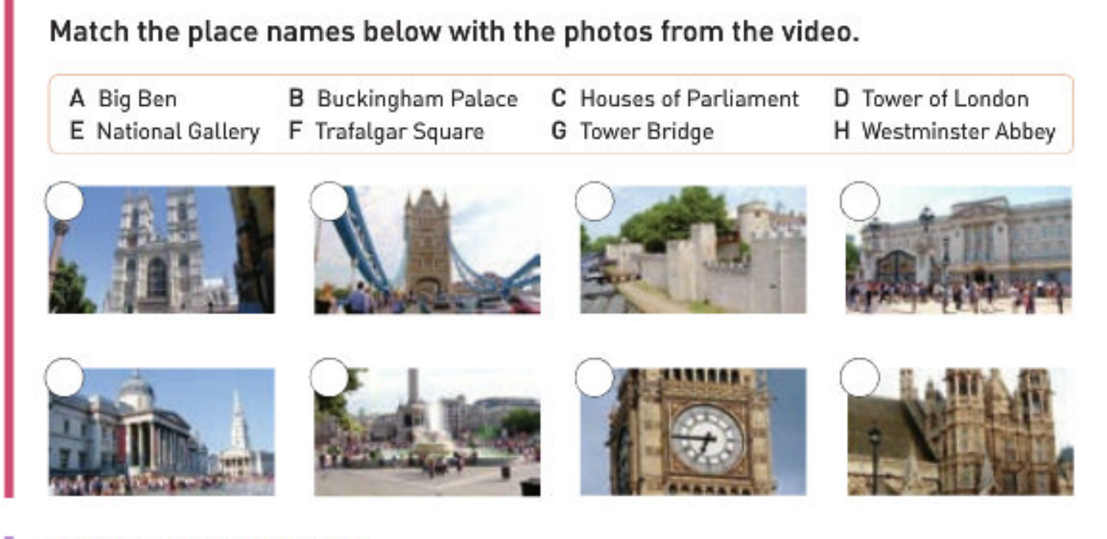
H
G
D
B
E
F
A
C

Slide 7

While-watching

Slide 8
Complete the following sentences below according to the video.
A. is a symbol of the city of London
is also called the Palace of Westminster
is where the king or queen lives
is where all royal funerals and most coronations take place
is in fact the name of the bell in the tower
is a traditional place for public meetings
Contains a great art collection.
____ 1. The Tower Bridge
____ 2. Westminster Abbey
____ 3. Buckingham Palace
____ 4. The National Gallery
____ 5. Trafalgar Square
____ 6. The Houses of Parliament
____ 7. Big Ben
A
D
C
G
F
B
E

Slide 9
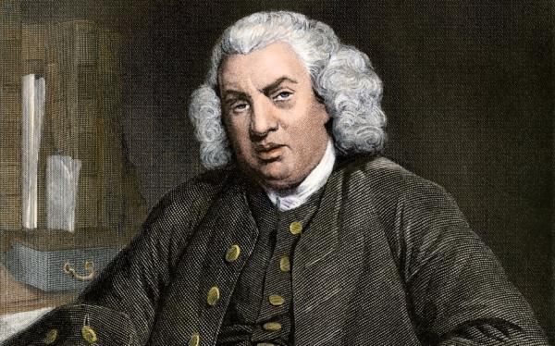
Answer the following questions.
What did Samuel Johnson say about London?
What makes London a great city to walk in?
Samuel Johnson said that when one is tired of London, one is tired of life.
It is a great city to walk in because there are no hills and many things to see.

