Slide 1



感恩遇见，相互成就，本课件资料仅供您个人参考、教学使用，严禁自行在网络传播，违者依知识产权法追究法律责任。
更多教学资源请关注
公众号：溯恩英语
知识产权声明

Slide 2
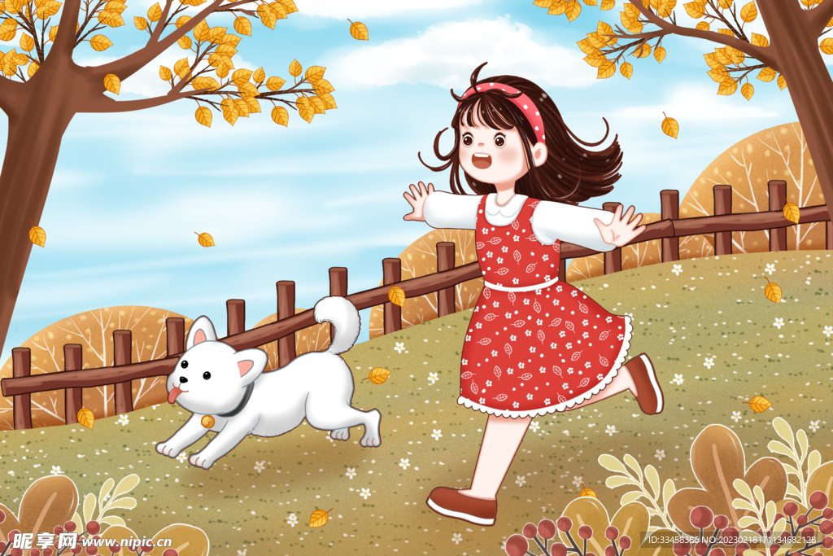
流浪狗Rufus的寻家之旅
2024-3 浙江省宁波十校
-流浪狗叙事角度+拟人手法+先抑后扬
的叙事方式
傅嘉

Slide 3
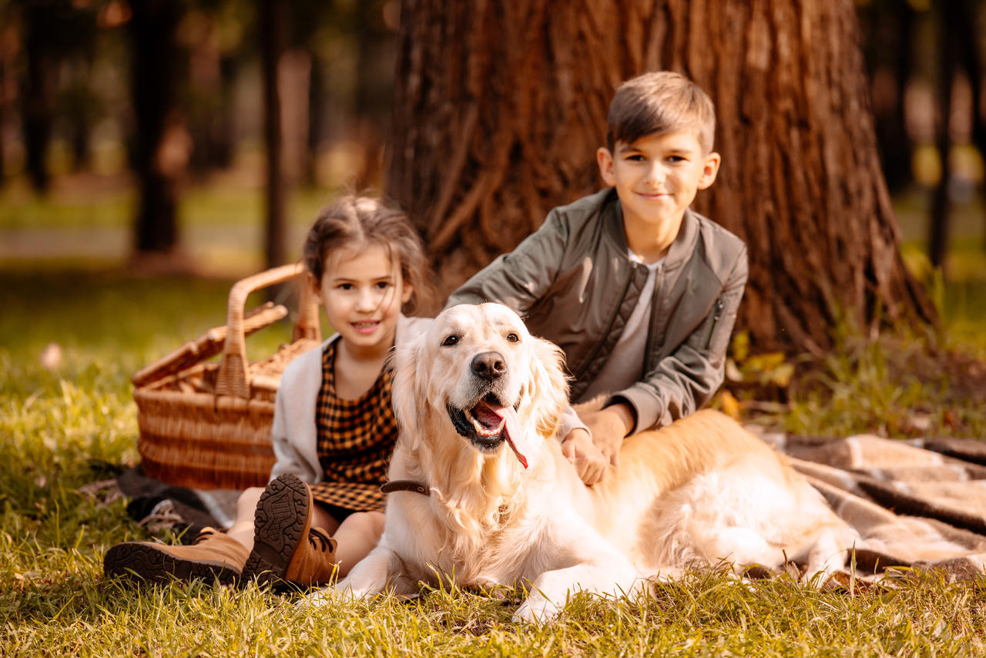
原文本
There once was a stray dog （流浪狗）named Rufus who was the most amazing dog on Kumquat Street. He could hear a ladybug blowing its nose. He could see a pill bug eating a black licorice candy at midnight. Rufus could even smell a caterpillar that hadn't washed its feet.
You would think that Rufus, being so amazing, was also happy. But he wasn‘t. You see, there was one thing that kept Rufus from being adopted by his favorite human. And that was ... Rufus barked backward. Here's what he sounded like: "Wob-wow! Wob-wow! Fra-fra-fra! Krab-krab! "
Rufus could stand being laughed at by every squirrel and cat in the neighborhood. What he couldn't stand was that his bark kept him from living with Janie Johnson.
Janie never laughed at Rufus when he barked. More than anything else, Rufus wanted to be her pet.
He wanted to play catch in her yard every day and sleep at the foot of her bed each night.
But Janie's father, Mr. Johnson, wouldn't hear of it. "What? A dog that barks backward? We'd be the laughingstocks of Kumquat Street! We Johnsons didn't get where we are today by adopting dogs that bark backward. No, Janie. It's out of the question."

Slide 4
原文本
"I'm sorry," Janie told Rufus one morning as they sat on her front porch. "I keep telling Daddy how great you are. He just won't listen."
"Krab-krab!" said Rufus.
"Yes, sometimes he is bad-tempered," said Janie "I'll keep trying, though. Don't worry."
But Rufus did worry. That evening he talked it over with his friend Bill Bulldog. "I don't think Mr Johnson will ever like me," Rufus said. "As long as I bark backward, he'll never let me live in his home."
"Have you tried treatment?" asked Bill.
Rufus said, "I've tried everything. Nothing helps. It's just the way I bark."
"You're a great dog Roof. Anyone can see that," said Bill. "It just takes some humans longer to figure it out, that's all. Hey, want to go with me to Succotash Street? I've heard that their garbage is fantastic."
Rufus yawned. "No, thanks," he said. "I'll take a nap."
When Rufus woke up, it was late afternoon. As he was lying there, his sharp ears heard Mr. Johnson saying, "It's almost suppertime. Is Janie still roller-skating? We Johnsons didn't get where we are today by being late for supper."

Slide 5
Read for plot
There once was a stray dog （流浪狗）named Rufus who was the most amazing dog on Kumquat Street. He could hear a ladybug blowing its nose. He could see a pill bug eating a black licorice candy at midnight. Rufus could even smell a caterpillar that hadn't washed its feet.
You would think that Rufus, being so amazing, was also happy. But he wasn't. You see, there was one thing that kept Rufus from being adopted by his favorite human. And that was ... Rufus barked backward. Here's what he sounded like: "Wob-wow! Wob-wow! Fra-fra-fra! Krab-krab! "
Q1： What was Rufus like ?
Q2: What was Rufus’s worry? And Why?

Slide 6
Read for plot
Rufus could stand being laughed at by every squirrel and cat in the neighborhood. What he couldn't stand was that his bark kept him from living with Janie Johnson.
Janie never laughed at Rufus when he barked. More than anything else, Rufus wanted to be her pet.
He wanted to play catch in her yard every day and sleep at the foot of her bed each night.
Q3： Whom did Rufus want to live with? And why?

Slide 7
Read for plot
But Janie's father, Mr. Johnson, wouldn't hear of it. "What? A dog that barks backward? We'd be the laughingstocks of Kumquat Street! We Johnsons didn't get where we are today by adopting dogs that bark backward. No, Janie. It's out of the question."
Q4： Why did Mr. Johnson refuse to adopt Rufus?
Q5： What does “out of the question”mean?

Slide 8
"I'm sorry," Janie told Rufus one morning as they sat on her front porch. "I keep telling Daddy how great you are. He just won't listen."
"Krab-krab!" said Rufus.
"Yes, sometimes he is bad-tempered," said Janie "I'll keep trying, though. Don't worry."
Q6: What did Janie do to comfort Rufus?

Slide 9
But Rufus did worry. That evening he talked it over with his friend Bill Bulldog. "I don't think Mr Johnson will ever like me," Rufus said. "As long as I bark backward, he'll never let me live in his home."
"Have you tried treatment?" asked Bill.
Rufus said, "I've tried everything. Nothing helps. It's just the way I bark."
"You're a great dog Roof. Anyone can see that," said Bill. "It just takes some humans longer to figure it out, that's all. Hey, want to go with me to Succotash Street? I've heard that their garbage is fantastic."
Rufus yawned. "No, thanks," he said. "I'll take a nap."
Q7: What did his friend do to comfort Rufus?

Slide 10
When Rufus woke up, it was late afternoon. As he was lying there, his sharp ears heard Mr. Johnson saying, "It's almost suppertime. Is Janie still roller-skating? We Johnsons didn't get where we are today by being late for supper."
Q8: What would their mother do next?

Slide 11
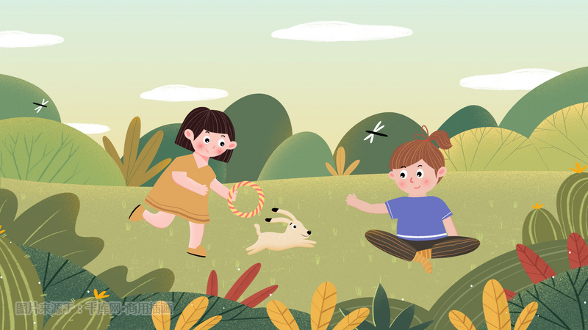
Read for clues and echoes
You see, there was one thing that kept Rufus from being adopted by his favorite human. And that was ... Rufus barked backward. Here's what he sounded like: "Wob-wow! Wob-wow! Fra-fra-fra! Krab-krab! ".
clues
echoes
1. Rufus never changed his barking way and still barked backward as usual and he was eventually adopted by Jannie.

Slide 12
Read for clues and echoes
What he couldn't stand was that his bark kept him from living with Janie Johnson. Janie never laughed at Rufus when he barked. More than anything else, Rufus wanted to be her pet. He wanted to play catch in her yard every day and sleep at the foot of her bed each night.
clues
echoes
2. His uniqueness didn’t stop him from living with Janie and now Rufus became her pet, playing catch in her yard each day and sleeping at the foot of her bed every night.

Slide 13
Read for clues and echoes
But Janie's father, Mr. Johnson, wouldn't hear of it. "What? A dog that barks backward? We'd be the laughingstocks of Kumquat Street! We Johnsons didn't get where we are today by adopting dogs that bark backward. No, Janie. It's out of the question."
clues
echoes
3. The Johnsons didn’t become the laughingstocks of Kumquat Street. Instead, residents in the street tended to cast an envious look at them as they saw Rufus barking backward, saying Rufus was so smart , amazing and unique.

Slide 14
Read for clues and echoes
But Rufus did worry. That evening he talked it over with his friend Bill Bulldog. "I don't think Mr Johnson will ever like me," Rufus said. "As long as I bark backward, he'll never let me live in his home." "Have you tried treatment?" asked Bill. Rufus said, "I've tried everything. Nothing helps. It's just the way I bark."
clues
echoes
4. One evening , wandering along the street , Bill saw Rufus walking Janie. Bill approached him and sent congratulations to Rufus on his finding home without changing his barking way.

Slide 15
Read for clues and echoes
clues
echoes
"You're a great dog Roof. Anyone can see that," said Bill. "It just takes some humans longer to figure it out, that's all. Hey, want to go with me to Succotash Street? I've heard that their garbage is fantastic."
5. Fortunately, it didn’t take Mr. Johnson too long to figure out that Rufus was so smart and amazing.
6. One thing was for sure– Rufus would never hunt for food in garbage again.

Slide 16
Read for clues and echoes
When Rufus woke up, it was late afternoon. As he was lying there, his sharp ears heard Mr. Johnson saying, "It's almost suppertime. Is Janie still roller-skating? We Johnsons didn't get where we are today by being late for supper."
clues
echoes
6. We Johnsons didn’t get where we are today by leaving Rufus homeless in Kumquat Street.

Slide 17
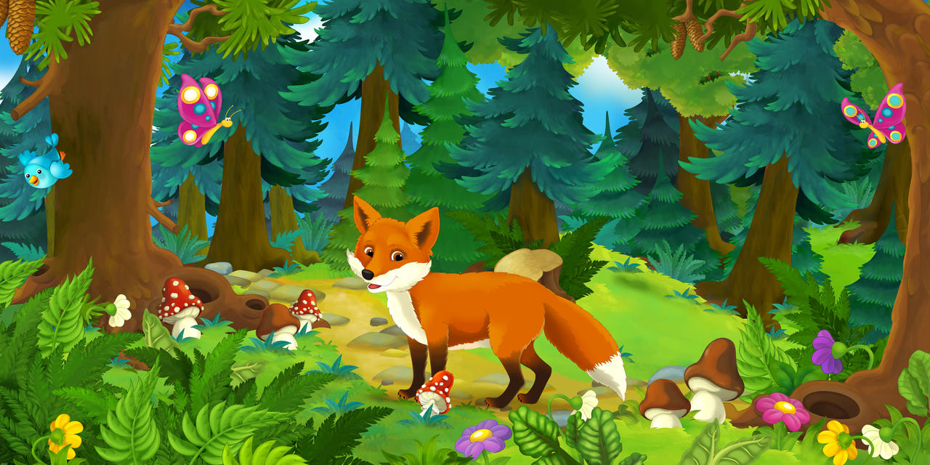
who
where
When
The cause
The process
The result
Six elements
Six detailed elements of the text
Rufus （流浪狗）, Bill（流浪狗）， Janie, Mr Johson,
Kumquat Street
只提到：supper time
Rufus desired to live with Janie but her father disagreed with her.
Rufus wanted to be accepted by Janie’s father , Mr. Johnson.
Where was Janie?

Slide 18
处理衔接处：
When Rufus woke up, it was late afternoon. As he was lying there, his sharp ears heard Mr. Johnson saying, "It's almost suppertime. Is Janie still roller-skating? We Johnsons didn't get where we are today by being late for supper."
Para1: Rufus ran down Kumquat Street to look for Janie.
Para2: At the sight of Janie and Rufus, Mr. Johnson ran up.
首段衔接1：A: （主语 Rufus平行叙述：直奔溜冰场） Rufus's heart sank/raced with worry as he pounded down Kumquat Street, his nose to the ground, sniffing for any trace of Janie's scent. Then the skating rink/circuit/ spot flashed across his mind. Rufus rushed straight toward the skating rink where Janie often skated but she was not there!

Slide 19
处理衔接处：
When Rufus woke up, it was late afternoon. As he was lying there, his sharp ears heard Mr. Johnson saying, "It's almost suppertime. Is Janie still roller-skating? We Johnsons didn't get where we are today by being late for supper."
Para1: Rufus ran down Kumquat Street to look for Janie.
Para2: At the sight of Janie and Rufus, Mr. Johnson ran up.
首段衔接1： B: （ 可以描述一下Kumquat Street） In the hustling and bustling Kumquat Street, Rufus ran up and down again and again, hoping to find his little human friend Janie.

Slide 20
处理衔接处：
When Rufus woke up, it was late afternoon. As he was lying there, his sharp ears heard Mr. Johnson saying, "It's almost suppertime. Is Janie still roller-skating? We Johnsons didn't get where we are today by being late for supper."
Para1: Rufus ran down Kumquat Street to look for Janie.
Para2: At the sight of Janie and Rufus, Mr. Johnson ran up.
首段衔接1： C: （ Janie 为叙事对象） Janie was nowhere to be seen. Where did she go? Was she lost somewhere?

Slide 21
Para1: Rufus ran down Kumquat Street to look for Janie.
Para2: At the sight of Janie and Rufus, Mr. Johnson ran up.
首段尾句衔接2：A: “ Rufus, I’m here. Can you take me home?” Janie cried out from somewhere.
首段尾句衔接2： B: Rufus followed the faint trail of her roller skates, weaving through the neighborhood with determination. Rufus knew he had to find Janie before something terrible happened. Fortunately, it didn’t take long before Rufus found the roller-skates dropped by Janie and the sobbing / weeping Janie, who was not too far away from the roller-skates.

Slide 22
Para1: Rufus ran down Kumquat Street to look for Janie.
Para2: At the sight of Janie and Rufus, Mr. Johnson ran up.
二段首句衔接3：A: （根据Para2主语 Mr.Johnson进行平行叙述：) Seeing Janie safe and sound, Mr. Johnson felt a heavy load taken off his mind. Rufus barked backward to Janie again and again as if reminding Janie to follow him home.
二段首句衔接3： B: （找到了Janie, 父亲可以松一口气了。 ）Mr. Johnson breathed a sigh of relief , knowing that Rufus helped him to find his adorable daughter. What Mr. Johnson never expected was that Janie and Rufus were like peas and carrots.

Slide 23
Para1: Rufus ran down Kumquat Street to look for Janie.
Para2: At the sight of Janie and Rufus, Mr. Johnson ran up.
二段尾句衔接2：A: Miraculously, Rufus’s dream came true!
二段尾句衔接2： B: Fortunately, it didn’t take too long for Rufus to find home. Now Rufus became her pet and enjoyed living with Janie , playing catch in her yard each day and sleeping at the foot of her bed every night.

Slide 24
习作句式及逻辑拆解 主语切换 方便行文
Para1: Rufus ran down Kumquat Street to look for Janie.
（时间状语从句+拟人手法+非谓语：Rufus 很担心+狗的嗅觉特征：）
Rufus's heart sank with worry as he pounded down Kumquat Street, his nose to the ground, sniffing for any trace of Janie's scent.
2. ( 无灵主语句： 溜冰场在脑海闪现）
Then the skating rink /circuit flashed across Rufus’s mind.
3.（定语从句： 直奔溜冰场但没有人影。）
Rufus rushed straight toward the skating rink where Janie often skated but she was not there!

Slide 25
习作句式及逻辑拆解 主语切换 方便行文
4. （时间状语从句： 夜幕降临，越来越担心）
As the evening wore on, Rufus felt increasingly anxious about Janie, totally at a loss what to do.
(简单句：Rufus 的心理活动）
“ I can bark backward! My barks will definitely attract Janie’s attention ! ” Rufus thought to himself.

Slide 26
习作句式及逻辑拆解 主语切换 方便行文
6. （doing 非谓语：Rufus继续寻找)
Rufus continued to search every corner of the neighboring streets, barking backward again and again--- "Wob-wow! Wob-wow! Fra-fra-fra! Krab-krab!
7. （无灵主语句+直接引语： 狗叫的方法奏效+Janie叫喊）
Amazingly, it worked! “ Rufus, I’m here. Can you take me home?” Janie cried out from somewhere.

Slide 27
习作句式及逻辑拆解 主语切换 方便行文
Para2: At the sight of Janie and Rufus, Mr. Johnson ran up.
（done 非谓语；先从Janie入手，描写Janie安然无恙）
Janie was safe and sound/ unharmed, guarded by devoted Rufus.
２. （ 二连动＋拟人手法；Rufus 驮着溜冰鞋+一遍一遍地叫）
Rufus carried Janie’s roller-skates on his back and barked backward again and again as if reminding Janie to follow him.
( 比喻手法: Janie 和Rufus 形影不离）
The pair was just like peas and carrots, which struck the chord of Mr. Johnson.

Slide 28
习作句式及逻辑拆解 主语切换 方便行文
4. （倒装句：父亲见到女儿的激动）
No sooner had Mr. Johnson approached them than he gathered Janie in his strong arms and hugged her tightly.
5. （ 独立主格 结构+sb did sth, 父亲对Rufus 的感激）
Tears of gratitude blurring his eyes, Mr. Johnson expressed his heartfelt thanks to Rufus for his timely assistance.

Slide 29
6. （ Doing sth, sb did sth; Janie再问父亲可否收留Rufus）
Looking into his father’s eyes, Janie whispered softy, “ Dad, may I keep Rufus as my pet?”
7. （ Doing sth, sb did sth; + 套用父亲的口头禅+最终答应收留Rufus）
Holding Janie’s small hands, Mr Johnson laughed happily, “We Johnsons didn’t get where we are today by leaving Rufus homeless in Kumquat Street. It’s our of question!”
8. ( 无灵主语句：美梦成真。）
Miraculously, Rufus’s dream came true!

Slide 30
习作欣赏
Para1: Rufus ran down Kumquat Street to look for Janie. Rufus's heart sank with worry as he pounded down Kumquat Street, his nose to the ground, sniffing for any trace of Janie's scent. Then the skating rink flashed across Rufus’s mind. Rufus rushed straight toward the skating rink where Janie often skated but she was not there! As the evening wore on, Rufus felt increasingly anxious about Janie, totally at a loss what to do.“ I can bark backward! My barks will definitely attract Janie’s attention ! ”Rufus thought to himself. Rufus continued to search every corner of the neighboring streets, barking backward again and again---"Wob-wow! Wob-wow! Fra-fra-fra! Krab-krab!” Amazingly, it worked! “ Rufus, I’m here. Can you take me home?” Janie cried out from somewhere.

Slide 31
Para2: At the sight of Janie and Rufus, Mr. Johnson ran up. Janie was safe and sound, guarded by devoted Rufus. Rufus carried Janie’s roller-skates on his back and barked backward again and again as if reminding Janie to follow him. The pair was just like peas and carrots, which struck the chord of Mr. Johnson. No sooner had Mr. Johnson approached them than he gathered Janie in his strong arms and hugged her tightly. Tears of gratitude blurring his eyes, Mr. Johnson expressed his heartfelt thanks to Rufus for his timely assistance. Looking into his father’s eyes, Janie whispered softy, “ Dad, may I keep Rufus as my pet?” Holding Janie’s small hands, Mr Johnson laughed happily, “We Johnsons didn’t get where we are today by leaving Rufus homeless in Kumquat Street. It’s our of question!” Miraculously, Rufus’s dream came true!

Slide 32
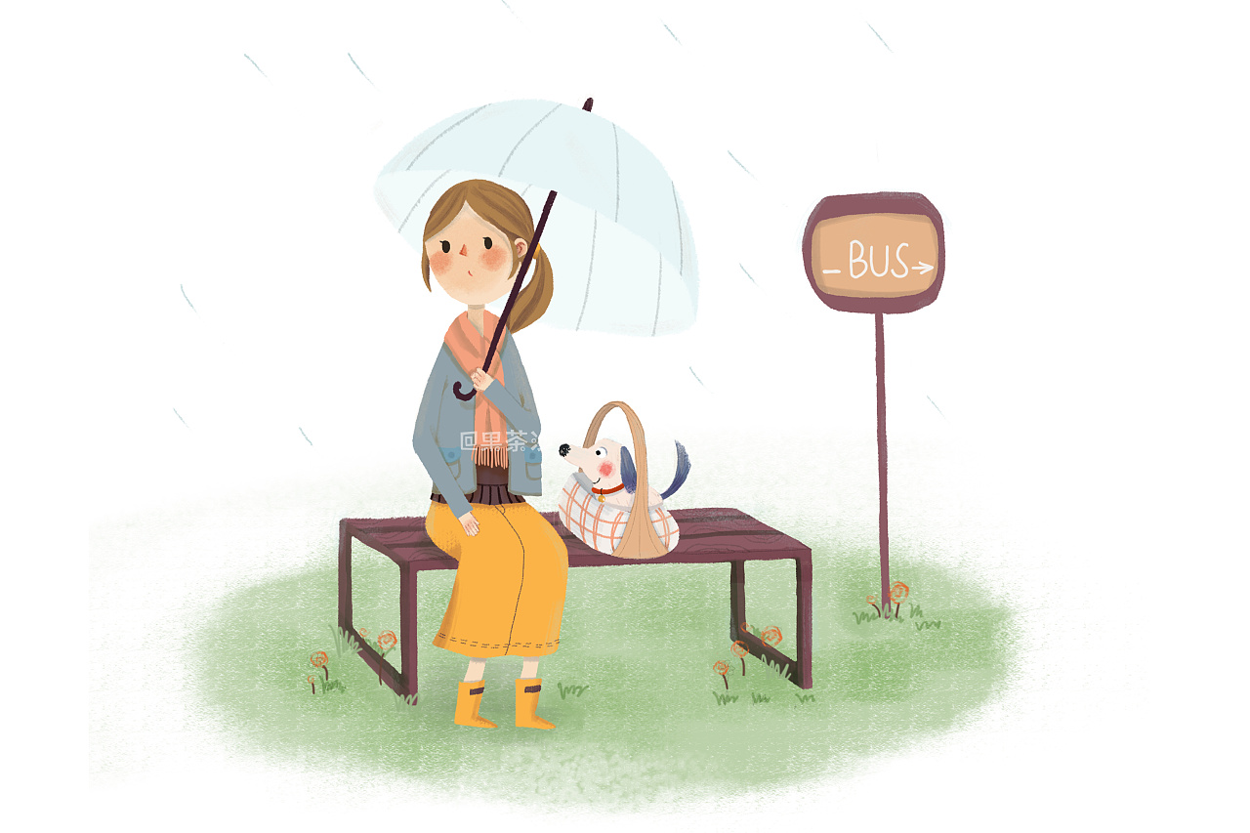
狗的行为特征语料库
The dog jumped into my father’s familiar arms, licking his face gently as if showing how much he missed my father. 2024-3强基联盟《漫长的重逢》
Rufus raced down the street with worry , sniffing any trace of Janie’s scent.
Seeing her young master come back home, Poppy barked excitedly, wagging her tail cheerfully. 《浙江高考真题Poppy的小狗》
The small adorable dog snuggled with my 13-month-old baby boy as if safeguarding him all the time.
( 2023-5 Z20 A Four-legged Guardian Angel)

Slide 33
狗的行为特征语料库
Rufus pricked/ strained up his ears for any voice from Janice but nothing came into his ears.
5. Rufus curled up under Janie’s bed, enjoying having his human friend at last.

