Slide 1


感恩遇见，相互成就，本课件资料仅供您个人参考、教学使用，严禁自行在网络传播，违者依知识产权法追究法律责任。
更多教学资源请关注
公众号：溯恩英语
知识产权声明

Slide 2
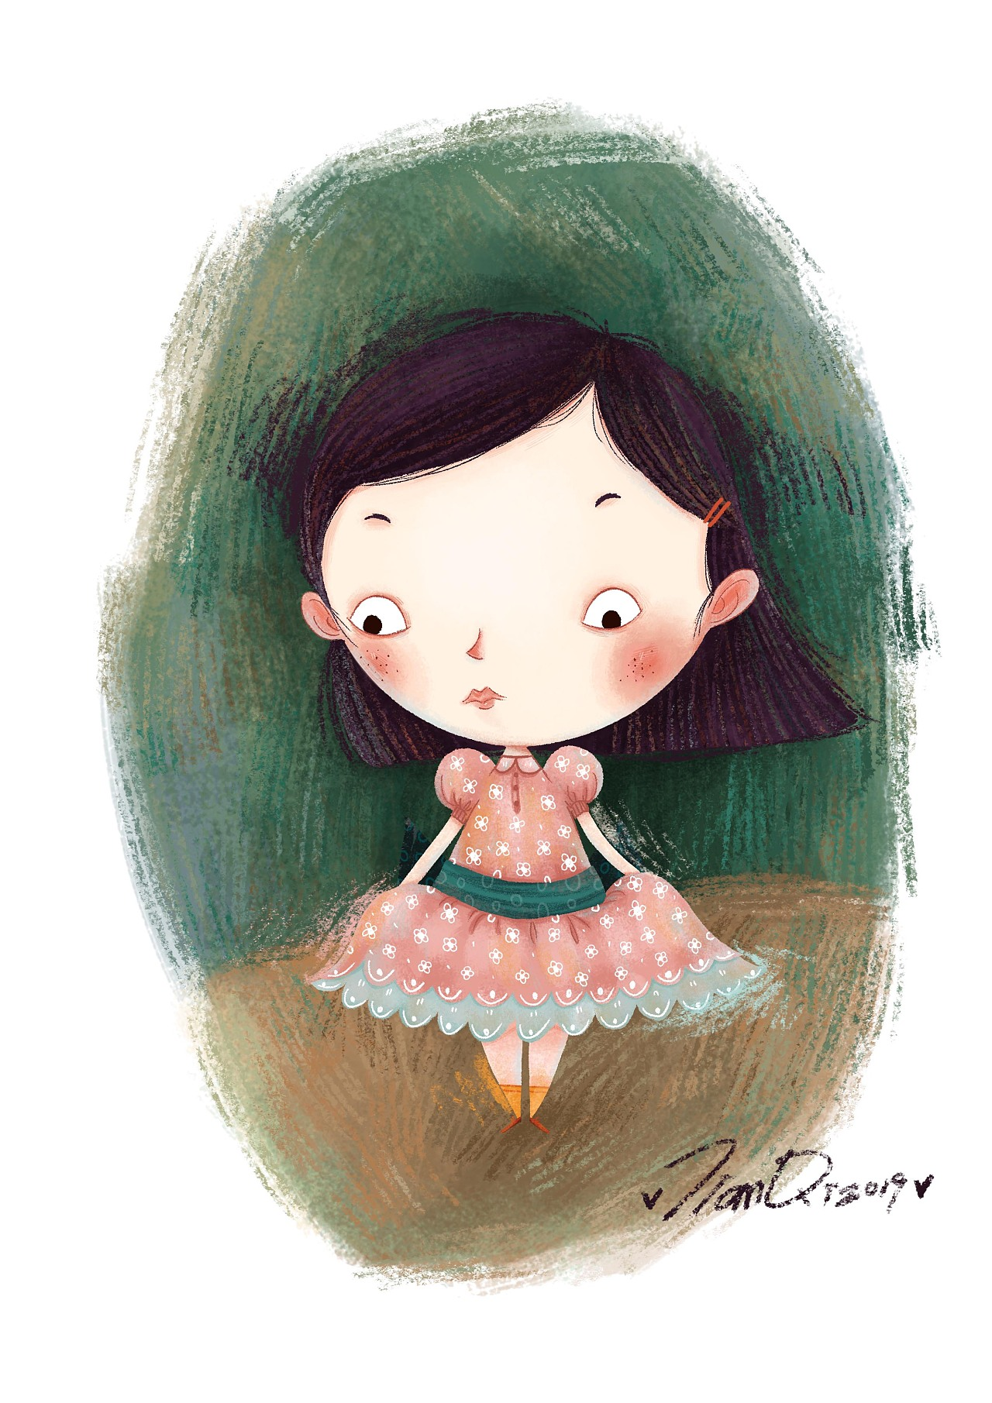
2024-3 天域全国名校协作体
自
画
像
Inner conflict-experience-solution读后续写
傅嘉

Slide 3
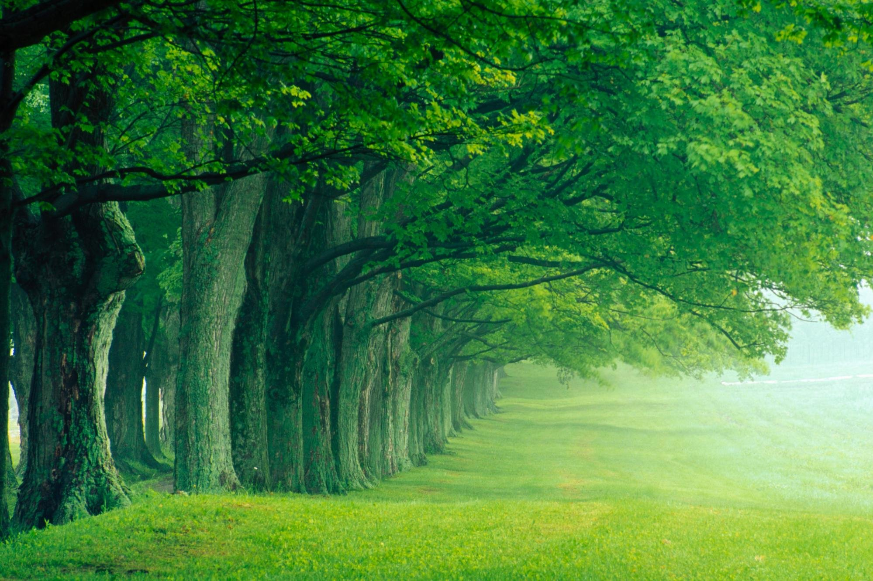

原文本
Self-Portrait
Alia was disappointed to find herself in the drawing studio. She had been sick with the flu during the week when everyone else got to pick their classes. She had hoped for Astronomy or Marine Biology, but they were full by the time she got to choose. She loved everything about science, from the way it used facts and formulas to how it revealed the basic nature of things. But art was so . . un-scientific.
The first class project was self-portraits. Some students were drawing self-portraits using mirrors. Others were working from photographs. Alia glanced at the incomplete sketches, feeling like a cat in a dog show. But she had no choice. Hesitantly, she lifted a pencil, only to pause before the canvas. Confusion and reluctance were evidently written on her face; she had no idea how to proceed with her strokes.
The teacher came up to Alia's easel（画架） . Seemingly having noticed her trouble, he sat next to her.
"Every portrait begins with a circle, " he said. "Then you create a series of lines. "
To demonstrate, he drew a group of small, quick portraits. He began each one with a circle, some straight lines, and a triangle to determine where the eyes, nose, and chin should go. To Alia's amazement, each portrait on the paper took form. Alia had never thought about it, but the features of everyone's face were in the same spots. "Go ahead and give it a try. " The teacher handed the pencil back to her.
Taking a deep breath, Alia began her own self-portrait. She drew the basic form of a head, the way she had been shown. From there, she used lines to plot the features of her face. She had to take note of each detail, with each stroke, line and curve demanding her close attention. One wrong measurement could throw off the whole portrait.

Slide 4

本文生词：
self-portrait 自画像；肖像
The drawing studio 画室
formulas n. 公式；方程式；
nature of things 事物本质
sketch n. 素描；速写；草图
reluctance n. 勉强
evidently adj. 明显的；
proceed with 开始进行
canvas n. 画布

Slide 5
本文生词：
10. stroke n. 笔画，笔划；（游泳）划水； 中风 vt 抚摸
11. demonstrate vt. 展示
12. triangle n. 三角形
13. form n. 形状
14. took form 成形；出现；显现
15. curve n. 曲线；弧线
plot her features : 勾勒出她的特点
（ plot n. 情节）

Slide 6
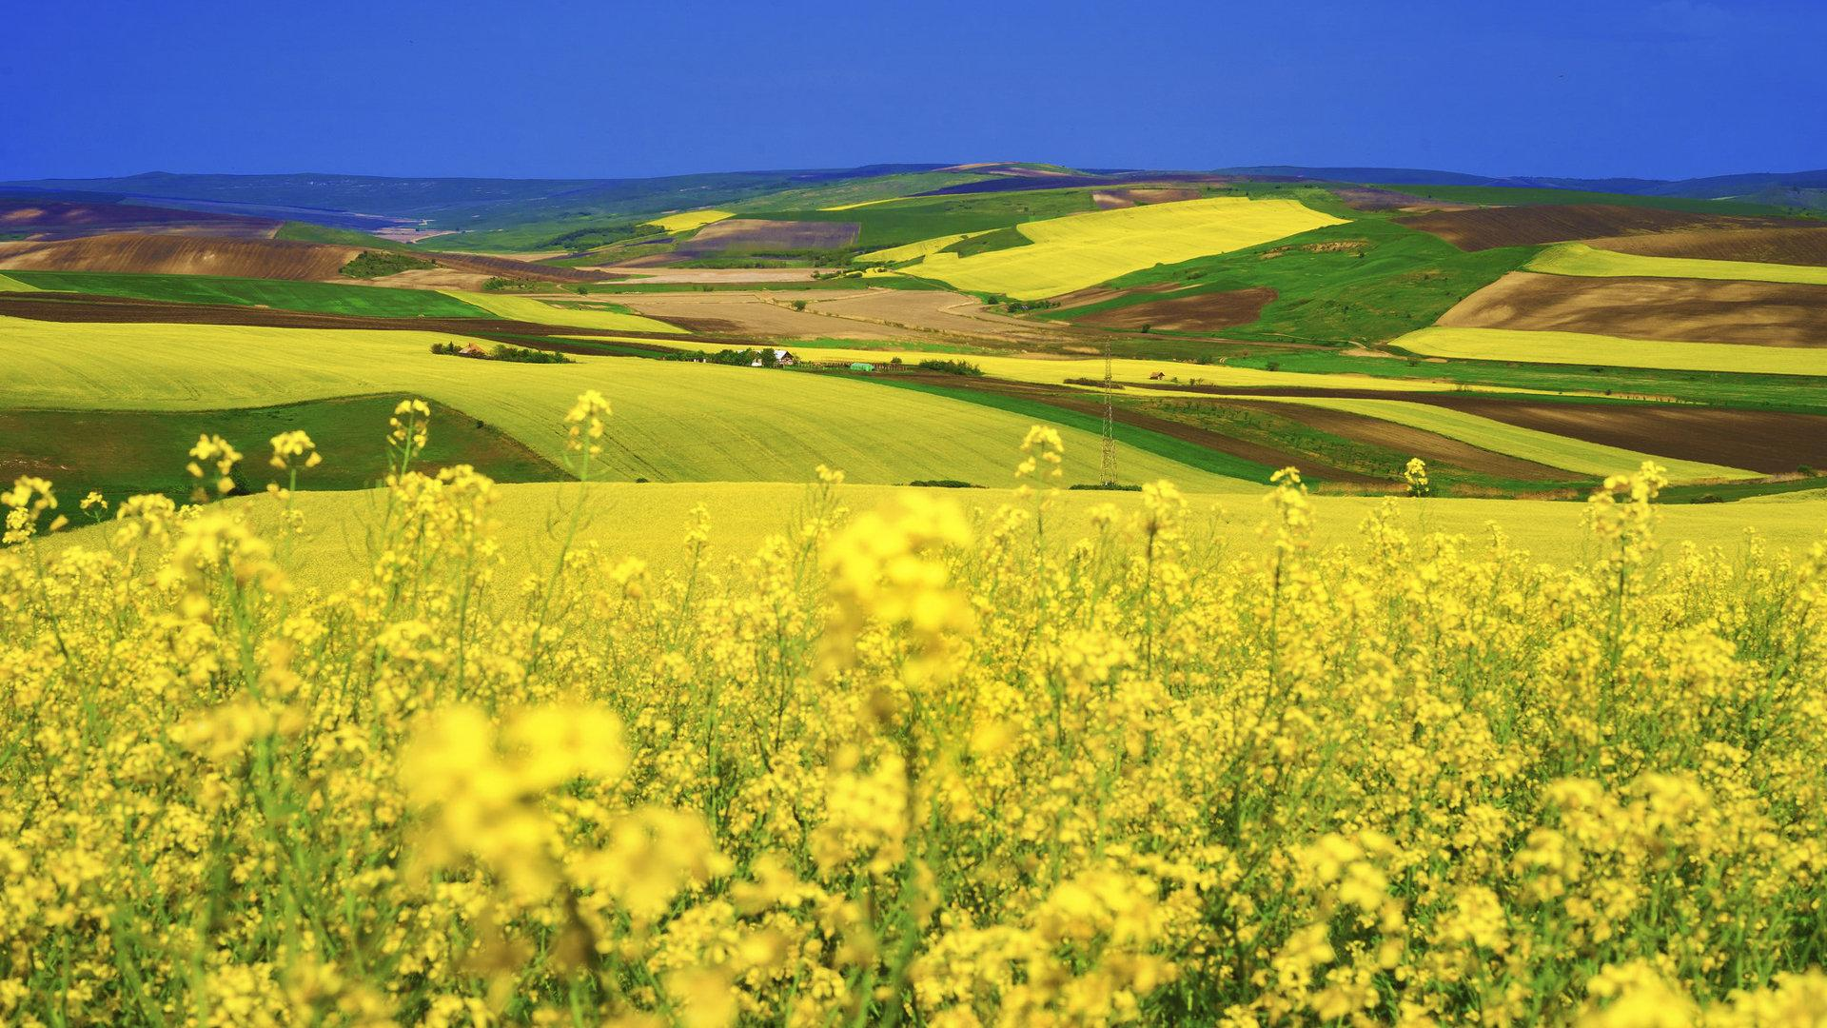
Alia was disappointed to find herself in the drawing studio. She had been sick with the flu during the week when everyone else got to pick their classes. She had hoped for Astronomy or Marine Biology, but they were full by the time she got to choose. She loved everything about science, from the way it used facts and formulas to how it revealed the basic nature of things. But art was so . . un-scientific.
Questions for information
Why was Alia disappointed?

Slide 7
The first class project was self-portraits. Some students were drawing self-portraits using mirrors. Others were working from photographs. Alia glanced at the incomplete sketches, feeling like a cat in a dog show. But she had no choice. Hesitantly, she lifted a pencil, only to pause before the canvas. Confusion and reluctance were evidently written on her face; she had no idea how to proceed with her strokes.
Questions for information
How did she feel in the first class?

Slide 8
The teacher came up to Alia's easel（画架） . Seemingly having noticed her trouble, he sat next to her.
"Every portrait begins with a circle, " he said. "Then you create a series of lines. "
To demonstrate, he drew a group of small, quick portraits. He began each one with a circle, some straight lines, and a triangle to determine where the eyes, nose, and chin should go. To Alia's amazement, each portrait on the paper took form. Alia had never thought about it, but the features of everyone's face were in the same spots. "Go ahead and give it a try. " The teacher handed the pencil back to her.
Questions for information
What did her teacher do to help her?

Slide 9
Taking a deep breath, Alia began her own self-portrait. She drew the basic form of a head, the way she had been shown. From there, she used lines to plot the features of her face. She had to take note of each detail, with each stroke, line and curve demanding her close attention. One wrong measurement could throw off the whole portrait.
Questions for information
What did Alia do after being shown by her teacher?

Slide 10
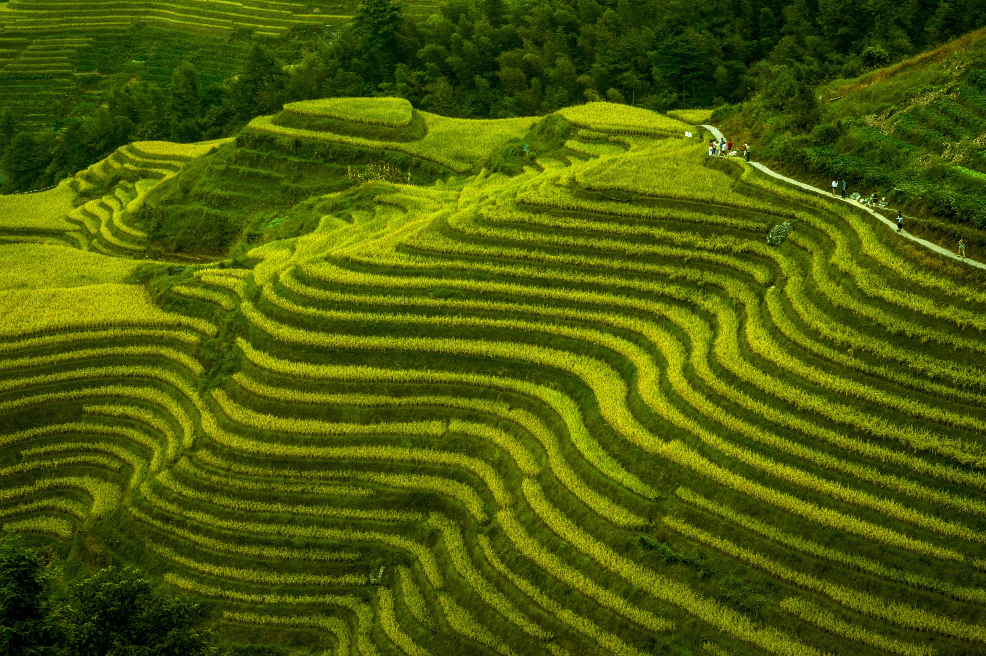
Alia was disappointed to find herself in the drawing studio. She had been sick with the flu during the week when everyone else got to pick their classes. She had hoped for Astronomy or Marine Biology, but they were full by the time she got to choose. She loved everything about science, from the way it used facts and formulas to how it revealed the basic nature of things. But art was so . . un-scientific.
clues and echoes
Echo1: Alia even felt blessed to find herself in the drawing studio. Without the flu, she couldn’t have chosen art. Thanks to the forced/ compelled choice, she had a chance to experience art and ended up in falling in love with it.

Slide 11
Alia was disappointed to find herself in the drawing studio. She had been sick with the flu during the week when everyone else got to pick their classes. She had hoped for Astronomy or Marine Biology, but they were full by the time she got to choose. She loved everything about science, from the way it used facts and formulas to how it revealed the basic nature of things. But art was so . . un-scientific.
clues and echoes
Echo2: Alia slowly changed her initial opinion about art. Art is involved in science and needs to be as precise as science, with which Alia was fascinated.

Slide 12
The first class project was self-portraits. Some students were drawing self-portraits using mirrors. Others were working from photographs. Alia glanced at the incomplete sketches, feeling like a cat in a dog show. But she had no choice. Hesitantly, she lifted a pencil, only to pause before the canvas. Confusion and reluctance were evidently written on her face; she had no idea how to proceed with her strokes.
clues and echoes
Echo3: ① Alia , sitting in the studio , felt like a fish in water.
②Sitting in the drawing studio, Alia no longer felt like a cat in a dog show. Instead, she took to art like a duck to water.

Slide 13
The first class project was self-portraits. Some students were drawing self-portraits using mirrors. Others were working from photographs. Alia glanced at the incomplete sketches, feeling like a cat in a dog show. But she had no choice. Hesitantly, she lifted a pencil, only to pause before the canvas. Confusion and reluctance were evidently written on her face; she had no idea how to proceed with her strokes.
clues and echoes
Echo4: ①Alia got accustomed to using her pencil to proceed with her strokes, just as her teacher demonstrated.
②Delight and excitement were apparently / evidently written on her face as she found increasing confidence in proceeding with every stroke.

Slide 14
The teacher came up to Alia's easel（画架） . Seemingly having noticed her trouble, he sat next to her.
"Every portrait begins with a circle, " he said. "Then you create a series of lines. "
To demonstrate, he drew a group of small, quick portraits. He began each one with a circle, some straight lines, and a triangle to determine where the eyes, nose, and chin should go. To Alia's amazement, each portrait on the paper took form. Alia had never thought about it, but the features of everyone's face were in the same spots. "Go ahead and give it a try. " The teacher handed the pencil back to her.
clues and echoes
Echo5: A circle , some straight lines and a triangle composed a self-portrait in a magic way, which aroused Alia’s interest in drawing.

Slide 15
To demonstrate, he drew a group of small, quick portraits. He began each one with a circle, some straight lines, and a triangle to determine where the eyes, nose, and chin should go. To Alia's amazement, each portrait on the paper took form. Alia had never thought about it, but the features of everyone's face were in the same spots. "Go ahead and give it a try. " The teacher handed the pencil back to her.
clues and echoes
Echo6: Whenever she encountered an opportunity that she seemed unwilling to take, her teacher’s words would echo in her ears ---Go ahead and give it a try.

Slide 16
Taking a deep breath, Alia began her own self-portrait. She drew the basic form of a head, the way she had been shown. From there, she used lines to plot the features of her face. She had to take note of each detail, with each stroke, line and curve demanding her close attention. One wrong measurement could throw off the whole portrait.
clues and echoes
Echo7: Put together on the canvas, every stroke, line and curve composed the outline of her self-portrait. With details added, a lifelike drawing/ sketch of her own image took form/ appeared on the canvas just before her eyes. It was just unbelievable/ incredible.

Slide 17
原文本叙事特征：
背景：故事主角Alia因流感失去选科学课的机会，被逼无奈选了画画课。
冲突：作者在第一段就呈现Alia失望的情绪。此类文本在设计的时候，重点突出主角的内心冲突。
体验：然后主角带着内心的冲突，去体验画画课，体验到了和科学与艺术看似截然不同的无关的两个学科，竟然都需要耐心，精确（严谨）。
解决：通过体验，解决了内心冲突。主角的认知又促使了自己新的成长。

Slide 18
体验绘画，绘画过程中探究艺术与科学的相似性 并最终得出体验绘画后的感悟---被逼无奈的选择正是自己的最爱。同时也说明，凡事不尝试，就不能武断地说不喜欢。
在续写部分中， 可以强调 Alia 在学习绘画过程中的转变和成长。 1. 描述 Alia 的学习过程：在续写中， 描述 Alia 通过老师的指导逐渐掌握绘画的基本技巧和方法。她开始从画圆圈和简单的线条开始，逐渐添加细节。 2. 强调 patience 和 precision： 强调绘画过程需要耐心和精确度。 Alia 学会了在绘画过程中 耐心地观察和思考， 精确地表达自己的想法和感受。 3. 呼应 scientific 的特点： 尽管艺术和科学看起来截然不同， 但在细节处理和表达方面，它们都需要精确性和系统性。 在续写中， 可以强调 Alia 通过绘画发现了科学和艺术之间的联系和共同点， 体验到了他们之间的互补性和丰富性。 4. 突出 Alia 的转变和发现： 在续写部分的结尾， 突出 Alia 对自己作品的欣赏和对绘画的新认识。 她意识到绘画不仅是一种艺术形式， 更是一种表达自己想法和感受的方式，这与科学所追求的客观性和逻辑性相辅相成 。

Slide 19
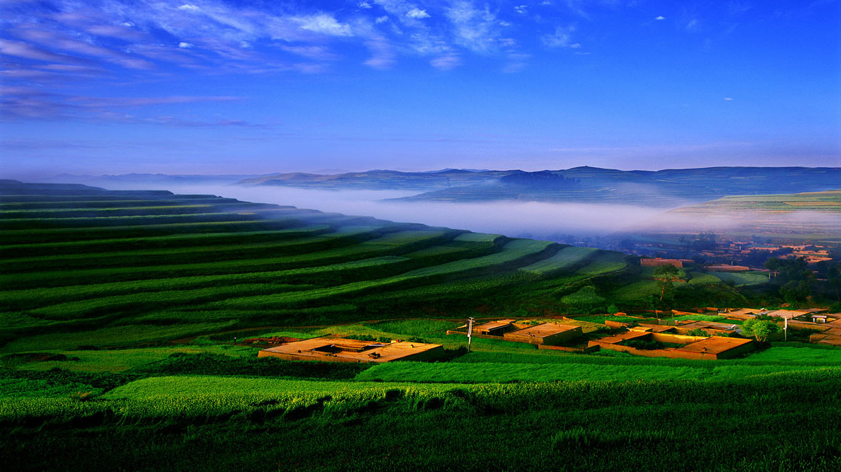
各段情节设计
本文难点：1. 文本内容比较难懂，词汇的要求很高。 2. 要解决的冲突与明显的问题和困境不同，是内心的挣扎与纠结形成了冲突，关键是如何克服这种内心的冲突。 3. 原文已经给出了如何克服内心冲突的方法---通过体验来解决内心冲突，并获得个人成长与感悟。由此判断，主角主动通过体验去解决内心冲突。所以老师只是帮助她如何进行体验，只起到间接作用。
Para1: The process took patience and precision.
Para2: Admiring her work, Alia suddenly realized drawing was just what she had hoped for.
首段情节设计：描述Alia 学画的过程，借用原文本P4-P5两段的绘画细节，进行创造性改写，增强与原文的协同性。根据Patience and precision , 重点描述一下Alia 沉浸在画画的世界，对于艺术和科学的共性产生了新认识。结合二段首句，可知该课结尾Alia 努力或耐心得到了回报。她画出了自己的自画像！

Slide 20
Para1: The process took patience and precision.
Para2: Admiring her work, Alia suddenly realized drawing was just what she had hoped for.
二段内容设计：
回扣第一段，描写肖像画完成后的内心的改变—内心冲突的化解—爱科学的同时，爱上了画画（艺术）；
通过画肖像画的体验过程，感受到科学与艺术的相似之处，借用所给段落首句关键词patience and precision 进行回扣；
成长---体验中成长与体验后的成长。

Slide 21
Deal with three links and the ending of the continuation
Taking a deep breath, Alia began her own self-portrait. She drew the basic form of a head, the way she had been shown. From there, she used lines to plot the features of her face. She had to take note of each detail, with each stroke, line and curve demanding her close attention. One wrong measurement could throw off the whole portrait.
Para1: The process took patience and precision.
Link1: When dealing with each delicate stroke on the canvas, Alia focused her eyes on every detail of herself in the mirror.

Slide 22
Para1: The process took patience and precision.
…
Link2: With details added, a lifelike drawing/ sketch of herself/ a self-portait took form/ appeared on the canvas just before her eyes. It was just unbelievable/ incredible. Her patience paid off!
Para2: Admiring her work, Alia suddenly realized drawing was just what she had hoped for.

Slide 23
Para1: The process took patience and precision.
…
Para2: Admiring her work, Alia suddenly realized drawing was just what she had hoped for.
Link3:
①Sitting in the drawing studio, Alia no longer felt like a cat in a dog show. Instead, she took to art like a duck to water.
② Never had Alia imagined that simple elements like lines, triangles, curves could form a drawing reflecting all her facial features.

Slide 24
Para1: The process took patience and precision.
…
Para2: Admiring her work, Alia suddenly realized drawing was just what she had hoped for.
Link3:
③ （主语切换到老师：回扣一下第三段开头句—这一次老师很震惊---Alia 一点就通，夸张一下她的天赋） Her teacher happened to come up to Alia's easel（画架） // happened to stop by her easel, stunned to see Alia’s gift for art!

Slide 25
Para1: The process took patience and precision.
…
Para2: Admiring her work, Alia suddenly realized drawing was just what she had hoped for.
Link3:
④（利用Admiring 来回扣原第二段Confusion and reluctance )
Delight and excitement were apparently / evidently written on her face as she found increasing confidence in proceeding with every stroke.

Slide 26
Para1: The process took patience and precision.
…
Para2: Admiring her work, Alia suddenly realized drawing was just what she had hoped for.
Ending: ①Thanks to the forced/ compelled choice, Alia had a chance to experience art and ended up in falling in love with it. The art class also taught Alia a valuable lesson ---Don’t assume you won’t like something before you try it/ experience it.

Slide 27
Para1: The process took patience and precision.
…
Para2: Admiring her work, Alia suddenly realized drawing was just what she had hoped for.
Ending:② The valuable experience was engraved in Alia’s heart for ever. Whenever she encountered an opportunity that she seemed unwilling to take, her teacher’s words would echo in her ears ---Go ahead and give it a try.

Slide 28
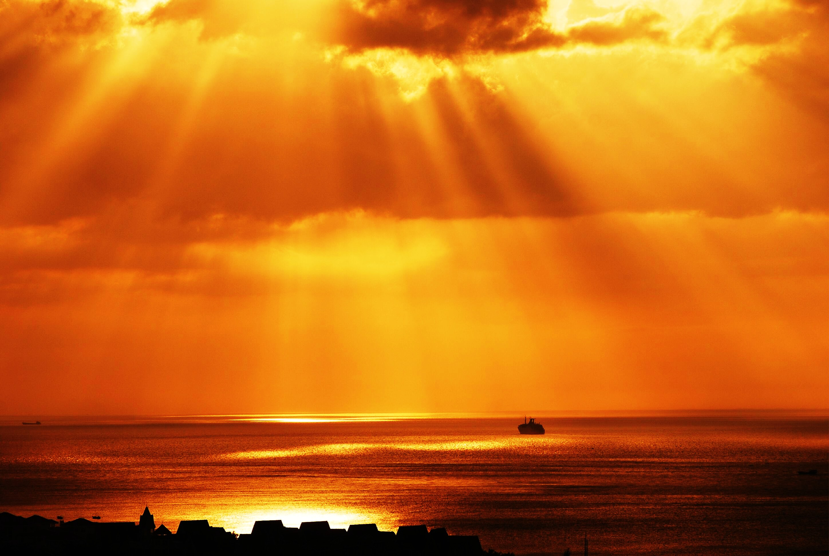
1. 平行衔接 （叙事对象一致+ 同一个角色的各种动作，情感体验等）
2. 交叉衔接 (叙事对象交叉+原故事出现的可以出场的角色言行与情感）
首段叙事逻辑处理
Para1: The process took patience and precision.
(When-从句简化: 呼应process+回扣原文尾段close attention )
When dealing with each delicate stroke on the canvas, Alia focused her eyes on every detail of herself in the mirror.
2. (非谓语：细致描写专心画自画像的场景）
To ensure that every stroke could capture/ represent the features of her own image, she carefully outlined her self- portrait by measuring the angles, the lines and the distance between and curves.

Slide 29
3. （ As 时间状语从句： 耐心专注带来的心理感受）
Time seemed to slow down as Alia immersed herself in the dance between pencil and canvas.
4. （As 方式状语从句：Alia 的对于笔画处理的变化+回扣老师的示范成果）
Gradually, Alia got accustomed to using her pencil to proceed with her strokes, just as her teacher previously demonstrated.

Slide 30
5. ①（非谓语Done 短语：+ 回扣前一句every stroke 的功效—构成了自画像）
Put together on the canvas, every stroke, line and curve composed the her self portrait.
②（定从：+回扣第四句）
A circle , some straight lines and a triangle composed a self-portrait in a magic way, which aroused Alia’s interest in drawing.

Slide 31
6. （比较级：专心致志时的惊叹！---艺术与科学同样精妙）
“Art needs as much precision , patience and focus / concentration as science!” she suddenly exclaimed excitedly .
7. （With 结构+无灵主语句：自画像在细节添加后，跃然纸上）
With details added, a lifelike drawing/ sketch of herself took form/ appeared on the canvas just before her eyes.
（无灵主语句： 耐心终有回报）
It was just unbelievable/ incredible. Her patience paid off!

Slide 32
1. 平行衔接 （叙事对象一致+ 同一个角色的各种动作，情感体验等）
2. 交叉衔接 (叙事对象交叉+原故事出现的可以出场的角色言行与情感）
二段叙事逻辑处理
Para2: Admiring her work, Alia suddenly realized drawing was just what she had hoped for.
1+2. （Doing 非谓语：回扣原文第一段进行逆向创作）
Sitting in the drawing studio, Alia no longer felt like a cat in a dog show. Instead, she took to art like a duck to water.
3. （简单句：平行主语Alia 改变了对画画的最初看法）
Now Alia completely changed her initial opinion about art.

Slide 33
4. （What 主从 +that 表从+定从：描述体验完成自画像后的心理感受）
What she never expected was that art is involved in science and needs to be as precise as science, with which Alia was fascinated.
5+6. （虚拟语气： 回扣原文第一段进行逆向创作---流感反而让她有机会发现自己真正热爱的东西。）
Alia even felt blessed to find herself in the drawing studio. Without the flu, she couldn’t have chosen art.

Slide 34
7. （介词短语+二连动：有幸体验画画并爱上它）
Thanks to the forced/ compelled choice, Alia had a chance to experience art and ended up in falling in love with it.
（无灵主语句：画画课教了Alia 宝贵的一课）
The art class also taught Alia a valuable lesson ---Don’t assume you won’t like something before you try it/ experience it.

Slide 35
习作欣赏
Para1: The process took patience and precision. When dealing with each delicate stroke on the canvas, Alia focused her eyes on every detail of herself in the mirror. To ensure that every stroke could capture the features of her own image, she carefully outlined her self-portrait by measuring the angles, the lines and the distance between lines, curves. Time seemed to slow down as Alia immersed herself in the dance between pencil and canvas.Gradually, Alia got accustomed to using her pencil to proceed with her strokes, just as her teacher previously demonstrated. A circle , some straight lines and a triangle composed a self-portrait in a magic way, which aroused Alia’s interest in drawing. “Art needs as much precision , patience and concentration as science!” she suddenly exclaimed excitedly .With details added, a lifelike drawing of herself took form on the canvas just before her eyes. It was just unbelievable/ incredible. Her patience paid off!

Slide 36
Para2: Admiring her work, Alia suddenly realized drawing was just what she had hoped for. Sitting in the drawing studio, Alia no longer felt like a cat in a dog show. Instead, she took to art like a duck to water. Now Alia completely changed her initial opinion about art. What she never expected was that art is involved in science and needs to be as precise as science, with which Alia was fascinated. Alia even felt blessed to find herself in the drawing studio. Without the flu, she couldn’t have chosen art. Thanks to the forced/ compelled choice, Alia had a chance to experience art and ended up in falling in love with it.
The art class also taught Alia a valuable lesson ---Don’t assume you won’t like something before you try it/ experience it. 或者---Go ahead and give it a try.

Slide 37
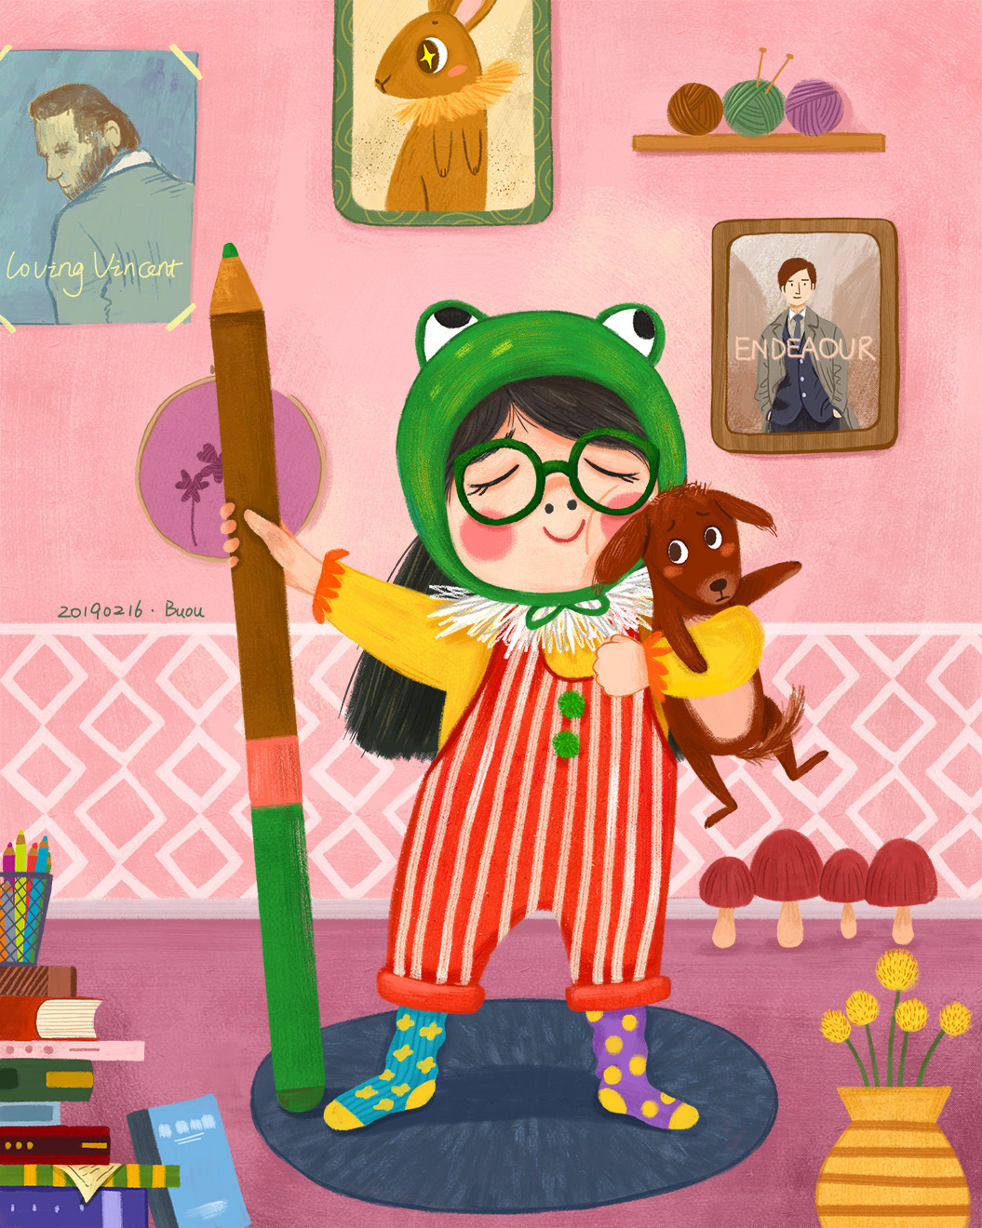
Don’t assume you don’t like something before you try it.

