Slide 1


感恩遇见，相互成就，本课件资料仅供您个人参考、教学使用，严禁自行在网络传播，违者依知识产权法追究法律责任。
更多教学资源请关注
公众号：溯恩英语
知识产权声明

Slide 2
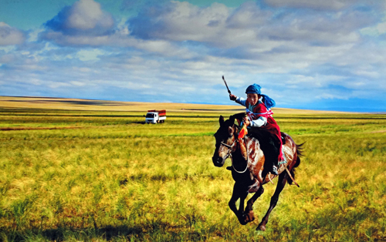

B3U1 Reading for Writing
My amazing Naadam experience
What does “Naadam” mean?
“Naadam” means “games” in Mongolian.

Slide 3
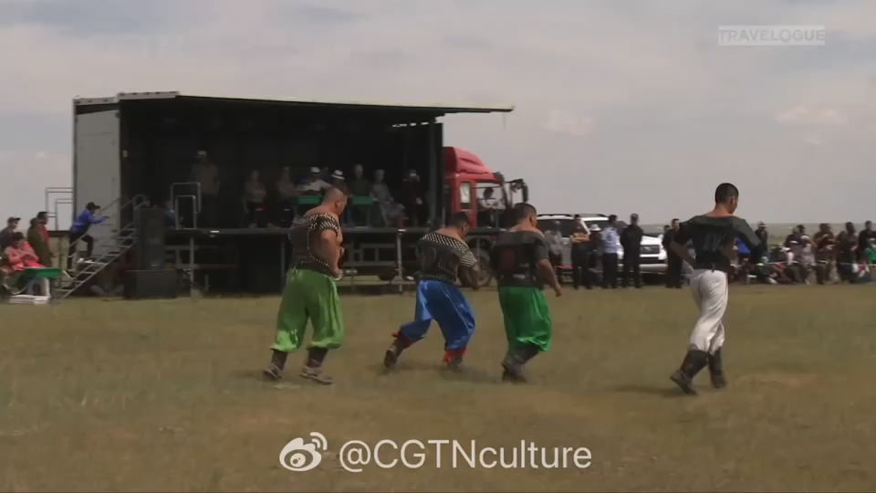
What activities will locals do during Naadam Festival?
wrestling

Slide 4
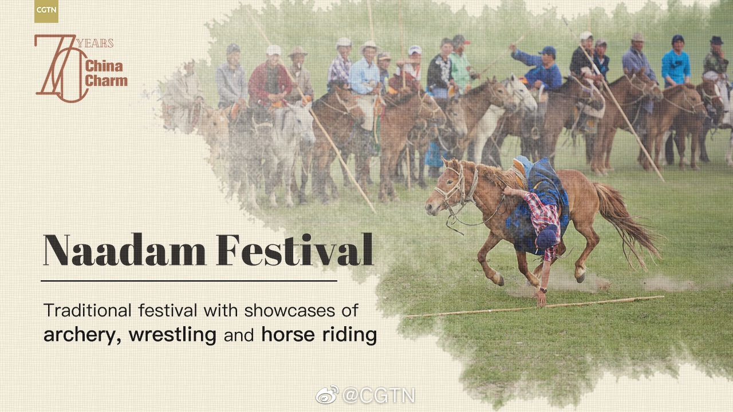
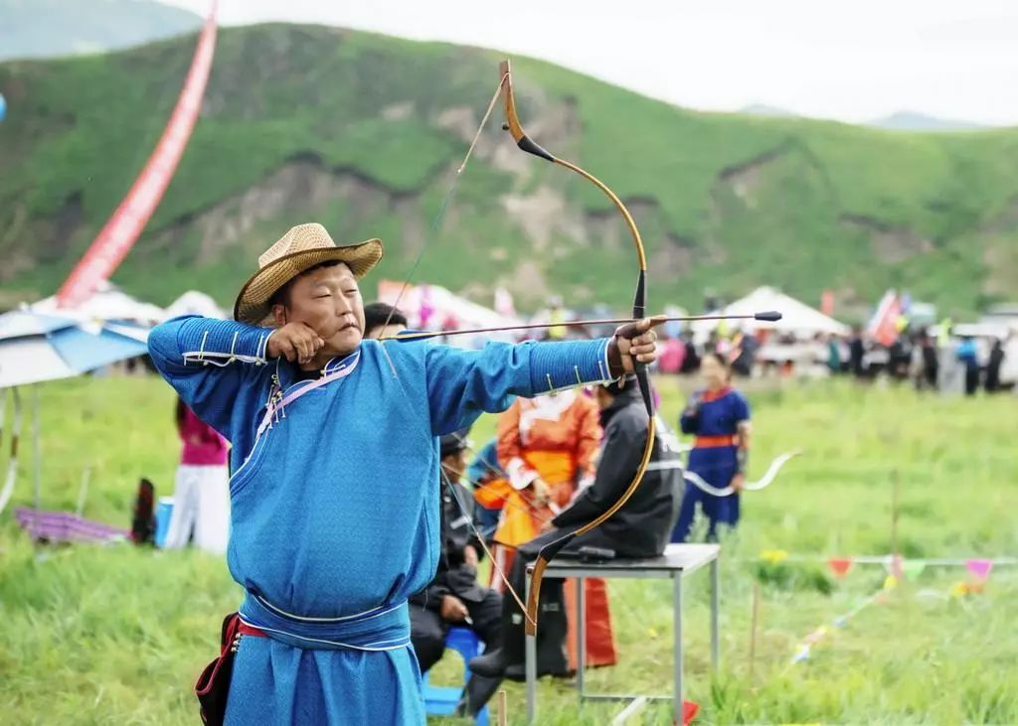
archery
horse racing

Slide 5
Pre-reading
Text type
It’s a narrative.
A diary entry
Time order
Place
Characters
Tense
Activities/events
Feelings
…….
Text features
Content
It’s a narrative about the author’s Naadam experience.
main idea

Slide 6
Introduction: learn more details about Naadam Festival
Aspects | Details | Useful expressions
Region (where)
Date (when)
Activities (what)
Inner Mongolia Autonomous Region
I experienced…in…
fourth day of the sixth month of the lunar calendar
The festival falls on…, usually lasting for…
Horse racing, wrestling and archery
It is represented by…
Feelings
(How)
…which are all so exciting to watch
Excited

Slide 7
Reading
Naadam Festival
The name of the festival/celebration:__________________
Time order | Details | Author’s feelings
1. I set off …with …
2. saw people wearing… Some were feeding...some were practicing…others were chatting or taking
exciting to watch…
On the first day…
amazed
1. The wrestling competition began.
2. I absolutely enjoy the archery,
too, but the horse racing were my
favorite part.
After the opening ceremony and
performances…
moved
surprised
worried
understandable
I’m finally back home now…
He invited me back… for winter…
I can’t wait.
tired, but worth it.

Slide 8
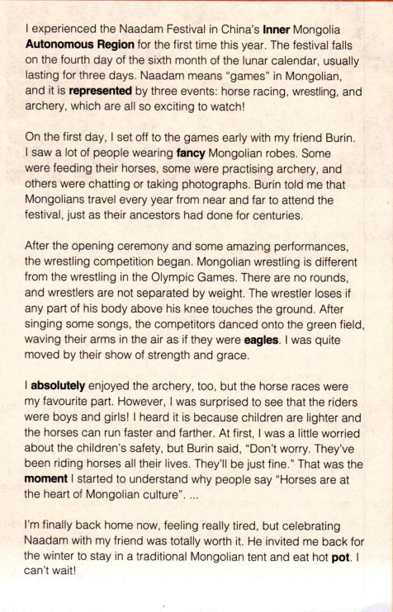
Structure Analysis
Now, read the diary entry again and analyze its structure.
Para. 1:
State the topic:
(when, where and with
whom and main feelings)
Opening para.
First body para.
Para. 2:
Describe the start of the festival and the surroundings.
Second body para.
Para. 3:
Describe in detail the festival activities.
Para. 4:
Third body para.
Para. 5:
Give a brief summary of the experience.
Closing para.

Slide 9
Conlusion
What should be included in wrting a diary?
opening
topic
feelings
body
activities
feelings
closing
summary
feelings
Title
when
where
who
what
the present tense
the future tense
past tense

Slide 10
Language study
My amazing Naadam experience

Slide 11
How did the writer describe his/ her feelings/ emotions during the event?
...and it is represented by three events: horse racing, wrestling, and archery, which are all so exciting to watch.(Para1)
After the opening ceremony and some amazing performances, the wrestling competition began. (Para2 )
However, I was surprised to see that the riders were boys and girls! (Para4)
At first, I was a little worried about the children’s safety. (Para4)
I’m finally back home now, feeling really tired, but celebrating with Naadam with my friend was totally worth it. (Para5)
Tip1: using -ing/-ed
to express emotions

Slide 12
I absolutely enjoyed the archery, too (Para5)
I’m finally back home now, feeling really tired, but celebrating with Naadan with my friend was totally worth it. (Para5)
He invited me back for the winter to stay in a traditional Mongolian tent and eat hot pot. I can’t wait!(Para5)
Tip2: using adj./adv. or other ways to express emotions

Slide 13
Para 1
1. The speech competition will begin at 8:00 am and end at 12:00.
The speech competition will begin at 8:00, and last for four hours.
The speech competition will begin at 8:00, ________ (last) for four hours.
lasting
The festival falls on the fourth day of the sixth month of the lunar calendar, usually __________(last) for three days.
lasting
fall vi. to happen or take place发生
Her birthday falls on a Monday this year.
今年她的生日适逢星期一。

Slide 14
Para 2
1. On the first day, I set off to the games early with my friend Burin.
1) set off=set out 出发
2） to make an alarm start ringing
使（警报）响起；拉响（警报）
Opening this door will set off the alarm.
一开这道门，警铃就会响。
3）explode 使. …爆炸
set off fireworks 燃放烟花

Slide 15
Para 4
I __________(absolute) enjoyed the archery, too.
absolutely
absolutely adv. used to emphasize that something is completely true
（强调真实无误）绝对地，完全地

