Slide 1


感恩遇见，相互成就，本课件资料仅供您个人参考、教学使用，严禁自行在网络传播，违者依知识产权法追究法律责任。
更多教学资源请关注
公众号：溯恩英语
知识产权声明

Slide 2
2024年3月浙江省温州市二模应用文
帖子——寻找city walk搭子
GDUFS felc 郭烨辉
2024.3

Slide 3
目录
01
审题分析与评价
02
分段建构与语料
03
例文评价与提升
04
语篇对比与迁移

Slide 4
审题分析与评价
01

Slide 5
原题呈现
假定你是李华，暑期想在家乡（杭州）寻找外国友人结伴“城市漫步”，请通过社交媒体发布一篇帖子，内容包括：
1.相关介绍
2.旅伴要求
注意:
1.写作词数应为 80 左右:
2.请按如下格式在答题卡的相应位置作答。
Join Me in a City Walk

Slide 6
试题简要评析
创新度: 这道题要求用英语发帖招募外国友人，并非传统信件，增加了新颖的写作场景和受众，提高了试题的实用性。
交互性: 要求用英语与外国友人进行网络虚拟情境的互动交流，不只是单向输出，体现了语言的交际功能。
综合性: 需要综合运用多项能力，包括对杭州的了解、跨文化交际能力、英语综合运用能力等，是一个贯穿多个领域的综合性任务。
语用能力: 要求根据不同语境调整语气语风，如介绍时保持客观、招募时吸引人，体现了语用能力的重要性。
创意思维: 对"城市漫步"这种新型方式的创意表达和运用，体现了创新思维能力。

Slide 7
破解题目信息
文体体裁 | 帖子
写作人 | 李华（杭州本地人）
目标读者 | 外国网友
写作背景 | 在社交媒体上寻找暑期杭州城市漫步的“搭子”
写作目的 | 找到一位在“city walk”上志同道合的外国友人，共同感受杭州城市魅力。 注意：邀请城市漫步的未来发生的事，即提前找好搭子；注意帖子的写作语言。
人称时态 | 第一人称 | 第二人称 | 一般现在时 | 一般将来时

Slide 8
框架形成
首段吸引网友兴趣
01
结合帖子的特殊写作情境，要用生动有趣的开场白或提问等方式,抓住读者眼球,激发他们的兴趣和好奇心。因为网络信息比较冗杂，需要设计一些比较attractive的开头段，该部分写作空间比较大。
次段述主体
02
第二段是整篇帖子的核心部分，也就是所说的“主体”（body），在这段中，必须紧密围绕题干给出的要点进行写作，即围绕“相关介绍”“旅伴要求”两大维度，添加细节丰富内容；字数控制在四句话左右，可各自分配两句话，该部分对语言精炼要求较高。
尾段表期待
03
根据题目要求，作为帖子，可以增加交互性的语言，比如“Interested? Please…………”随即给出联系方式，让感兴趣的旅伴联系自己，期待与外国友人分享和交流的心情。

Slide 9
分段建构与语料
02

Slide 10
首段写作——Eye-catching Expressions&Skills
Q1:首段如何结合帖子特点，吸引人来关注？
共同点：突出时间、人物、地点
自身优势
Do you know there's a different way to experience Hangzhou - beyond the famous West Lake? Are you willing to experience a soulful and impressive journey under the guide of a local this summer break?
Skill 1 : 疑问发端
设置悬念
Hey This Li hua, a local of Hangzhou. I am looking for some foreign friends to join me in exploring the fascinating city of Hangzhou this summer!
Skill 2 : 感叹
+个人姓名放首句
Wander around Hangzhou, one step at a time! Are you an adventurous soul seeking to explore a city rich in history and culture?
Join me, Li Hua, an native, on an unforgettable "city walk" through the charming streets of my beloved hometown this summer.
Skill 3 : 感叹句+ 疑问句结合

Slide 11
要点写作1——Relevant Description
Q2:结合题干，相关介绍这个要点的核心是什么？
根据发帖目的，介绍的重点可以放在即将进行的"城市漫步"活动本身，也就是时间、游览地点、人物，突出这种体验的独特性和魅力，从而吸引外国友人加入。
Option①：不确定性——从city walk本身特征出发
我们的 "城市漫步 "不会遵循死板的路线。相反，我们将按照自己的节奏在杭城漫步，让好奇心和个人兴趣引导我们的脚步。
Our "city walk" won't follow a ______ route. Instead, we'll _________ at our own pace, letting curiosity and personal interests guide our steps.
rigid
meander
It'll be a great opportunity to experience the rich culture, history, and cuisine that Hangzhou has to offer.

Slide 12
要点写作1——Relevant Description
Q3:结合题干（杭州），暗示了什么？
根据对家乡（杭州）的隐性提示，可以在介绍中提及杭州城市的一些景色，从而也可以让city walk更加具有确定性和体验感。可以穿插一些杭州的地理位置、人文特色等背景信息,唤起读者对这座城市的向往和好感。利用杭州的知名景点、特色小吃等元素,勾勒出独特的城市形象。
Option②：半确定性——介绍本次城市漫步的景点特色
这不仅是一次观光之旅，更是一次沉浸于杭州真正精髓的机会--它充满活力的文化、热情好客的待客之道和经久不衰的传统。一路上，前一刻，我们可能会欣赏西湖美景；下一刻，我们可能就会在城市小巷目睹传统手工艺品的展示了。
immerse
More than just sightseeing, this is an opportunity to ___________ yourself in the true essence of Hangzhou – its vibrant culture, warm ________________, and enduring legacy.
Along the way, one moment, we might find ourselves admiring the West Lake（行程1）; the next, we may be witnessing a traditional handicraft demonstration in the alleys of the city（行程2）.
hospitality

Slide 13
要点写作2——Requirements for buddies
Q4:在表达这个要点时，用什么句式相对比较好？
Eg1: The ability to communicate comfortably in English is crucial for sharing insights throughout our adventures.
相对正式严肃
Eg2: While our pace will be leisurely, some level of physical fitness may be required as we'll be exploring the city on foot.
要求比较委婉
Eg3: If you're eager to delve into Chinese culture, open to embracing new perspectives and social interactions, I can't wait to await your contact!
非常得体委婉

Slide 14
要点写作2——Requirements for buddies
Q5:在表达这个要点时，可以从什么角度出发？
也可以体现结伴的双赢影响，英语能力的锻炼，友谊的建立，思想文化的交流等
√Open-mindedness and cultural curiosity
√Sense of adventure and flexibility
√Ability to communicate in English
√Respect for local culture
√Enthusiasm for social interactions

Slide 15
结尾段写作
进一步深化交际功能，提供进一步联系方式
帖子的结尾还是比较形式化的，主要目的是再次发出寻找搭子的期望，希望对方联系自己。篇幅可以较短，可以放在旅伴要求的后面，可以不单成一段。
To express your interest or ask any questions, feel free to reach out to me via email or send private messages to me . I'm excited to connect with fellow explorers and craft an authentic, one-of-a-kind experience together.
Interested? Email me at lihua111223@email.com to secure your spot on this unforgettable journey.
Let's create unforgettable memories together while soaking up the essence of this captivating city.

Slide 16
例文评价与提升
03

Slide 17
官方范文
Join Me in a City Walk
自身优势
Hey everyone! This is Li Hua , a travel enthusiast from Hangzhou, I'm on the lookout for some foreign friends to join me in exploring the fascinating city of Hangzhou this summer.
Our city walk will take us into the heart of Hangzhou, where we'll wander through bustling streets and unfrequented alleys, sample must-try local cuisine,and even try our hand at time-honoured handicrafts, If you're a native English speaker with an appetite for adventure, join me and we'll see a blend of tradition, modernity and endless discoveries.
I can assure you that exploring a city with a local will be the last decision you'll come to regret, If interested, send me a message and let's together hit the road!
写信目的
介绍
要求
进一步交际

Slide 18
学生例文
Join Me in a City Walk
Hi, everyone！I’m Li Hua from Hangzhou. Eager to explore the hidden gems awaiting discovery, I’m earnestly expecting to take a city walk here with an foreign friend this summer.
Hangzhou, hailed as the paradise on earth, boasts a galaxy of historically reputed sites, ranging from the bracing West Lake to the antiquely serene LingYin Temple, where you could fully immerse in its timeless charm of beauty and faith behind. Apart from that,I would like to acquaint you with the inclusive local culture through savoring tasty cuisine, sharing some intriguing stories or legends amidst the hustle and bustle of urban street life.
If you are fluent in English, retain enthusiastic in discovering new places and open-minded for cultural exchange, please feel free to leave a comment or message me. Let’s create unforgettable memories together!
作者语言能力很强，全文要点详细，逻辑较为清晰，但是开头语言风格比较正式，类似信件，建议开头段作简单修改。

Slide 19
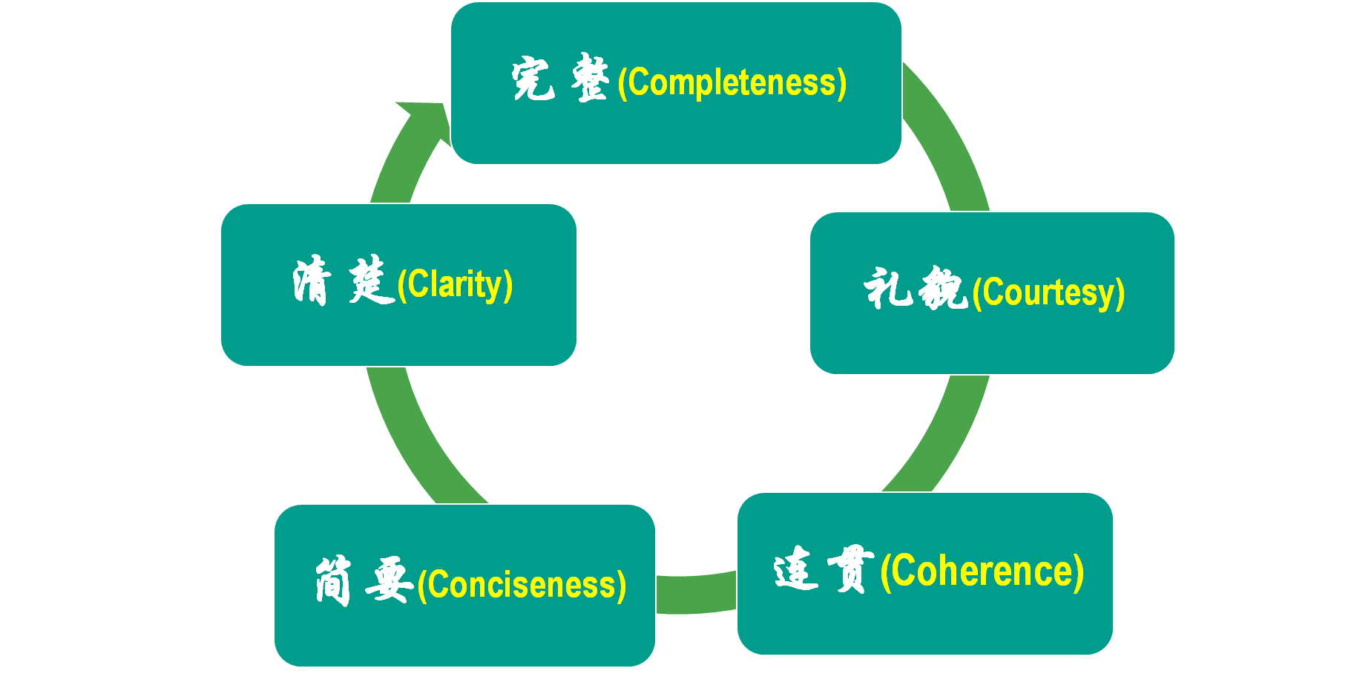
开头段修改
Hey there! I’m Li Hua, a native from Hangzhou. I am earnestly expecting to take a city walk with an foreign buddy this summer vacation.
After reading these excellent compositions, please note down the materials that will be useful to your writing. Then revise and polish your own articles according to the following 5 aspects of reference.

Slide 20
语篇对比与迁移
04

Slide 21
类似题材：Z20 联考(二）
假定你是李华，上周末你参加了学校组织的市科技馆研学活动。请你在校英文论坛发表一篇帖子，分享此次经历，内容包括：
1.活动过程；
2.个人感悟；
3.期待评论。
注意：
1.写作词数应为 80 左右；
2.请按如下格式在答题卡的相应位置作答。
An Unforgettable Tech Exploration Tour
______________________________________________________________________________________________________________________________________________

Slide 22
参考范文
An Unforgettable Tech Exploration Tour
Last weekend I participated in a fabulous tech exploration tour in the city science museum organized by our school.
It kicked off with an exhibition of the history of Chinese science, unfolding the awe-striking wisdom behind. What followed was a hands-on experience, which uncovered the secrets of science. With a lecture on the prospect of science, the tour was brought to an end. Not only did the tour instill me with a sense of pride in our scientific advances, but it also planted in my heart a seed of scientific exploration.
Anybody who shares the same feeling? Anticipating your comments!
范文点评：
本篇范文首句开门见山直入主题，间接明了；中段描述活动过程条理清晰，使用很多表示先后关系的逻辑性词，对活动事项的描述很有深度，在阐发个人感受时上升到家国情怀的维度，具有写作格局，尾段期待评论的语气和态度自然而亲切。

Slide 23
类似话题：2023.12强基联盟
假定你是李华，你的外国朋友Daniel正在你的城市旅游。请写封邮件邀请他与你一起进行一次城市漫步（city walk），内容包括：
1.发出邀请；
2.介绍行程。
注意：
1.写作词数应为80左右；
2.请按如下格式在答题卡的相应位置作答。

Slide 24
参考范文
Dear Daniel,
I hope you’re having a wonderful time touring our city. You told me earlier that you are free this Sunday, so maybe we can do a city walk to explore some lesser-known sites and experience the authentic lifestyle here.
Here is my plan. We’ll meet at 9:00 am, at the old pagoda near my school to admire the beautiful architecture and soak in its cultural grandeur. Then, we can head to the ruins of the city wall built around 2,000 years ago, and feel first-hand the weight of history. Our next stop will be an ordinary bridge decorated with delicately carved stone lions, whose distinct facial features and vivid expressions will blow you away! After that, we can hitthe snack street to sample some street food and browse the unique handicrafts, some of which can make perfect souvenirs!
This city walk will make your trip truly complete. I really want to spend this Sunday with you and discover these hidden gems together. So, are you in?
Yours sincerely,
Li Hua

