Slide 1


感恩遇见，相互成就，本课件资料仅供您个人参考、教学使用，严禁自行在网络传播，违者依知识产权法追究法律责任。
更多教学资源请关注
公众号：溯恩英语
知识产权声明

Slide 2


高三宁波十校英语
2024.03
Spring is the season of promises and anticipation.
客 观 题 解 析
Fay

Slide 3
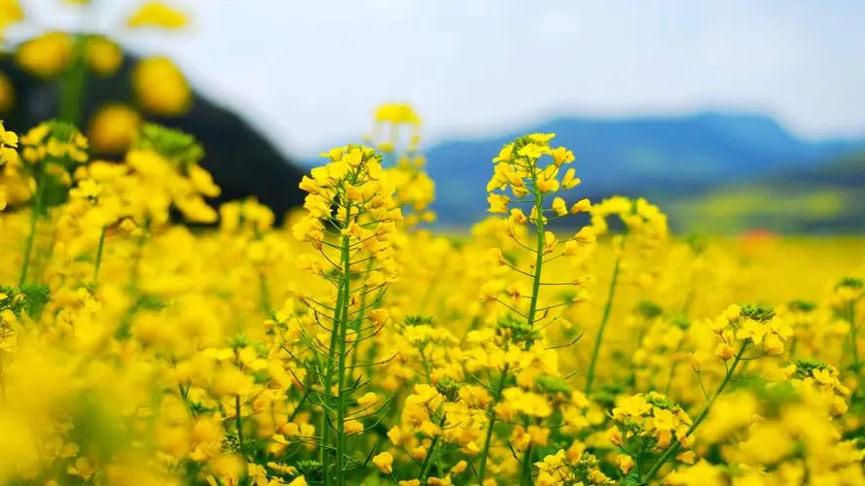
阅 读 理 解
comprehension

Slide 4


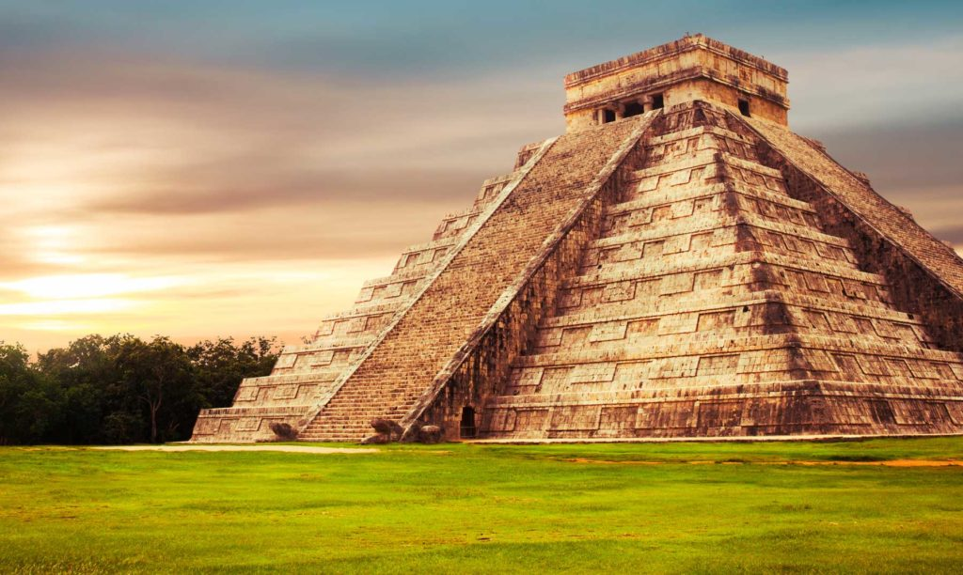
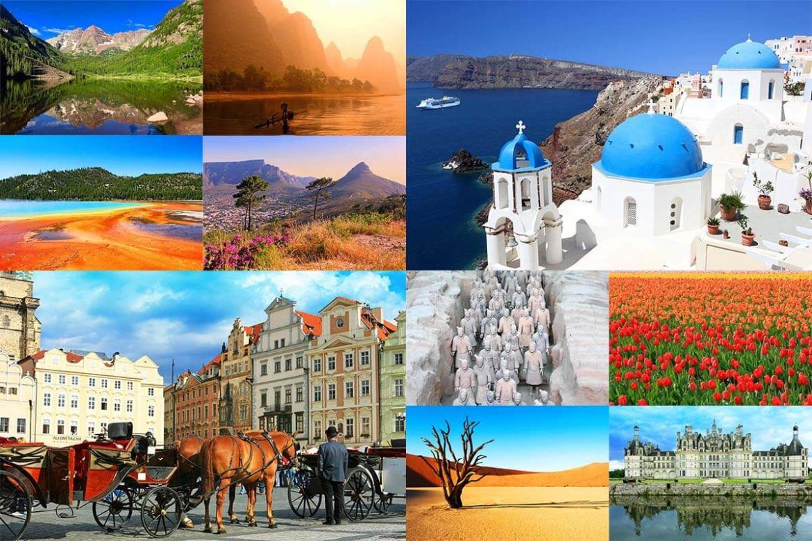
The world awaits.
Where will you go next?
The following are among the most exciting destinations to visit.
Grab your bags and go!

Slide 5
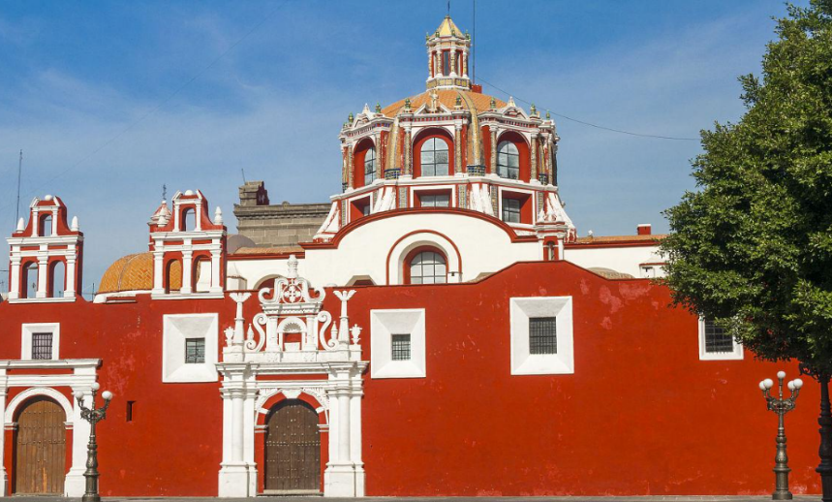

A
Puebla, Mexico
Founded in 1931, the Mexico’s fourth-largest city is a stronghold of Baroque architecture. In Puebla’s city center, a UNESCO World Heritage Site, there are a large number of gorgeous 17th- and 18th-century Baroque buildings. Many are decorated with colored titles, the use of which illustrates the combination of Puebla’s local and European colonial styles. In 2017, an earthquake shook the area, leading to restorations of facilities throughout the city afterward. Despite that, Puebla remains rooted in tradition.
一成不变；始终如一
21. Where can tourists enjoy architecture exhibiting a combination of native and foreign styles?
Guatemala.
B. Göbekli Tepe, Turkey.
C. Puebla, Mexico.
D. Telč, Czech Republic.

Slide 6
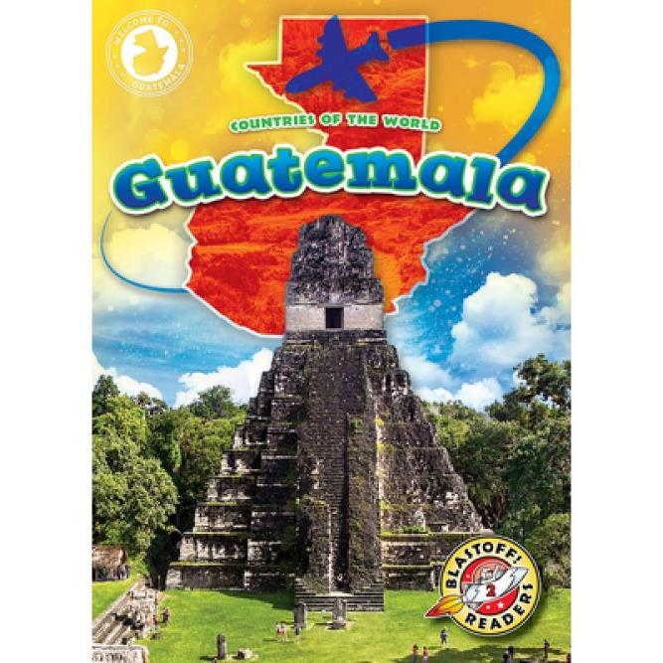

Guatemala
Archaeologists have found long-hidden ruins of an extensive pre-Columbian civilization here, confirming that Guatemala is the place to dive into Mayan culture, then and now. Ancient roots run particularly deep in the northernmost Petén region. In modern, multicultural Guatemala, people with Mayan origin make up about half the population, making the country the only one in Central America with a native cultural majority.
22. What has made Guatemala special?
A. The long-hidden ruins.
B. The deeply rooted Mayan culture.
C. The modern and multicultural society.
D. The only Central American country with Mayan population.

Slide 7
Puebla, Mexico
Founded in 1931, the Mexico’s fourth-largest city is a stronghold of Baroque architecture. In Puebla’s city center, a UNESCO World Heritage Site, there are a large number of gorgeous 17th- and 18th-century Baroque buildings. Many are decorated with colored titles, the use of which illustrates the combination of Puebla’s local and European colonial styles. In 2017, an earthquake shook the area, leading to restorations of facilities throughout the city afterward. Despite that, Puebla remains rooted in tradition.
Telč, Czech Republic
The storybook town was probably founded in the mid-14th century. Stone walls and a system of man-made ponds help protect Telč historic town center, a UNESCO World Heritage Site. The triangular market square is bordered by a rainbow of light-colored houses, which were originally built of wood and rebuilt in stone after a fire in the late 14th century.
Göbekli Tepe, Turkey
Estimated to date back to the 10th-9th millennia B.C.E, the monumental limestone pillars at Göbekli Tepe had been hiding in plain sight for several thousand years. The detailed exploration of these giant stones only began in the 1990s. What have been revealed—primarily massive stones decorated with bas-reliefs (浅浮雕) of animal—comprise the world’s oldest known temple complex. The extraordinary discoveries made here have rewritten the story of how the first civilizations began.
Guatemala
Archaeologists have found long-hidden ruins of an extensive pre-Columbian civilization here, confirming that Guatemala is the place to dive into Mayan culture, then and now. Ancient roots run particularly deep in the northernmost Petén region. In modern, multicultural Guatemala, people with Mayan origin make up about half the population, making the country the only one in Central America with a native cultural majority.
23. According to the text, what do the above destinations have in common?
A. They have historic sites. B. They are in Central America.
C. They were once destroyed by fire. D. They were discovered in recent decades.

Slide 8

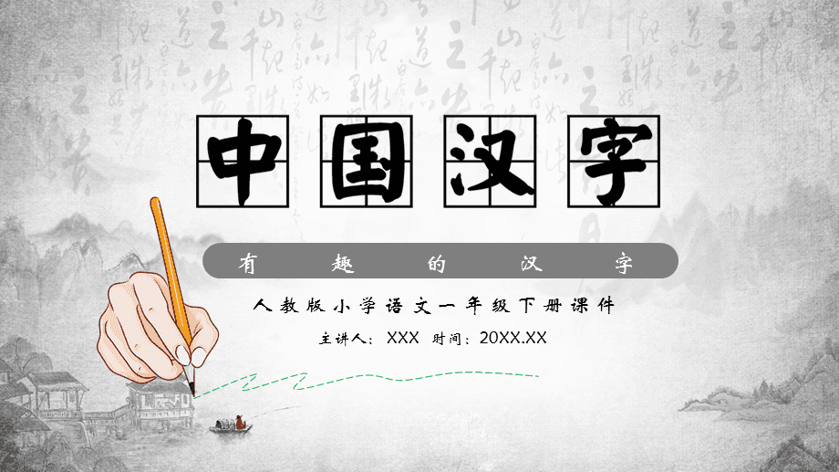
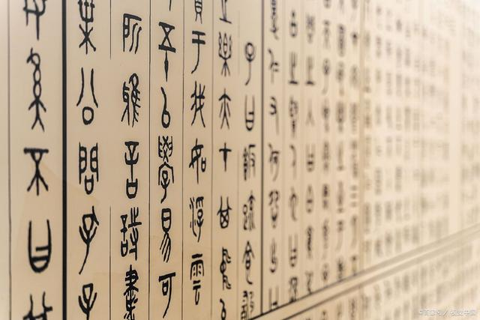
One of the earliest forms of writing which is still being used today is Chinese characters, or hanzi.

Slide 9
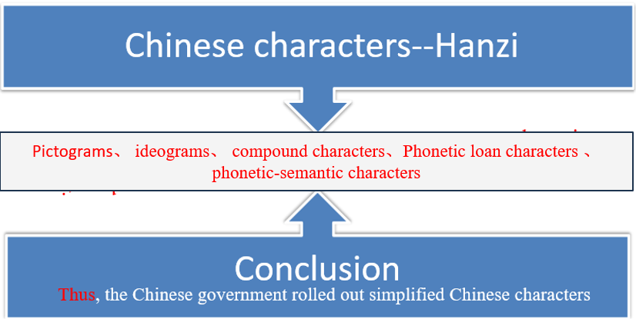
B
One of the earliest forms of writing which is still being used today is Chinese characters, or hanzi. The image that many people have of Chinese characters is that they are all pictograms, but this is far from the case because pictograms have very limited use. Simple pictograms might be practical, for example, if one is making a shopping list of items to buy at the store, but they are fairly useless if one is writing something more complex or abstract. So it is a mistake to assume that written Chinese is a “picture language”.
Besides pictograms, there are simple ideograms. These are characters which provide an abstract picture of an idea, but in an often easily recognizable form. For example, “up” is “上” while “down” is “下”. While the meanings of many ideograms are not this easy to work out, they tend to be simple, easy-to-remember characters which are commonly used.
Next we have a common category of hanzi: compound characters. These are where elements of two or more characters are combined in one character for a new meaning. Some of these are easy to understand. In many cases, however, the meanings of compound characters are more difficult to work out.
Phonetic loan characters are the characters which started out as pictograms. However, they were often used to mean other words that had the same pronunciation. A good example of this is “目”. While it can be used in modern Chinese with the meaning “eye”, it is most often used to mean “an item on a list”. The reason was that Chinese had a word for “an item on a list” but lacked a character for it, so the word took the character “目”, a character with the same pronunciation.
A final category of Chinese characters is by far the most common. These are phonetic-semantic characters. With phonetic-semantic characters, one element of each character gives a clue to the pronunciation, while the other gives a clue to the meaning.
Over the centuries, Chinese characters have continually been developed, with a trend towards the simple and more abstract. It was thought that the complexity of some Chinese characters was keeping people from being able to learn them. Thus, during the 1950s and 1960s, the Chinese government rolled out simplified Chinese characters.

Slide 10
One of the earliest forms of writing which is still being used today is Chinese characters, or hanzi. The image that many people have of Chinese characters is that they are all pictograms, but this is far from the case because pictograms have very limited use. Simple pictograms might be practical, for example, if one is making a shopping list of items to buy at the store, but they are fairly useless if one is writing something more complex or abstract. So it is a mistake to assume that written Chinese is a “picture language”.
Next we have a common category of hanzi: compound characters. These are where elements of two or more characters are combined in one character for a new meaning. Some of these are easy to understand. In many cases, however, the meanings of compound characters are more difficult to work out.
24. Why are pictograms sometimes not practical for use in a writing system?
A. They are only available for shopping.
B. They are too complex for people to learn.
C. They cannot convey abstract ideas very well.
D. They are quite complicated and difficult to write.
25. What do we know about compound characters according to the passage?
A. They are drawings of objects used in a writing system.
B. They are characters which use elements of two or more characters.
C. They are characters used in a writing system to convey abstract concepts.
D. They are characters which give clues to both the meaning and pronunciation.

Slide 11
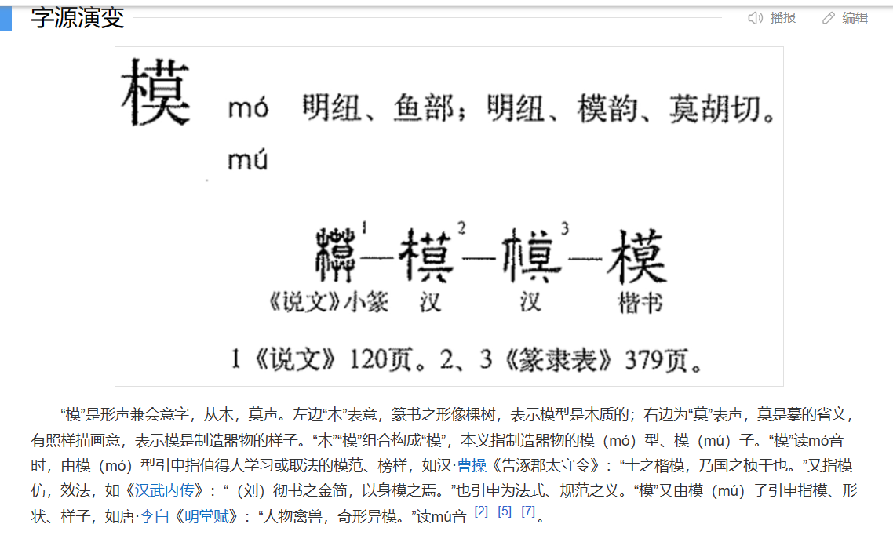




26. Which of the following categories does the character “模” belong to?
A. Pictograms. B. Phonetic loan characters.
C. Ideograms. D. Phonetic-semantic characters.
characters which provide an abstract picture of an idea
表意字
上 下
elements of two or more characters are combined in one character for a new meaning
囍 鑫
复合字
Phonetic loan characters
the characters which started out as pictograms. However, they were often used to mean other words that had the same pronunciation
借音字
胃 闻
one element of each character gives a clue to the pronunciation, while the other gives a clue to the meaning.
形声字
清 露
汉字有六种：象形，指物，会意，形声，转注，假借 。
象形：组合笔画形成物体的形状；指物：利用笔画的位置关系表示抽象概念；会意：既有的象形文字或指事文字；形声：事物类型的意符和表示发音的声符组合；转注：某字借用作音韵相同,字形相同或者字义相同的另一字；假借：没有此意思的文字,借用同音或音近字。

Slide 12

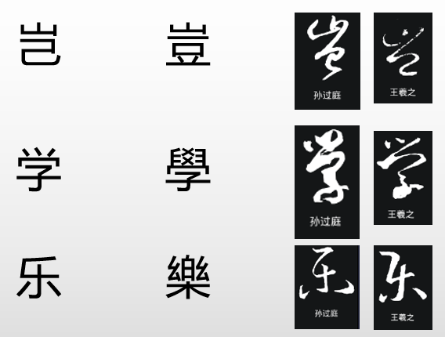
Over the centuries, Chinese characters have continually been developed, with a trend towards the simple and more abstract. It was thought that the complexity of some Chinese characters was keeping people from being able to learn them. Thus, during the 1950s and 1960s, the Chinese government rolled out simplified Chinese characters
推出、推广或展开
27. What would be the benefit of simplifying Chinese characters according to the passage?
A. Creating a standard character set for China.
B. Visualizing the image of Chinese characters.
C. Popularizing the use of Chinese characters.
D. Reproducing a high-grade character for calligraphy.

Slide 13

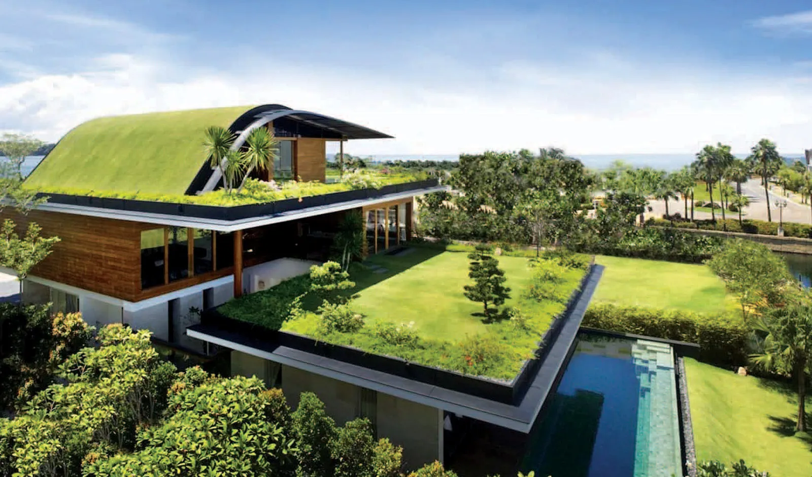
“Green roofs” “Green Buildings”

Slide 14
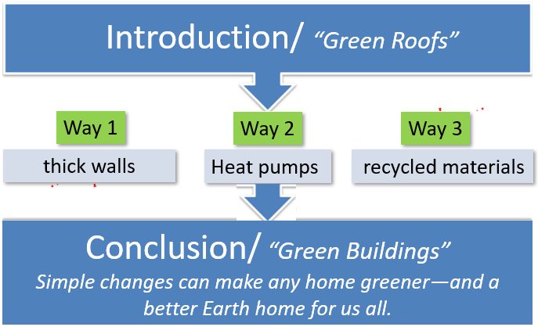
C
Students at the Calhoun School in New York City have much more than a roof over their heads. They have a rooftop garden, with lush grass, colorful flowers and fragrant herbs. “Green roofs” are sprouting up all over, from schools to city skyscrapers. And roofs aren’t the only things going green. Architects are finding all sorts of new ways to build buildings that are easier on the environment. These schools, homes, and offices are called “green buildings”.
Normally it takes a lot of energy to run appliances. Too often, that energy comes from burning fossil fuels. So green buildings are designed to do all these things with much less energy. An energy-smart building starts with thick walls. A layer of insulation(隔热材料) traps air to stop heat from passing through. That keeps heat inside in the winter, and keeps heat outside in the summer. This saves energy for heating and cooling.
Heat pumps are another power-saving way to stay comfortable. A ground heat pump moves heat through pipes that run through the ground next to the building. A few feet under the ground, the temperature stays around 10℃ all year round. Water flowing around the pipes helps heat the building in winter and cool it in summer.
Another way to build green is to use recycled materials. That saves the cost and pollution of manufacturing something new. In the Chicago Center for Green Technology, the ceiling tiles(瓷砖)are made of pressed newspaper. The bathroom floors are tiled with recycled glass, and the stall walls are recycled plastic. Builders have found many creative ways to re-use old materials.
As more people become concerned about climate change, more buildings are going green. Green buildings produce less of the gases that warm the planet. City planners like green buildings because they save money. And they are healthier for the people who work and live inside. But you don’t need to build a whole new building. Simple changes like shading windows and planting trees can make any home greener—and a better Earth home for us all.
31

Slide 15
Students at the Calhoun School in New York City have much more than a roof over their heads. They have a rooftop garden, with lush grass, colorful flowers and fragrant herbs. “Green roofs” are sprouting up all over, from schools to city skyscrapers. And roofs aren’t the only things going green. Architects are finding all sorts of new ways to build buildings that are easier on the environment. These schools, homes, and offices are called “green buildings”.
Normally it takes a lot of energy to run appliances. Too often, that energy comes from burning fossil fuels. So green buildings are designed to do all these things with much less energy. An energy-smart building starts with thick walls. A layer of insulation(隔热材料) traps air to stop heat from passing through. That keeps heat inside in the winter, and keeps heat outside in the summer. This saves energy for heating and cooling.
涌现
28. How are green buildings designed to keep warm in the winter?
By burning fossil fuels.
B. By using thick walls with insulators.
C. By running heating devices.
D. By equipping buildings with appliances.
绝缘体

Slide 16
…….This saves energy for heating and cooling.
Heat pumps are another power-saving way to stay comfortable. A ground heat pump moves heat through pipes that run through the ground next to the building. A few feet under the ground, the temperature stays around 10℃ all year round. Water flowing around the pipes helps heat the building in winter and cool it in summer.
Another way to build green is to use recycled materials. That saves the cost and pollution of manufacturing something new. In the Chicago Center for Green Technology, the ceiling tiles(瓷砖)are made of pressed newspaper. The bathroom floors are tiled with recycled glass, and the stall walls are recycled plastic. Builders have found many creative ways to re-use old materials.
As more people become concerned about climate change, more buildings are going green. Green buildings produce less of the gases that warm the planet. City planners like green buildings because they save money.
29. According to the passage, the advantages of green buildings include the following EXCEPT __________ .
A. saving water B. using recycled materials
C. using less energy D. reducing greenhouse gas emissions
30. In which section of a magazine can we read the text?
A. Education. B. Culture. C. Economy. D. Technology.

Slide 17
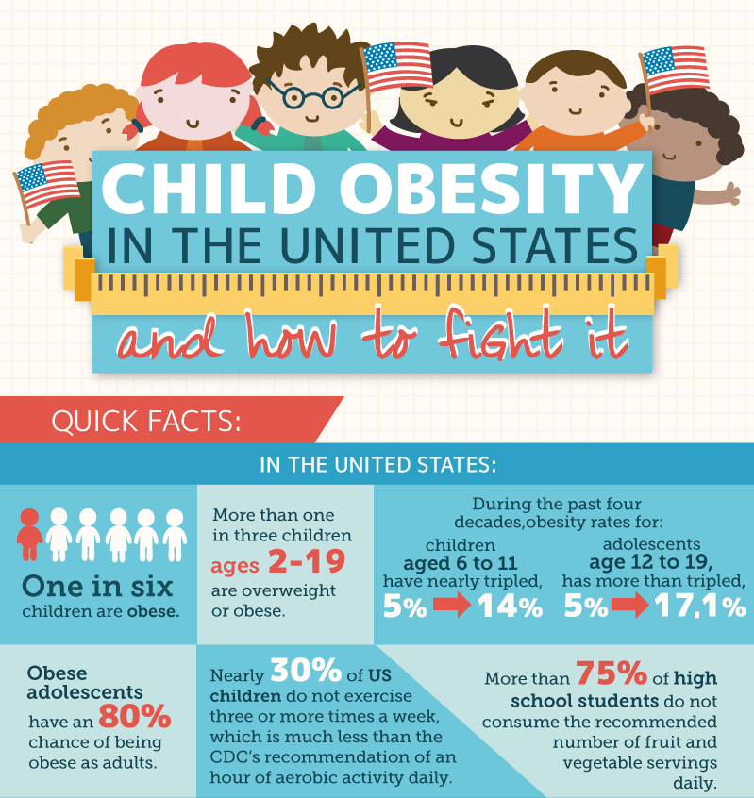

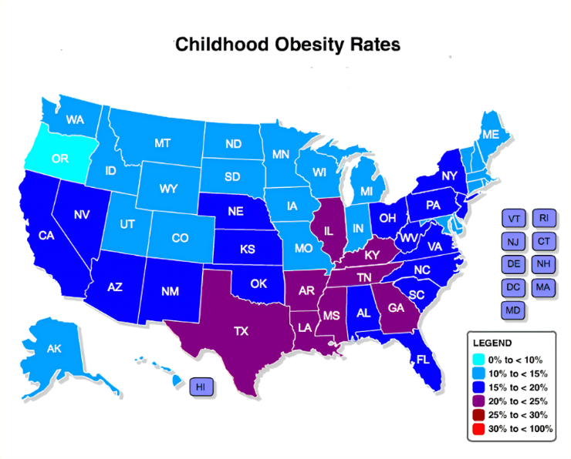
The rate of childhood obesity in the U.S. has tripled over the past 50 years.

Slide 18
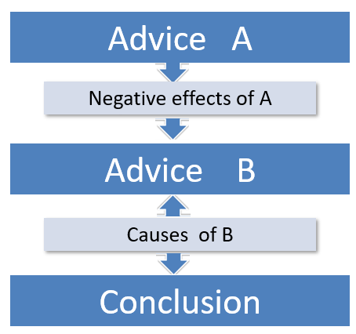
The rate of childhood obesity in the U.S. has tripled over the past 50 years. The American Academy of Pediatrics (AAP) made waves this year by recommending that doctors put obese kids as young as two years old on intensive, family-oriented lifestyle and behavior plans. It also suggested prescribing weight-loss drugs to children 12 and older and surgery to teens 13 and older. This advice reflects the organization’s adoption of a more active position on childhood obesity.
Yet the lifestyle programs the AAP recommends are expensive, inaccessible to most children and hard to maintain. Few weight-loss drugs have been approved for children. And surgery has potential risks and few long-term safety data. Furthermore, it’s not clear whether interventions in youngsters help to improve health or merely add to the psychological burden overweight kids face from the society.
Rather than paying close attention to numbers on a scale, the U.S. and countries with similar trends should focus on an underlying truth: we need to invest in more and safer places for children to play where they can move and run around, climb and jump, ride and skate.
Why is it so hard to get kids moving? Experts blame the problem on the privatization of sports—as public investment in school-based athletics dwindles, expensive private leagues have grown, leaving many kids out. In addition to fewer opportunities at school, researchers cite increased screen time and a lack of safe places for them to play outside the home. New York City, for example, had 2,067 public playgrounds as of 2019—a very small amount for its large population. In Los Angeles in 2015, only 33 percent of youths lived within walking distance of a park.
Kids everywhere need more places to play. Public funding to build and keep up these areas is crucial, but other options such as shared-use agreements can make unused spaces available to the public. These opportunities aren’t primarily about changing children’s waistlines—they’re how we keep childhood healthy and fun.
A Χ
B √

Slide 19

The rate of childhood obesity in the U.S. has tripled over the past 50 years. The American Academy of Pediatrics (AAP) made waves this year by recommending that doctors put obese kids as young as two years old on intensive, family-oriented lifestyle and behavior plans. It also suggested prescribing weight-loss drugs to children 12 and older and surgery to teens 13 and older. This advice reflects the organization’s adoption of a more active position on childhood obesity.
Yet the lifestyle programs the AAP recommends are expensive, inaccessible to most children and hard to maintain. Few weight-loss drugs have been approved for children. And surgery has potential risks and few long-term safety data. Furthermore, it’s not clear whether interventions in youngsters help to improve health or merely add to the psychological burden overweight kids face from the society.
打破现状
32. What can we learn from the first two paragraphs?
A. Childhood obesity is well under control in recent years.
B. Weight-loss surgery are recommended to children 12 and older.
C. AAP plays a more active role in fighting against childhood obesity.
D. Expensive as it is, lifestyle programs are practical for most children.

Slide 20
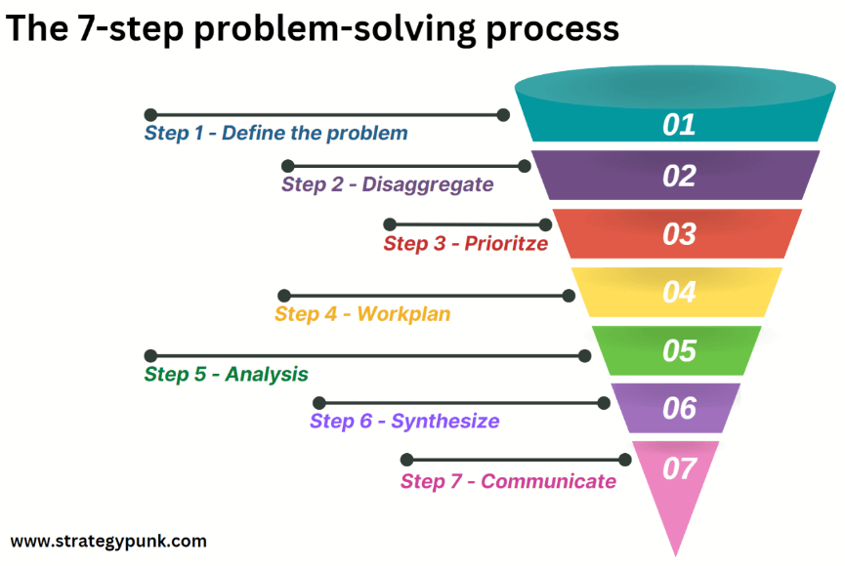
Why is it so hard to get kids moving? Experts blame the problem on the privatization of sports—as public investment in school-based athletics dwindles, expensive private leagues have grown, leaving many kids out. In addition to fewer opportunities at school, researchers cite increased screen time and a lack of safe places for them to play outside the home. New York City, for example, had 2,067 public playgrounds as of 2019—a very small amount for its large population. In Los Angeles in 2015, only 33 percent of youths lived within walking distance of a park.
35. What’s the main idea of the text?
A. Sports play an important role in children’s growth.
B. More safe areas for outdoor fun are in urgent need.
C. Family-oriented lifestyles are crucial to children’s health.
D. Medical intervention is important to ease psychological burden.
Advice B √
we need to invest in more and safer places for children to play
make unused spaces available to the public
33. The underlined word “dwindle” is closest in meaning to __________ .
decline B. quit C. increase D. develop
34. In the author’s opinion, what measures should be taken to create more safe areas?
Prepare fitness equipment at home.
B. Live within walking distance of a park.
C. Promote investment in private athletics.
D. Open up playgrounds when school’s out.
为什么让孩子动起来这么难？专家们将问题归咎于体育的私有化——随着对学校体育运动的公共投资______，昂贵的私人联赛不断增长，将许多孩子排除在外。
Kids everywhere need more places to play. Public funding to build and keep up these areas is crucial, but other options such as shared-use agreements can make unused spaces available to the public.

Slide 21
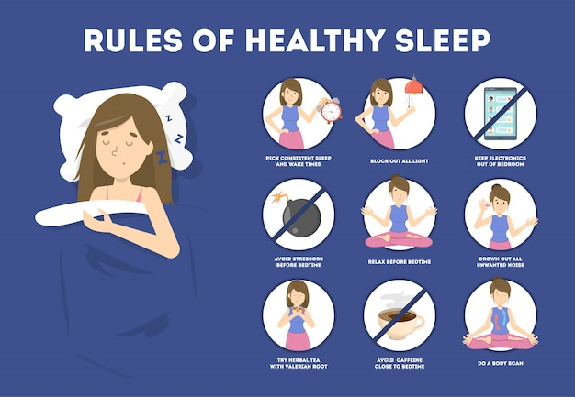

七选五
Here are three simple “first-aid” techniques that could make a difference.

Slide 22

Do you have sweaty palms when you are sitting in the exam hall? Do worrying thoughts keep you awake at night? You may have experienced one of these on certain occasions. 36 Here are three simple “first-aid” techniques that could make a difference.
Sit at your bed
Do you jump out of bed the moment the alarm rings every morning? Perhaps the next time you get up in the morning, you can try this. Slowly get up and sit at your bed for a few minutes. 37 The important thing is not to let any hurried thoughts clutter your mind. In these few quiet minutes to yourself, you will be able to feel refreshed.
38
On many occasions, we have our handphones right next to the served food, and our eyes are busy with the world within these tiny devices. Such actions seem to be the perfect recipe for an overworked brain.
Instead, take mealtime as a time to enjoy your food. Slow down and let your eyes feast on the different colors, and allow your tongue to taste the variety of flavors. 39 It also helps you to feel more relaxed.
Get moving
Playing sports such as basketball, soccer or simply going for a run helps reduce the body’s stress hormones and instead stimulates the production of endorphins that lift your mood. 40 All you have to do is to ensure you incorporate a regular routine of exercise of low to moderate intensity. This will also help you feel more energized and healthy, besides ridding you of stress and anxiety.
These are the ways you can achieve harmony with your body and mind, and feel less anxious and stressed. Give them a try. Your mind will thank you for it.
These are the ways you can achieve harmony with your body and mind, and feel less anxious and stressed. Give them a try. Your mind will thank you for it.
G：承上启下—上文的问题下文的解决方式
C：承上启下—上文身体行为 下文精神平和
A：总结观点
E：承上启下—上文关于进食 下文并列另一个益处
D：承上启下—上文关于运动 下文强调运动强度不用太高
A. Eat mindfully
B. Exercise regularly
C. Let the body and mind feel the peace.
D. There is no need for you to become a gym rat.
E. It helps you to be conscious of the food you put in your mouth.
F. This, in turn, has the effect of bringing your body into a state of deep relaxation.
G. It is a sign that anxiety is creeping up on you, and your brain is nudging you for help.
A gym rat 健身狂

Slide 23
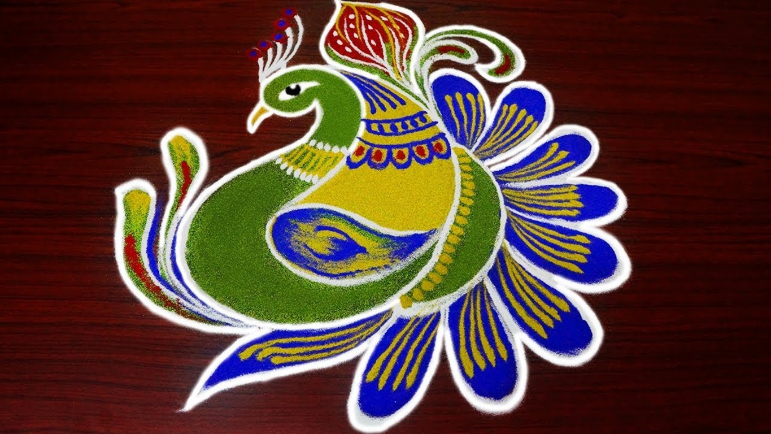

完 形 填 空
C l o z e

Slide 24
The rangoli (印度传统地画艺术) was a giant good-luck charm. Grandma used to make one for the start of the new year. First, she would draw on the floor with chalk. Then, she would fill the drawing with uncooked 41 rice.
This year, Manju was old enough to help. He 42 paper into a cone (圆锥体) and filled it with rice. Side by side, he placed rice across the drawing together with Grandma. Sometimes his rice skittered outside the drawing, sometimes he used the 43 color. And sometimes he rubbed away the 44 , so Grandma had to redraw it. But 45 , the bright swirls of rice transformed into a beautiful peacock. When Manju admired the peacock, he 46 a small piece of tile(瓷砖) peeking through on Grandma’s side.
A 47 ? But Grandma was away to answer the telephone. Should he fix it?
“I’ll surprise Grandma!” He decided. He 48 across, trying to reach the gap. Almost. His left leg inched up. There! Suddenly, Manju began to 49 . His proud smile vanished. “No!” He crashed down onto the rangoli, scattering rice 50 .
Manju rose to his feet and pushed the rice back. But the colors were 51 . When Grandma came back, Manju 52 . He said, “I’m sorry. I should have waited for you.” Grandma shook her head. “You saw a 53 and tried to fix it. I’m proud of you.” They picked up the rice, 54 each grain by color. Just before nightfall, they finished fixing the rangoli.
Grandma lit candles around the rangoli. In the flickering light, the peacock seemed 55 with mystical powers. Manju smiled. The new year felt full of good luck, thanks to Grandma—and him.

Slide 25
The rangoli (印度传统地画艺术) was a giant good-luck charm. Grandma used to make one for the start of the new year. First, she would draw on the floor with chalk. Then, she would fill the drawing with uncooked 41 rice.
This year, Manju was old enough to help. He 42 paper into a cone (圆锥体) and filled it with rice. Side by side, he placed rice across the drawing together with Grandma. Sometimes his rice skittered outside the drawing, sometimes he used the 43 color. And sometimes he rubbed away the 44 , so Grandma had to redraw it. But 45 , the bright swirls of rice transformed into a beautiful peacock. When Manju admired the peacock, he 46 a small piece of tile(瓷砖) peeking through on Grandma’s side.
41. A. burst B. marked C. colored D. carried
42. A. rolled B. brought C. slid D. sank
43. A. pale B. wrong C. fresh D. bright
44. A. viewpoint B. outline C. proposal D. case
45. A. slowly B. fluently C. passively D. instantly
46. A. imagined B. spotted C. witnessed D. missed
下文
动作逻辑
问题
列举
上文
下文

Slide 26
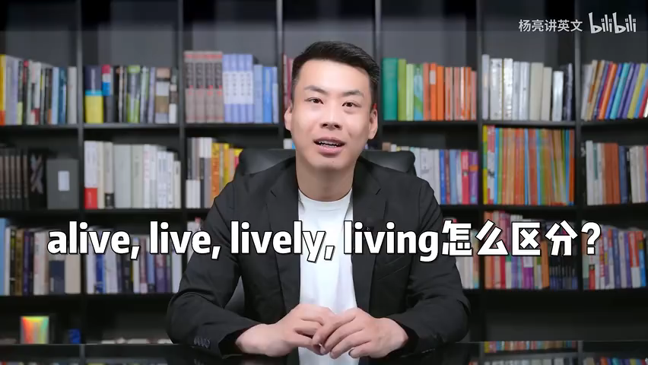
A 47 ? But Grandma was away to answer the telephone. Should he fix it?
“I’ll surprise Grandma!” He decided. He 48 across, trying to reach the gap. Almost. His left leg inched up. There! Suddenly, Manju began to 49 . His proud smile vanished. “No!” He crashed down onto the rangoli, scattering rice 50 .
Manju rose to his feet and pushed the rice back. But the colors were 51 . When Grandma came back, Manju 52 . He said, “I’m sorry. I should have waited for you.” Grandma shook her head. “You saw a 53 and tried to fix it. I’m proud of you.” They picked up the rice, 54 each grain by color. Just before nightfall, they finished fixing the rangoli.
Grandma lit candles around the rangoli. In the flickering light, the peacock seemed 55 with mystical powers. Manju smiled. The new year felt full of good luck, thanks to Grandma—and him.
事故发生，笑容消失-----米粒四散
承认错误，弥补过失----米粒分类，修改画作
一起修改成功，栩栩如生
47. A. cone B. rice C. chalk D. gap
48. A. extended B. expanded C. stretched D. spread
49. A. swell B. lift C. shake D. rest
50. A. somewhere B. everywhere C. anywhere D. nowhere
51. A. mixed B. removed C. classified D. displayed
52. A. looked into B. looked through C. looked out D. looked down
53. A. problem B. puzzle C. selection D. collection
54. A. analyzing B. searching C. sorting D. checking
55. A. lovely B. living C. live D. alive
故事逻辑链
情绪动作

Slide 27

语 法 填 空

Slide 28
One of the most endangered animals in the world is the Siberian tiger, 56 (know) as the Northeast Tiger in China. There are less than 500 of these beautiful animals still living in the wild. The Siberian tiger is the largest of all tigers. 57 adult male can grow up to 3.3 meters in 58 (long) and weigh as much as 300 kilograms.
Long ago, Siberian tigers were all over Northeast Asia and Russian Far East. 59 , today they are found mainly along the Chinese-Russian border and 60 (possible) in North Korea. The main reason for their decrease in numbers is the disappearance of their natural habitat. Fortunately, steps 61 (take) to save this magnificent creature in recent years and as a consequence numbers are 62 the rise.
There is also a fairly large population of Siberian tigers in zoos, some of 63 are expected to be reintroduced to the wild. Of course, they would need to learn how to hunt and take care of 64 (they), and this is easier said than done. Another big issue is the problem of space. At present, there just is not enough 65 (spoil) forest available to support reintroducing many Siberian tigers into the wild.
56.known 考查非谓语
58.length 考查词形变化（介宾结构）
57.An 考查冠词
59.However 考查逻辑关系—转折
61.have been taken 考查谓语动词时态语态
60.posiibly 前后并列＋修饰介宾
62.on考查介词—固定搭配 on the rise在增加；在上涨
63.which考查定语从句
64.themselves考查代词
65.unspoiled考查过去分词做定语
易错点：
卷面书写：①首字母必须大写However, An ②Known书写首字母太大 ③possibly l双写
词形变化：熟练掌握常见词形变化，积累巩固
时态语态：加强谓语动词时态语态双叠加练习，关注句子主干分析
从句难点：先行词有限定修饰词无法识出别从句some of______
失分最多
unspoiled

Slide 29
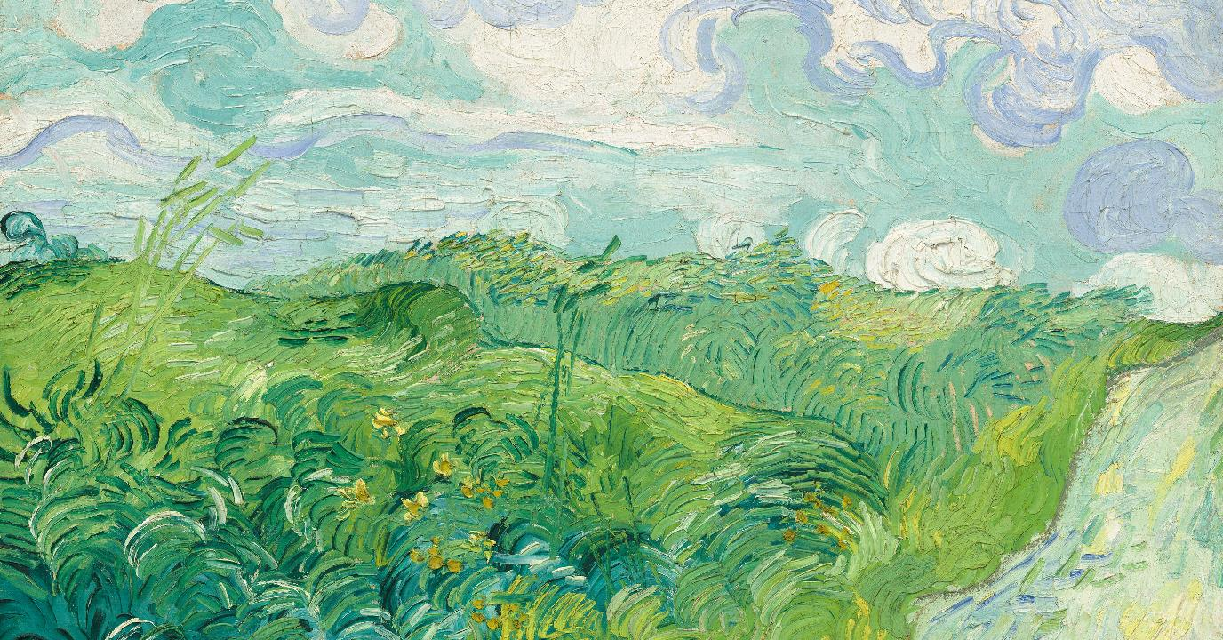
重 点 词 汇
comprehension

Slide 30
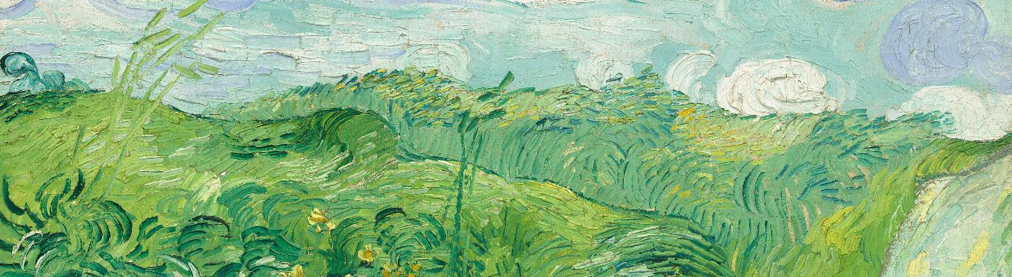


部分词汇
熟词生义
词形变化
Tender
Complex
Abstract
Category
Complicated
Triple
Invest
Option
Waistline
Clutter
Swirl
Vanish
Spoil ……
Border
Dive
Fairly
Shade
Inch
Root
…
Recognizable
Complexity
Emission
Intensive
intensity
Inaccessible
Psychological
Privatization
Primarily
Practical
Growth
Investment
Uncooked
Unspoiled
Disappearance
Magnificent
Mystical
Combination
Simplify
Simplified
……

Slide 31
好 句 摘 录
The world awaits.
Grab your bags and go!
It was thought that the complexity of some Chinese characters was keeping people from being able to learn them.
Simple changes like shading windows and planting trees can make any home greener—and a better Earth home for us all.
Rather than paying close attention to numbers on a scale, the U.S. and countries with similar trends should focus on an underlying truth.
These are the ways you can achieve harmony with your body and mind, and feel less anxious and stressed. Give them a try.
Sometimes his rice skittered outside the drawing, sometimes he used the wrong color. And sometimes he rubbed away the outline, so Grandma had to redraw it.
His proud smile vanished.
In the flickering light, the peacock seemed alive with mystical powers. Manju smiled. The new year felt full of good luck, thanks to Grandma—and him.

Slide 32
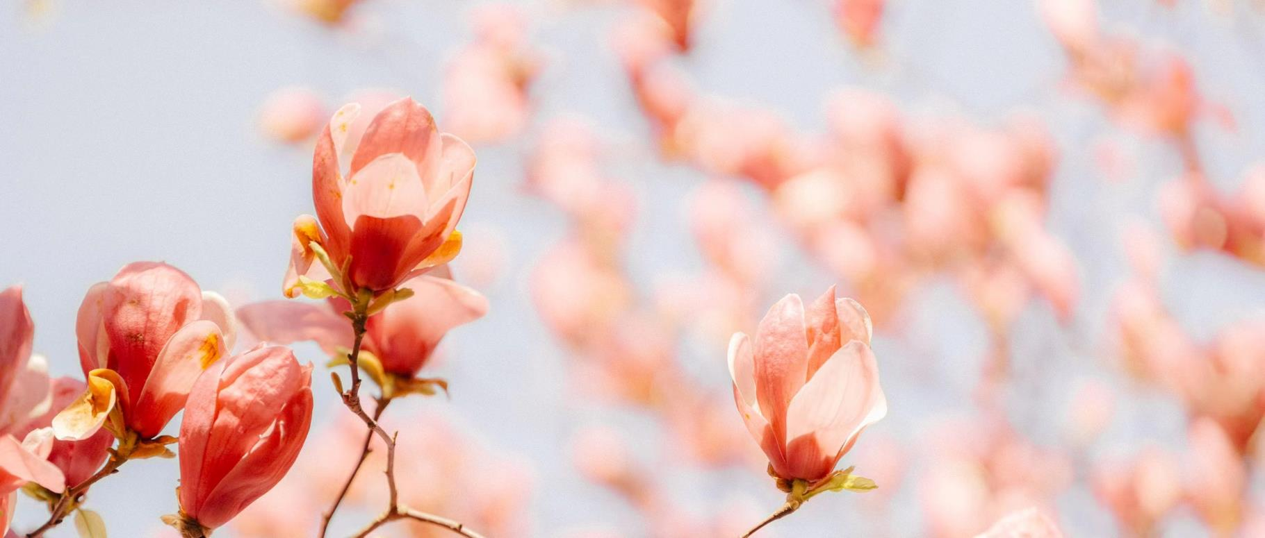
Flowers are the language
of the heart;
they speak volumes without saying a word.
THANK YOU
FAY

