Slide 1


感恩遇见，相互成就，本课件资料仅供您个人参考、教学使用，严禁自行在网络传播，违者依知识产权法追究法律责任。
更多教学资源请关注
公众号：溯恩高中英语
知识产权声明

Slide 2
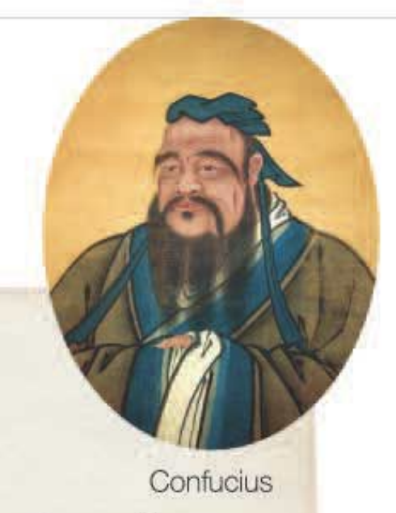
B3U2 Video Time
仁
Benevolence (/bəˈnevələns/)
慈善的
义
Righteousness
/ˈraɪtʃəsnəs/
正义的
礼
Propriety
/prəˈpraɪəti/
得体的举止
智
Wisdom
/ˈwɪzdəm/
才智
信
Fidelity
/fɪˈdeləti/
忠诚
Five virtues
Teachings of Confucius
孔子的教诲

Slide 3
Word bank
Before watch
recur v. /rɪˈkɜː(r)/ to happen again or a number of times
再发生；反复出现
2. represent v. /ˌreprɪˈzent/ to be a symbol of something 作为…的象征；代表
3. element n. /ˈelɪmənt/ 要素
4. indicate v. /ˈɪndɪkeɪt/ to show that something is true or exists 表明；标示；显示
to name a few 举几个例子
6. Loving one’s parents, loving people, loving everything in the world.
--Mencius (亲亲而仁民，仁民而爱物 –孟子)
7. concept n. /ˈkɒnsept/ an idea or a principle that is connected with something abstract 概念；观念
8. Whatever you don’t like done to yourself, don’t do it to others.
=Do not do to others anything that you would not want done to you.
己所不欲勿施于人。
9. direct v. /dəˈrekt/ 指导 10. hold true 同样适用

Slide 4


Slide 5
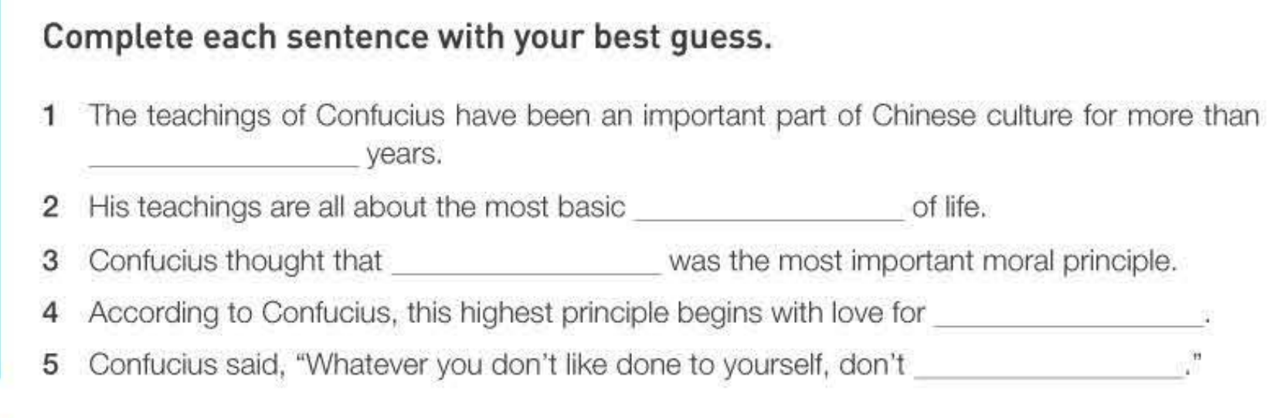
2000
values
ren
parents
do it to others

Slide 6
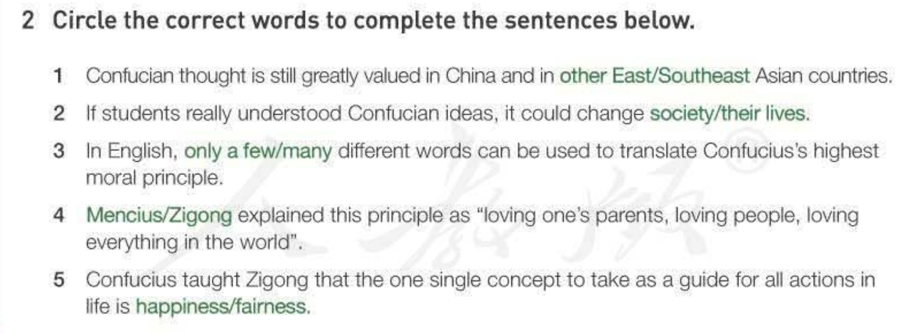
other east
their lives
many
Mencius
fairness

