Slide 1


感恩遇见，相互成就，本课件资料仅供您个人参考、教学使用，严禁自行在网络传播，违者依知识产权法追究法律责任。
更多教学资源请关注
公众号：溯恩高中英语
知识产权声明

Slide 2
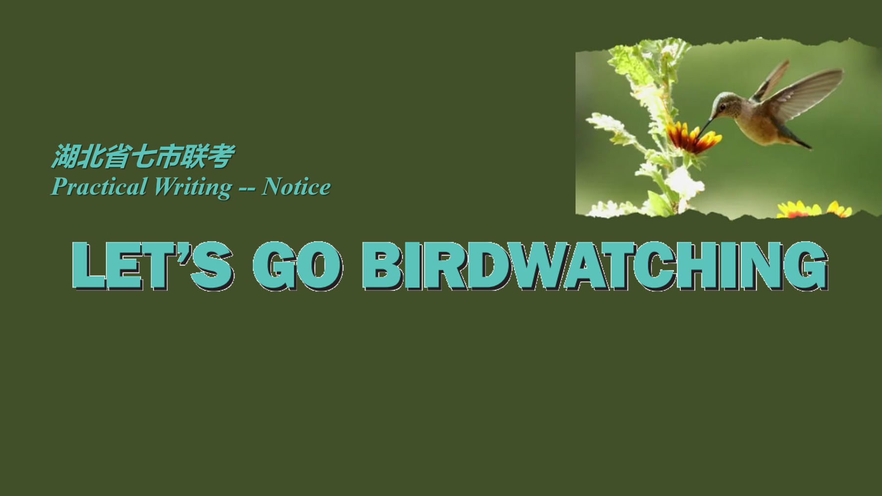

Slide 3
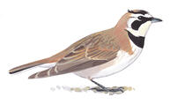
I. Question Review:
1. Genre:
2. Tense:
3. Person:
4. Voice:
5. Points:
6. Structure:
7. Language:
4月1日是“国际爱鸟日”，你校学生会本周将组织学生进行户外观鸟活动。请写一则英文通知，请你校外国交换生参与。内容包括：1.活动简介；2注意事项。
注意：
1.写作词数应为80左右；
2.请按如下格式在答题纸的相应位置作答。
written notice
future& present
the 1st person “We”
Inviting (to exchange students)
①Activity Introduction
Basic Info.& Concrete Contents
②Attention Points
③Appealing to students’ participation!
International Bird’s Day
birdwatching/ birding
Any hidden requirement?
Notice
Student Union
①Background+ Basic Info.
②About the activity+ Dos& Don’ts ③ Appeal to active participation!
Be complete, concise, concrete, courteous and coherent!

Slide 4
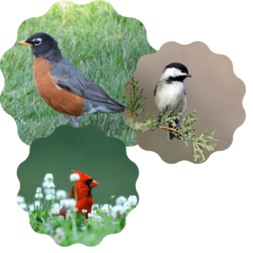
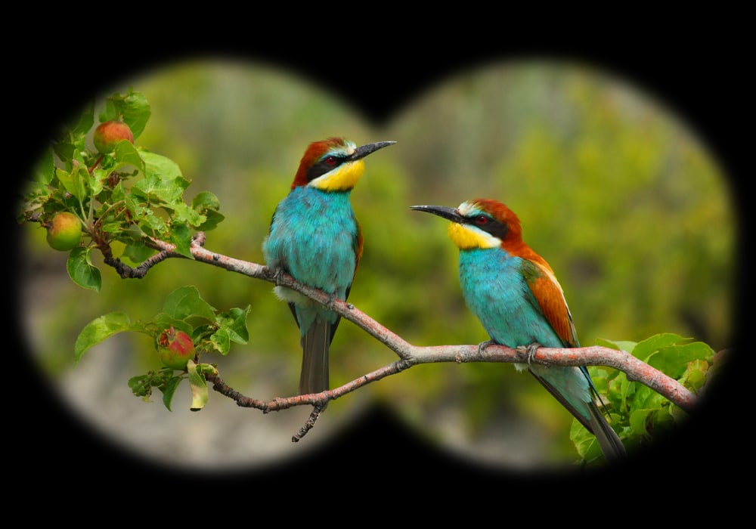
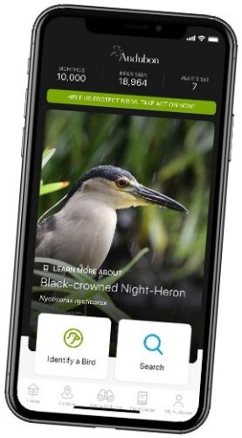
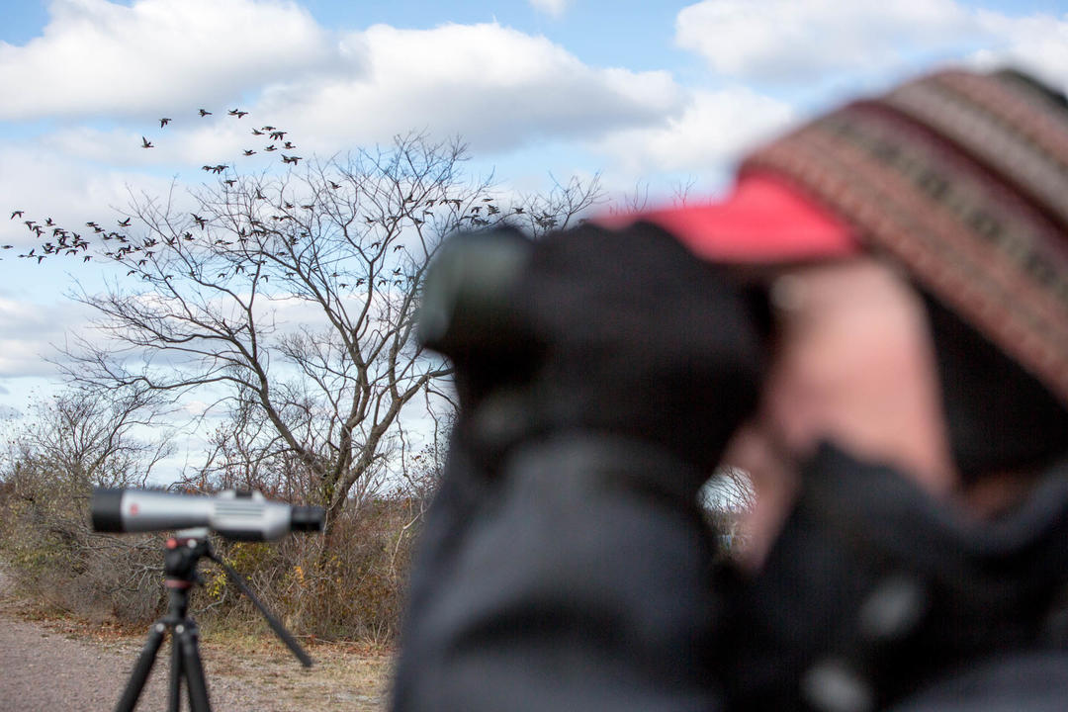
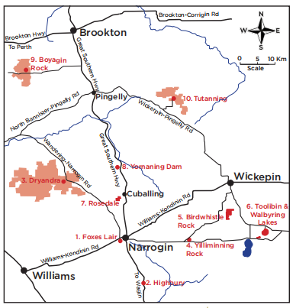
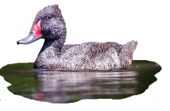
II. Brainstorm the contents
About Birding
What to look | Where to look | When to look | How to look | Tips
Different species
Appearance
Behaviors
Habitats
Bird songs
...
Urban Park
Forest Nearby
Waters
Beaches
Wetlands
...
Spring: prepare nests and lay eggs
Summer: hunt for food and watch over young
Fall: migraters depart for winter areas
Winter: ducks and geese are common along flowing waterways
Tools/ Kit
Guide
Recording
Assistance
...
For outdoor activities
For bird protection
For ecosystem
For safty
For efficiency
...

Slide 5
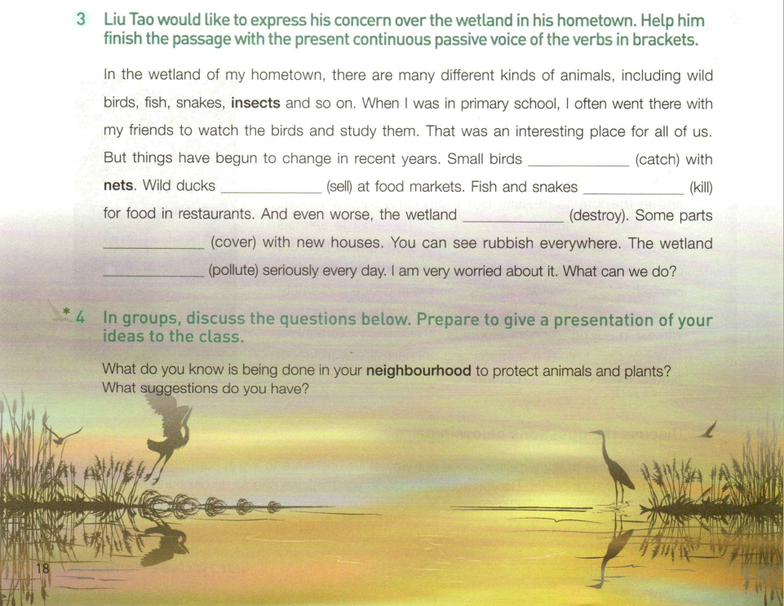
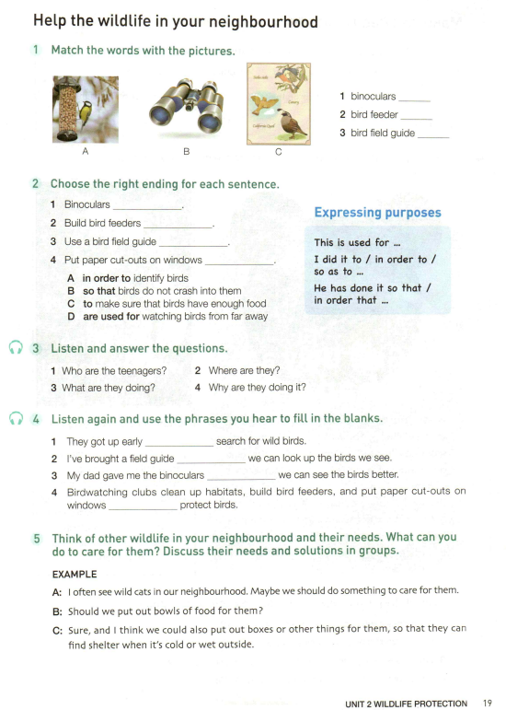
II. Brainstorm the contents
Reference in Text Book:
Watch the birds and study them.
That was an interesting place for all of us.
Binoculars are used for watching birds from far away.
Use a bird field guide to identify birds.
Build bird feeders to make sure birds have enough food.
They got up early so as to search for wild birds.
Birdwatching is an interesting hobby.
Birdwatching clubs clean up habitats, build bird feeders, and put paper cut-puts on windows in order to protect birds.
gains
significance
tools
contents
... dos
Are these enlightening to you?

Slide 6
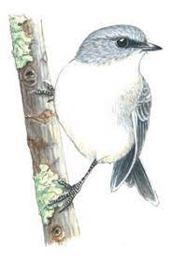
What’re appealing to exchange students?
II. Brainstorm the contents
How to be appealing?
Why should “I” take part in it?
Boost Cultural Exchange
Improve Language Skills
Strengthen Bonds
Broaden Knowledge
Appreciate Local Biodiversity
Create Memories
...
Connect to Nature
Improve Physical Health
Benefit Mental Well-being
Education&Knowledge
Stimulate Social Interaction
Enhance Patience& Focus
Develop Hobby& Interest
...

Slide 7
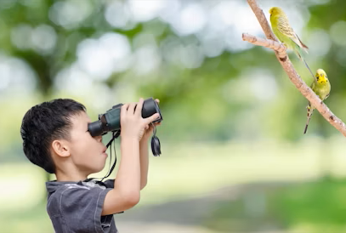
II. Brainstorm the contents
What are the dos and don’ts?
For Participants:
Please remember to bring along binoculars and bird guides for a better birding experience.
As we will be outdoors, don't forget to dress warmly and wear comfortable hiking shoes.
Participants are advised to remain on the paths and respect the natural habitat of the wildlife.
For Nature&Birds:
Please keep yourselves from using flash photography as it can disturb the birds.
Note that picking of plants and littering is strictly prohibited during the birding activity.
To avoid disturbing the birds, we kindly ask you to keep your voices low during the activity.
Birding-- a vigorous outdoor activity

Slide 8
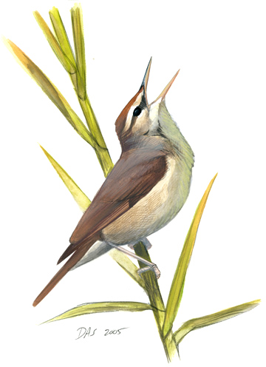
III. Polish Your Draft
For Notice
About background& basic info.:
To celebrate/ promote/ arouse/ encourage..., ... is scheduled to be held/shown/ released on.... in....
On the occasion of International Bird Day, the Student Union is delighted to invite you to....
The anticipation is over! Our Student Union is thrilled to bring you BIRDING together this weekend.
Dos& Don’ts
Be sure to/ We’re expected to/We should not do...
Participants are kindly requested to...
We encourage you to...
Please avoid...
For everyone's safety and enjoyment, please resist from...
About the activity:
During..., you will..../ We will lead you to....
Several captivating segments including... have been planned.
Participants will gain firsthand experience of....
You will be thrilled to engage in... during...
...offers a unique chance to explore...
About the appealing:
Look forward to your participation!
Join us in this exciting event where your active participation will make all the difference!
We are counting on your participation to make it an enriching experience.
Be complete, concise, concrete, courteous, coherent& appealing!

Slide 9
III. Sample Writing
Official Version
Notice
With the approaching of the International Bird Loving Day, our school will hold an outdoor bird-watching activity this Sunday morning. As scheduled, the activity will begin at 8:00 a.m. at the school lecture hall where the biology teacher will explain basic principles of scientific observation. Then, we’ll walk to the forest park near our school where an experienced guide will lead us some dos and don’ts of bird-watching. Please wear comfortable shoes and take sun cream with you in case of getting sun burnt. Being punctual is also of vital importance. Whoever is interested is welcome to join us.
Student Union

Slide 10
III. Sample Writing
Teacher’s Version
Notice
On the occasion of International Bird’s Day, our Student Union is inviting you to a Birdwatching Activity this Friday.
It offers an excellent opportunity to acquaint yourself, especially our exchange students, with local bird species and further your understanding of regional biodiversity. You’ll observe feathered friends closely, learn about their distinctive behaviors, interact with peers and create memorable experiences. The event promises both an instructional experience and a relaxing stay in the picturesque forest park.
Our gathering time is 8 a.m. at the campus gate and binoculars will be provided. As we will be outdoors, don't forget to dress warmly and wear comfortable hiking shoes.
Come and join us in this vigorous gathering!
Student Union

