Slide 1


感恩遇见，相互成就，本课件资料仅供您个人参考、教学使用，严禁自行在网络传播，违者依知识产权法追究法律责任。
更多教学资源请关注
公众号：溯恩高中英语
知识产权声明

Slide 2
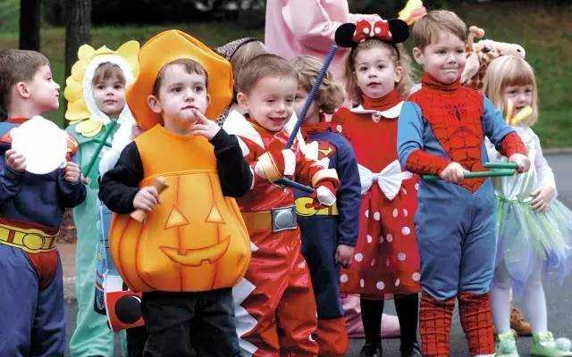
万圣节之秋叶魔法服
2024-3 金丽衢十二校
Motive---Action---Result/Reflection 续写手法
傅嘉

Slide 3
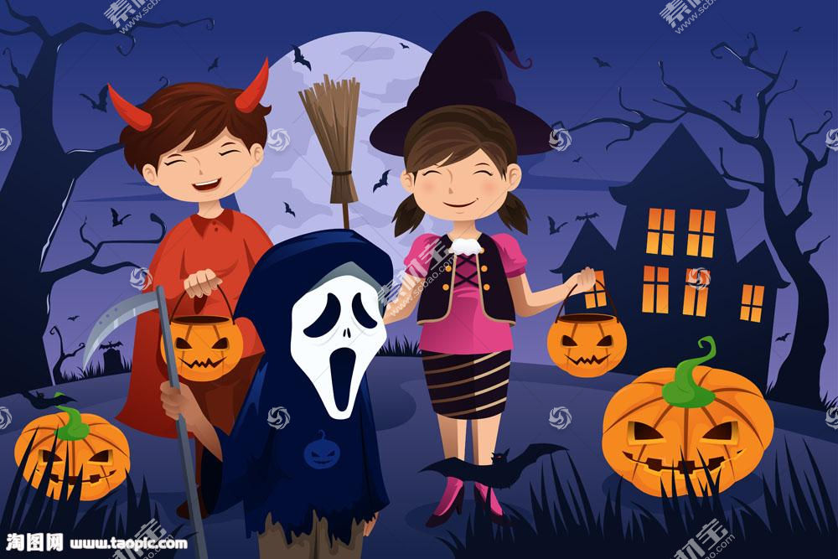

原文本
Every October, my neighborhood has a Halloween costume contest. And every October, my neighbor Ollie and I race to the announcement board in the park to find out the theme. One year, the theme was “Dress up as your favorite book character.” Another year, it was “Be something scary.” But this year, the theme was kind of, well, themeless.
“Be creative?” I said, reading the announcement board. “That’s not really a theme, is it?”
Ollie hopped off his skateboards to get a closer look. “You’re right,” he agreed. “I think my favorite theme ever was ‘Superheroes’. I loved my Super-Force Flying Eagles costume so much, I kept that thing hanging in my closet for years!”
“My favorite theme was ‘Farm Animals’.” I giggled. “Remember how you insisted on being a Stegosaurus(剑龙)?”
“When I was five, dinosaurs were my world.” Ollie laughed. “I would have loved to see a Stegosaurus out grazing with the cows.”
“Now that’s the creative spirit we need for this challenge!” I said. “Maybe, since we don’t know exactly what we want to be yet, we should start by choosing some cool costume-making materials.”
“I’ve got it!” Ollie said, scooping up a bunch of fallen leaves.
“Really?” I said. “You’re going to make an entire costume out of leaves?”
“Why not?” he said, scooping up some more.
“They’re totally free, and I can guarantee, no one will be a tree as great as me.”
“Don’t you mean, a tree as great as we?” I grinned.
“Um, first, that grammar doesn’t sound right,” said Ollie. “And second, no way! Think of your own creative ideas.”
“Aw, come on,” I said. “You should be flattered that I like your idea so much. Plus, I just thought of the perfect way to make branches.”
Finally, Ollie said OK.

Slide 4
Read for information
Every October, my neighborhood has a Halloween costume contest. And every October, my neighbor Ollie and I race to the announcement board in the park to find out the theme. One year, the theme was “Dress up as your favorite book character.” Another year, it was “Be something scary.” But this year, the theme was kind of, well, themeless.
“Be creative?” I said, reading the announcement board. “That’s not really a theme, is it?”
Q1: What is the theme of the coming Halloween costume contest?

Slide 5
Read for information
Ollie hopped off his skateboards to get a closer look. “You’re right,” he agreed. “I think my favorite theme ever was ‘Superheroes’. I loved my Super-Force Flying Eagles costume so much, I kept that thing hanging in my closet for years!”
“My favorite theme was ‘Farm Animals’.” I giggled. “Remember how you insisted on being a Stegosaurus(剑龙)?”
“When I was five, dinosaurs were my world.” Ollie laughed. “I would have loved to see a Stegosaurus out grazing with the cows.”
Q2： What did Olie and I talk about ？

Slide 6
Read for information
“Now that’s the creative spirit we need for this challenge!” I said. “Maybe, since we don’t know exactly what we want to be yet, we should start by choosing some cool costume-making materials.”
“I’ve got it!” Ollie said, scooping up a bunch of fallen leaves.
“Really?” I said. “You’re going to make an entire costume out of leaves?”
“Why not?” he said, scooping up some more.
“They’re totally free, and I can guarantee, no one will be a tree as great as me.”
“Don’t you mean, a tree as great as we?” I grinned.
“Um, first, that grammar doesn’t sound right,” said Ollie. “And second, no way! Think of your own creative ideas.”
“Aw, come on,” I said. “You should be flattered that I like your idea so much. Plus, I just thought of the perfect way to make branches.”
Finally, Ollie said OK.
Q3： What was their creative idea for their costume?

Slide 7
Read for clues and echoes
Every October, my neighborhood has a Halloween costume contest. And every October, my neighbor Ollie and I race to the announcement board in the park to find out the theme. One year, the theme was “Dress up as your favorite book character.” Another year, it was “Be something scary.” But this year, the theme was kind of, well, themeless. “Be creative?” I said, reading the announcement board. “That’s not really a theme, is it?”
clues
echoes
Ollie and I raced to the park, where the grand Halloween costume contest was held as scheduled.

Slide 8
Read for clues and echoes
Every October, my neighborhood has a Halloween costume contest. And every October, my neighbor Ollie and I race to the announcement board in the park to find out the theme. One year, the theme was “Dress up as your favorite book character.” Another year, it was “Be something scary.” But this year, the theme was kind of, well, themeless. “Be creative?” I said, reading the announcement board. “That’s not really a theme, is it?”
clues
echoes
2. Some kids dressed up as witches or wizard, carrying a broken broom with them.
3. Some dressed up as caterpillar, which attracted much attention from the audience.

Slide 9
Read for clues and echoes
Ollie hopped off his skateboards to get a closer look. “You’re right,” he agreed. “I think my favorite theme ever was ‘Superheroes’. I loved my Super-Force Flying Eagles costume so much, I kept that thing hanging in my closet for years!” “My favorite theme was ‘Farm Animals’.” I giggled. “Remember how you insisted on being a Stegosaurus(剑龙)?” “When I was five, dinosaurs were my world.” Ollie laughed. “I would have loved to see a Stegosaurus out grazing with the cows.”
clues
echoes
其他参赛选手的作品描述可以对Part2 进行回扣，理由：仍然会有五岁孩子对万圣节的一些喜欢的东西进行展示。

Slide 10
Read for clues and echoes
Ollie hopped off his skateboards to get a closer look. “You’re right,” he agreed. “I think my favorite theme ever was ‘Superheroes’. I loved my Super-Force Flying Eagles costume so much, I kept that thing hanging in my closet for years!” “My favorite theme was ‘Farm Animals’.” I giggled. “Remember how you insisted on being a Stegosaurus(剑龙)?” “When I was five, dinosaurs were my world.” Ollie laughed. “I would have loved to see a Stegosaurus out grazing with the cows.”
clues
echoes
3.Others dressed up as Superman, Batman or Spiderman--- various Superheroes in their mind.
4. A Stegosaurus grazed with cows in the park, just as Ollie did at the age of 5. Incredible!

Slide 11
Read for clues and echoes
“Now that’s the creative spirit we need for this challenge!” I said. “Maybe, since we don’t know exactly what we want to be yet, we should start by choosing some cool costume-making materials.” “I’ve got it!” Ollie said, scooping up a bunch of fallen leaves. “Really?” I said. “You’re going to make an entire costume out of leaves?”
clues
echoes
5. Colorful fallen leaves were genuinely ideal costume-making materials, which was not only free but also environment- friendly.

Slide 12
Read for clues and echoes
“Why not?” he said, scooping up some more. “They’re totally free, and I can guarantee, no one will be a tree as great as me.” “Don’t you mean, a tree as great as we?” I grinned. “Um, first, that grammar doesn’t sound right,” said Ollie. “And second, no way! Think of your own creative ideas.” “Aw, come on,” I said. “You should be flattered that I like your idea so much. Plus, I just thought of the perfect way to make branches.” Finally, Ollie said OK.
clues
echoes
6. We grinned from ear to ear when hearing the announcement“The first place goes to the costume made of tree leaves .”

Slide 13
Analysis of the story --- charater and plot
Key role: Ollie & I ---从两人谈话的语气推测是孩子
Minor role：contestants/ opponents / judges/ audience
(这些人物可能在第二段会出场，但续写一般不增加人物，具体请重新阅读《电梯惊魂》）
Place : 制作服装在家里比较合理；参赛地点可以是公园，可以是社区的auditorium
Cause: join in Halloween Costume Contest in October
How: 1. first make a costume with fallen trees
2. show/ display their elegantly-made work
Result: Won over other contestants // the first place
Reflection ： turn waste into wealth// environment-friendly

Slide 14
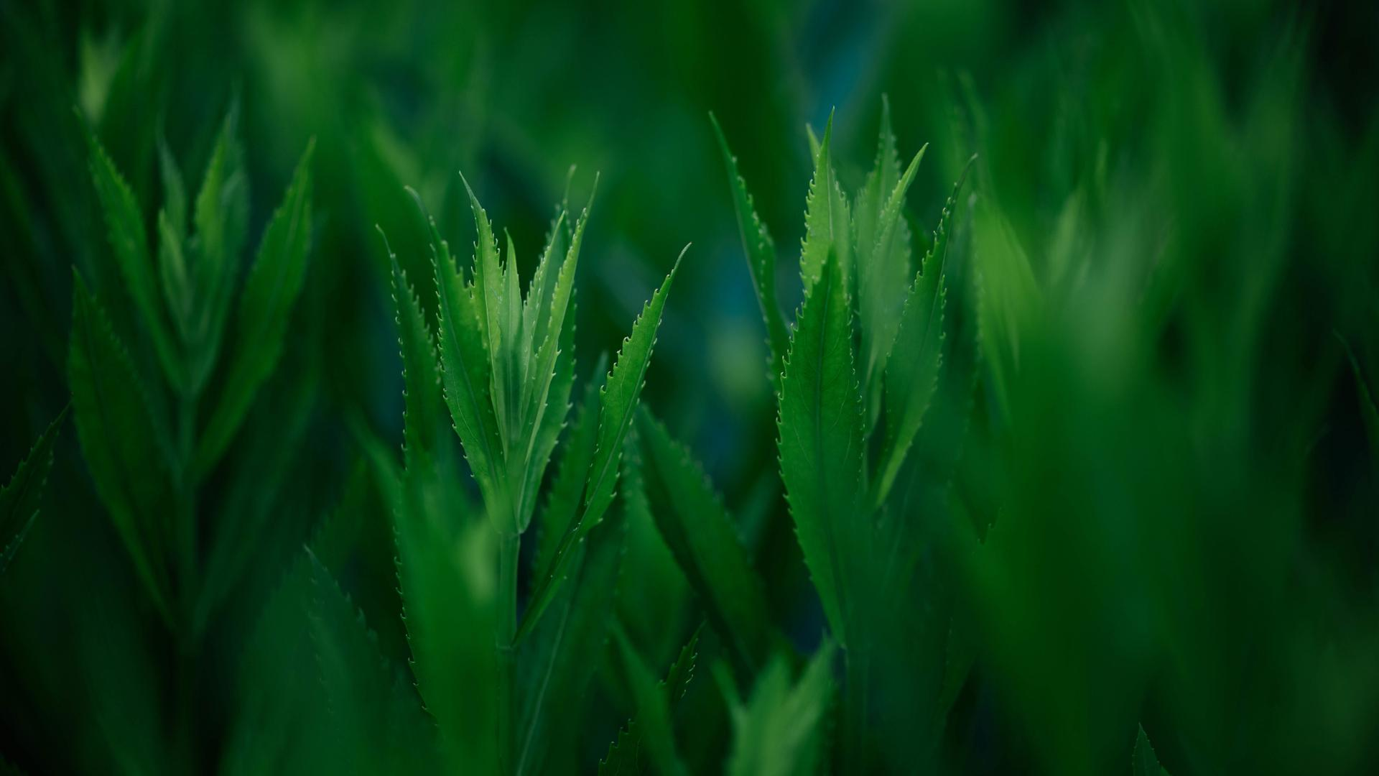
Design plots for each paragraph
Para1: We ended up filling two jumbo bags with different kinds of leaves.
第一段： 侧重于描述我和Ollie 一起制作万圣节服饰---
（把两袋树叶拖回家---倒出叶子---准备其他材料—开始浩大的制作服装的工程---完成服装---欣赏作品---坚信作品会脱颖而出。）

Slide 15
Design plots for each paragraph
Para2: Then the big moment came.
第二段：穿上作品飞奔去参赛---赛会上所见所闻所感所说---我们展示树叶服装（联想一下模特时装秀场景）--喝彩与掌声雷动-比赛结果（可以直接以比赛结果结束）---比赛结束后去穿着万圣节服装进行传统的要糖果活动。（设计一个穿服装去要糖果的细节来体现考生文化素养。）

Slide 16
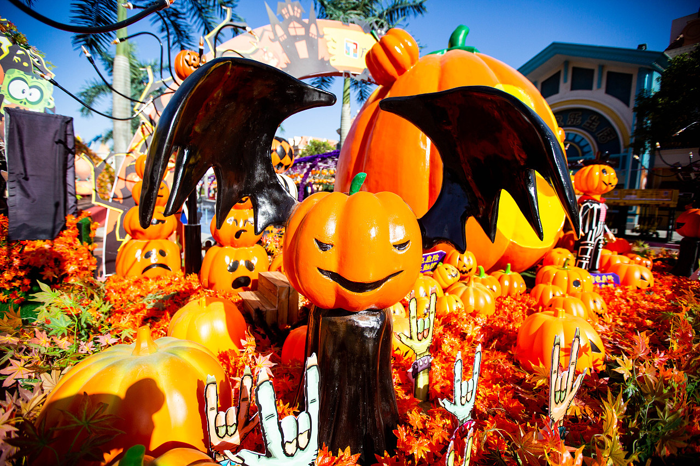
处理衔接处+ 结合原文part 3:
“I’ve got it!” Ollie said, scooping up a bunch of fallen leaves.
“Really?” I said. “You’re going to make an entire costume out of leaves?”
“Why not?” he said, scooping up some more.
“They’re totally free, and I can guarantee, no one will be a tree as great as me.”
“Don’t you mean, a tree as great as we?” I grinned.
“Um, first, that grammar doesn’t sound right,” said Ollie. “And second, no way! Think of your own creative ideas.”
“Aw, come on,” I said. “You should be flattered that I like your idea so much. Plus, I just thought of the perfect way to make branches.”
Finally, Ollie said OK.
Para1: We ended up filling two jumbo bags with different kinds of leaves.
Para2: Then the big moment came.
首段衔接1：A: Various trees grew in the park, so these fallen leaves of many sizes had rich colors.
首段衔接1：B: Thrilled and delighted, we grinned from ear to ear, staring at the two bags and imagining the creative design.

Slide 17
处理衔接处+ 结合原文part 3:
“I’ve got it!” Ollie said, scooping up a bunch of fallen leaves.
“Really?” I said. “You’re going to make an entire costume out of leaves?”
“Why not?” he said, scooping up some more.
“They’re totally free, and I can guarantee, no one will be a tree as great as me.”
“Don’t you mean, a tree as great as we?” I grinned.
“Um, first, that grammar doesn’t sound right,” said Ollie. “And second, no way! Think of your own creative ideas.”
“Aw, come on,” I said. “You should be flattered that I like your idea so much. Plus, I just thought of the perfect way to make branches.”
Finally, Ollie said OK.
Para1: We ended up filling two jumbo bags with different kinds of leaves.
Para2: Then the big moment came.
首段衔接1： C: Thrilled and delighted, we two dragged the two jumbo bags back to Ollie’s yard.

Slide 18
Para1: We ended up filling two jumbo bags with different kinds of leaves.
Para2: Then the big moment came.
首段尾句衔接2：A: After what seemed like centuries, a shining colorful Halloween costume took form/ appeared/ turned up before our eyes. Our joint efforts paid off.
首段尾句衔接2： B: Our costume would stand out in the coming Halloween costume contest. Absolutely!

Slide 19
Para2: Then the big moment came.
二段首句衔接3：A: The Halloween costume contest was held in the park as scheduled.
二段首句衔接3： B: Ollie and I , dressed in our carefully- crafted/ beautifully-made costume, raced to the park, where the grand annual Halloween costume contest was held.

Slide 20
Para2: Then the big moment came.
二段尾句衔接4：A: In the end, our leaf costume was awarded the first place because of its uniqueness , creativity and above all its environmentally friendly material.
二段尾句衔接4： B: As evening wore on, Ollie and I , dressed like two moving trees, together with other excited kids, went from door to door, playing trick or treat and enjoying that fun and kind of terrifying night.

Slide 21
Para2: Then the big moment came.
二段尾句衔接4：C: In the end, our leaf costume was awarded the first place because of its uniqueness , creativity and above all its environmentally friendly material. The memorable experience taught us a valuable lesson ---creativity comes from nature and we can turn waste into wealth/ treasure.

Slide 22
习作句式及逻辑拆解 主语切换 方便行文
Para1: We ended up filling two jumbo bags with different kinds of leaves.
（二连形： 把装有树叶的袋子拖回家）
Thrilled and delighted, we two dragged the two jumbo bags back to Ollie’s yard.
2. ( 倒装句： 急切地准备开始，行动力杠杠滴！）
No sooner had we returned home than we poured out all the leaves.

Slide 23
习作句式及逻辑拆解 主语切换 方便行文
Para1: We ended up filling two jumbo bags with different kinds of leaves.
3.（无灵主语句： 颜色绚丽，大小形状各异的树叶，美！）
Various brightly-colored leaves of sizes and shapes shone brilliantly in the sunshine.
4. （After doing sth ： 备好所有备用材料，开启浩大工程）
After preparing other necessary materials like old clothes, thread and needles, glue sticks and scissors, we initiated/ launched our project.

Slide 24
习作句式及逻辑拆解 主语切换 方便行文
5. (夸张手法 ：看似不可能的任务终于完成了！）
After what seemed like centuries, the seemingly impossible mission was completed!
6. （doing 非谓语：欣赏自己作品时的自豪感油然而生！)
Admiring the amazing masterpiece full of vigor, we were overwhelmed with an enormous sense of pride.

Slide 25
习作句式及逻辑拆解 主语切换 方便行文
7. （无灵主语句： 自信自己的作品一定会脱颖而出！）
Our costume would stand out in the coming Halloween costume contest. Absolutely!

Slide 26
习作句式及逻辑拆解 主语切换 方便行文
Para2: Then the big moment came.
（done 非谓语+定语从句；我俩飞奔去比赛场地！）
Ollie and I , dressed in our carefully- crafted costume, raced to the park, where the grand annual Halloween costume contest was held.
２. （ 简单句；渲染一下公园的万圣节气氛哦！）
The crowded park was beautifully decorated with many jack-o-lanterns!
3. ( 夸张手法: 所见令人震惊！）
What we saw on the spot shocked us deeply!

Slide 27
习作句式及逻辑拆解 主语切换 方便行文
4. （两个简单句：所有孩子都全力以赴，竞争异常激烈！）
All kids went all out to design and create their Halloween costumes. The competition was obviously intense!
5. （两个简单句：轮到我们上台展示,自信的我们）
Our showtime was up ! With confidence written on our face, Ollie and I， two moving trees, walked on the stage like professional fashion models.

Slide 28
6. （ 无灵主语句+感叹句; 我们勇夺第一。）
Cheers and applauses exploded in the air. We won the first prize for our unique creativity. What a thrill!
7. (As 时间状语从句，doing sth ; + 夜幕降临，穿着万圣节服装，挨家挨户去要糖果。）
As evening wore on, Ollie and I , in our leaf costumes, went from door to door, playing trick or treat and enjoying that fun and kind of terrifying night.

Slide 29
习作欣赏一
Para1: We ended up filling two jumbo bags with different kinds of leaves. Thrilled and delighted, we two dragged the two jumbo bags back to Ollie’s yard. No sooner had we returned home than we poured out all the leaves. Various brightly-colored leaves of sizes and shapes shone brilliantly in the sunshine. After preparing other necessary materials like old clothes, thread and needles, glue sticks and scissors, we initiated/ launched our project. After what seemed like centuries, the seemingly impossible mission was completed! Admiring the amazing masterpiece full of vigor, we were overwhelmed with an enormous sense of pride. Our costume would stand out in the coming Halloween costume contest. Absolutely!

Slide 30
Para2: Then the big moment came. Ollie and I , dressed in our carefully- crafted/ beautifully-made costume, raced to the park, where the grand annual Halloween costume contest was held. The crowded park was beautifully decorated with many jack-o-lanterns! What we saw on the spot shocked us deeply! All kids went all out to design and create their Halloween costumes. The competition was apparently intense! Our show time was up ! Ollie and I， two moving trees, walked on the stage like professional fashion models. We won the first prize for our unique creativity. What a thrill! As evening wore on, Ollie and I , in our leaf costumes , went from door to door, playing trick or treat and enjoying that fun and kind of terrifying night.

Slide 31
习作欣赏二
Para1: We ended up filling two jumbo bags with different kinds of leaves. Various trees grew in the park, so these fallen leaves of many sizes had rich colors. Oak leaves bore gold yellow while maple leaves took on bright red. After finishing collecting fallen leaves in the park, Ollie and I
dragged the two jumbo bags back to the garage of Ollie’s house. Seeing us two excited kids, Ollie’s parents cast us a curious look, wondering what we were doing. Ollie and I exchanged a meaningful look, smiling“ It’s a secret.” Then we embarked on the journey of making those two bags of leaves into a unique and creative costume. After what seemed like centuries, a shining colorful Halloween costume took form/ appeared/ turned up before our eyes. Our joint efforts paid off.

Slide 32
Para2: Then the big moment came. The Halloween costume contest was held in the park as scheduled. Overwhelmed with an enormous sense of excitement mingled with joy, Ollie and I dressed up in our elaborate leaf costume and raced to the park. Never in our wildest dream had we imagined that our costume attracted so much attention from the audience, judges and other contestants. The contest was not that serious. Instead, it was a fun activity. Kids in various costumes showed up on the stage in turns like fashion models. In the end, our leaf costume was awarded the first place because of its uniqueness , creativity and above all its environmentally friendly material.

Slide 33
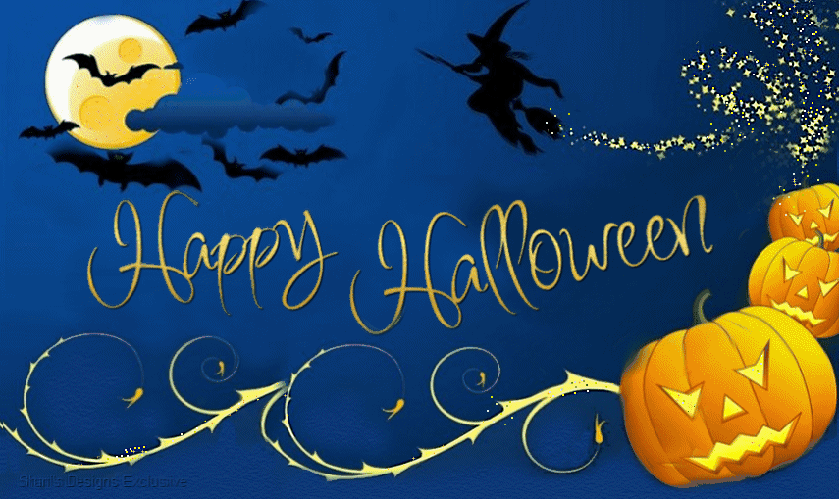

Slide 34
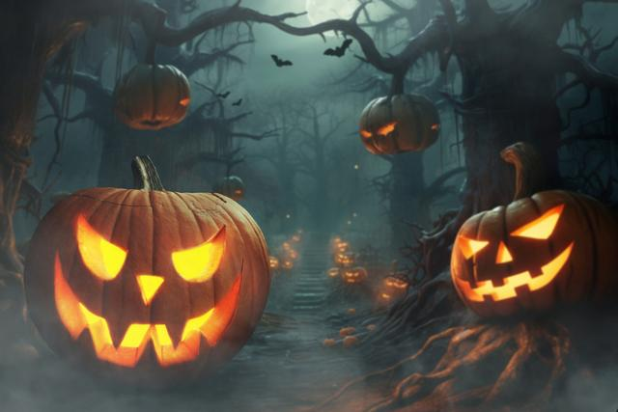
Brief introduction to Halloween
jack-o'-lanterns

Slide 35
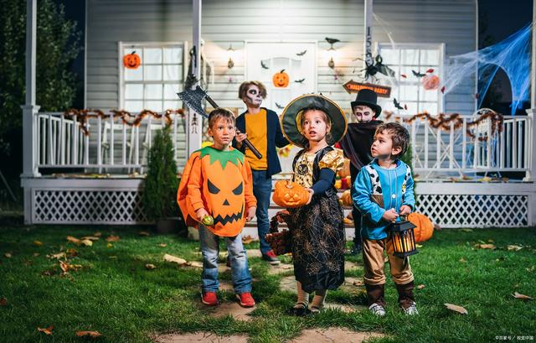
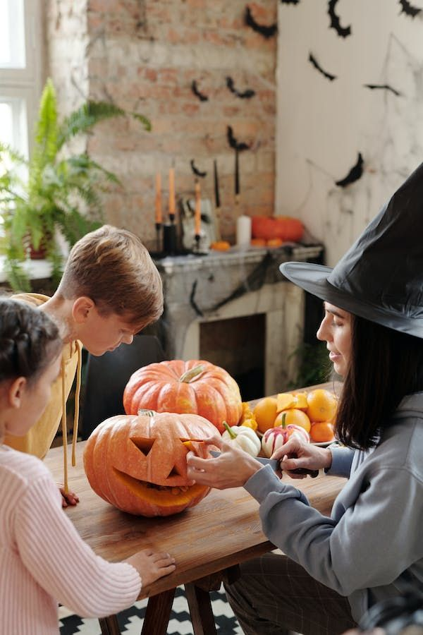
Jack-o-lantern: 万圣节南瓜灯
Pick pumpkins in a pumpkin patch: 去南瓜地买南瓜
Carve them into jack-o’-lanterns: 雕刻成南瓜灯
Dress up in fun costumes: 穿好玩儿的道具服
Go from door to door asking for candy and playing trick or treat
It’s just a fun tradition: 很好玩儿的传统

Slide 36
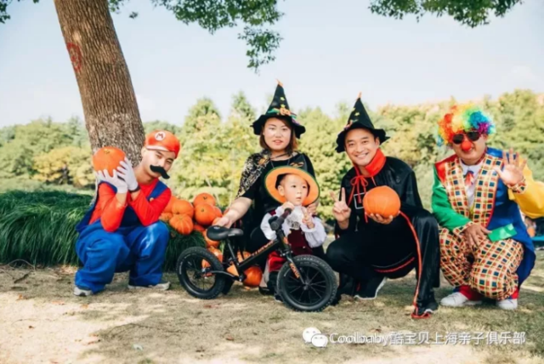
Halloween is a fun holiday for both kids and adults: 万圣节对孩子、大人来说，都很好玩儿
It's not so serious or sacred: 不是那么严肃、神圣
It's a no-pressure holiday: 是个没有压力的节日
It is a big and fun party: 基本上就是一个大派对

Slide 37
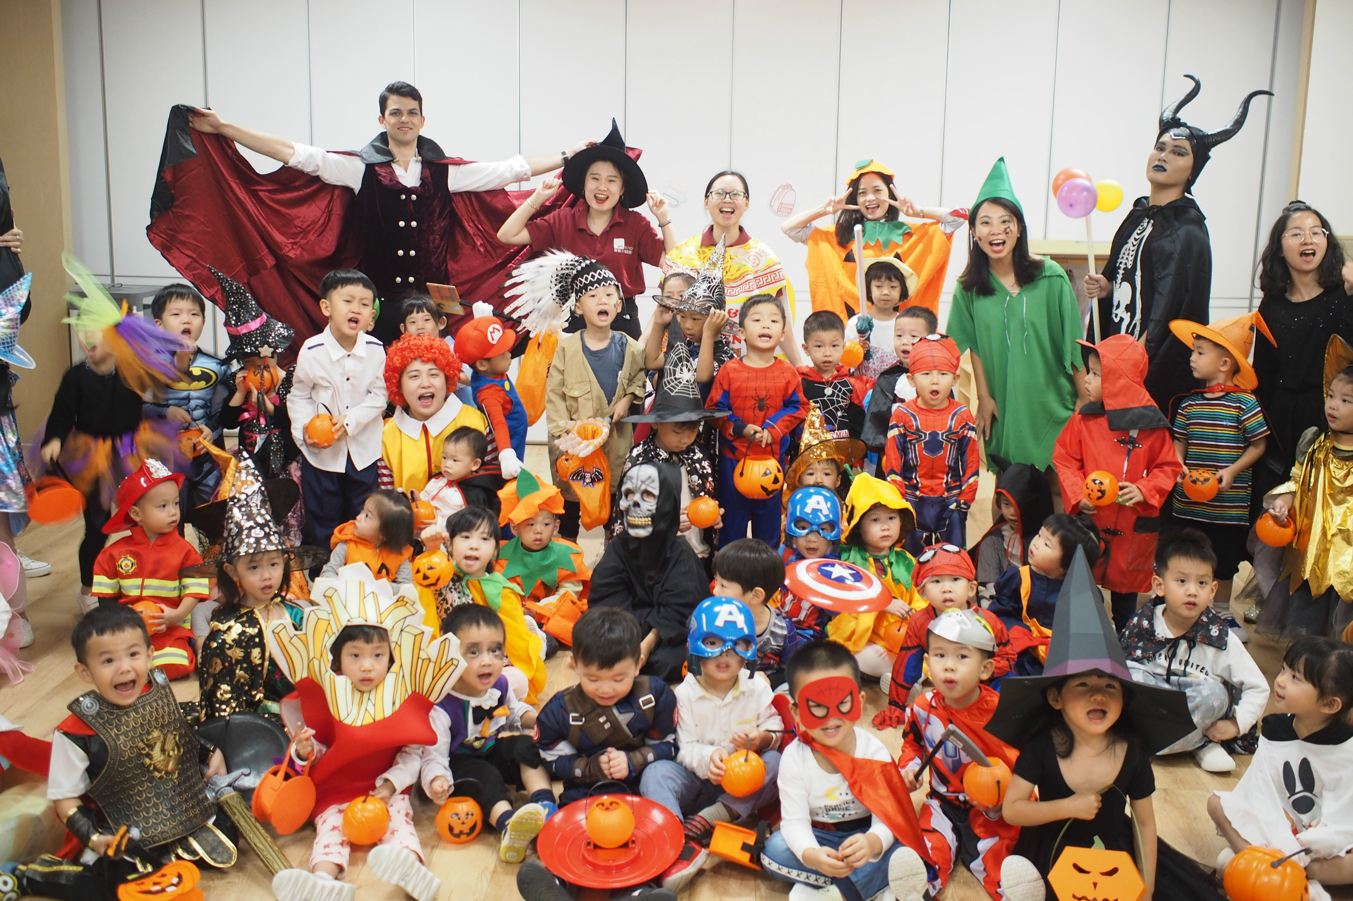
Costume categories | 装扮流派
Different costume categories: 道具服、装扮的几个大类
Boys often dress up as superheroes:小男孩儿最爱超级英雄，如超人、蜘蛛侠
Or monsters, goblins, ghouls: (魔鬼，妖怪，僵尸）
Little girls often dress up as princesses or witches: 小女孩儿最喜欢打扮成小公主或者小女巫
You can either go for the dark side or the bright side: 装扮可以选择黑暗形象或者正面形象
Themed costume parties on Halloween: 还有主题装扮派对，去的人一定要打扮成和主题相关的样子。比如美剧主题、还有上图这种美食主题，把自己打扮成甜甜圈、肯德基、酱油

Slide 38
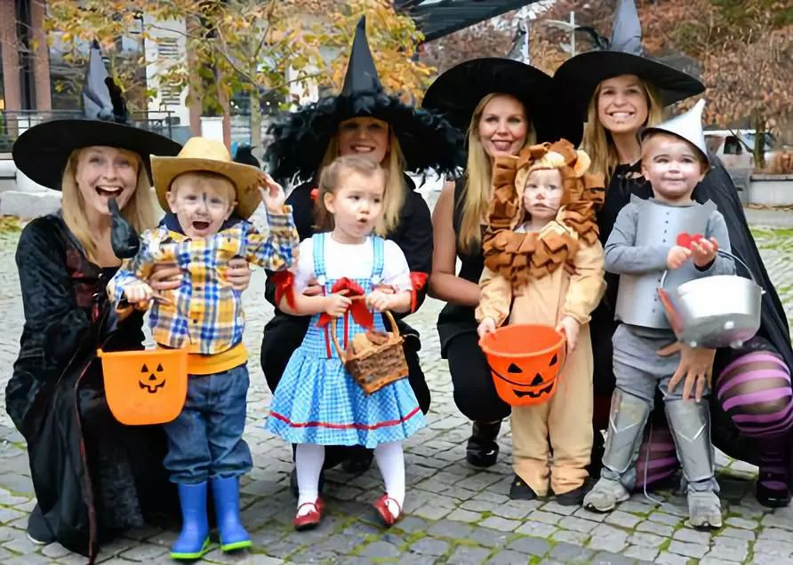
Creative, funny, topical ｜ 创意、搞笑、热点
For adults, dressing up as superheroes or monsters is too old, been there, done that: 对大人来说，打扮成超级英雄、或者鬼怪已经没有创意了 Tons of people will dress up as politicians like US President --- Joe Biden
You can go for the creative and surprise factor: 可以走创意、意想不到的路线
People in the news are often inspiration for costumes: 新闻人物通常是很多人的灵感来源
There’s also a lot of crossdressing: 也可以男扮女装、女扮男装

Slide 39
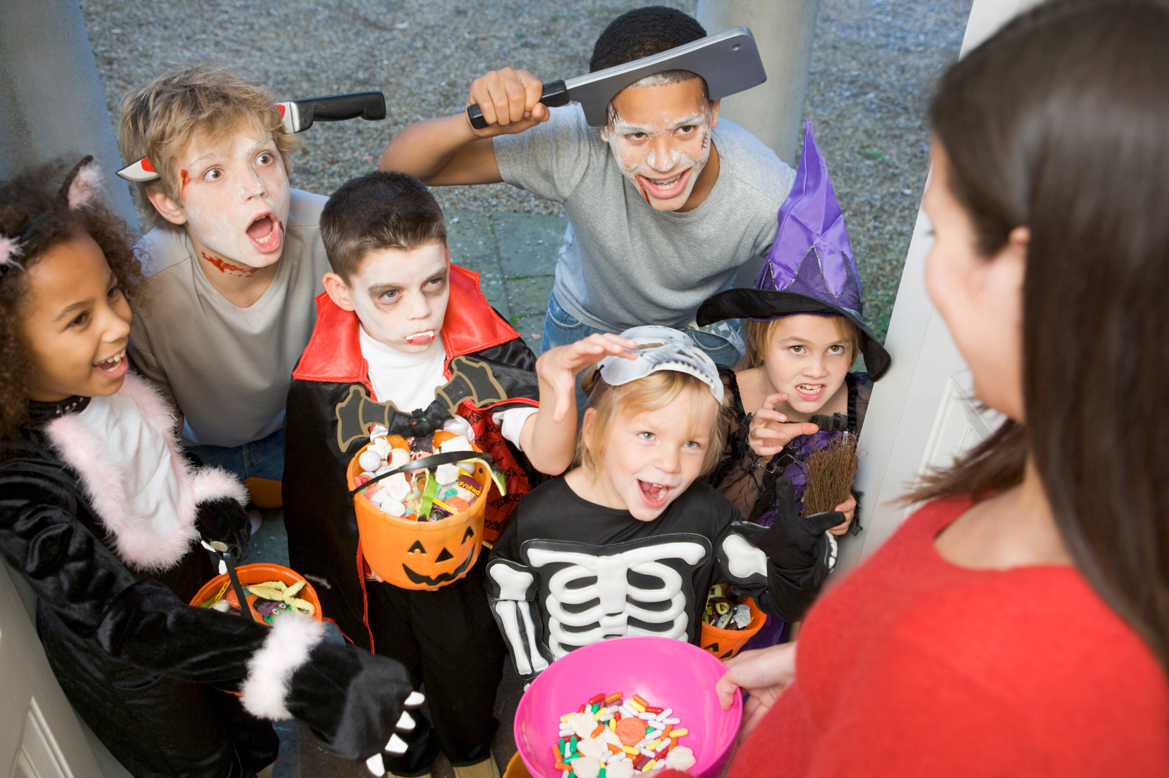
Kids love trick-or-treating: 小朋友最喜欢“不给糖，就捣蛋”了
Kids dress up in a costume and knock on neighbor’s doors: 穿上万圣节道具服，挨家挨户敲门讨糖
Kids will say “Trick or treat!” to ask for candy: 小朋友会大声说“Trick or Treat!"
A treat is a candy: “treat"这里指的就是糖果
If you don’t give out candy, kids might play a trick on you: 如果你不给糖，小朋友也许会搞个恶作剧

Slide 40
