Slide 1


感恩遇见，相互成就，本课件资料仅供您个人参考、教学使用，严禁自行在网络传播，违者依知识产权法追究法律责任。
更多教学资源请关注
公众号：溯恩高中英语
知识产权声明

Slide 2
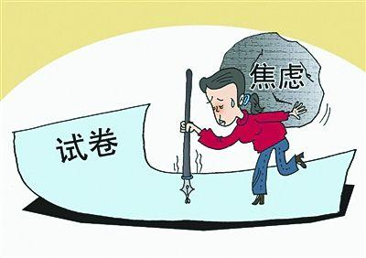
金丽衢12校联考应用文
专栏投稿
——主题：“高中生如何养成
良好的心理状态”
龙泉市第一中学 兰建珍

Slide 3
首考回顾
（2024.1首考）
请你写一篇短文向校英文报“Sports and Health” 栏目投稿，向同学们推荐一项适合课间开展的运动，内容包括：1.介绍这项运动；2. 说明推荐理由。
高考阅卷样卷（13分）
Stand Up and Exercise, Everybody!
Nowadays, we students are pressed with mounting academic demands. As a result, we experience prolonged sedentary periods and less exercise times（写作背景）. I hereby encourage everyone who is reading this passage to stand up and start jogging during the class breaks.（写作目的——推荐一项课间运动）.
Jogging, an aerobic exercise that trains all parts of your body, is both inexpensive to do and very flexible（运动介绍）. You can easily fit jogging sessions into your tight study schedule, and all you need are some comfortable clothes and a pair of trainers of your preference（推荐理由1）.Besides, jogging has several scientifically proved mental benefits, such as boosting your cognition and mental clarity with all those physical and mental benefits（推荐理由2）.
Jogging is such an excellent exercise for us students, so let's stand up and hit the trail today!（呼吁）（词数124）

Slide 4
你校英语报近期将推出一个主题为“高中生如何养成良好的心理状态”的专栏。你与美国教育专家 Dr. Smith 进行了交流后写一篇英语文章投稿，主要内容如下：
1. 交流的主要内容；
2. 交流后的收获。
注意：
1.写作词数为80左右；
2.请在答题纸的相应位置作答。
二、谋篇
Para.1: background ？ ＋purpose ？
Para.2: 交流的主要内容
（why次 + how主）
Para.3: 交流后的收获？
或呼吁（call on/appeal to/advocate）
一、审题
1. 体裁：投稿
2. 格式：（标题）+ 征文；不可用信件格式
3. 人称：第一、三人称
4. 时态： 一般过去时 & 一般现在时

Slide 5
  Para.1 background? ＋purpose? (不可用 I’m writing to...我写信...)
1 Recently, I had the opportunity to interview Dr. Smith, a renowned American education expert, on the topic of fostering a positive mindset among high school students.
2 Having communicated with the American education expert Dr. Smith about how our senior high school students form good mental health, I am hereby eager to share some pertinent information about it.
3 Nowadays high.school students have been facing pressure physically and ementally. Recently I had a conversation with an American education professor Dr. Smith, and here I’d like to share something with you.
4 As a new column themed “How to cultivate a positive mindset among senior school students” is to be rolled out by our English Newspaper, I’m glad to share my communication with Dr. Smith, an American renowned education expert.

Slide 6
Para.2 WHY to foster a positive mindset?
1 Cultivating a positive mindset among middle school students is of utmost importance. It allows us to overcome challenges, build resilience 适应力;还原能力, form healthy relationships, and nurture our overall well-being.
2 A positive mindset encourages us to seek opportunities, take risks, and persevere when faced with setbacks. It motivates us to constantly improve and develop newskills, fostering personal and professional growth. As the American author, Napoleon Hill once said/put it,"What the mind can conceive想出（主意、计划等）；想像；构想；设想 and believe, it can achieve."

Slide 7
Para.2 How to foster a positive mindset among high school students?
1 Gratitude: be aware of the importance of gratitude and maintain a gratitude journal. By focusing on the positive aspects of their lives, they develop a greater appreciation for themselves and their surroundings.
2 Goal setting: understand the power of setting realistic and achievable goals. Breaking down larger goals into smaller, more manageable tasks alows us students to experience a sense of accomplishment, boosting our confidence and motivation.
3 Emotional intelligence: Recognizing and managing their emotions equips them with the tools to navigate challenging situations in a positive and constructive manner.
4 Seeking help when needed: spending quality time with friends and family, like a relaxing sunset cruise; turn to teachers or mental health professionals when needed;
5 Learn stress management techniques: get ourselves trained on effective stress management techniques such as deep breathing, mindfulness, exercise, and time management to help us cope with academic pressures.

Slide 8
  Para.3 交流后的收获？
1 Therefore, by implementing practical strategies and fostering an environment that promotes positivity, we will be optimistic, ambitious, and well-prepared to face the opportunities and challenges that lie ahead of them.
2 I came to realize that achieving academic success in high school shouldn’t come at the expense of mental health. Dr. Smith’s insights serve as a reminder for students to prioritize their well-being while striving for excellence.
3 After our conversation, I gained insights into the effective strategies and practical tips for high school students to nurture their mental well-being. So Dr. Smith’s expertise and advice will greatly benefit our upcoming English column on fostering a healthy mindset among high school students.
4 All in all, fostering a positive mindset is of utmost importance. It’s high time we paid special attention to striking a balabce between academic pressure and personal well-being.

Slide 9
One possible version:
Recently, I had the opportunity to interview Dr. Smith, a renowned American education expert, on the topic of fostering a positive mindset among high school students.
Dr. Smith emphasized the importance of maintaining a balance between academic pressure and personal well-being. He highlighted the significance of self-care practices练习、做法 such as regular exercise, adequate sleep, and mindfulness techniques打坐冥想. According to Dr. Smith, cultivating hobbies and spending quality time with friends and family can also greatly contribute to a healthy mental state.
I came to realize that achieving academic success in high school shouldn’t come at the expense of mental health. Dr. Smith’s insights serve as a reminder for students to prioritize their well-being while striving for excellence.

Slide 10
下水作文:
As a new column themed “How to cultivate a positive mindset among senior school students” is to be rolled out by our English Newspaper, I’m glad to share my communication with Dr. Smith, an American renowned education expert.
Dr. Smith stressed cultivating a positive mindset is of utmost importance for us, which allows us to overcome challenges, build resilience 适应力;还原能力, form healthy relationships, and nurture our overall well-being. To achieve this, we are encouraged to get ourselves trained on effective stress management techniques such as deep breathing, mindfulness, exercise, and time management. Besides, breaking down larger goals into smaller, more manageable tasks alows us to experience a sense of accomplishment, boosting our confidence and motivation.
All in all, fostering a positive mindset is of utmost importance. It’s high time we paid special attention to striking a balabce between academic pressure and personal well-being.

Slide 11
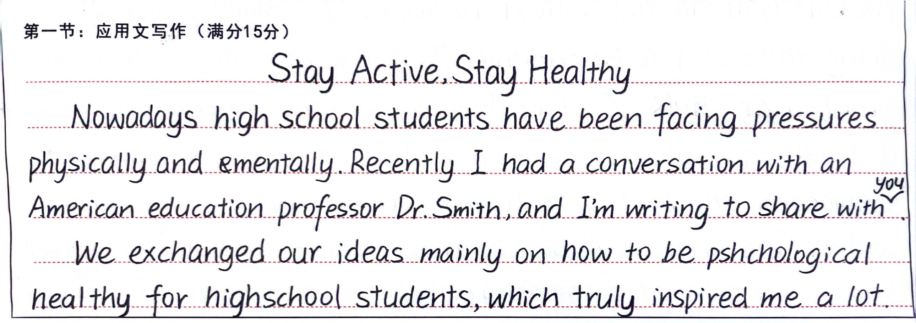
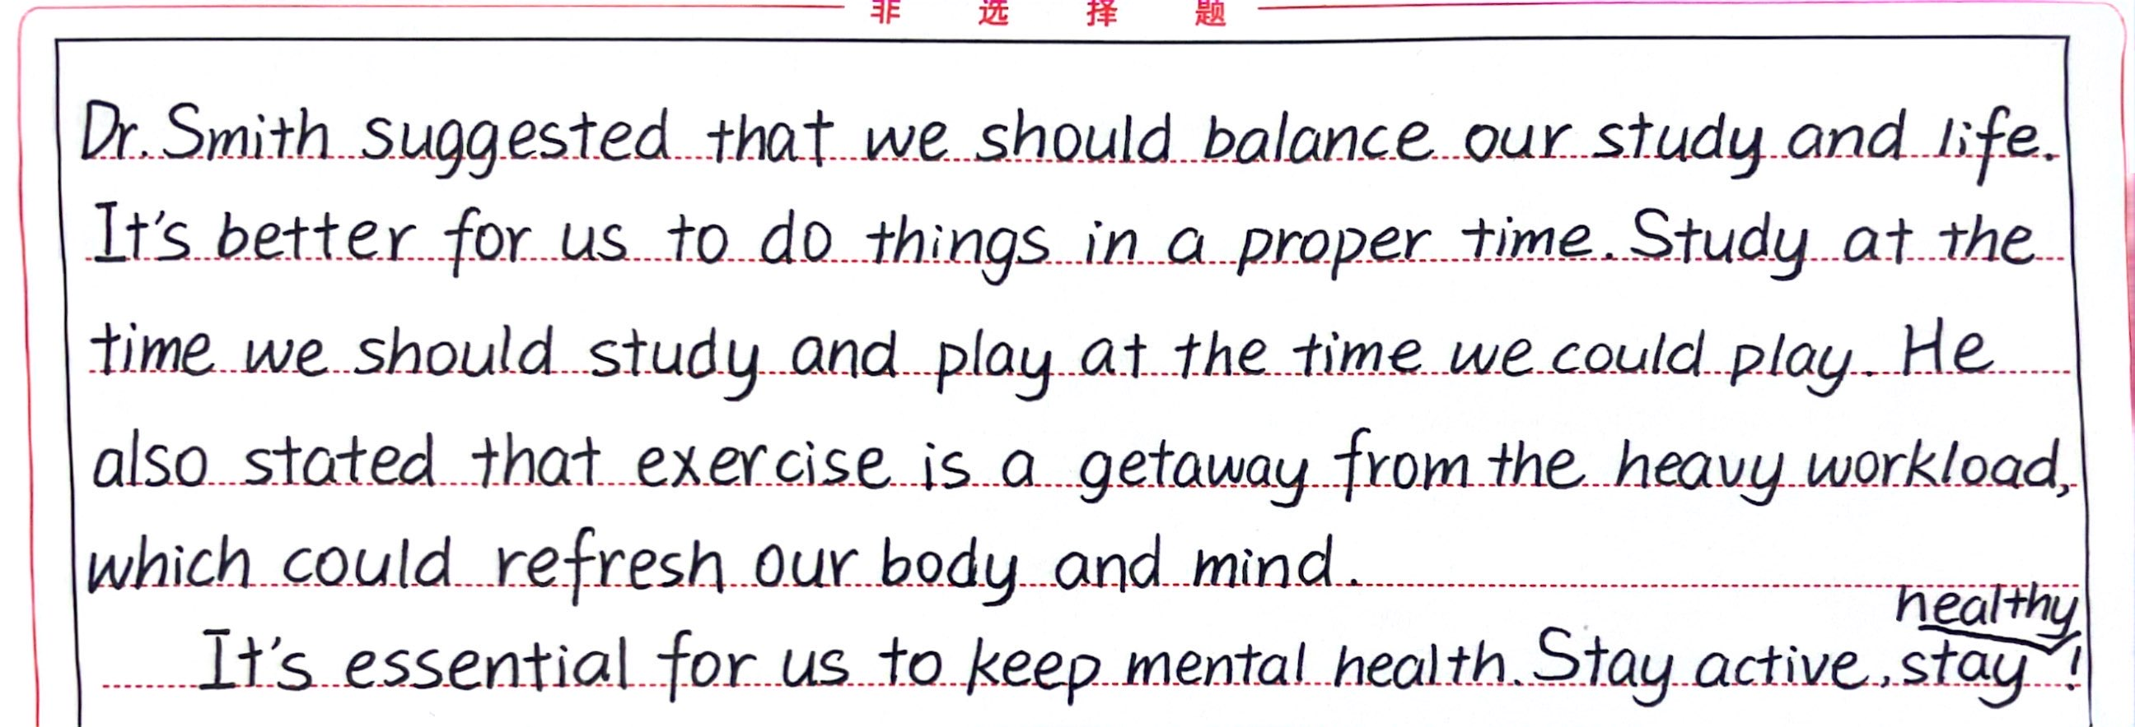

曾欣凯 13
这篇文章行文流畅，语言简练，富有美感，让人感受到作者的用心和情感。
格式规范，结构合理，层次分明，书写美观，全文从内容到语言水到渠成，首位呼应，具有较强的交际性。
但也会出现一些错误，如文章红色字体所标注的；在语言包括词、短语、句式的丰富性上做得还是不够，需要加强。

Slide 12
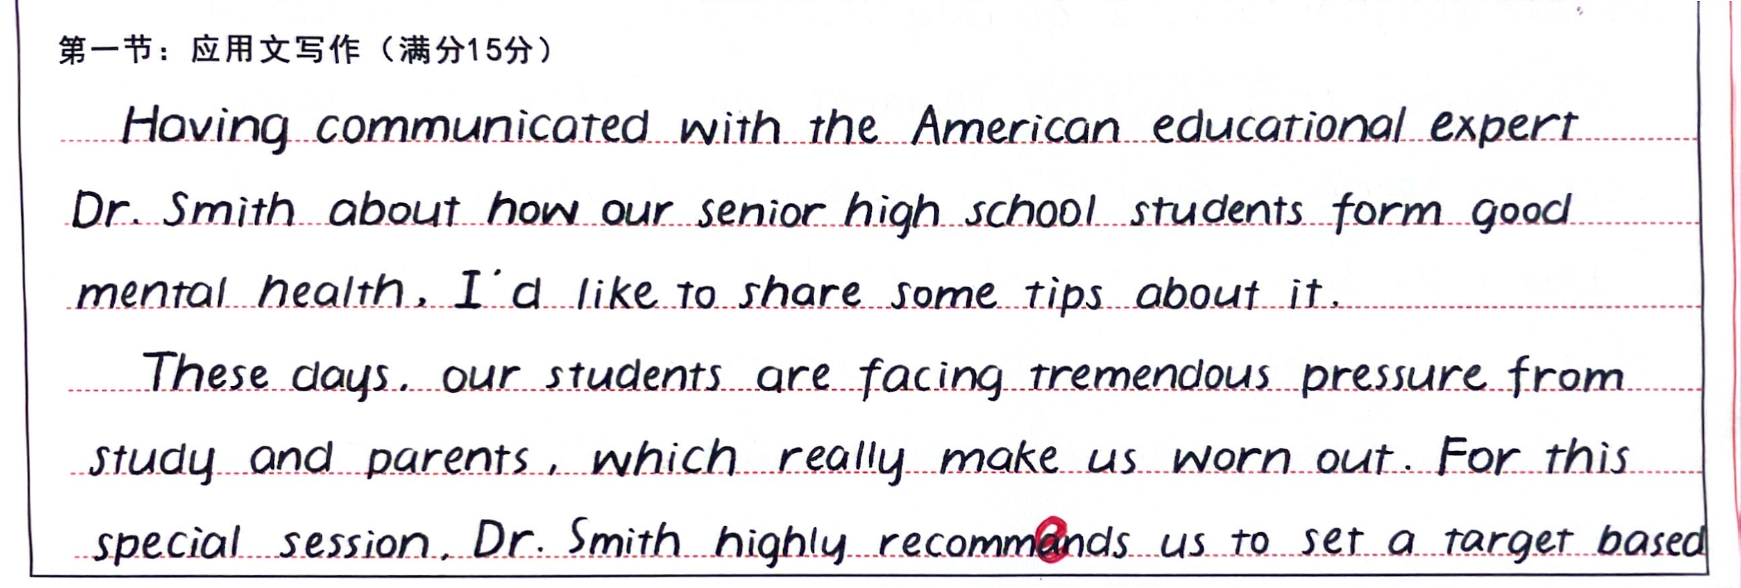
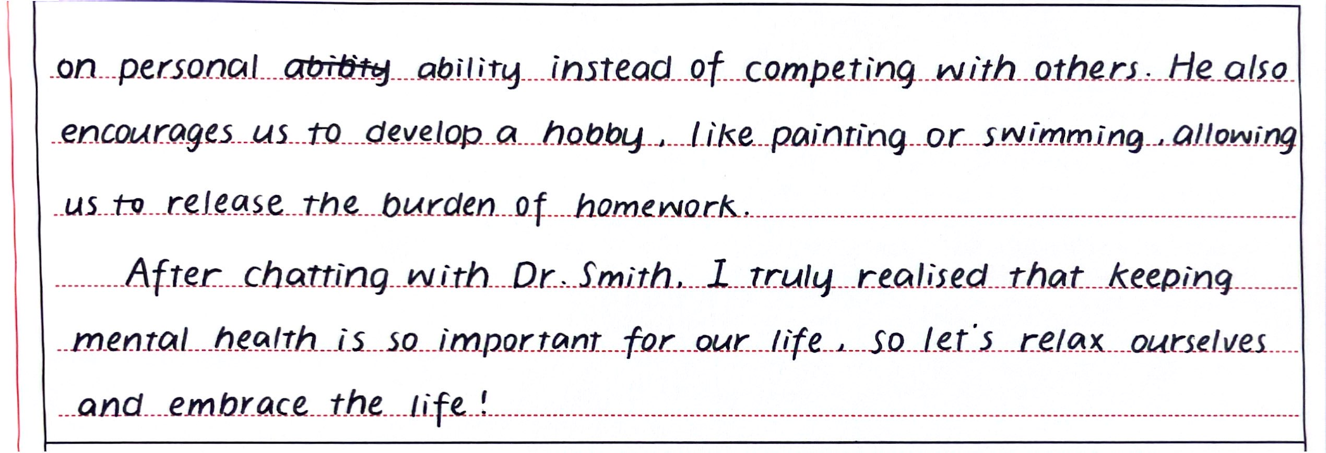





游婉诗 12
这篇应用文的格式规范，结构合理，层次分明，书写美观，使得读者能够轻松地把握作者的思路、意图和写作内容。
从写作背景＋目的;到 “高中生养成良好的心理状态”的原因和方法；再到交流后自己的收获，逻辑清晰，一气呵成，不失为一篇好文章。
但语言上若能在准确性和丰富性上有突破，那么定能锦上添花！

