Slide 1


感恩遇见，相互成就，本课件资料仅供您个人参考、教学使用，严禁自行在网络传播，违者依知识产权法追究法律责任。
更多教学资源请关注
公众号：溯恩英语
知识产权声明

Slide 2

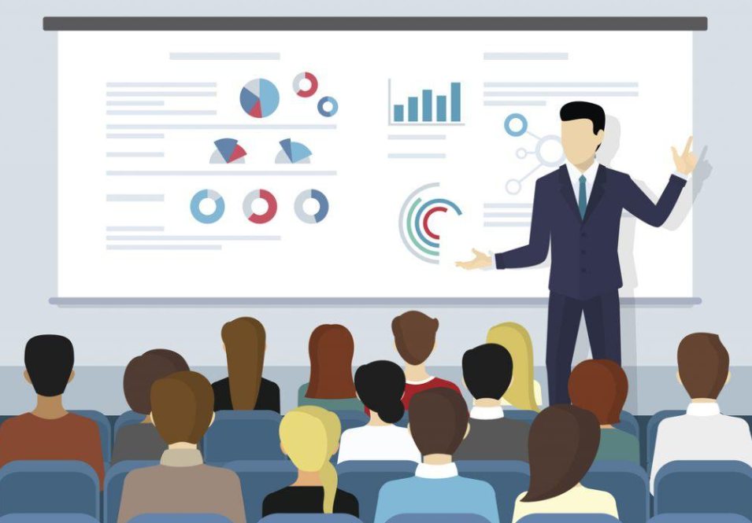
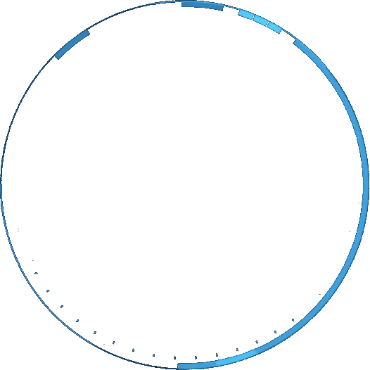




A Special Presentation

Slide 3
contents
understanding the original text
1
analyzing the given sentences
2
plotting the possible storyline
3
appreciating possible versions
4

Slide 4
  characters
  setting
  problem
  possible solution
阅读下面材料，根据其内容和所给段落开头语续写两段，使之构成一篇完整的短文。
Tom could communicate well with other people through the computer or even on the phone, but when it came to making public presentations, he was hopeless. He was aware that people at conferences would count up the times he said such things as “what I really meant to say was” when he got nervous.
Tom was an expert in Reality Robotics Company. His boss had asked him to do something that he was absolutely scared about. The next month he would be presenting on behalf of his company, and there would be a lot of people, and his boss, who had never attended Tom’s presentations, wanted to impress the audience with the innovative work that the company was doing. Tom knew his boss’s respect for him would plummet (坠落) if he said that he could not do it. So, he worked like crazy on the task.
One day, he felt a great need to relax. He turned on the TV. He laughed, and smiled through the first show, making him feel a little better. But it was the second show that really got to him, where the ventriloquist (腹语术者) Arthur worked with his dummy (假人). This really provided him with an inspiration for how he was going to make his much-feared presentation a success.
The next day, he organized a meeting of the people that had the skills he needed, and, of course, his boss. When he explained what he wanted to do, he could sense that everyone was with him on this plan. But a lot of work had to be done for the object of the plan to be completed.
It was the day of the presentation. Tom was somewhat nervous, but nowhere near to the extent that he usually was for just such a situation. And they had to get to their destination early, for what needed to be done had to be completed before the audience knew what was going on.
注意：1.续写词数应为150左右；2.请按如下格式在答题卡的相应位置作答。
Paragraph 1: The much-anticipated presentation started.
Paragraph 2: Tom walked onto the stage, looking exactly the same as the presenter.

Slide 5
understanding the original text
1. Tom was going to be presenting on behalf of his company before many people, which was what he was scared of.
2. Tom was afraid the boss’s
respect for him would fail.
Main character: Tom
A Reality Robotics Company expert
Poor at making public presentations
On the day of the presentation
1. work diligently/ tirelessly on it
2. an inspiration from a dummy show, which was supported by his boss and colleagues

Slide 6
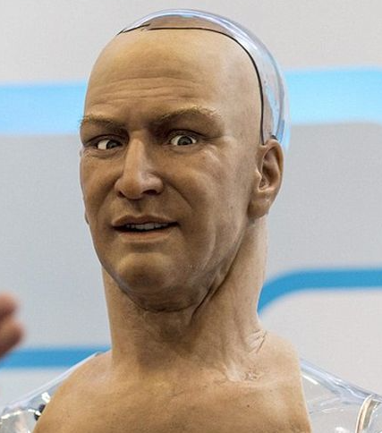
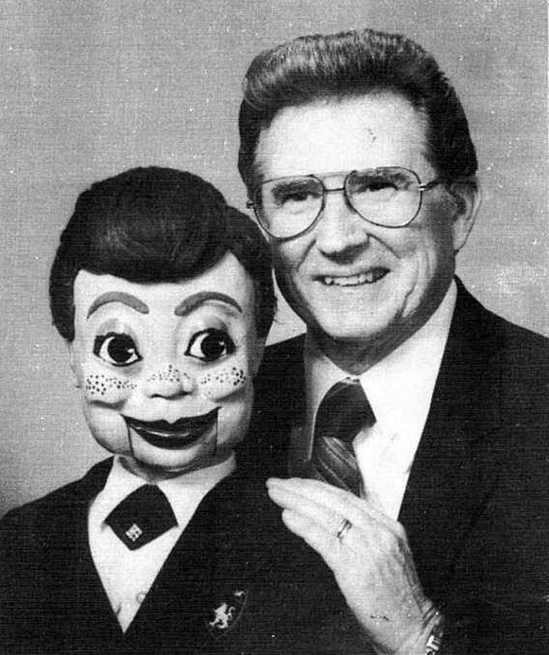

analyzing the given sentences
Paragraph 1: The much-anticipated presentation started.
Paragraph 2: Tom walked onto the stage, looking exactly the same as the presenter.
...It was the day of the presentation. Tom was somewhat nervous, but nowhere near to the extent that he usually was for just such a situation. And they had to get to their destination early, for what needed to be done had to be completed before the audience knew what was going on.
The humanoid presenter gave a presentation.
Tom revealed the truth.
humanoid
dummy

Slide 7

a ventriloquist’s show

Slide 8
plotting the possible storyline
The humanoid presenter gave a presentation.
Paragraph 1: The much-anticipated presentation started.
Paragraph 2: Tom walked onto the stage, looking exactly the same as the presenter.
1. How would Tom feel?
2. What did the presenter show to the audience?
3. How was the presentation?
4. The presentation ended.
1. How would Tom feel?
confidently put, without stumbles or “what I really meant to say was”
Tom revealed the truth.
1. How would the audience react?
2. What did Tom explain to them?
3. How did the boss and the colleagues feel?

Slide 9
What is wrong about the following article?
Paragraph 1: The much-anticipated presentation started. Tom’s heart pounded in his chest, but he kept his composure. He took a deep breath and began, his voice steady and confident. The audience was captivated by his engaging delivery and the innovative ideas he shared about Reality Robotics Company’s latest projects. Gone were the nervous stammers and “what I really meant to say was” moments. Instead, Tom spoke fluently and with authority, drawing laughter and applause from the crowd. His boss sat in the front row, a proud smile on his face as he realized that his trust in Tom had been well-placed.
Paragraph 2: Tom walked onto the stage, looking exactly the same as the presenter. The audience gasped in surprise, and then laughter erupted as they realized the clever ruse. Tom revealed the real presenter, his dummy, and the crowd roared with approval. His unique approach had not only overcome his fear of public speaking but also made the presentation memorable and engaging. As he concluded his talk, the audience stood and clapped, their applause thunderous. At that moment, Tom felt a sense of accomplishment wash over him-he had transformed from a hopeless public speaker into a confident presenter, and it was all thanks to the inspiration he had found from the ventriloquist on TV.
It mixes the identity of Tom and that of the presenter.

Slide 10
A revised version
Paragraph 1: The much-anticipated presentation started. Tom’s heart pounded in his chest, but he kept his composure. The presenter took a deep breath and began, his voice steady and confident. The audience was captivated by his engaging delivery and the innovative ideas he shared about Reality Robotics Company’s latest projects. Gone were the nervous stammers and “what I really meant to say was” moments. Instead, he spoke fluently and with authority, drawing laughter and applause from the crowd. His boss sat in the front row, a proud smile on his face as he realized that his trust in Tom had been well-placed.
Paragraph 2: Tom walked onto the stage, looking exactly the same as the presenter. At the two identical “Tom”, the audience gasped in surprise, and then laughter erupted as they realized the clever ruse. After Tom introduced the real presenter, a humanoid robot newly invented by his team, and the crowd roared with approval. His unique approach had not only overcome his fear of public speaking but also made the presentation memorable and engaging. As he concluded his talk, the audience stood and clapped, their applause thunderous. At that moment, Tom felt a sense of accomplishment wash over him-he transformed a doomed disaster into a grand success, both for himself and his company, which was all thanks to the inspiration he had found from the ventriloquist on TV.

Slide 11
appreciating possible versions
The much-anticipated presentation started. The presenter began with a small joke, and then shared some interesting facts about Reality Robotics Company before introducing the innovative work the company was doing. (演讲内容-协同) No stumbling, nor uttering of Tom’s dreaded phrase-“but what I really meant to say was...”(演讲状态-协同) Instead, the audience were totally drawn by the innovative product the presenter described. They hoped they would be given a demonstration to see how effective the new invention was.(观众状态) As the presentation neared its end, the presenter said calmly and confidently, “And now I would like to share this stage with the man who invented me.” (演讲结束-衔接下文)
Tom walked onto the stage, looking exactly the same as the presenter. The “identical twins” took the audience by surprise. (观众反应) Tom then spoke slowly, “What you have just witnessed is a demonstration of the latest invention from the company-a presentation robot.” Suddenly it all clicked (揭露真相) and the audience erupted in cheers.(观众反应) Tom then explained how the company created such a robot and programmed it to speak. “As you could see and hear, it had the confidence I could never exhibit in such a presentation. We can model it into an exact copy of you.” (演讲内容-协同) The audience got excited at the prospect.(观众反应) The boss smiled approvingly. Maybe Tom deserved a promotion, he thought. (老板反应-协同)
The much-anticipated presentation started. The presenter began with a small joke, and then shared some interesting facts about Reality Robotics Company before introducing the innovative work the company was doing. No stumbling, nor uttering of Tom’s dreaded phrase-“but what I really meant to say was...” Instead, the audience were totally drawn by the innovative product the presenter described. They hoped they would be given a demonstration to see how effective the new invention was. As the presentation neared its end, the presenter said calmly and confidently, “And now I would like to share this stage with the man who invented me.”
Tom walked onto the stage, looking exactly the same as the presenter. The “identical twins” took the audience by surprise. Tom then spoke slowly, “What you have just witnessed is a demonstration of the latest invention from the company-a presentation robot.” Suddenly it all clicked and the audience erupted in cheers. Tom then explained how the company created such a robot and programmed it to speak. “As you could see and hear, it had the confidence I could never exhibit in such a presentation. We can model it into an exact copy of you.” The audience got excited at the prospect. The boss smiled approvingly. Maybe Tom deserved a promotion, he thought.

Slide 12
language focus
From which aspects can we describe the presenter?
(Para. 1)
The presenter exuded an air of authority and expertise. (气质) With a smile that was both friendly and professional,(表情) he greeted the audience and launched into his speech with ease.(动作)
His voice was clear and confident, and he spoke with a passion that was infectious.(语气声音)
He described the robotic product with enthusiasm, highlighting its innovative features and capabilities in high spirits. (内容)
The presenter's knowledge of the subject matter was evident in every word he spoke. He seamlessly (天衣无缝地) integrated technical details with real-world examples, making the complex concepts accessible and understandable for all. (内容)

Slide 13
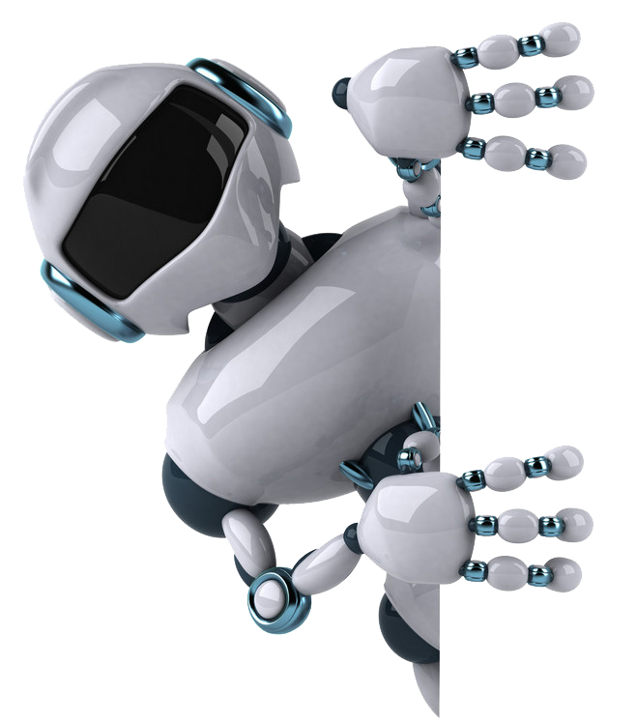
language focus
How to describe different reactions of the audience?
(Para. 1)
The audience was drawn in by his words, hanging on every syllable as he painted a vivid picture of the future this technology promised.
(Para. 2)
The crowds were fascinated by the cutting-edge technology and couldn't keep their eyes off the humanlike robot. They leaned forward in their seats, eagerly anticipating the demonstration and the capabilities this new product promised to bring.
And then some were truly excited. They clapped and cheered as the robot performed its tasks, marveling at its precision and efficiency. They saw the potential for this technology to revolutionize industries and improve people’s lives, and they couldn't wait to see what the future held/ was in store.

