Slide 1



感恩遇见，相互成就，本课件资料仅供您个人参考、教学使用，严禁自行在网络传播，违者依知识产权法追究法律责任。
更多教学资源请关注
公众号：溯恩英语
知识产权声明

Slide 2
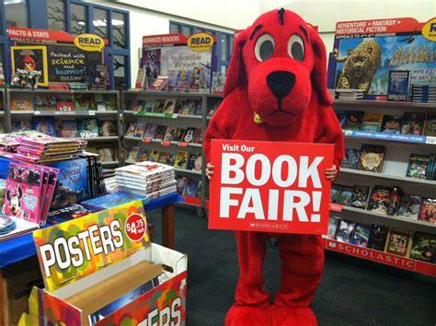
2024年3月浙江省五校联考
校园书展搭档
Experience+ Reflection 续写手法
傅嘉

Slide 3

原文本
Our school holds an annual book fair each January, where new and used books are available for students to purchase. Our librarian, Mr. Egan, is the school sponsor(主办者)for it. Traditionally, the tenth-grade students are responsible for the planning, set-up, and selling at the fair. I am sure that Mr. Egan consulted our teacher, Ms. Cates, for suggestions as to who would be the student directors, and I was pleasantly surprised when he approached me to be one of the students in charge. I was even more surprised when he told me that the student I would be working with was Charlie Lyons.
Charlie and I have known each other since kindergarten but have never been close. Ever since we were partners for the science project last year, there is very little we choose to say to each other. Needless to say, the science project fell short of our expectations. In light of that event, I was shocked that Mr. Egan and Ms. Cates found us a suitable match. At the meeting with Mr. Egan, we divided the responsibilities between us. I would be in charge of setting up the room and getting the volunteers to work the sale for all three days. Charlie would be in charge of all the books. We were both quite satisfied with our jobs, and even more satisfied that there would be little contact between us.
With only two weeks to plan, I knew I could not waste time. I asked John and Rachel to help me with the set-up and twelve other classmates to work at the fair. I figured that, between Mr. Egan, the friends who volunteered to help, and me, we would be just fine.
Meanwhile, I tried on two separate occasions to start a conversation with Charlie about the progress he was making, but each time his response was, "Everything's cool."
On the day of the set-up, my friends and I arrived, only to find Charlie with his head in his hands, surrounded by a million boxes of books. I asked him, "Charlie, what's wrong?"

Slide 4

Our school holds an annual book fair each January, where new and used books are available for students to purchase. Our librarian, Mr. Egan, is the school sponsor(主办者)for it. Traditionally, the tenth-grade students are responsible for the planning, set-up, and selling at the fair. I am sure that Mr. Egan consulted our teacher, Ms. Cates, for suggestions as to who would be the student directors, and I was pleasantly surprised when he approached me to be one of the students in charge. I was even more surprised when he told me that the student I would be working with was Charlie Lyons.
main idea
Brief introduction to our school book fair and my position as well as my partner

Slide 5
Charlie and I have known each other since kindergarten but have never been close. Ever since we were partners for the science project last year, there is very little we choose to say to each other. Needless to say, the science project fell short of our expectations. In light of that event, I was shocked that Mr. Egan and Ms. Cates found us a suitable match. At the meeting with Mr. Egan, we divided the responsibilities between us. I would be in charge of setting up the room and getting the volunteers to work the sale for all three days. Charlie would be in charge of all the books. We were both quite satisfied with our jobs, and even more satisfied that there would be little contact between us.
main idea
relation between us + the first failed science project
+ our separate tasks for the book fair

Slide 6
With only two weeks to plan, I knew I could not waste time. I asked John and Rachel to help me with the set-up and twelve other classmates to work at the fair. I figured that, between Mr. Egan, the friends who volunteered to help, and me, we would be just fine.
main idea
I got help from my friends and did my job fine.

Slide 7
Meanwhile, I tried on two separate occasions to start a conversation with Charlie about the progress he was making, but each time his response was, "Everything's cool."
main idea
Charlies was quite confident.

Slide 8
On the day of the set-up, my friends and I arrived, only to find Charlie with his head in his hands, surrounded by a million boxes of books. I asked him, "Charlie, what's wrong?"
main idea
Charlie was at loss what to do with numerous books.

Slide 9

Read for hints and echoes

Slide 10
Our school holds an annual book fair each January, where new and used books are available for students to purchase. Our librarian, Mr. Egan, is the school sponsor(主办者)for it. Traditionally, the tenth-grade students are responsible for the planning, set-up, and selling at the fair. I am sure that Mr. Egan consulted our teacher, Ms. Cates, for suggestions as to who would be the student directors, and I was pleasantly surprised when he approached me to be one of the students in charge. I was even more surprised when he told me that the student I would be working with was Charlie Lyons.
echo1:
As a student director, I should have kept track of his work progress.

Slide 11
Charlie and I have known each other since kindergarten but have never been close. Ever since we were partners for the science project last year, there is very little we choose to say to each other. Needless to say, the science project fell short of our expectations. In light of that event, I was shocked that Mr. Egan and Ms. Cates found us a suitable match. At the meeting with Mr. Egan, we divided the responsibilities between us. I would be in charge of setting up the room and getting the volunteers to work the sale for all three days. Charlie would be in charge of all the books. We were both quite satisfied with our jobs, and even more satisfied that there would be little contact between us.
echo2
My friends and I eventually helped Charlie sort out all the books into different categories and put them into their sections.

Slide 12
With only two weeks to plan, I knew I could not waste time. I asked John and Rachel to help me with the set-up and twelve other classmates to work at the fair. I figured that, between Mr. Egan, the friends who volunteered to help, and me, we would be just fine.
echo3
My job went smoothly.

Slide 13
Meanwhile, I tried on two separate occasions to start a conversation with Charlie about the progress he was making, but each time his response was, "Everything's cool."
On the day of the set-up, my friends and I arrived, only to find Charlie with his head in his hands, surrounded by a million boxes of books. I asked him, "Charlie, what's wrong?"
main idea
Charlie was overconfident and didn’t expect that he had so many books to handle. I lent him a hand together with my friends.

Slide 14

Analysis of the story --- charater and plot
Key role： I
Minor role：1. Charlie
2. Mr. Egan and Mrs. Cates
3. John, Rachel and my friends
Time： January
Cause: our school holds an annual book fair
How: Charlie and I are responsible for the planning set-up and selling
Where: in our school
Problem: Charlie didn’t do his job
Result: the book fair was a big success due to our cooperation

Slide 15
Design plots for each paragraph
Para 1: He responded in despair, "There are a lot more books here than I expected."
第一段： Charlie竟然啥都没做－－－我的情绪－－－安慰他－－－我以及我朋友帮Charlie 整理书展需要的书籍---Charlie 指挥我们---还是非常有专业性---Charlie 其实做了不少功课---合作显成效，书展大获成功。

Slide 16
Design plots for each paragraph
Para 2: After the book fair was over, I couldn't stop wondering why Mr. Egan put us together.
第二段：首次成功合作---虽有波折，但还算圆满完成任务—带着疑惑去找Mr. Egan---解惑---Mrs. Cates 殷殷希望---我的反思---Science Project 失败缘由---book fair 带给我的感悟，凸显成长---团队精神的意义。

Slide 17
三处衔接1、2处理
On the day of the set-up, my friends and I arrived, only to find Charlie with his head in his hands, surrounded by a million boxes of books. I asked him, "Charlie, what's wrong?"
Para 1: He responded in despair, "There are a lot more books here than I expected."
首段首句Link1:
A : When I heard his answer/ response/ reply, an overwhelming panic seized me.
B: When I heard his answer/ response/ reply, my heart almost froze in my chest.

Slide 18
三处衔接1、2处理
On the day of the set-up, my friends and I arrived, only to find Charlie with his head in his hands, surrounded by a million boxes of books. I asked him, "Charlie, what's wrong?"
Para 1: He responded in despair, "There are a lot more books here than I expected."
首段首句Link1:
C : Hearing this unexpected response, I was literally dumbfounded!

Slide 19
三处衔接1、2处理
Para 1: He responded in despair, "There are a lot more books here than I expected."
Para 2: After the book fair was over, I couldn't stop wondering why Mr. Egan put us together.
首段尾句Link2: A
Amazingly, Charlie was so organized that everything went smoothly under his guidance. The book fair, attracting numerous readers, was a great success thanks to our perfect cooperation / collaboration.

Slide 20
三处衔接1、2处理
Para 1: He responded in despair, "There are a lot more books here than I expected."
首段尾句Link2: B
Charlie guided us to sort out all the books into different categories efficiently and professionally. Obviously, he devoted much time to doing research into this unfamiliar field. Thanks to his expertise and our perfect cooperation , the book fair was held as scheduled and was well received by teachers and students.

Slide 21
三处衔接1、2处理
Para 1: He responded in despair, "There are a lot more books here than I expected."
Para 2: After the book fair was over, I couldn't stop wondering why Mr. Egan put us together.
首段尾句Link2: C
After what seemed like centuries, all the books were categorized and put into different sections of the room. Everything being perfect ，the book fair was really a big success， attracting much attention from young readers.

Slide 22
衔接处3处理
Para 2: After the book fair was over, I couldn't stop wondering why Mr. Egan put us together.
二段首句Link3: A：
This was the first time that the co-work between Charlie and me paid off.

Slide 23
衔接处3处理
Para 2: After the book fair was over, I couldn't stop wondering why Mr. Egan put us together.
二段首句Link3: B
I still remembered Mr. Egan and Mrs Cate thumbed up for our joint efforts to make the book fair so wonderful.

Slide 24
结尾句(句群）处理
Para 2: After the book fair was over, I couldn't stop wondering why Mr. Egan put us together.
Ending sentences:
I did owe my gratitude to Mr. Egan and Mrs. Cates because they revealed /demonstrated that strong teamwork spirits do play a critical role in cooperation projects and individualism makes little sense.

Slide 25
各段句间主语平行或交叉进行叙事
Para 1: He responded in despair, "There are a lot more books here than I expected."
（ 时间状语从句：+情绪描写：惊慌）
When I heard his answer/ response/ reply, an overwhelming panic seized me.
2. （非谓语：我的自责）
Being his partner/ teammate, I should have kept track of his progress instead of just asking about it.

Slide 26
各段句间主语平行或交叉进行叙事
3. （It 句型： 埋怨没有意义)
However, it was useless complaining about his overconfidence.
4. (二连动：赶紧补救，体现我作为负责人的领导力）
I took a glance at the million boxes of books in the room and assessed the time that we would spend in sorting out all the books.

Slide 27
5. （简单句+doing sth: 使Charlie振作）
“Come on. My friends and I will lend you a hand. Tell us how to launch the mission.” I cheered him up, smiling.
6. （非谓语doing sth + 二连动：Charlie 的行动力）
Hearing that, Charlie cast me a grateful look and quickly assigned my friends and me different tasks of arranging all the books.

Slide 28
（状语从句： 一切紧张顺利）
Amazingly, Charlie was so organized that everything went smoothly under his guidance.
（ 非谓语：书展非常成功，合作很完美）
The book fair, attracting numerous readers, was a great success thanks to our perfect cooperation / collaboration.

Slide 29
各段句间主语平行或交叉进行叙事
Para 2: After the book fair was over, I couldn't stop wondering why Mr. Egan put us together.
1. （定语从句 ：第一次合作有了成效）
This was the first time that the co-work between Charlie and me paid off.
2. (介词短语表让步：齐心协力完成任务）
In spite of an unexpected episode of the book fair, Charlie and I, with my friends’ help, accomplished the seemingly impossible task.

Slide 30
各段句间主语平行或交叉进行叙事
Para 2: After the book fair was over, I couldn't stop wondering why Mr. Egan put us together.
（倒装句：+ 带着困惑找Mr. Egan）
No sooner had the book fair ended than I approached Mr. Egan with my confusion/ puzzle.
4. （非谓语：Mr. Egan 解惑）
Smiling gently at me, Mr. Egan said that Mrs. Cates told him about something about our failed science project.

Slide 31
5. （被动语态+宾语从句：Mrs Cates 对我殷切希望）
Beyond that, I was also told that Mrs. Cates hoped that the book fair could make a difference to me.
6. （doing sth +定语从句+表语从句：反思去年科学课题合作失败的缘由）
Looking back on last year’s science project, I realized that the reason why our first cooperation in science project ended in failure was that we lacked necessary communication and teamwork.

Slide 32
7. （原因状语从句+宾语从句：感恩老师让我感悟+成长）
I did owe my gratitude to Mr. Egan and Mrs. Cates because they revealed me that strong teamwork spirits do play a critical role in cooperation projects and individualism makes little sense.

Slide 33
习作欣赏
Para 1: He responded in despair, "There are a lot more books here than I expected." When I heard his answer/ response/ reply, an overwhelming panic seized me. Being his partner/ teammate, I should have kept track of his progress instead of just asking about it. However, it was useless complaining about his overconfidence. I took a glance at the million boxes of books in the room and assessed the time that we would spend in sorting out all the books. “Come on. My friends and I will lend you a hand. Tell us how to launch the mission.” I cheered him up, smiling. Hearing that, Charlie cast me a grateful look and quickly assigned my friends and me different tasks of arranging all the books. Amazingly, Charlie was so organized that everything went smoothly under his guidance. The book fair, attracting numerous readers, was a great success thanks to our perfect cooperation / collaboration.

Slide 34
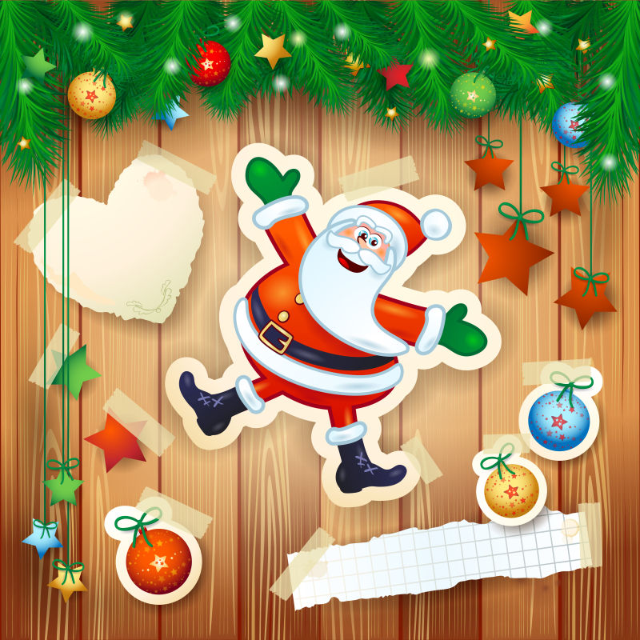
Para 2: After the book fair was over, I couldn't stop wondering why Mr. Egan put us together. This was the first time that the co-work between Charlie and I paid off. In spite of an unexpected episode of the book fair, Charlie and me, with my friends’ help, accomplished the seemingly impossible task. No sooner had the book fair ended than I approached Mr. Egan with my confusion. Smiling gently at me, Mr. Egan said that Mrs. Cates told him about something about our failed science project. Beyond that, I was also told that Mrs. Cates hoped that the book fair could make a difference to me. Looking back on last year’s science project, I realized that the reason why our first cooperation in science project ended in failure was that we lacked necessary communication and teamwork. I did owe my gratitude to Mr. Egan and Mrs. Cate because they revealed to me that strong teamwork spirits do play a critical role in cooperation projects and individualism makes little sense.

Slide 35
Brief Introduction to BOOK FAIR
---Refer to the teaching plan

