Slide 1


感恩遇见，相互成就，本课件资料仅供您个人参考、教学使用，严禁自行在网络传播，违者依知识产权法追究法律责任。
更多教学资源请关注
公众号：溯恩英语
知识产权声明

Slide 2
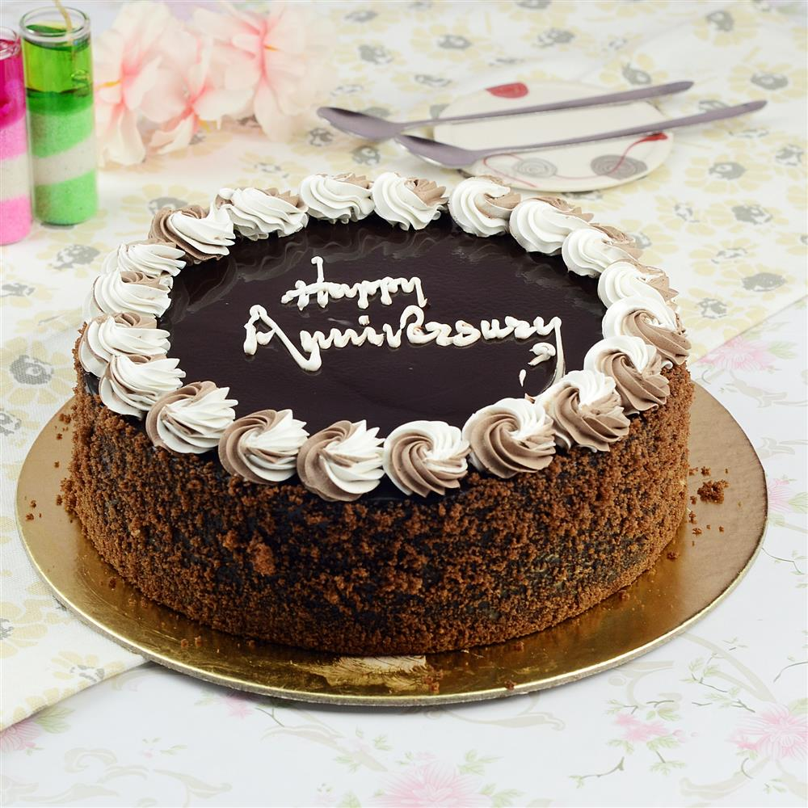
A Lumpy, but Loving Chocolate Cake
＊Something that is lumpy contains lumps or is covered with lumps.

Slide 3
【续写原文】 Cindy nervously glanced at the clock on the kitchen wall. Five minutes before midnight. Her parents were still out there celebrating their 15th anniversary. “They should be home any time now,” she thought as she put the finishing touches on the chocolate cake. It was the first time in her 12 years she had tried to make a cake from zero, and to be honest, it wasn't exactly an artistic success. The cake was... well, lumpy. And the coating was bitter, as if she had run out of sugar or something. Which, of course, she had.
And then there was the way the kitchen looked. Imagine a huge blender (食物搅拌器) filled with all the stuff needed for chocolate cake - including the bowls, plates and tools. Now imagine that the blender is turned on. High speed. With the cover off. Do you get the idea? But Cindy wasn't thinking about the mess. She was anxious for her parents to return home from their date. So she could present her anniversary gift to them. Picturing her parents' surprised faces when they saw the cake, she could feel a wave of excitement washing over her. She turned off the kitchen lights and waited excitedly in the darkness, hoping to give her parents a big surprise. Time seemed to her to be crawling with feet of lead while she anxiously awaited her parents' arrival.
When at last she saw the flash of the car headlights, she positioned herself in the kitchen doorway, her heart thumping like a drum. By the time she heard the key sliding into the front door, she was THIS CLOSE to exploding. Assuming Cindy was already sound asleep, her parents tried to steal in quietly, but Cindy would have none of that. She turned on the lights dramatically and trumpeted "Ta-daaa!" She gestured grandly toward the kitchen table, where a slightly off-balance chocolate cake awaited their inspection.

Slide 4
Step 1: Read for the basic information.
Who:
When:
Where:
....When at last she saw the flash of the car headlights, she positioned herself in the kitchen doorway.
...Assuming Cindy was already sound asleep, her parents tried to steal in quietly.
How did Cindy feel?
excited&anxious&nervous
1. She turned off the kitchen lights and waited excitedly in the darkness, hoping to give her parents a big surprise.
2. Time seemed to her to be crawling with feet of lead while she anxiously awaited her parents’ arrival.
3. ...her heart thumping like a drum
4. By the time she heard the key sliding into the front door, she was THIS ClOSE to exploding.
Why did Cindy feel excited and anxious?
Cindy; her mother; her father
注意人称
at midnight
outside the kitchen
give her parents a big surprise.

Slide 5

Assuming Cindy was already sound sleep, her parents tried to steal in quietly, but Cindy would have none of that. She turned on the lights dramatically and trumpeted “Ta-daaa!” She gestured grandly toward the kitchen table, where a slightly off-balance chocolate cake awaited their inspection.
gestured grandly toward the kitchen table,
Step 2: Read for the problem/conflict/change :
Para.1: But her mother’s eyes never made it all the way to the cake.
conflict
between Cindy and her mother
misunderstanding
her father
What did her mother look towards? What did she see?
Look towards the kitchen
The mess
Para. 4: And then there was the way the kitchen looked. Imagine a huge blender filled with all the stuff needed for chocolate--including the bowls, plates and tools. Now imagine that the blender is turned on. High speed. With the cover off.
伏笔
Step 3: Infer the proper plot and think of relevant expressions
Scene 1:
Scene 2:
Scene 3:
The mess in the kitchen her mother saw and her reaction.
angry
Cindy’s reaction.
sad/disappointed&embarrassed
The atmosphere in the house & Cindy’s father saw something special on the kitchen table.
Para.2: “Wow, look at the beautiful chocolate cake,” her father exclaimed.

Slide 6

The plots you wrote：
1. 妈妈看到一片凌乱但是不生气，还关心我手受伤没；
2. 妈妈看到一片狼藉后，就去睡觉了，爸爸很生气；
3. 妈妈生气因为我半夜还没上床睡觉；
4. 第一段就向妈妈解释蛋糕的事情；
5. 爸爸在外面停车，第一段结尾才走进来；
Are they proper?

Slide 7
Para. 2: “Wow, look at the beautiful chocolate cake,” her father exclaimed.
Scene1:
lumpy and slightly off-balance
Cindy’s mother saw the cake and understand everything/Cindy poured out everything.
mother : guilty
妈妈瞬间明白一切
1. Suddenly, it all clicked into place.(一切豁然开朗)
2. It was a sudden moment of clarity for her mother.
4. In a flash/In the blink of an eye/In a split second, the realization dawned on her mother.
感到愧疚
1. At the thought of her harsh words and fierce anger at her loving daughter, she was seized by a pang of conscience.
2. A strong sense of guilt crept up on her heart.
愧疚感涌上心头
Scene 2:
happy
Cindy’s mother apologized to Cindy and Cindy ’s reaction
开心：1. Sustained ripples of rapture interwoven with undisguised excitement surged through Cindy’s entire being. 2. Cindy’s face lit up with a radiant smile.
Scene 3:
Ending : Enjoyed the loving cake.
a harmonious scene

Slide 8
Ending:
【画面定格】The bright moon held above in the starry sky, the elaborately prepared cake flavored with deep love, the broad smiles illuminating their faces blended to be a harmonious scene.
【自然情节】 They gathered around the table, and amid laughter and stories, they enjoyed the cake together, savoring each sweet and bitter bite as a cherished memory in the making.
【主题升华】 Love is a magician----not only can it sweeten the bitter cake, but also make the imperfect cake perfect for the family celebration.

Slide 9
妈妈看到的是...
1. Her mother's eyes landed/fell/descended upon the complete mess.
2. What caught her mother’s eye was the utter chaos.
3. The image that unfolded before her mother’s eyes was...
厨房的混乱场景
1. The kitchen had become a battlefield in a war started by chocolate — chocolate fingerprints were stamped on the white walls, bowls, plates and tools with chocolate-colored goo(粘稠物质) were scattered over the marble countertops(厨房台面), and cocoa powder was sprinkled like snow over the smooth tiles.

Slide 10
“Why do you do that? Don’t you know how hard to clean it?”
“Why do you always bother me, even on my anniversary?”
“What have you done? Cindy!” Mom’s voice was shaking/She said in fury, frowning and pulling a long face.
【直接引语要简练扼要！】

Slide 11
感到失望：
1. Cindy was rooted to the ground. Her previous excitement and expectations all vanished, which was replaced by/ gave way to a sense of bitter disappointment.（情绪转变）
2. Cindy felt a pang of disappointment and a sharp tug at her heartstrings, tears blurring/misting her eyes.
3. Her heart sank to the bottom.
沉默/死寂：
1. The house was engulfed in total silence.
2. Dead silence descended upon the house.
站在原地一动不动
伤心

Slide 12
Appreciate the possible versions!!!

Slide 13
【Possible version】
But her mother’s eyes never made it all the way to the cake. Instead, they landed on the chaos in the kitchen. Flour was scattered like snow over the countertops, and chocolate fingerprints were stamped across the tiles(瓷砖). Amid this chaos, Cindy stood, a nervous smile flickering(一闪而过) on her face, her hands coated in a mix of sugar and flour. “W-What have you done, Cindy?!” her mother asked, her trembling voice filled with noticeable anger. Cindy’s heart sank. All her efforts to prepare the cake seemed to have just backfired(适得其反). She stammered to explain herself but words failed her, her mind in a total blank. Cindy looked up at her father as if asking for help.
“Wow, look at the beautiful cake!” her father exclaimed. He came over and rubbed her head affectionately. Cindy was reduced to tears. Between sobs, she poured out everything. Her mother’s stern expression softened as she realized all Cindy had done was to give them an anniversary surprise. “I’m sorry, honey.” She gently wiped her tears away and the next second Cindy was in a tight embrace. “Let’s clean the kitchen together!” suggested her father. Soon everything was back in place and they sat around the table for the cake. Slightly off-balanced and bitter as it was, it tasted surprisingly delicious for them. The imperfect cake was just perfect for the celebration as a family.

