Slide 1


感恩遇见，相互成就，本课件资料仅供您个人参考、教学使用，严禁自行在网络传播，违者依知识产权法追究法律责任。
更多教学资源请关注
公众号：溯恩英语
知识产权声明

Slide 2


Slide 3

The Evaluation Standards Of NEMT（Score:13-15）
01 覆盖了所有内容要点。
02 语法结构与词汇丰富性；应用了较多的语法结构和词汇；
03 语法结构与词汇的准确性；有些许错误，但为尽力使用较复杂结构或较高级词汇所致；具备较强的语言运用能力。
04 上下文的连贯性；有效地使用了语句间的衔接手段，使全文结构紧凑。
Just listed ones?
A single subject? All simple sentence? Diversity of expression can be realized by?
What dominate the accuracy of expressions?
言
Linking words+ Contents/ Structure
颜
+
How to realize it?

Slide 4
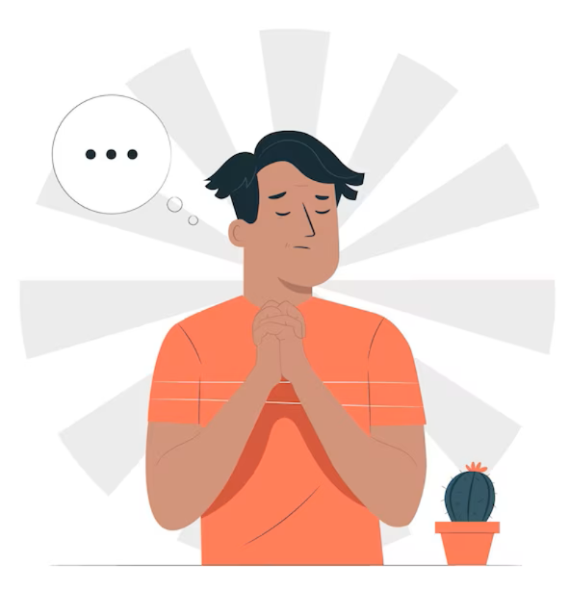
假定你是李华，毕业在即，你校英文报举办了以“An Unforgettable Activity in High School”为主题的征文活动。请你写一篇英文短文投稿，分享一次你参加过的校园活动。内容包括：
1.活动内容。2.活动感受。
注意：1.写作词数应为80左右；
2.请按如下格式在答题卡的相应位置作答。
Question Review:
1. Genre:
2. Tense:
3. Person:
4. Voice:
5. Points:
6. Structure:
ACCURACY!
Any HIDDEN one?
--WHY IT?
①Introduction
②About the activity
③ Feelings (Why it?/Conclusion)
Realistic school life is MONOTONOUS...
Have NO idea about the activities....
--What could be the solutions?

Slide 5
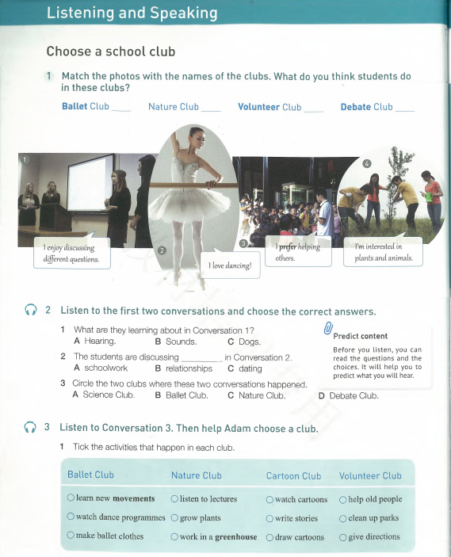
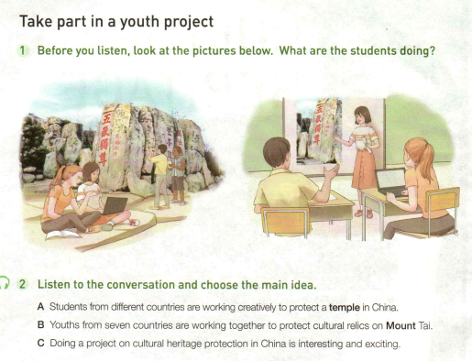
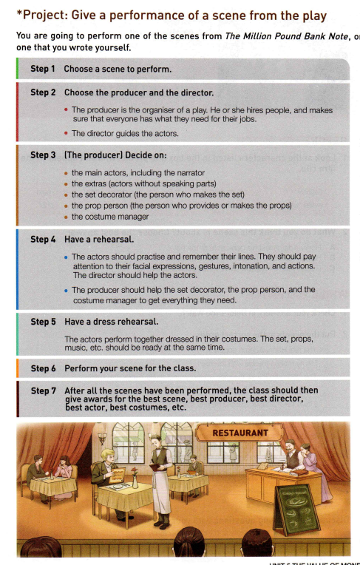
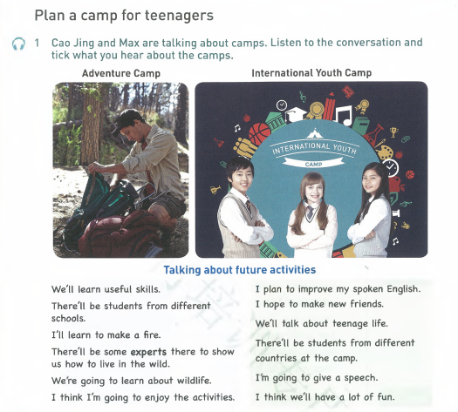
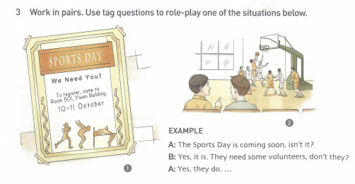
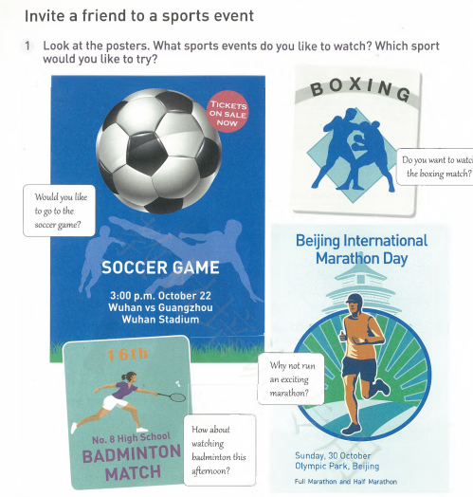
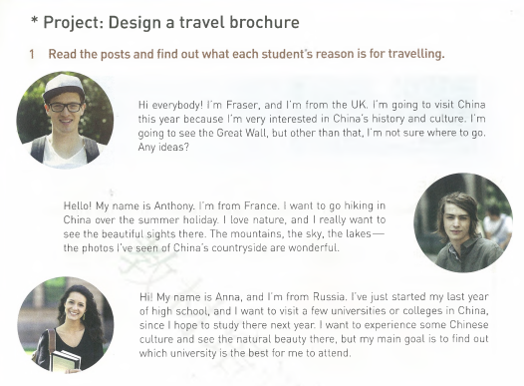
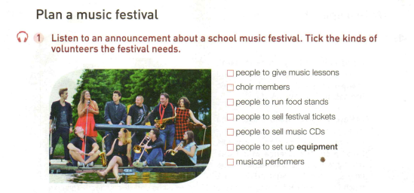
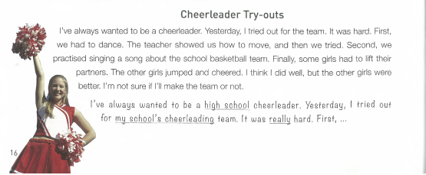
BORROWING THE ACTIVITIES FROM TEXTBOOKS
More to be recalled by you...

Slide 6

BORROWING THE ACTIVITIES FROM NEMT
【2023浙江卷1月】上周末你参加了校学生会组织的“认识我们身边的植物”活动。请为校英文报写篇报道，内容包括：1. 活动的过程；2. 收获与感想。
【2022浙江1月卷】假定你是李华，在“中国——爱尔兰文化节”活动中结识了爱尔兰朋友Chris，现在他已回国，请你给他写一封邮件，内容包括：1. 回忆活动经历；2. 分享个人收获；3. 希望保持联系。
【2022新高考卷I】假定你是校广播站英语节目“Talk and Talk”的负责人李华，请给外教Caroline写邮件邀请她做一次访谈。内容包括：1.节目介绍；2.访谈的时间和话题。
【2020新高考卷I】 假定你是李华，上周日你校举办了5公里越野赛跑活动。请你为校英文报写一篇报道，内容包括：1. 参加人员；2. 跑步路线：从校门口到南山脚下；3. 活动反响。
【2017年全国II卷】假定你是李华，想邀请外教Henry一起参观中国剪纸（paper-cutting）艺术展。请给他写封邮件，内容包括：1. 展览时间、地点；2. 展览内容。

Slide 7
BORROWING THE ACTIVITIES FROM PRACTICE EXAMS
【2024年九省联考】你校英文报计划举办主题为“携手行动，节约粮食”的作文比赛，请你写一则活动通知，内容包括：1. 介绍活动目的；2. 说明参赛要求。
【2023年Z20名校联盟】假定你是李华,上周末你参加了学校组织的市科技馆研学活动。请你在校英文论坛发表一篇帖子,分享此次经历,内容包括:1.活动过程; 2.个人感悟; 3.期待评论。
【2023年湖北圆创联盟】假定你是李华，你校于上周五举行了趣味运动会，你的新西兰朋友Terry很想了解该活动，请你给他写一封邮件,内容包括:1.趣味运动会情况；2.你的感受和收获。
【2023四省联考】你刚观看了你校与英国一所友好学校联合在线上举办的音乐会。请在线上留言板上写一则评论,内容包括:1. 音乐会特点；2. 观看感受；3. 意见建议。
【2023温州二模】假定你是学校官网英语版学生编辑李华，校学生会将举行送你一朵花（A Flower for You）活动,请你写一则倡议,内容包括:1. 活动目的；2. 活动内容；3. 呼吁参加。
【2023金华十校】假定你是某国际学校的学生会主席李华,你校即将组织急救演练,请你用英文写一则书面通知,内容需包括演练的时间、地点及参与人员,演练的具体内容以及注意事项等

Slide 8
SORTING THEM OUT:
Club Activites
Talent Show
Adventures
Sports& Music
Practical Activities
Cultural Communication
...
ABOUT THE ACTIVITY:
Time
Location
Participants
Process
Highlight(s)
Characteristics
...
FEELINGS RELATED TO:
Experiences
Gains
Personal
Collective
More significant
...
“DRAFTING THE ESSAY
by
STICKING TO THE REQUIREMENT”

Slide 9

“SENTENCE PATTERNS& LINKING WORDS”
Introduce the topic:
Looking back at our exciting high school days, it's hard to forget that extraordinary...
High school, the stage where confidence meets curiosity. One of our biggest leaps was...
About the activity:
Merely Basic Info.?
... was a celebration of ..., which brought out the best in us.
The day of ...was a showcase of ..., which was an symbol of our hard work and dedication.
The journey through ...was paved with ..., each leaving us with newfound insights and cherished memories.
Conclusion:
It’s obviously that the activity was more than just a high school event; it was a remarkable chapter in our coming-of-age story.
Linking Words:
As we know...
start with
in turn
For one thing.... For another...
Furthermore/ Morover/ Plus/ Better still,....
For instance,.../ like....
Similarly/Likewise...
Following this,...
Briefly Speaking
...
Draw Attention
Add Intrigue
Set The Tone
More Than An Activity
Can you brainstorm more?
growth and learning about...
leaving an imprint in...
enduring impact on...
a stepping stone to...
the farewell note of...

Slide 10
“OFFICIAL VERSION”
An Unforgettable Activity in High School
My high school has witnessed many colorful activities in the past 3 years, among which the coming-of-age ceremony is especially unforgettable. Present at the ceremony were all we students from Grade 3, along with our parents and teachers. It kicked off with an inspiring speech delivered by our president, which conveyed congratulations and anticipations about our future. Then came a series of activities, ranging from expressing gratitude to our parents and teachers to making a promise of being responsible for the adulthood. The highlight was when we walked through the coming-of-age gate. The ceremony will be rooted in my mind as a reminder that I should shoulder my responsibility as an adult.
Introduce the topic
Details:
participants/ process/ contents/ highlight...
Feeling/ Reflection
(Be Concrete& Various Expressions)
(Why it?- Not Limited To The Activity.)

Slide 11
“TEACHER’S VERSION”
An Unforgettable Activity in High School
If there is one event that my high school heart will always remember, it is the annual Fire Safety Drill. It was an ordinary weekday morning until the resounding blare of the fire alarm echoed through the school corridors, signaling the start of the activity. Recalling what the firefighter instructed in previous lecture, we students all evacuating in an orderly manner, sticking to the safety principles. The twist was a mock fire extinguishing operation, where students volunteered and cooperated with peers to deal with fires with proper tools like extinguisher and rescue pretend victims. Feelings of responsibility, teamwork and selflessness flooded throughout this event. It prepared us for unexpected situations and symbolized our unity in crises. An unforgettable lesson indeed!
Introduce the topic
brief& to the point
Details:
time/ participants/ process/ highlight/ details...
Feelings/ Significance& Gain (Why?Self and More)
(Be Concise& Immersing)

Slide 12

假定你是李华，毕业在即，你校英文报举办了以“An Unforgettable Activity in High School”为主题的征文活动。请你写一篇英文短文投稿，分享一次你参加过的校园活动。内容包括：
1.活动内容。2.活动感受。
注意：1.写作词数应为80左右；
2.请按如下格式在答题卡的相应位置作答。
“AFTER WRITING”
How about adapting it into a report?
What should we pay attention to?

