Slide 1



感恩遇见，相互成就，本课件资料仅供您个人参考、教学使用，严禁自行在网络传播，违者依知识产权法追究法律责任。
更多教学资源请关注
公众号：溯恩英语
知识产权声明

Slide 2

2024年浙江省高二精诚联盟英语
试卷讲评课件
傅嘉

Slide 3
PART 1
阅读理解

Slide 4
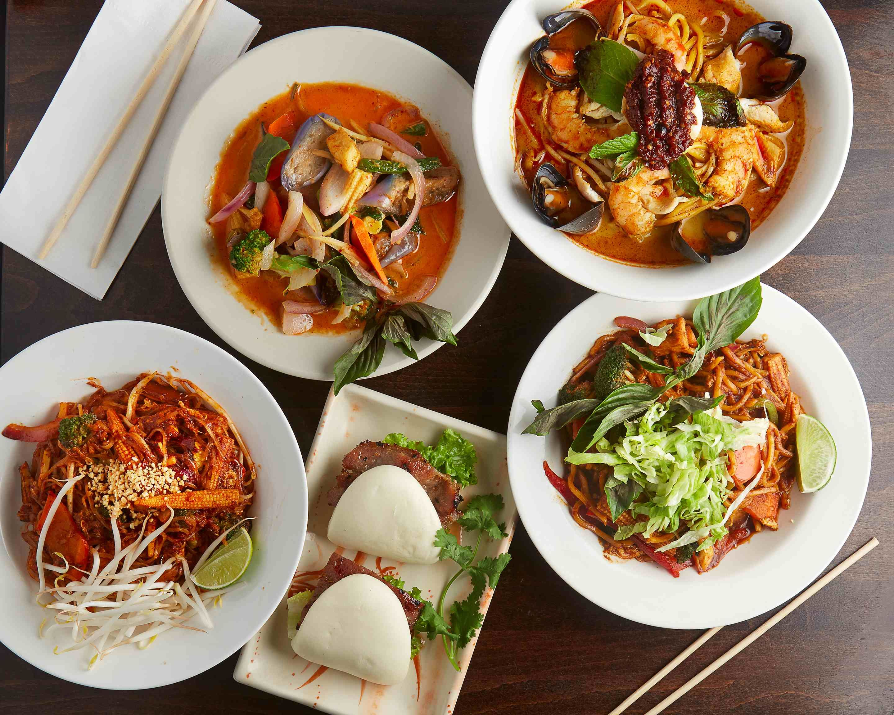
A 篇
介绍一家名为LoveMama 的餐馆

Slide 5


主题语境--人与社会
A 篇：应用文
History
(Para2) Established in 2013. With humble beginnings as a food cart, the popularity of Love Mama's Malaysian street food boosted to opening a Manhattan restaurant in 2014.
点击添加标题
Manhattan：美国纽约辖区和中心区
曼哈顿（Manhattan）， 是美国纽约市5个行政区之中人口最稠密的一个区，也是最小的一个行政区
细节理解题
21. In which country is the LoveMama restaurant located?
A. In Thailand. B. In America.
C. In Malaysia. D. In Vietnam.

Slide 6
(Para5) My boyfriend forgot to tell them about allergies and told them halfway as they were preparing our order. They responded really well. In the end, we even got to have a nice conversation with the owner of the restaurant. Super great guy! We were pleasantly surprised with the low price at the end of the meal too. If you are in New York, you have to check out LoveMama. Best meal I have had in a while.—Mary Brooklin
点击添加标题
22. What specialty about this restaurant is true?
A. It’s centuried and reopened in 2014.
B. It can provide take-out orders except noodles.
C. It runs with customer-friendly business strategies.
D. It is an independent restaurant and runs around the clock.
细节理解题

Slide 7
Stopped by here for Valentine's Day and we were not disappointed. We got 3 different dishes all from the Malaysian portion of the menu as none of us had ever had Malaysian food. While the service was not good, we didn't mind at all. For $20 each with tip and feeling full and happy, this is a spot I'd definitely recommend! —Peter Anderson
点击添加标题
time-honored 历史悠久的 cost-effective 划算的；
23. How does Peter Anderson find this restaurant?
Disappointing. B. Average.
C. Time-honored. D. Cost-effective.

Slide 8
A 篇：语料库
1.specialties 特色；特别之处
2.takeout 外卖
3.cater for individuals and groups 为散客和团体提供餐饮服务
4. humble adj. 不起眼的；卑微的；
5.review n. 评论
6.stop by 停留；拜访
7. definitely recommend sth 肯定力荐sth
8. centuried 历史悠久的
9. time-honored 历史悠久的；
10. cost-effective 划算的

Slide 9
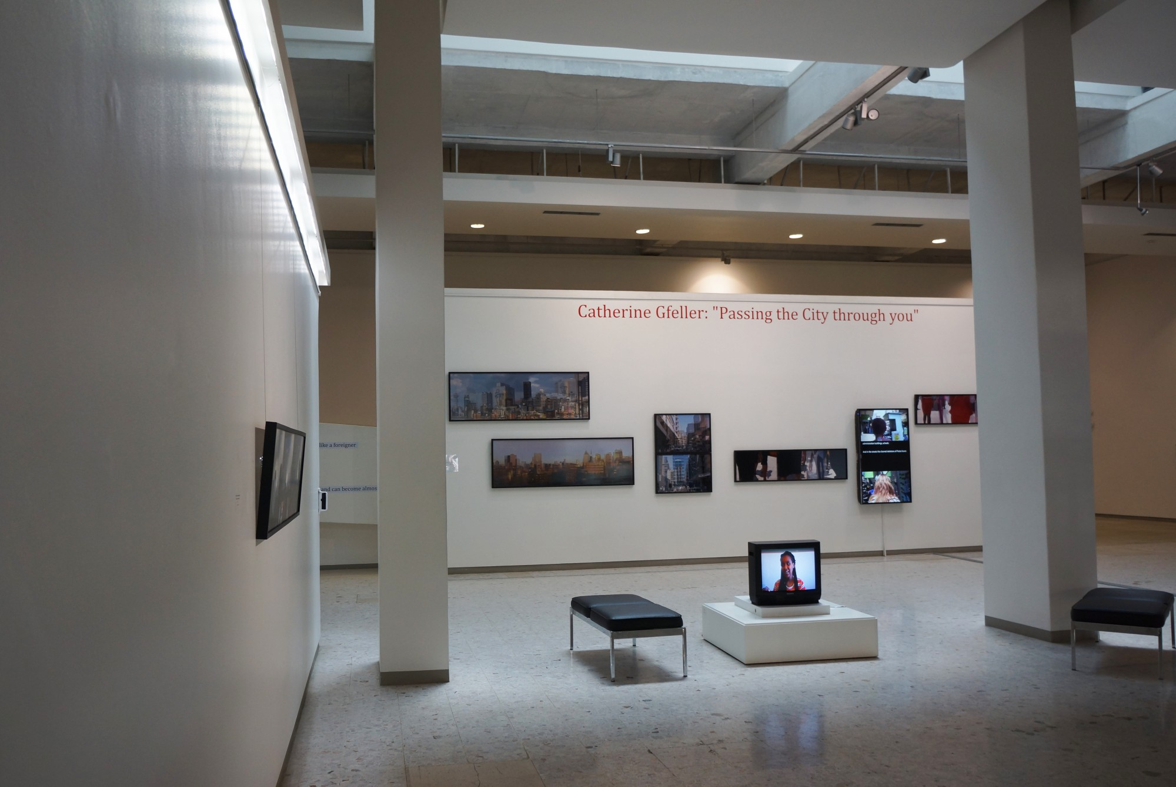
B 篇
女摄影师Catherine Gfeller
北京瑞士大使馆举办个人影展

Slide 10
主题语境--人与自我
B 篇：记叙文
(Para. 1) Passing the Cities through the Lens (镜头) of Women, a solo exhibition by Swiss artist Catherine Gfeller, is being held at the Swiss embassy in Beijing.
点击添加标题
第一段就介绍举办摄影展 ，下文介绍相关的展品来源以及举办影展的目的意义加上重要人物的评议。说明文本具有新闻特征。Brochure 手册，只描述静态事物，没有新闻时效性的特征。故B.
24.Where is the passage probably taken from?
A. A leaflet. B. A newspaper.
C. A brochure. D. A research paper.
推理判断题

Slide 11
主题语境--人与社会
B 篇：记叙文
(Para. 2) Between 2016 and 2019, Swiss artist Catherine Gfeller embarked on a journey to a number of Chinese cities, weaving a narrative as she engaged with the stories of women from different backgrounds. Her vision of the women, the challenges they confront, and their distinctive spirit are the focuses of the artist's subsequent explorations.
点击添加标题
细节理解题
25.What does Catherine Gfeller’s exhibition focus on?
A. Chinese women’s viewpoints. B. Chinese urban landscapes.
C. Chinese traditional roles of women. D. Chinese women’s status in society.
.

Slide 12
主题语境--人与自我
B 篇：记叙文
Ambassador of Switzerland to China Jurg Burri said at the opening ceremony, "Ms Gfeller cares very much about people, especially women in cities. Women's issues are a global topic and I hope that more women's voices will be heard.".
点击添加标题
A选项虽然是事实但与本题没有因果关系；B:偷换概念：Women’s issues is a global topic. C. 没有提到此人对Gfeller 探索城市的方式表示支持。 故D为正确选项。与原文的Para5 完全贴合。
推理判断题
26. Why does the author cite Jurg Burri’s words?
A. Jurg Burri is the Ambassador of Switzerland to China.
B. The theme of Catherine Gfeller exhibition is a global topic.
C. Jurg Burri is in favor of Catherine Gfeller’s means of exploring cities.
D. Catherine Gfeller attaches great importance to women’s perspectives.

Slide 13
主题语境--人与自我
B 篇：记叙文
(Para. 1) Passing the Cities through the Lens (镜头) of Women, a solo exhibition by Swiss artist Catherine Gfeller, is being held at the Swiss embassy in Beijing.
点击添加标题
第一段就介绍举办摄影展 ，下文介绍相关的展品来源以及举办影展的目的意义加上重要人物的评议。
27.What is the purpose of the passage?
A. To introduce an exhibition. B. To educate readers.
C. To persuade readers. D. To advertise an exhibition.
归纳概括题

Slide 14
B 篇：语料库
1.a solo exhibition 个人展览
2. the Swiss embassy 瑞士大使馆
3.embark on a journey to a number of Chinese cities 开始去中国的几个城市旅游
4. weave a narrative 编织一个故事
5. distinctive spirit 独特的精神
6. subsequent explorations 后来的探索
7. the bustling streets 繁华的接到
8. a means of …一种方式

Slide 15
B 篇：语料库
9. essence 精髓；精华
10. spotlight the perspectives and voices of women
让公众关注女性的观点和声音
11.through her lens 借助于镜头
12.inhabit 居住
13. perceive the new ways of life 感知生活新方式
14. find an anchor in their cities 在她们居住的城市找到支柱
15. Ambassador of Switzerland 瑞士大使

Slide 16

C 篇
OpenAI 研发的
视频生成工具 Sora

Slide 17
主题语境--人与社会之科技
C 篇：夹叙夹议文
(Para. 1) Many got sleepless nights after Sora amazed the world with its remarkable ability of creating videos directly from text instructions. Discussions about what the artificial intelligence model can do and make a difference continue.
(Para. 2) Some said it could give a huge blow to traditional industries such as film and television making, looking forward to the day when a movie can be created right after a novel is put into the model. But others remain skeptical about how powerful the model can be in changing the landscape of AI application.
点击添加标题
28.Which of the following might have similar meaning to the underlined word in Paragraph 2?
A. push. B. strike. C. warning. D. bonus.
词义猜测题

Slide 18
（para7) However, new technologies do not mean good news to everyone. Many also concern about AI models' safety issues since related regulations are lagging behind.
All …not = Not all …为部分否定：并非所有人都能从这项新的人工智能技术中获益;
点击添加标题
29. What can we know from the passage?
A. All people can not benefit from the new AI technologies.
B. AI model’s safety isn’t concerning despite lagging legal restrictions.
C. The AI-generated videos by Shen Yang’s team were better than those created by Sora.
D. The text-to-video model was developed by a group of young talent from Tsinghua University.
推理判断题
B: 与原文Para7最后一个句子语义相反;

Slide 19
C. 根据原文Para5 Shen 说的： There‘s a huge gap in between. 可知两者差距非常大。暗示他们团队的视频生成器是前一代的工具，落后于Sora. D. 偷梁换柱。Sora 视频生成器是OpenAI研发的。故A正确。
点击添加标题
29. What can we know from the passage?
A. All people can not benefit from the new AI technologies.
B. AI model’s safety isn’t concerning despite lagging legal restrictions.
C. The AI-generated videos by Shen Yang’s team were better than those created by Sora.
D. The text-to-video model was developed by a group of young talent from Tsinghua University.
推理判断题

Slide 20
(Para. 4) Shen Yang, a professor at the School of Journalism and Communication, Tsinghua University , said, "Sora represents a revolutionary leap in the field of AI-generated content (AIGC)."
…
(para6) As a frequent user of AI, Shen said the technology not only helps improve his productivity, but also benefits his daily life. His wife was suffering from cancer and many complications, and he used AI to assist in finding treatment, which has remarkably prolonged her life. He even wrote an award-winning science fiction novel using AI.
点击添加标题
推理判断题
30. What kind of attitude does Shen have towards Sora?
A. Favorable. B. Objective. C. Unconcerned. D. Reserved.

Slide 21
C 篇：夹叙夹议文
（para1）Many got sleepless nights after Sora amazed the world with its remarkable ability of creating videos directly from text instructions. Discussions about what the artificial intelligence model can do and make a difference continue.
（para2) Some said it could give a huge blow to traditional industries such as film and television making, looking forward to the day when a movie can be created right after a novel is put into the model. But others remain skeptical about how powerful the model can be in changing the landscape of AI application.
点击添加标题
主旨概括题
31.Which of the following is the best title?
A. Sora: An AI video. B. Video Making: AI Models.
C. Sora: A Powerful AI Tool. D. Video Making: Future of AI.

Slide 22
C 篇：语料库
1.make a difference 有影响；有意义
2. a huge blow to traditional industries 对传统产业的巨大打击
3. remain skeptical about sth 对sth 保持怀疑
4.represent a revolutionary leap in the field of AI-generated content 代表了人工智能生成内容领域的革命性飞跃
5. the philosophy of AI 人工智能的哲学
6. a huge gap 巨大差别
7. improve his productivity 提高效率

Slide 23
C 篇：语料库
8. Suffer from cancer and many complications 患有癌症以及多种并发症
9. remarkably prolong her life 大大延长了她的寿命
10.related regulations are lagging behind相关规定相对滞后
11. current AI models 当前的人工智能模型
12. be capable of 具备…能力；能够…
13. concerning ①adj. 令人担忧的；② prep： 关于

Slide 24


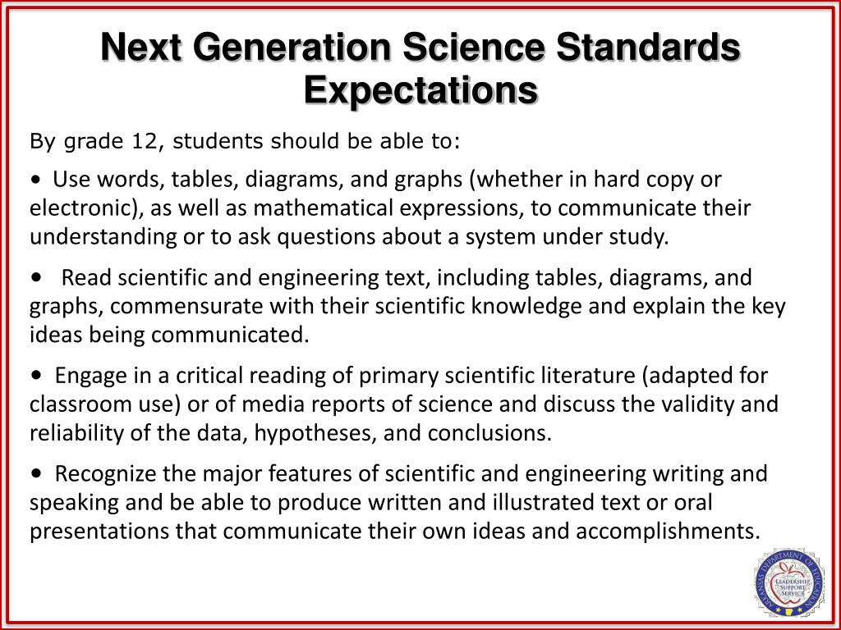
D
探讨不同官员对修改小学生（13岁前的学生）的科学标准这一事件的不同看法和评论

Slide 25
D 篇：说明文
主题语境--人与社会---科学教育
(Para. 1) The weather in Texas may have cooled since the recent extreme heat, but the temperature will be high at the State Board of Education meeting in Austin this month as officials debate how climate change is taught in Texas schools.
点击添加标题
写作手法题
32. Why is the weather in Texas mentioned in Paragraph1?
To forecast a policy shift in Texas schools.
B. To stress the consequences of climate change.
C. To indicate the atmosphere at the board meeting.
D. To draw the public's attention to energy shortages.

Slide 26
（Para2)Pat Hardy, who agrees with the views of the energy department, is resisting proposed changes to science standards for pre-teen pupils. These would emphasize the significance of human activity in recent climate change and encourage discussion of reduction measures.
(para3)Most scientists and experts sharply argue against Hardy's views. “They casually view the career work of scholars and scientists as just another misguided opinion,” says Dan Quinn, senior communications strategist at the Texas Freedom Network, a non-profit group that monitors public education. Such debates reflect fierce discussions across the US and around the world, as researchers, policymakers, teachers and students step up demands for a greater focus on teaching about the facts of climate change in schools.
点击添加标题
推理判断题
33. What does Quinn think of Hardy?
Hardy overstates the existing panic.
Hardy denies the value of scientific work.
C. Hardy shows no concern for pre-teens.
D. Hardy expresses self-contradictory views

Slide 27
(Para5）Glenn Branch, the center's deputy director, cautions that setting state-level science standards is only one limited norm in a country that decentralizes (使分权)decisions to local school boards. Even if a state is considered a high performer in its science standards, “that does not mean it will be taught”, he says.
该题可以用排除法解题：A：原文未及，杜撰的答案：B:原文未及；D: 标准需要紧急应用。该段的语义：即便是一个州设立了很高的（教学）标准， 也不表示在这个州会以这种教学标准进行科学的教学 。所以 所谓的科学标准或规范实际影响有限 。
点击添加标题
细节理解题
34. Which will Branch probably agree about state-level science standards?
The standards call for regular revision.
The standards cater to local needs.
C. The standards have limited influence.
D. The standards require urgent application.

Slide 28
(Para6)Branch points out that, even if a growing number of official guidelines and textbooks reflect scientific consensus (共识) on climate change, unofficial educational materials that convey more biased(带有偏见的) perspectives are being distributed to teachers. They include materials sponsored by libertarian think-tanks(智库) and energy industry associations.
该题可以用排除法解题：A：原文未及，杜撰的答案：B:偏见不是老师赋予气候变化教学的；C: 歪曲了能源部，杜撰的答案 。
点击添加标题
推理判断题
35. What is implied about climate change teaching in some schools in the last paragraph?
It agrees to major public demands.
It reflects teachers' personal biases.
C. It may misrepresent the energy department.
D. It can be impacted by external forces.

Slide 29
长难句分析；
1. Glenn Branch, the center's deputy director, cautions that setting state-level science standards is only one limited norm in a country that decentralizes (使分权)decisions to local school boards. Even if a state is considered a high performer in its science standards, “that does not mean it will be taught”, he says.
主语
同位语
谓语
that引导宾语从句
that 引导的定语从句,修饰想象出 a country
Even if 引导的状语从句,

Slide 30
长难句分析；
2. Branch points out that, even if a growing number of official guidelines and textbooks reflect scientific consensus (共识) on climate change, unofficial educational materials that convey more biased(带有偏见的) perspectives are being distributed to teachers.
主语
谓语
that 引导宾语从句
该宾语从句= even if 让步状语从句， 主句
宾语从句的主句的主语
宾语从句的主句的主语的that 引导的定语从句
宾语从句的主句的谓语

Slide 31
D 篇：语料库
1.emphasize the significance of human activity强调人类活动的重要性
2.reduction measures 减排措施
3.sharply argue against Hardy‘s views 尖锐地反对Hardy的观点
4. casually view the career work of scholars and scientists as just another misguided opinion 随便把学者和科学家的职业工作看作是另一种误导的观点
5. senior communications strategist 高级传播策略师

Slide 32
D 篇：语料库
6. monitor public education 监察公众教育
7.reflect fierce discussions反映激烈的讨论
8.address climate change应对气候变化：
9.the most populous states人口最多的州
10. caution that setting state-level science standards is only one limited norm in a country 警告说制定国家级的科学标准只是一个国家有限的规范
11. convey more biased(带有偏见的) perspectives 传达更多 带有偏见的观点

Slide 33
D 篇：语料库
12.be distributed to teachers 分发给教师
13. overstate the existing panic 夸大现有的恐慌
14. self-contradictory views 自相矛盾的观点
15. call for regular revision. 需要定期修订
16. cater to local needs 迎合当地需求
17. misrepresent 歪曲
18. external forces 外部力量。

Slide 34
PART 2
七选五

Slide 35
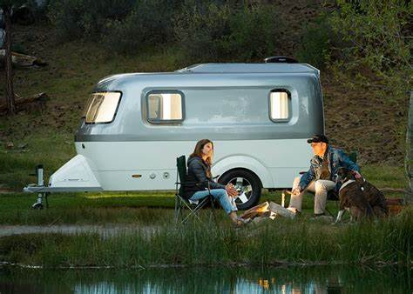
提供露营新手的一些小贴士

Slide 36

首先观察选项设置的特点：
主题语境与语篇分析-- 七选五 人与自然
A. I see and hear all kinds of wildlife.
B. But nature isn’t just there for us to exploit.
C. Set up a place where you can stay comfortably.
D. If you’re near a body of water, you can go swimming.
E. Become familiar with different trees and what they offer.
F. If you can accept nature as it is, it can work in your favor.
G. The river stays cool pretty much year-round and is refreshing in summer.
关注：逻辑词；主语；宾语；D/F句式一致，可能出现冗余选项。

Slide 37
Nature supports us in a wide variety of ways, whether we are conscious of these gifts or not. 36 By following these tricks for first-time campers, anyone can engage with nature in a more grateful way.
段中题：提出问题。后一句指出解决问题的一些方法，让人们可以与大自然亲近。
A. I see and hear all kinds of wildlife.
B. But nature isn’t just there for us to exploit.
C. Set up a place where you can stay comfortably.
D. If you’re near a body of water, you can go swimming.
E. Become familiar with different trees and what they offer.
F. If you can accept nature as it is, it can work in your favor.
G. The river stays cool pretty much year-round and is refreshing in summer.

Slide 38
Take full advantage of Nature
If you’re close to flowing water, you can choose from various approaches to stay hydrated, as well as wash dishes and do laundry, without taking much trouble to bring all your water with you. 37 This is a fantastic way to begin your day.
段中设空。
下文this 指代空格中内容；
+人称为第二人称you
根据两个选项句式一致，必有一冗余选项法则，排除F。即F不可能是任何空格的选项。
A. I see and hear all kinds of wildlife.
B. But nature isn’t just there for us to exploit.
C. Set up a place where you can stay comfortably.
D. If you’re near a body of water, you can go swimming.
E. Become familiar with different trees and what they offer.
F. If you can accept nature as it is, it can work in your favor.
G. The river stays cool pretty much year-round and is refreshing in summer.

Slide 39
Do your Research
38 Some trees supply wood that’s appropriate for making walking sticks. Some wood is suitable for starting fires, while other wood is fit for keeping them going. Other trees may provide nuts and fruits.
段首题：根据后面的关键词trees
A. I see and hear all kinds of wildlife.
B. But nature isn’t just there for us to exploit.
C. Set up a place where you can stay comfortably.
D. If you’re near a body of water, you can go swimming.
E. Become familiar with different trees and what they offer.
F. If you can accept nature as it is, it can work in your favor.
G. The river stays cool pretty much year-round and is refreshing in summer.

Slide 40
Fully Enjoy Nature
My hope is that the strategies for first-time campers will help you appreciate the great outdoors. Whether you’re hiking, fishing, swimming, or cooking by a warm fire, each of them is fun. I live approximately 2 miles from fabulous Current River, which is fed by cold springs some 40 miles upstream. 39_____
段尾设空。
Current River与G项The river 呼应，描述河流全貌
E. Become familiar with different trees and what they offer.
F. If you can accept nature as it is, it can work in your favor.
G. The river stays cool pretty much year-round and is refreshing in summer.

Slide 41
I have no interest in hunting or party; I fancy simply sitting on a sand bar at dawn, watching the mist rise from the water. 40 I listen for the beavers making splashes at night with their wide, flat tails. I hear coyotes howling at night too. I’ve seen cottonmouth snakes and even panther tracks! I love the serenity and the small thrills, the kinds of experiences I wouldn’t trade for anything in the world.
段中设空:
叙事人称均为I+ all kinds of wildlife 故A为正确选项
A. I see and hear all kinds of wildlife.
B. But nature isn’t just there for us to exploit.
C. Set up a place where you can stay comfortably.
D. If you’re near a body of water, you can go swimming.
E. Become familiar with different trees and what they offer.
….

Slide 42
七选五语料库
1.be conscious of = be aware of
2.following these tricks 遵照这些诀窍
3. engage with nature 亲近自然
4.take full advantage of 充分利用
5.do laundry 洗衣服
6.take much trouble to do sth 费了很大劲做
7. be appropriate for making walking sticks 适合做拐杖
=be suitable for =be fit for

Slide 43
七选五语料库
8. strategy n. 策略；战略
9. approximately adv. 大约
10.cold springs 冰冷的泉水
11.fancy simply sitting on a sand bar at dawn 喜欢黎明时分坐在沙洲上
12. trade A for B 用A 换取B；交易
13. refreshing adj. 令人精神振作；令人耳目一新；令人清醒的；

Slide 44
PART 3
完形填空

Slide 45

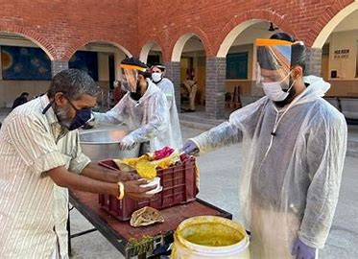
The Very Caring Family
主题语境：人与社会
PART 3

Slide 46
Each morning at 6 a.m., Kamaljeet Singh, 57, is up and out of the house. He starts by spending three hours helping 41 food to nearly two dozen drop-off locations across Delhi, India, then 42 the numerous facilities run by the volunteer organization he leads with his brother, Premjit. The organization, Veerji Ka Dera, was founded in 1989 by their father, Trilokchan Singh.
41. A. contribute B. distribute C. purchase D. donate
42. A. checks on B. decides on C. carries on D. checks out
41.考查动词词义辨析。本句句意：他花三个小时帮忙把食物分发到德里近24个食物投放点。 contribute vi 贡献；distribute vt. 分配；分发 purchase vt 购买；donate vt.捐赠
43. 考查词组辨析；然后检查数不清的各种设施设备，这些设施都是由志愿者组织管理的。该组织由他和他的弟弟一起领导的。Check on :检查；核查；decide on 决定；carry on 继续； check out 结账；办理图书借阅手续；

Slide 47
“He was a very 43 man,” says Kamaljeet of his father, who died in 2010. In the 1980s, Trilokchan began organizing volunteers to help him clean temples. Then they began 44 one of India’s most underserved groups（弱势群体）: the migrant workers who came to Delhi from rural areas. It started with a free breakfast, and eventually the group was also providing basic first aid for minor, often job-related, 45 .
43. A. selfish B. mean C. selfless D. fearless
44. A. supporting B. convincing C. supposing D. reminding
45. A. issues B. sufferings C. pains D. injuries
43. 根据红色部分字体的内容，可知他们的父亲是个很无私的人。上个世纪80年代就开始支持外来务工人员。Selfish 自私的；mean 卑鄙的小气的Selfless adj. 无私的；fearless adj. 无畏的；
44. 考查词义辨析：supporting 支持 convincing 说服；supposing 认为；reminding 提醒
45. 根据provide basic first aid 应该选择injuries .

Slide 48
After his death, Kamaljeet and Premjit, inspired by their father’s lifetime of service, 46 the organization. “We are continuing helping the poor,” says Premjit, 61, “Our aim is that no one goes hungry and 47 for in Delhi.”
46. A. took on B. turned on C. turned over D. took over
47. A. unfriendly B. uncared C. unconcerned D. unnecessary
46. 考查词组辨析：句意：父亲死后，兄弟俩接管了该机构。 take on 呈现；录用；turn on 打开； turn over ;移交； take over 接管
47. 语义：我们的目标是没有一个人挨饿没有一个人得不到照顾。 Care for sb--- be cared for 被照顾---- be uncared for ---得不到照顾= go uncared for

Slide 49
Veerji Ka Dera now 48 about 2,500 daily wage workers and homeless people a day, in addition to offering basic medical care to as many as 500 people. It’s all made 49 by the roughly 250 families who 50 their time to cook, drive, nurse, farm and clean. During the Covid-19 pandemic, with special 51 from the government, it 52 down to feed 5,000 people a day and offer medical care to those 53 .
48. A. sponsors B. employs С. feeds D. dismisses
49. A. apparent B. adequate C. possible D. moderate
50. A. volunteer B. waste C. take D. spend
48.回扣原文第一段：说明feed vt 喂养符合语意； 49/50: 句it 指的是上文划线的整个句子，大约250个家庭使这件事可能做成。这250个家庭自愿奉献时间去做饭，开车，护理，种田以及搞卫生等. The roughly 250 families all make it possible. –It was all made possible by the roughly 250 families….

Slide 50
….During the Covid-19 pandemic, with special 51 from the government, it 52 down to feed 5,000 people a day and offer medical care to those 53 .
51. A. authority B. potential C. privilege D. permission
52. A. doubled B. brought C. slid D. fell
53. A. in place B. in time C. in panic D. in relief
本句语义：新冠疫情期间，得到了政府特别的许可，该机构加倍努力地每天给5000人提供食物以及给那些惊慌失措的人提供医疗,本段首句2500亦为暗示。 51. 考查名词词义辨析: A. 管理机构；B. 潜力；C. 特权，殊荣。D.许可，允许 52. Double down 加倍努力；bring down 减少；slide down 滑倒；fall down 摔倒 53. in place 合适的位置；in time 即时； in panic 惊慌，惊恐；in relief 如释重负地

Slide 51
In 2023, the award -the Real Heroes of Rising India - was 54 to them by India’s Health Minister for their 55 act.
54. A. provided B. presented C. preserved D. observed
55. A. concerning B. stunning C. challenging D. rewarding
本句语义：印度卫生部部长在2023年给他们颁发一个奖项---The Real Heroes of Rising India ,以嘉奖他们的有意义的行为。
54. 考查词组搭配： provide sth for sb; present the award to sb ; preserve sth for sb 为sb 保存sth ; observe sth for sb 为sb 观察sth
55. 考查形容词词义辨析： concerning adj. 令人担忧的；stunning adj. 令人吃惊的；challenging adj. 有挑战的；rewarding adj. 有意义的；有回报的

Slide 52
完形填空语料库
1.the migrant workers 外来务工人员
2. rural areas 农村 、 乡村地区
3. double down to do sth 加倍努力去做
4. take over the organization 接管机构
5. present a reward to sb 给某人颁奖

Slide 53
PART 4
语法填空

Slide 54
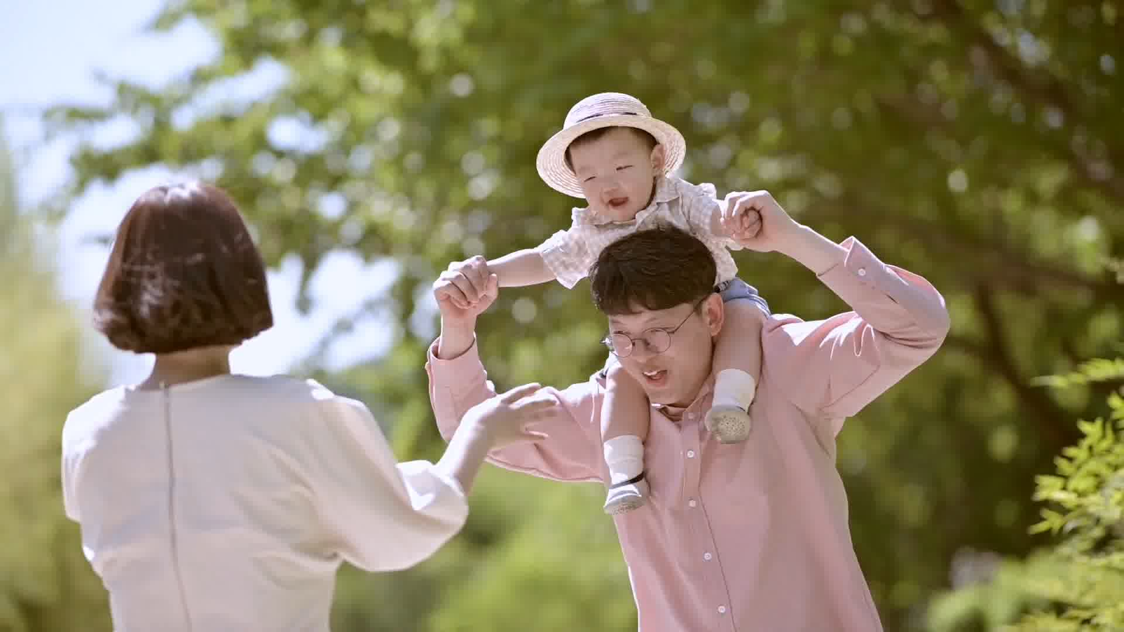

主题语境：人与社会—家庭
主旨大意：中国家庭规模的变迁
设空类型：有提示词5，无提示词5

Slide 55
考查冠词： a history of …
The Lantern Festival falls on the first full moon of the new lunar year. The Festival, with 56 history of over 2,000 years, 57 (date) back to the Han Dynasty. The festival originates from an Act, released by Emperor Wendi of the Western Han Dynasty, 58
(honor) deities(神明) and ancestors with lantern displays.
考查动词时态 date back to 通常表客观事实，故一般现在时
a
dates
to honor
考查非谓语动词不定式：表示目的，由于出现了 released by….这个后置定语的结构，考生不容易察觉。

Slide 56
考查定语从句关系代词
A large quantity of customs and traditions are associated with the Lantern Festival, one of 59 is the lighting of Lanterns that 60 (display) in different shapes and sizes. In many northern parts of China, grand lantern displays featuring diverse sizes and themes, create an attractive scene, 61 , in the south, the tradition of floating lanterns offers a beautiful gesture of releasing the past to embrace the future. More than just a visual feast, the lanterns are part of China's intangible cultural heritage, representing hope and renewal as they light up the 62 (dark) to welcome the new year.
考查定从的谓语
which
are displayed
考查并列连词：前后对比
while
darkness
考查形容词变名词构词法

Slide 57
本篇语空超难的一道题。考查代词，兼顾文章的上下结构与语义考查；与59空: one of which …呼应：传统习俗之一是灯展；还有一个重要的传统是猜灯谜。
63 important tradition is the solving of lantern riddles. Lantern owners write riddles on pieces of paper and attach them to their lanterns while festival-goers of all ages stroll among the lights, trying to solve these riddles. 64 (basic), successful solvers often receive gifts, adding to the festive atmosphere.
The cultural celebration has successfully extended beyond traditional foods 65 the way people prepare for the festival.
Another
考查形容词变副词的构词法规律：
Basically
to
考查介词: extend to 延伸到…

Slide 58
Therefore, there is every reason to believe that this trend of families in reduced size is 64 （agree） to our times. To create a brighter future, we should do our best to build our society into one in 65 every member lives healthily and harmoniously.
考查动词变形容词
agreeable
which
考查定语从句关系代词

Slide 59
语法填空语料库
1.date back to the Han Dynasty 追溯到汉代
2.originate from an Act 起源于一则法令
3.release vt. 释放；发行
4. ancestor n. 祖先
5.lantern displays 灯会；灯展
6.be associated with …与……有关
7. the Lantern Festival 元宵节
8. feature diverse sizes and themes具有不同的尺寸和主题

Slide 60
语法填空语料库
9. embrace the future 拥抱未来
10.represent hope and renewal 代表希望和新生
11. riddle n. 灯谜
12.stroll among the lights 在灯盏之间漫步
13. solver n. 解开灯谜的人
14. the festive atmosphere 节日的气氛
15. extend to… 延伸到……

Slide 61




Sharing is joy！

