Slide 1


感恩遇见，相互成就，本课件资料仅供您个人参考、教学使用，严禁自行在网络传播，违者依知识产权法追究法律责任。
更多教学资源请关注
公众号：溯恩英语
知识产权声明

Slide 2
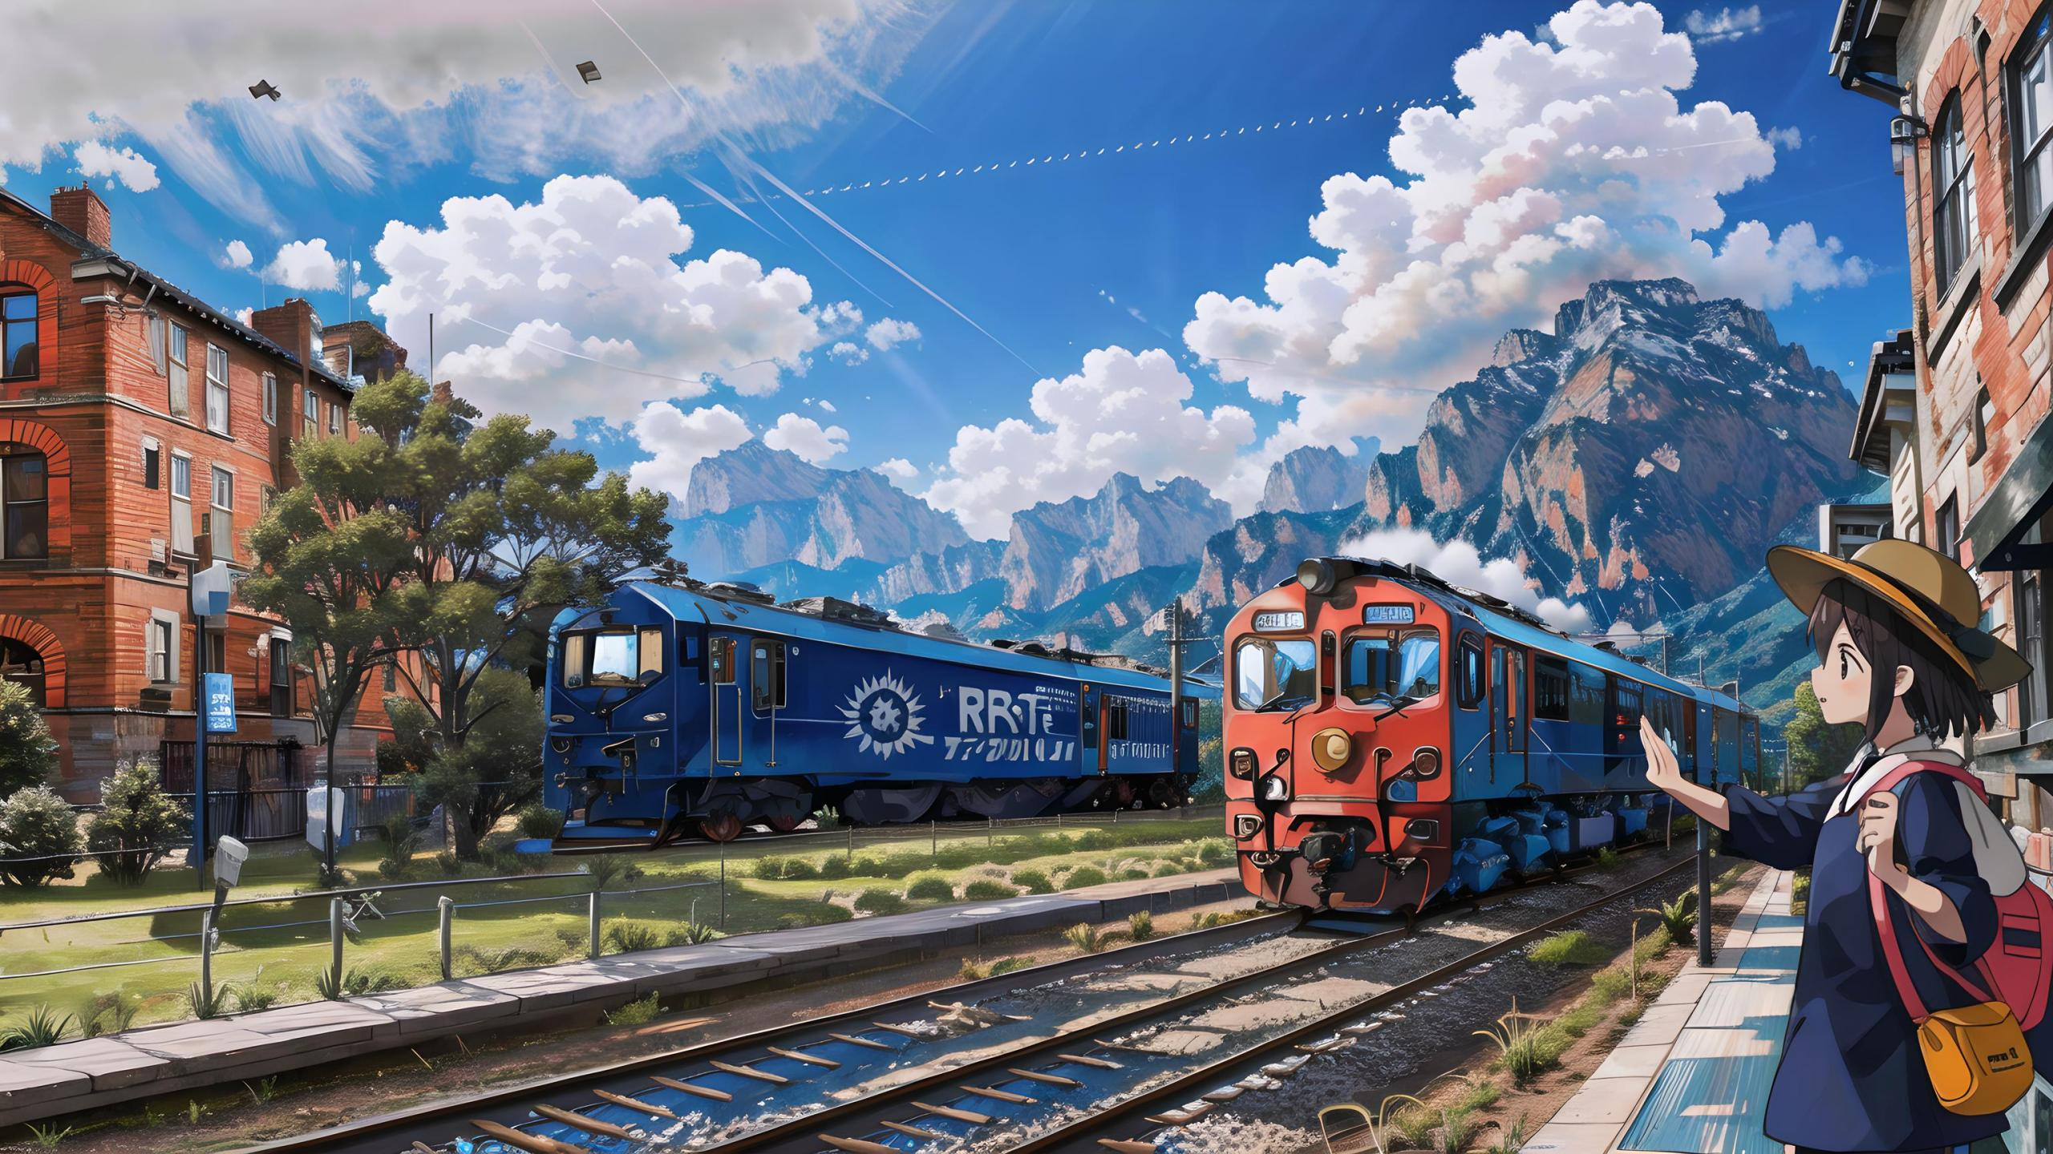



Slide 3


原文本
It was late, about 10:15 p.m., when Janice Esposito arrived at the Bellport train station; she jumped into her Honda Odyssey and began the 20-minute drive home to her husband and seven-year-old son. She’d just returned from visiting her mother and had traveled the route many times before. She practically drove on autopilot: a left onto Station Road, then a left on Montauk Highway, and then—wham!
Out of nowhere a car T-boned Esposito’s minivan, pushing her to move backward some 100 feet onto the railroad tracks. She sat in the minivan, bruised (撞伤) but mostly just knocked out by the impact and the airbags.
As it happened, Pete DiPinto was getting ready for bed. He’d just closed his book and was getting under the covers when he heard the sound of metal on metal and breaking glass coming from not far outside his bedroom window. A volunteer firefighter and retired teacher, DiPinto, 64, never stopped to think. He grabbed a flashlight and, still dressed in his pajamas (睡衣), ran out the door. “Any firefighter would have done what I did,” he told Newsday. “We’re always on duty .”
The first car he came upon, 2,000 feet from his front yard, was the one that had hit Esposito. Once DiPinto concluded the driver was OK, he looked around and sprinted to Esposito’s minivan positioned on the railroad tracks.

Slide 4
Read for plot
It was late, about 10:15 p.m., when Janice Esposito arrived at the Bellport train station; she jumped into her Honda Odyssey and began the 20-minute drive home to her husband and seven-year-old son. She’d just returned from visiting her mother and had traveled the route many times before. She practically drove on autopilot: a left onto Station Road, then a left on Montauk Highway, and then—wham!
Q1： What was Janice Esposito doing? When was the time?

Slide 5
Read for plot
Out of nowhere a car T-boned Esposito’s minivan, pushing her to move backward some 100 feet onto the railroad tracks. She sat in the minivan, bruised (撞伤) but mostly just knocked out by the impact and the airbags.
Q2： What happened? What was the result?

Slide 6
Read for plot
As it happened, Pete DiPinto was getting ready for bed. He’d just closed his book and was getting under the covers when he heard the sound of metal on metal and breaking glass coming from not far outside his bedroom window. A volunteer firefighter and retired teacher, DiPinto, 64, never stopped to think. He grabbed a flashlight and, still dressed in his pajamas (睡衣), ran out of the door. “Any firefighter would have done what I did,” he told Newsday. “We’re always on duty .”
Q3： What was Pete DiPinto doing? Where did he always hide?
Q4: What did he take? What was he dressed in ?

Slide 7
Read for plot
The first car he came upon, 2,000 feet from his front yard, was the one that had hit Esposito. Once DiPinto concluded the driver was OK, he looked around and sprinted to Esposito’s minivan positioned on the railroad tracks.
Q5： What did he see first? What did he do next?

Slide 8
Read for clues and echoes
It was late, about 10:15 p.m., when Janice Esposito arrived at the Bellport train station; she jumped into her Honda Odyssey and began the 20-minute drive home to her husband and seven-year-old son. She’d just returned from visiting her mother and had traveled the route many times before. .
clues
echoes
1. Her husband arrived at the spot with their seven-year-old son calling “mom” emotionally.
2. No sooner had her mother heard the news than she hurried to the hospital. The whole family conveyed their heartfelt gratitude to the hero.

Slide 9
Read for clues and echoes
She sat in the minivan, bruised (撞伤) but mostly just knocked out by the impact and the airbags. .
clues
echoes
3. To her family’s relief, she was only slightly wounded. Thanks to DiPinto’s quick action, bravery and selflessness, Janice had a narrow escape.

Slide 10
Read for clues and echoes
He grabbed a flashlight and, still dressed in his pajamas (睡衣), ran out the door. “Any firefighter would have done what I did,” he told Newsday. “We’re always on duty .”.
clues
echoes
4. He shone the flashlight into the car and found Janice was stuck behind the wheel, almost unconscious.
5 He was awarded the title “ A Hero In Pajams” by their mayor for his heroic deed.

Slide 11
who
where
When
The cause
The process
The result
Six elements
Six detailed elements of the text
Janice Esposito， Pete DiPinto（ a volunteer firefighter)
the railroad tracks.
It was late, about 10:15 p.m.
a car T-boned Esposito’s minivan, pushing her van onto the railroad track.
Pete DiPinto rushed to the spot and the train was travelling fast towards the minivan.
Janice Esposito would be rescued；Her van was crashed.

Slide 12
Characters Analysis
本文提到的人物不少，但哪些人物可以在续写的两个段落里出现并有利于设计情节，需要思考。
Pete DiPinto 主角 （身份volunteer firefighter ,说明救人经验丰富，接续救人情节基本他是主要描述的对象）
Janice Esposito 配角
the driver （撞车司机 估计没他什么事）
Her mother , her husband and seven-year-old 是Janice 家人，均为配角, 但如果设计Janice被送到医院救治，还可以描写家人对Pete DiPinto 深表谢意。

Slide 13
Time & Place Analysis
It was late, 10:25 p.m. 说明深夜。夜色很浓，能见度不好（后面设计续写内容是可以考虑渲染一下环境特征哦。）（所以flashlight 可以派上用场。 时间可以再延长一下，方便构思。
the railroad tracks , the oncoming train 说明情况危急，必须反应迅速，立即行动，立刻救人。
救人后一般伤员要送医院，思考：如何设计情节？

Slide 14
Conflict Analysis
1.Pete DiPinto came to Janice Esposito’s rescue.
2.The result should be positive.
3. The result is that Janice had a near brush with death.

Slide 15

三处衔接的处理：
1. 结合P1+P2 所给句+解决原文冲突 设计P1 衔接处1（即一段首句）：（先考虑主语是he 或 the train 或 Janice ） (确定主语，方便句子产出。）
2. 结合P2所给句 设计P1 衔接处2（即一段尾句）：
3.结合 P 1衔接处2+P2 所给句，设计衔接处3 （即二段首句） ：
然后预判各段的主要内容，进行情节设计，人物处理，地点是否需要切换；
Para1. And then he heard a terrible sound: the bells signaling an oncoming train.
Para2. The heavy diesel train, traveling at 65 miles per hour, crashed into the minivan.
续写结尾句处理：
1. 根据 三个大类：人与自然；人与自我；人与社会 来判定是否文本有主题意义； 如有，是否可以升华式结尾。

Slide 16
结尾句处理方式：
1. 根据 三个大类：人与自然、人与社会、人与自我， 来判定是否文本有主题意义； 如有，是否可以升华式结尾。例如：The successful rescue not only saved Janice’s life but also revealed the meaning of his volunteer job as a firefighter, which filled DiPinto’s heart with overwhelming pride.
2. 情景式结尾。以一个场景或画面来结尾。例如： The ambulance speeding for hospital in the darkness , a smile bloomed across DiPinto’s face---He saved another life tonight. “ It’s time to go to sleep” , he yawned.

Slide 17
结尾句处理方式：
3. 感悟式结尾。从中感悟到什么道理。例A:The unforgettable experience would be engraved in DiPinto’s heart for ever, which taught him a valuable lesson –--It takes professional skills , quick mind and bravery to rescue people out of danger.
例B: The successful rescue not only saved Janice’s life but also revealed the meaning of his volunteer job as a firefighter, which filled DiPinto’s heart with overwhelming pride.

Slide 18
三处衔接句 （结合各段所给句的人或物 平行叙事 或交叉叙事）
Para1. And then he heard a terrible sound: the bells signaling an oncoming train.
首段衔接1 首句：A: DiPinto's heart froze in his chest as he realized the upcoming danger.
首段衔接2首句：B: The terrible sound brought DiPinto’s heart into his mouth but his mind was racing fast---he was trying to find a solution to save the driver trapped on the railroad tracks.!
Para2. The heavy train, traveling at 65 miles per hour, crashed into the minivan.

Slide 19
三处衔接句 （结合各段所给句的人或物 平行叙事 或交叉叙事）
Para1. And then he heard a terrible sound: the bells signaling an oncoming train.
首段衔接2 尾句：A: The heavy diesel train, rumbling like thunders in the darkness , was approaching the minivan.
首段衔接2 尾句：B: The speeding train was roaring towards the minivan like a monster, adding to a touch of terror.
Para2. The heavy train, traveling at 65 miles per hour, crashed into the minivan.

Slide 20
三处衔接句 （结合各段所给句的人或物 平行叙事 或交叉叙事）
Para2. The heavy train, traveling at 65 miles per hour, crashed into the minivan.
二段衔接3 首句：A: The train smashed the minivan into pieces ruthlessly, speeding into the vast darkness.
二段衔接3 首句：B: With a loud / tremendous bang , the minivan broke into pieces.
续写结尾句： Afterward, DiPinto was awarded a title “ A Hero In Pajamas” by the Mayor of their city to honor his courageous , fearless and selfless actions .

Slide 21
二段结尾句 （结合文章主旨或体现的道理 或经验教训 设计结尾）
Para2. The heavy train, traveling at 65 miles per hour, crashed into the minivan.
续写结尾句1： Afterward, DiPinto was awarded a title “ A Hero In Pajamas” by the Mayor of their city to honor his courageous , fearless and selfless actions .
续写结尾句2. The successful rescue not only saved Janice’s life but also revealed the meaning of his volunteer job as a firefighter, which filled DiPinto’s heart with overwhelming pride.

Slide 22
二段结尾句 （结合文章主旨或体现的道理 或经验教训 设计结尾）
Para2. The heavy diesel train, traveling at 65 miles per hour, crashed into the minivan.
情景式结尾3. （呼应原文中 DiPinto 正要睡觉的场景。也很妙！）The ambulance speeding for hospital in the darkness , a smile bloomed across DiPinto’s face---He saved another life tonight. “ It’s time to go to sleep” , he yawned.
情景式结尾4. （英雄一般要宣传，会有媒体采访。设计一家你熟悉的媒体，想想被采访的，要说啥？）
“ It was a life –or- death struggle.” said DiPinto when interviewed by China Daily,“ But I made it and I’m proud of what I did.”

Slide 23

习作句式及逻辑拆解 主语切换 方便行文
Para1. And then he heard a terrible sound: the bells signaling an oncoming train.
（无灵主语句+时间状语从句：DiPinto意识到即将到来的危险）
DiPinto's heart froze in his chest as he realized the upcoming danger.
2. (无灵主语句。两个并列短句，显示出紧急紧迫）
Every second counted! He had to race against time!

Slide 24
习作句式及逻辑拆解 主语切换 方便行文
Para1. And then he heard a terrible sound: the bells signaling an oncoming train.
（定语从句：毫不犹豫冲向minivan)
Without hesitation, he sprinted / dashed/ rushed towards Janice ‘s minivan, which was stuck firmly on the railway tracks.
4. (时间状语从句，主句二连动：他到了车旁，手电筒照进车内发现女车主几近昏迷）
As he approached the vehicle, he shone his flashlight into the minivan and saw Janice trapped/ stuck behind the wheel , almost unconscious.

Slide 25
习作句式及逻辑拆解 主语切换 方便行文
5. （二连动：评估情况，火速展开救援）
DiPinto quickly assessed the situation and kicked off his rescue operation.
6. （三连动：具体表现为砸窗，开车门，把人拉出来）
Despite the huge potential risk, he swiftly smashed open the minivan window , swung open the door and with all his might pulled her out of the vehicle before it was too late.
7. （拟人手法+with 结构：飞速行驶的列车像个恶魔，有恐怖感）
The speeding train was roaring towards the minivan like a monster, with darkness adding to a touch of terror.

Slide 26
习作句式及逻辑拆解 主语切换 方便行文
Para2. The heavy train, traveling at 65 miles per hour, crashed into the minivan.
( with 结构： 描述火车撞击卡车的瞬间情景）
With a loud / tremendous bang , the minivan broke into pieces.
2. (独立主格结构+句子+doing短语：描写碎片乱飞时，Dipinto 用自己身体护住女司机）
Flying debris/ pieces of the minivan shooting in all directions,, DiPinto shielded Janice as best as he could, using his own body to protect her from being hurt by the pieces.

Slide 27
习作句式及逻辑拆解 主语切换 方便行文
（副词性状语+感叹句： 两人都没被碎片伤到）
Miraculously, both of them escaped the harm by the flying debris! What a relief!
4. （No sooner had sb done sth than 从句：火车驶离，DiPinto 赶紧掏出手机拨打911）
No sooner had the train passed by than DiPinto produced his cellphone out of his pajamas and dialed 911.

Slide 28
习作句式及逻辑拆解 主语切换 方便行文
5. （ It …before 句型：急救人员反应迅速）
It didn’t take long before emergency responders arrived at the scene to assess the situation and rushed her to the hospital for timely medical assistance.
6.（介词短语+夸张手法：Janice 与死神擦肩而过）
Thanks to DiPinto‘s heroic and timely rescue, Janice had a near brush with death . // Janice had a narrow escape.

Slide 29
习作句式及逻辑拆解 主语切换 方便行文
7. （三连形：结尾1：渲染他的英勇行为）
Afterward, DiPinto was awarded a title “ A Hero In Pajamas” by the Mayor of their city to honor his courageous , fearless and selfless actions.
7. （无灵主语句：结尾2：升华到职业的高度）
The good news about Janice infused the heart of DiPinto with an overwhelming sense of pride . Being a volunteer firefighter does make a difference to those in need.
7. （夸张手法+接受媒体采访：结尾3：生与死之争，但成功了）
“ It was a life –or- death struggle.” said DiPinto when interviewed by China Daily,“ But I made it and I’m proud of what I did.”

Slide 30
习作 欣赏
Para1. And then he heard a terrible sound: the bells signaling an oncoming train. DiPinto's heart froze in his chest as he realized the upcoming danger. Every second counted! He had to race against time! Without hesitation, he sprinted / dashed/ rushed towards Janice ‘s minivan, which was stuck firmly on the railway tracks.As he approached the vehicle, he shone his flashlight into the minivan and saw Janice trapped behind the wheel , almost unconscious. DiPinto quickly assessed the situation and kicked off his rescue operation. Despite the huge potential risk, he swiftly smashed open the minivan window , swung open the door and with all his might pulled her out of the vehicle before it was too late. The speeding train was roaring towards the minivan like a monster, with darkness adding to a touch of terror.

Slide 31
习作 欣赏
Para2. The heavy train, traveling at 65 miles per hour, crashed into the minivan. With a loud / tremendous bang , the minivan broke into pieces. Flying debris shooting in all directions, DiPinto shielded Janice as best as he could, using his own body to protect her from being hurt again by the pieces. Miraculously, both of them escaped the harm by the flying debris! What a relief! No sooner had the train passed by than DiPinto produced his cellphone out of his pajamas and dialed 911. It didn’t take long before emergency responders arrived at the scene to assess the situation and rushed her to hospital for professional medical assistance. Thanks to DiPinto's heroic and timely rescue, Janice had a near brush with death. Afterward, DiPinto was awarded a title “ A Hero In Pajamas” by the Mayor of their city to honor his courageous, fearless and selfless actions.

Slide 32

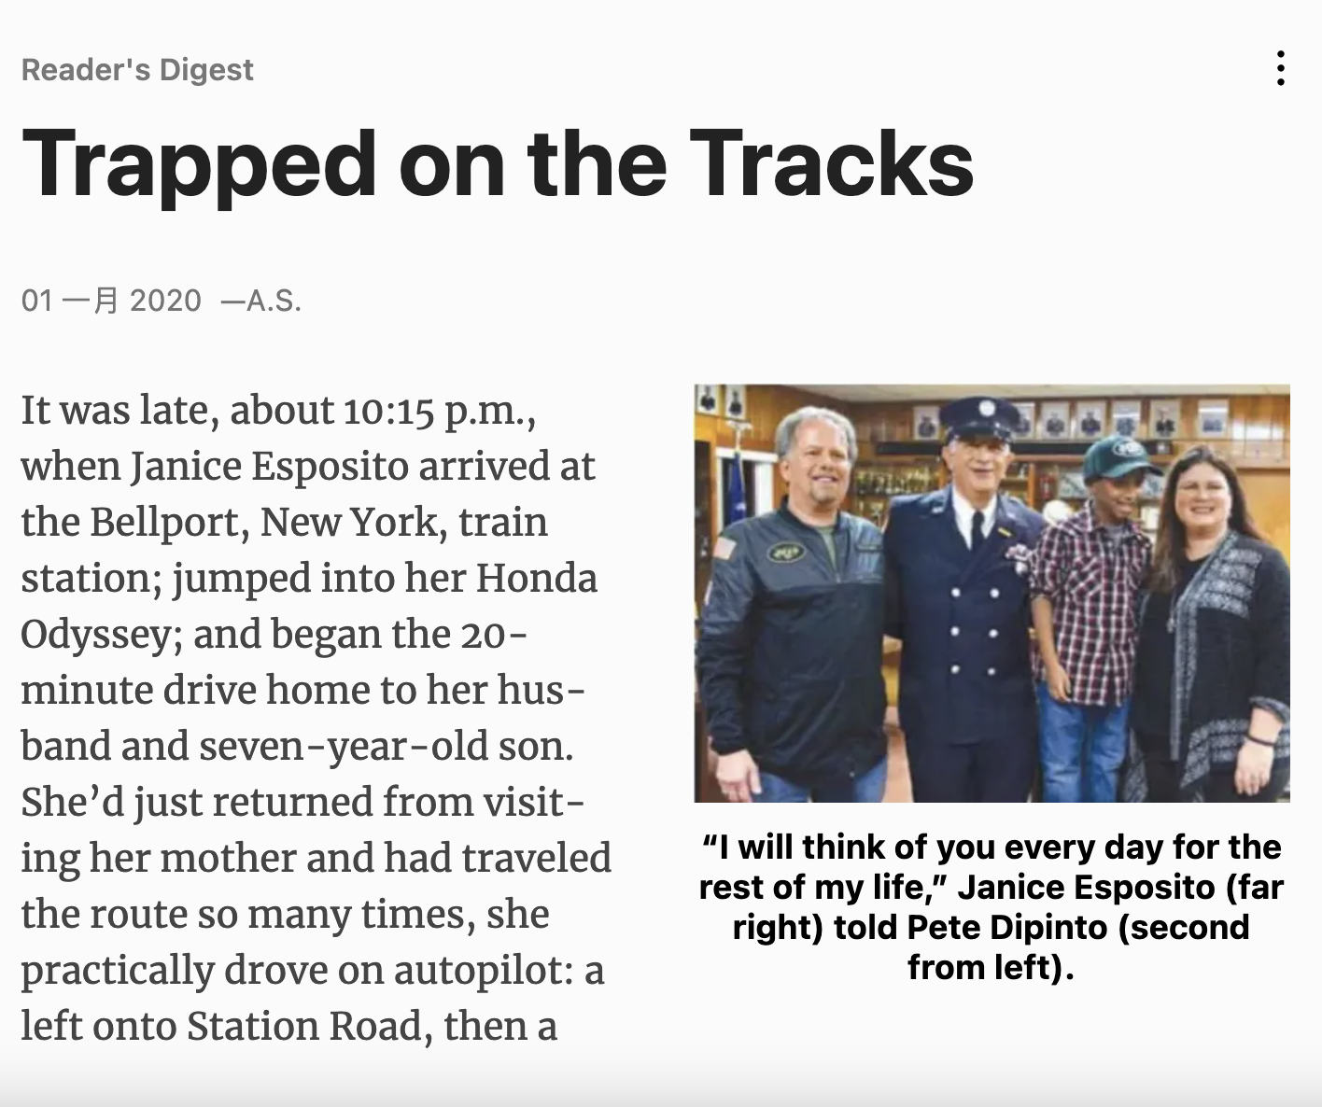

Slide 33

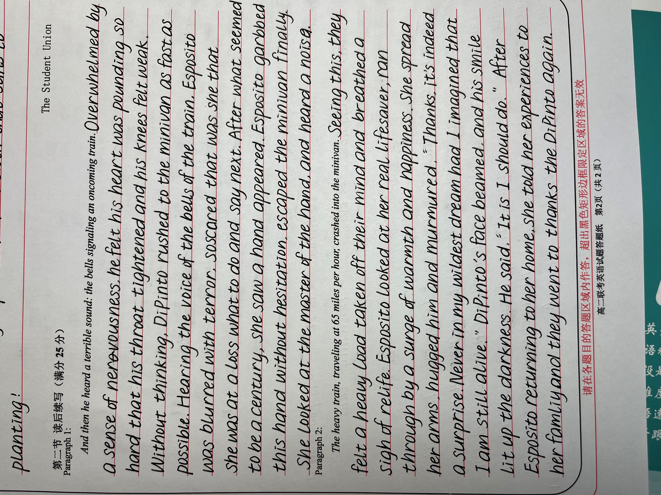
学生习作:
该生第一段情节构建符合逻辑，动作，情绪，人物的处理都比较到位。拼写错误 grabbed
went to thank
等。
考虑到前面客观题比较难，能有这样的发挥已经很不错了。

Slide 34

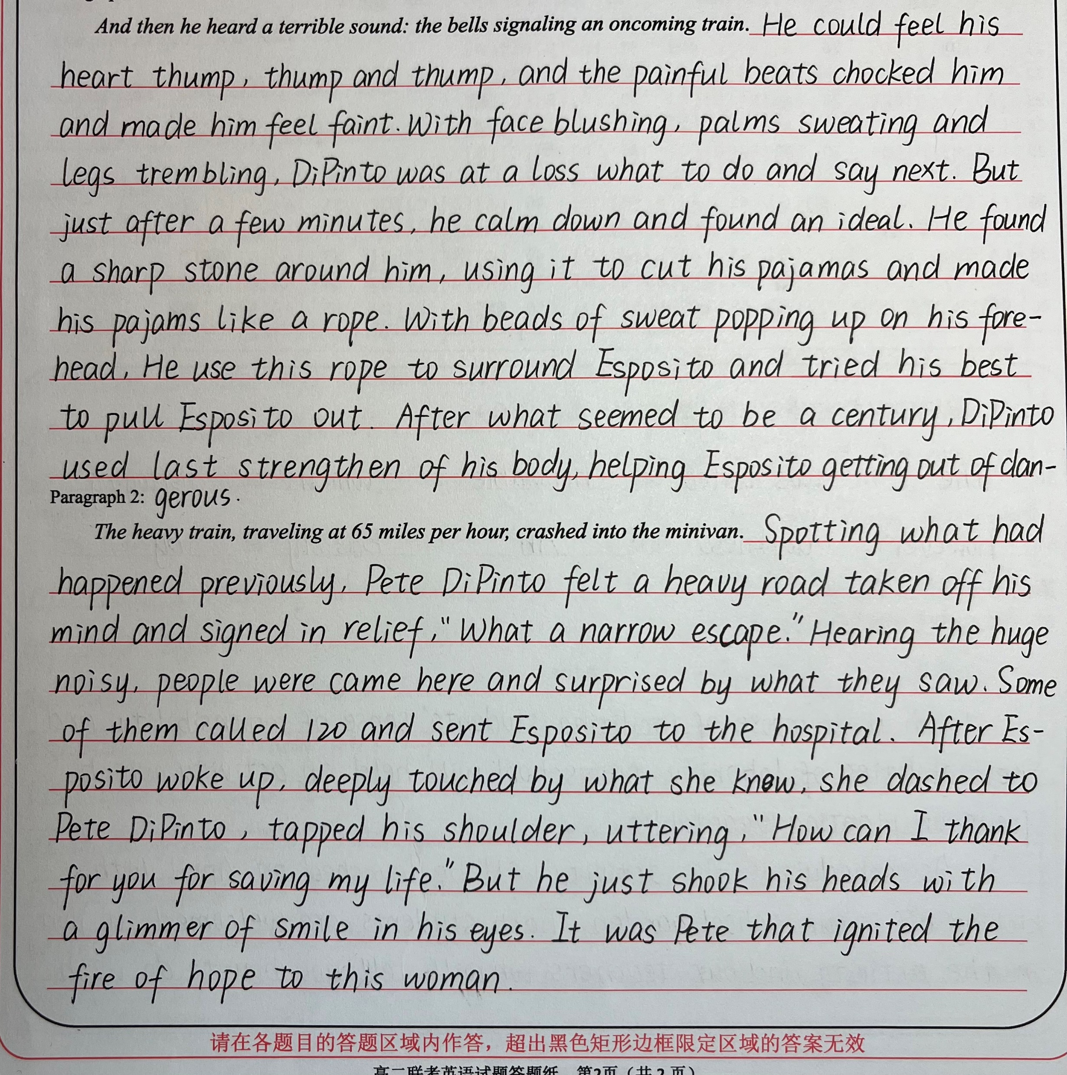
学生习作:
该生描写细腻，第一段有时态，拼写错误几处。第二段比一段出彩。故事看懂且所给句的第二句crashed into the minivan 也理解了。构建情节能力还是不错的。Call 120 体现缺少文化意识：call 911.

Slide 35
