Slide 1


感恩遇见，相互成就，本课件资料仅供您个人参考、教学使用，严禁自行在网络传播，违者依知识产权法追究法律责任。
更多教学资源请关注
公众号：溯恩英语
知识产权声明

Slide 2

2024年3月浙江省9+1高中联盟读后续写讲评
超级英雄Tommy
傅嘉
motive- action -result- reflection续写手法

Slide 3


原文本
It was a cold, snowy evening. Tommy was running as fast as he could, focused on nothing but his destination ---the shop on the street corner. Two weeks ago，he saw figurines of Marvel superheroes on the shelves and felt he had to have one. He's been walking the neighbor's dog ever since then to earn money to realize his little dream. He was so excited and hardly noticing the world around him. Maybe that's why he tripped over the legs of a homeless woman, who was sitting on the sidewalk, her back against the wall. He murmured (低语)"sorry" and moved on to his destination.

Slide 4
原文本
Once he entered the shop, he went straight to the shelves with figurines. Hulk, Thor, Captain America, Iron Man, and many more --- all of his admired heroes. With his heart pounding like crazy he reached for Spiderman.
"You like these, true believer?"
Tommy turned around. An old man was standing behind him with a wide smile on his face. "Y-yes ... Yes, they're awesome!" answered Tommy. "They're strong and fast and help other people a lot ..." the boy looked at figurines in admiration. "I wish I could be a superhero too."

Slide 5
原文本
"Then become one!" said the old man.
"How?" Tommy asked in surprise. "I don't have any superpowers."
"And why would you need them?" the old man smiled. Seeing the confusion on the boy's face, he squatted (蹲下) and put his hands on Tommy's arms. "Did you know, that shopkeeper lady over there has a disabled husband? She's been working hard and taking care of him for years. I've never heard a word of complaint from her. And this person” --- he pointed at a redhead man, who just entered the shop. "He's a firefighter; he's saved countless lives. He never gives up, no matter how dangerous the situation seems to be."

Slide 6
原文本
The old man looked Tommy in the eyes and smiled. "You don't need a superpower to be a hero for someone else. The path of a superhero starts not in the mind, not in the muscles, but in the heart."

Slide 7
Read for information
Answer the questions as fast as possible

Slide 8
It was a cold, snowy evening. Tommy was running as fast as he could, focused on nothing but his destination ---the shop on the street corner. Two weeks ago，he saw figurines of Marvel superheroes on the shelves and felt he had to have one. He's been walking the neighbor's dog ever since then to earn money to realize his little dream. He was so excited and hardly noticing the world around him. Maybe that's why he tripped over the legs of a homeless woman, who was sitting on the sidewalk, her back against the wall. He murmured (低语)"sorry" and moved on to his destination.
Q1： What was Tommy’s desire?
Q2: What happened on the way to the shop?

Slide 9
Once he entered the shop, he went straight to the shelves with figurines. Hulk, Thor, Captain America, Iron Man, and many more --- all of his admired heroes. With his heart pounding like crazy he reached for Spiderman.
"You like these, true believer?"
Tommy turned around. An old man was standing behind him with a wide smile on his face. "Y-yes ... Yes, they're awesome!" answered Tommy. "They're strong and fast and help other people a lot ..." the boy looked at figurines in admiration. "I wish I could be a superhero too."
Q3： Why did Tommy like figurines of Supermen?

Slide 10
"Then become one!" said the old man.
"How?" Tommy asked in surprise. "I don't have any superpowers."
"And why would you need them?" the old man smiled. Seeing the confusion on the boy's face, he squatted (蹲下) and put his hands on Tommy's arms. "Did you know, that shopkeeper lady over there has a disabled husband? She's been working hard and taking care of him for years. I've never heard a word of complaint from her. And this person” --- he pointed at a redhead man, who just entered the shop. "He's a firefighter; he's saved countless lives. He never gives up, no matter how dangerous the situation seems to be."
Q4： What did the old man tell Tommy to do?
Q5: How did he convince Tommy?
Q6: Why did the old man mention the lady and the firefighter?

Slide 11
The old man looked Tommy in the eyes and smiled. "You don't need a superpower to be a hero for someone else. The path of a superhero starts not in the mind, not in the muscles, but in the heart."
Q7： What does it take for Tommy to be a hero?

Slide 12
Read for hidden clues and echoes
Hidden clues can be freely employed
when plotting the continuation part

Slide 13
It was a cold, snowy evening. Tommy was running as fast as he could, focused on nothing but his destination ---the shop on the street corner. Two weeks ago，he saw figurines of Marvel superheroes on the shelves and felt he had to have one. He's been walking the neighbor's dog ever since then to earn money to realize his little dream. He was so excited and hardly noticing the world around him. Maybe that's why he tripped over the legs of a homeless woman, who was sitting on the sidewalk, her back against the wall. He murmured (低语)"sorry" and moved on to his destination.
Echo1: Despite the fact that it was snowing heavily, that night was the warmest one in the woman’s heart because of Tommy’s kindness.

Slide 14
It was a cold, snowy evening. Tommy was running as fast as he could, focused on nothing but his destination ---the shop on the street corner. Two weeks ago，he saw figurines of Marvel superheroes on the shelves and felt he had to have one. He's been walking the neighbor's dog ever since then to earn money to realize his little dream. He was so excited and hardly noticing the world around him. Maybe that's why he tripped over the legs of a homeless woman, who was sitting on the sidewalk, her back against the wall. He murmured (低语)"sorry" and moved on to his destination.
Echo2: Tommy was racing back as fast as he could, focused on nothing but the trembling homeless woman on the sidewalk.

Slide 15
It was a cold, snowy evening. Tommy was running as fast as he could, focused on nothing but his destination ---the shop on the street corner. Two weeks ago，he saw figurines of Marvel superheroes on the shelves and felt he had to have one. He's been walking the neighbor's dog ever since then to earn money to realize his little dream. He was so excited and hardly noticing the world around him. Maybe that's why he tripped over the legs of a homeless woman, who was sitting on the sidewalk, her back against the wall. He murmured (低语)"sorry" and moved on to his destination.
Echo3: The money earned by walking his neighbor’s dog didn’t go to any superman figurine. Instead, with a determined look, he chose something else.

Slide 16
It was a cold, snowy evening. Tommy was running as fast as he could, focused on nothing but his destination ---the shop on the street corner. Two weeks ago，he saw figurines of Marvel superheroes on the shelves and felt he had to have one. He's been walking the neighbor's dog ever since then to earn money to realize his little dream. He was so excited and hardly noticing the world around him. Maybe that's why he tripped over the legs of a homeless woman, who was sitting on the sidewalk, her back against the wall. He murmured (低语)"sorry" and moved on to his destination.
Echo4: Tommy felt his face burning as he only thought of his so-called dream/ desire---to own a superman figurine, completely ignoring others/ the world around him. Someone was suffering out in the world!

Slide 17
It was a cold, snowy evening. Tommy was running as fast as he could, focused on nothing but his destination ---the shop on the street corner. Two weeks ago，he saw figurines of Marvel superheroes on the shelves and felt he had to have one. He's been walking the neighbor's dog ever since then to earn money to realize his little dream. He was so excited and hardly noticing the world around him. Maybe that's why he tripped over the legs of a homeless woman, who was sitting on the sidewalk, her back against the wall. He murmured (低语)"sorry" and moved on to his destination.
Echo5: Seeing Tommy off in the dark night, the woman murmured “thanks” again and again, tears of gratitude blurring her eyes.

Slide 18
Once he entered the shop, he went straight to the shelves with figurines. Hulk, Thor, Captain America, Iron Man, and many more --- all of his admired heroes. With his heart pounding like crazy he reached for Spiderman.
"You like these, true believer?"
Tommy turned around. An old man was standing behind him with a wide smile on his face. "Y-yes ... Yes, they're awesome!" answered Tommy. "They're strong and fast and help other people a lot ..." the boy looked at figurines in admiration. "I wish I could be a superhero too."
Echo6: His heart beating like crazy, he was approaching the woman with a heavy shopping bag full of stuff.

Slide 19
Once he entered the shop, he went straight to the shelves with figurines. Hulk, Thor, Captain America, Iron Man, and many more --- all of his admired heroes. With his heart pounding like crazy he reached for Spiderman.
"You like these, true believer?"
Tommy turned around. An old man was standing behind him with a wide smile on his face. "Y-yes ... Yes, they're awesome!" answered Tommy. "They're strong and fast and help other people a lot ..." the boy looked at figurines in admiration. "I wish I could be a superhero too."
Echo7: Little Tommy was not only a true believer of Manvel supermen but only a firm practitioner of his belief--- He could be a superhero without a superpower. And what counts / matters/ is important is that helping others is just awesome!

Slide 20
"Then become one!" said the old man.
"How?" Tommy asked in surprise. "I don't have any superpowers."
"And why would you need them?" the old man smiled. Seeing the confusion on the boy's face, he squatted (蹲下) and put his hands on Tommy's arms. "Did you know, that shopkeeper lady over there has a disabled husband? She's been working hard and taking care of him for years. I've never heard a word of complaint from her. And this person” --- he pointed at a redhead man, who just entered the shop. "He's a firefighter; he's saved countless lives. He never gives up, no matter how dangerous the situation seems to be."
Echo8: His mind raced fast and a great idea occurred to him. Initial confusion on the boys’ face was replaced by/ gave way to determination and excitement.

Slide 21
"Then become one!" said the old man.
"How?" Tommy asked in surprise. "I don't have any superpowers."
"And why would you need them?" the old man smiled. Seeing the confusion on the boy's face, he squatted (蹲下) and put his hands on Tommy's arms. "Did you know, that shopkeeper lady over there has a disabled husband? She's been working hard and taking care of him for years. I've never heard a word of complaint from her. And this person” --- he pointed at a redhead man, who just entered the shop. "He's a firefighter; he's saved countless lives. He never gives up, no matter how dangerous the situation seems to be."
Echo9: He could learn a lot from the caring and dedicated shopkeeper lady as well as the fearless and devoted firefighter.

Slide 22
clues and echoes
The old man looked Tommy in the eyes and smiled. "You don't need a superpower to be a hero for someone else. The path of a superhero starts not in the mind, not in the muscles, but in the heart."
Echo10: That cold and snowy night, little Tommy became a hero for the homeless woman. It also dawned on him that to be a superhero only needs a willing heart rather than a superpower.

Slide 23
原文本叙事特征：
人物分析： 主角Tommy , 配角the old man the homeless woman 第一段中提到the homeless woman 肯定有特别的用意， 她可以成就Tommy 成为平凡英雄。另外两个人物 : the shopkeeper lady the firefighter 是 Tommy 学习的楷模，英雄就在身边；
地点：on the sidewalk 因踩到homeless woman而差点绊倒, 但是此次是忽视她的； the shop 是Tommy 思想转变的地点，在这里，Tommy 接受了一个智者的建议，实现了第二个转变，把原本要买的超人小雕像变成别的东西，可能是吃的or 盖的如毯子or 袜子衣服帽子等。也可以笼统地写。
时间： a cold , snowy evening 寒冷，下雪 ---暗示Tommy 的善举温暖了这个女人的雪夜。
原文主人公有个梦想---想拥有一个超人小塑像---并努力遛狗挣钱---反向结局---没有买小超人塑像---拿着挣到的钱去做善事，成为别人的平凡英雄。
主人公Tommy在这之后会有反思有成长。

Slide 24
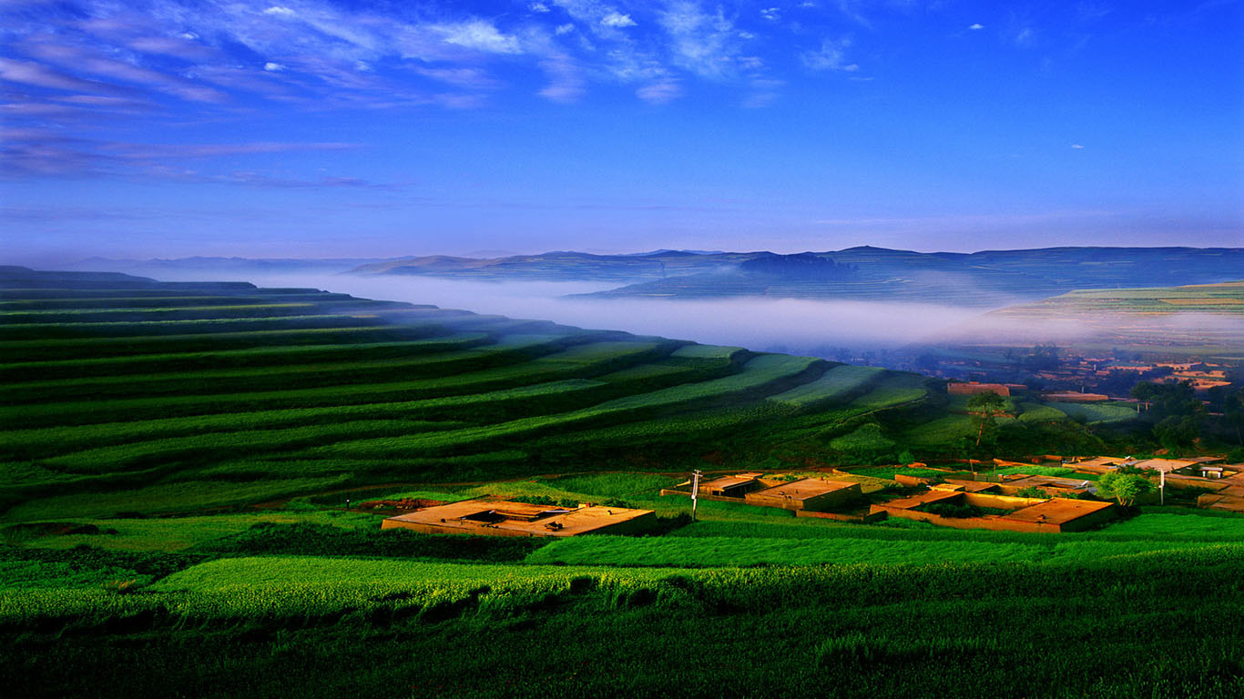
各段情节设计
Para1: Tommy lowered his head and looked at his shoes thinking intensely.
Para2: The homeless woman was right there, where he saw
her last time.
首段情节设计：Tommy 想啊想—想到好点子---看看身边的两个平凡英雄，立志向他们学习---心里感到羞愧，一心只想自己的小梦想---成为街头的女子的英雄---怎么做---不买超人小雕像买了别的东西---心狂跳，决定要做没有超能力的英雄。

Slide 25
Para1: Tommy lowered his head and looked at his shoes thinking intensely.
Para2: The homeless woman was right there, where he saw
her last time.
二段内容设计：
Tommy 飞奔回去，一心想着可怜的女子---描述女子瑟瑟发抖的样子--- 夜色中行人匆匆，没有人为她停留---把购物袋塞到她手里---回家---女子喃喃道谢---小汤姆实现成为他人英雄的愿望---感悟：原来超级英雄只需要一颗愿意去做英雄的心。

Slide 26
Deal with three links and the ending of the continuation
The old man looked Tommy in the eyes and smiled. "You don't need a superpower to be a hero for someone else. The path of a superhero starts not in the mind, not in the muscles, but in the heart."
Para1: Tommy lowered his head and looked at his shoes thinking intensely.
Link1 A: His mind raced fast and a great idea occurred to him./ hit him/ struck him. // and he came up with a brilliant idea.

Slide 27
Deal with three links and the ending of the continuation
The old man looked Tommy in the eyes and smiled. "You don't need a superpower to be a hero for someone else. The path of a superhero starts not in the mind, not in the muscles, but in the heart."
Para1: Tommy lowered his head and looked at his shoes thinking intensely.
Link1B: Tommy’s heart ached and his face was burning with shame as he only thought of how to get / own / possess a figurine of Marvel superheroes, completely ignoring the world around him.

Slide 28
Para1: Tommy lowered his head and looked at his shoes thinking intensely.
…
Link2A: His heart beating like crazy, he decided to offer the woman a heavy shopping bag full of stuff.
Para2: The homeless woman was right there, where he saw
her last time.

Slide 29
Para1: Tommy lowered his head and looked at his shoes thinking intensely.
…
Link2B: Tommy made a crucial decision. He didn’t buy a superman figurine. Instead, he came out of the store with a large heavy shopping bag, heading back home.
Para2: The homeless woman was right there, where he saw
her last time.

Slide 30
Para1: Tommy lowered his head and looked at his shoes thinking intensely.
Para2: The homeless woman was right there, where he saw
her last time.
Link3:
① Tommy was racing back as fast as he could, focused on nothing but the homeless woman on the sidewalk.
② She looked like a trembling leaf on the hustling and bustling street in the dark and cold evening.

Slide 31
Para1: Tommy lowered his head and looked at his shoes thinking intensely.
Para2: The homeless woman was right there, where he saw
her last time.
Ending ①
(呼应老人讲的话） It also dawned on him that to be a superhero only needs a willing heart rather than a superpower.

Slide 32
Para1: Tommy lowered his head and looked at his shoes thinking intensely.
Para2: The homeless woman was right there, where he saw
her last time.
Ending ②
（Tommy 不仅相信漫威超人而且成了坚定的践行者）Tommy was not only a true believer of Manvel supermen but only a firm practitioner of his belief--- He could be a superhero without a superpower. And what counts is that helping others is just awesome!

Slide 33
Para1: Tommy lowered his head and looked at his shoes thinking intensely.
Para2: The homeless woman was right there, where he saw
her last time.
Ending③
（Tommy 把自己体验到的感悟说出来）
“ Yes, I made it! To be a superman doesn’t need a superpower. It only needs a kind and generous heart. ” Little Tommy exclaimed!

Slide 34
习作欣赏A

Slide 35
Para1: Tommy lowered his head and looked at his shoes thinking intensely. His mind raced fast and a great idea occurred to him. Initial confusion on his face was replaced by / gave way to determination and excitement. Raising his head and looking around at the two respected heroes, Tommy decided to learn from the caring and dedicated shopkeeper lady as well as the fearless and devoted firefighter. They were actually brilliant supermen around him. Tommy felt his face burning as he only thought of his so-called dream ---to own a superman figurine, completely ignoring others around him. Someone was suffering out in the world! The homeless woman! The money earned by walking his neighbor’s dog didn’t go to any superman figurine. Instead, with a determined look, he chose something else. His heart beating like crazy, he decided to offer the woman a heavy shopping bag full of stuff.

Slide 36
Para2: The homeless woman was right there, where he saw her last time. Tommy was racing back as fast as he could, focused on nothing but the homeless woman on the sidewalk. The woman was shaking like a trembling leaf. As it was snowing harder and harder, people were going down the hustling and bustling street, ignoring the woman as he did before. No sooner had Tommy approached her than he stuffed the shopping bag into her hands. “ Good evening. You may need this.” With these words, Tommy left for his warm home. Seeing Tommy off in the dark night, the woman murmured “thanks” again and again, tears of gratitude blurring her eyes. That cold and snowy night, little Tommy became a hero for the homeless woman. It also dawned on him that to be a superhero only needs a willing heart rather than a superpower.

Slide 37
习作欣赏B

Slide 38
Para1: Tommy lowered his head and looked at his shoes thinking intensely. A million thoughts raced in his mind. “ How can I be a superhero without a superpower?” he thought to himself. All of a sudden , a scene of a homeless woman, trembling in the biting cold and dark evening , flashed across his head. Tommy’s heart ached and his face was burning with shame as he had been thinking of only a figurine of Marvel superheroes, completely ignoring the world around him. As Tommy raised his head, the gentle old man cast him an encouraging look , saying goodbye to him. Tommy made a crucial decision. He didn’t buy a superman figurine. Instead, he came out of the store with a large shopping bag, heading back home.

Slide 39
Para2: The homeless woman was right there, where he saw her last time. She was shaking in the cold like a leaf. People were hustling and bustling on the street, ignoring the woman just as he did previously. This evening, little Tommy would make a difference to someone else in the world. Heart beating with excitement, Tom quickened up his steps , approached the woman and offered her the large bag full of items, with a smile on his face. No sooner had the woman taken the bag from his hands than little Tommy disappeared into the deep darkness. Stunned and moved, the woman said thanks again and again, tears blurring her vision. “ Thank you, little superman!” With Tommy’s gesture of kindness, that night would be a warmest night for her.

Slide 40
Para2: The homeless woman was right there, where he saw
her last time. She looked like a trembling leaf on the hustling and bustling street in the dark and cold evening. “But I could make a difference to her life tonight.” Tommy urged himself to speed up his steps, striving to carry the huge bag full of stuff. “ Good evening, you may need this. ” With these words, Tommy put down the bag, turned away and headed for his warm home. An overwhelming sense of pride welled up inside him as he turned back to find the woman’s face lit up. “ Yes, I made it! To be a superman doesn’t need a superpower. It only needs a kind and generous heart. ” Little Tommy exclaimed!

Slide 41
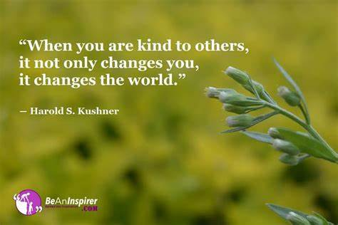

Slide 42
