Slide 1


感恩遇见，相互成就，本课件资料仅供您个人参考、教学使用，严禁自行在网络传播，违者依知识产权法追究法律责任。
更多教学资源请关注
公众号：溯恩英语
知识产权声明

Slide 2

浙江强基联盟2023学年第二学期
高三3月联考应用文讲评
信息整合下的结构化思维交际写作
Assistant Teacher for Robert
为外教招聘助教
浙江省义乌中学 陈敏之

Slide 3

假如学校外教Robert想聘请一名同学做他的助教，请你在学校英文报上替他写一则校园招聘信息，内容包括：
1. 招聘目的；2.选拔方式；3.报名要求。
注意：
1.词数80个左右；题目已给出，不计入总词数；
2. 请按如下格式在答题卡的相应位置作答。
I WANT YOU
文 体
招聘启事
写作目的
+ 招聘目的
Para. 1
对 象
学 生
第二/三人称
选拔方式
+原因/目的
Para. 2
必要衔接
报名要求
期待报名
Para. 3
时 态
一般现在时+一般将来时

Slide 4
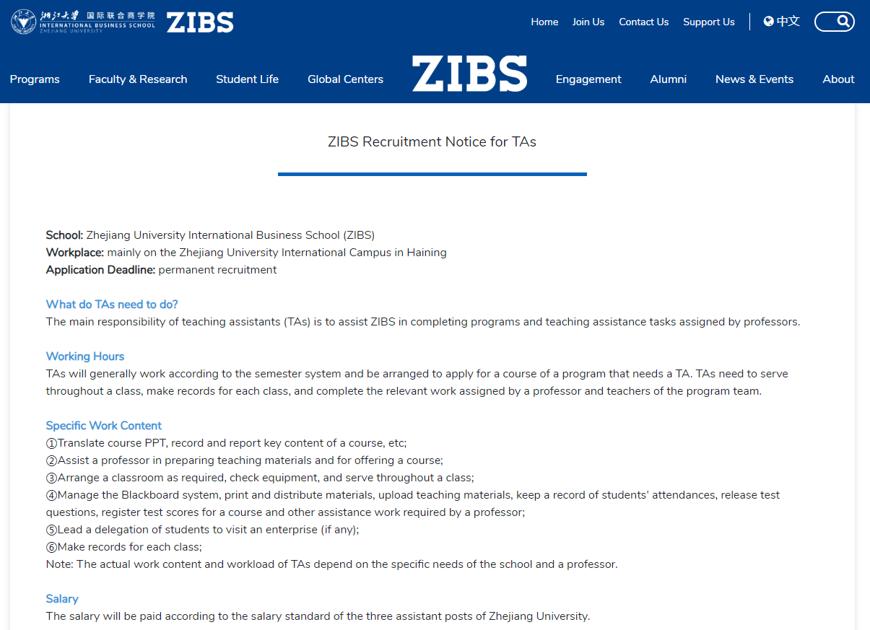
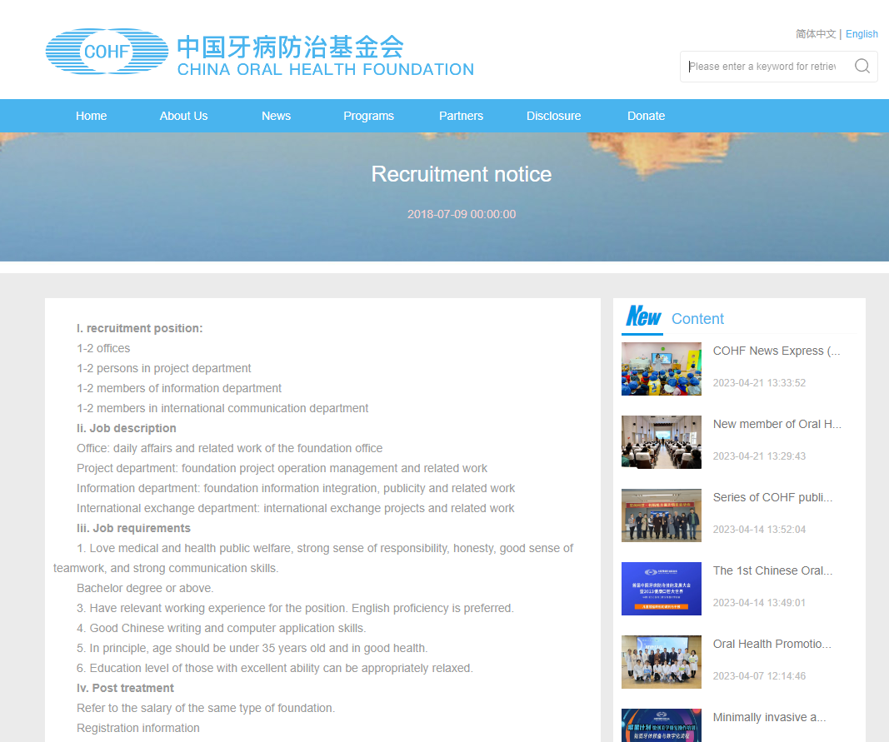
position
job description
job requirements
salary
selection process

Slide 5



1. Purpose of recruitment
for Robert
provide support to a lead teacher in charge of a classroom
assist Robert in dealing with academic stuffs (supervising students, developing lesson plans & preparing lesson material)
for students
help ensure better teacher-student communication and relationships
for the applicant himself/ herself
offer an easy access to connecting to Robert and enhance both administrative and linguistic abilities

Slide 6
Para. 1
写作目的
+ 招聘目的
信息整合
To (招聘目的), our esteemed foreign teacher Robert wants to (写作目的).
To help with academic stuffs and better teacher-stuff communication, our esteemed foreign teacher Robert wants to find a qualified student assistant.
Our respectable foreign teacher Robert is (写作目的), in an effort to (招聘目的).
Our respectable foreign teacher Robert is looking for/ seeking a diligent and enthusiastic student to join him as his assistant teacher, in an effort to enhance the learning experience for all students, while providing an exceptional opportunity for personal growth and professional development.
结构化思维
（对要点3的总括）
交际意识
（引发共鸣/增加兴趣）

Slide 7



2. Selection process
信息整合
选拔方式
+原因/目的
A students’ version:
Applicants will be required to submit a resume, a brief cover letter expressing their interest and qualifications, and any relevant academic or teaching experience. Shortlisted candidates will be invited to participate in an interview conducted by Robert to further assess their suitability for the position.
A students’ version:
Applicants will be required to submit a resume, a brief cover letter expressing their interest and qualifications, and any relevant academic or teaching experience. Qualified candidates will be invited to participate in an interview conducted by Robert to further assess their suitability for the position.
Applicants will undergo a rigorous selection process, including application screenings and interviews, to evaluate whether they are fit for the post.
To select the most suitable candidate, Robert will conduct a thorough evaluation process, including a review of applications, followed by in-person or online interviews.
Selection will involve application reviews and interviews, focusing on academic performance, language skills, and interpersonal abilities.

Slide 8

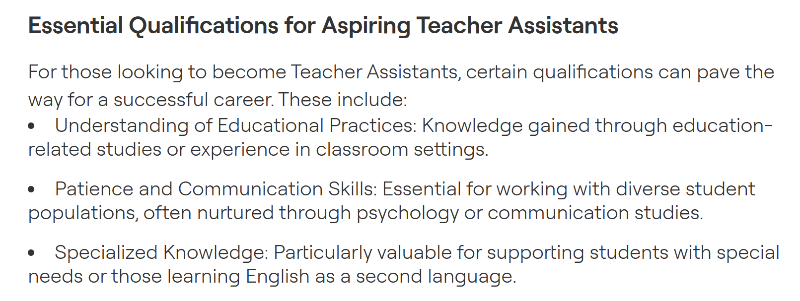
3. Job requirements
报名要求
Language
Fluency in oral English communication and mastery of English writing
Communication
Outstanding interpersonal and presentation abilities
Class Knowledge
Solid understanding of classroom activities and teaching procedures
Others
a sense of responsibility
a strong ability to work under pressure
a compassionate and positive attitude
a specific interest in education
You are expected to/ must be….
… is a must/ an essential/ preferred.
… will give you an advantage / edge over other candidates.

Slide 9
3. Job requirements
必要衔接
报名要求
To apply,
To be eligible (符合条件的),
To excel in this role,
To excel in this role, you must demonstrate (vt.表现出) excellent written and verbal communication skills, as well as in-depth knowledge of classroom activities and teaching methods.
To apply, you should be equipped with fluency in oral English communication and mastery of English writing. Solid understanding of classroom activities will also give you an advantage/ edge over others.

Slide 10
交际意识
（增加兴趣）
3. Job requirements
必要衔接
报名要求
期待报名
Join sth./ sb. to do sth.! Apply now!
Seize/ Grab this opportunity to do sth.! Looking forward to receiving your applications!
Don't miss out on this exciting opportunity! Apply soon!
Join Robert in this exciting opportunity to make a difference in our English class! Apply now!
Seize this opportunity to work closely with Robert, learn from his expertise, and contribute to the overall growth and development of our school! Apply soon!
Grab this golden opportunity to collaborate with Robert and contribute significantly to our english learning! Apply promptly!

Slide 11
I WANT YOU
Our school foreign teacher, Robert, is looking for a student assistant to work with him.The purpose is to provide better support for his teaching work and enhance the learning experience of students.
The selection will be based on an interview. Candidates should have a good command of English and be able to communicate fluently with both the teacher and students. They should also be responsible, patient and have a passion for teaching.
Anyone who is interested in this position can send their resume and a brief self-introduction to Robert’s email address: robert@email. com before April 30th. We believe that this opportunity will be a valuable experience for the selected candidate and we look forward to seeing your application.
I WANT YOU
Our school foreign teacher, Robert, is looking for a student assistant to work with him. The purpose is to provide better support for his teaching work and enhance the learning experience of students.
The selection will be based on an interview. Candidates should have a good command of English and be able to communicate fluently with both the teacher and students. They should also be responsible, patient and have a passion for teaching.
Anyone who is interested in this position can send their resume and a brief self-introduction to Robert’s email address: robert@email. com before April 30th. We believe that this opportunity will be a valuable experience for the selected candidate and we look forward to seeing your application.
结构总体完整，要点齐全
Para. 1 writing purpose + recruiting purpose
Para. 2 selection process
+ requirements
Para. 3 registration + appeal
要点二内容太少，并且缺少要点间衔接
方式真实具体，符合交际

