Slide 1


感恩遇见，相互成就，本课件资料仅供您个人参考、教学使用，严禁自行在网络传播，违者依知识产权法追究法律责任。
更多教学资源请关注
公众号：溯恩英语
知识产权声明

Slide 2
2024年4月浙江省杭州市二模应用文
栏目投稿——介绍英语文学阅读课

Slide 3
目录
01
审题分析与评价
02
分段建构与语料
03
例文评价与提升
04
比对真题知考情

Slide 4
审题分析与评价
Part 01

Slide 5
原题呈现
本学期你校开设了每周一节的英语文学阅读课，请你就此写一篇短文向学校英文报“Student Voice"栏目投稿，内容包括：
1. 课程介绍（目的、内容、上课方式等）；
2. 你的收获。
注意：
1. 写作词数应为80个左右；
2. 请按如下格式在答题卡的相应位置作答。
English Literature Reading Class Opens a New World

Slide 6
破解题目信息
文体体裁 | 栏目投稿
写作人 | 某位参与文学阅读课的学生
目标读者 | 英文报读者(学生+老师)
写作背景 | 介绍新开设的每周一节的英语文学阅读课，以及作者在这门课程中的收获
写作目的 | 作者通过介绍这门课程的目的、内容、上课方式等方面，表达了自己在这门课程中的成长和进步，并可以适当鼓励其他学生也参与这门课程。 注意：结合题提供的角度参考组织要点；讨论个人收获时，应该进行适当的自我反思，展示出个人的独特思维。
人称时态 | 第一人称 | *第二人称 | 一般现在时

Slide 7
框架形成
首段吸引读者兴趣
01
首段可以用来引入话题，吸引读者的注意力，也可以直接说明投稿的核心价值或意图，即介绍或引入课程。
次段述主体
02
第二段是整篇帖子的核心部分，也就是所说的“主体”（body），在这段中，必须紧密围绕题干给出的要点进行写作，即围绕“课程介绍”“你的收获”两大维度，添加细节丰富内容；字数控制在四句话左右，可各自分配两句话，该部分对语言精炼要求较高。
03
尾段总结稿件内涵
根据题目要求，尾段可以深化收获的意义，从个人上升到群体的维度，指出该课程更大的价值，也可能对所有人都可能有很大裨益。

Slide 8
分段建构与语料
Part 02

Slide 9


首段：引入课程话题
Q1:首段侧重写什么？
As a student who is currently enrolled in the English literature reading class offered by our school, I am excited to share my thoughts and experiences here.
I am exhilarated/thrilled to share my experiences and insights from this fascinating journey through the English literature.

Slide 10
Before Writing: What is the definition of literature-reading course
English Literature reading courses are educational sessions focused on exploring and understanding the vast body of works written in English.
These lessons delve into novels, poetry, plays, and essays from various periods, regions, and genres.
The primary aim is to develop critical reading skills, enhance comprehension, and foster an appreciation for literary art. Students learn to analyze themes, characters, language use, and the historical and cultural contexts that shape these works. Additionally, such lessons often involve discussions, literary criticisms, and personal interpretations, encouraging learners to engage deeply with the texts. They serve not just to build literary knowledge but also to improve empathy, analytical thinking, and communication skills.

Slide 11
要点写作1——Course Description
Q2:结合题干，课程介绍这个要点的角度可以是？
Option①：课程目的
课程以经典和当代作品为重点，旨在通过深入讨论和互动环节拓宽我们的视野并提高我们的英语水平。
Focused on classic and ______________ works, the course aims to broaden our horizons and enhance our English _______________ through __________ discussions and interactive sessions.【包含上课方式】
contemporary
proficiency
in-depth
expose students to a diverse range of English literature
enhance critical reading and analytical skills
uncover the essence of each piece
cultivate a deeper appreciation of literature
foster an understanding of diverse cultures and perspectives
empower students with the ability to critically engage with texts
可用
语块

Slide 12
要点写作1——Course Description
Q2:结合题干，课程介绍这个要点的角度可以是？
Option②：课程内容
课程内容包括不同时期和文化背景的经典小说、短篇小说、诗歌和戏剧。
The course content includes classic novels, short stories, poems, and plays from _________(vary) time periods and cultural backgrounds.
various
该课程每周都会推出一部新的文学名著，从经典小说到当代诗歌，应有尽有。
Each week this class __________ with a new literary masterpiece ranging from classic novels to contemporary poetry.
unfolds

Slide 13
要点写作1——Course Description
Q2:结合题干，课程介绍这个要点的角度可以是？
Option③：上课方式
每节课都结合了导读、小组讨论和个人演讲。我们还结合多媒体资源使文学作品更加生动。
guided
Each session combines _________(guide) readings, group discussions, and individual presentations. We also incorporate multimedia resources to better bring the literature _____ life.
to
employ an interactive and student-centered approach
use a dynamic format
provide some relevant videos or clips
analyze themes, characters, and literary techniques
engage in thoughtful conversations and write analytical essays about the texts
可用
语块

Slide 14
要点写作2——What you have learnt
Q3:在表达个人收获时，从哪些角度切入？
Eg1: My reading and comprehension skills have improved significantly and I become more aware of the underlying messages and symbols in literature.
从文学作品阅读出发
Eg2: Not only does literature reading give me great enjoyment, but I’ve honed(磨炼) critical thinking skills.
乐趣+思辨力
Eg3: My personal gains from the course are substantial and multifaceted. Engaging deeply with diverse literary works has broadened my understanding of different cultures and historical contexts, significantly enriching my world view.
总+分

Slide 15
Other perspectives for reference
1. Broaden Perspectives:
"Expanding world view", "Understanding diverse cultures"
2. Personal Growth:
"Cultivating empathy", "Building self-confidence"
3. Literary Appreciation:
"Nurturing a love for reading", "Appreciating literary beauty"
4. Interactive Learning Experience:
"Engaging in group collaborations", "Participating in lively debates"

Slide 16
结尾段写作
结尾段的重心可以在个人更深感悟和展望上。可以强调这门课程如何在情感层面上丰富了学生，以及这种丰富经验如何影响学生的未来追求和个人成长。
The English Literature Reading class has been a transformative journey that transcends academic learning. It has opened doors to new worlds, cultures, and emotions, enriching my life in diverse ways.
人生更深价值体悟
This class hasn't just taught me about literature; it has taught me how to embrace a new world. I am profoundly grateful for this enriching experience in this semester.
呼应标题 open a new world
Moreover,the class has sparked a newfound passion for literature within me, igniting my desire to explore further in the vast world of English letters. It has undoubtedly been a highlight of this academic semester.
文学热情接续

Slide 17
例文评价与提升
Part 03

Slide 18
官方范文
English Literature Reading Class Opens a New World
I'm excited to share my experience with the weekly English Literature Reading class.
Starting this semester, the class is designed specifically for us to enhance our English proficiency. Each week this class unfolds with a new literary masterpiece ranging from classic novels to contemporary poetry. Through interactive discussions, group readings, and insightful analysis, we are able to explore the depths of literary. Not only does literature reading give me great enjoyment, but I’ve honed critical thinking skills.
Moreover,the class has sparked a newfound passion for literature within me, igniting my desire to explore further in the vast world of English letters. It has undoubtedly been a highlight of this academic semester.

Slide 19
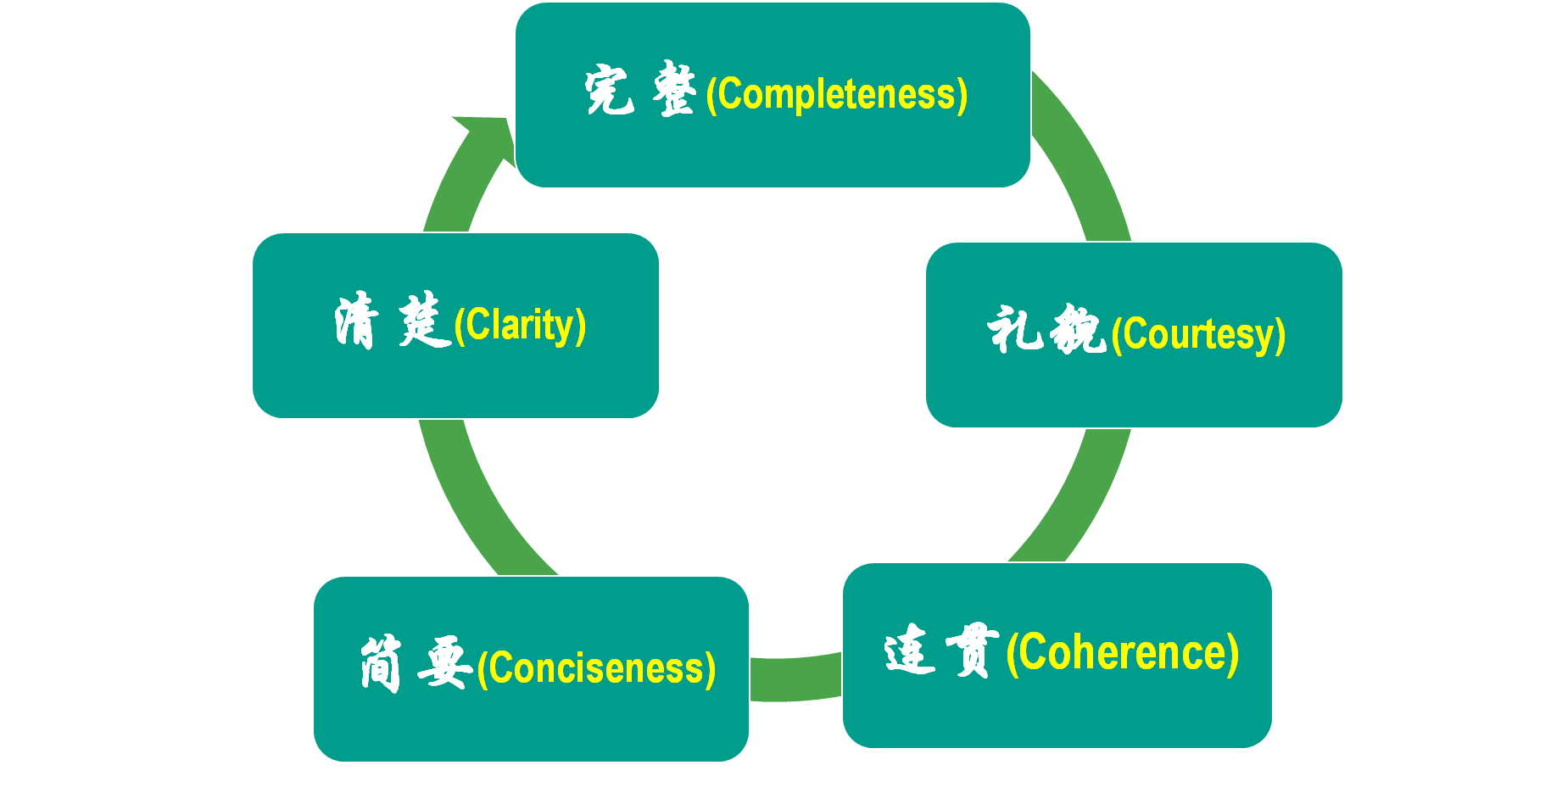
修改
After reading the excellent composition, please note down the materials that will be useful to your writing. Then revise and polish your own articles according to the following 5 aspects of reference.

Slide 20
比对真题知考情
Part 04

Slide 21
2024年1月浙江首考
(考生回忆版) 请你写一篇短文向校英文报“Sports and Health”栏目投稿，向同学们推荐一项适合课间开展的运动，内容包括:
1.介绍这项运动;
2.说明推荐理由。
注意:
1.写作词数应为80个左右;
2.请按如下格式在答题纸的相应位置作答。
Stand Up and Exercise, Everybody!
______________________________________________________________

Slide 22
优秀习作
Stand Up and Exercise, Everybody！
Are you weary of staying at your desk all day？It’s high time that we students liberated ourselves from dull routine by trying something new — Tai Chi.
Featuring graceful and low-impact exercise, Tai Chi involves slow and controlable movements, which makes it a fabulous choice for quick breaks between classes. What’s more, as a time-honored Chinese martial art, Tai Chi brings numerous benefits in terms of maintaining health, ranging from propelling blood circulation to promoting relaxation. Just a few minutes of Tai Chi can leave you refreshed and rejuvenated to embrace your next lesson.
Stand up and join Tai Chi movement! Let’s add color to our campus life and cultivate a healthy lifestyle!
点评：文章要点齐全，逻辑组织严密，词汇与句法使用多样，refreshed and rejuvenated使用了押头韵修辞。综合来看，作者写作水平颇高。

Slide 23
启示
比较2024年1月浙江首考真题和杭州二模，反映出近些年英语高考的思辨性得到不断强化和重视，应用文的话题重要性增强，体裁重要性下移，更加突出对学生思维的考量，落实到文字上其实就是学生的“ideas”够不够有“针对性” “深刻性” “独特性”。
在应用文教学中，加强不同话题语境的素材积累和语块积累，语料的足够输入造就语料择优的输出。

