Slide 1


感恩遇见，相互成就，本课件资料仅供您个人参考、教学使用，严禁自行在网络传播，违者依知识产权法追究法律责任。
更多教学资源请关注
公众号：溯恩英语
知识产权声明

Slide 2
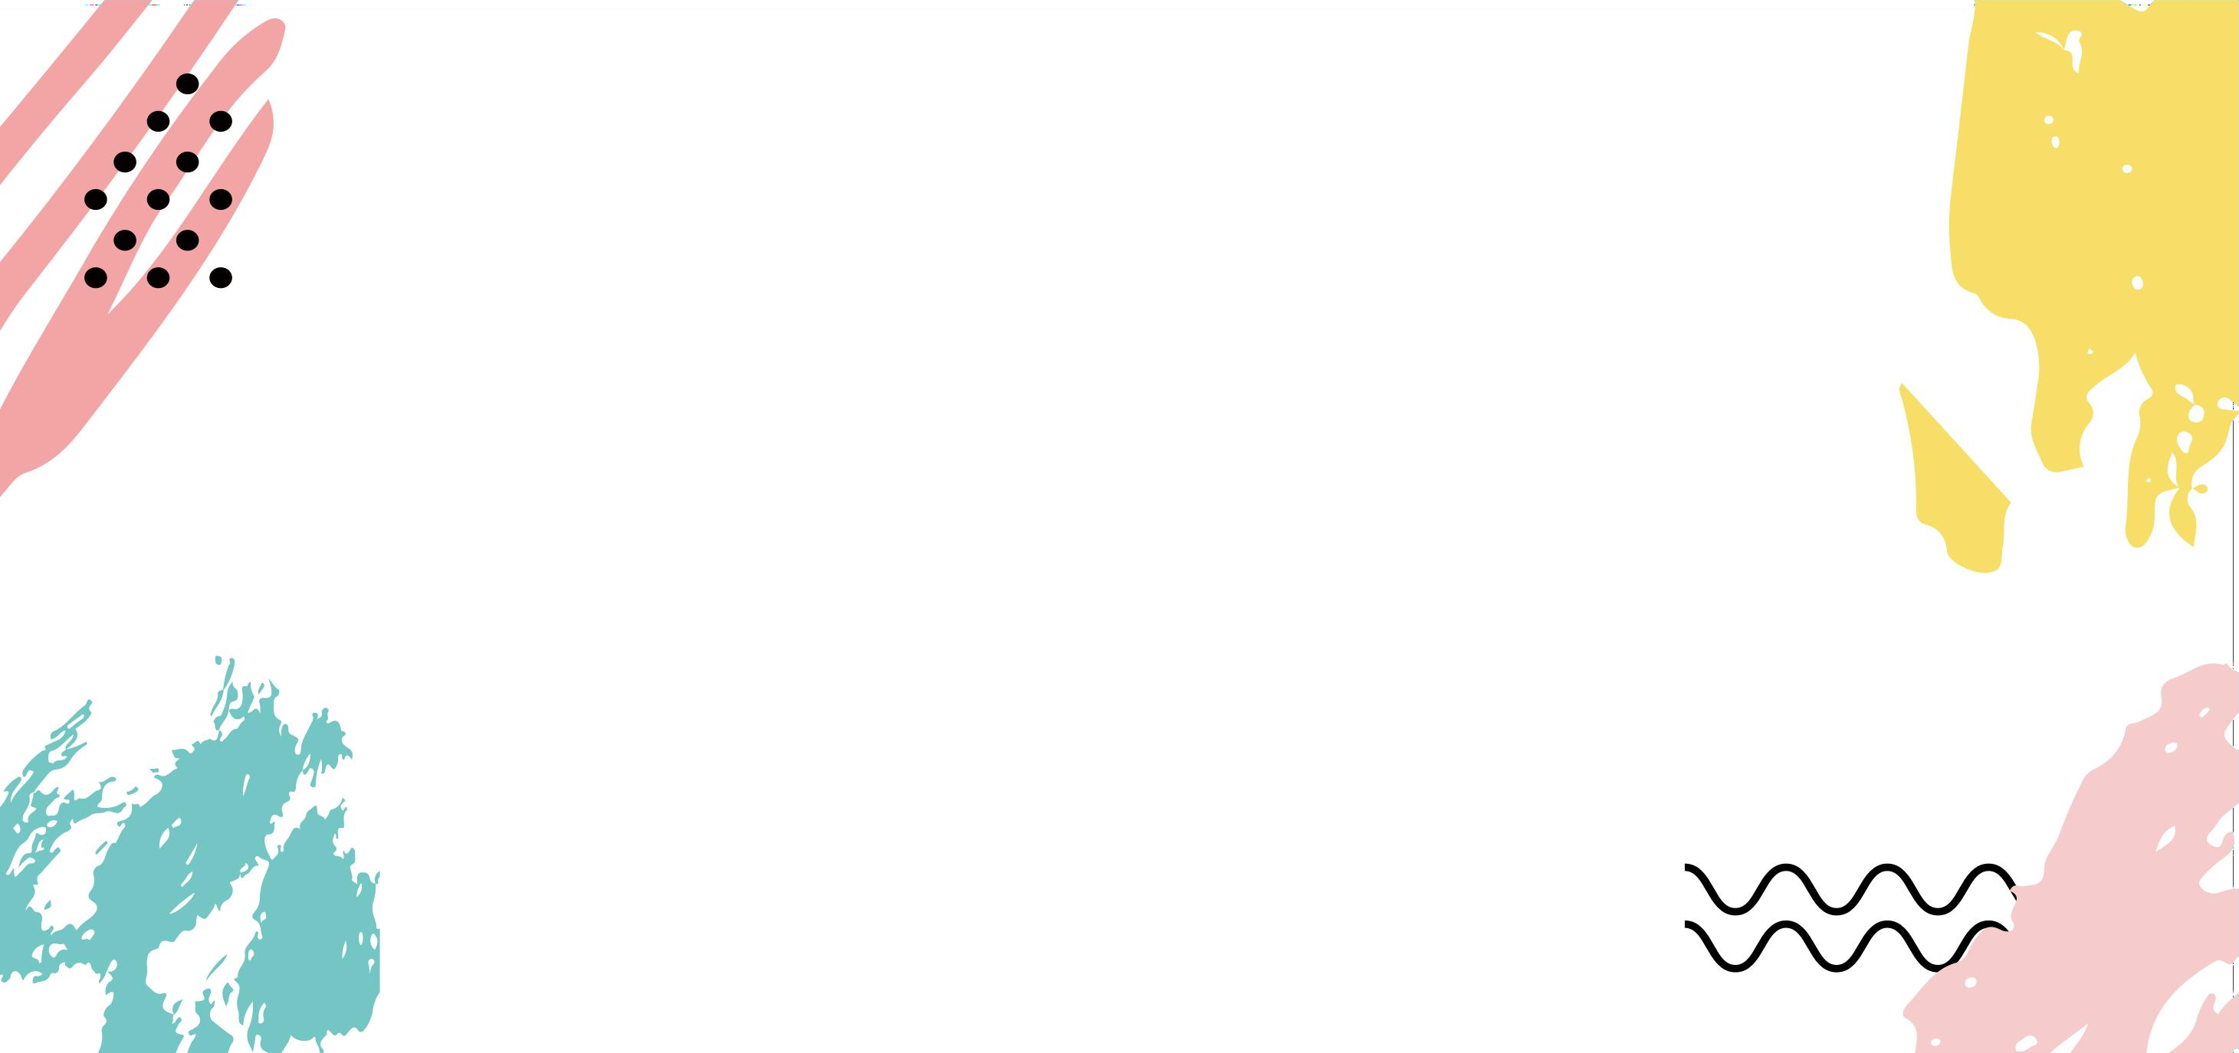
How to write linking sentences
based on cohesion theory.
--Royal

Slide 3
Learning Objectives
In this class, you will:
1. Learn about the features of linking sentences.
2. Figure out the tips of writing linking sentences.
3. Assess and polish linking sentences based on the tips.

Slide 4
Assessment criteria
第五档（21--25）
（1）与所给短文融洽度高，与所提供个段落开头语衔接非常合理；
（2）文章内容新颖、丰富、合理，非常又逻辑性，续写完整；
（3）所使用语法结构和词汇丰富、准确、语言错误很少，且完全不影响意义表达；
（4）自然有效地使用了语句间的连接成分，使所续写短文结构紧凑，全文结构非常清晰，前后呼应，意义非常连贯。
Reasonable coherence
Logical, abundant and complete content
Accurate, diverse and vivid language
Echo

Slide 5
Focusing on the three linking sentences
Given sentence 1
Linking sentence（1）
Linking sentence（2）
Given sentence 2
Linking sentence（3）

Slide 6
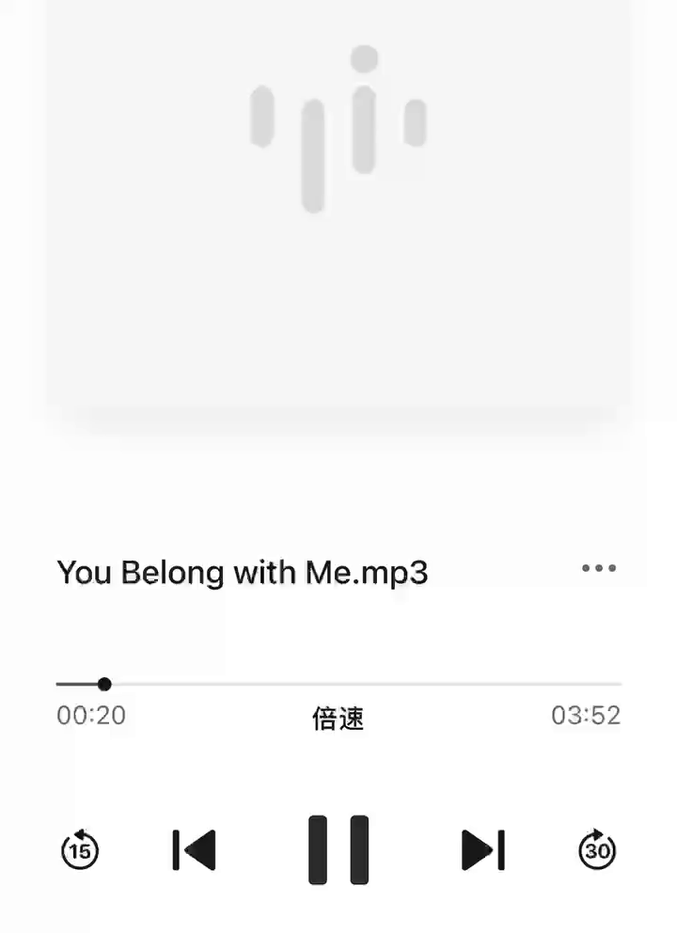
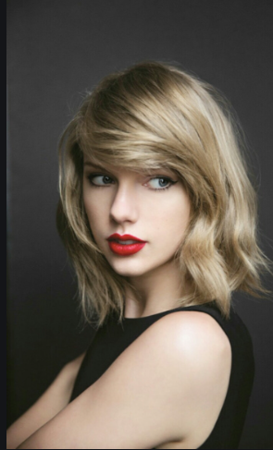
Listenning and Finding
How to make the lyrics coherent（连贯） based on the underlined words?
...
I’m listening to the kind of music she doesn’t like
and she will never know your story like I do
But she wears short skirts
I wear T-shirts
She is cheer captain
And I’m on the bleachers
Use pronouns（代词）

Slide 7
Appreciating and Concluding Tip 1
Last para.（Orginal part） | 深圳一模-- Fake news VS Genuine news（Honesty） I went to Perry's usual caretaker to ask if he knew Perry was missing."He's not missing. He's retired.He's ready for some quieter days,”he said.Learning the truth,I immediately told Ashley and suggested writing a story to say goodbye to Perry.
Para.1 （Given sentence） | Para1：To my surprise, Ashley insisted on reporting the “Deerfield Stole Perry” story.
Para.2 (Given sentence) | Paragraph 2：On Thursday, the paper came out with the headline “Bye-Bye, Perry” on the front page.

Slide 8
Appreciating and Concluding Tip 1
Last para.（Orginal part） | 深圳一模-- Fake news VS Genuine news（Honesty） I went to Perry's usual caretaker to ask if he knew Perry was missing."He's not missing. He's retired.He's ready for some quieter days,”he said.Learning the truth,I immediately told Ashley and suggested writing a story to say goodbye to Perry.
Para.1 （Given sentence） | Para1：To my surprise, Ashley insisted on reporting the “Deerfield Stole Perry” story.
Para.2 (Given sentence) | Paragraph 2：On Thursday, the paper came out with the headline “Bye-Bye, Perry” on the front page.
Subject（same）：Use Pronouns
（相同主语，用代词指代）
This is the very story we need to attract more readers,” she argued. （linking sentence 1）
Soon, it sparked heated discussions among students about Perry. （linking sentence 3）

Slide 9
Appreciating and Concluding Tip1
Last para.（Orginal part） | 深圳一模-- Fake news VS Genuine news（Honesty） I went to Perry's usual caretaker to ask if he knew Perry was missing."He's not missing. He's retired.He's ready for some quieter days,”he said.Learning the truth,I immediately told Ashley and suggested writing a story to say goodbye to Perry.
Para.1 （Given sentence） | Para1：To my surprise, Ashley insisted on reporting the “Deerfield Stole Perry” story.
Para.2 (Given sentence) | Paragraph 2：On Thursday, the paper came out with the headline “Bye-Bye, Perry” on the front page.
WHY did she insist on that?
This is the very story we need to attract more readers,” she argued. （linking sentence 1）
Soon, it sparked heated discussions among students about Perry. （linking sentence 3）

Slide 10
Appreciating and Concluding Tip 1
Last para.（Orginal part） | 深圳一模-- Fake news VS Genuine news（Honesty） I went to Perry's usual caretaker to ask if he knew Perry was missing."He's not missing. He's retired.He's ready for some quieter days,”he said.Learning the truth,I immediately told Ashley and suggested writing a story to say goodbye to Perry.
Para.1 （Given sentence） | Para1：To my surprise, Ashley insisted on reporting the “Deerfield Stole Perry” story.
Para.2 (Given sentence) | Paragraph 2：On Thursday, the paper came out with the headline “Bye-Bye, Perry” on the front page.
WHY did she insist on that?
This is the very story we need to attract more readers,” she argued. （linking sentence 1）
Soon, it sparked heated discussions among students about Perry. （linking sentence 3）

Slide 11
Appreciating and Concluding Tip 1
Last para.（Orginal part） | 深圳一模-- Fake news VS Genuine news（Honesty） I went to Perry's usual caretaker to ask if he knew Perry was missing."He's not missing. He's retired.He's ready for some quieter days,”he said.Learning the truth,I immediately told Ashley and suggested writing a story to say goodbye to Perry.
Para.1 （Given sentence） | Para1：To my surprise, Ashley insisted on reporting the “Deerfield Stole Perry” story.
Para.2 (Given sentence) | Paragraph 2：On Thursday, the paper came out with the headline “Bye-Bye, Perry” on the front page.
This is the very story we need to attract more readers,” she argued. （linking sentence 1）
WHAT was the result?
Soon, it sparked heated discussions among students about Perry. （linking sentence 3）

Slide 12
Appreciating and Concluding Tip 1
Last para.（Orginal part） | 深圳一模-- Fake news VS Genuine news（Honesty） I went to Perry's usual caretaker to ask if he knew Perry was missing."He's not missing. He's retired.He's ready for some quieter days,”he said.Learning the truth,I immediately told Ashley and suggested writing a story to say goodbye to Perry.
Para.1 （Given sentence） | Para1：To my surprise, Ashley insisted on reporting the “Deerfield Stole Perry” story.
Para.2 (Given sentence) | Paragraph 2：On Thursday, the paper came out with the headline “Bye-Bye, Perry” on the front page.
This is the very story we need to attract more readers,” she argued. （linking sentence 1）
WHAT was the result?
Soon, it sparked heated discussions among students about Perry. （linking sentence 3）

Slide 13
Appreciating and Concluding Tip 1
Tip1:Same Subject(Pronoun)+Specific Information（5W1H）
Last para.（Orginal part） | 深圳一模-- 真假新闻（Honesty） I went to Perry's usual caretaker to ask if he knew Perry was missing."He's not missing. He's retired.He's ready for some quieter days,”he said.Learning the truth,I immediately told Ashley and suggested writing a story to say goodbye to Perry.
Para.1 （Given sentence） | Para1：To my surprise, Ashley insisted on reporting the “Deerfield Stole Perry” story.
Para.2 (Given sentence) | Paragraph 2：On Thursday, the paper came out with the headline “Bye-Bye, Perry” on the front page.
WHY
This is the very story we need to attract more readers,” she argued. （linking sentence 1）
WHAT
Soon, it sparked heated discussions among students about Perry. （linking sentence 3）

Slide 14
Appreciating and Concluding Tip 2
Last para.（Orginal part） | T8周测-- 挽救南瓜灯（积极心态-变废为宝） ...They looked at the pumpkin together.It was not too small or too large. It was perfectly round. It had a neat, brown stem they would make a good handle when they cut a cap out of the pumpkin and hollowed it out to hold a candle. They just smiled at each other and reached down to pick up the pumpkin. Together they carried it to the car and headed home.
Para.1 （Given sentence） | Para.1:Now they were ready to carve their Jack O'Lantern for Halloween!
Para.2 (Given sentence) | Para. 2：Tylar looked at the broken pumpkin and then turned around to Jacob.

Slide 15
Appreciating and Concluding Tip 2
Last para.（Orginal part） | T8周测-- 挽救南瓜灯（积极心态-变废为宝） They looked at the pumpkin together.It was not too small or too large. It was perfectly round. It had a neat, brown stem they would make a good handle when they cut a cap out of the pumpkin and hollowed it out to hold a candle. They just smiled at each other and reached down to pick up the pumpkin. Together they carried it to the car and headed home.
Para.1 （Given sentence） | Para.1:Now they were ready to carve their Jack O'Lantern for Halloween!
Para.2 (Given sentence) | Para. 2: Tyler looked at the broken pumpkin and then turned around to Jacob.
Subject（different）：Character B
(角色B作主语)
Tyler was responsible for the opening while Jacob took charge of
hollowing the pumpkin to make room for a candle. (linking sentence 1)
The poor boy sat on the ground, with sorrow and regret written on his tear- stained face.（linking sentence 3）

Slide 16
Appreciating and Concluding Tip 2
Last para.（Orginal part） | T8周测-- 挽救南瓜灯（积极心态-变废为宝） They looked at the pumpkin together.It was not too small or too large. It was perfectly round. It had a neat, brown stem they would make a good handle when they cut a cap out of the pumpkin and hollowed it out to hold a candle. They just smiled at each other and reached down to pick up the pumpkin. Together they carried it to the car and headed home.
Para.1 （Given sentence） | Para.1:Now they were ready to carve their Jack O'Lantern for Halloween!
Para.2 (Given sentence) | Para. 2: Tyler looked at the broken pumpkin and then turned around to Jacob.
HOW to carve it?
Tyler was responsible for the opening while Jacob took charge of
hollowing the pumpkin to make room for a candle. (linking sentence 1)
The poor boy sat on the ground, with sorrow and regret written on his tear- stained face.（linking sentence 3）

Slide 17
Appreciating and Concluding Tip 2
Last para.（Orginal part） | T8周测-- 挽救南瓜灯（积极心态-变废为宝） They looked at the pumpkin together.It was not too small or too large. It was perfectly round. It had a neat, brown stem they would make a good handle when they cut a cap out of the pumpkin and hollowed it out to hold a candle. They just smiled at each other and reached down to pick up the pumpkin. Together they carried it to the car and headed home.
Para.1 （Given sentence） | Para.1:Now they were ready to carve their Jack O'Lantern for Halloween!
Para.2 (Given sentence) | Para. 2: Tyler looked at the broken pumpkin and then turned around to Jacob.
HOW to carve it?
Tyler was responsible for the opening while Jacob took charge of
hollowing the pumpkin to make room for a candle. (linking sentence 1)
The poor boy sat on the ground, with sorrow and regret written on his tear- stained face.（linking sentence 3）

Slide 18
Appreciating and Concluding Tip 2
Last para.（Orginal part） | T8周测-- 挽救南瓜灯（积极心态-变废为宝） They looked at the pumpkin together.It was not too small or too large. It was perfectly round. It had a neat, brown stem they would make a good handle when they cut a cap out of the pumpkin and hollowed it out to hold a candle. They just smiled at each other and reached down to pick up the pumpkin. Together they carried it to the car and headed home.
Para.1 （Given sentence） | Para.1:Now they were ready to carve their Jack O'Lantern for Halloween!
Para.2 (Given sentence) | Para. 2: Tyler looked at the broken pumpkin and then turned around to Jacob.
Tyler was responsible for the opening while Jacob took charge of
hollowing the pumpkin to make room for a candle. (linking sentence 1)
WHAT was Jacob’s response?
The poor boy sat on the ground, with sorrow and regret written on his tear- stained face.（linking sentence 3）

Slide 19
Appreciating and Concluding Tip2
Last para.（Orginal part） | T8周测-- 挽救南瓜灯（积极心态-变废为宝） They looked at the pumpkin together.It was not too small or too large. It was perfectly round. It had a neat, brown stem they would make a good handle when they cut a cap out of the pumpkin and hollowed it out to hold a candle. They just smiled at each other and reached down to pick up the pumpkin. Together they carried it to the car and headed home.
Para.1 （Given sentence） | Para.1:Now they were ready to carve their Jack O'Lantern for Halloween!
Para.2 (Given sentence) | Para. 2: Tyler looked at the broken pumpkin and then turned around to Jacob.
Tyler was responsible for the opening while Jacob took charge of
hollowing the pumpkin to make room for a candle. (linking sentence 1)
WHAT was Jacob’s response?
The poor boy sat on the ground, with sorrow and regret written on his tear- stained face.（linking sentence 3）

Slide 20
Appreciating and Concluding Tip 2
Tip2: Character B+Response（action&emotion）角色B的反应
Last para.（Orginal part） | T8周测-- 挽救南瓜灯（积极心态-变废为宝） They looked at the pumpkin together.It was not too small or too large. It was perfectly round. It had a neat, brown stem they would make a good handle when they cut a cap out of the pumpkin and hollowed it out to hold a candle. They just smiled at each other and reached down to pick up the pumpkin. Together they carried it to the car and headed home.
Para.1 （Given sentence） | Para.1:Now they were ready to carve their Jack O'Lantern for Halloween!
Para.2 (Given sentence) | Para. 2: Tyler looked at the broken pumpkin and then turned around to Jacob.
Tyler was responsible for the opening while Jacob took charge of
hollowing the pumpkin to make room for a candle. (linking sentence 1)
Response(action&emotion)
The poor boy sat on the ground, with sorrow and regret written on his tear- stained face.（linking sentence 3）

Slide 21
Appreciating and Concluding Tip3
Tip3: Echo of Key Words+Cause&Effect（关键词呼应，凸显因果关系）
Passage 1(真假新闻--诚信) | Then I went to gather all the necessary information to write an article about perry and the precious memories we shared over the years. (Linking sentence 2) Para. 2：Paragraph 2：On Thursday, the paper came out with the headline “Bye-Bye, Perry” on the front page.
Passsage 2 (补救破南瓜--积极心态，变废为宝） | Para. 2：Tyler looked at the broken pumpkin and then turned around to Jacob.
cause--effect
...
When Jacob reminded "be careful", Tyler slipped and the
enormous pumpkin was broken.( Linking sentence 2)

Slide 22
Conclusion
Tip 1：Same Subject （pronoun）+Specific Information（5W1H）
（主语不变，解释首句关键词）
LOREM
Tip 2：CharacterB+Reponse（emotion&action）（角色B的反应 ：情绪/动作）
LOREM
Tip 3：Echo of Key Words +Cause&Effect
（关键词呼应，凸显因果关系）

Slide 23
Language Accumulation
句型1：形容词（短语），主+谓
_______________________________________________(百感交集）, my girls came to realize that it was time for our Squirt to return to where it belonged to.
_____________________(又开心又激动）, I gave a jump in the air.
句型2：Doing sth, 主+谓...
___________________________（他后悔地低下头）, the little boy murmured an apology to Tyler.
句型3：so+adj.+谓+主 that主+谓... （so +adj位于句首倒装）
___________________( 如此羞愧）that I could feel my face _____________.(脸红了）
句型4：with复合结构/独立主格
He sighed (失望地）_________________. (with+情感名词）
______________________________(她的计划因为这次意外泡汤了）, she let out a cry of anger. (with+sth+done)
______________________ (眼睛充满泪水；独立主格)，he showed the police his heart-felt gratitude，____________________( 声音颤抖；with复合结构）in excitement .
He sat on the sofa motionlessly, crossing his fingers in his lap, ____________________ on his tear-stained face.（悲伤和遗憾写在满是泪水的脸上；with+sth+done）
Overwhelmed with a mixed feeling of joy and sorrow
Delighted and thrilled
Lowering his head regretfully
So ashamed was I
burning/blushing
with disappointment
With her plan ruined by the accident
Tears welling up in his eyes
with his voice trembling
with sorrow and regret written

Slide 24
Pair work：Discuss what rank will you give to each text.
Para1：To my surprise, Ashley insisted on reporting the “Deerfield Stole Perry” story.
Linking sentence 1
...
Linking sentence 2
Paragraph 2：On Thursday, the paper came out with the headline “Bye-Bye, Perry” on the front page.
Linking sentence 3
Checklist of Textual Coherence（语篇衔接评价表）
 | Content (Tip1/2/3) | Langauge
Linking Sentence1
Linking Sentence 2
Linking Sentence 3

Slide 25
Pair Work：Assessing Students’ Writing
(补救摔破的南瓜--积极心态，变废为宝）
Student 1
Para1: Now they were ready to carve their Jack O’ Lantern for Halloween!
Looking at the pumpkin，they held a deep breath，gathered their courage and began to carve.
...
With a sense of panic, they finally realized the problem but everything seemed too late.
Para2: Tyler looked at the broken pumpkin and then turned around to Jacob.
I believed that we could use the the broken pumpkin to carve Jack O’ Lantern.
Student 2
Para1: Now they were ready to carve their Jack O’ Lantern for Halloween!
They found a knife, stuck it into the pumpkin deeply and began to carve it softly.
...
Tyler and Jacob widened their eyes and wind flew over their face. The pumkin was broken.
Para2: Tyler looked at the broken pumpkin and then turned around to Jacob.
He asked, “what’s wrong with you,dear?” with tears of guilt.

Slide 26
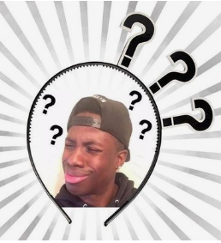
Pair Work：Assessing Students’ Writing
Student 3
Para1: Now they were ready to carve their Jack O’ Lantern for Halloween!
They kicked the door of their neighbors，and asked in an excited voice：“trick or treat”.
...
A strange wind blew through the room and the table was broken under the pressure.
Para2: Tyler looked at the broken pumpkin and then turned around to Jacob.
Jacob was good at drawing, and he used the black pens to draw the three holes.

Slide 27




Assessment Criteria
Checklist of Textual Coherence（语篇衔接评价表）
 | Content (Tip1/2/3) | Langauge (非谓语/with结构/倒装...）
Linking Sentence1
Linking Sentence 2
Linking Sentence 3
1= Improvable
4=Excellent
2= Average 3=Very Good
5=Outstanding

Slide 28


Polishing and Presenting
coherent with the first sentence?
coherent with the second para.?
1
Content
Tip1: Prounoun+Specific Information
Tip2: Character B+Response
Tip3: Echo of Key Words+Cause&Effect
Assessment Criteria
clarity in conveying information?
vivid language use?
2
Language
句型1：形容词（短语）+主谓...
句型2：Doing sth, 主+谓...
句型3：so+adj.+... that从句
句型4：with复合结构
...

Slide 29
Homework
Reflect your own writing and polish it
based on cohesion theory.

