Slide 1


感恩遇见，相互成就，本课件资料仅供您个人参考、教学使用，严禁自行在网络传播，违者依知识产权法追究法律责任。
更多教学资源请关注
公众号：溯恩英语
知识产权声明

Slide 2
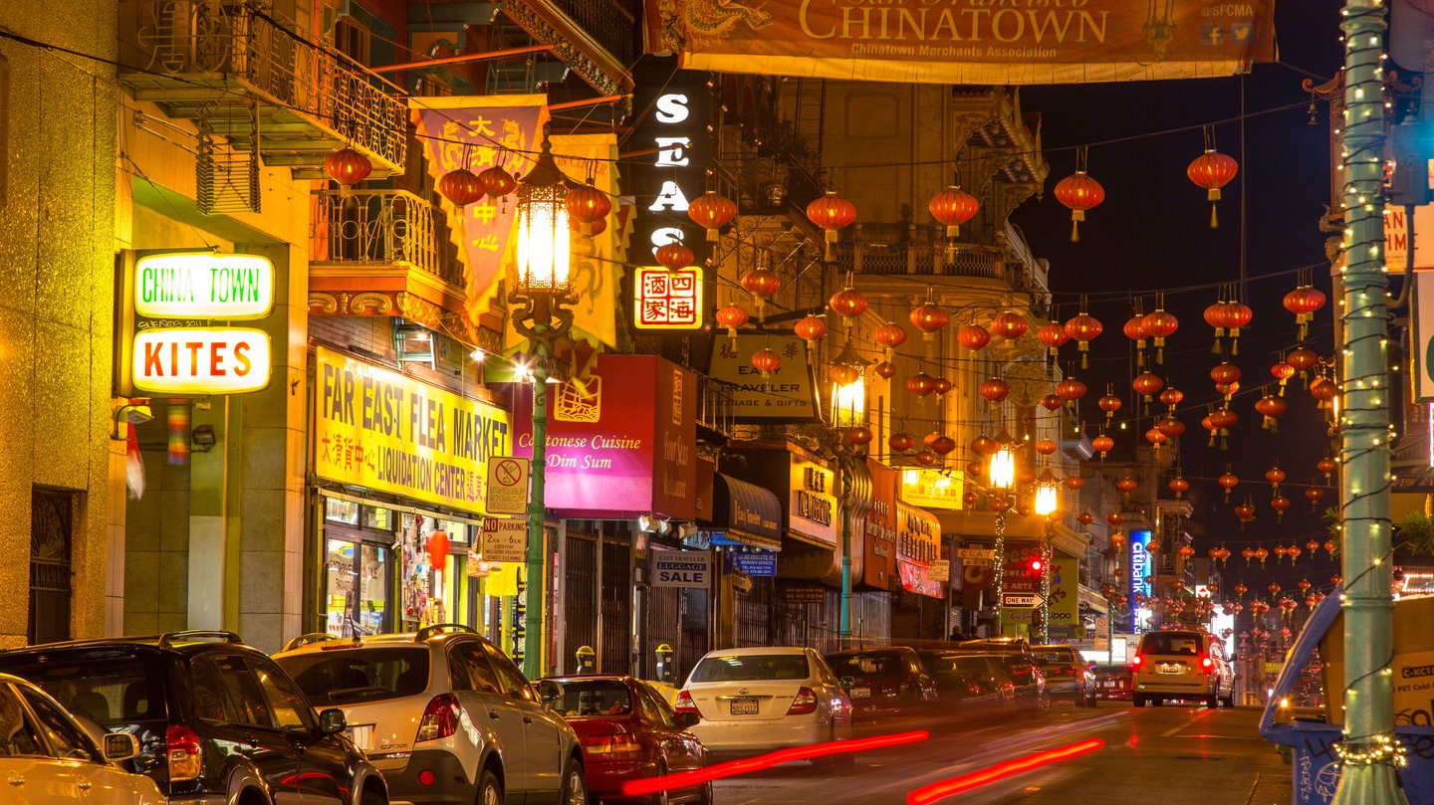
Welcome to Chinatown
B3 U3 Diverse Cultures
Reading for Writing
Welcome to Chinatown

Slide 3
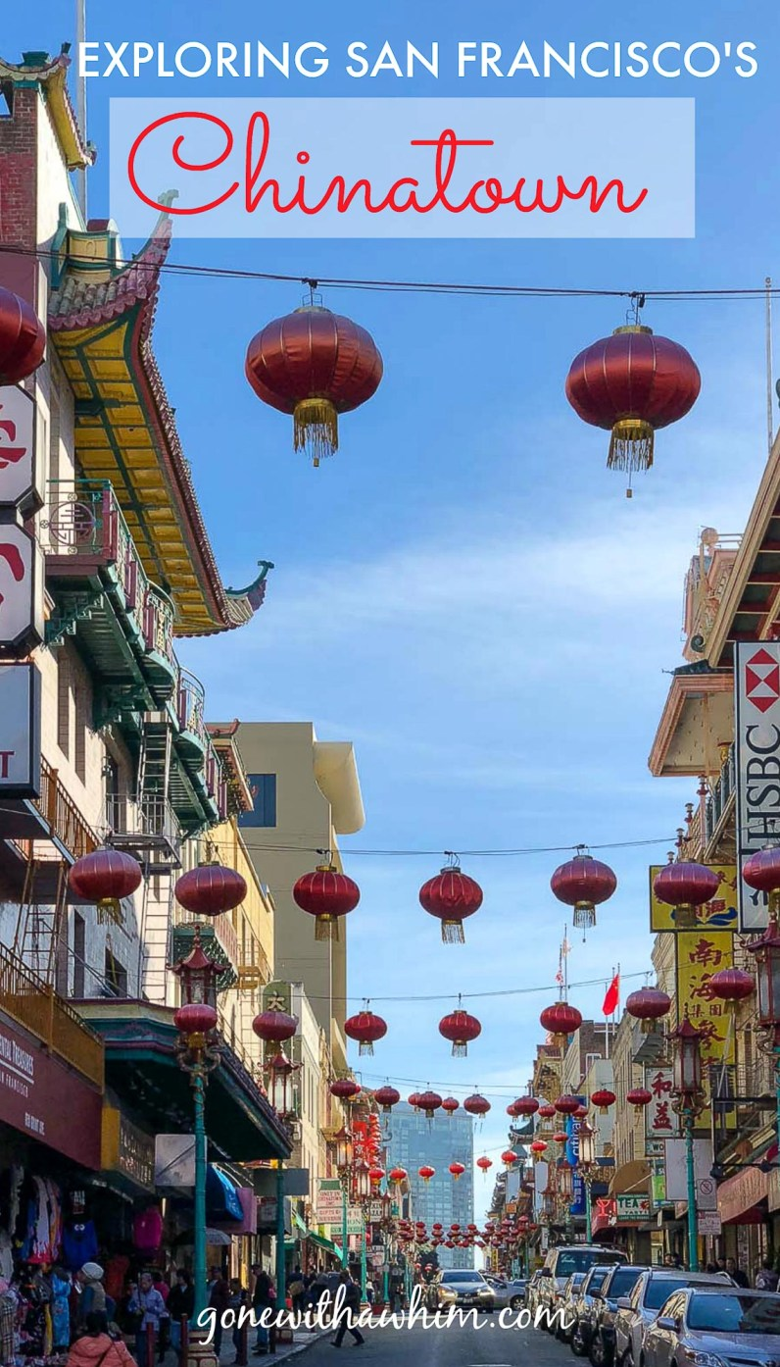
Read for the organization
WELCOME TO CHINATOWN!

Slide 4
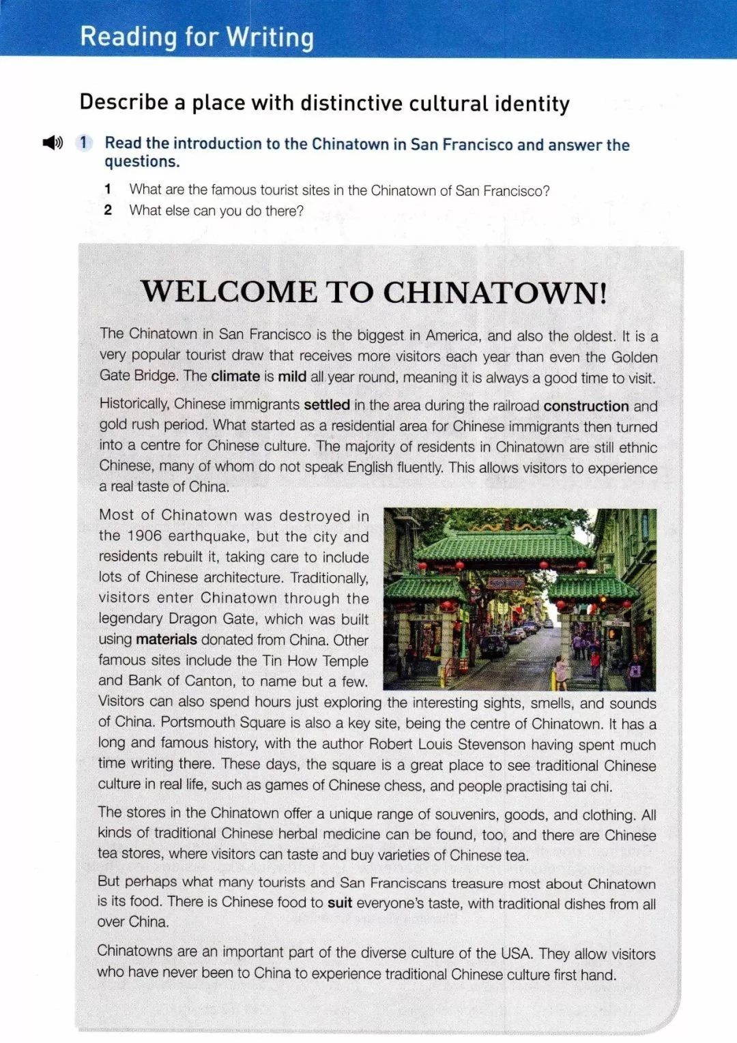

General
introduction
_________
_______________
to San Francisco Chinatown
Introduction
P1
Detailed
information
________ _____________ of the Chinatown
Body
P2-5
_____________of Chinatown
Summary
Importance
P6

Slide 5
Describe a place with distinctive cultural identity
cultural identity
Items used to describe a place
___ location | ___ climate | ___ history
___ population | ___ ethnic groups | ___ languages
___ famous figures | ___ legends/stories | ___ famous food/drink
___ tourist attractions | ___ businesses and industries | ___ other names for the city/town

Slide 6
What items are mentioned in the text?
location
climate
ethnic groups
languages
history
famous figures
tourist attractions
businesses and industries
famous food/drink

Slide 7
The sentences that are used to describe the items above.
n. attraction
吸引人的地方
 | items | Details
Para 1
Para 2
Location
in San Francisco
(largest, oldest, popular tourist draw)
Climate
mild all year around
Chinese immigrants settled
(railroad construction, gold rush)
History
Language
do not speak English fluently
Residents
The majority: ethnic Chinese ( 华人)

Slide 8
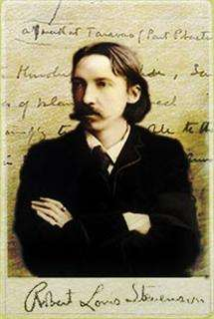
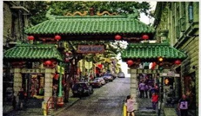
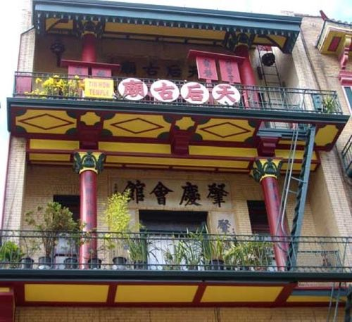
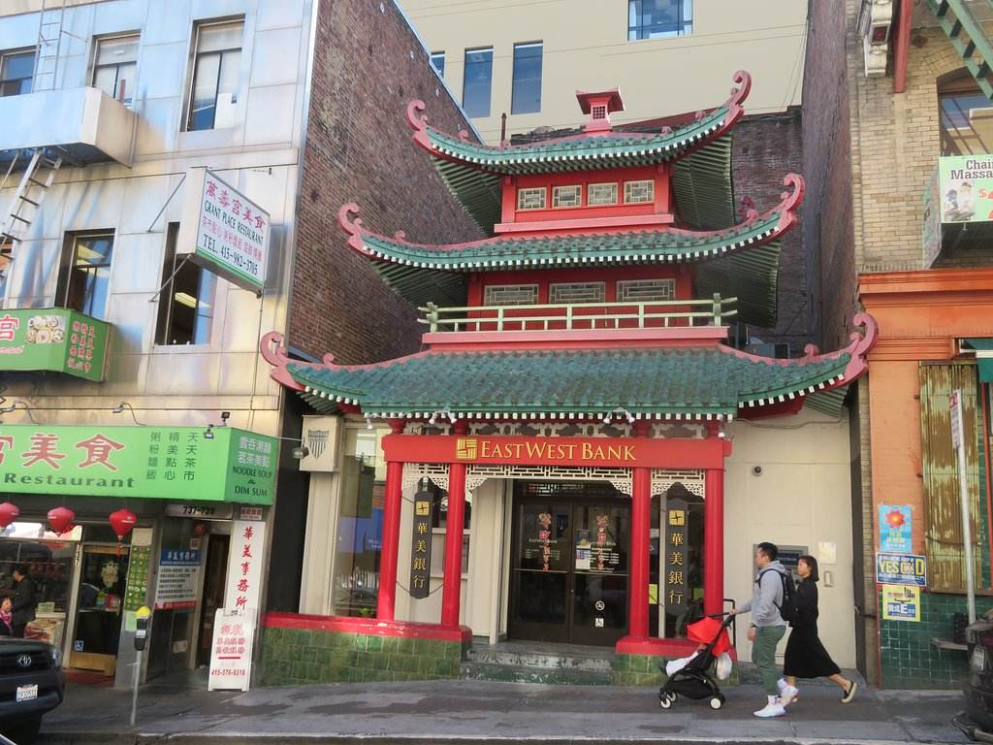
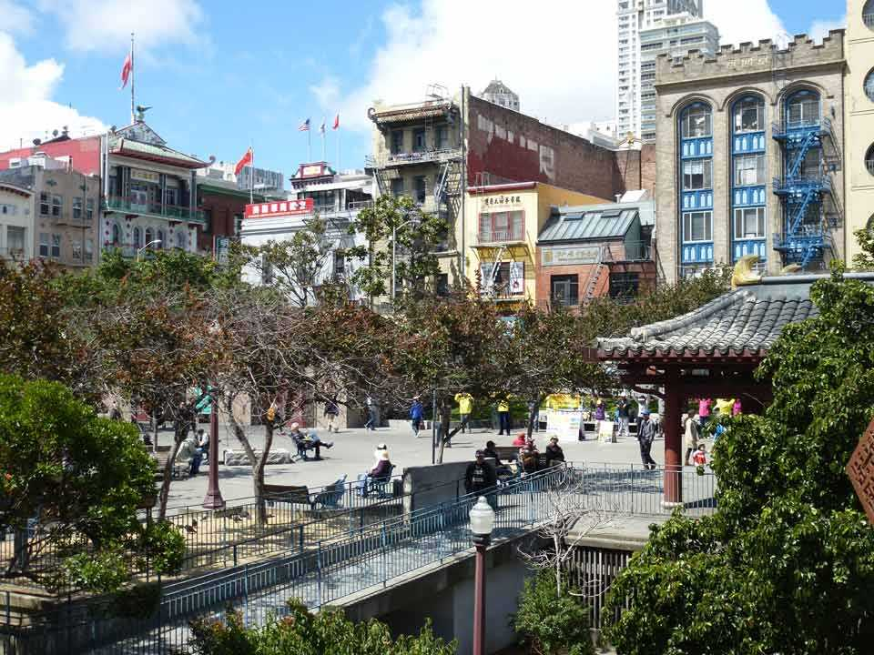
The sentences that are used to describe the items above.
 | items | Details
Para 3
Robert Louis Stevenson (an author from Scotland)
(Treasure Island, Kidnapped, Strange Case of Dr. Jekyll and Mr. Hyde)
famous figures
Tourist attractions
Dragon Gate, Tin How Temple, Bank of Canton, Portsmouth Square

Slide 9
The sentences that are used to describe the items above.
 | items | Details
Para 4
Para 5
Para 6
Businesses and industries
Souvenirs, goods, clothing; traditional Chinese herbal medicine, Chinese tea
Famous food/drink
Traditional dishes from all over China
Summary
An important part of the diverse culture

Slide 10
Phrases and expressions for the introduction of a city/town
Location
Area
Features
History
Residents
Cultures
is located in…
is divided up into…;
is… in size
the most tourist destination
the city’s most powerful draw
one of the most diverse places
has a history of …years
has a population of… ;
is home to…ethnic groups
popular festivals/foods/tourist sights include…

Slide 11
Language study
Para 1
1. It is a very popular tourist draw that receives more visitors each year than even the Golden Gate Bridge.
draw n. a thing or an event that attracts a lot of people
有吸引力的人（或事物）
She is currently one of the biggest draws on the Irish music scene.她是目前爱尔兰音乐界最受欢迎的人物之一。
2. The climate is mild all year round, which _______ (mean) it is always a good time to visit.
meaning
means

Slide 12
Para 2
to make a place your permanent home定居
1. Historically, Chinese immigrants settled in the area during the railroad construction and gold rush period.
to make a place your permanent home 定居
to put an end to an argument or a disagreement结束（争论、争端等）；解决（分歧、纠纷等）
It's time you settled your differences with your father.
settle v.
to make yourself or somebody else comfortable in a new position
使处于舒适的位置
He settled himself comfortably in his usual chair.
to fall from above and come to rest on something; to stay for some time on something 降落；停留
Dust had settled on everything.
Two birds settled on the fence.

Slide 13
2. ________ started as a residential area for Chinese immigrants then turned into a center for Chinese culture.
What
what 引导主语从句，同时在从句中做主语
“这里原本是中国移民的居住地， 后来变成一个中国文化中心。”
Para 5
But perhaps _______ many tourist and San Francisco treasure most about Chinatown is its food.
what
what 引导主语从句，同时在从句中做宾语
“很多游客和旧金山人最钟爱的或许是唐人街的美食。”

Slide 14
2. ________ started as a residential area for Chinese immigrants then turned into a center for Chinese culture.
What
what 引导主语从句，同时在从句中做主语
这里原本是中国移民的居住地， 后来变成一个中国文化中心。
3. The majority of residents in Chinatown are still ethnic Chinese , many of _________ do not speak English fluently.
whom
3. The majority of residents in Chinatown are still ethnic Chinese, of_________ many do not speak English fluently.
whom
从句中为了使关键词和谓语动词靠近，可以把介词+whom/ which提前。

Slide 15
Para 3
Other famous sites include Tin How Temple and Bank of Canton,
to name but a few.
to name but a few: 仅举几例
She has been a dentist, a basketball payer and a pilot, to name but a few.

Slide 16
Complete the paragraph with the proper forms of the given words in the brackets.
Most of Chinatown ____________(destroy) in the 1906 earthquake, but the city and residents rebuilt it, _______(take) care to include lost of Chinese architecture. Traditionally, visitors enter Chinatown through the legendary Dragon Gate, which was built using materials ________ (donate) from China. Other famous sites include the Tin How Temple and Bank of Canton, to name but a few. Visitors can also spend hours just exploring the interesting sights, smells and sounds long and famous history, with the author Robert Louis Stevenson __________(spend) much time _______(write) there. These days, the square is a great place to see traditional Chinese culture in real life, such as games of Chinese chess, and people practicing tai chi.
was destroyed
taking
donated
having spent
writing

Slide 17
Para 5
suit one’s taste 对某人的胃口
There is Chinese food to suit everyone’s taste, with traditional dishes from all over China.
to be convenient or useful for somebody
对（某人）方便；满足（某人）需要；合（某人）心
If you want to go by bus, that suits me fine.
要是你想坐公共汽车走，我也没问题。
suit
v. n.t
(especially of clothes, colours, etc.尤指服装、颜色等) to make you look attractive相配；合身
Blue suits you. You should wear it more often.
a set of clothes made of the same cloth, including a jacket and trousers or a skirt西服；西装；套装
He is dressed in a formal black suit.

