Slide 1

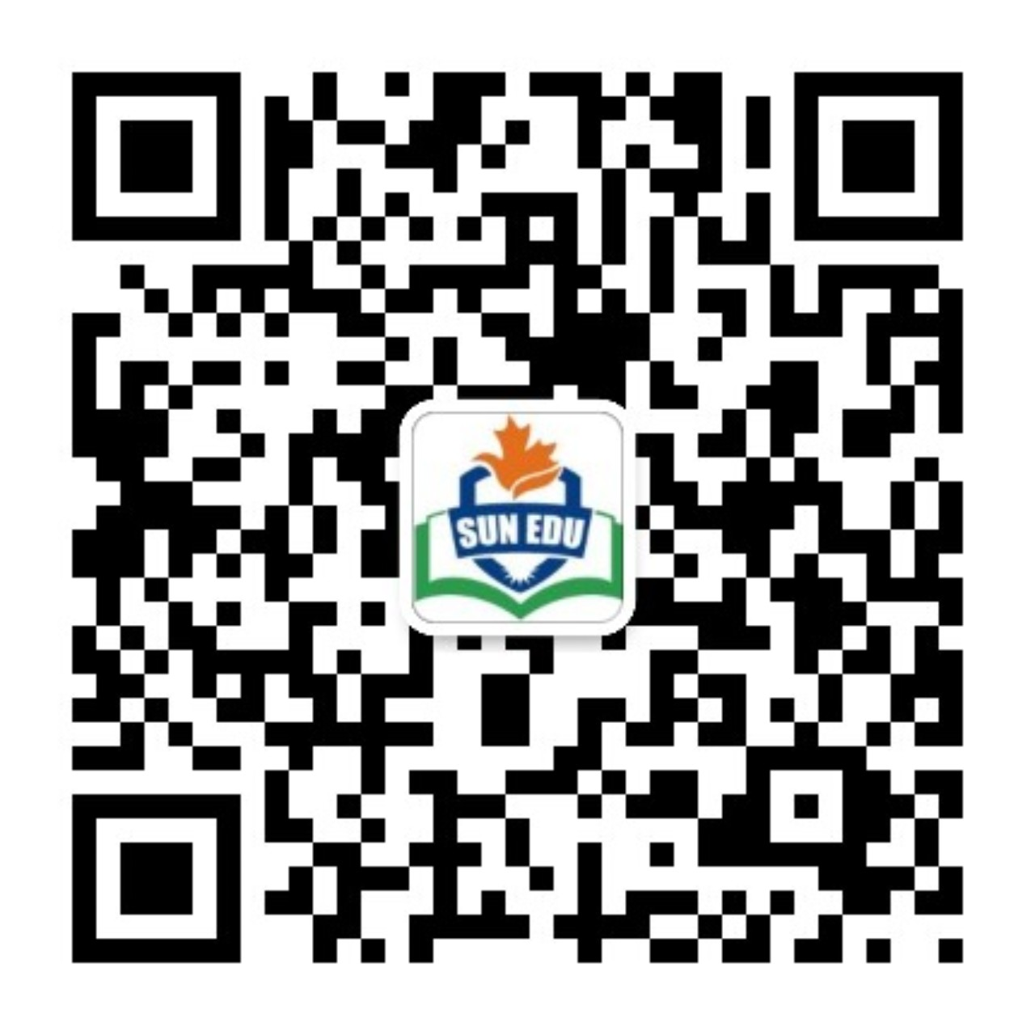
感恩遇见，相互成就，本课件资料仅供您个人参考、教学使用，严禁自行在网络传播，违者依知识产权法追究法律责任。
更多教学资源请关注
公众号：溯恩英语
知识产权声明

Slide 2
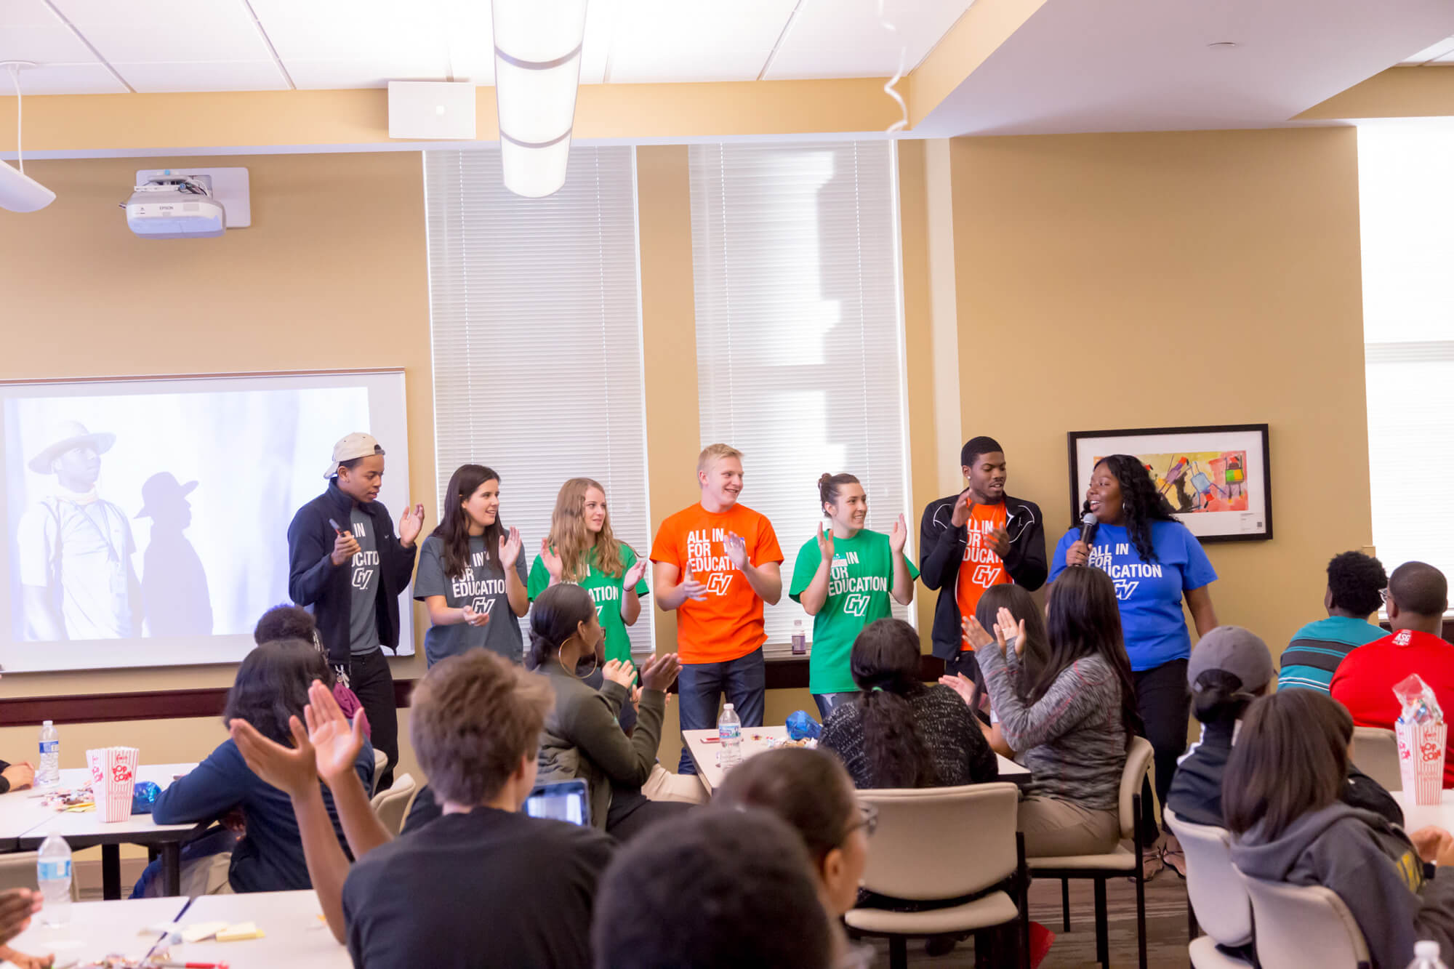
绍兴模考应用文
通知——开设中国传统文化研讨活动
2024.4.9

Slide 3

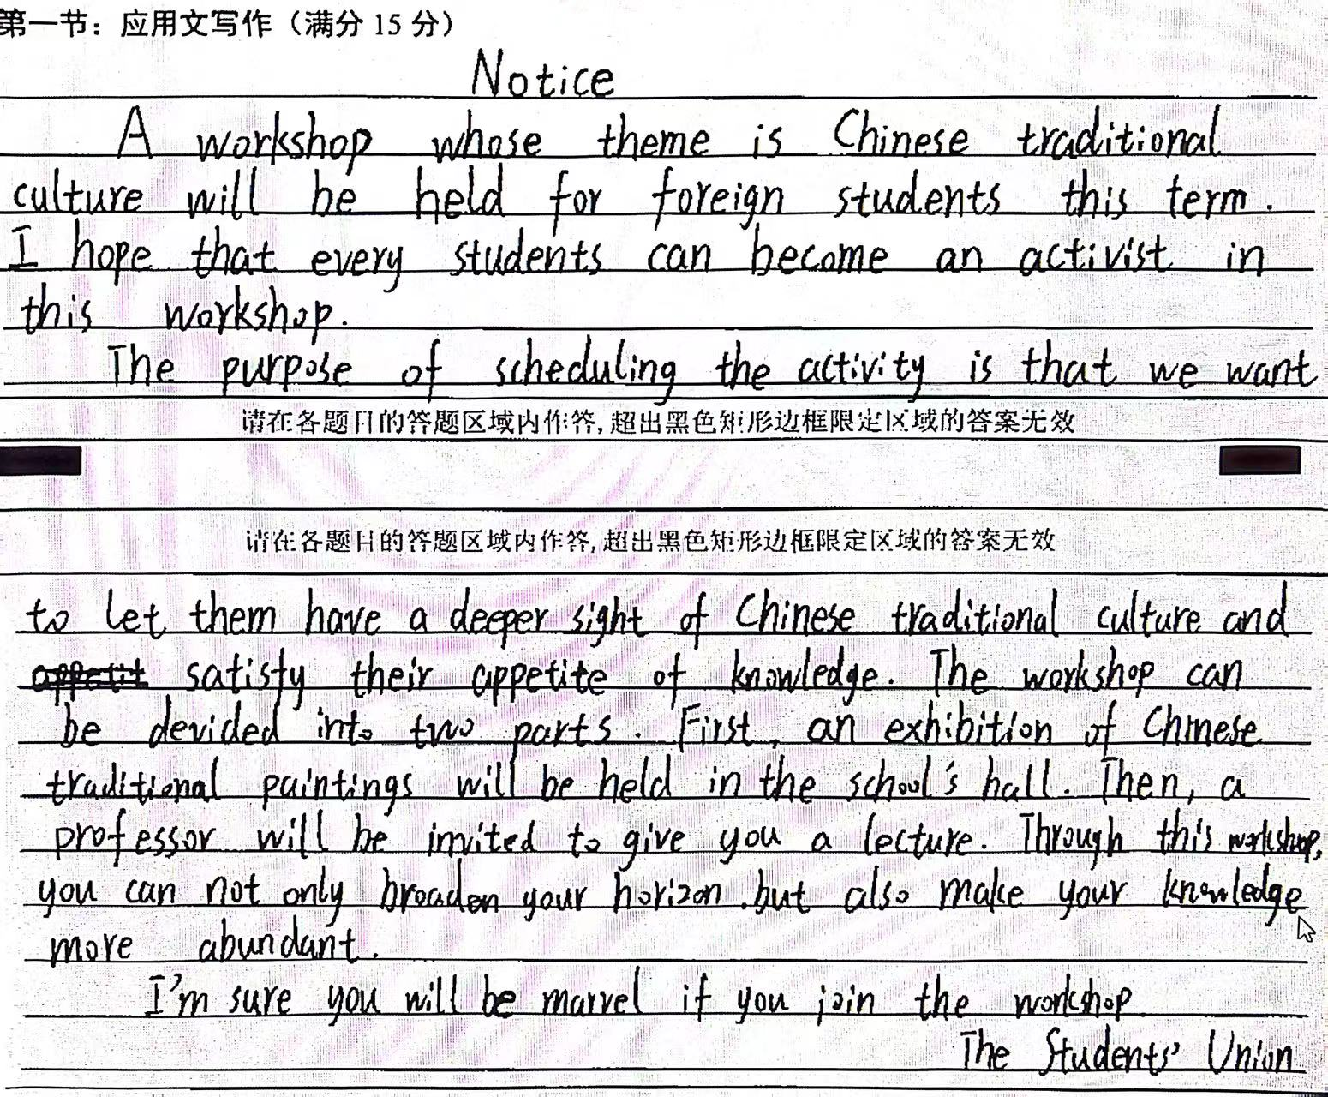
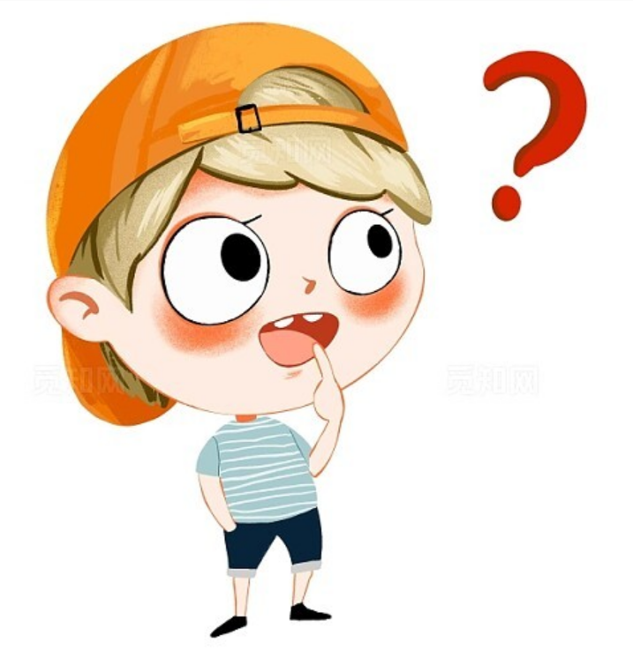
原题：
假定你是某国际学校学生会主席李华，本学期你校将为外籍学生开设一系列以中国传统文化为主题的研讨活动(workshop),请你写一则通知，内容包括：
1.介绍活动；
2.阐明理由；
3.邀请参加。
通知常用篇章结构是什么？要注意什么（时态、人称）？

Slide 4

01
真题通知范例学习
02
模考通知分析构思
03
原题参考范文欣赏
04
优秀学生习作诵读
05
类似话题练习巩固

Slide 5
01. 真题学习
【2018·全国卷Ⅱ】
你受学生会委托为校宣传栏“英语天地”写一则通知，请大家观看一部英文短片Growing Together，内容包括：
1．短片内容：学校的发展；
2．放映时间和地点
3．欢迎对短片提出意见。
时态：
一般现在时为主
人称：无I
Notice
Aimed at enriching students' campus life, an English movie titled Growing Together will be screened(播放) this Friday at 7:00 P.M. on the school playground.
The film will showcase the development of our school, capturing moments of our collective growth and achievements. From the rise of the academic buildings to the expansion of extracurricular activities, each scene witnesses our shared endeavors. During the event, we encourage any kind of feedback on the film from you. Hopefully, you can send your advice or opinions to us by the school QQ or WeChat.
We are expecting your attendance.
The Students' Union
概述通知及缘由
陈述通知具体内容:
1. 内容
2. 参加人员、时间、地点（可放para.1）
3. 报名方式、注意事项等（根据题目要求）
表达欢迎或期待（呼吁）

Slide 6
02. 原题分析
workshop: A workshop is a structured and interactive session designed to create an environment for meaningful work and to guide a group through a process that will lead to great outcomes.
Workshops typically involve hands-on activities, facilitation techniques, group discussions, simulations, and collaborative exercises, which allow participants to explore, ideate, and participate in achieving their desired outcomes.
模考原题：
假定你是某国际学校学生会主席李华，本学期你校将为外籍学生开设一系列以中国传统文化为主题的研讨活动(workshop),请你写一则通知，内容包括：
1.介绍活动；2.阐明理由；3.邀请参加。
文体体裁
写作人
目标读者
写作背景
写作目的
人称及时态
篇章结构
para.1 | 概述通知&缘由：目的+事件
para.2 | 陈述通知具体内容： 活动具体介绍+（他们）参加活动的好处
para.3 | 表达欢迎或期待： 期待他们(外籍学生)参加
通知
某国际学校学生会主席李华
外籍学生
介绍为外籍学生开设的一系列以中国传统文化为主题的研讨活动并阐明理由
概述通知&缘由：目的+事件
陈述通知具体内容： 活动具体介绍
表达欢迎或期待： （或）他们参加活动的好处+期待他们参加
邀请学校的外籍学生参加以中国传统文化为主题的研讨活动： 通过通知的形式，向外籍学生介绍这一系列活动的内容和他们参与研讨活动的意义，并邀请他们积极参与其中。
第一人称we(无I)&第二人称 | 一般现在时

Slide 7
假定你是某国际学校学生会主席李华，本学期你校将为外籍学生开设一系列以中国传统文化为主题的研讨活动(workshop),请你写一则通知，内容包括： 1.介绍活动；2.阐明理由；3.邀请参加。
para.1 概述通知及缘由
word bank:
a series of
一系列 _____________________
以...为题 _____________________
外籍学生 _____________________
中国传统文化_____________________
本学期 _____________________
融入当地文化_____________________
with the theme of/center around/focus on
international students
traditional Chinese culture
this semester/term
blend into the local culture

Slide 8

假定你是某国际学校学生会主席李华，本学期你校将为外籍学生开设一系列以中国传统文化为主题的研讨活动(workshop),请你写一则通知，内容包括： 1.介绍活动；2.阐明理由；3.邀请参加。
目的：
加深对中国文化的了解 provide a deeper understanding of /deepen one’s insight into Chinese culture
促进文化交流 promote cultural exchange
体验真正的中国风情 experience a real taste of China
品味中国文化之美 savor the beauty of Chinese culture
发现中国文化特色 discover Chinese cultural features
弥合文化鸿沟 bridge the culture gap
加深文化理解 enhance cultural understanding
建立有意义的跨文化联系foster meaningful cross-cultural connections
拓宽个人视野broaden one's perspectives
提供文化分享平台provide a platform where sb can actively engage in sharing traditions, customs, and values.
...
para.1 概述通知及缘由
的
facilitate
To ____________international students in appreciating the rich diversity of _______
____________, a series of workshops _____ around this theme is ________________ this semester.
traditional
Chinese culture
centered
(being) organized

Slide 9
假定你是某国际学校学生会主席李华，本学期你校将为外籍学生开设一系列以中国传统文化为主题的研讨活动(workshop),请你写一则通知，内容包括： 1.介绍活动；2.阐明理由；3.邀请参加。
Form:
interactions combined with hands-on practice
Content:share knowledge of
Calligraphy /paper cutting/ traditional Chinese festivals/Tea Ceremony / Chinese Ink Wash Painting/Chinese Seal Carving/Tai Chi/ Chinese knot/
shadow play皮影/ sugar painting糖画/ Beijing Opera facial makeup京戏脸谱/Hanfu/Treasures of Study文房四宝/ Four Great Inventions四大发明/ ancient music/ lion dance/Tang poetry/...
para.2 陈述通知具体内容
地点
时间
http://home.rapidbbs.cn/?fromuid=22138
活动介绍
内容/形式

Slide 10
word bank: （拓展——中国传统文化活动相关表达） 1. appreciate its time-honored development 欣赏某物悠久的历史 2. have a better understanding of the diversity of Chinese regional cuisines 更好了解中国各地美食的多样性
3. discover Chinese elements and features 发现中国元素和特色 4. explore Chinese history and culture探索中国历史文化 5. enjoy Chinese folk arts and crafts 鉴赏民俗手工艺 6. learn the vibrant celebrations of Chinese festivals 了解中国传统节日热闹庆祝活动 7. watch videos about traditional Chinese opera performances to appreciate the rich cultural heritage 观看传统的中国戏曲表演视频
8. understand the cultural significance of the Chinese zodiac 了解中国生肖
9. participate in the ancient art of Chinese paper cutting 参与中国传统剪纸艺术 10. admire the craftsmanship of traditional Chinese porcelain 赞赏中国传统瓷器工艺 11. appreciate the grace and charm of traditional Chinese tea ceremonies 欣赏茶道
12. appreciate the traditional Chinese ethnic dance 欣赏中国传统民族舞蹈 13. explore Chinese ethnic culture探索中华民族文化

Slide 11
假定你是某国际学校学生会主席李华，本学期你校将为外籍学生开设一系列以中国传统文化为主题的研讨活动(workshop),请你写一则通知，内容包括： 1.介绍活动；2.阐明理由；3.邀请参加。
活动时间、地点
按计划，研讨活动每周五下午2点到下午5点在学校图书馆举行。
As scheduled, the workshops are expected to last 3 hours, from 2 p.m. to 5 p.m. every Friday in the school library.
活动内容
在这期间，会有许多你们感兴趣的活动，从……到……
During this period/by then, there will be many activities you are surely interested in, ranging from...to...

Slide 12
假定你是某国际学校学生会主席李华，本学期你校将为外籍学生开设一系列以中国传统文化为主题的研讨活动(workshop),请你写一则通知，内容包括： 1.介绍活动；2.阐明理由；3.邀请参加。
These workshops are_________ to last 3 hours, from 2 p.m. to 5 p.m., every Friday in the school library(时间&地点). By then, we’ll ____________ interactions centering on various aspects of traditional Chinese culture, including Chinese Festivals and the exquisite craft of Paper Cutting. Additionally, __________ activities will be tailored for you to learn the unique techniques behind these cultural practices. (内容). By actively participate in these informative workshops, you can not only experience the charm of Chinese culture firsthand, but broaden your horizons.(意义)
scheduled
delve into
hands-on

Slide 13
假定你是某国际学校学生会主席李华，本学期你校将为外籍学生开设一系列以中国传统文化为主题的研讨活动(workshop),请你写一则通知，内容包括： 1.介绍活动；2.阐明理由；3.邀请参加。
para.3 表达欢迎或期待
的
1. Looking forward to your coming/participation. 2. We eagerly await your presence and engagement in the event. 3. Your participation will certainly make the event a huge success!
4. If you have a passion for traditional Chinese culture, come
here to have fun and more than fun!
5. Your involvement is highly anticipated, and we can't wait to see you here!
6. ...
Culture knows no borders. Come and join us in exploring the ___________(rich) of Chinese culture in the workshops!
richness

Slide 14
03. 范文学习
Notice
To help international students adapt to the life here, our school is organizing a series of workshops on traditional Chinese culture.
As scheduled, the workshops are to take place every Thursday this semester, from 6pm to8pm. During this period, you will be exposed to a selection of traditional Chinese cultures in daily life, gaining a better insight into Four Treasures of Study, Four Great Inventions, ancient music and lion dance, all these profound Chinese cultures. A certain amount of time will be set aside in each workshop for interaction, in which session a teacher will be available to clarify your doubts or offer some suggestions if necessary.
The workshops are supposed to expand your perspective of Chinese culture and meanwhile,make your campus life here easier and more fruitful. We sincerely hope to see you there!
The Students' Union

Slide 15
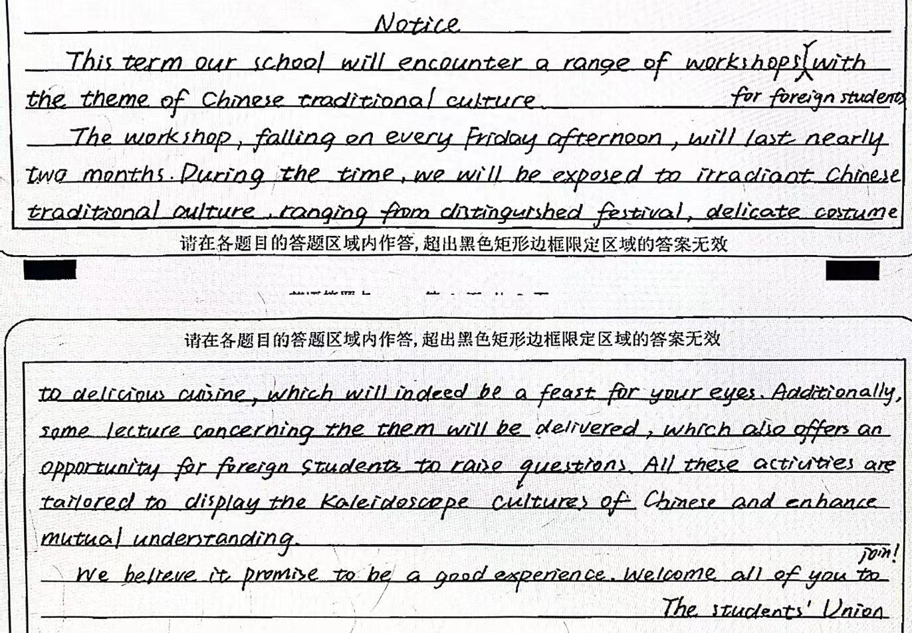
04. 学生美文
该习作亮点：
1. 简洁、合理地补充了要点（活动时间、地点）有效地完成了交际；
2. 衔接巧妙（during the time, additionally, these）
3. 虽有语言错误，但话题词汇（festival,cuisine等）和句式使用丰富、准确；
traditional Chinese culture
festivals
kaleidoscopic 万花筒似的
promises

Slide 16

05. 同话题练习巩固1
假定你是李华，你校交换生Chelsea回英国前向你咨询给亲友带什么中国特色礼物。请你写信回复她。要点如下：
1.推荐礼物；
2.推荐原因；
3.表达祝福

Slide 17
范文： Dear Chelsea, Hope this letter finds you well！In response to your inquiry about Chinese gifts to take home, I'd like to recommend Chinese knots as as your top choice. Chinese knots, usually red, are delicately woven handicrafts that marry interest and wisdom. Not only are they visually beautiful, but they also carry profound cultural significance. Symbolizing unity, happiness, and best wishes for the future, they are not just gifts but expressions of good intentions and positive energy. I believe your beloved ones will appreciate the aesthetic appeal and the thoughtful meaning behind each knot. I do hope my recommendation will be beneficial to you. Wish you a pleasant journey back to Britain. Yours, Li Hua

Slide 18
拓展——中国传统文化特色物品 u Tea Leaves (茶叶) Chinese tea culture, with its rich history, makes high-quality tea leaves an excellent gift choice. Gifting tea of high quality not only demonstrates a love for Chinese tea culture but also provides a unique tea-tasting experience for the tea enthusiasts. This gift reflects a passion for Chinese tea culture and adds tranquility to daily life. u Chinese knot (中国结) Chinese knot, with a mix of interest, temperament [ˈtemprəmənt]气质 and wisdom, is my top priority. As a kind of unique Chinese handwoven handicraft, the Chinese knot is not only beautiful in shape, but also rich in meaning, symbolizing unity, happiness and good wishes for the future.

Slide 19
拓展——中国传统文化特色物品 u Chinese Brush (毛笔) The Chinese brush is a vital tool in traditional Chinese calligraphy and painting, known for its unique craftsmanship and quality. Choosing a Chinese brush as a gift not only showcases the unique charm of Chinese calligraphy culture but also sparks people’s interest in art. A refined Chinese brush is both a practical tool and a profound appreciation of traditional Chinese culture. u Mooncakes (月饼) Mooncakes, a traditional Chinese delicacy especially popular during the Mid-Autumn Festival, carry cultural significance. Offering mooncakes as a gift not only shows respect for traditional festivals but also expresses a desire to share joyous occasions. This gift symbolizes reunion, blessings, and a delightful experience of Chinese pastry culture.

Slide 20
拓展——中国传统文化特色物品 u Hanfu (汉服) Hanfu, representative of traditional Chinese clothing, boasts a rich history and unique design. Choosing Hanfu as a gift not only praises classical Chinese costumes but also represents a return to traditional Chinese culture. A set of exquisite Hanfu is both fashionable and a vivid interpretation of traditional Chinese culture. u Paper Cutting (剪纸) Known as the world-class intangible cultural heritage, Paper cutting has a variety of shapes and colors. Choosing paper cutting as a gift not only showcases the distinctive charm of Chinese art but also reflects respect for meticulous [məˈtɪkjələs]细腻的 craftsmanship and cultural traditions.

Slide 21
拓展——中国传统文化特色物品 u Peking Opera Masks (京剧面具) Peking Opera masks, treasures of traditional Chinese performing arts, embody 体现profound cultural significance. Selecting these masks as a gift not only displays the beauty of Chinese opera but is also a unique expression of respect for traditional Chinese culture. This gift is both artistically valuable and offers a profound glimpse into the beauty of Chinese theatrical [θiˈætrɪk(ə)l] 戏剧的culture. u Zongzi (粽子) As for authentic Chinese snacks, Zongzi is a must-try traditional delicacy(美味)especially eaten on the day of the Dragon Boat Festival. Made from sticky rice stuffed with different fillings and wrapped with bamboo leaves, Zongzi has a distinctive fragrance which is loved by people of all ages. With various shapes, it is used to extent people’s wishes for good health.
...

Slide 22
05. 同话题练习巩固2
（天津卷应用文）
你作为交换生去英国学校，学校要办一个促进中英文化交流的活动叫 Chinese workshop，活动内容包括中国美食手工艺品和书法，活动有一项是教别人做中国传统的东西。请描述这项活动的意义，并申请参加此次活动，阐述参加内容及想法。

Slide 23
范文：
Dear sir or madam,
My name is Lihua and I’m writing to join the Chinese Workshop, which, I believe, will greatly facilitate British students’ understanding of Chinese culture by offering them firsthand experience of trying Chinese craftwork.
The craftwork I am itchy to teach British students is paper-cutting. Symbolizing good luck and prosperity, this artwork carries with it blissful message and deep cultural connotation. Also, it allows me to teach from easy works like a heart shape or butterfly, from which British students will be more likely to derive a sense of achievement, thus giving them a brief taste of Chinese culture.
Looking forward to hearing from you.
Yours,
Li Hua

Slide 24

The end

