Slide 1


感恩遇见，相互成就，本课件资料仅供您个人参考、教学使用，严禁自行在网络传播，违者依知识产权法追究法律责任。
更多教学资源请关注
公众号：溯恩英语
知识产权声明

Slide 2
选择性必修三unit1
教材答案和讲评

Slide 3
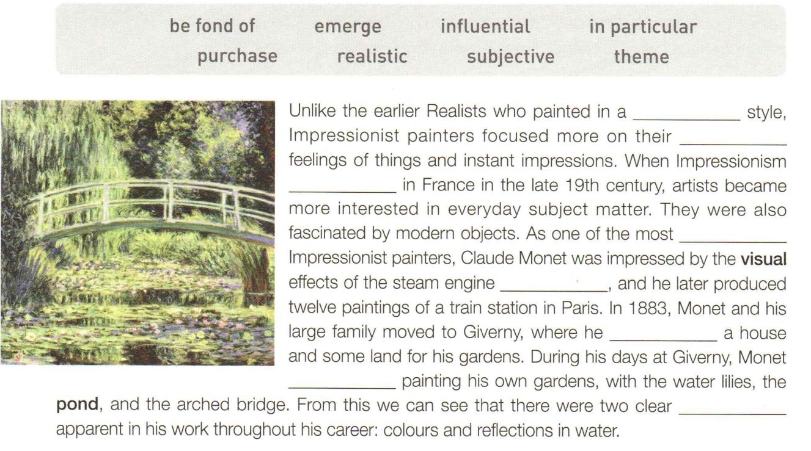
P4 Ex 2
realistic
subjective
emerged
influential
in particular
purchased
was fond of
themes

Slide 4
Ex 1 on P61
suffixes | meanings | examples
a teaching, a system,
a movement
realism, Impressionism, Cubism, Buddhism, criticism, Confucianism,
humanism, socialism, capitalism
-ism
(n)
-istic
(adj)
being of or connected to sth.
realistic, humanistic, artistic, characteristic
denoting (/dɪˈnəʊt/标志) a quality or state
reality, stupidity, curiosity, anxiety, variety difficulty, safety, possibility, necessity, ability,
-ity
(n)

Slide 5
suffixes | meanings | examples
reputation, intention, exhibition, recognition, innovation, invention, presentation, explanation, description, introduction, education, suggestion, animation, collection, attention, competition, information, punctuation, pronunciation
denoting an action or a state
-(t)ion
(n.)
denoting a person who believes, practices, does, or uses sth.
realist, artist, impressionist, economist, biologist, archaeologist, chemist, dentist, journalist, tourist, scientist, typist
-ist
(n.)
-ive
(adj./n)
active, primitive, subjective, creative, competitive,
perspective, detective, representative
denoting having the nature of sth.

Slide 6
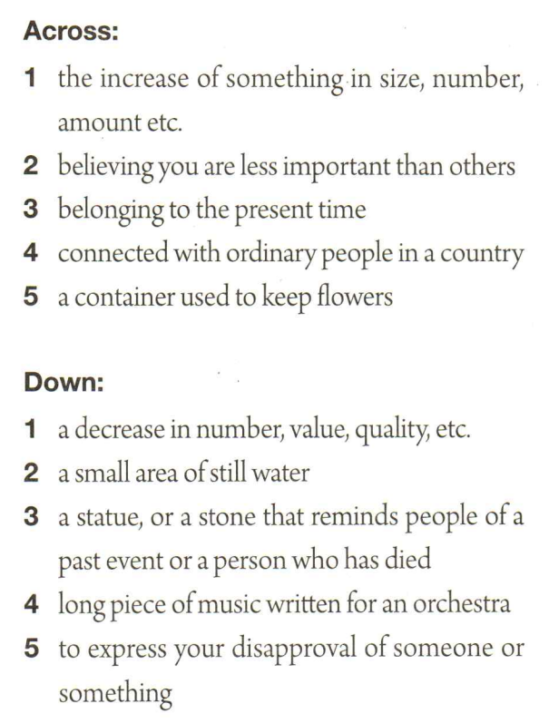
expansion
humble
contemporary
civil
vase
decline
pond
memorial
symphony
criticise
Ex 2 on P61

Slide 7
Ex 3 on P61
His elegant behaviour and handsome face set himself apart from other guests.
I think that she is worthy of the greatest respect among all contemporary female writers.
In recent years, medical workers have made/achieved a breakthrough in cancer research.
Among all Impressionist paintings I have seen, I like Renoir’s works in particular.
The film Dunkirk brings an important event in World War II to life.

Slide 8
Ex 1 on P62
2. The reason that he bought the computer was to work at home rather than go to the office.
3. A good way to relax is to do deep breathing exercises for ten minutes.
My goal this year is to perform a flute solo at the school’s art festival.
To tell you the truth, my purpose in taking yoga classed is to stay in shape.
With his car stuck in the snow, all he could do was wait for help to arrive.

Slide 9
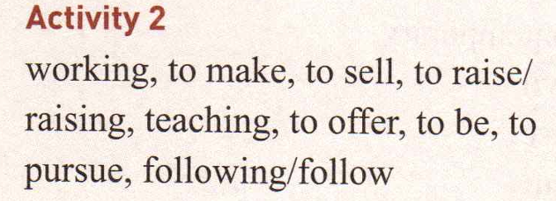

Slide 10
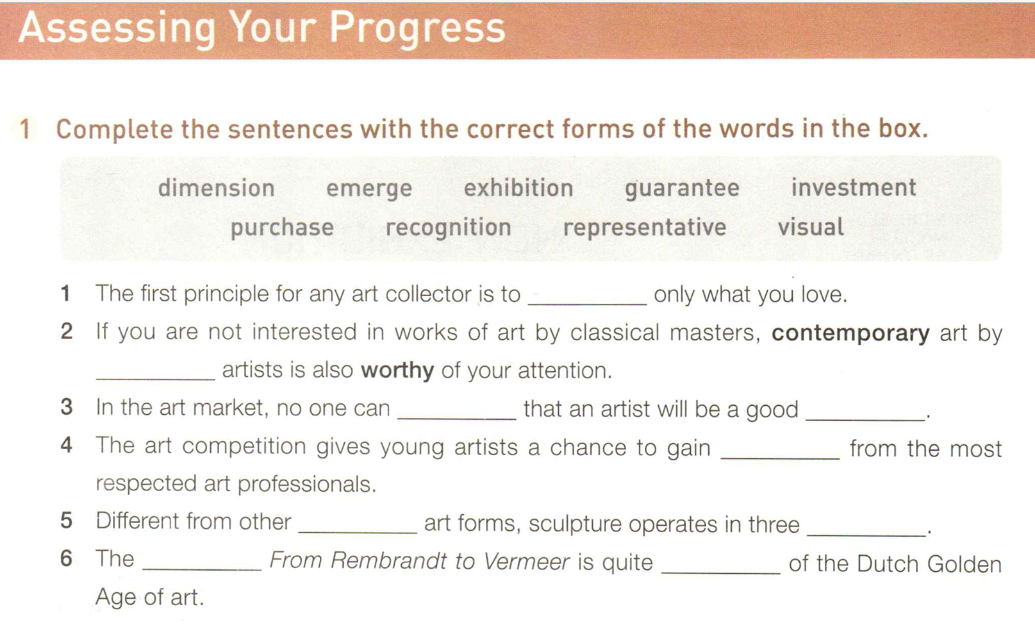
purchase
emerging
guarantee
investment
recgonition
visual
demensions
exhibition
representative

