Slide 1


感恩遇见，相互成就，本课件资料仅供您个人参考、教学使用，严禁自行在网络传播，违者依知识产权法追究法律责任。
更多教学资源请关注
公众号：溯恩英语
知识产权声明

Slide 2
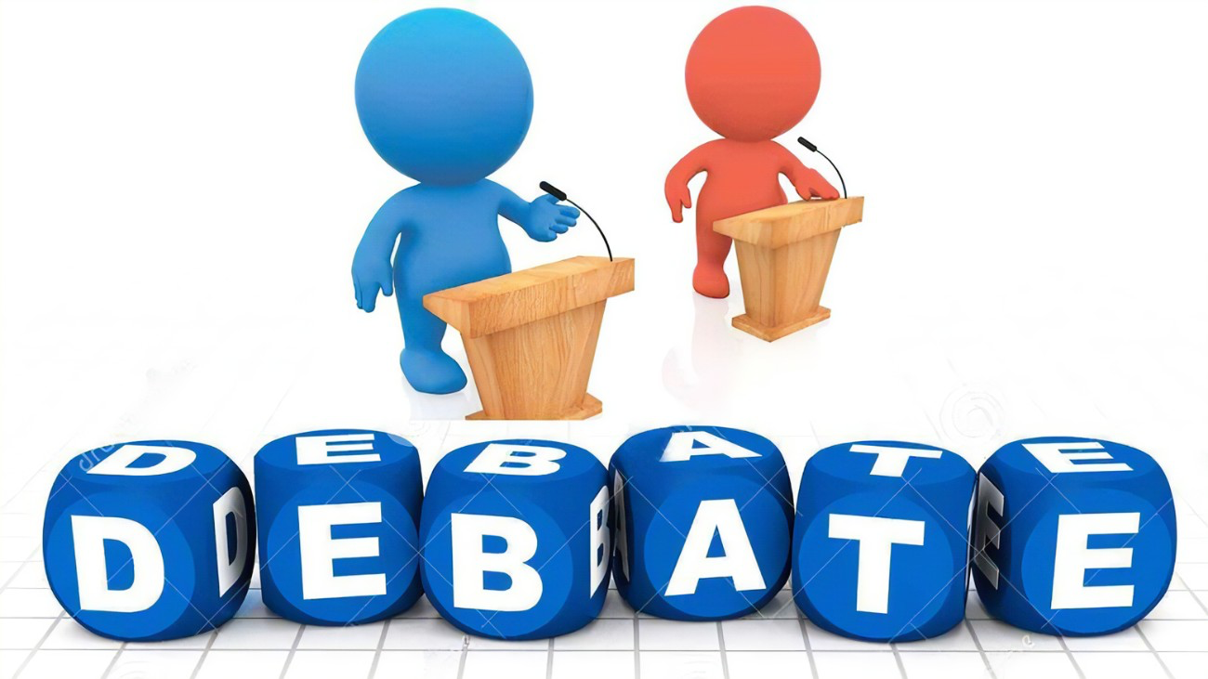
多元视角构建交际性应用文写作
To Recommend/Propose
A Debate TOPIC
2024温州二模应用文讲评

Slide 3

I. Recall& Compare:
假定你是李华，你校外教David正在策划一场英语辩论赛，现向同学们征集辩题。请你给他写一封邮件，内容包括： 1. 提供辩论题目；2. 说明选题理由。 注意： 1. 词数80左右； 2. 可适当增加细节，使内容充实，行文连贯。
NMET-Zhejiang, Jan. 2024
请根据材料写一篇应用文，请你写一篇短文向校英文报"Sports and Health"投稿，向同学们推荐一个适合课间的运动。
1.介绍推荐的运动；2.推荐理由。
注意：
1.写作词数应为80左右；
2.请按以下格式在答题纸的相应位置作答。
Dear David， Yours， Li Hua
A Letter of Recommendation
Para.1: Greeting + Background + Purpose
debate recommend/ropose
Para.2: Contents + Reasons
recommendation about 2 reasons
Para.3. Expectations/ Wishes/ Thanks

Slide 4

II. Analysis:
假定你是李华，你校外教David正在策划一场英语辩论赛，现向同学们征集辩题。请你给他写一封邮件，内容包括： 1. 提供辩论题目；2. 说明选题理由。 注意： 1. 词数80左右； 2. 可适当增加细节，使内容充实，行文连贯。
What’re the appealing debate topics?
Dear David， Yours， Li Hua
Genre:
Person:
Voice:
Contents:
Structure:
A Letter of Advice/ Recommendation
1st.
keen, polite, formal
& convicing
topic+ reasons
+expectations/whishes/thanks

Slide 5
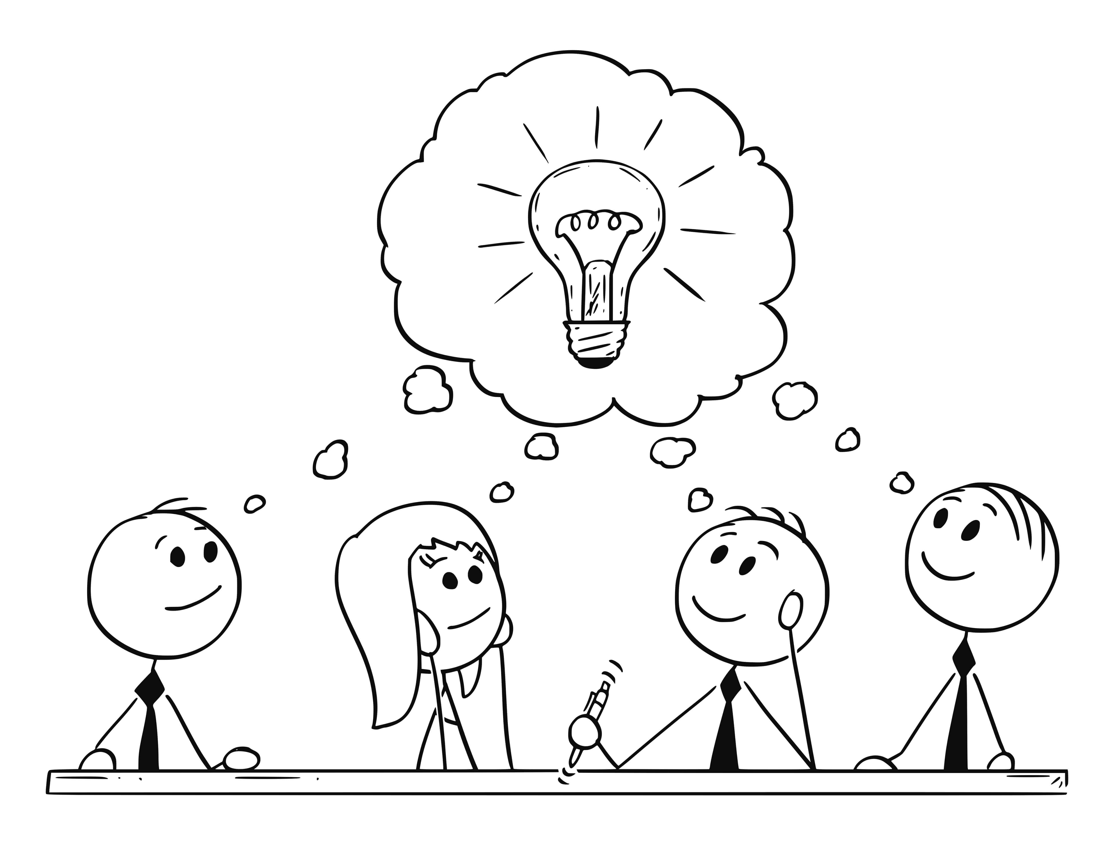
III. About Debate
Why
What
Potential Benefits:
listening
pubclic speaking
critical thinking
confidence...
A debate is an organized argument or contest of ideas in which the participants discuss a topic from two opposing sides.
A debate is an organized argument or contest of ideas in which the participants discuss a topic from two opposing sides.
Why
How
Potential Benefits:
research
organization
collaboration
presentation...
Each side will show in an organized and clever way why they believe to have the right answers. They will use examples and evidence to support their ideas while working towards a conclusion.
Each side will show in an organized and clever way why they believe to have the right answers. They will use examples and evidence to support their ideas while working towards a conclusion.

Slide 6

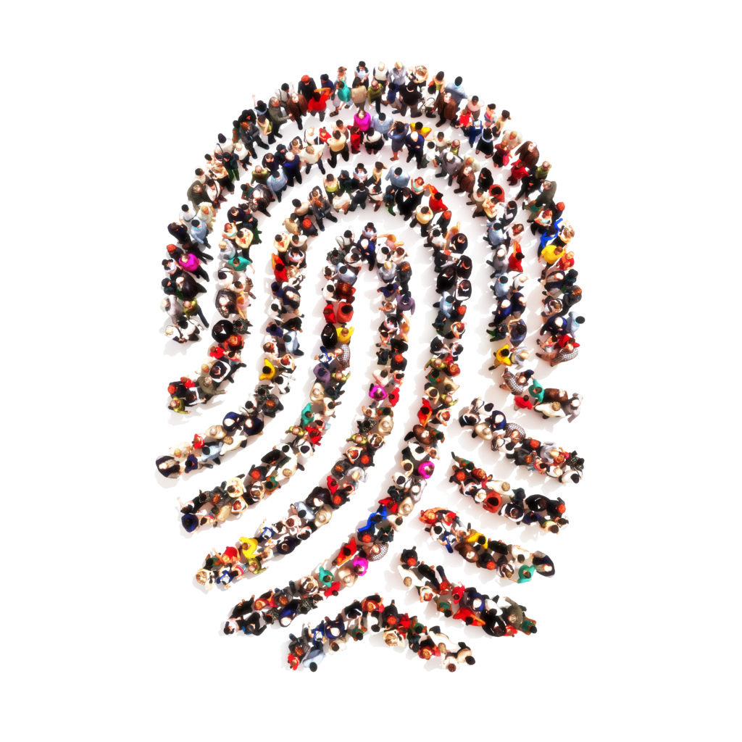


IV. Discussion:What could be our candidate debate topic?
Draft your versions?
Is space exploration worth the investment?
Is artificial intelligence a threat or opportunity?
Should schools require uniforms?
Should schools limit students‘use of technology?
Is a gap year beneficial for students?
Should the voting age be lowered to 16?
Should government s provide free higher education?
All students should be required to take a cooking class.
All museums should be free to the public.
...
relevant
controversial
intellectually stimulating
identities?
fields?
capabilities?

Slide 7
V. Polish Your Expressions
Compare& Appreciate
Opening:
Learning that...., I’m writing to offer my suggestion/ recommend... to you.
Hope this message finds you well. I am writing this email to contribute to our upcoming English debate.
Greetings! With great enthusiasm for our upcoming debate, I'd like to propose a topic that will stimulate an enlightening discussion.
Introduction& Reasons:
To begin with,.... In addition,.... Last but not least,....
The topic I would like to put forward for your consideration is...
I recommend it mainly for the following two reasons.
After much thought and deliberation, I believe we would benefit from debating on...
Opening:
Learning that...., I’m writing to offer my suggestion/ recommend... to you.
Hope this message finds you well. I am writing this email to contribute to our upcoming English debate.
Greetings! With great enthusiasm for our upcoming debate, I'd like to propose a topic that will stimulate an enlightening discussion.
Introduction& Reasons:
To begin with,.... In addition,.... Last but not least,....
The topic I would like to put forward for your consideration is...
I recommend it mainly for the following two reasons.
After much thought and deliberation, I believe we would benefit from debating on...
Be communicative
Be polite& formal
Be keen& coherent
Be clear
Be convincing

Slide 8
V. Polish Your Expressions
Compare& Appreciate
Closing:
I sincerely hope that my suggestions would be helpful.
Looking forward to your thoughts on my proposal.
Thank you for considering my suggestion and I eagerly await your response.
I am eagerly waiting for your opinion on my proposed topic. Thank you once again for all the effort you're putting into organizing this debate.
Be polite& communicative

Slide 9

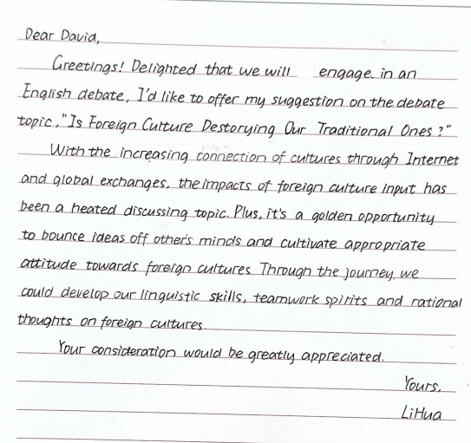
VI. Students’ Version
有呼语，开篇扣题阐述写作目的
阐述论题大背景及争议性
结合学生身份阐述论题价值
结尾感谢
要点衔接不足
Plus, discussing this topic will provide us ... to bounce ideas off peers’ minds...
补充动词，增强表达力度及说服力
improve our linguistic skills, enhance teamwork spirits and deepen rational thoughts on diverse cultures

Slide 10
VII. Teachers’ Version
Dear Mr. David,
Greetings!(问候) As an enthusiastic participant in our upcoming English debate, I find it beneficial to introduce the topic: "Is autonomous learning effective?"(背景+目的)
Autonomous learning, the self-directed pursuit of knowledge, is an increasingly significant topic in today's education. It promotes students’ active planning, while it also raises concerns on loose education. (议题介绍)Despite improving our English listening and speaking in the process, debating this topic will allow us to have an overall investigation in its pros and cons, like self-realization and possible learning gaps. Hence, it may also encourage us to explore a more balanced way in study. (原因)
Thank you again for your efforts in organizing this debate. I’m eagerly waiting for your opinion on my proposal.(感谢+交际性)
Yours,
Li Hua

