Slide 1


感恩遇见，相互成就，本课件资料仅供您个人参考、教学使用，严禁自行在网络传播，违者依知识产权法追究法律责任。
更多教学资源请关注
公众号：溯恩英语
知识产权声明

Slide 2

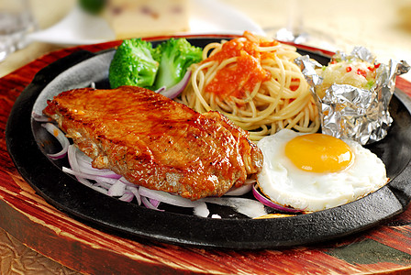
最后的早餐
最美的告别
四点定位+伏笔+Conflict+Solution
续写手法
浙江金华市汤溪高级中学 郑素红

Slide 3


Special#2，Please
My flight arrived in San Diego around midnight，and by the time I drove home and got into bed it was nearly 2:00 a. m. I was tired and jet-lagged when I dragged myself out of the bed. Nevertheless，I had to be up bright and early that morning: I was the opening keynoter（主旨发言人） at a national conference.
In short，I needed to recover quickly. A hearty breakfast in the early morning sun was what I needed. I headed for Carlos & Annie’s，a popular restaurant located in the heart of the seaside town.
“I’d like steak and eggs，please,” I said to the waitress after I had finally found a table in the restaurant. “Oh, I'm sorry,” she apologized. “We're out of Special#2. We've served the last of our steaks. How about Special#14?” “Oh，no steak and eggs?” I couldn't seem to accept it.
I'm not sure if it was my heartfelt sigh that caught Carlos，the owner's attention. His warm，caring brown eyes seemed determined to pinpoint the best solution. He then said, “You know，I think I did see one final steak back
there.”
Pressing my luck，I quickly declared, “Wow，that would be great. But you know，I'm not sure if I want a breakfast steak at all. What I really want is a steak—one that’s two inches thick，tender and juicy，served medium rare.” “Not to worry,” Carlos assured me and left. The young waitress gave me a wink（眨眼） and said with a knowing smile, “Carlos is being Carlos again!” I did not give her words much thought.
Then，I noticed Carlos as he left the restaurant through the side door and walked into a neighborhood grocery store across the street. Carlos exchanged morning greetings with everyone he knew and even helped the owner of the bookstore next door by holding the items that filled her arms. Then he reentered the restaurant with a bag in his hand.

Slide 4
Read for main ideas

Slide 5
My flight arrived in San Diego around midnight，and by the time I drove home and got into bed it was nearly 2:00 a. m. I was tired and jet-lagged when I dragged myself out of the bed. Nevertheless，I had to be up bright and early that morning: I was the opening keynoter（主旨发言人） at a national conference.
main idea
I was tired but I had to be up early in the morning for a coming important conference.

Slide 6
In short，I needed to recover quickly. A hearty breakfast in the early morning sun was what I needed. I headed for Carlos & Annie’s，a popular restaurant located in the heart of the seaside town.
“I’d like steak and eggs，please,” I said to the waitress after I had finally found a table in the restaurant. “Oh, I'm sorry,” she apologized. “We're out of Special#2. We've served the last of our steaks. How about Special#14?” “Oh，no steak and eggs?” I couldn't seem to accept it.
main idea
I needed a hearty breakfast to recover but I couldn’t get what I desired--- Special #2.

Slide 7
I'm not sure if it was my heartfelt sigh that caught Carlos，the owner's attention. His warm，caring brown eyes seemed determined to pinpoint the best solution. He then said, “You know，I think I did see one final steak back there.”
main idea
Carlos came to solve my problem.

Slide 8
Pressing my luck，I quickly declared, “Wow，that would be great. But you know，I'm not sure if I want a breakfast steak at all. What I really want is a steak—one that’s two inches thick，tender and juicy，served medium rare.” “Not to worry,” Carlos assured me and left. The young waitress gave me a wink（眨眼） and said with a knowing smile, “Carlos is being Carlos again!” I did not give her words much thought.
main idea
I told Carlos what I exactly wanted for my breakfast and he assured me.

Slide 9
Then，I noticed Carlos as he left the restaurant through the side door and walked into a neighborhood grocery store across the street. Carlos exchanged morning greetings with everyone he knew and even helped the owner of the bookstore next door by holding the items that filled her arms. Then he reentered the restaurant with a bag in his hand.
main idea
Carlos went to a grocery and bought ingredients for my breakfast and he was a really kind, thoughtful and helpful man.

Slide 10
原文本类型探究
1. 矛盾与冲突：（conflict )
作者我想要一顿心仪的早饭 Special#2 vs 饭店只有Special# 14
2. 解决冲突： ( solution )
原店主Carlos 去附近店里买了食材，为我做了符合我心意的早饭
3. 结果与反思: ( result& reflection)
①我满意而去；店主坚守职业情操，顾客至上，让每一位顾客满意。 回扣原文第二段：我的疲倦一扫而空，精神抖擞，去迎接未来挑战；美食拥有神奇的治愈的力量。

Slide 11
3. 结果与反思: ( result& reflection)
②原店主Carlos 乐于助人，体贴周到，让身边所有与他打过交道的人都能感受到生活中的那种小确幸。善意和欢乐让我们觉得生活多么美好。

Slide 12
Read for clues and echoes

Slide 13
clues | echoes
... I was tired and jet-lagged when I dragged myself out of the bed. Nevertheless，I had to be up bright and early that morning: I was the opening keynoter（主旨发言人） at a national conference. | I became refreshed after I consumed the carefully- prepared Special#2. I learned a valuable lesson from Carlos---Stick to professionalism and be dedicated to what you do.

Slide 14
clues | echoes
In short，I needed to recover quickly. A hearty breakfast in the early morning sun was what I needed. I headed for Carlos & Annie’s，a popular restaurant located in the heart of the seaside town. | 3. Taking every bite in the early but warm morning sun, I felt the gradual return of energy and my passion for the coming challenge was ignited. I became increasingly confident that I would be a perfect opening keynoter at the national conference.

Slide 15
clues | echoes
I'm not sure if it was my heartfelt sigh that caught Carlos，the owner's attention. His warm，caring brown eyes seemed determined to pinpoint the best solution. He then said, “You know，I think I did see one final steak back there.” | Carlos’ thoughtfulness, care understanding and helpfulness created a wonderful memory for me, which was enough to warm my heart and ignite my confidence to face future challenges. Under no circumstances would Carlos let any customer down.

Slide 16
clues | echoes
Pressing my luck，I quickly declared, “Wow，that would be great. But you know，I'm not sure if I want a breakfast steak at all. What I really want is a steak—one that’s two inches thick，tender and juicy，served medium rare.” “Not to worry,” Carlos assured me and left. The young waitress gave me a wink（眨眼） and said with a knowing smile, “Carlos is being Carlos again!” I did not give her words much thought. | 6. What I never expected was that the steak was exactly what I wished: two inches thick，tender and juicy，served medium rare. 7. The morning episode reminded that actually, Carlos is always being Carlos! Customers come first!

Slide 17
clues | echoes
Then，I noticed Carlos as he left the restaurant through the side door and walked into a neighborhood grocery store across the street. Carlos exchanged morning greetings with everyone he knew and even helped the owner of the bookstore next door by holding the items that filled her arms. Then he reentered the restaurant with a bag in his hand. | 8. Carlos was always ready to help others and put himself into others’ position. No wonder that Carlos and Annie’s enjoyed such a great reputation far and near in the seaside town.

Slide 18
Sort through details of the story

Slide 19
本文故事情节梳理：
我深夜飞回圣地亚哥，驱车回家已是凌晨2点。累且需倒时差且一大早要起来去参加国家级会议作主讲人。
我急需一顿心仪的早饭来提振自己，结果饭店waitress 的回答让我失望。
店主Carlos非常贴心，或许是他看出了我的疲态。去附近的店里买了一袋食材为我做早餐。在买食材的途中，展现了Carlos 非常暖心的细小的举动。
续写部分：享用美食，提振精神 + 感叹，感想，感谢

Slide 20
本文六要素：
Time： in the early morning
Place: in a restaurant : Carlos and Annie’s
Characters: Carlos, I , waitress
Why: I needed a hearty breakfast to lift up my spirits.
How: Carlos bought ingredients and made a special meal for me.
Result: the content of the continuation

Slide 21
Character Analysis
本文以第一人称视角进行叙事，透过我的经历，透过的我的眼睛去认识店主 Carlos ; 实际的故事的主角是Carlos, 作者我只是配角，起到推波助澜的作用； Waitress 寥寥数语，就让读者深知Carlos 人品以及职业操守；讲述平凡人的平凡事。
续写的人物处理：I ， Carlos肯定是要安排的角色。 Waitress 可有可无，看情节需要来设定。
本文立意角度：虽然Carlos 已经卖掉这家饭店，但对于顾客我的要求，仍然竭尽全力予以满足，体现其饭店高品质的服务意识以及店老板Carlos的职业操守。
小清新的手法：与Carlos相处收获的kindness 以及体会到的欢欣joy,让我以及所有人都倍觉人世间是多么美好。

Slide 22
Design plots for each paragraph

Slide 23
续写两段的构思安排：
Para1:Within minutes, an exact Special#2 was in front of me.
Scene 1:
How to describe Special#2?( From look, fragrance &taste)
Scene2:
How did Carlos and I interact?
Scene3:
How did I feel and what would I do after breakfast?
( common sense: check out and say goodbye )

Slide 24
Para2: I was about to leave when I learned Carlos had already sold the restaurant.
Scene 1:
How did I feel at the unexpected news?
Scene2:
What did I think of Carlos?
Scene3:
What did I do and what did I learn from Carlos?

Slide 25

结合原文本最后一段定首段第一句 (句群）
Para1:Within minutes, an exact Special#2 was in front of me.
手法1. （首句以an exact Special#2为叙事对象+回扣原文：)
The steak was indeed two inches thick, just as I had wished, tender and juicy, cooked perfectly medium rare.

Slide 26
结合原文本最后一段定首段第一句 (句群）
Para1:Within minutes, an exact Special#2 was in front of me.
手法2. （首句以an exact Special#2为叙事对象+意想不到的惊喜：)
What I never expected was that the steak was exactly what I wished: two inches thick，tender and juicy，served medium rare.

Slide 27
结合原文本最后一段定首段第一句
Para1:Within minutes, an exact Special#2 was in front of me.
手法3. 首句以an exact Special#2为叙事对象+生活常识（精致的餐盘+对具体菜品的描写---牛排配煎蛋+配菜)
The delicate plate perfectly matched Special#2 . The steak, precisely two inches thick, juicy and tender, was accompanied by a freshly-fried egg and some cabbage.

Slide 28
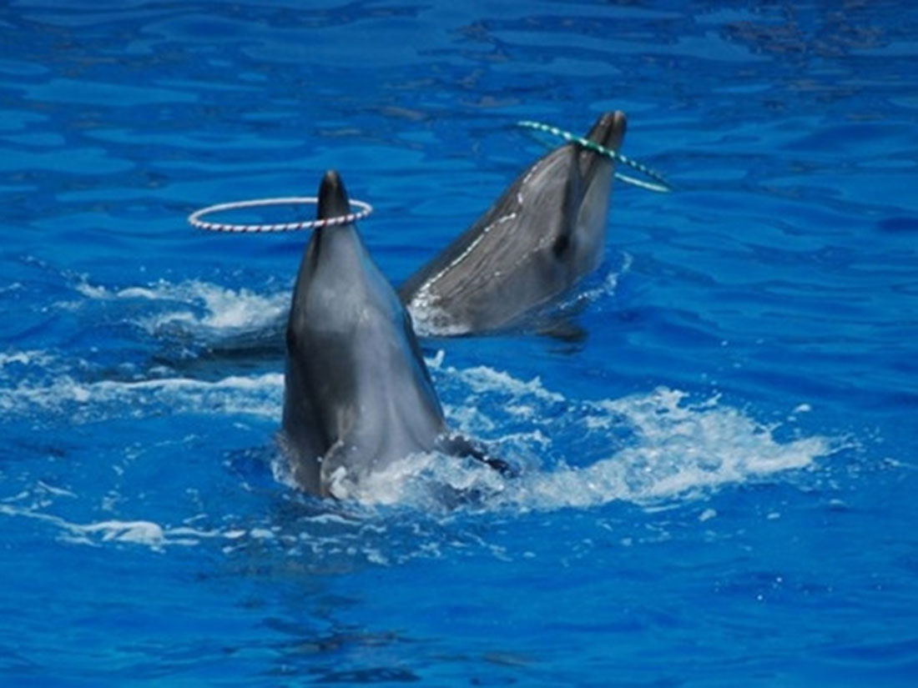
结合第二段首句定首段尾句（句群）
Para1:Within minutes, an exact Special#2 was in front of me.
手法1： (吃早饭+恢复精力+热情+迎接挑战的信心+结账）
Taking every bite in the early warm morning sun, I felt the gradual return of energy and my passion for the coming challenge was ignited. I became increasingly confident that I would be a perfect opening keynoter at the national conference. Full / Recovered/ Refreshed and satisfied, I went to check out at the cashier’s.
Para2: I was about to leave when I learned Carlos had already sold the restaurant.

Slide 29
结合第二段首句定首段尾句
Para1:Within minutes, an exact Special#2 was in front of me.
手法2： (在清晨的阳光中吃早饭+恢复精力+热情+感谢Carlos+赞扬）
With every bite in the morning sun, I felt energetic and passionate for the coming national conference, grateful for the unexpected kindness from Carlos. What a marvelous chef!
Para2: I was about to leave when I learned Carlos had already sold the restaurant.

Slide 30
结合第二段首句定首段尾句
Para1:Within minutes, an exact Special#2 was in front of me.
手法3： ( 用完早餐+起身+感谢+结账+告别）
Having finished my breakfast, I rose from the table, expressed my heartfelt thanks to Carlos ，paid my bill and said goodbye.
Para2: I was about to leave when I learned Carlos had already sold the restaurant.

Slide 31
结合第二段首句定第二段第一句
Para2: I was about to leave when I learned Carlos had already sold the restaurant.
手法1：(My response +告知我消息的waitress的解释）
I was stunned. Seeing my shock on my face, the waitress explained that today was Carlos' last workday. He had decided to retire and someone would take over the restaurant.

Slide 32
结合第二段首句定第二段第一句
Para2: I was about to leave when I learned Carlos had already sold the restaurant.
手法2： （我明白Waitress的话了）
It seemed that I realized the meaning of “ Carlos is being Carlos again.” Without the title of the owner of Carlos and Annie’s , Carlos could enjoy more free time and didn’t need to consider whether to make profits or not.

Slide 33
结合第二段首句定第二段第一句
Para2: I was about to leave when I learned Carlos had already sold the restaurant.
手法3： （我明白过来Carlos原本完全可以编个理由打发我。+虚拟语气 could have done …）
It dawned on that Carlos could have made up an excuse just to let me go. Actually , he took great trouble / went to great lengths / went all out to buy ingredients for me to cook Special#2.

Slide 34
定第二 段尾句
Para2: I was about to leave when I learned Carlos had already sold the restaurant.
结尾1： (回扣原文第二段：I needed a hearty breakfast to refresh myself.)
After conveying my sincere gratitude for his efforts to make such a special breakfast to refresh me, I stepped out of the restaurant with reignited confidence to embrace/ face future challenges.

Slide 35
定第二 段尾句
Para2: I was about to leave when I learned Carlos had already sold the restaurant.
结尾2： (美味的食物+美好的人：温暖疲惫的我)
Carlos’ thoughtfulness, care , understanding and helpfulness created not only a magic breakfast but also a wonderful memory for me, which was enough to warm my heart and keep me refreshed to face future challenges.

Slide 36
定第二 段尾句
Para2: I was about to leave when I learned Carlos had already sold the restaurant.
结尾3： (结合本段所给首句 I was about to leave +回扣第一段尾句：去会场做报告。与原文达到高度协同与一致)
As I stepped out of the restaurant, I quickened my brisk steps to the conference venue, determined to deliver my speech as perfectly and professionally as Carlos cooked every meal.

Slide 37
定第二 段尾句
Para2: I was about to leave when I learned Carlos had already sold the restaurant.
感悟式结尾4： (美食+美好的人=magic healing power)
Thanks to the magic healing power of Special#2, my exhaustion was replaced with energy and refreshment. From Carlos, I learnt a valuable lesson：Stick to professionalism and be dedicated to what you do.

Slide 38
定第二 段尾句
Para2: I was about to leave when I learned Carlos had already sold the restaurant.
结尾5： (小确幸)
As I headed for the conference, Carlos’ warm look cast at me, his morning greetings to everyone he knew and warmhearted help offered to the bookstore keeper crowded into my mind. Those small acts/ gestures of kindness in our life turned into numerous little blessings/ joys, which made the world a wonderful place for us to live in.

Slide 39
习作欣赏一

Slide 40
Para1:Within minutes, an exact Special#2 was in front of me. The delicate plate perfectly matched Special#2 . The steak, precisely two inches thick, juicy and tender, was accompanied by a freshly-fried egg. It smelt so fragrant! The moment it was served, my mouth was watering! The delicious breakfast not only feasted my eyes but also consoled/ nourished my weary soul. Carlos, with a proud look in his eyes, urged me to take a bite. Each bite exploded in my mouth like little flavor bombs. Immediately, I sensed a gradual return of my energy. This meal, prepared with great care and professionalism, showcased remarkable dedication , excellent service and craftsmanship. Refreshed and satisfied, I rose from the table, expressed my heartfelt thanks to Carlos and said goodbye.

Slide 41
Para2: I was about to leave when I learned Carlos had already sold the restaurant. I was stunned. Seeing my shock on my face, the waitress explained that today was Carlos' last workday. He had decided to retire and someone would take over the restaurant. Suddenly, my breakfast took on a new significance. Carlos' gesture of going all out to ensure I got my desired breakfast was not just about customer service; but it was his special way to say goodbye to his customers and his restaurant. Actually, he could have chosen to ignore my request. However, by making his last Special #2, Carlos displayed his dignity, dedication and professionalism, which touched me deeply. As I left Carlos & Annie’s, I felt blessed/ fortunate/ lucky to have experienced such a memorable goodbye/ farewell.

Slide 42
习作欣赏二

Slide 43
Para1:Within minutes, an exact Special#2 was in front of me. The steak was indeed two inches thick, just as I had wished, tender and juicy, cooked perfectly medium rare. Undoubtedly, it was exactly my hearty breakfast. The delicate look alone was enough to revive my spirits, not to mention its fragrance and flavor. Carlos came out of the kitchen, approached my table and smiled at me, saying, “I hope you will enjoy it!" This specially-cooked breakfast awakened every taste bud in my mouth. With every bite in the morning sun, I felt refreshed and energetic for the coming national conference, grateful for the unexpected kindness from Carlos. Having finished my breakfast, I expressed my heartfelt thanks to Carlos’ thoughtfulness, paid my bill and made for the door.

Slide 44
Para2: I was about to leave when I learned Carlos had already sold the restaurant. It dawned on me that Carlos could just make up an excuse to let me go since the restaurant had been sold. Actually , he went to great lengths to buy ingredients to cook me Special#2. What touched me deeply was not the carefully- prepared meal but his professionalism and dedication . Today was just one of thousands of his past ordinary workdays. Though he would bid farewell to his customers as well as the restaurant, Carlos still insisted on providing the same high-quality service for his customer. Special#2 was his unique way to show his consistent act of kindness, thoughtfulness and craftsman spirit. As I stepped out of the restaurant, I quickened my brisk steps to the conference venue, determined to deliver my speech as perfectly and professionally as Carlos cooked every meal.

Slide 45

Those warm episodes shine in our memory forever.

