Slide 1


感恩遇见，相互成就，本课件资料仅供您个人参考、教学使用，严禁自行在网络传播，违者依知识产权法追究法律责任。
更多教学资源请关注
公众号：溯恩英语
知识产权声明

Slide 2
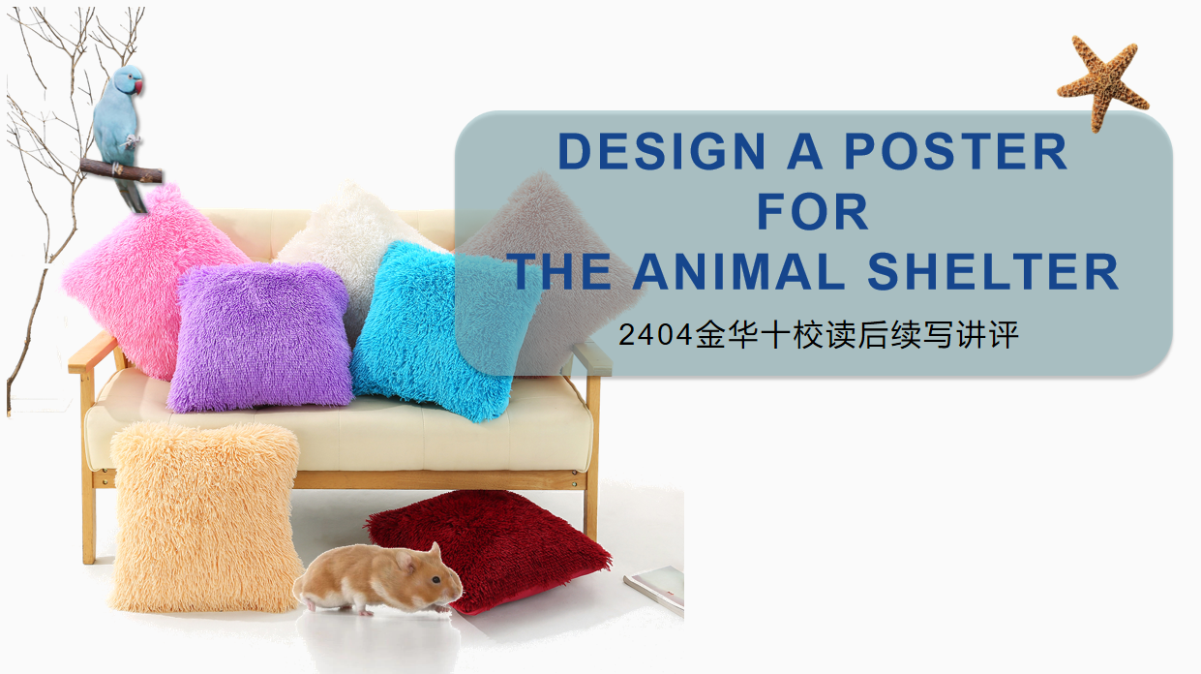

Slide 3

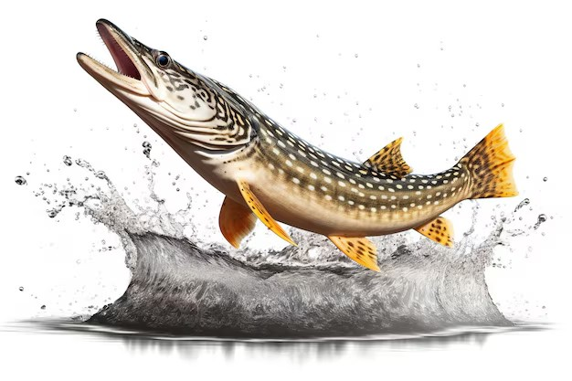
①I was doing homework with my friend Ollie at his home when he randomly scribbling (乱画) a fish. But not just any fish. This fish was riding a skateboard and blowing a bubble that said "I'd rather be skating!" I laughed and drew a sea star saying “fooling around and get to work!"
②Just then, Ollie's grandma Abuela and her friend Mr. Goldberg came into the kit Mr. Goldberg was in charge of the local animal shelter. Abuela poured their tea inquired about how things were going at the animal shelter. Mr. Goldberg sighed, shaking his head. He explained that not enough people were adopting pets, resulting in too many animals without homes.
③Overhearing the conversation, Ollie offered to adopt some excitedly. But Abuela said that one noisy parrot was plenty for this house.
④"Blue isn't noisy," defended Ollie. "He's just musical."
⑤"I'd have a whole farm full of animals if I could," I said. "But my parents say two cats and a hamster (仓鼠）are enough."
⑥Mr. Goldberg said he kept trying to attract people to adopt animals, but found it hard to get people's attention these days. Ollie drew a sad whale, and I wrote the words "Please adopt me" in the shape of a whale spout (喷水). Mr. Goldberg took a look at our drawings and made favorable comments on them, saying that these clever talking animals just might grab people's attention. And he asked us if we were willing to design a poster for his animal shelter, a proposal we happily accepted. We decided to draw some ideas on our own and meet up again the next afternoon.
⑦That night, when I was sitting in the living room brainstorming ideas for the poster, my little brother brought in our hamster, Mr. Nibbles, to give him a little run-around time. He made a hamster playground out of couch pillows and Mr. Nibbles began to run around merrily.
Para.1: Suddenly, an idea formed in my mind. Para.2: We decided to make both Mr. Nibbles and Blue the stars of the poster.

Slide 4
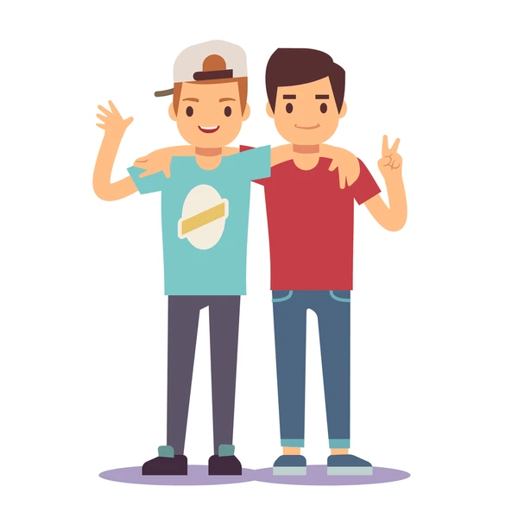

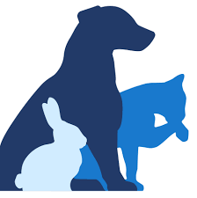

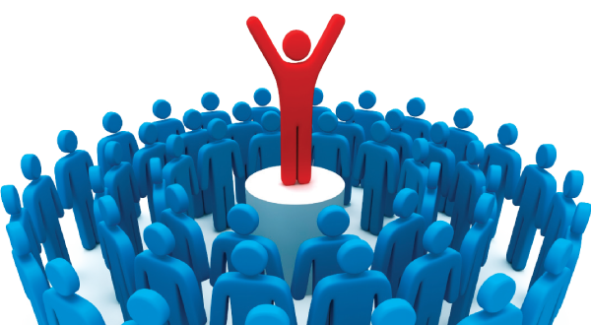

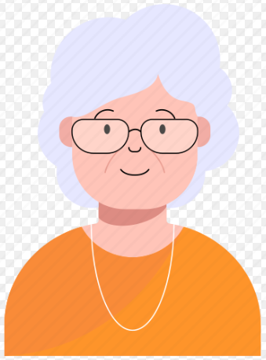
I. TRACK DOWN THE PLOT
The Event
The Conflict
The Clues
The Characters
analyze
link
combine
Para.1: Suddenly, an idea formed in my mind. Para.2: We decided to make both Mr. Nibbles and Blue the stars of the poster.
Para.1: Suddenly, an idea formed in my mind. Para.2: We decided to make both Mr. Nibbles and Blue the stars of the poster.
My friend Ollie& I
Clever Talking?
Clever
Design A Poster
to
Grab People’s Attention
The fish was riding... and blowing...
Blue’s just musical.
A whale spout saying...
Mr. Nibbles ran... merrily...in couch.
Over-populated animals
Few Adoption
Blue
Mr. Nibbles
musical
How
merrily
Mr. Goldberg
Fool? Noisy?
my family
grandma Abuela

Slide 5
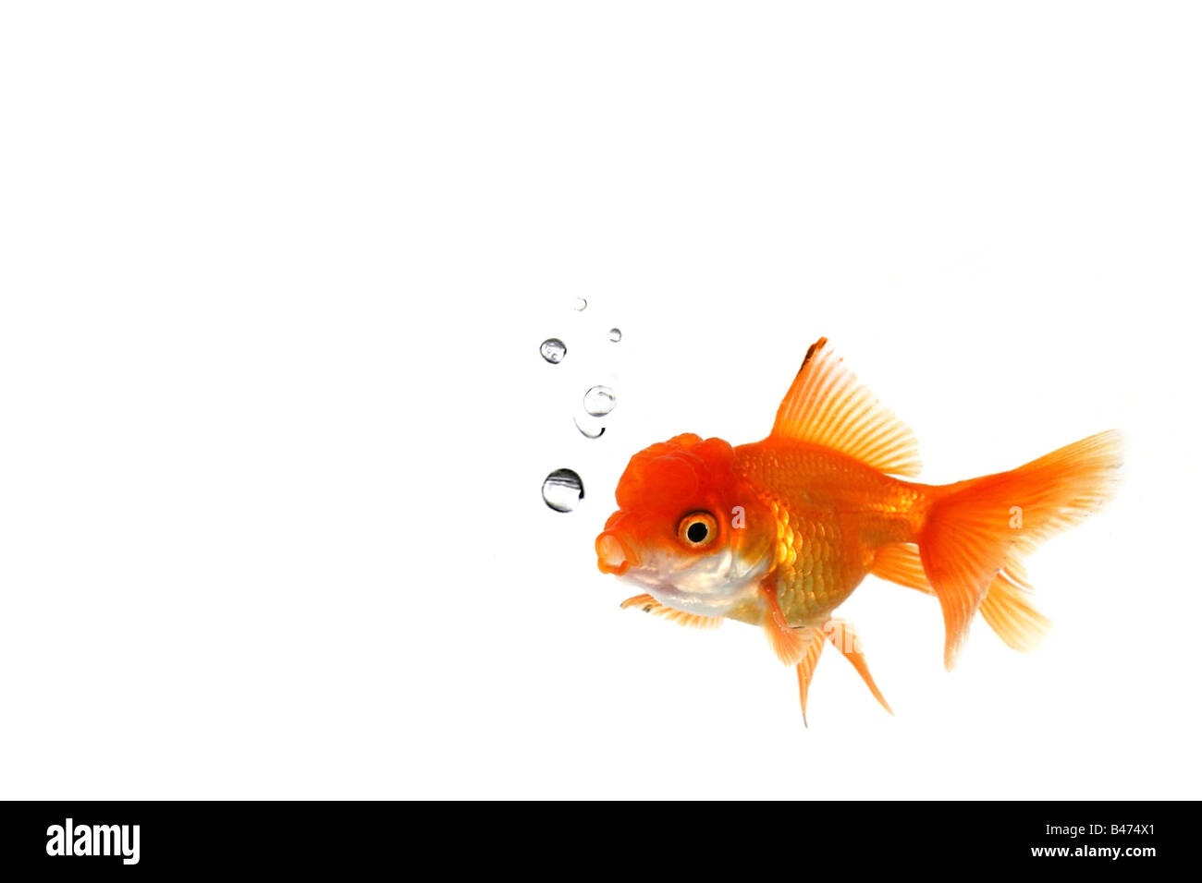
II. Plan the writing
⑦That night, when I was sitting in the living room brainstorming ideas for the poster, my little brother brought in our hamster, Mr. Nibbles, to give him a little run-around time. He made a hamster playground out of couch pillows and Mr. Nibbles began to run around merrily.
⑦That night, when I was sitting in the living room brainstorming ideas for the poster, my little brother brought in our hamster, Mr. Nibbles, to give him a little run-around time. He made a hamster playground out of couch pillows and Mr. Nibbles began to run around merrily.
Para.1: Suddenly, an idea formed in my mind.
Para.2: We decided to make both Mr. Nibbles and Blue the stars of the poster.
What’s the idea?
(What struck me to boost the idea?)
Link Ollie to the plan/ Ollie’s reaction.
Attach importance to the connection of characters, time, venues....
Mr. Nibbles could be a helping hand!
The joy, companion, vitality, likability...
Share- Brainstorm- Propose...
How to make it?
The completion& influence of the poster.
Reflection/ Theme:
Poster’s design: cheerful hamster& musical parrot+clever talking...grab the attention
Link to Mr. Goldberg/ grandma& Public’s feedback
A sense of achievement.
Joint work made a difference.
Scribbles could be significant.
Be persistent in practicing it in the future.
...

Slide 6
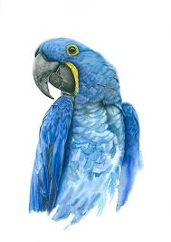
III. Descriptions
Para.1: Suddenly, an idea formed in my mind.
What would be my idea? (What struck me?)
- Hamster involved:
- Adopters invovled:
How about featuring cheerful Mr. Nibbles in the poster?
We could take advantage of Mr. Nibbles’s running with the most heartwarming sentiments!
What if I depicted the joy and companionship the pet brought to our lives? It could then be subtly linked to potential adopters.
How did Ollie react on hearing my idea?
I rushed to Ollie next afternoon. On hearing my idea, he replied with immediate consent. Indeed, who could resist the charm of our energetic pets? Looking back at me with a broad smile, he suggested, "Mr. Nibbles could team up with Blue!"
I called Ollie to tell about the idea instantly. There was a moment's silence. Then, a deafening exclaim flooded into my ears. “Brilliant! Maybe we can count Blue in as well!”
- Time/Venue Transition Action/Look/Remarks:
- Evolving

Slide 7
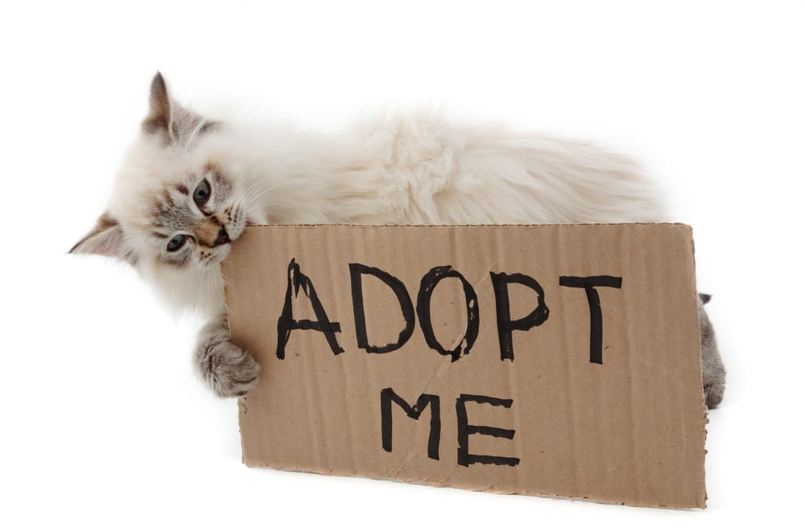


III. Descriptions
Para.2: We decided to make both Mr. Nibbles and Blue the stars of the poster.
How to describe the details to star them?
- Ollie& I:
- Scene/Clever talks:
- Location/Scene:
Ollie and I scribbled down potential elements that we could incorporate into the design: An energetic hamster works out with the piped music of a blue parrot!
Accompany Mr. Nibbles and Blue’s funny performance, their clever talks were the hightlight!
Delighted Mr. Nibbles enjoyed himself in a customized pillow playgound in the center of the poster, with Mr. Blues hovering above and singing intoxicatedly.
What were the clever talks?

Slide 8
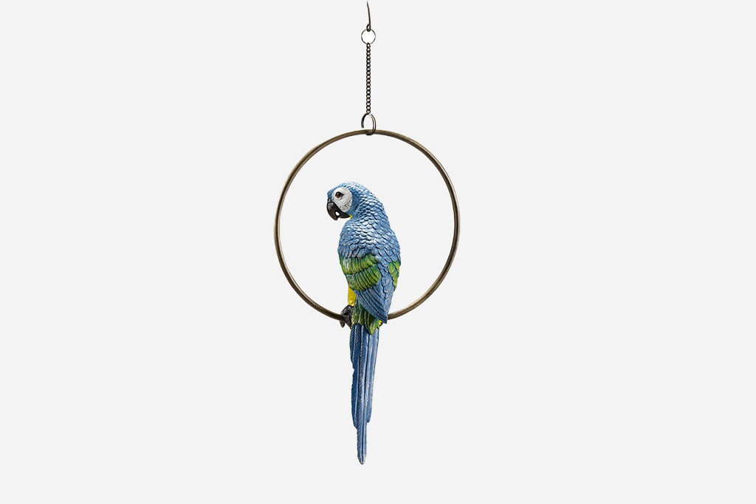
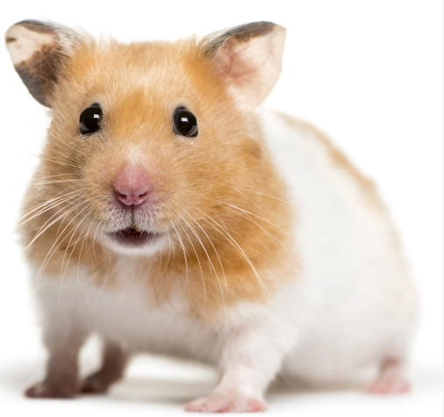
III. Descriptions
Brief! Eye-catching! Relevant!Serve the purpose!!!
What would the animals say in the poster? Just funny clever talks?
"Invite me into your life and let's create symphonies together!"
"My tuneful conversations are waiting for a partner. Adopt me!"
"Take me home and enjoy a daily concert with my sweet melodies!"
"Join me on a merry marathon of fun!"
"Together, let’s race towards shared moments of joy!"
"Bored? Not around me! My merry runs bring laughter and excitement!"
A kitten might say, "_______________".
A dog might say, "_______________".
A bunny could say, "_______________".
A turtle might say, "_______________".
Can you brainstorm more for the lovely animals?

Slide 9
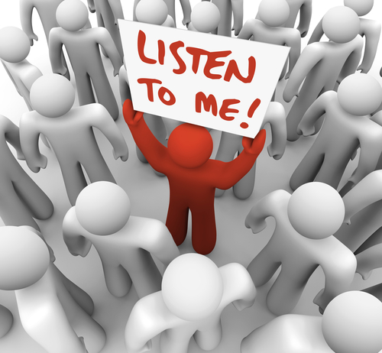
III. Descriptions
Para.2: We decided to make both Mr. Nibbles and Blue the stars of the poster.
How did Mr. Goldberg and public react?
He looked up from the poster to share a warm, appreciative gaze with us. "Your creativity is incredible. ”
Staring at the speech bubbles, he sighed with a mixture of relief and hope. "This right here," he tapped at the message gently.
Mr. Goldberg's reaction was one of utter surprise and delight. He took one look at our poster and a slow grin spread over his face.
Following the unveiling of our poster, the local animal shelter reported a marked increase in visitors.
The poster further engaged the public to take part in a series of following animal shelter events, which even attracted many local schools and organizations to lend a helping hand as well.
- Action/Look/Remarks:
- Action Chain:
- Look
- Public Attention
- Something Further

Slide 10
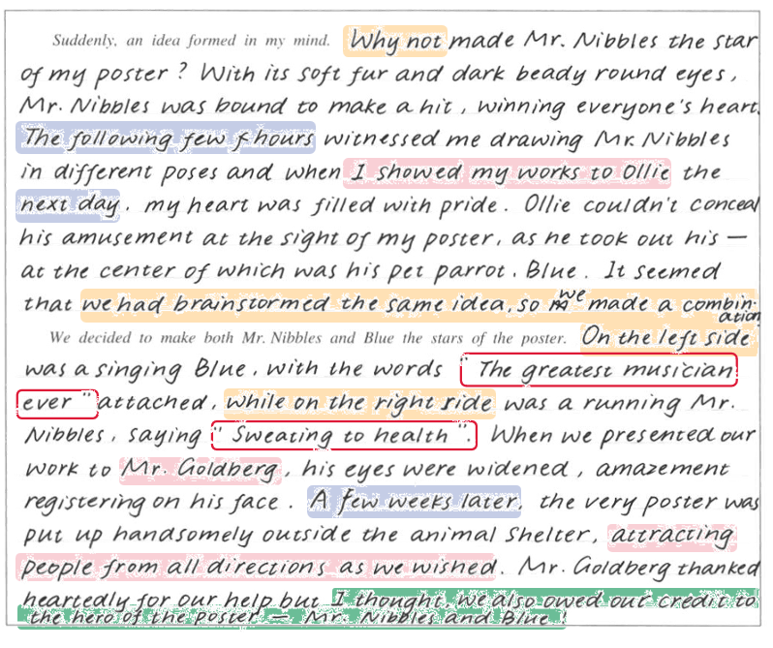
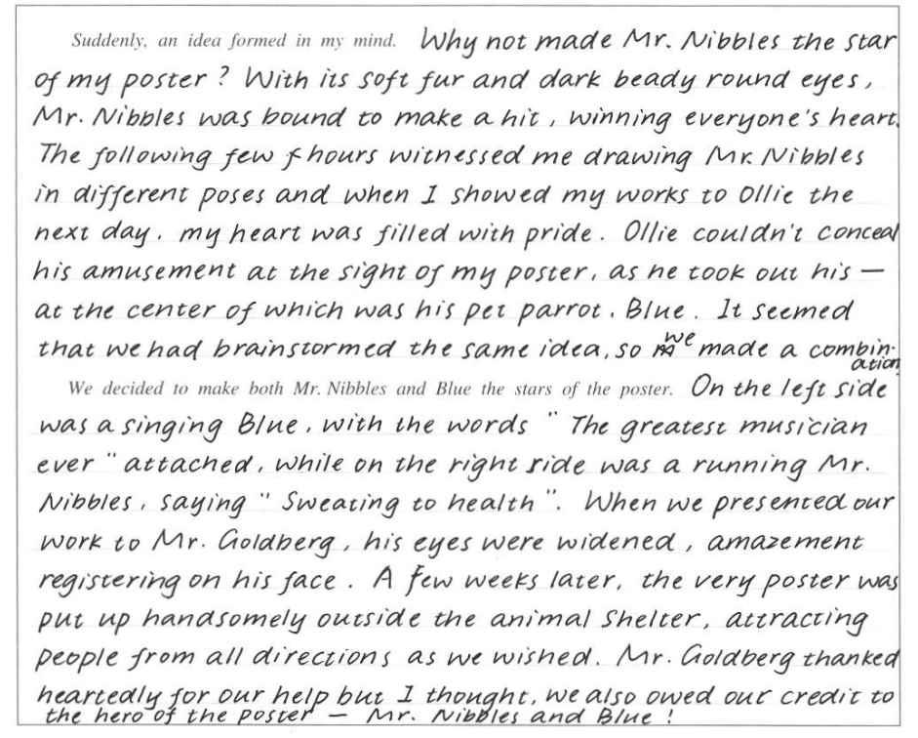
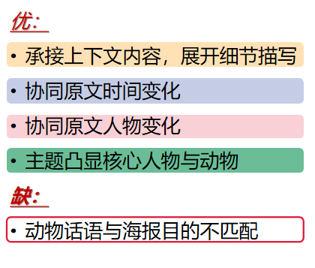
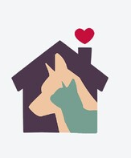
IV. Students’ works

Slide 11
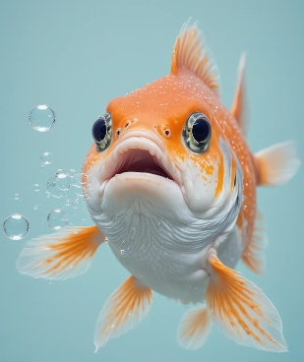
V. Teacher’s version
Para.1: Suddenly, an idea formed in my mind. Barely did people realize these likable creatures’ likability in the warmth of a home! Cats’ rhythmic purr rap, dogs’ tail-chasing waggle dance, fishes’ bubble-decorating slides.... I could make them visible! (设想内容)Who would have the heart to turn down those fun and delight? An image sketched itself- Whoopee! Mr. Nibbles relished its pillow playground carnival, uttering, "Adopt me-bring joy home!" (仓鼠-协同)At the moment, parents walked in. A ripple of laughter wove in the room as they spotted the merry “parkour”, making me more assertive.(父母反应-协同) With the brimming inspiration, I called Ollie to pour down my thoughts and was immediately echoed by his yell, “Terrific! Don’t forget Blue!”(衔接下文)
Para.2: We decided to make both Mr. Nibbles and Blue the stars of the poster. Next day, Ollie and I started to illustrate our ideas. (衔接上下文)Mr. Nibbles’ excited entertainment boasted its charm with my family’s engaged “playgound construction”, while Blue was crooning its melodious blues on a lovely swing, blowing Abuela and Ollie away. His speech bubble read, "Adopt me! Our duet will be astounding!"(仓鼠、鹦鹉及奶奶协同) Mr. Goldberg’s gaze sharpened as the poster was handed.(Mr. Goldberg反应) More satisfying, our work was then welcomed by increasing pet adoptions - it did capture people's hearts and attention! (公众反应-协同)This shared creation was our proud triumph, reversely further imprinting the adorables on Ollie and me, or everyone.

