Slide 1


感恩遇见，相互成就，本课件资料仅供您个人参考、教学使用，严禁自行在网络传播，违者依知识产权法追究法律责任。
更多教学资源请关注
公众号：溯恩英语
知识产权声明

Slide 2


湖丽衢英语质量检测
2024.04
Sweet April showers do bring May flowers.
题 目 解 析
Fay

Slide 3
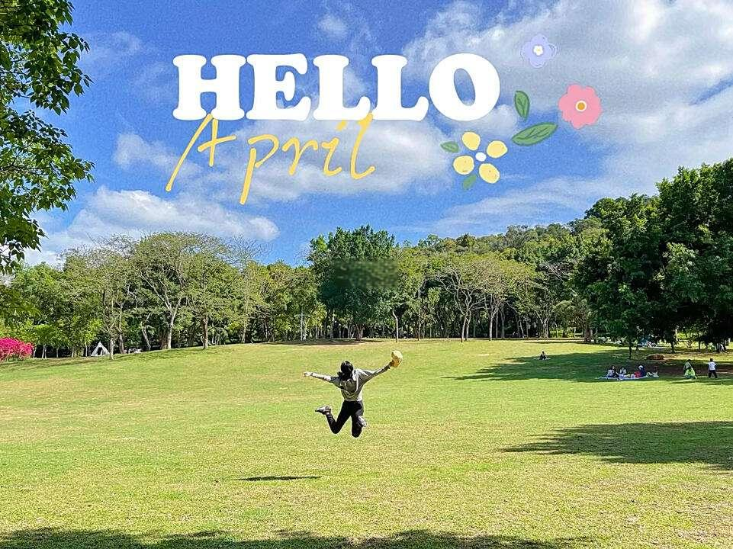
阅 读 理 解
comprehension

Slide 4




语篇 | 体裁 | 主要内容
A | 应用文 | 旅游宣传手册，介绍了几个与地质和古生物学相关的旅行团项目，包括探索威尔士的自然景观、加拿大落基山脉的地质以及艾伯塔省的恐龙博物馆和石林。
B | 说明文 | 美国退伍老兵Mazyck通过参与AstroAccess组织的零重力飞行体验，克服身体障碍感受到失重漂浮的喜悦，并强调了推动太空探索对所有人无障碍的重要性。
C | 说明文 | 文章说明了CO2 Revolution公司通过结合无人机技术和大数据分析来有效促进大规模植树造林，为大型企业提供了一种既能盈利又能减少碳足迹的可持续商业模式。
D | 说明文 | 主要介绍了对4个月大的婴儿在双语环境中大脑对语言处理的神经机制进行的研究，发现双语环境对婴儿的大脑发育有积极影响，可能有助于他们更早地区分不同的语言。
七选五 | 应用文 | 提供了一些实用的拍照技巧，以帮助人们在照片中看起来更好。

Slide 5
Explore the science behind these amazing landscapes
Retracing Charles Darwin's travels across North Wales
13 May 2024|6 days
Uncover the best of Wales as you explore the dramatic Welsh landscapes of Eryri (Snowdonia) National Park and examine the region geology and how it has been transformed by volcanic and glacial activity over the years. Discover the story of Charles Darwin's 1831 and 1842 tours of Wales,and retrace his travels on this small group journey to Shrewsbury and Snowdonia.
The Rockies and the Badlands:Geology and dinosaurs in Canada
17 June 2024|7 days
Explore the majestic Rocky Mountains west of Calgary and the otherworldly Badlands to the cast,witness the stunning scenery and geology of southerm Alberta.This tour includes two visits to UNESCO World Heritage sites,where you will see first-hand the rugged peaks and glacial features of the Banff portion of Canadian Rocky Mountain Parks and the bone-riddled badlands of Dinosaur Provincial Park.
Short break:Dinosaurs and Hoodoos:Alberta
23 July 2024|3 days
Visit one of the world's premier dinosaur museums,sail all the way around a World Heritage site with outstanding dinosaur fossils and explore the multi-hued canyons and wind-sculpted hoodoos ( 石 林 )of the Alberta Badlands.Throughout this tour you will be accompanied by palaeontologist (古生物学家)Jon Noad,who will share the stories of the rocks,including tales about past oceans,swamps,rivers and deserts,the rise and fall of the dinosaurs and,more recently,ice sheets that covered Alberta and carved out spectacular landscapes.
23A. A travel brochure
22B
22A.Scientific facts
22D
the best or most important
21appeal to dinosaur enthusiast most
22D
22C
22B

Slide 6
US Army veteran (退伍老兵)Mazyck remembers when doctors told her she would never walk again.She'd been paralyzed from the waist down after a serious accident while parachuting in 2003.The doctors never said anything about floating,though.In 2021,she got to do just that.
Mazyck was one of 12 participants in a Zero G flight,organized by the group AstroAccess. This type of flight recreates the weightlessness that astronauts experience without going all the way to space.Flying over the Pacific Ocean off Southern California,the modified 747 jet airplane made 15 steep dives and climbs,allowing the flyers multiple periods of weightlessness.
The experience left Mazyck feeling joyful.“The flight was something that I would have never in my wildest dreams thought I would've experienced,"she says,"especially the floating, the weightlessness."
Traditionally,strict physical requirements have prevented disabled people from becoming astronauts.AstroAccess is working to make space accessible to all.“Space removes the barriers between people;now is the time to remove the barriers to space itself,"says Mazyck,"It is sending a message to people who have historically been excluded from STEM that not only is there room for you in space,there is a need for you.”
During the flight,she says,the participants did experiments and made observations.They took note of things that people without certain disabilities might not realize are issues.For example,people who couldn't grip with their legs needed another way to hold themselves still while weightless.The group also experimented with signaling lights for the deaf and with ways of using braille(盲文)for the blind.
These types of issues are easy enough to address.Now is the time to make space accessible 一 before space tourism or space settlements become commonplace."I am so proud and elated about what's happening here,"Mazyck adds."We are paving the way for the future."
24.B.It offers weightlessness experience.
26. C. Courageous and optimistic.
25. D.Trials and observations.
27C.Making Space a Place for Everyone

Slide 7
Main parts of Problem-solving Passages.
1
Problem Statement:介绍文章要解决的核心问题。描述问题的背景、现状、影响范围以及为什么这个问题重要或紧迫。
2
Cause Analysis:探讨问题产生的原因。包括历史背景、社会经济因素、技术挑战、政策缺陷等。理解问题的根源有助于提出更有效的解决方案
6
Case Studies or Evidence：提供实际案例研究、统计数据、专家意见或其他形式的证据来支持解决方案的有效性。
3
4
5
Solution Proposal:核心部分，提出一个或多个解决问题的方案。解决方案可能包括技术创新、政策建议、教育改革、社会行动等。
Advantages and Potential:解释这些方案的优势和潜在影响。包括成本效益分析、预期结果、长期影响、可持续性和可行性等。
Challenges and Limitations:讨论解决方案可能面临挑战和限制，并提出克服它们的方法或建议。
7
Conclusion and Call to Action：以总结问题和解决方案的为主要点，并可能包含一个呼吁行动。
problem
28+29
solution1
solution2
30
Challenges&conclusion
31

Slide 8
problem
Three years ago,Juan Carlos Sesma had a realization.Global warming and climate change seemed to be a mounting problem,with scientific records indicating rising temperatures and sea levels across the world.At the same time forest fires,logging,and aggressive human expansion meant the supply of trees which helped to regulate and remove greenhouse gases from our atmosphere was dwindling .
He decided the best way to tackle a problem this large was to combine two of the most powerful forces emerging in technology:big data and robotics.Sesma founded a new company called CO2 Revolution,whose plan was to use drones(无人机)to better understand where new trees should be planted and to automate the process of planting so that much larger areas of forest could be repopulated.The company designed a special smart seed that helped to deliver just the right amount of protection and nutrition to the young saplings.The overall goal was to considerably lower the time and cost of large scale re-forestation.
CO2 Revolution isn't alone.In the UK,a startup called Biocarbon Engineering ran a trial carlier this year where it used drones to help replant Mangrove trees in Myanmar.It has also deployed( 部 署 )its technology in Australia,South Africa,and Morocco.“In a lot of places, people will either have a map taken by aeroplane,or just use Google Earth satellite imagery.They'll draw things out freehand and manually plant,either by hand or tractor,"said CEO Susan Graham in a recent interview.
The challenge for all these startups is to find ways to create a profitable,or at least sustainable,business model.For Sesma and the team at CO2 Revolution,recent regulatory action has highlighted one potential pathway.“We offer a solution that allows clients to carry out massive plantings,incrcasing forest mass and thus compensating for their carbon footprint.” Amid growing calls for carbon sequestration,this kind of effort might prove not just noble,but financially sensible for large corporations.
28:What drove Sesma to set up CO2 Revolution?
29:the meaning of “dwindling”
Solution1:startup1—CO2 Revolution
30:A:Drones are populated in larger areas of forests.×
30:D:Smart seeds are designed to improve the accuracy of planting.√
30:C:Biocarbon Engineering sets up worldwide technology centers.×
Solution2:startup2—Biocarbon Engineering
30:B:CO2 Revolution calls for a profitable drone model..×
Challenges&conclusion
31:beneficial

Slide 9
Main parts of Experimental Study Article.
1
Background and Objective:介绍研究的背景，阐述研究问题的重要性，以及研究旨在解决的具体问题或目标.
2
Methodology:描述实验的设计、参与者的选择标准、使用的材料、实施的具体步骤、数据收集和分析方法。
3
4
5
Results and findings:报告实验数据的分析结果，通常包括统计数据、图表、图形等。
Discussion and Analysis:对实验结果进行解释和讨论，分析结果的意义，探讨结果与预期假设之间的关系，以及与现有研究的一致性或差异。同时，讨论实验的局限性和可能的改进方向。
Challenges and Limitations:讨论解决方案可能面临挑战和限制，并提出克服它们的方法或建议。
6
Conclusion：总结研究的主要发现，强调研究的贡献和对未来研究或实践的意义。
Importance
32、34、35
Methods
Findings
33、34
Conclusion
34、35

Slide 10
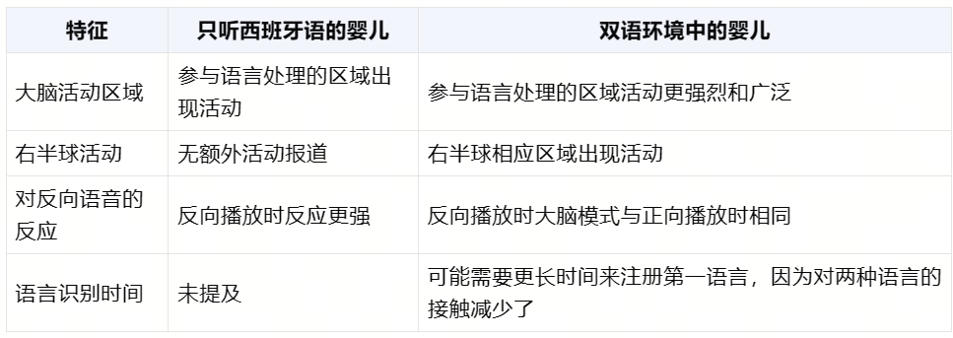
Babies as young as 4 months old who are born into a bilingual(双语的)environment show distinct and potentially advantagcous brain pattcrms for speech processing.Our early-life experiences can have lifelong effects on our behavior.The brain is most sensitive to its environment during the first year of life,which is thought to be a critical period for language development.
Previous studies have looked into the brain mechanisms that underlie (构成 … … 的基础) speech processing in babies who hear just one language.To better understand this in bilingual-exposed infants,Borja Blanco at the University of Cambridge and his collcagues compared how 31 babies who only heard Spanish and 26 babies who heard Spanish and Basque, all aged 4 months,responded to Spanish recordings of The Little Prince by Antoine de Saint-Exupery.
The team used an imaging technique called functional near-infrared spectroscopy (fNIRS) to measure changes in brain activities.In the Spanish-only babies,the recordings caused activation in areas which play a role in speech processing.In the bilingual-exposed babies,the recordings similarly evoked these responses,but they were larger and wider.These infants also had activation in equivalent areas of their brains’right hemispheres ( 脑 半 球 ) .When the recordings were then played backwards as a control arm of the experiment,the infants exposed to just Spanish had larger responses to the backwards speech,while those to Spanish and Basque had similar brain patterns as before.This may be because the bilingual infants take longer to register their primary language,in this case Spanish,as hearing both this and Basque reduces their overall exposure to either language.
If this is the case,it could help them be sensitive to linguistic differences and enable them to learn to distinguish between languages at a younger age.The researchers note that a bilingual environment stimulates changes in the brain mechanisms underlying speech processing in young infants,adding weight to the idea that the neural basis of learning two or more languages is established very early in life.
Importance
extremely important
Methods
Findings
来识别主要语言，
因为双语婴儿在识别他们的第一语言——在本例中是西班牙语——上需要更长的时间，因为他们同时听到这两种语言，这减少了他们对任何一种语言的总体接触时间。
这可能使得双语婴儿在处理语言信息时，对语言的声音和结构更加敏感，不容易受到录音倒放这种非正常语言模式的干扰。换句话说，双语婴儿的大脑对于语言的处理可能更为灵活和适应性强。
增加权重
研究者指出，双语环境会刺激婴儿大脑中语言处理机制的变化，这为学习两种或更多语言的神经基础在生命早期就已经建立的观点增添了重要性。
Conclusion

Slide 11
七
选
五
Very often,we take a picture on our smartphones and then immediately check the screen to see how it came out. 36 We've gathered our best tips to ensure you know how to look good in pictures.
Know your angles.
Knowing your angles is the first step to taking a great picture.Maybe you like one side of your face better than the other.Maybe you're completely symmetrical and can take a photo from the front. 37 So snap some selfies and start to get acquainted with your best angle.
Doing so will have you feeling confident and looking your best in your next shot.
Make sure the light is behind the camera.
Great lighting makes a great photo.The key is to make sure you're in front of the light, and that the light is behind the camera.So,if you're outside,make sure the sun is behind the camera. 38
Take multiples.
39 .Take different photos of the same shot,so you have options when choosing which photo to keep.You'll be surprised how often your facial expression changes in the same shot.
Invest in a good quality camera.
While smartphone cameras keep getting better and better,nothing beats the clear and crisp image quality of a digital single-lens reflex (DSLR)camera.The bad news?A good DSLR can cost anywhere from $400 on up. 40
With these photo tips in mind,next time you snap a photo,you'll look at it with a smile.
G：承上启下—上文的问题下文的解决方式(提高拍照技巧)
B：承上启下—上文的情境下文的解决方式(多自拍)
D：并列递进--提供了关于室内拍摄时如何利用光线的建议。这与上文提到的户外拍摄时确保太阳在相机后面的原则相一致，都是为了确保拍摄时有最佳的光线效果。
A：引出下文（多拍照片）--这与下文提到的拍摄不同表情的变化相呼应
F：转折/解释说明--虽然DSLR相机价格较高，但如果追求专业级别的图像质量，这样的投资是值得的。
A.You can never take too many photos,right?
B.Whatever the case is,you have to take the time to study your face.
C.You'll also show more of your eyelashes and brows from this angle.
D.And if you're indoors,make sure windows and lighting fixtures are behind the camera.
E.Most of the photos you see from celebrities and online influencers come from a DSLR.
F. But it might be worth the investment if you really want to achieve that professional look.
G.But if you tend to find yourself deleting every picture you take,it's time to up your photo game.
是时候提高拍照技巧

Slide 12
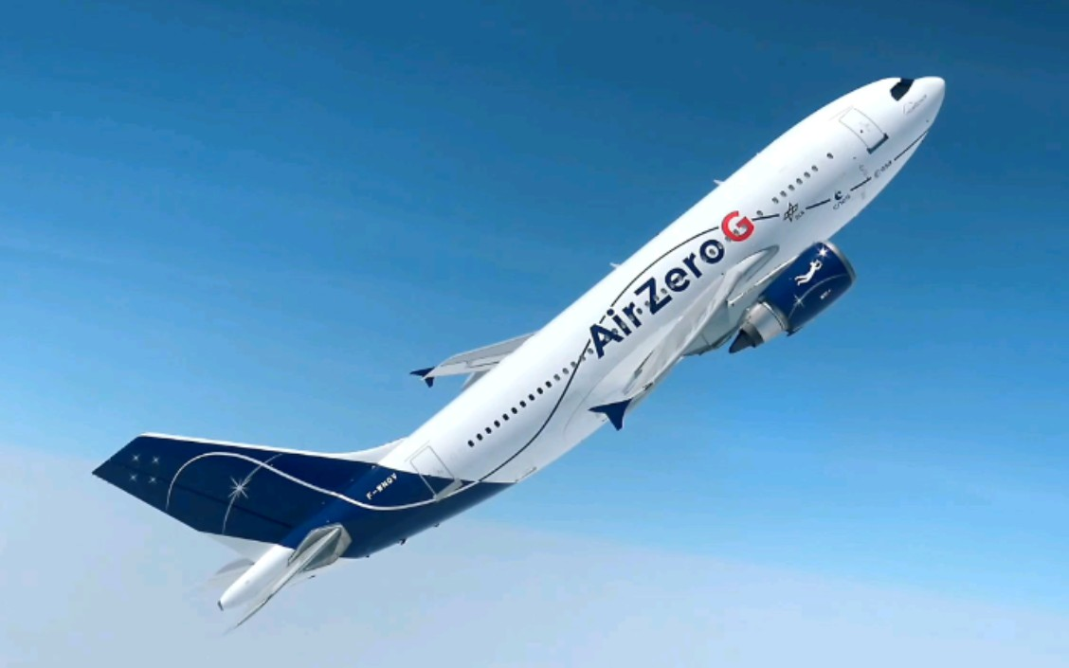
词块汇总
Uncover the best of Wales: 探索威尔士之最
retrace his travels: 重走他的旅行路线
Explore the majestic Rocky Mountains: 探索雄伟的落基山脉
witness the stunning scenery and geology: 见证壮丽的风景和地质
rugged peaks and glacial features: 崎岖的山峰和冰川特征
bone-riddled badlands: 遍布骨头的荒地
multi-hued canyons and wind-sculpted hoodoos: 多彩峡谷和风雕石林
the rise and fall of the dinosaurs: 恐龙的兴衰
paralyze from the waist down: 腰部以下瘫痪
Zero G flight: 零重力飞行
recreate the weightlessness: 重现失重状态
steep dives and climbs: 陡峭的俯冲和爬升
feel joyful: 感到高兴
conduct experiments and made observations: 进行实验和观察
take note of issues: 记录问题
experiment with signaling lights: 试验信号灯
address these types of issues: 解决这些问题
make space accessible: 使太空变得可进入
pave the way for the future: 为未来铺路

Slide 13
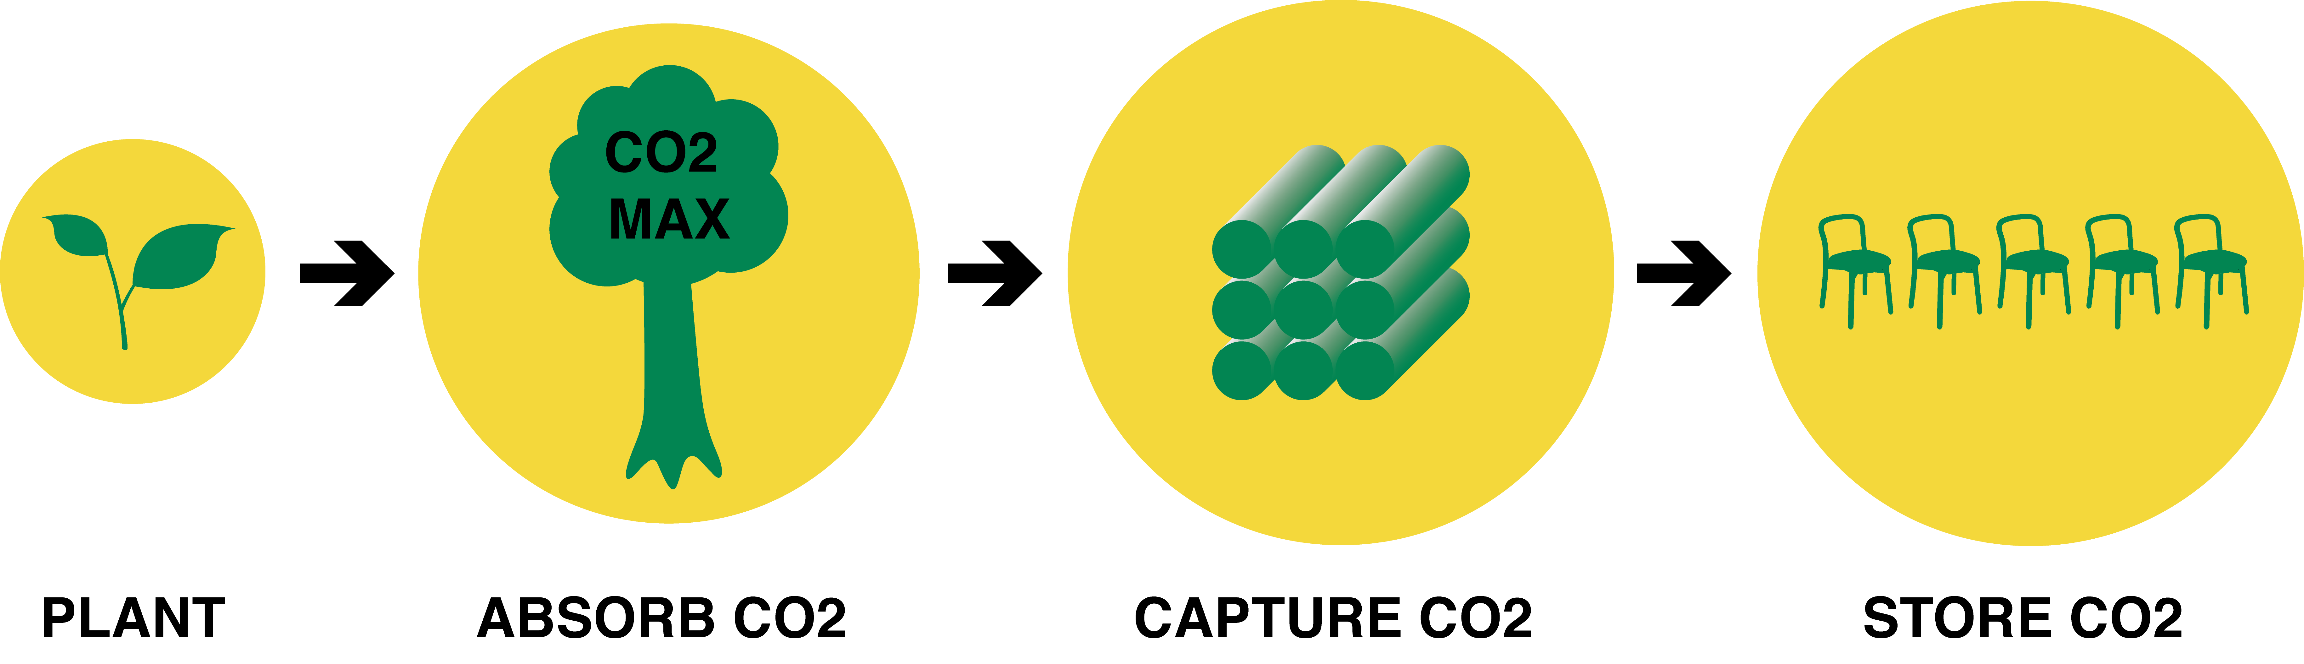

词块汇总
Forest fires, logging, and aggressive human expansion: 森林火灾、伐木和人类的激进扩张
Regulate and remove greenhouse gases: 调节和减少温室气体
Automate the process: 自动化过程
Repopulate large areas of forest: 重新种植大面积的森林
Deliver protection and nutrition: 提供保护和营养
Lower the time and cost: 降低时间和成本
Run a trial: 进行试验
Draw things out freehand: 手绘
Manually plant: 手工种植
Create a profitable business model: 创建盈利的商业模式
Carry out massive plantings: 进行大规模种植
Increase forest mass: 增加森林面积
Compensate for carbon footprint: 补偿碳足迹
Carbon sequestration: 碳封存
"Carbon sequestration" refers to the process of capturing carbon, primarily in the form of carbon dioxide (CO2), and storing it in such a way that it prevents the release of this greenhouse gas into the atmosphere, thereby helping to mitigate climate change

Slide 14
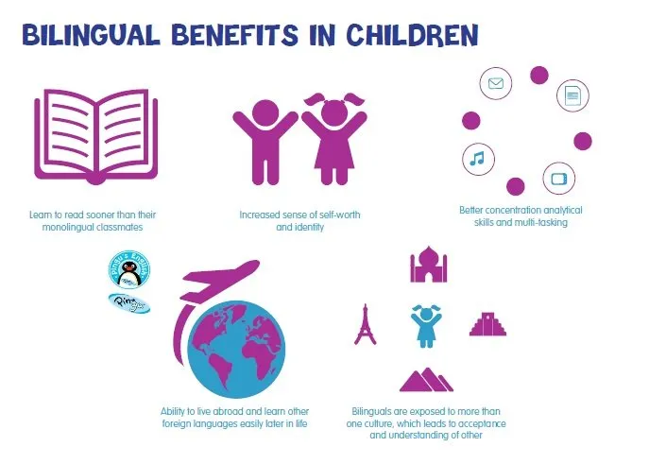
词块汇总
bilingual environment: 双语环境
distinct brain patterns: 独特的大脑模式
speech processing: 语音处理
critical period: 关键时期
bilingual-exposed infants处于双语环境中的婴儿
underlie speech processing构成语言处理的基础
brain mechanisms: 大脑机制
functional near-infrared spectroscopy (fNIRS): 功能性近红外光谱成像
activation in areas: 区域激活
evoke responses引发反应
equivalent areas: 相应区域
right hemispheres: 右半球
play backwards: 倒放
control arm of the experiment: 实验的对照组
primary language: 主要语言
sensitive to differences: 对差异敏感
distinguish between languages: 区分不同语言
stimulates changes: 刺激变化
add weight to the idea为…观点增加分量

Slide 15

完 形 填 空
C l o z e
文章讲述了叙述者和旅行伙伴Lucas在旅行中的经历。Lucas与一个当地人Michael交谈，并邀请他共进晚餐。起初，叙述者对Michael携带刀子感到害怕，但随着Michael不断尝试与他们沟通，叙述者对他的恐惧逐渐消失。他们最终在Michael家中与他的家人共进晚餐，但之后没有留下联系方式，体现了一种短暂的、旅行中的友谊。

Slide 16
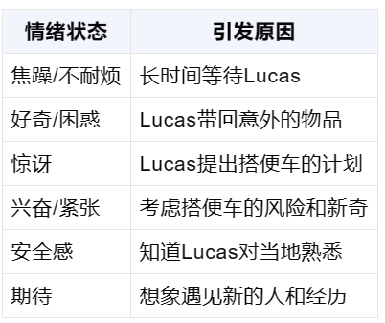
I'm sitting impatiently in our dusty car looking out.My travel buddy,Lucas,having taken in enough of the 41 , has gone to speak with someone from one of the nearby tourist souvenir huts. After ages,he walks towards me, 42 some sausages,hot water,a new cowboy hat,and a big grin on his face. “We're giving a man a 43 ,”he tells me.
The idea seems 44 but somehow safe, given that there are two of us and Lucas is a _45 to the country.How exciting to create an opportunity to meet people that you wouldn't have met 46 .
Impatiently, enough, after ages, exciting等词揭示了主人公的情绪变化和故事起因
整个故事以主人公的情绪变化为线索
41.A.meal B.gift C.money D.view
42.A.leaving B.carrying C.taking D.offering
43.A.treat B.welcome C.ride D.coin
44.A.daring B.pleasant C.practical D.worthwhile
45.A.newcomer B.foreigner C.local D.visitor
46.A.otherwise B.instead C.though D.nevertheless
大胆的
如果没有这次机会，他们就不会遇到某些人

Slide 17
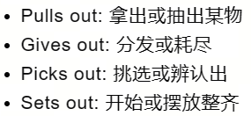
Now,as I look at Lucas' new friend,I see a different kettle of fish.Michael is big.I mean really BIG.I watch in the side mirror as Michael 47 towards the car.In his right boot is a big knife,pushed far enough in that only the handle and the base of the blade poke out.A knife!
I would normally be alert to this 48 stranger now sitting in the back of my vehicle. However,with Lucas now eagerly 49 with him in a language I barely understand,I'm trying to let myself 50 .Then Lucas loosely translates the conversation they're having as Michael proudly 51 his knife,explaining that he uses it for everything:opening bottles, picking his teeth,castrating his cows.
Gradually,my 52 towards our new stranger grows as he persistently tries to communicate with me, 53 the mood of the car.Twenty minutes down winding mountain roads and we reach Michael's house,where we are invited to have a meal with his 54 .Later that day,we leave the house without taking any contact details from Michael.There is an unspoken understanding that this 55 friendship is enough.
伸出,突出,显露
大致翻译
47.A.climbs B.cycles C.flies D.marches
48.A.cold B.friendly C.enormous D.slim
49.A.singing B.chatting C.arguing D.complaining
50.A.sleep B.wait C.ease D.forget
51.A.pulls out B.gives out C.picks out D.sets out
52.A.fear B.warmth C.anger D.sympathy
53.A.maintaining B.ruining C.darkening D.lifting
54.A.family B.friends C.neighbors D.guests
55.A.permanent B.brief C.close D.renewed

Slide 18
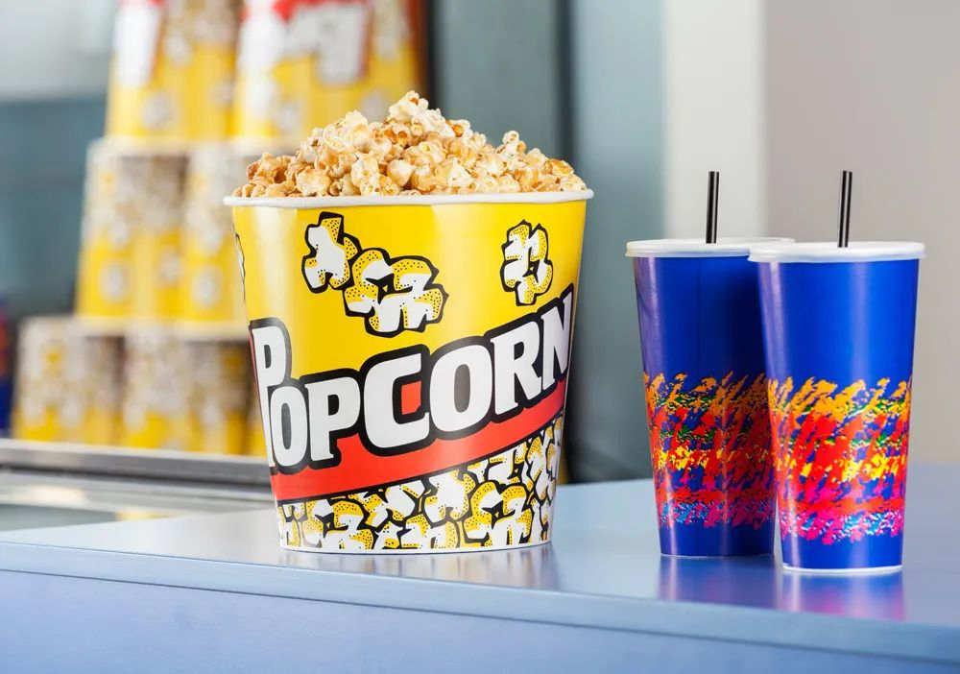
语 法 填 空
说明文:探讨了爆米花与电影院之间关系的历史和原因。

Slide 19

For most of us, popcorn is synonymous(同义的)with movie theaters. We go to the movies, buy a popcorn, and enjoy the show 56 even thinking twice about it. But, why? Why do we always eat popcorn at the movies?
One reason for popcorn's increasing 57 (popular)was its mobility: in 1885, the first steam-powered popcorn maker hit the streets, invented by Charles Cretor. The mobile nature of the machine made 58 the perfect production machine to serve customers 59 (attend)outdoor sporting events, or circuses and 60 (fair).Not only was popcorn mobile, but it could be mass-produced without a kitchen , an advantage 61 another crunchy snack —the potato chip—lacked. Another reason for its dominance over other snacks was its appealing smell when 62 (heat).
But it wasn't super fancy to movie theatres at first as they didn't allow such a loud and messy food into their performances. 63 relationship between popcorn and the movies was really set in stone during World War II. Things like chocolate and sugar were limited during the war while salt and popcorn kernels were never limited. So the country's favorite go-to-movie snack was even 64 (available)and popular. Ever since, popcorn and movies 65 (continue)to be as iconic as any duo(二重奏)out there.
56.without 考查介词与语义
58.it 考查代词代词，指代前文中提到的具体事物，即蒸汽动力爆米花机。
57.popularity考查名词表示爆米花之所以越来越受欢迎的一个原因是它的便携性
60.fairs 考查名词单复数fair:集市，展览会；露天游乐场
59.attending 考查非谓语，修饰前面的customers
61..that/which 考查定语从句
62.heated考查过去分词—被加热（when省略）
63.The考查冠词
64.more available考查形容比较级
65.have continued考查谓语时态--完成时

Slide 20
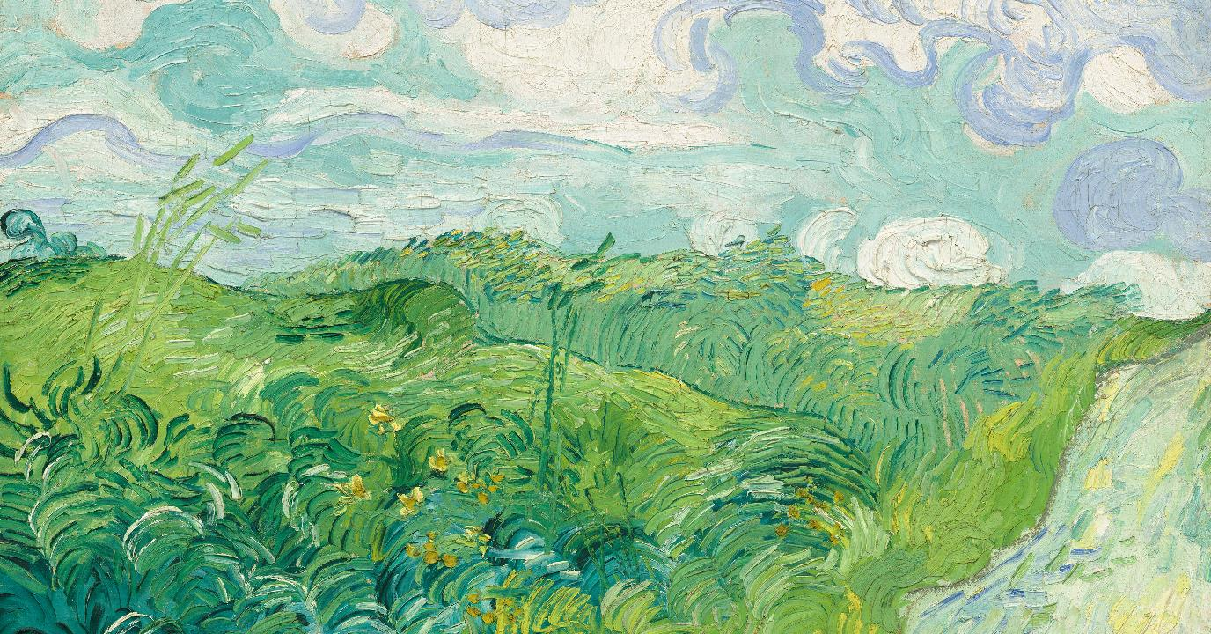
作 文 范 文
composition

Slide 21
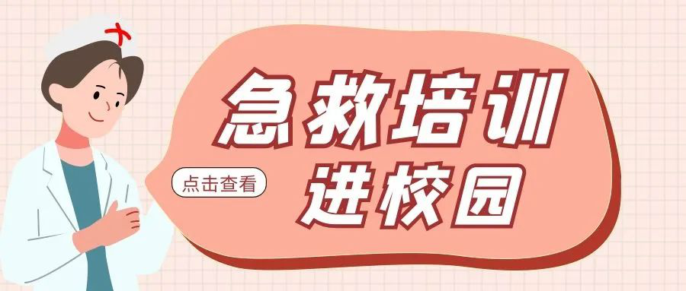
上周末你校举办了“急救知识进校园”的活动。请你为校英文报写一篇报道，内容包括：
1. 活动的过程；
2. 活动的影响。
注意：
1. 写作词数应为80个左右；
2. 请按如下格式在答题卷的相应位置作答。
First Aid Knowledge Hits the Campus
One possible version：
First Aid Knowledge Hits the Campus
Last weekend, our school hosted an event titled “First Aid Knowledge Hits the Campus”.
The event began with a lecture by a professional trainer, covering CPR techniques, wound dressing, and handling common emergencies. Following the lecture, students participated in hands-on workshops, practicing their skills under the guidance of experts.
This initiative not only equipped our students with valuable lifesaving skills but also raised awareness of the importance of prompt first aid. The positive feedback from students shows the need for more such practical and informative events on campus.

Slide 22
I first met Bo when I voluntecred to be a docent(讲解员)at the zoo.It was a summer program our school participated in,where biology students earned extra credit by teaching little kids about some of the animals.I needed to increase my biology grade,so I asked my friend Sue Wang to be my partner.“Melanie,I'll do this with you,"she said,"but I'll do the talking.No way will I handle the animals!”That was OK with me.
During the training course,our instructor,Mr.Lindsey came to Sue and me and said,“OK, girls,your animal is a boa(蟒蛇).”I felt myself go cold.“I have to handle a boa?”
That night,I had a nightmare.I was carrying the snake around a classroom,showing the kids,when all of a sudden it started constricting(收紧).It squeezed and squeezed,and I couldn't breathe!I woke up in a sweat,my body rigid.
Next day I told my instructor.“Sure you can do it,”he said.He slid the door of the snake carrier open.“Now put your elbow in—slowly —and wait for him to crawl on your arm.Good, that's the way.”He wasn't wet or slimy.He was dry and soft!But it was scary!Mr.Lindsey stood beside me.“Relax,Melanie.You need to show him you aren't afraid.He needs to trust you, and you need to trust him.”Yeah,right.He didn't do anything.Awesome!I named him Bo. After a few school visits,I began to really like my boa and was pretty much at ease with him.
Then came the day I will never forget.As usual,I opened the carrier and took him out. After Sue talked about how boas live mostly in rain forests in Central and South America,I walked around the classroom,saying,"“Don't be afraid.See,he is nice.You can touch him gently, here,on his back.His name is Bo.”
Most of the kids actually did touch him,and everything went fine until one boy,for some unknown reasons,tapped Bo on the head.I froze.
注意：
1. 续写词数应为150个左右；
2. 请按如下格式在答题卷的相应位置作答。
My worst nightmare came true!
I closed the carrier and signaled the kids to come inside

Slide 23
I first met Bo when I voluntecred to be a docent(讲解员)at the zoo.It was a summer program our school participated in,where biology students earned extra credit by teaching little kids about some of the animals.I needed to increase my biology grade,so I asked my friend Sue Wang to be my partner.“Melanie,I'll do this with you,"she said,"but I'll do the talking.No way will I handle the animals!”That was OK with me. | 我第一次遇见Bo是在我自愿成为动物园讲解员的时候。这是我们学校参与的一个暑期项目，生物学学生可以通过教授小孩子一些关于动物的知识来获得额外的学分。我需要提高我的生物学成绩，所以我让我的朋友Sue Wang成为我的搭档。“梅兰妮，我会和你一起做这个，”她说，“但我会负责说话。我绝不会处理动物的！”这对我来说没问题。
Then came the day I will never forget.As usual,I opened the carrier and took him out. After Sue talked about how boas live mostly in rain forests in Central and South America,I walked around the classroom,saying,"“Don't be afraid.See,he is nice.You can touch him gently, here,on his back.His name is Bo.” | 然后是那个我永远不会忘记的日子。像往常一样，我打开笼子把他拿出来。Sue讲解了蟒蛇主要生活在中南美的雨林后，我在教室里走来走去，说：“不要害怕。看，它很温顺。你可以在这里轻轻地触摸它，它的背上。它的名字是Bo。”
Most of the kids actually did touch him,and everything went fine until one boy,for some unknown reasons,tapped Bo on the head.I froze. | 大多数孩子实际上都触摸了它，一切都很顺利，直到一个男孩，出于某种未知的原因，轻敲了Bo的头部。我僵住了。

Slide 24
Next day I told my instructor.“Sure you can do it,”he said.He slid the door of the snake carrier open.“Now put your elbow in—slowly —and wait for him to crawl on your arm.Good, that's the way.”He wasn't wet or slimy.He was dry and soft!But it was scary!Mr.Lindsey stood beside me.“Relax,Melanie.You need to show him you aren't afraid.He needs to trust you, and you need to trust him.”Yeah,right.He didn't do anything.Awesome!I named him Bo. After a few school visits,I began to really like my boa and was pretty much at ease with him. | 第二天我告诉了我的指导老师。“你肯定能做到，”他说。他打开了蛇笼的门。“现在把你的胳膊肘放进去——慢慢地——等它爬到你的手臂上。好，就这样。”它并不湿也不滑。它干燥而柔软！但这很可怕！林赛先生站在我旁边。“放松，梅兰妮。你需要向他展示你并不害怕。他需要信任你，你也需要信任他。”是的，对吧。他什么也没做。太棒了！我给它起名叫Bo。经过几次学校访问后，我开始真的喜欢我的蟒蛇，和他相处也变得相当轻松。
During the training course,our instructor,Mr.Lindsey came to Sue and me and said,“OK, girls,your animal is a boa(蟒蛇).”I felt myself go cold.“I have to handle a boa?” | 在培训课程中，我们的指导老师林赛先生来到Sue和我面前说：“好的，姑娘们，你们的动物是一条蟒蛇。”我感到自己浑身发冷。“我必须处理一条蟒蛇吗？”
That night,I had a nightmare.I was carrying the snake around a classroom,showing the kids,when all of a sudden it started constricting(收紧).It squeezed and squeezed,and I couldn't breathe!I woke up in a sweat,my body rigid. | 那个晚上，我做了一个噩梦。我带着蛇在教室里走来走去，给孩子们展示，突然它开始收紧。它越挤越紧，我喘不过气来！我一身冷汗，身体僵硬地醒来

Slide 25
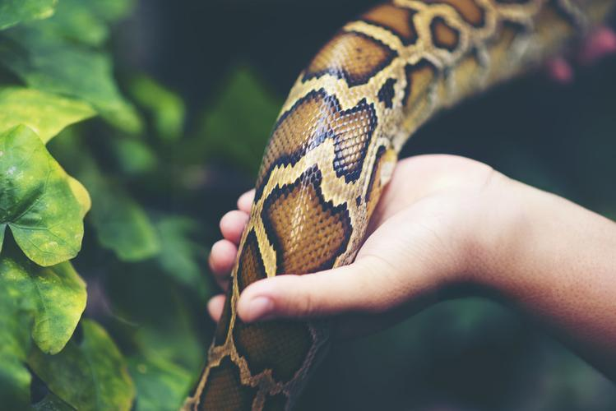
参考范文 | 中文翻译
My worst nightmare came true! The moment the boy tapped Bo on the head, I felt a jolt of panic. I knew I had to stay calm for the children's sake, but my heart was pounding. I took a deep breath and gently stroked Bo, trying to soothe him and show the class that there was no danger."Bo is a bit sensitive to sudden noises," I explained, trying to sound as reassuring as possible. "Let's remember to be gentle and patient when we're around animals, okay?" The children nodded, their faces a mix of curiosity and newfound respect. | 我最可怕的噩梦成真了！当那个男孩轻敲Bo的头部时，我感到一阵恐慌。我知道为了孩子们我必须保持镇定，但我的心脏却在狂跳。我深吸了一口气，轻轻地抚摸Bo，试图安抚他，并向全班展示没有什么危险。"Bo对突然的声音有点敏感，"我尽可能地安抚地说。"记住，我们在动物周围时要温柔和有耐心，好吗？" 孩子们点点头，他们的脸上充满了好奇和新发现的尊重。
I closed the carrier and signaled the kids to come inside. As I did, I realized that this incident could be a teaching moment. Once everyone was seated, Sue and I discussed how important it is to treat animals with kindness and respect. We talked about the different ways animals communicate and how understanding these can help us coexist with them. The children listened intently, and I realized it was about making a difference and creating a bond between the children and the natural world. | 我关上了运输箱，并向孩子们示意进来。当我这么做的时候，我意识到这个事件可以成为一个教育的时刻。一旦大家都坐好了，Sue和我讨论了以善意和尊重对待动物的重要性。我们谈到了动物交流的不同方式，以及理解这些可以帮助我们与它们共存。孩子们聚精会神地听着，我意识到这是关于产生影响，并在孩子们与自然世界之间建立联系。

Slide 26
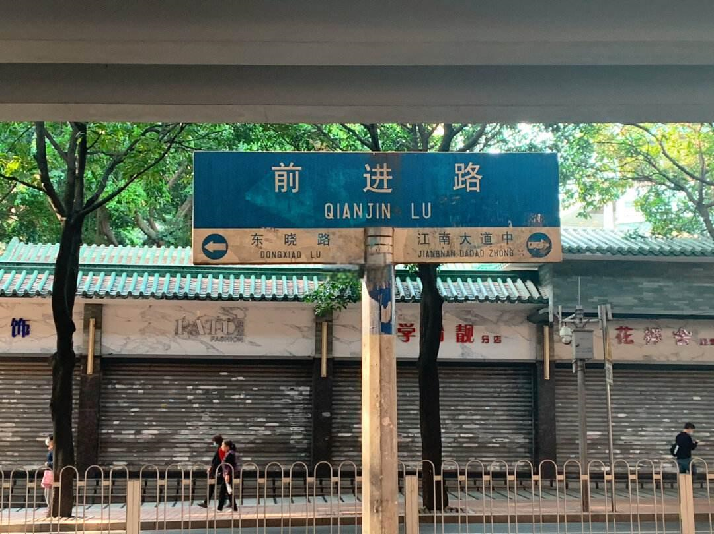
Each breath of fresh mountain air filled me with a sense of kinship with the earth, a reminder that the air we share is a vital thread in the fabric of life that binds us all
THANK YOU
FAY

