Slide 1


感恩遇见，相互成就，本课件资料仅供您个人参考、教学使用，严禁自行在网络传播，违者依知识产权法追究法律责任。
更多教学资源请关注
公众号：溯恩英语
知识产权声明

Slide 2
2024 年 4 月 高 三 绍 模客 观 题 试 卷 讲 评
海亮高级中学 陈虹

Slide 3
01
题型概况
02
目录
阅读理解
03
CONTENT
完型填空
04
语法填空

Slide 4
题型概况
01

Slide 5
题型 | 话题 | 体裁 | 词数
阅读A | 人与社会:Four unusual monuments | 应用文 | 314
阅读B | 人与自然:Abel Cruz’s fog net | 说明文 | 317
阅读C | 人与社会：The true prosperity | 议论文 | 305
阅读D | 人与社会 The young’s new understanding of liberies | 议论文 | 311
七选五 | 人与自我 New university life | 演讲稿 | 225
完型填空 | 人与自我 Volunteeing at VA | 记叙文 | 233
语法填空 | 人与社会 LiShizhen and his book | 说明文 | 198

Slide 6
阅读理解
02

Slide 7


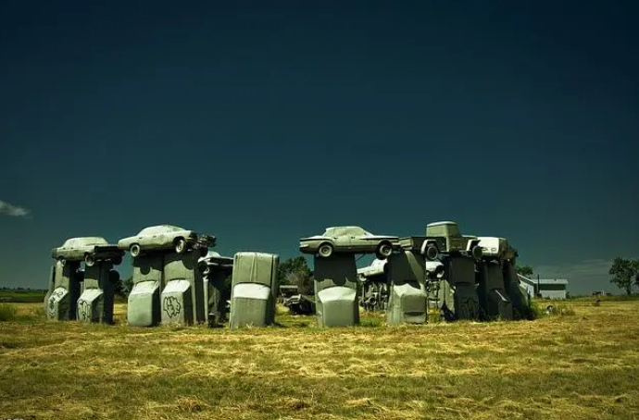
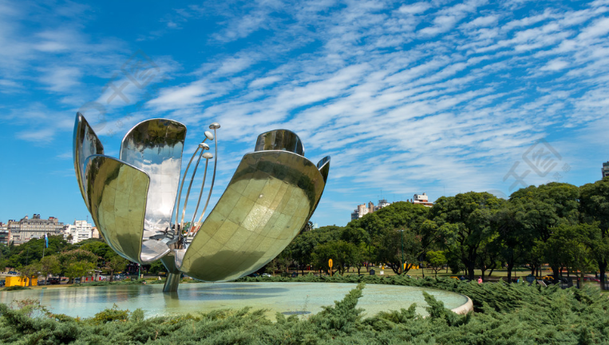
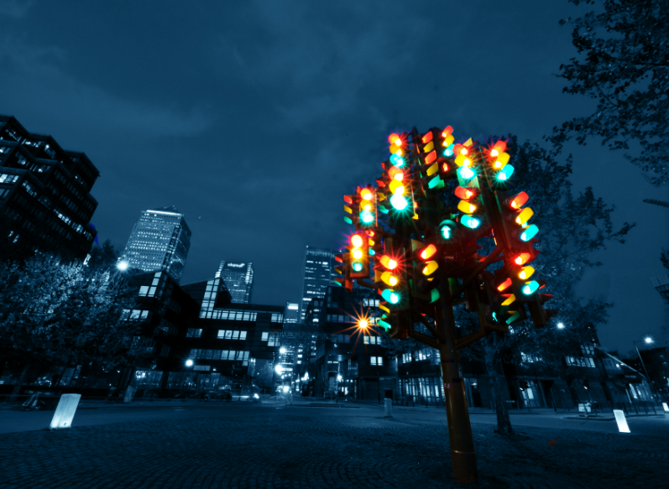
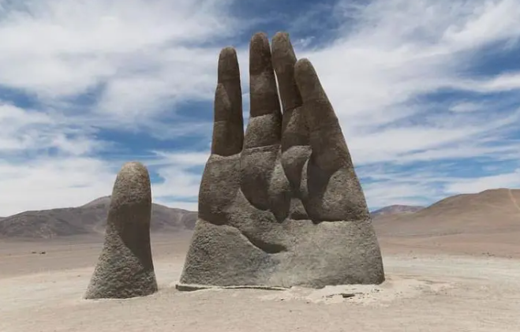
A 篇
The introduction of four monuments
本文是一篇应用文。文章介绍了分布在全世界的四个各具特色而有不同寻常的纪念碑。

Slide 8
A 篇
21.Why did the people of Alliance change their attitude toward Carhenge?
A.It reminded them of Stonchenge.
B.It brought them financial benefits.
C.It added beauty to their community.
D.It displayed the creativity of the designer.
知识回顾：
"经济效益"在英语中可以用以下表达方式：
Economic benefits
Economic advantages
Economic gains
Economic value
Economic returns
Economic perks
Financial benefits
细节理解题
Carhenge
.....At first,the people of Alliance didn't like it,but they soon changed their minds after it became popular with tourists,who brought lots of money to the town.
Tip: 细节题的关键在于同义词的理解

Slide 9
A 篇
key word
22.Which of the four monuments was designed by a foreign artist?
A.Carhenge B.Floralis Genérica.
C.Traffic Light Tree. D.Mano del Desierto.
细节理解题
Carhenge
.....The monument was made in 1987 by a local arist...
Floralis Genérica
......Eduardo Catalano,a native of Argentina,gave the statue...
Traffic Light Tree
.....It was created by French artist,...
Mano del Desierto (Hand of the Desert)
The Hand of the Desert is in the Atacama Descrt in Chile.The sculpture was designed by the Chilean sculptor Mario Irarrazabal

Slide 10
A 篇
推理判断题
23.Where is the text probably from?
A. A guide book. B.A news report.
C.A science magazine. D.An architecture
知识补充：
近五年高考试卷中，关于文章出处包括以下选项：
A novel or book
A magazine or newspaper
A website or online publication
A speech or interview
A diary or journal entry
An academic journal or research paper
An advertisement or brochure
A guidebook or travel brochure
第一段：...these are four unusual monuments from around the world you might like to visit.
最后一段：If you're looking for something new to see,you know where to go!
Tip: 应用文的阅读不能忽略首末两段

Slide 11
语料积累
建筑物“坐落于”的不同表达方法
It stands in a pool of water in front of the National Muscum of Fine Arts in Buenos Aires,Argentina. 它坐落在阿根廷布宜诺斯艾利斯的国家美术博物馆前的一个水池里。
The Traffic Light Tree is situated at Heron Quay...红绿灯树位于苍鹭码头
It was ... was installed in 1998. 它...于1998年安装。
其他语料
have a lot in common with 与...有共同之处
randomly adv. 随机地
roundabout n. 环岛
from a distance 从远处

Slide 12
长难句分析
At first,the people of Alliance didn't like it,but they soon changed their minds after it became popular with tourists,who brought lots of money to the town.
状语
主语
状语
谓语
宾语
主语
（
谓语
宾语
主语
谓语
表语
）
谓语
宾语
状语
定语从句
状语
一开始，联盟镇的人并不喜欢它，但在它受到游客的欢迎后，他们很快就改变了主意，这些游客给镇上带来了很多钱。
Tip:在长难句中“and”扮演着很重要的角色，搞清楚“and”连接的对象是分析长难句句子结构的关键

Slide 13
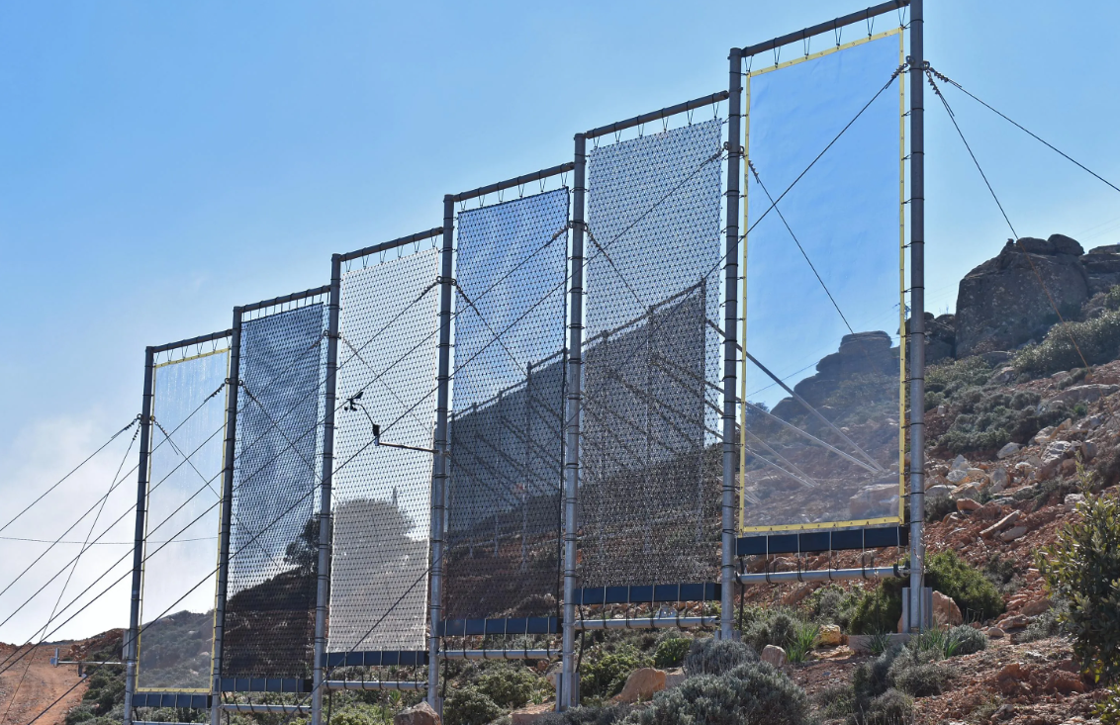
B 篇
Abel Cruz’s fog net
本文是一篇说明文，主要通过介绍Abel Cruz的创新技术和使命，以及解决利马水资源问题的方法，向读者解释了利用雾网收集水资源的原理和效果，以及Abel Cruz的目标和努力。

Slide 14
Lima,the capital of Peru,is the world's second largest desert city.The region is water-stressed.The annual rainfall is less than 4 cm.Access to water is an ongoing problem for the residents in and around the South American capital.
When industrial engineer Abel Cruz was a boy,his weekly work was to climb down a valley in the foothills of the Peruvian Andes to fetch the family's water from a spring."It was downhil from the house,far away and steep." he says.Cruz began dreaming up better ways to collect water.Then he noticed that subtropical plants capture rain and mist with their wide leaves.Actually Lima docsn't lack in humidiy(湿度),averaging 83%year-round.Located in the foothills of the Andean mountains,it is close to the Pacific Occan,which ensures that blankets of dense fog roll in for thrce-quarters of a year.Eventually,Abel Cruz struck upon the idea of a fog net.
Each upraised net is 20 square metres,where micro-droplets of water suspended in the foggy atmosphere
condense(凝结)and drip down into collection tanks.Approximately 200 to 400 litres of water is collected daily from each net.Locals can fetch it in buckets for small-scale farming.Working in Lima with support from the Creating Water Foundation,Cruz has installed over 3,600 nets on hillsides around the city to capture fog drifting in from the Pacific Ocean.Cruz raised funds for hundreds of nets in Peru with his revolutionary initiative Peruvians Without Water.He aims to set up even more fog harvesters,and to treat the water to make it drinkable.
“The planet has less and less fresh water,”Cruz points out,"because the glaciers that are natural reservoirs are disappearing.So we must find a way to accumulate and save water for times of drought.”The technology is life-changing for the poor households who normally have to rely on water tanks being delivered to them.His approach ends cxtreme poverty and brings rural development.Moreover,he is trying to bring healthy and clean water also to urban areas lacking water.
Background
Invention
Operation
Significance

Slide 15
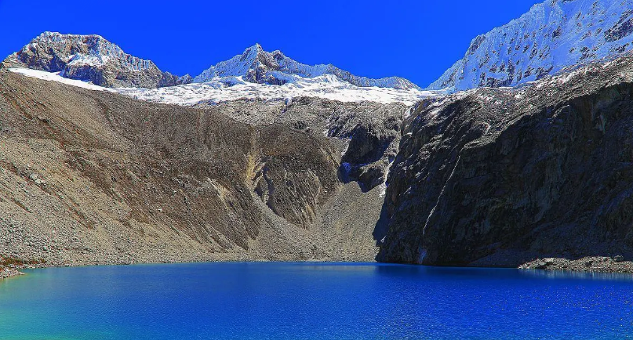
B 篇
推理判断题
24.Why does the author mention Cruz's childhood experience in paragraph 2?
A.To illustrate the urgency of reducing poverty.
B.To highlight his responsibility for the family.
C.To trace the origin of Cruz's great invention.
D.To stress Lima's terrible geographical conditions.
突然或意外地找到某物或想法
第二段：....Cruz began dreaming up better ways to collect water.....Eventually,Abel Cruz struck upon the idea of a fog net.

Slide 16

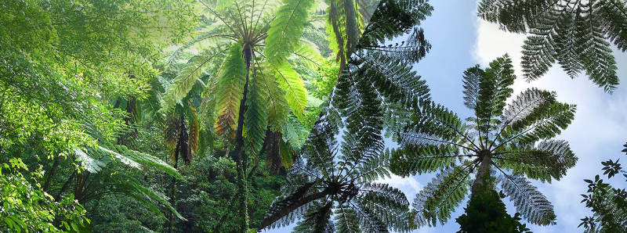
B 篇
25.What do we know about Cruz's invention?
A.It was inspired from subtropical plants.
B.It used collection tanks to condense water.
C.It lowered costs in building irrigation channels.
D.It solved the drinking water issue with fog harvesters.
细节理解题
第二段：....Then he noticed that subtropical plants capture rain and mist with their wide leaves......

Slide 17
B 篇
26.What may Abel Cruz's efforts lead to?
A.Guaranteeing crop harvests in Peru.
B.Promoting the recycle of water resources.
C.Ending poverty by improving traditional farming.
D.Improving the life quality for people in water-stressed areas.
细节理解题
第四段：....The technology is life-changing for the poor households .... His approach ends cxtreme poverty and brings rural development.Moreover,he is trying to bring healthy and clean water also to urban areas lacking water.

Slide 18
B 篇
推理判断题
27.What's the author's purpose in writing the passage?
A.To describe the functions of an innovative fog-catcher.
B.To call people's attention to the worsening water crisis.
C.To seck more support in raising funds for water collection.
D.To introduce Abel Cruz's invention and its great significance.
解析：分析文章结构可知，本文的主题是介绍Abel Cruz的发明。文中最后一段提到了这个发明的重要性。
Tip:对于说明文和议论文，分析文章结构对于推理判断题和主旨题都至关重要。

Slide 19
语言积累
water-stressed - 水资源短缺的 annual rainfall - 年降雨量
access to water - 获取水资源 foothills - 山麓
capture rain and mist - 捕捉雨水和薄雾 humidity - 湿度
dense fog - 浓雾 condense - 凝结
collection tanks - 收集罐 small-scale farming - 小规模农业
revolutionary initiative - 革命性倡议 fog harvesters - 雾收集器
accumulate and save water - 积累和保存水资源
extreme poverty - 极端贫困
rural development - 农村发展
healthy and clean water - 健康干净的水源

Slide 20
长难句分析
The technology is life-changing for the poor households who normally have to rely on water tanks being delivered to them.
（
知识回顾：
“household”的用法：
名词：指代一个家庭的所有成员：
The entire household was excited about the upcoming family reunion.
形容词：表示与家庭有关的
She manages the household finances and takes care of the household chores.
主语
谓语
表语
状语
）
谓语
宾语
定语
定语从句
这项技术正在改变那些通常不得不依赖发给他们的水箱的贫困家庭的生活。

Slide 21

C 篇
The true prosperity
本文是一篇议论文，文章强调了幸福的主观性和复杂性，提倡对于幸福的更广泛定义，并呼吁企业不仅追求经济利润，还应该关注社会价值和社会幸福，为整个社会的繁荣做出贡献。

Slide 22
To build a prosperous(繁荣的) society,a fundamental understanding of the modern economy as a driving forcc in today's world is csscntial. What kind of prosperity have we achieved so far?The widespread definition of prosperity focuses on economic power and growth as measures of success.Let's take a look at history.The Second Industrial Revolution enabled mass production and created a sufficient supply of goods.This has greatly increased the importance of money in its role as“a store of value,”and “a medium of exchange.”As a result,we have pursued economic power as the only indicator of prosperity,such as GDP.Waves of globalization and technological evolution have promoted overall economic growth,but have allowed the few who are strong to achieve greater power while exploiting the many who are weak.Consequently,inequality has worsened,and disunity has intensified. The path to a truly prosperous world requires a shift in focus towards the most suitable happiness for all,in addition to economic power.Defining happiness,however,is a complex task.What makes people happy?The degree to which the same thing creates happiness differs from person to person.Happiness is subjective and complicated.This is a world of"multiple values"where each of us determines worth as opposed to "one fixed price" based merely on an cconomic perspective.Individuals shouldn't be defined by a single identity or role but by multidimensional nature as well as multiple roles making independent choices and taking actions for their happiness in different aspects. Businesses must be pioneers in pursuing not only economic growth but also the happiness of all citizens of society.Companies can contribute through the pursuit of social value as well as cconomic profit.At the heart of this lies “purpose".A company's purpose defines the value it brings to society.The true worth of a company should be determined not just by the return s it creates for shareholders but by the value it creates for society as a whole.
Subject
The widespread definition
The true definition
Conclusion

Slide 23
C 篇
28.What is the author's attitude to the widely accepted standard of prosperity?
A.Indifferent. B.Critical. C.Uncertain. D.Approving
推理判断题
第二段：....As a result,we have pursued economic power as the only indicator of prosperity,such as GDP.Waves of globalization and technological evolution have promoted overall economic growth,but have allowed the few who are strong to achieve greater power while exploiting the many who are weak. Consequently, inequality has worsened,and disunity has intensified.
关键词
Tip:作者的观点态度题要注意文中的关键词和表达情感态度的词语。
情感态度

Slide 24
C 篇
29.What is the side cffect of technological evolution?
A.The slower cconomic growth speed.
B.The sharp reduction of job opportunities.
C.The enlarged gap between the rich and the poor.
D.The increasing conflict between different
细节理解题
第二段：....Waves of globalization and technological evolution have promoted overall economic growth,but have allowed the few who are strong to achieve greater power while exploiting the many who are weak. Consequently, inequality has worsened,and disunity has intensified.
利用

Slide 25
C 篇
30.Which statement will the author agree with according to the passage?
A.Happiness is changeable and beyond control.
B.Happiness largely depends on economic power.
C.The pursuit of profit determines a company's true worth.
D.A prosperous world should be measured by multiple values.
推理判断题
第三段：....Individuals shouldn't be defined by a single identity or role but by multidimensional nature as well as multiple roles making independent choices and taking actions for their happiness in different aspects.

Slide 26
C 篇
推理判断题
31.Who are the main intended readers of the text?
A.Social psychologists. B.Enterprise administrators.
C.School educators. D.Technological researchers.
第四段：Businesses must be pioneers in pursuing not only economic growth but also the happiness of all citizens of society.Companies can contribute through the pursuit of social value as well as cconomic profit.At the heart of this lies “purpose".A company's purpose defines the value it brings to society.The true worth of a company should be determined not just by the return s it creates for shareholders but by the value it creates for society as a whole.

Slide 27
语言积累
prosperity - 繁荣 mass production-大规模生产
standard - 标准 critical - 批判的
side effect - 副作用 technological evolution - 技术进化
enlarged - 扩大的 exploit-剥削；压榨；利用
gap between the rich and the poor - 富贫差距
multidimensional - 多维度的 shareholder-股东
intended readers - 预期读者
administrators - 管理者

Slide 28
长难句分析
Waves of globalization and technological evolution have promoted overall economic growth, but have allowed the few who are strong to achieve greater power while exploiting the many who are weak.
主语
定语
谓语
宾语
谓语
定语从句
（
）
宾语
状语
定语从句
全球化和技术发展的浪潮促进了整体经济的增长，但让少数强大的人在利用弱势人的同时获得更大的权力。

Slide 29

D 篇
The young ’s new understanding of liberies
本文是一篇议论文，文章其赞扬年轻人喜欢图书馆和阅读的行为，认为他们知道对自己有益的事情，寻找人际连接，发现传统机构的美感和乐趣，为图书馆带来新的生机。

Slide 30
Introduction
A recent survey in the US found that Gen Z-ers and Millennials(千禧一代)visit libraries more often than their parents or grandparents.The young love librarics because they are sccure,comfortable,free and —as my 11-year-old would say —"aesthetic".This means they look good in the background of an Instagram post or TikTok video.It's also a great place to meet people.If you're both young and in a library,chances are you have similar interests. And then,too,there are the books.Gen Z-ers are turning out to be big readers,especially of paper books.Even though,or perhaps because,they have in their pockets the most limilessly distracting devices ever invented,many are deliberately choosing to pick up a piece of 15th-century technology instead.They like the fact that books are self-contained and require concentration. There is,sometimes,a sense of nostalgic(怀旧的) cosplay in the way young people read.In New York,for example,the latest TikTok-fuelled craze is reading with strangers in bars.You have to buy a ticket in advance,and then you all gather and sit in silence for 30 minutes,reading whatever book you've brought along.Like an expensive version of going to the library,except that afterwards you all have a drink and talk about books. The very thought of it makes me suffer,but that's because I'm a child of the 1970s and 80s.To me,reading is a private pleasure,while screens —TV or cinema —are social.I did once,in a fit of ambitious parenting,introduce a“family reading hour”,during which my husband and children were pressed to join me at the fireside for some silent reading.It could not have felt more pcrformative if we had dressed up in top hats and crinolincs(旧时的衬 裙). But still,I applaud these young readers —for knowing what is good for them,for sccking out human connection,for finding the beauty and pleasure in old institutions,and for bringing new life to the library.
Reasons
”My”personal experience
Conclusion

Slide 31
D 篇
32.Which of the following is a reason why the young love libraries?
A.They enjoy the sense of safety and freedom.
B.They are free to use social media in libraries.
C.They consider e-reading a way to discover beauty.
D.They expect to meet people with different interests.
细节理解题
第一段：....The young love libraries because they are sccure,comfortable,free and —as my 11-year-old would say —"aesthetic".

Slide 32
D 篇
33.What do we know about the latest TikTok-fuelled craze in New York?
A.It's a trend of reading with the family in bars.
B.It's a learning approach advocating silent reading.
C.It's a gathering attended by strangers free of charge.
D.It's a reading fashion integrating the old and the new.
细节理解题
第三段：...In New York,for example,the latest TikTok-fuelled craze is reading with strangers in bars....Like an expensive version of going to the library,except that afterwards you all have a drink and talk about books.

Slide 33
D 篇
34.What can be learned about the author's understanding of reading from paragraph 4?
A.It is a delightful social experience.
B.It is a way of personal enjoyment.
C.It is a significant parenting pattern.
D.It is a painful routine practice.
推理判断题
第四段：...To me,reading is a private pleasure,while screens —TV or cinema —are social....

Slide 34
D 篇
35.Which of the following is the best title for the text?
A.A Gen Z Way to Refresh Libraries
B.A Realistic Look of Library Reading
C.A Broad View of Libraries and Social Media
D.A New Way to See Human Connection with Libraries
主旨题
A recent survey in the US found that Gen Z-ers and Millennials(千禧一代)visit libraries more often than their parents or grandparents....
......
But still,I applaud these young readers —for knowing what is good for them,for sccking out human connection,for finding the beauty and pleasure in old institutions,and for bringing new life to the library.

Slide 35
语言积累
知识积累：
“in a fit of”的用法：
描述某人在一时冲动或情绪激动的状态下做了某事。它通常接在动词或名词前，表示行为发生的背景或状态。
例如：
She slammed the door in a fit of anger.（她愤怒地砰地关上了门。）
He burst into tears in a fit of frustration.（他因沮丧而突然哭了起来。）
He made the decision in a fit of desperation.（他在绝望中做出了决定。）
aesthetic-美的；艺术的 craze - 狂热，风靡
sweep - 席卷，扫荡 in silence - 安静地
human connection - 人际关系 pleasure - 乐趣，愉悦
old institutions - 老机构 in a fit of -一阵
parenting -育儿 performative-像表演一样
integration of the old and the new - 新旧融合

Slide 36
长难句分析
Even though,or perhaps because,they have in their pockets the most limilessly distracting devices ever invented,many are deliberately choosing to pick up a piece of 15th-century technology instead.
状语从句
主语
谓语
状语
宾语
定语
主语
谓语
宾语
尽管或者也许因为他们的口袋里装着有史以来最具分散注意力的设备，许多人故意选择拿起一件15世纪的技术产品。

Slide 37
美句欣赏
But still,I applaud these young readers —for knowing what is good for them,for secking out human connection,for finding the beauty and pleasure in old institutions,and for bringing new life to the library.
但我还是为这些年轻读者鼓掌——因为他们知道什么对他们有益，因为他们在寻找人际联系，因为他们在古老的机构中找到美丽和乐趣，因为他们为图书馆带来新生命。
Tip:通过排比，可以使句子更加具有韵律感，强调重点的同时，使句子更加具有表现力。

Slide 38
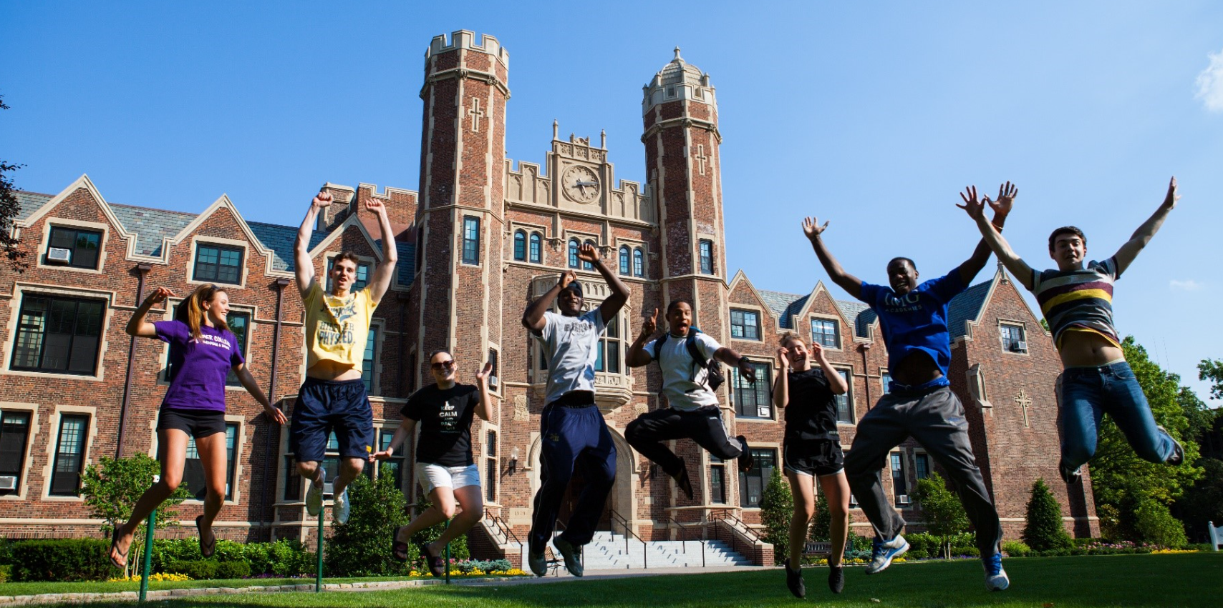
七选五
New university life
本文是一篇演讲稿。作者从自身亲历出发，告诫新生该如何迎接全新的大学生活。

Slide 39
Dear Fresher,joining a university can be a pleasant but challenging experience:horrific and yet beautiful, scary but exciting. 36
A.It is a big turn on the pages of your life.
B.Extracurricular activities build confidence.
C.I no longer struggle too hard to fit square pegs into round holes.
D.It is a good idea for you to make friends with like-minded people.
E.That was why I got uninspired by every friendship I tried to make.
F.While the new phase of life is challenging,remember who you truly are.
G.Seck out opportunitics to do stuff you are passionate about during your free time.
解析：该句的位置在第一段，是在引出”如何迎接大学“这一话题，在本段中位于段末，对前文的总结。

Slide 40
Do not panic if,like me,you do not make friends on the first day or week.Before I met Sanaa,I had tried to force myself to make friends with classmates in my other majors.Then I was starting to get convinced that there was something wrong with me. 37 Eventually,when I started making more friends,it made sense why the friendships I had forced did not work out.It was my first lesson in understanding my uniqueness,and reminding me that my “friends”are somewhere,out there. 38
解析：本句是在段中，承上启下。首先根据段意本段是在结合自身经历.根据前文讲述自己的误解，后文我正确的认识，可知能”认识到这一点“是我”意识到我出了问题“故E项中的”that“指代前文。
A.It is a big turn on the pages of your life.
B.Extracurricular activities build confidence.
C.I no longer struggle too hard to fit square pegs into round holes.
D.It is a good idea for you to make friends with like-minded people.
E.That was why I got uninspired by every friendship I tried to make..

Slide 41
Do not panic if,like me,you do not make friends on the first day or week.Before I met Sanaa,I had tried to force myself to make friends with classmates in my other majors.Then I was starting to get convinced that there was something wrong with me. 37 Eventually,when I started making more friends,it made sense why the friendships I had forced did not work out.It was my first lesson in understanding my uniqueness,and reminding me that my “friends”are somewhere,out there. 38
解析：本句是在段末，对整段的总结。本段是在讲述自己对交朋友认识的变化过程，该句应该是最后的认识，故C 项”我不再费力地去适应这种环境“符合题意
知识补充：fit square pegs into round holes
在19世纪的工匠行业中，木工匠们通常使用圆形的钻头来钻圆孔，然后再用方形的木钉或木桩来填充这些孔洞。如果一个木匠试图把方形的木钉塞进一个圆孔里，那将是不可能的，因为形状不匹配。
这个表达后来演变为一个俗语，用来形容试图让不相容的事物或人强行适应某种情况或环境，通常会导致困难、失败或不切实际的情况。因此，这个表达被广泛应用于描述适应不当、强行适应或不合理的情况。
A.It is a big turn on the pages of your life.
B.Extracurricular activities build confidence.
C.I no longer struggle too hard to fit square pegs into round holes.
D.It is a good idea for you to make friends with like-minded people.
E.That was why I got uninspired by every friendship I tried to make..

Slide 42
So,dear Fresher,as I say welcome to university life,I am also saying,give yourself time —to understand your school,your course,and your new rhythm of life.Do not fall into the trap of people-pleasing to fit in.
39 Of course,you must leave room to grow and breathe —to discover amazing cultures,new accents, and new ways of matching your clothes-but do not do anything that needs you to abandon your genuine self in order to become.
A.It is a big turn on the pages of your life.
B.Extracurricular activities build confidence.
C.I no longer struggle too hard to fit square pegs into round holes.
D.It is a good idea for you to make friends with like-minded people.
E.That was why I got uninspired by every friendship I tried to make.
F.While the new phase of life is challenging,remember who you truly are.
G.Seck out opportunitics to do stuff you are passionate about during your free time.
解析：本句是在段首，首先承接上文”不要总是想要取悦别人“；总结后文”不要做放弃真实自己“与F项”记住“你是真正的谁。”符合题意

Slide 43
Finally,it might not look like it,but the four,five,or six years you will be in university will pass by really quickly. 40 Perhaps that is DIYs,writing blog posts,participating in club activities in your department,or joining the dance troupe.
So,dear Fresher,go forward,and leave your mark!You will be surprised at how much experience that will contribute to your CV.
Curriculum Vitae 的缩写，简历
A.It is a big turn on the pages of your life.
B.Extracurricular activities build confidence.
C.I no longer struggle too hard to fit square pegs into round holes.
D.It is a good idea for you to make friends with like-minded people.
E.That was why I got uninspired by every friendship I tried to make.
F.While the new phase of life is challenging,remember who you truly are.
G.Seck out opportunitics to do stuff you are passionate about during your free time.
解析：本段在段中，承上启下。前文在讲时间飞逝，后文是可以参加的各种各样的活动，可知本句要表达的意思是要抓住体会多体验各种不同的经历。

Slide 44
语料积累
与大学生活相关的语料
in my other major 在我其他的专业中
understand my uniqueness 认识到我的独特性
your new rhythm of life 你新的生活节奏
go forward,and leave your mark 向前走吧，留下你的印记！
与认识自己相关的语料
people-pleasing 取悦别人的
leave room to grow and breathe 留下生长和呼吸的空间
genuine self 真实的自己
it might not look like it 也许看起来不是这样

Slide 45
完型填空
03

Slide 46
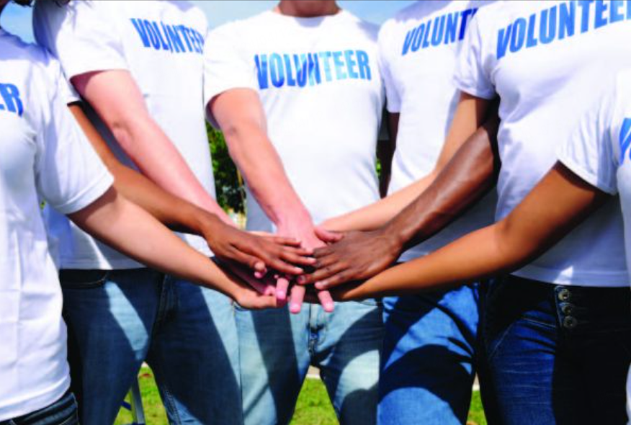
Volunteeing at VA
文章讲述了作者在退役军人事务医院的自愿者经历所带给自己的感受。

Slide 47
I was interested in volunteering at a hospital because both of my parents work in hospitals.I wanted to see what the 41 was after hearing them talk about it.To be more 42 ,I wanted to work at the VA— Veterans(老兵)Affairs hospital —in Palo Alto because the 43 of VA is "to serve those who served"and I really 44 this very idea.
To my greatest joy,I was 45 the VA program,and throughout this summer break I've spent around 110 hours 46 at VA Palo Alto in different departments.To be honest,I had never at all felt more welcomed and 47 in every department I went to.After some initial experiences,I 48 to work in the Office of Information Technology (OIT)since I am interested in computers,and I wanted to see how they are used in a hospital setting.
41.A.opportunity | B.decision | C.experience | D.adventure
42.A.specific | B.privatc | C.flexiblc | D.cautious
43.A.concept | B.mission | C.profession | D.advantage
44.A.contributed | B.generated | C.transformed | D.shared
45.A.accepted into | B.committed to | C.concerned about | D.withdrawn from
46.A.studying | B.voluntecring | C.obscrving | D.exercising
47.A.convinced | B.determined | C.valued | D.amused
48.A.applied | B.refused | C.promised | D.arranged
被...接受

Slide 48
My overall experience of volunteering at VA can be 49 into the words of “eye-opening and 50 ” Throughout my whole life I have been 51 to health care,from both my parents being physicians and my health problems,but I have never 52 been on the other side of the glass,so to speak.What I 53 most about my cxpcricnce was the 54 to see what it's like to help people.I want to continue volunteering at VA because I believe there is no other experience that can be as 55 as working in a hospital that treats Veterans.
49.A.classified | B.summarizcd | C.divided | D.combined
50.A.normal | B.relevant | C.reliable | D.worthy
51.A.attached | B.devoted | C.exposed | D.submitted
52.A.actually | B.totally | C.absolutely | D.appropriately
53.A.respect | B.treasure | C.understand | D.agree
54.A.ability | B.responsibility | C.approach | D.courage
55.A.relaxing | B.challenging | C.fulfilling | D.thrilling
be exposed to :接触到
珍惜
使人满足的

Slide 49
语料积累
to serve those who served 为服役过人服务
share this idea 同意这个想法
be accepted in 被接受
eye-opening 大开眼界的
on the other side of the glass 站在另一面
so to speak 可以这么说
"so to speak"通常用在句子的末尾，作为一个插入语或补充说明，表示作者或说话人用了一种不太准确或不太合适的词语或表达方式，但仍然希望读者或听众能够理解其含义。
例如：
She’s the queen of the house, so to speak. （她可以说是家里的女王。）
He’s the brains behind the operation, so to speak. （他可以说是这个行动的大脑。）

Slide 50
长难句分析
After some initial experiences,I applied to work in the Office of Information Technology (OIT)since I am interested in computers,and I wanted to see how they are used in a hospital setting.
状语
主语
谓语
宾语
定语
主语
谓语
宾语
（
）
宾语从句
主语
谓语
原因状语从句
在有了一些初步经验后，我申请在信息技术办公室（OIT）工作，因为我对计算机感兴趣，想看看它们在医院环境中是如何被使用的。

Slide 51
语法填空
04

Slide 52
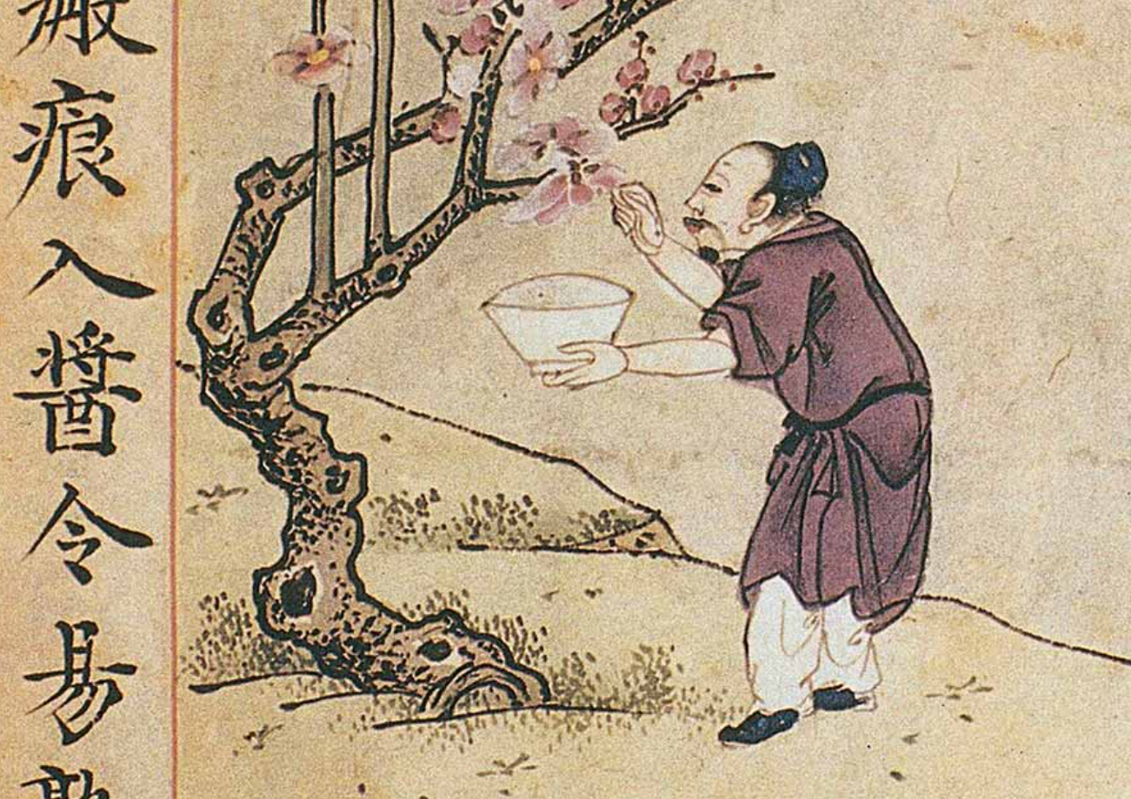
LiShizhen and his book
本文介绍了李时珍写作《本草纲目》的过程，以及该书所具有的医学和社会价值。

Slide 53
To write his own medical text,Li Shizhen referenced over 800 medical texts,countless books on history and geography,and works of literature.He even studied the complete works of many ancient poets,from 56 he selected a surprising number of verses about medicine.However,the greatest issue he encountered was the widespread 57 (inconsistent)in the use of drug names.Rcalising the importance of field rescarch outweighed 58 of extensive reading,in1565 Li travelled far and wide into the mountains and wilderness.He covered what are today's provinces of Hunan,Jiangxi,Anhui and Jiangsu,and many other places.
After over a decade of field research.Li 59 (successful) completed the first draft of his masterpiece, Bencao Gangmu,or the Compendium of Materia Medica in 1578.He revised 60 work at least three times right up until his death in 1593
inconsistence和inconsistency的区别：
前者通常强调的是某物在不同方面或不同情况下的不稳定状态或不相符之处，后者用于描述行为、观点、陈述等方面的不一致或矛盾之处。它强调的是在相同情况下或相同主题下的不一致性。
which
56. 定语从句
inconsistency
57. 词性变化
that
58. 代词
successfully
59. 词性转换
the
60. 冠词

Slide 54
Since its first publication in 1596,the book 61 (receive)world-wide recognition.British naturalist Charles Darwin acknowledged the book 62 an “ancient Chinese encyclopedia.”In 2011,the book 63 (list)on the UNESCO Memory of the World Register.In 2017,an intermational conference was held in Beijing 64 (celebrate) Li's 500th birthday.
Today,there are a 65 (grow)number of intemational cxchanges centering on Li Shizhen and his book,and many people around the world can still find the wisdom of human development in this ancient classic.
61.谓语动词
has received
as
62. 介词
was listed
63.谓语动词
to celebreate
64.非谓语动词
growing
65. 非谓语动词
非谓语动词做前置定语通常两种情况：
--ing:1. 对后面名词功能或特性的解释： reading room（阅览室）
2. 表示正在发生的动作：boiling water(正在烧的水)
---ed: 表示动作已经结束： boiled water(开水)

Slide 55

语料积累
做研究相关的语料
reference 引用 field rescarch 实地考察
extensive reading 泛读 the wilderness 野外
the first draft 第一稿 revise 修改
acknowledge sth as 承认具有...

