Slide 1


感恩遇见，相互成就，本课件资料仅供您个人参考、教学使用，严禁自行在网络传播，违者依知识产权法追究法律责任。
更多教学资源请关注
公众号：溯恩英语
知识产权声明

Slide 2

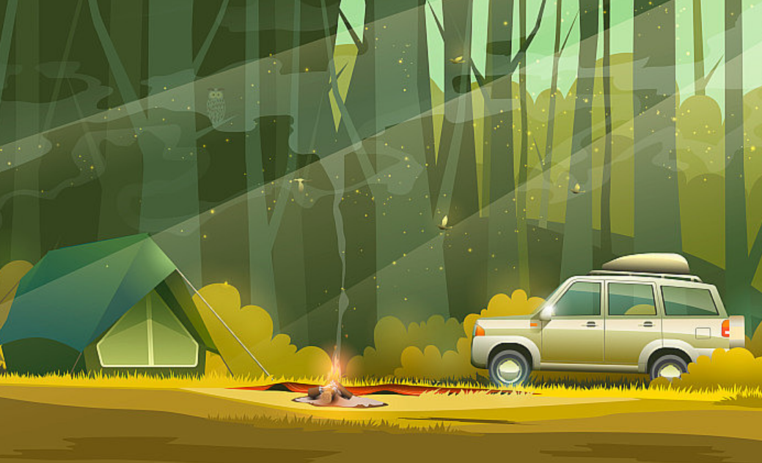
绍兴二模续写
基于主题的环境描写

Slide 3

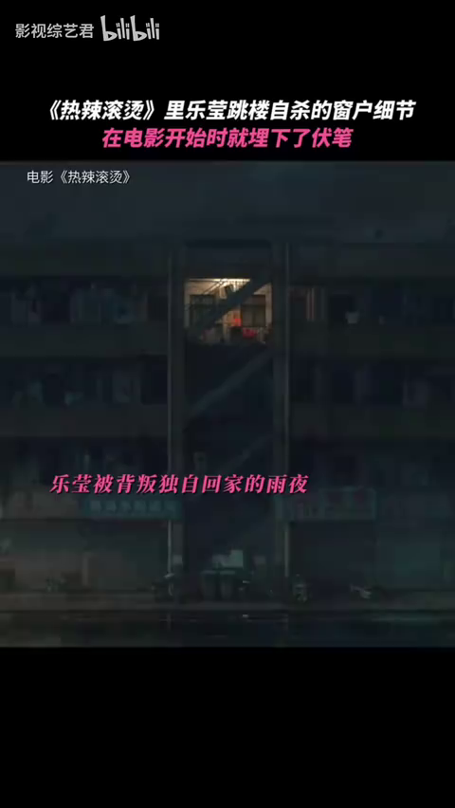
What are the functions of environmental descriptions?
How to describe a natural setting?
1. to reveal the setting
2. to foreshadow events
3. to develop the characters
4. to reflect the theme
5...

Slide 4
借五感写环境
借动作写环境
01
02
04
03
借修辞写环境
借关键词写环境

Slide 5
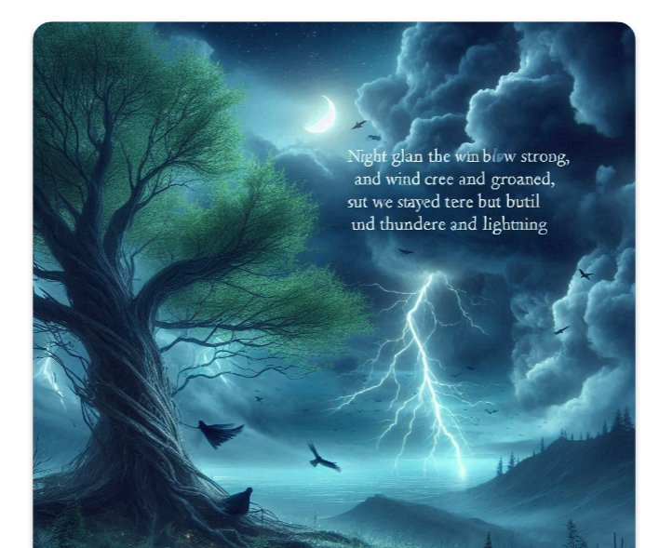
01. 借五感写环境
1. Night fell the wind blew strong, and the tree creaked and groaned. A storm was gathering but we stayed there until thunder and lightning crashed.
夜幕降临,风刮得很大,树吱吱作响,呻吟着。暴风雨正在积聚,但我们一直呆在那里,直到电闪雷鸣。
听觉

Slide 6
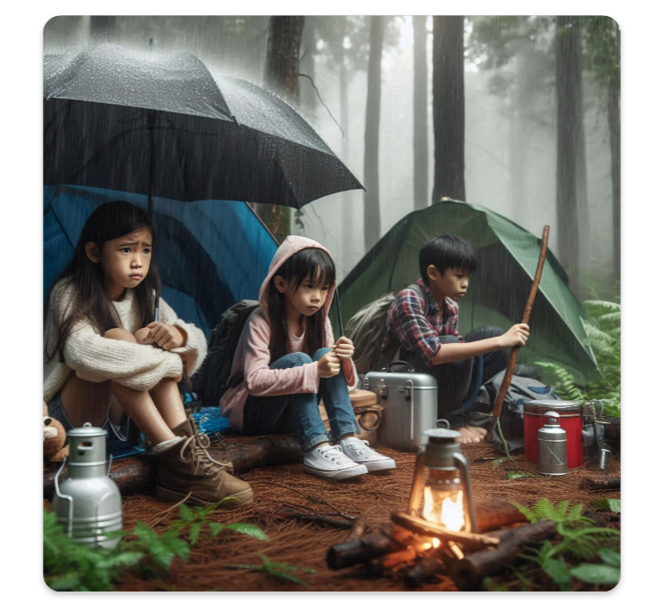
01. 借五感写环境
2. Yet towards night, as the dark clouds gathered overhead, the atmosphere shifted, and a sudden storm erupted with unforgiving anger.
视觉
+听觉

Slide 7
01. 借五感写环境
3. Soon the hole would be filled with choking, black smoke. Their eyes watered and they gasped for fresh air.
嗅觉+
视触觉

Slide 8
02. 借动作写环境
Soon the hole would be filled with choking, black smoke. Their eyes watered and they gasped for fresh air.
很快，洞里就充满了令人窒息的黑烟。他们的眼睛湿润了，他们喘着粗气。

Slide 9
02. 借动作写环境
2.As I walked, thunder rumbled in the mountains all around, and rain began to fall in heavy drops. When I reached the place the storm was at its fiercest and the countryside was lit up by wild flashes of lightning. With the rain streaming down my face, I clasped my hands together and looked up into the darkness.四周的山上雷声隆隆，大雨倾盆而下。当我到达那里时，暴风雨正在猛烈地袭来，田野被猛烈的闪电照亮了。雨水顺着我的脸淌下来，我双手合十，抬头望向黑暗。

Slide 10
03. 借关键词写环境
Though the night was freezing cold, it seemed like spring to Robin.
虽然晚上很冷，但对罗宾来说好像是春天了。
(原文出现关键词cold, 在结尾处借用了次关键词来升华主题。)

Slide 11
04. 借修辞写环境
Rain poured down from the heavens like a relentless waterfall, transforming the peaceful campsite into a muddy battleground.
雨水像无情的瀑布一样从天上倾泻而下，把宁静的营地变成了泥泞的战场。
比喻
simile

Slide 12
04. 借修辞写环境
Ground- up ice raked John's eyes like tiny claws. The furious wind, pounded him, tore at him, spun him around, he felt like he was locked in a cage with a furious beast, trying to rip him to pieces.磨碎的冰像小爪子一样划着约翰的眼睛。狂风猛击着他，撕扯着他，把他旋转着，他觉得自己被关在一个笼子里，里面有一头狂怒的野兽，想把他撕成碎片。
比喻
+拟人personification
+夸张
exaggeration

Slide 13
拓展：A. 积极环境描写
凉风+树叶声响Outside the window, a cool gentle breeze blew, leaving the leaves rustling/ [ˈrʌslɪŋ], as if celebrating my narrow escape/cheering for them.庆祝我死里逃生/为他们欢呼
阳光出现Overwhelmed with great joy, the girl jumped up and down with excitement, her eyes glittering like diamonds. Near the horizon.the sky was growing scarlet, a beam of sunlight shedding a soft glow on the girl's rosy face. She felt she was the luckiest person in the world. (一束阳光在女孩红润的脸上洒下柔和的光芒。）
微笑+阳光A smile slowly worked its way across her face. The amber-like sunshine shedding a soft glow on her rosy cheeks, she was ready to make her memories in the new house.(微笑慢慢掠过她的脸庞。琥珀般的阳光在她红润的脸颊上洒下柔和的光芒，她准备在新房子里留下自己的回忆。）
阳光洒满房间 One morning Mary woke to find bright sunshine flooding her room.

Slide 14
A. 积极环境描写
心里满是阳光The sweetness of the sun fills my lungs.
月光 It was a bright, moonlit night.
湖面在月光下闪着银光。 The lake shone silver in the moonlight.I watched them fascinated.
鸟叫Outside the bakery, the birds chirped happily, as if celebrating their achievement.
听到滴水声+看到电筒光They could hear water dripping in the distance, and the walls of the tunnel shone wetly in the beams of torchlight.
远处隐约传来一阵欢呼声A faint cheer rose from a long way off .
救护车和消防车来了。Ambulance and fire-engine bells seemed to be ringing everywhere.
声音越过水面随风飘来。Sounds drifted across the water on the wind.
灯光透着希望Just when we were but to give up, a faint light flickered in the distance.

Slide 15
B.消极环境描写
昏暗的灯光（视觉） The poor light weakened my sight.
奇怪的寂静(听觉)A strange, empty silence hung in the air.
出现野兽(视觉)From between the trees, were six pairs of eyes. Red, fiery eyes that stared towards my window. They didn't move. They just stayed there, glowing in the dark.
黑暗中的眼睛Close by, a pair of eyes, like burning coals broke the darkness.
一阵低沉的呻吟声传来A muffled moan came from somewhere nearby, and as the boys listened there came another moan, followed by a faint scratching(抓) noise.
影子That night, a long shadow, glided right into the camp .
狂风 Violent gales blew us so far off course we lost all sense of where we were.
火/浓烟1. Soon the hole would be filled with choking, black smoke (呛人的黑烟). Their eyes watered (熏得直流泪) and they gasped for fresh air(拼命呼吸新鲜空气).
2. 火蔓延 Flames were creeping along the bed curtains as I ran in. The smoke had dulled his senses.
暴雨+闪电 1. As I walked, thunder rumbled in the mountains all around, and rain began to fall in heavy drops. When I reached the place the storm was at its fiercest and the countryside was lit up by wild flashes of lightning.

Slide 16
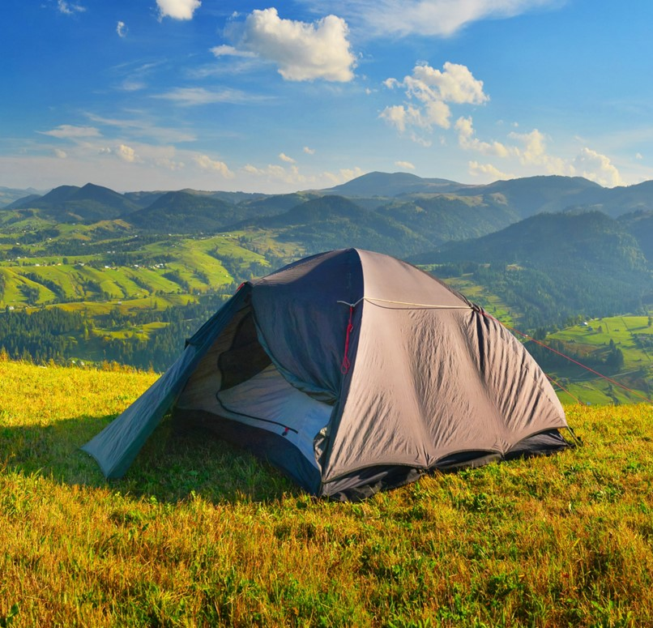
Part. 01
Read for setting

Slide 17
1. Kevin woke to the blaring beep of his alarm clock. "Can't wait for that camping trip, "Kevin thought, filled with excitement. As he was leaving home, his dad grabbed him by the hand and said, "Before you go, just tell me the directions on where you and your friends are going to stay. "
2. "But dad!" Kevin complained.
3. "No buts!" Kevin's dad added.
4. "Fine. "Kevin told him the directions and left.
5. The three friends, Kevin, Jay and Nathan, had been planning this adventure for weeks, packing their stuff-tents, snacks, and a map-preparing for a 3-day outdoor exploration. Excitement ran through Kevin as they departed for their campsite. "This trip is going to be awesome, " Nathan excitedly yelled as they set off. But little did they know that nature had a surprise in store for them.
6. The first day at the campsite was going great, setting up tents, collecting firewood, and sharing stories. "Man, we nailed these tents, " Kevin said. "I know it was easy really, "Nathan replied. The friends were happy.
7. Yet towards night, as the dark clouds gathered overhead, the atmosphere shifted, and a sudden storm erupted with unforgiving anger. Rain poured down from the heavens like a relentless waterfall, transforming the peaceful campsite into a muddy battleground. Worse still, a huge tree was uprooted and crashed down with a deafening crack on their only means of escape - their car. Kevin's eyes widened in horror as he spotted the damaged wreckage beneath the fallen giant. "Our car!" he screamed over the howling wind, his voice a mix of disbelief and despair. "We're stuck here, " he declared, his words barely audible against the backdrop of thunder and raindrops. They realized that their plans had been violently spoiled by forces beyond their control. The once quiet campsite now stood as a deserted battlefield, the fallen tree serving as a painful reminder of the unpredictable nature of the world around them.
注意：1. 续写词数应为150左右；2. 请按如下格式在答题卡的相应位置作答。
Paragraph 1: The next day, they found themselves facing the immediate problem of finding water.
Paragraph 2: On the third night, a distant engine sound broke the terrible stillness.

Slide 18

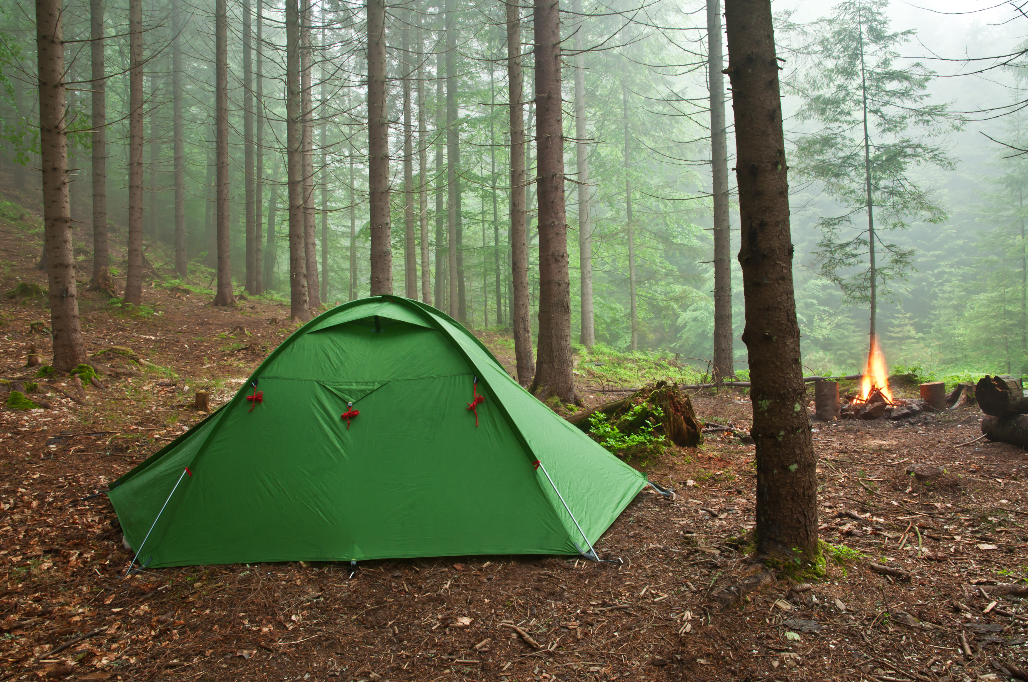
Activity 1: find out where the story happened?
for a 3-day outdoor exploration
Kevin, Jay and Nathan
campsite

Slide 19
Part. 02
Read for changes

Slide 20
Activity 2: find out what happened
But little did they know that nature had a surprise in store for them.
the first day
towards night
forces beyond their control
the dark clouds gathered overhead, the atmosphere shifted, and a sudden storm erupted with unforgiving anger. Rain poured down from the heavens like a relentless waterfall,Worse still, a huge tree was uprooted and crashed down on their car.
Kevin's eyes widened in horror...wind, his voice a mix of disbelief and despair. . .. a painful reminder of the unpredictable nature of the world around them.
great & easy
set up tents,
collected firewood, shared stories.
The friends were happy.

Slide 21
Activity 3: sort out the changes of emotions and setting
Activity 4: plot the natural setting story based on the changes
"This trip is going to be awesome, "
little did they know that nature had a surprise in store for them.
the fallen tree serving as a painful reminder of the unpredictable nature of the world around them.
day 1ed home…
day 2ed home…
day 3d home…
a deserted battlefield:
dark clouds/ a sudden storm
rain/a huge tree/the howling wind/thunder/raindrops
para1.
natural setting: calm after the storm
para.2
natural setting: moonlight/gentle breeze...
excited
quiet
horrified
desperate

Slide 22
Part. 03
Continue the story

Slide 23
Activity 5: plot the natural setting
Paragraph 1: The next day, they found themselves facing the immediate problem of finding water.
natural setting: water(+night)
clues: The three friends..., packing their stuff-tents, snacks, and a map-preparing for a 3-day outdoor exploration. The once quiet campsite now stood as a deserted battlefield, the fallen tree serving as a painful reminder of the unpredictable nature of the world around them. | 与环境有关情节设计1
找水源
听觉+视觉+动作 It suddenly hit Kevin like a bucket of cold water: a stream marked on the map which was several miles away from their campsite. Exhausted as they were, they trudged through the muddy forest, guided by the map. After what felt like hours of searching, the faint sound of water reached their ears. A surge of excitement flooded over them and they quickened their pace.

Slide 24
Activity 5: plot the natural setting
Paragraph 1: The next day, they found themselves facing the immediate problem of finding water.
natural setting: water(+night)
clues: The three friends..., packing their stuff-tents, snacks, and a map-preparing for a 3-day outdoor exploration. The once quiet campsite now stood as a deserted battlefield, the fallen tree serving as a painful reminder of the unpredictable nature of the world around them. | 与环境有关情节设计2
恐怖的夜晚
听觉+视觉+动作+修辞 However, as night fell, more challenge emerged - limited food, frightful wilderness sounds, and the overwhelming darkness that sent shivers down their spines. They huddled closer, whispering prayers for rescue, their voices trembling with desperation.

Slide 25
Activity 5: plot the natural setting
Paragraph 2: On the third night, a distant engine sound broke the terrible stillness.
.
natural setting: water(+night)
clues: As he was leaving home, his dad grabbed him by the hand and said, "Before you go, just tell me the directions on where you and your friends are going to stay. " 2. "But dad!" Kevin complained. 3. "No buts!" Kevin's dad added. 4. "Fine. "Kevin told him the directions and left. | 与环境有关情节设计3
爸爸前来相救的环境描写（黑暗中的车灯+月光下的身影）
Kevin's heart leapt with hope as the familiar sound drew nearer. Through the darkness, headlights pierced the darkness, providing a beacon of rescue. Under the faint moonlight, they saw it was Kevin's dad who emerged from the vehicle. A wave of relief flooded over them.

Slide 26
Part. 04
Read for appreciation

Slide 27
范文学习
The next day, they found themselves facing the immediate problem of finding water. The boys pushed through the bushes, and the search for water soon drained their energy. They were about to give up when they heard a small sound, a splash of some sort. “Wait! Did you hear that?” Jay’s voice sounded helpful as they followed the faint sound of the water. “Me too! Let's keep going,”, Kevin encouraged, sounding determined. They ran as fast as they could and found a small stream- a lifeline in all the challenges. However, with time passing by, more challenge emerged - limited food, frightful night filled with wilderness sounds, and the uncertainty of survival in the wild. Their nerves were near the edge of breaking down after long hours of uncertainty in the wilderness.

Slide 28
On the third night, a distant engine sound broke the terrible stillness. “It must be my dad!” Kevin yelled. Relief washed over the weary faces as they witnessed the approach of a rugged 【ˈrʌɡɪd】坚固的vehicle, with headlights cutting through the darkness - a beacon of hope amidst the peril【ˈperəl】危难. Kevin's dad stepped out to meet the group. The emotions that played across their faces - disbelief, gratitude, and overwhelming joy - mirrored the shared trouble that had forged a deep bond among them. The journey back was filled with survival stories and lessons learned, deepening their understanding of the wilderness. Back home, Kevin's dad said, “Good thing you told me those directions,” teaching them the importance of informing someone about plans. The experience turned into tales of courage and resilience,embedded【ɪmˈbed】使深留脑中 in their memories as lessons for a lifetime.

Slide 29
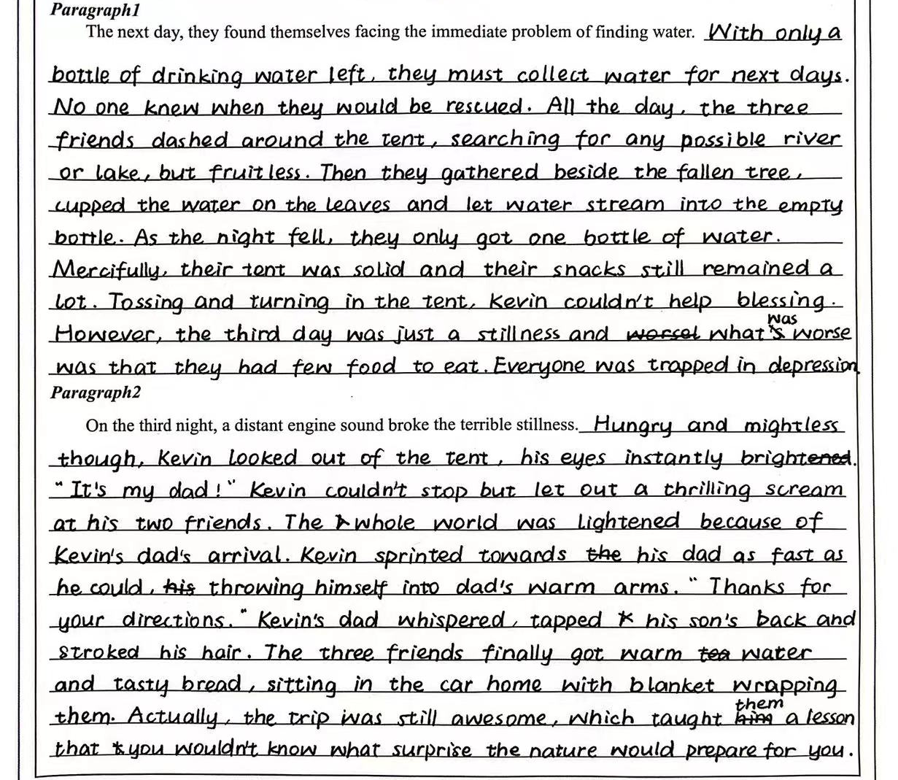
高分习作赏析
谢可颖 20.5
内容：第一段描述了三人在野外寻找水源的困境，第二段则描绘了他们获救情景，衔接紧密。
语言表达：使用了准确的动词/名词/形容词来描述场景和人物情感，很有画面感，如“dashed around ”、“cupped the water ”等，
情感描绘：用人物的内心活动和对话来展现人物在困境中的情绪变化，如 “it's my Dad!”
主题思想：最后一段的总结“the trip was still awesome...you wouldn't know what surprise the nature would prepare for you”，首尾呼应，进一步强化主题：野外冒险虽充满挑战和不确定但依旧令人神往。

