Slide 1


感恩遇见，相互成就，本课件资料仅供您个人参考、教学使用，严禁自行在网络传播，违者依知识产权法追究法律责任。
更多教学资源请关注
公众号：溯恩英语
知识产权声明

Slide 2

24届浙江金华十校应用文
基于主题意义探究的应用文写作

Slide 3
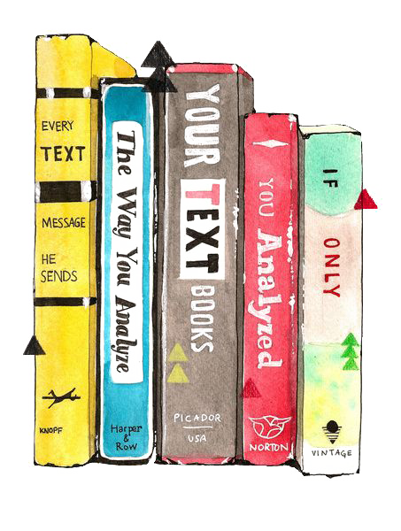


审题
提纲
行文

Slide 4

审题
假定你是李华，你校将于4月23日(世界读书日)开展主题为“The Power of Reading”的英语演讲比赛，请你以此为主题写一篇演讲稿参赛，内容包括：
1.你的经历；
2.你的感受。
The Power of Reading
Good morning, ladies and gentlemen!
假定你是李华，你校将于4月23日(世界读书日)开展主题为“The Power of Reading”的英语演讲比赛，请你以此为主题写一篇演讲稿参赛，内容包括：
1.你的经历；
2.你的感受。
The Power of Reading
Good morning, ladies and gentlemen!
假定你是李华，你校将于4月23日(世界读书日)开展主题为“The Power of Reading”的英语演讲比赛，请你以此为主题写一篇演讲稿参赛，内容包括：
1.你的经历；
2.你的感受。
The Power of Reading
Good morning, ladies and gentlemen!
背景
文体
要点
主题

Slide 5



World Reading Day
提纲
演讲稿格式
title：标题
opening：问候+自我介绍+演讲主题
body
ending：感谢聆听
背景
The Power of Reading
the power of reading
要点
1.你的经历；
2.你的感受。
experience
feeling
to be theme-related
The Power of Reading
the power of reading
主题
to run throughout the whole passage
utilize the power of reading
文体
embrace the delight/ pleasure/ joy of reading
dive into/ explore the wonders/ magic of fluttering pages
learn from the wisdom that goes beyond words
to be persuasive/ motivating

Slide 6
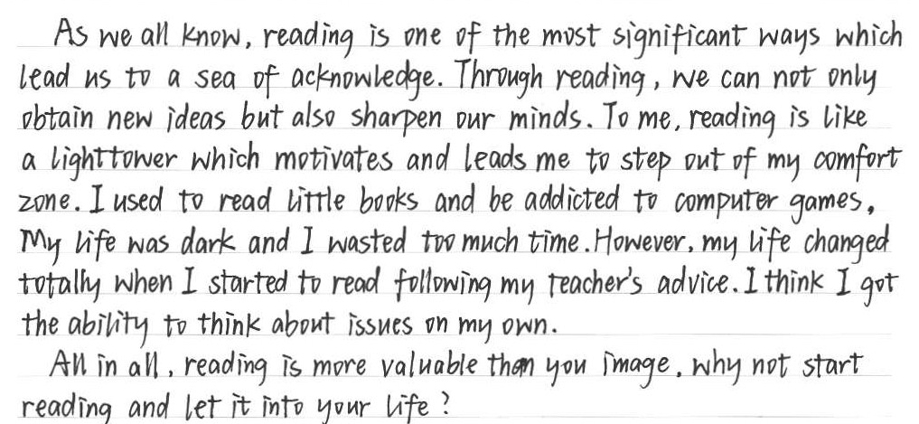
Which part is not theme-related?
How to modify it?
too general
add specific personal experience that embodies the power of reading
name, content, quotes
changing process
要点
to be theme-related/ concrete

Slide 7

行文
How is the article related to the theme?
A possible version:
The Power of Reading
Good morning, ladies and gentlemen! It’s my great honor to give the speech entitled “The Power of Reading” on this World Reading Day.
There was a time when my study suffered greatly because of my inability to adapt to the new school life quickly. Feeling at a loss, one day I caught sight of the book “The Old Man and the Sea” in the library accidentally. On reading it, I was captivated by the old fisherman’s brave struggle with the fish and his strong willpower. The sentence “A man can be destroyed but not defeated” inspired me never to yield to difficulties. Since then, I have enjoyed immersing myself in reading, for it opens up a magical world from which I draw endless strength.
Let’s grab a book and start reading, igniting the fire of reading and embracing the wisdom it brings! That’s all. Thank you!
word choice
sentence patterns
key points
structure
change——transformative power of reading

Slide 8
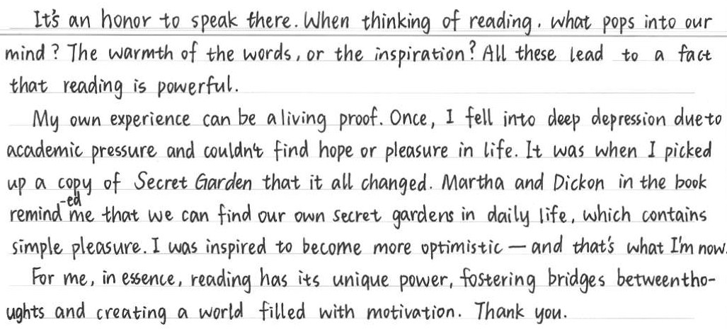
赏析下文，分析这篇文章是如何通过用词、句式、要点内容、篇章结构来体现主题意义的？

Slide 9

用 词 | warmth, inspiration; living proof; simple pleasure; inspired; optimistic; unique power; foster bridges; create a world filled with motivation
句 式 | What pops into our mind? The warmth of the words, or the inspiration? All these lead to... It was when... that it all changed. ...reminded me that..., which contains simple pleasure. I was inspired to become more optimistic- and that’s what I’m now. For me, reading has its unique power, fostering... and creating....
要点内容 | transformative power
篇章结构 | Beginning: It’s an honor to speak here. Ending: Thank you.

Slide 10

For your reference
用 词 | adjectives: trusted companions; numerous benefits; captivating; immense verb phrases: nurture my soul; explore new worlds and meet new people both real and imagined; guide me through life’s joys and sorrows/ through the mazes of life; instill a sense of wonder and curiosity in me; fill me with a sense of wonder; challenge our minds, expand our vocabulary, and sharpen our critical thinking skills; hold fascination for sb.; fall for sth.
句 式 | 递进：Reading is not just about words on a page; it’s about worlds within worlds, adventures without boundaries. It’s not just because the story is captivating; it’s because, for those moments, I’m not just a reader—I’m a participant in that world. Reading is not just a hobby or a pastime; it’s a gateway to infinite possibilities. 强调句：I recall a time when I was deeply troubled, and it was a book that provided solace and wisdom. 分词结构：It was a book that became my beacon of hope, providing insights and wisdom that helped me navigate through the tough times. The pages were filled with stories of resilience and perseverance, inspiring me to rise above my challenges. 并列（例举）：This experience taught me the transformative power of reading - it can take us to places we’ve never been, introduce us to people we’ve never met, and help us understand ourselves better. Through books, we can walk in someone else’s shoes, feel their pain, and share their joys. 其他： The joy of discovering new knowledge and the thrill of understanding complex concepts are indescribable. ... is second to none./ There’s no greater power than what reading brings.

Slide 11
下水作文：word choice
The Power of Reading
Good morning, ladies and gentlemen! It’s my great honor to recount my enchanting journey of reading on this World Reading Day.
I grew up in a household where books were cherished. The very first book my mother gave me was “Alice’s Adventures in Wonderland”, which, for me, was a portal to a world filled with imagination and insight. As I delved into its pages, I realized I wasn’t merely observing a story; I was an active participant in that enchanted universe. Ever since, books have cast a spell on me, captivating me with their boundless allure. Each time I turn a page, I am transported to distinctive landscapes, introduced to enduring and optimistic characters, and immersed in exquisitely crafted words.
So, start with a book at hand and prepare to marvel at the treasures reading has in store for you! That’s all. Thank you!
下水作文：word choice sentence pattern key points
The Power of Reading
Good morning, ladies and gentlemen! It’s my great honor to recount my enchanting journey of reading on this World Reading Day.
(I grew up in a household where books were cherished. The very first book my mother gave me was “Alice’s Adventures in Wonderland”, which, for me, was a portal to a world filled with imagination and insight. As I delved into its pages, I realized I wasn’t merely observing a story; I was an active participant in that enchanted universe. Ever since, books have cast a spell on me, captivating me with their boundless allure. Each time I turn a page, I am transported to distinctive landscapes, introduced to enduring and optimistic characters, and immersed in exquisitely crafted words.)
So, start with a book at hand and prepare to marvel at the treasures reading has in store for you! That’s all. Thank you!
下水作文：word choice sentence pattern key points structure
The Power of Reading
Good morning, ladies and gentlemen! It’s my great honor to recount my enchanting journey of reading on this World Reading Day.
(I grew up in a household where books were cherished. The very first book my mother gave me was “Alice’s Adventures in Wonderland”, which, for me, was a portal to a world filled with imagination and insight. As I delved into its pages, I realized I wasn’t merely observing a story; I was an active participant in that enchanted universe. Ever since, books have cast a spell on me, captivating me with their boundless allure. Each time I turn a page, I am transported to distinctive landscapes, introduced to enduring and optimistic characters, and immersed in exquisitely crafted words.)
So, start with a book at hand and prepare to marvel at the treasures reading has in store for you! That’s all. Thank you!
下水作文：（一直喜欢书的角度）
The Power of Reading
Good morning, ladies and gentlemen! It’s my great honor to recount my enchanting journey of reading on this World Reading Day.
I grew up in a household where books were cherished. The very first book my mother gave me was “Alice’s Adventures in Wonderland”, which, for me, was a portal to a world filled with imagination and insight. As I delved into its pages, I realized I wasn’t merely observing a story; I was an active participant in that enchanted universe. Ever since, books have cast a spell on me, captivating me with their boundless allure. Each time I turn a page, I am transported to captivating landscapes, introduced to enduring and optimistic personas, and immersed in exquisitely crafted words.
So, start with a book at hand and prepare to marvel at the treasures reading has in store for you! That’s all. Thank you!
下水作文：word choice sentence pattern
The Power of Reading
Good morning, ladies and gentlemen! It’s my great honor to recount my enchanting journey of reading on this World Reading Day.
I grew up in a household where books were cherished. The very first book my mother gave me was “Alice’s Adventures in Wonderland”, which, for me, was a portal to a world filled with imagination and insight. As I delved into its pages, I realized I wasn’t merely observing a story; I was an active participant in that enchanted universe. Ever since, books have cast a spell on me, captivating me with their boundless allure. Each time I turn a page, I am transported to distinctive landscapes, introduced to enduring and optimistic characters, and immersed in exquisitely crafted words.
So, start with a book at hand and prepare to marvel at the treasures reading has in store for you! That’s all. Thank you!

Slide 12


主题意义
文体
内容
用词
结构
句式
要点

Slide 13

Practice: 请从审题、提纲、行文三个角度分析撰写一篇能够体现主题意义的作文。
假定你是李华，你校外教David正在策划一场英语辩论赛，现向同学们征集辩题。请你给他写一封邮件，内容包括：
1. 提供辩论题目；
2. 说明选题理由。

Slide 14
Dear David,
Knowing that you are planning an English debate competition and collecting debate topics, I’m writing to propose the topic “Is technology making us more connected or more isolated?”
In today’s digital age, technology influences how we interact with others. This topic allows students to explore the positive and negative aspects of technology in terms of fostering relationships or creating barriers between individuals. By debating, students can gain a better understanding of the complex relationship between technology and human connections.
I believe this topic will engage the participants and the audience, sparking meaningful discussions.
Best regards,
Li Hua

