Slide 1


感恩遇见，相互成就，本课件资料仅供您个人参考、教学使用，严禁自行在网络传播，违者依知识产权法追究法律责任。
更多教学资源请关注
公众号：溯恩英语
知识产权声明

Slide 2
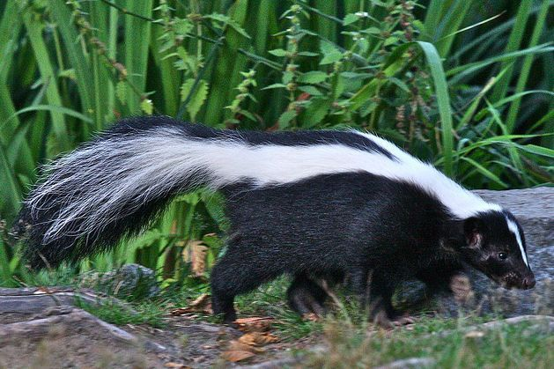
臭鼬与我家的奇妙缘分
四点定位+伏笔+experience
续写手法
浙江金华市汤溪高级中学 郑素红

Slide 3


Basic knowledge about the skunk
臭鼬是社会性动物，以家庭为单位生活，有时一窝多达10～12只，一般是五六只。以奇臭的腺体分泌物作为防卫武器。挖洞而居、用草叶作为垫巢材料。巢域为10.4公顷左右。杂食性，秋、冬季以野果、小型哺乳类及谷物为食，而春、夏季多以昆虫和谷物等为主，偶吃小鸟、鸟卵、蛇、蛙等。白天在地洞中休息，黄昏和夜晚出来活动。
臭鼬用它那特殊的黑白颜色警告敌人攻击它。如果敌人靠得太近，臭鼬会低下来，竖起尾巴，用前爪跺地发出警告。如果这样的警告未被理睬，臭鼬便会转过身，向敌人喷种恶臭的液体。这种液体是由尾巴旁的腺体分泌出来的。在3.5米距离内，臭鼬一般不会打不中目标。这种液体会导致被击中者短时间失明，其强烈的臭味在约800米的范围内都可以闻到。所以绝大部分掠食者，暨如美洲野猫，美洲狮，除非它们非常饥饿，一般都会避开臭鼬。唯一的例外是猫头鹰的亲戚——美洲雕鸮，它没有嗅觉，所以完全不嫌弃臭鼬。有人曾在一只美洲雕鸮的巢里发现了57只臭鼬。
在秋末，它们会变得非常胖，一年四季在户外活动，在冬季比在炎热的夏季更活跃。

Slide 4
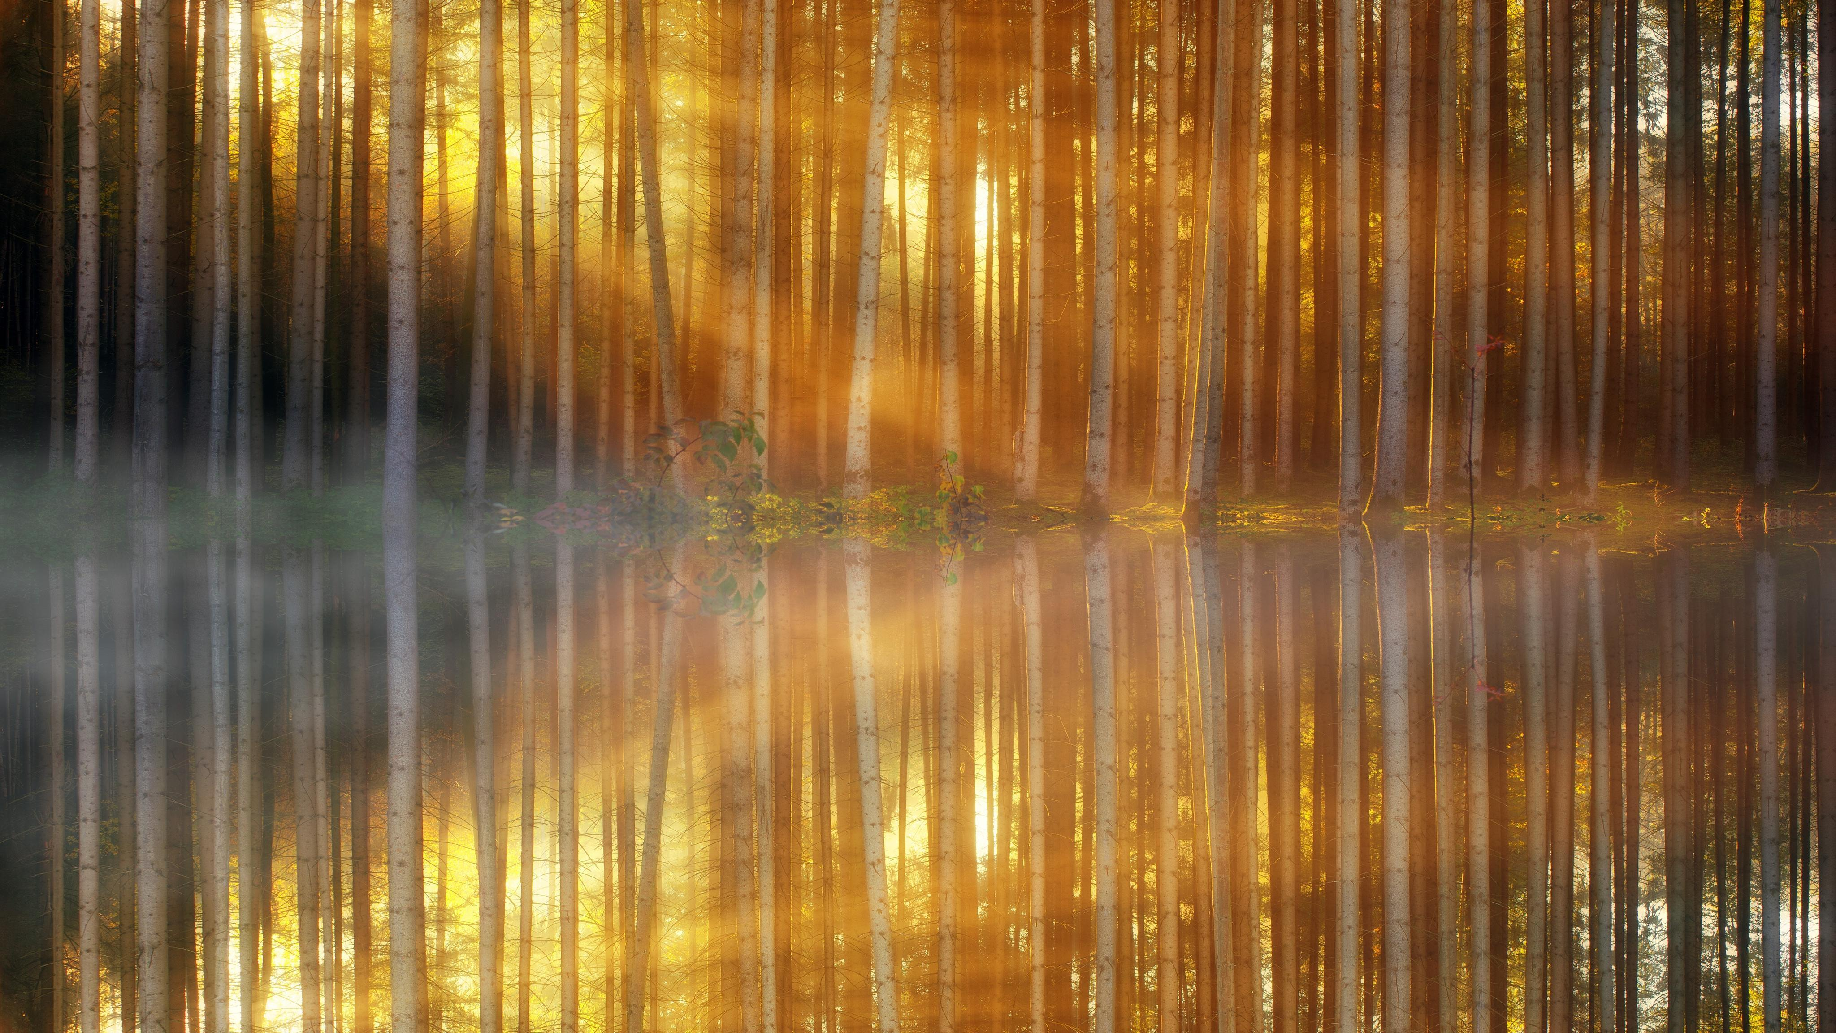
Whenever I spread marmalade（橘子酱）, I am reminded of my mother, a five-foot-tall angel who even befriended a skunk（臭鼬）.
One day, while she was busy picking beans in the backyard, she came across a skunk no more than a meter away. The skunk’s embarrassment was evident as he had undoubtedly been rummaging（乱翻）through the garbage. He still had a marmalade jar stuck on his nose. Mom took pity on him. Instead of worrying the creature would spray something smelly all over her and the beans, she smiled compassionately at the little thing and extended a helping hand. Kneeling on the ground, she inched across the grass, reached out, and twisted the jar—very carefully.
The jar slipped off. The skunk nodded a thank-you before slipping away into the woods at the back of the garden. Obviously, there was no spraying incident, thanks to my remarkable mother. She repeated this tale numerous times, always calling the skunk Marmalade. However, that was not the end of the story. Three summers later, when I was about twelve, another encounter occurred.
It was a rainy morning, and both my mother and father had gone to work. My friend Rob came over to play, and we decided to run the electric train in my room. Suddenly, a scratching sound emerged from the attic（阁楼）. Rob assumed that it might be some kind of animal. Curiosity got the better of us, and we ventured towards the source of the sound.
I cautiously opened the attic door in the hall. The noise ceased abruptly. I climbed up the stairs, Rob following my lead. There behind the toy box near the chimney stood the animal—black with a distinct white stripe down his back. Was he scared and trembling? I believe so, at least that’s what I remember. Instinctively, I retreated, fearing the potential spray or bites from the creature. “Hey, Rob,” I whispered urgently, “It’s a skunk. Let’s go to the kitchen and figure out a way to get him out of here.”

Slide 5
Read for main ideas

Slide 6
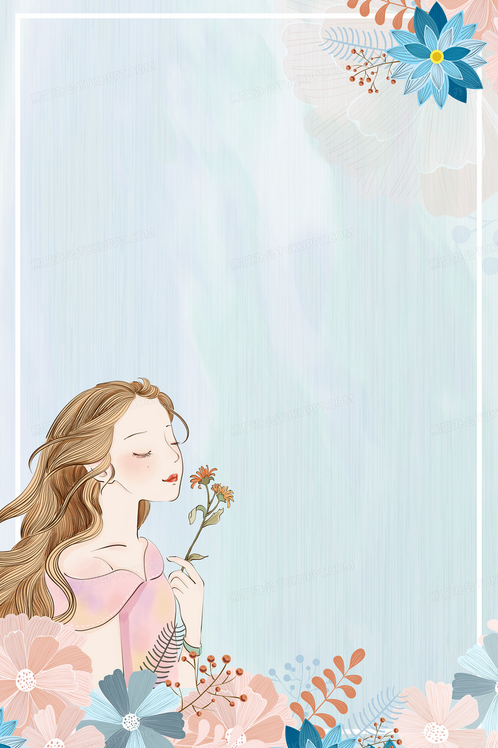
本文生词：
befriend vt. 友善地对待；
spray something smelly 喷臭气
compassionately adv. 同情地；
4. kneel on the ground 蹲着
5. a scratching sound 刮擦声
6. get the better of … 战胜
7. cease vi&vt. 停止
8. a distinct white stripe adj. 一条明显的白色条纹；
9. urgently adv. 急切地
10. instinctively adv. 本能地

Slide 7
Whenever I spread marmalade（橘子酱）, I am reminded of my mother, a five-foot-tall angel who even befriended a skunk（臭鼬）.
main idea
Lead in the following story about my mother and a skun

Slide 8
One day, while she was busy picking beans in the backyard, she came across a skunk no more than a meter away. The skunk’s embarrassment was evident as he had undoubtedly been rummaging（乱翻）through the garbage. He still had a marmalade jar stuck on his nose. Mom took pity on him. Instead of worrying the creature would spray something smelly all over her and the beans, she smiled compassionately at the little thing and extended a helping hand. Kneeling on the ground, she inched across the grass, reached out, and twisted the jar—very carefully.
The jar slipped off. The skunk nodded a thank-you before slipping away into the woods at the back of the garden. Obviously, there was no spraying incident, thanks to my remarkable mother. She repeated this tale numerous times, always calling the skunk Marmalade. However, that was not the end of the story. Three summers later, when I was about twelve, another encounter occurred.
main idea
My mother’s encounter with the skunk Marmalade

Slide 9
It was a rainy morning, and both my mother and father had gone to work. My friend Rob came over to play, and we decided to run the electric train in my room. Suddenly, a scratching sound emerged from the attic（阁楼）. Rob assumed that it might be some kind of animal. Curiosity got the better of us, and we ventured towards the source of the sound.
main idea
Rob and heard a scratching sound from the attic.

Slide 10
I cautiously opened the attic door in the hall. The noise ceased abruptly. I climbed up the stairs, Rob following my lead. There behind the toy box near the chimney stood the animal—black with a distinct white stripe down his back. Was he scared and trembling? I believe so, at least that’s what I remember. Instinctively, I retreated, fearing the potential spray or bites from the creature. “Hey, Rob,” I whispered urgently, “It’s a skunk. Let’s go to the kitchen and figure out a way to get him out of here.”
main idea
Rob and I encountered a skunk in the attic.
Notes:
in

Slide 11
原文本类型探究
本文续写类型不同于常见的“ 问题/冲突 +解决”类型的文本；相反，本文讲述了两次不同的经历；
1. Experience 1 --- My mother’s encounter with a skunk / thanks to her kindness, the skunk got rid of the marmalade jar on his nose and the skunk got its nickname Marmalade.
2. Experience 2 --- Rob and I found a skunk in the attic / experience 2 is the content of the continuation writing .
3. result& reflection--- Rob and I treated the skunk kindly just as my mother did 3 summers before. // We human can treat wild animals kindly as long as we care about them.

Slide 12
Read for clues and echoes

Slide 13
clues | echoes
Whenever I spread marmalade（橘子酱）, I am reminded of my mother, a five-foot-tall angel who even befriended a skunk（臭鼬）. | We human can befriend any wild animal as long as we are as caring as an angel. ( It can be used as an ending) Thinking of the tale that my mother told me repeatedly, I came up with a great idea-- get some marmalade.

Slide 14
clues | echoes
The jar slipped off. The skunk nodded a thank-you before slipping away into the woods at the back of the garden. Obviously, there was no spraying incident, thanks to my remarkable mother. She repeated this tale numerous times, always calling the skunk Marmalade. However, that was not the end of the story. Three summers later, when I was about twelve, another encounter occurred. | Nodding a thank-you back to Rob and me, the skunk slipped away into the woods at the back of the garden. What an amazing encounter!

Slide 15
clues | echoes
It was a rainy morning, and both my mother and father had gone to work. My friend Rob came over to play, and we decided to run the electric train in my room. Suddenly, a scratching sound emerged from the attic（阁楼）. Rob assumed that it might be some kind of animal. Curiosity got the better of us, and we ventured towards the source of the sound. | No sooner had my mother come back home after work than I shared the incredible incident of the skunk with her. She smiled, eyes shining with joy, affirming, “ It must be the skunk I encountered three summers ago.”

Slide 16
clues | echoes
It was a rainy morning, and both my mother and father had gone to work. My friend Rob came over to play, and we decided to run the electric train in my room. Suddenly, a scratching sound emerged from the attic（阁楼）. Rob assumed that it might be some kind of animal. Curiosity got the better of us, and we ventured towards the source of the sound. | 6. After seeing the skunk off , Rob and I returned to my room to run the electric train.

Slide 17
clues | echoes
I cautiously opened the attic door in the hall. The noise ceased abruptly. I climbed up the stairs, Rob following my lead. There behind the toy box near the chimney stood the animal—black with a distinct white stripe down his back. Was he scared and trembling? I believe so, at least that’s what I remember. Instinctively, I retreated, fearing the potential spray or bites from the creature. “Hey, Rob,” I whispered urgently, “It’s a skunk. Let’s go to the kitchen and figure out a way to get him out of here.” | 7. All of a sudden , an image of a skunk with a marmalade jar stuck on its nose flashed across my mind. Marmalade would definitely work if we wanted it to get him out of the attic.

Slide 18
Sort through details of the story

Slide 19
6 elements in a narrative
Time： on a rainy morning
Place: at the attic , in my house
Characters: a skunk , my mother , I , Rob
Experience 1: My kind-hearted mother helped a skunk rid a marmalade jar stuck on his nose
Result 1: The skunk slipped away into the wood after nodding a thank-you.
5. Experience 2: Rob and I got a skunk out of the attic.
Result2: The skunk feasted a jar of marmalade and left our house .
6. Reflection: We human can live in harmony with wild animals as long as we love them/ care for them. / care about them.

Slide 20
Character Analysis
My mother ：an angel ---- a kind-hearted and helpful woman
2. The skunk (Marmalade): He didn’t spray anything smelly--- trust my mother.
Rob and I: We saw a scared and trembling skunk at the attic of
our house– find a way to get him out ---kind-
hearted and helpful ---( predict : the skunk wouldn’t
bite or spray us .
We human ( my mother , Rob and I ) can live peacefully and
harmoniously with wild animals ( the skunk) as long as we trust
and love each other.

Slide 21
Design plots for each paragraph

Slide 22
续写两段的构思安排：
Para1: In the cupboard, several paper cups and a jar of marmalade caught our sight.
Scene 1:
What way did we come up with to get the skunk out?
Scene2:
How did the paper cups and marmalade work ?
Scene3:
What did the skunk do?
How did the skunk feel?

Slide 23
Para 2: Rob and I followed the skunk as he ate his way down the stairs.
Scene 1:
What did we do as the skunk ate his way down the stairs?
Scene2:
How did the skunk feel?
Scene3:
What did we do before saying goodbye to the skunk?
What did the skunk do before saying goodbye?
How did I feel?

Slide 24
---结合故事主旨
---确定故事走向
---四句定向写作
写作指导
一、 定四句
1. 结合第一段和原来文本最后一段以及所给的第一段第1句的信息词，来创作第一段的首句。
2. 结合所给第二段首句信息词，使第2段首句和第1段尾句相呼应来创作第一段的尾句
3. 结合所给第二段首句信息词，来创作第2段的首句。
4. 结合故事要体现的主旨以及照顾原文伏笔，以此来作为第2段的尾句。根据不同的文章主旨，可以提炼主旨，领悟人生道理。
亦或以情景结尾，巧妙构思，余味悠长。

Slide 25
结合原文本最后一段定首段第一句 (句群）
Para 1: In the cupboard, several paper cups and a jar of marmalade caught our sight.
手法1. （首句以marmalade 相关连的故事+回扣原文：)
My heart almost beat out of my chest as the image of my mother compassionately helping a skunk get rid of a marmalade jar on his nose flashed across my mind.

Slide 26
结合原文本最后一段定首段第一句 (句群）
Para 1: In the cupboard, several paper cups and a jar of marmalade caught our sight.
手法2. （妈妈讲了无数次的故事再次回响+ 想到点子)
The story about Marmalade echoed in my ears and a great idea occurred to me / hit me / struck me.

Slide 27
结合第二段首句定首段尾句（句群）
Para 1: In the cupboard, several paper cups and a jar of marmalade caught our sight.
手法1： ( 橘子酱起作用+臭鼬走出阁楼+享用放在楼道上的果酱）
The fragrance of the marmalade worked and the skunk came out of the attic. Seeing the paper cups full of marmalade on the stairway, he feasted happily.
Para 2: Rob and I followed the skunk as he ate his way down the stairs.

Slide 28
结合第二段首句定首段尾句
Para 1: In the cupboard, several paper cups and a jar of marmalade caught our sight.
手法2： (臭鼬惊喜但谨慎，开始享用美食；我们则紧张观看）
Surprised but cautious, he began to feast on his delicacy on the stairs Heart in mouth, we could hardly contain emotions as the skunk made his way down the stairs.
Para 2: Rob and I followed the skunk as he ate his way down the stairs.

Slide 29
结合第二段首句定第二段第一句
Para 2: Rob and I followed the skunk as he ate his way down the stairs.
手法1：(以the skunk 为叙事对象：吃了后的满意+感激+告别）
Content and grateful, the skunk gazed at us and nodded a thank-you, stepping out and disappearing into the dense woods at the back of our yard.

Slide 30
结合第二段首句定第二段第一句
Para 2: Rob and I followed the skunk as he ate his way down the stairs.
手法2： （Rob and I 的视角叙事）
What a marvelous/ fantastic/ remarkable sight. Rob and I were holding our breath, watching the skunk leisurely licking the marmalade put in paper cups from the top stairs to the ground floor.

Slide 31
定第二 段尾句
Para 2: Rob and I followed the skunk as he ate his way down the stairs.
结尾1： (回扣原文第二段： 臭鼬感激我和Rob+ 感叹命运峰回路转再次邂逅臭鼬.)
Nodding a thank-you back to Rob and me, the skunk stepped out and slipped away into the woods at the back of the garden. I couldn’t help marveling at the amazing twist of fate that brought Marmalade back into our life once again.

Slide 32
定第二 段尾句
Para 2: Rob and I followed the skunk as he ate his way down the stairs.
结尾2： (给妈妈打完电话后，我沉思：…)
Giggling, I hung up, lost in thought. Trust is a magic and it works/ does/ creates wonders. What an amazing encounter!

Slide 33
定第二 段尾句
Para 2: Rob and I followed the skunk as he ate his way down the stairs.
结尾3： ： (给妈妈打完电话后，我沉思+回扣妈妈befriend the skunk+ 感想…)
Giggling, I hung up, lost in thought. We human can befriend wild animals as long as we are as caring as an angel.

Slide 34
习作欣赏一

Slide 35
Para 1: In the cupboard, several paper cups and a jar of marmalade caught our sight. My heart almost beat out of my chest as the image of my mother compassionately helping a skunk get rid of a marmalade jar on his nose flashed across my mind. Rob’s jaw dropped as I recounted/ related the tale of Marmalade. Overwhelmed with excitement mixed with fear, we grabbed the jar of marmalade and some paper cups, hoping to use marmalade to coax / lure / tempt the skunk out of the house. As we tiptoed out of the kitchen, I poured some marmalade into the paper cups, put them all the way down the stairs and waited anxiously. The fragrance of the marmalade worked and the skunk came out of the attic. Seeing the paper cups full of marmalade on the stairway, he feasted happily.

Slide 36
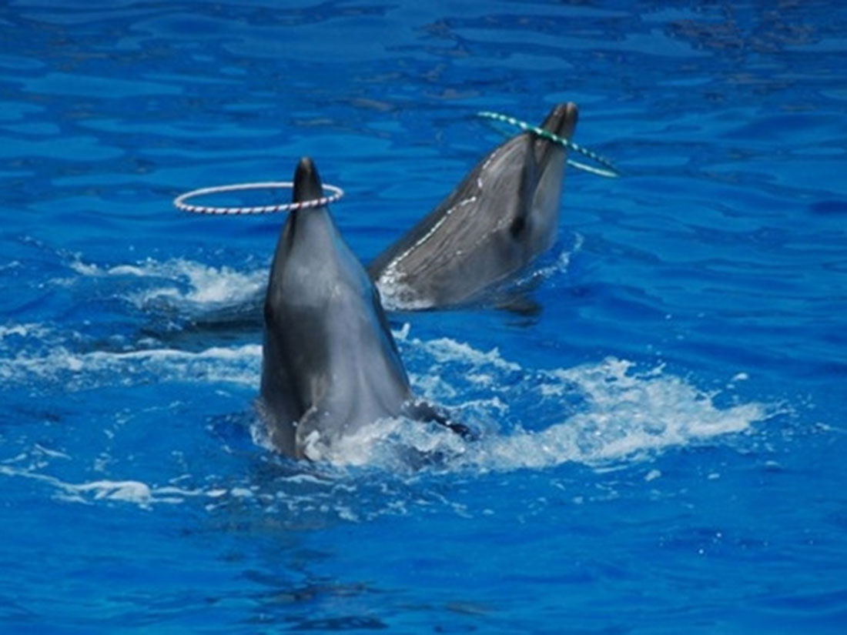
Para 2: Rob and I followed the skunk as he ate his way down the stairs. What a marvelous/ fantastic/ remarkable sight. Rob and I were holding our breath, watching the skunk leisurely licking the marmalade put in paper cups from the top stairs to the ground floor. Full and satisfied, the skunk turned his head back to look at us, its initial fear giving way to gratitude. Kneeling on the floor, we extended the last paper cup filled with marmalade towards the skunk. Casting us a grateful look, the skunk finished his last cup of marmalade. Nodding a thank-you back to Rob and me, the skunk stepped out and slipped away into the woods at the back of the garden. I couldn’t help marveling at the amazing twist of fate that brought Marmalade back into our life once again.

Slide 37
习作欣赏二

Slide 38
Para 1: In the cupboard, several paper cups and a jar of marmalade caught our sight. The story about Marmalade echoed in my ears and a great idea occurred to me / hit me / struck me. “The skunk loves marmalade!” I exclaimed to Rob. Grabbing some paper cups and a jar of marmalade, we filled each cup with some jam, placed all the way from upstairs to the ground floor and waited patiently and quietly for the skunk to show up. Then, a scraping sound came into our ears and the skunk turned up, attracted by the fragrant smell. “Here he comes!” Rob whispered with excitement. Surprised but cautious, he began to feast on his delicacy. Heart in mouth, we could hardly contain emotions as the skunk made his way down the stairs.

Slide 39
Para 2: Rob and I followed the skunk as he ate his way down the stairs. Content and grateful, the skunk gazed at us and nodded a thank-you, stepping out and disappearing into the dense woods at the back of our yard. Seeing the skunk off , Rob and I breathed a sigh of relief. No sooner had everything come back to normal than I phoned my mom and shared the incredible incident of the skunk with her. On the phone, she affirmed in a pleasant tone, “ It is definitely MarmaIade that I encountered three summers ago. He just missed marmalade so much. ” Giggling, I hung up, lost in thought. Trust is a magic and it works/ does/ creates wonders. What an amazing encounter! 或者： We human can befriend wild animals as long as we are as caring as an angel.

Slide 40
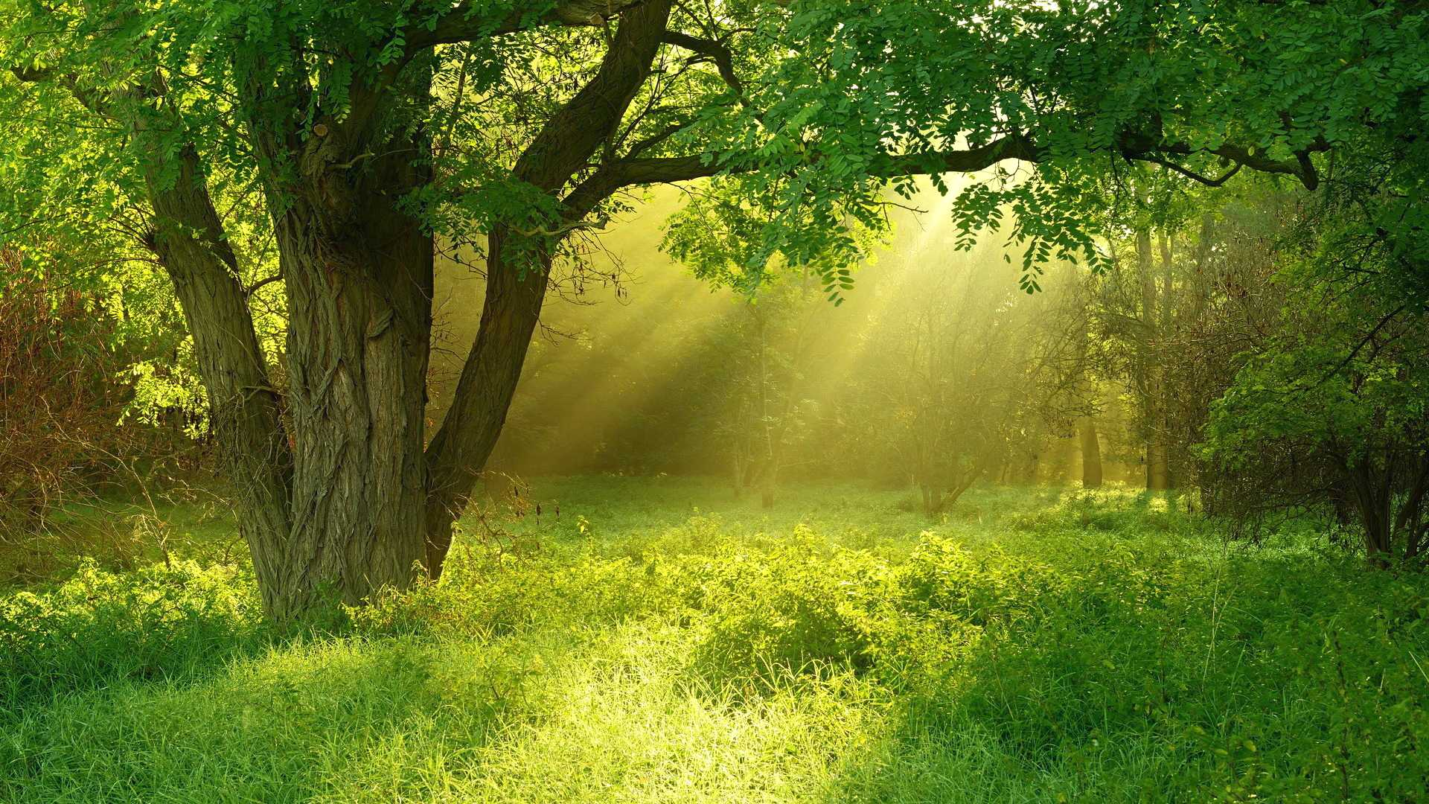
Human can live peacefully and harmoniously with wild animals.

