Slide 1


感恩遇见，相互成就，本课件资料仅供您个人参考、教学使用，严禁自行在网络传播，违者依知识产权法追究法律责任。
更多教学资源请关注
公众号：溯恩英语
知识产权声明

Slide 2
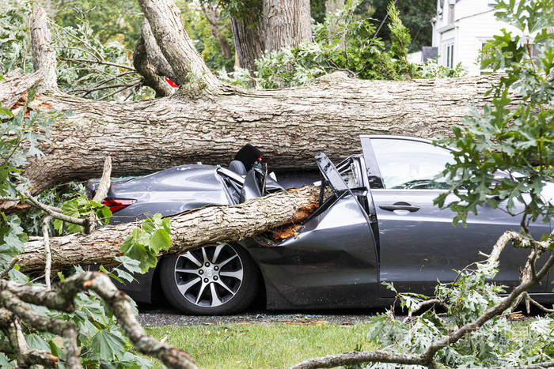
An unforgettable camping trip

Slide 3

①Kevin woke to the blaring beep of his alarm clock. “Can’t wait for that camping trip,” Kevin thought, filled with excitement. As he was leaving home, his dad grabbed him by the hand and said, “Before you go, just tell me the directions on where you and your friends are going to stay.”
②“But dad!” Kevin complained.
③“No buts!” Kevin's dad added.
④“Fine.” Kevin told him the directions and left.
⑤The three friends, Kevin, Jay and Nathan, had been planning this adventure for weeks, packing their stuff-tents, snacks, and a map- preparing for a 3-day outdoor exploration. Excitement ran through Kevin as they departed for their campsite. “This trip is going to be awesome,” Nathan excitedly yelled as they set off. But little did they know that nature had a surprise in store for them.
⑥The first day at the campsite was going great, setting up tents, collecting firewood, and sharing stories. “Man, we nailed these tents,” Kevin said. “I know it was easy really,” Nathan replied. The friends were happy.
⑦Yet towards night, as the dark clouds gathered overhead, the atmosphere shifted, and a sudden storm erupted with unforgiving anger. Rain poured down from the heavens like a relentless waterfall, transforming the peaceful campsite into a muddy battleground. Worse still, a huge tree was uprooted and crashed down with a deafening crack on their only means of escape - their car. Kevin’s eyes widened in horror as he spotted the damaged wreckage beneath the fallen giant. “Our car!” he screamed over the howling wind, his voice a mix of disbelief and despair. “We’re stuck here,” he declared, his words barely audible against the backdrop of thunder and raindrops. They realized that their plans had been violently spoiled by forces beyond their control. The once quiet campsite now stood as a deserted battlefield, the fallen tree serving as a painful reminder of the unpredictable nature of the world around them.
Paragraph 1: The next day, they found themselves facing the immediate problem of finding water.
Paragraph 2: On the third night, a distant engine sound broke the terrible stillness.
Before the trip
On the 1st day

Slide 4
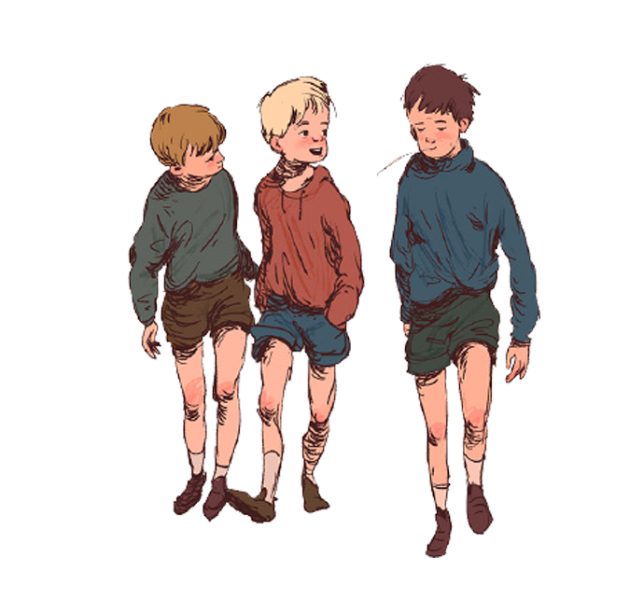

“can’t wait7…”
…filled with excitement
“But dad!” …complained.
Excitement ran through …
“This trip is going to be awesome,” …excitedly yelled…
…had been planning this adventure for weeks, packing their stuff… preparing for a 3-day outdoor exploration
Kevin
, Jay and Nathan
Kevin’s dad
…grabbed… “Before you go, just tell me the directions…”

Slide 5
①-⑤ before the camping trip
⑥-⑦ on the 1st day
Paragraph 1: The next day, they found themselves facing the immediate problem of finding water.
Paragraph 2: On the third night, a distant engine sound broke the terrible stillness.
On the 2nd day
On the 3rd day
Main idea:
Kevin and his friends went on a camping trip when they came across unexpected problems brought by nature. Kevin’s father came to their rescue.

Slide 6
What might they do in the following two days?
How did they feel?
the unpredictability and brutality of nature
 | Before the trip | On the 1st day |  | On the 2nd day | On the 3rd day
Kevin, Jay and Nathan | had been planning for weeks, packing their stuff- tents, snacks, and a map
Kevin’s father | “tell me the directions on where you and your friends are going to stay”
a great trip as expected
an unexpected turn
problem(s)
rescue
Yet toward night,...dark clouds…a sudden storm…rain…a huge tree…
eyes widened in horror
screamed…mix of disbelief and despair
…realized…plans had been violently spoiled by forces beyond control
Para.1 The next day, they found themselves facing the immediate problem of finding water
Para. 2 On the third night, a distant engine sound broke the terrible stillness.
…was going great, setting up tents, collecting firewood, and sharing stories.
nailed tents
helpless, desperate
the necessity of checking weather reports when traveling to the wild
excited
the importance of letting parents know about your whereabouts
carefree,
happy
helpless, desperate
relieved,
reflective
five senses/ rhetorical devices to describe a situation+
direct/ indirect ways of showing emotions
savior
general→specific
concerned,
supportive
knew about the storm & kept track of Kevin’s directions

Slide 7

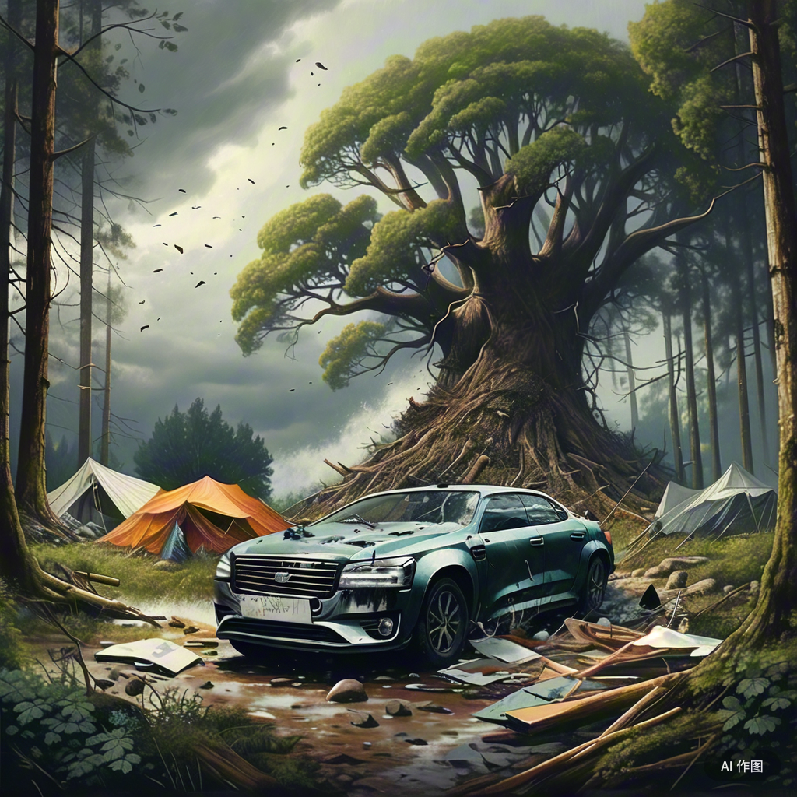
Yet towards night, as the dark clouds gathered overhead, the atmosphere shifted, and a sudden storm erupted with unforgiving anger. Rain poured down from the heavens like a relentless waterfall, transforming the peaceful campsite into a muddy battleground. Worse still, a huge tree was uprooted and crashed down with a deafening crack on their only means of escape - their car. Kevin’s eyes widened in horror as he spotted the damaged wreckage beneath the fallen giant. “Our car!” he screamed over the howling wind, his voice a mix of disbelief and despair. “We’re stuck here,” he declared, his words barely audible against the backdrop of thunder and raindrops. They realized that their plans had been violently spoiled by forces beyond their control. The once quiet campsite now stood as a deserted battlefield, the fallen tree serving as a painful reminder of the unpredictable nature of the world around them.
Yet towards night, as the dark clouds gathered overhead, the atmosphere shifted, and a sudden storm erupted with unforgiving anger. Rain poured down from the heavens like a relentless waterfall, transforming the peaceful campsite into a muddy battleground. Worse still, a huge tree was uprooted and crashed down with a deafening crack on their only means of escape - their car. Kevin’s eyes widened in horror as he spotted the damaged wreckage beneath the fallen giant. “Our car!” he screamed over the howling wind, his voice a mix of disbelief and despair. “We’re stuck here,” he declared, his words barely audible against the backdrop of thunder and raindrops. They realized that their plans had been violently spoiled by forces beyond their control. The once quiet campsite now stood as a deserted battlefield, the fallen tree serving as a painful reminder of the unpredictable nature of the world around them.
Yet towards night, as the dark clouds gathered overhead, the atmosphere shifted, and a sudden storm erupted with unforgiving anger. Rain poured down from the heavens like a relentless waterfall, transforming the peaceful campsite into a muddy battleground. Worse still, a huge tree was uprooted and crashed down with a deafening crack on their only means of escape - their car. Kevin’s eyes widened in horror as he spotted the damaged wreckage beneath the fallen giant. “Our car!” he screamed over the howling wind, his voice a mix of disbelief and despair. “We’re stuck here,” he declared, his words barely audible against the backdrop of thunder and raindrops. They realized that their plans had been violently spoiled by forces beyond their control. The once quiet campsite now stood as a deserted battlefield, the fallen tree serving as a painful reminder of the unpredictable nature of the world around them.
Yet towards night, as the dark clouds gathered overhead, the atmosphere shifted, and a sudden storm erupted with unforgiving anger. Rain poured down from the heavens like a relentless waterfall, transforming the peaceful campsite into a muddy battleground. Worse still, a huge tree was uprooted and crashed down with a deafening crack on their only means of escape - their car. Kevin’s eyes widened in horror as he spotted the damaged wreckage beneath the fallen giant. “Our car!” he screamed over the howling wind, his voice a mix of disbelief and despair. “We’re stuck here,” he declared, his words barely audible against the backdrop of thunder and raindrops. They realized that their plans had been violently spoiled by forces beyond their control. The once quiet campsite now stood as a deserted battlefield, the fallen tree serving as a painful reminder of the unpredictable nature of the world around them.
theme
表层：show the sudden change of weather that spoiled their camping plan
深层：the unpredictability and brutality of nature
the fragility of human plans in the face of such forces
What do you think of this situation?
How did the author describe this chaotic and dangerous situation?
How did the author describe their feelings?
What’s the purpose of this paragraph?
five senses: sight, hearing, smell, taste, and touch
rhetorical devices: personification; simile; contrast; exaggeration
direct ways: words showing emotions
indirect ways: facial expressions, tones, words, actions, thinking, environment

Slide 8

Para.1 The next day, they found themselves facing the immediate problem of finding water.
What did they do to find water?
Did they find water? How did they feel?
What other problems did they meet?
lack edible snacks
lose track of direction
suffer cold and hunger
can’t go back home with the damaged car
What did they do and how did they feel?
“The three friends, Kevin, Jay and Nathan, had been planning this adventure for weeks, packing their stuff-tents, snacks, and a map- preparing for a 3-day outdoor exploration.”
Worse still, a huge tree was uprooted and crashed down with a deafening crack on their only means of escape - their car. Kevin’s eyes widened in horror as he spotted the damaged wreckage beneath the fallen giant. “Our car!”

Slide 9
Para. 2 On the third night, a distant engine sound broke the terrible stillness.
Who was it?
father?
other rescuers?
How did the three kids feel?
What did father do to rescue them?
What did the three kids refelct on?
...
the unpredictability and brutality of nature
the importance of letting parents know about your whereabouts
the necessity of checking weather reports when traveling to the wild
strengthened friendship and trust among them

Slide 10
模仿第⑦段，描写第一段寻找水源的过程。
描述场景
five senses: sight, hearing, smell, taste, and touch
rhetorical devices: personification; simile; contrast; exaggeration
描述角色
direct ways: words showing emotions
indirect ways: facial expressions, tones, words, thinking, environment
Para. 1... The relentless sun beat down (personification), and Kevin’s lips were dry and cracked, parched (干燥的) from dehydration. Nathan scanned the distant horizon with his keen eyes (sight), straining his ears for any sound of running water (hearing). Jay’s nostrils flared as he tried to catch a whiff of moisture in the arid air (smell).(parallelism) They trudged through the dense underbrush, their hands brushing against rough bark and prickly leaves (touch). Suddenly, Kevin’s eyes lit up as he spied a glint of water in the distance (sight). Excitedly (direct), they followed the sound of a small stream trickling nearby, its gentle gurgling (汩汩声) a welcome (indirect) melody to their ears (sight+ sound). They eagerly rushed to (indirect) its banks, dipping their hands into the cool, crystal-clear water (sight+ touch). Relief washed over them (direct) as they quenched their thirst, savoring (taste) every drop (indirect) .
Para. 1... The relentless sun beat down, and Kevin’s lips were dry and cracked, parched from dehydration. Nathan scanned the distant horizon with his keen eyes, straining his ears for any sound of running water. Jay’s nostrils flared as he tried to catch a whiff of moisture in the arid air. They trudged through the dense underbrush, their hands brushing against rough bark and prickly leaves. Suddenly, Kevin’s eyes lit up as he spied a glint of water in the distance. Excitedly, they followed the sound of a small stream trickling nearby, its gentle gurgling a welcome melody to their ears. They eagerly rushed to its banks, dipping their hands into the cool, crystal-clear water. Relief washed over them as they quenched their thirst, savoring every drop.

Slide 11
模仿第⑦段，描写第二段见到“救星”后的内容。
描述场景
five senses: sight, hearing, smell, taste, and touch
rhetorical devices: personification; simile; contrast; exaggeration
描述角色
direct ways: words showing emotions
indirect ways: facial expressions, tones, words, thinking, environment
Para. 2 ... As the headlights cut through the darkness (sight), the boys’ eyes lit up (sight) with renewed hope (direct). The ground trembled (personification/ exaggeration) beneath their feet as the approaching vehicle drew nearer (sight), sending a thrill of anticipation through their bodies (direct). The scent of diesel fuel (柴油) filled the air (smell), a welcome whiff of civilization (来自人类文明的气息) (indirect) after what seemed days of isolation (exaggeration). “We’re saved!” Nathan exclaimed, his voice trembling with emotion (direct+ indirect). As the rescue truck came into view (sight), Kevin felt a wave of relief wash over him (direct). It was like a beacon of hope (simile) in their mud-soaked, distant world. Once a deserted battlefield, the campsite was now a safe haven (避难所) (indirect) (metaphor+contrast).
Para. 2 ... As the headlights cut through the darkness, the boys’ eyes lit up with renewed hope. The ground trembled beneath their feet as the approaching vehicle drew nearer, sending a thrill of anticipation through their bodies. The scent of diesel fuel (柴油) filled the air, a welcome whiff of civilization (来自人类文明的气息) after what seemed days of isolation. “We’re saved!” Nathan exclaimed, his voice trembling with emotion. As the rescue truck came into view, Kevin felt a wave of relief wash over him. It was like a beacon of hope in their mud-soaked, distant world. Once a deserted battlefield, the campsite was now a safe haven.

Slide 12
One possible version:
Paragraph 1:
The next day, they found themselves facing the immediate problem of finding water. The boys pushed through the bushes, and the search for water soon drained their energy. They were about to give up when they heard a small sound, a splash of some sort. “Wait, did you hear that?” Jay’s voice sounded hopeful as they followed the faint sound of water. “Me too! Let’s keep going,” Kevin encouraged determinedly. They ran as fast as they could and found a small stream- a lifeline in all the challenges. However, with time passing by, more challenges emerged- limited food, frightful night filled with wilderness sounds, and the uncertainty of survival in the wild. Their nerves were near the edge of breaking down after long hours of uncertainty in the wilderness. Paragraph 2: On the third night, a distant engine sound broke the terrible stillness. “It must be my dad!” Kevin yelled. Relief washed over the weary faces as they witnessed the approach of a rugged vehicle, with headlights cutting through the darkness- a beacon of hope amid the peril. Kevin’s dad stepped out to meet the group. The emotions that played across their faces- disbelief, gratitude, and overwhelming joy- mirrored the shared trouble that had forged a deep bond among them. The journey back was filled with survival stories and lessons learned, deepening their understanding of the wilderness. Back home, Kevin’s dad said, “Good thing you told me those directions,” teaching them the importance of informing someone about plans. The experience turned into tales of courage and resilience, embedded in their memories as lessons for a lifetime.

Slide 13
A student’s version:
Paragraph 1:
The next day, they found themselves facing the immediate problem of finding water. The rain had stopped, but the ground was still soaked, and the nearby stream they had planned to use was now a muddy mess. Kevin, Jay, and Nathan realized that they had to be creative and resourceful. They set out in search of clean water, carefully avoiding the damaged car and the fallen tree. After a long and arduous search, they finally found a small, clear pool of water hidden deep within the woods. They filled their canteens and water bottles, feeling a sense of relief knowing that they had solved one of their major problems. However, they knew that there were still many more challenges to face. Paragraph 2:
On the third night, a distant engine sound broke the terrible stillness. The boys’ hearts leaped in their chests. With eagerness, they scrambled out of their tents. As the car drew nearer, they saw the familiar figure of Kevin’s dad step out. Relief washed over them as they ran towards him. Kevin’s dad hugged them tightly and ushered them into the warm car. As they drove home, Kevin reflected on the lessons he had learned from this ordeal. He realized the importance of being prepared and informed when venturing into the unknown, and the value of having a support system that could come to his aid when needed. From then on, he promised to be more cautious and responsible in his future adventures.

Slide 14
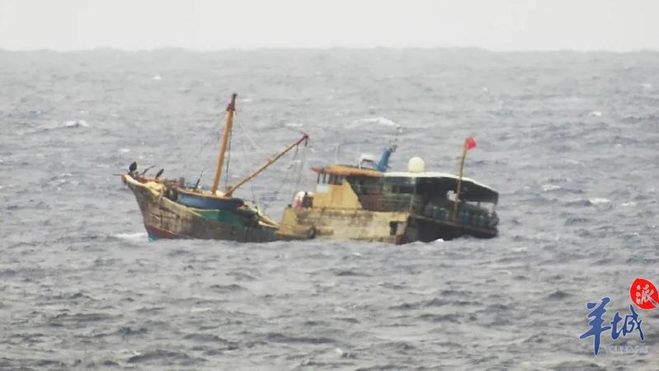
利用本节课所学，描写一个海中遇险的片段
描述场景
five senses: sight, hearing, smell, taste, and touch
rhetorical devices: personification; simile; contrast; exaggeration
描述角色
direct ways: words showing emotions
indirect ways: facial expressions, tones, words, thinking, environment
As dusk descended, the sky darkened with gathering clouds. Suddenly, the serene ocean was torn apart by a furious tempest (暴风雨；骚乱). The rain came down in sheets, as if the heavens themselves were weeping, transforming the once calm waters into a roaring beast. A massive wave loomed and crashed upon their boat, sending seawater flooding over the deck. The impact nearly capsized (倾覆) the vessel, leaving it rocking dramatically. John clung desperately to the railing, his eyes wide with fear. “Our compass! It’s gone!” His voice trembled with panic. “We’re completely lost at sea!” The others on board, faces etched with panic and disbelief,
shared his dread. Their peaceful sailing trip had been violently
shattered by nature’s fury, with the damaged boat serving as
a stark reminder of the unpredictable world they’d ventured into.
As dusk descended, the sky darkened with gathering clouds. Suddenly, the serene ocean was torn apart by a furious tempest (暴风雨；骚乱). The rain came down in sheets, as if the heavens themselves were weeping, transforming the once calm waters into a roaring beast. A massive wave loomed and crashed upon their boat, sending seawater flooding over the deck. The impact nearly capsized (倾覆) the vessel, leaving it rocking dramatically. John clung desperately to the railing, his eyes wide with fear. “Our compass! It’s gone!” His voice trembled with panic. “We’re completely lost at sea!” The others on board, faces etched with panic and disbelief,
shared his dread. Their peaceful sailing trip had been violently
shattered by nature’s fury, with the damaged boat serving as
a stark reminder of the unpredictable world they’d ventured into.

