Slide 1

Text patterns of exposition
余杭第一中学 董钶梦

Slide 2

Lead-in
What do you know about exposition？
Do you know some text patterns of exposition？

Slide 3
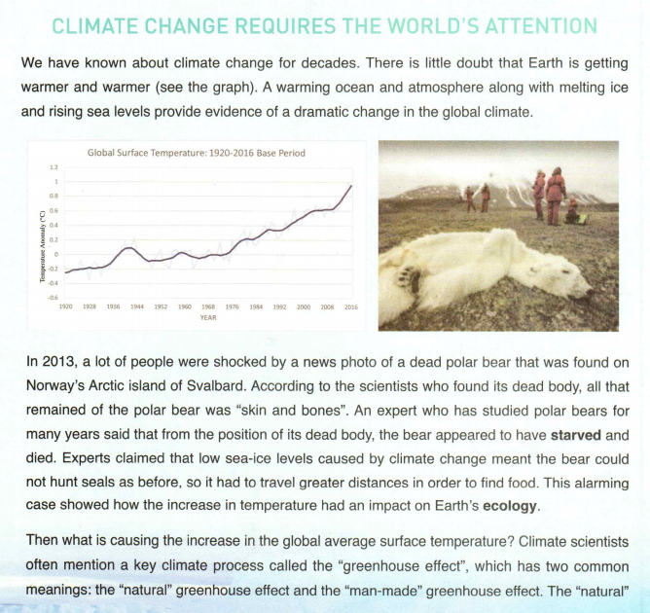
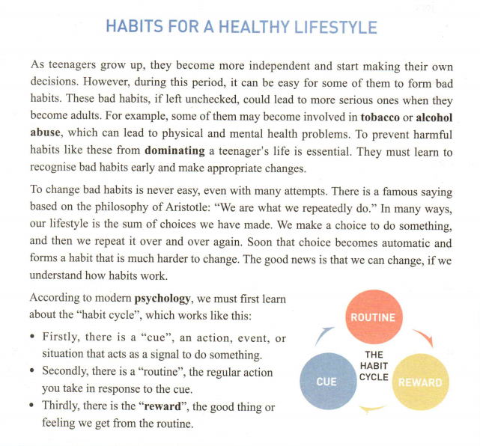
Read for text pattern
Complete the mind map.

Slide 4
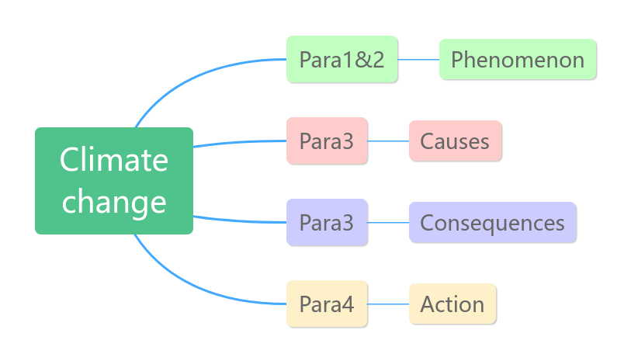
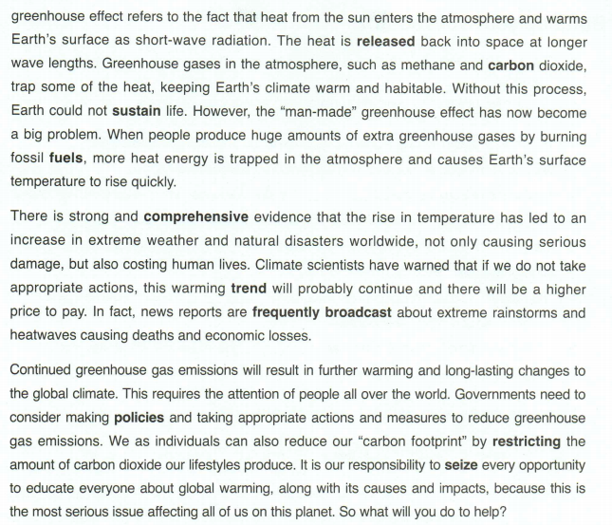
Read for text pattern
Text pattern
phenomenon--analysis

Slide 5
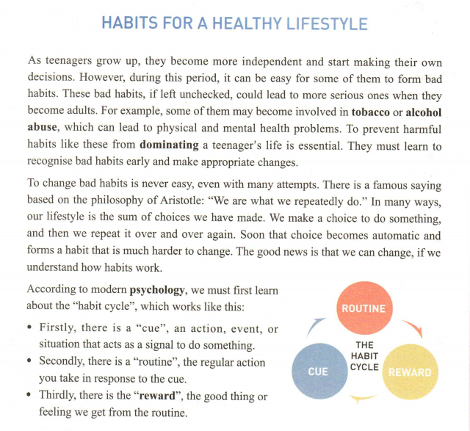
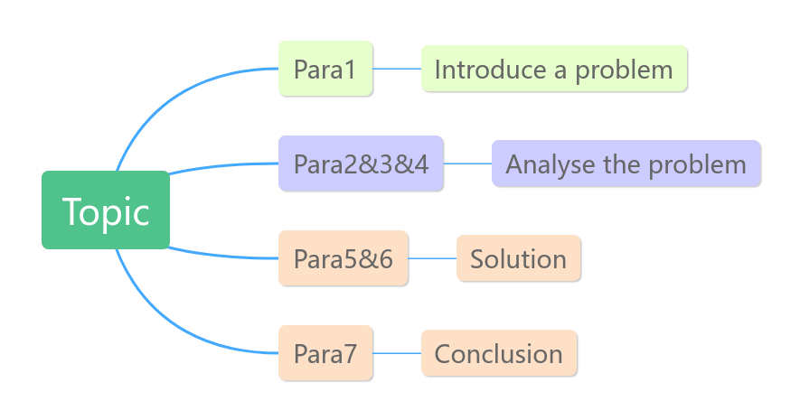
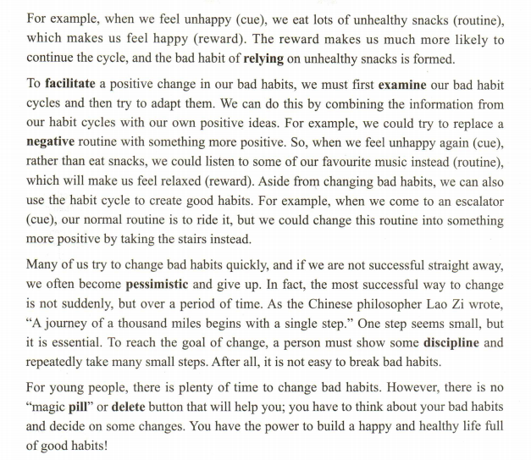
Read for text pattern
Text pattern
problem--solution--result

Slide 6
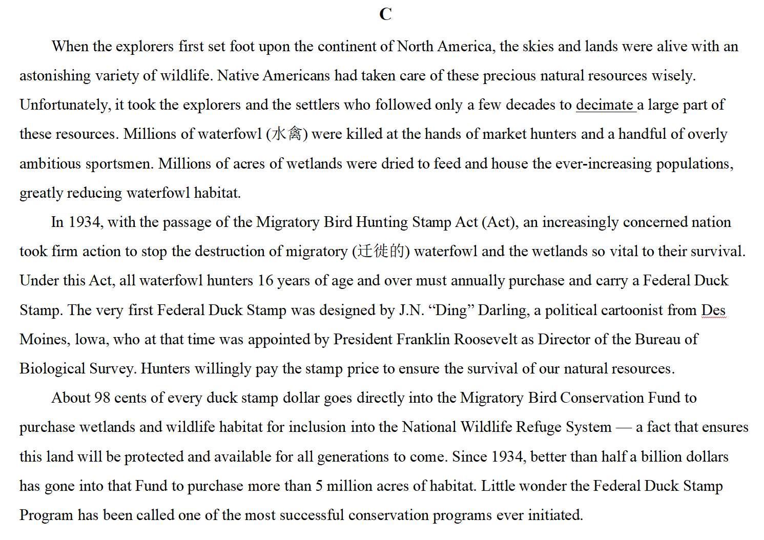
Read with text pattern
2021年全国I卷C篇
Read and identify the text pattern.
problem--solution--result
phenomenon--analysis
Problem:
waterfowl were killed
Tip1：
Identify the text pattern
topic sentence of each para
signal words
Solution:
Federal Duck Stamp
Result:
a success

Slide 7
Read with text pattern
Read the questions and circle the key words.
problem--solution--result
1. What was a cause of the waterfowl population decline in North America?
2. What is a direct result of the Act passed in 1934?
3. Which of the following is a suitable title for the text?
Tip2:
Read the questions, circle the key words

Slide 8
Read with text pattern
2021年全国I卷C篇
Locate the relevant part.
What was a cause of the waterfowl population decline in North America?
What is a direct result of the Act passed in 1934?
Which of the following is a suitable title for the text?
Problem:
waterfowl were killed
Solution:
Federal Duck Stamp
Tip3：
Locate the revevant part.
Result:
a success

Slide 9
Read with text pattern
problem: waterfowl were killed
Para1:When the explorers first set foot upon the continent of North America, the skies and lands were alive with an astonishing variety of wildlife. Native Americans had taken care of these precious natural resources wisely. Unfortunately, it took the explorers and the settlers who followed only a few decades to decimate a large part of these resources. Millions of waterfowl (水禽) were killed at the hands of market hunters and a handful of overly ambitious sportsmen. Millions of acres of wetlands were dried to feed and house the ever-increasing populations, greatly reducing waterfowl habitat.
1. What was a cause of the waterfowl population decline in North America?
A. Loss of wetlands. B. Popularity of water sports.
C. Pollution of rivers D. Arrival of other wild animals.

Slide 10
Read with text pattern
result: a success
Para3: About 98 cents of every duck stamp dollar goes directly into the Migratory Bird Conservation Fund to purchase wetlands and wildlife habitat for inclusion into the National Wildlife Refuge System — a fact that ensures this land will be protected and available for all generations to come. Since 1934, better than half a billion dollars has gone into that Fund to purchase more than 5 million acres of habitat. Little wonder the Federal Duck Stamp Program has been called one of the most successful conservation programs ever initiated.
2. What is a direct result of the Act passed in 1934?
Possible answer:___________________________
The government has collected money / purchased habitat.

Slide 11
Read with text pattern
Problem:
waterfowl were killed
3. Which of the following is a suitable title
for the text?
A. The Federal Duck Stamp Story
B. The National Wildlife Refuge System
C. The Benefits of Saving Waterfowl
D. The History of Migratory Bird Hunting
Solution:
Federal Duck Stamp
Result:
a success

Slide 12
Read with text pattern
Read an exposition with the help of text pattern.
Identify the
text pattern
Read the questions,
circle the key words
Locate the
relevant part
topic sentence of each paragraph
signal words
cause, result, suitable title...

Slide 13
Practice
2023年全国I卷D篇
Identify the “text pattern” and answer the question.
Para1: On March 7, 1907, the English statistician Francis Galton published a paper which illustrated what has come to be known as the "wisdom of crowds" effect. The experiment of estimation he conducted showed that in some cases, the average of a large number of independent estimates could be quite accurate.
Para2: This effect capitalizes on the fact that when people make errors, those errors aren't always the same. Some people will tend to overestimate, and some to underestimate. When enough of these errors are averaged together, they cancel each other out, resulting in a more accurate estimate. If people are similar and tend to make the same errors, then their errors won't cancel each other out. In more technical terms, the wisdom of crowds requires that people's estimates be independent. If for whatever reasons, people's errors become correlated or dependent, the accuracy of the estimate will go down.
phenomenon:
“wisdom of crowds” effect
analysis:
causes
4. What is paragraph 2 of the text mainly about?
A. The methods of estimation. B. The underlying logic of the effect. C. The causes of people’s errors. D. The design of Galton’s experiment.

Slide 14
Practice
Identify the “text pattern” and answer the question.
Para3: But a new study led by Joaquin Navajas offered an interesting twist (转折) on this classic phenomenon. The key finding of the study was that when crowds were further divided into smaller groups that were allowed to have a discussion, the averages from these groups were more accurate than those from an equal number of independent individuals. For instance, the average obtained from the estimates of four discussion groups of five was significantly more accurate than the average obtained from 20 independent individuals.
Para4: In a follow-up study with 100 university students, the researchers tried to get a better sense of what the group members actually did in their discussion. Did they tend to go with those most confident about their estimates? Did they follow those least willing to change their minds? This happened some of the time, but it wasn't the dominant response. Most frequently, the groups reported that they "shared arguments and reasoned together". Somehow, these arguments and reasoning resulted in a global reduction in error.
new
phenomenon:
a new study about “wisdom of crowds” effect
new
analysis:
causes
5. What did the follow-up study focus on?
A. The size of the groups. B. The dominant members.
C. The discussion process. D. The individual estimates.

Slide 15
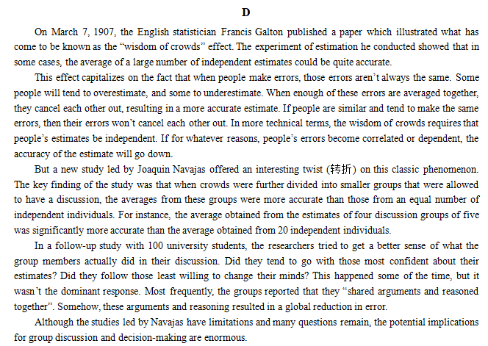
Practice
2023年全国I卷D篇
What’s the text pattern?
phenomenon:
“wisdom of crowds” effect
problem--solution--result
phenomenon--analysis
analysis:
causes
new phenomenon:
a new study about it
new
analysis:
causes
conclusion：
author’s attitude

Slide 16
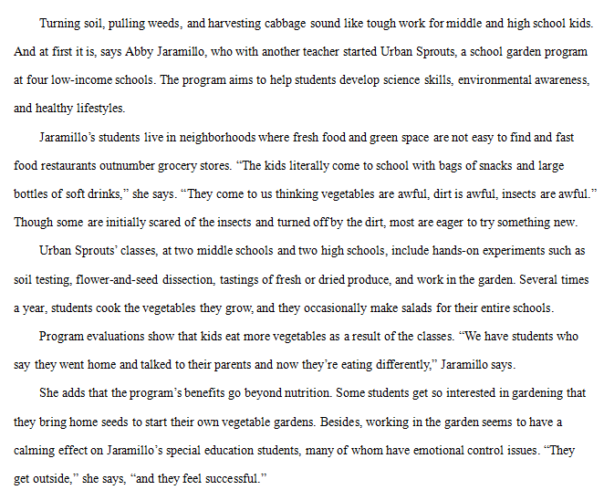
Group Work
2023年新课标II卷B篇
problem--solution--result
figure out the text pattern
figure out the question
What was a problem facing Jaramillo at the start of the program?
1. ____________________________？
A. The kids’ parents distrusted her.
B. Students had little time for her classes.
C. Some kids disliked garden work.
D. There was no space for school gardens.
2. _______________________________？
A. Rescuing School Gardens
B. Experiencing Country Life
C. Growing Vegetable Lovers
D. Changing Local Landscape
Problem
Solution
What can be a suitable title for the text
Result

Slide 17
Conclusion
Text patterns can help us!
Identify the
text pattern
Read the questions,
circle the key words
Locate the
relevant part
topic sentence of each paragraph
signal words
cause, result, suitable title...
problem--solution--result
phenomenon--analysis
...

Slide 18
Assignment
Finish the exercise with the help of text pattern.
2020年1月浙江卷B
2019年6月浙江卷C
2017年11月浙江卷B

