Slide 1



感恩遇见，相互成就，本课件资料仅供您个人参考、教学使用，严禁自行在网络传播，违者依知识产权法追究法律责任。
更多教学资源请关注
公众号：溯恩英语
知识产权声明

Slide 2
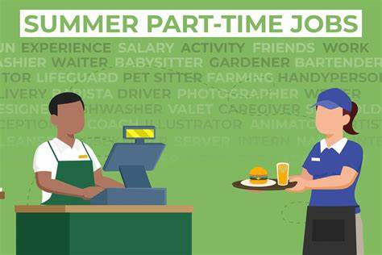
2024-4台州市二模英语考试
傅嘉
problem---solution +结合《课程标准》阐述“三处衔接一处结尾”

Slide 3

I stood in the restaurant kitchen, my eyes wide, arms hanging awkwardly ,ready to work but unsure of what to do.“You will be trained first,”my manager Aaron said,“ and do remember to check every detail!” With these words, he walked away.
A workmate threw me a dish brush and said, “Let‘s get started.” He introduced me to the basics of washing dishes and demonstrated the process. This was the beginning of my part-time job， a new stage where I was both eager to learn and anxious about the challenges ahead.
On a Friday night, Aaron swiftly entered the kitchen. “Who has just bused(收拾)the back right table?” he shouted, his voice sharp with urgency. My hands, slippery with bubbles from the bowl I was washing, nearly let it slip through my fingers. I wanted to say I was guilty, but Aaron's cold stare didn't promise a happy reward for the guy who admitted. Finally, a mix of fear and my own conscience pushed the response out of my mouth.
“I did, Aaron.”
“What were you thinking? Get back out here and look at what you missed!” His words forced me forward. I grabbed a rag(抹布)and followed him out to table twenty-two. As we made our way through the restaurant, he said something about rags, but I didn't hear clearly with other conversations going on around us.
I quickly realized the true issue was the mess beneath the table. A nearly full cup of beer had tipped over, creating a small lake on the floor. It was a significant mistake on my part. “Take care of it!” Aaron turned and stormed off to the front of the restaurant. I dropped down to clean up the beer. That was when another problem occurred. I had brought only one rag. One already wet rag. It did nothing but increase the size of the lake. “More rags,” I thought. Immediately, I rushed into the kitchen and hurriedly grabbed five dry rags, hoping Aaron wouldn't notice my brief absence.

Slide 4
Read for main ideas
《高中英语课程标准》中，对普通高中英语课程语言技能要求提出的目标：
1.通过阅读能从语篇中提取主要信息和主要观点；
2. 能够理解语篇的要义。

Slide 5
I stood in the restaurant kitchen, my eyes wide, arms hanging awkwardly ,ready to work but unsure of what to do. “You will be trained first,” my manager Aaron said,“ and do remember to check every detail!” With these words, he walked away.
A workmate threw me a dish brush and said, “Let‘s get started.” He introduced me to the basics of washing dishes and demonstrated the process. This was the beginning of my part-time job， a new stage where I was both eager to learn and anxious about the challenges ahead.
main idea
part-time job in a restaurant and Aaron , a strict manager.

Slide 6
On a Friday night, Aaron swiftly entered the kitchen. “Who has just bused(收拾)the back right table?” he shouted, his voice sharp with urgency. My hands, slippery with bubbles from the bowl I was washing, nearly let it slip through my fingers. I wanted to say I was guilty, but Aaron's cold stare didn't promise a happy reward for the guy who admitted. Finally, a mix of fear and my own conscience pushed the response out of my mouth.
“I did, Aaron.”
“What were you thinking? Get back out here and look at what you missed!” His words forced me forward. I grabbed a rag(抹布)and followed him out to table twenty-two. As we made our way through the restaurant, he said something about rags, but I didn't hear clearly with other conversations going on around us.
main idea
I made a mistake because I ignored details.

Slide 7
I quickly realized the true issue was the mess beneath the table. A nearly full cup of beer had tipped over, creating a small lake on the floor. It was a significant mistake on my part. “Take care of it!” Aaron turned and stormed off to the front of the restaurant. I dropped down to clean up the beer. That was when another problem occurred. I had brought only one rag. One already wet rag. It did nothing but increase the size of the lake. “More rags,” I thought. Immediately, I rushed into the kitchen and hurriedly grabbed five dry rags, hoping Aaron wouldn't notice my brief absence.
main idea
I wanted to make it up but I had only one wet rag.

Slide 8



1. 基于语义连贯
理顺叙事元素
深度解读语篇
--摘自 吴俊峰老师的2024年 高考临门一脚读后续写押题

Slide 9
原文本类型探究
梳理原文故事叙事模式，构建“ 问题---解决 ”的叙事模式。
1. conflicts
Conflict1 : I ignored a small lake formed by a tripped- over cup of beer.
Conlfict2: I was a green hand in the restaurant.
2. solutions：
Solution1: Deal with the small lake and dry the wet floor with more dry rags.
Solution2: Pay attention to details and learn more from my coworkers especially my manager Aaron.

Slide 10
3. 矛盾与冲突1 解决后的结果：首尾呼应 （结尾与叙事背景呼应）
The ending result: I owed my growth to my strict manager Aaron. “ Do remember check every detail” is one of my most unforgettable lessons.
《课程标准》 读后续写的主题意义的探究: 培养学生核心素养。在英语学科中落实立德树人的根本任务。读后续写，将语言的理解与语言的产出紧密结合， 实现语言育人作用。
4. 矛盾冲突2 解决后的结果；确定主题词：升华主题 （结尾与主题升华呼应 严师出高徒）
Never had I imagined that my work was well received by customers . Aaron’s harsh words still motivated me to become a better person.

Slide 11

Read for clues and echoes
阅读过程中寻找原文伏笔，进行同向顺承或反向表达：

Slide 12
clues | echoes
I stood in the restaurant kitchen, my eyes wide, arms hanging awkwardly ,ready to work but unsure of what to do. “You will be trained first,” my manager Aaron said,“ and do remember to check every detail!” With these words, he walked away. | Aaron’s “Do remember to check every detail “is one of my most unforgettable lessons. ( 点题）

Slide 13
clues | echoes
A workmate threw me a dish brush and said, “Let‘s get started.” He introduced me to the basics of washing dishes and demonstrated the process. This was the beginning of my part-time job， a new stage where I was both eager to learn and anxious about the challenges ahead. | 2. By observing my workmates , I learnt the basics of washing dishes and how to serve customers. 3. It was really kind of beyond expectation that I started to enjoy the challenges that came with “details”. I was grateful to Aaron for teaching me such an important lesson.

Slide 14
clues | echoes
On a Friday night, Aaron swiftly entered the kitchen. “Who has just bused(收拾)the back right table?” he shouted, his voice sharp with urgency. My hands, slippery with bubbles from the bowl I was washing, nearly let it slip through my fingers. I wanted to say I was guilty, but Aaron's cold stare didn't promise a happy reward for the guy who admitted. Finally, a mix of fear and my own conscience pushed the response out of my mouth. | When clearing up the table , I would always double-check everything , ensuring nothing went wrong. 5. I felt a mix of fear, guilt, shame and determination surging inside me.

Slide 15

clues | echoes
“I did, Aaron.” “What were you thinking? Get back out here and look at what you missed!” His words forced me forward. I grabbed a rag(抹布)and followed him out to table twenty-two. As we made our way through the restaurant, he said something about rags, but I didn't hear clearly with other conversations going on around us. | 6. I admitted my mistakes, took responsibility and corrected them.

Slide 16
clues | echoes
I quickly realized the true issue was the mess beneath the table. A nearly full cup of beer had tipped over, creating a small lake on the floor. It was a significant mistake on my part. “Take care of it!” Aaron turned and stormed off to the front of the restaurant. I dropped down to clean up the beer. That was when another problem occurred. I had brought only one rag. One already wet rag. It did nothing but increase the size of the lake. “More rags,” I thought. Immediately, I rushed into the kitchen and hurriedly grabbed five dry rags, hoping Aaron wouldn't notice my brief absence. | 7. I took responsibility for my mistake and tried my best to do my work as carefully as possible from that day on. With five dry rags , I eventually cleaned the mess and determined not to make any mistake like this.

Slide 17
Sort through details of the story

Slide 18
Analyze the original story
I got a part-time job in a restaurant and the core requirement from the manager.
My first mistake: a lake formed by beer under the table
My second mistake: took a wet rag
Para1: my feelings --- my action to handle the beer lake--- the manager’s feeling ---my reflection
Para2: Thoughts about the manager’s working standard ----my attitude towards my job –results and effects ( from customers/ my colleagues / manager ---my growth and development--- reflection
( teach me to pay attention to details// I was inspired/ motivated to be a better man
Notes:
ch

Slide 19
本文六要素：
Time： a Friday night
Place: in a restaurant
Characters: I --- part-time worker , Aaron --- manager; a workmate, ( customers in the restaurant)
Why: a cup of beer tipped over and formed a small lake under a table --- it was my mistake.
How: (continuation content：deal with the small lake )
Result: （continuation content：work after dealing with the small lake and my harvest from the experience)

Slide 20
Aspects in Continuation
本文以第一人称视角进行叙事， 故事的主角是I是餐厅兼职工作人员 配角 Aaron 经理，对工作很苛刻。还有一个工友workmate。可见续写的人物主要是I 以及经理。考虑到餐厅是服务单位，故而customer 也可以在适当的场景出现一下。比如盛赞我的工作。
地点不变：in the restaurant; 时间 one Friday night ,周五是周末的开始，一般饭店用餐人会比较多。可以作为续写的入笔点。
本文立意角度： 一般来说，原文如果有一个角色说了一句比较有哲理的话，这句话一定是主题的暗示语。考生可以完全借鉴这句话来引领文章的行文方向 ，并以此升华主题，体现育人作用。本文的主题句： Do remember every detail.

Slide 21
2. 基于语义连贯
设置问题驱动
合理发展情节
--摘自 吴俊峰老师的2024年 高考临门一脚读后续写押题

Slide 22

续写两段的构思安排：
Para1: I had just rushed out when I found Aaron standing in my way.
Scene 1:
How did I feel?
Scene2:
What did I do? What did Aaron do?
Scene3:
What did I do with the dry rags? How did Aaron feel then?

Slide 23
Para 2: After cleaning up the mess, I reflected on Aaron's words.
Scene 1:
What was my reflection?
Scene2:
What would I do for customers after the episode?
Scene3:
How did the customers react to my service & work?
What did I learn from the experience/ from Aaron?

Slide 24
3. 基于语义连贯
增强语境关联
促成协同效应
--摘自 吴俊峰老师的2024 年 高考临门一脚读后续写押题

Slide 25
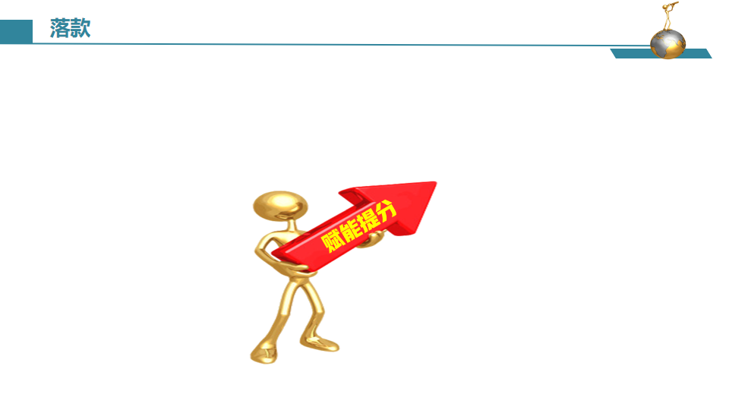


语篇衔接的三个“一定”
根据衔接连贯理论，通过词汇的有效衔接（词汇同现或词汇复现）实现语义连贯和逻辑衔接。
第一段结尾
①一定要有与第二段段首句中的同词或同义词。
②实现无缝衔接
第一、二段开头
①一定要把段首句的名词或动词（尤其是后半句），用在写作开头，实现语义连贯。
②力争高分开头
第二段结尾
①一定要呼应原文中体现主题或伏笔的关键词。
②实现主题升华
--摘自 吴俊峰老师的2024 年 高考临门一脚读后续写押题

Slide 26
Design plots for each paragraph
确定核心词汇：所给段落首句的名词、动词、地点、时间等要读透，并利用所给段落首句的核心词汇进行两段首句的创作，增强与原文的协同性，一致性，确保续写内容与原文故事语义连贯；
附评分标准：第五档：（21—25 分）与所给短文融洽度高，与段落开头衔接合理，内容丰富，有效地使用了语句间连接成分，使所续写短文结构紧凑

Slide 27
结合原文本最后一段定首段Link 1
Para1: I had just rushed out when I found Aaron standing in my way.
Link1 A: （我刚兼职不久就犯了错，看到严厉的老板，自然害怕。)
My heart sank/ missed a beat as I saw the serious/ stern look on his face.

Slide 28
结合原文本最后一段定首段Link 1
Para1: I had just rushed out when I found Aaron standing in my way.
Link1B: （见到老板不悦的表情，心情低落)
Seeing the dissatisfaction on his face, I was in low spirits.

Slide 29
结合第二段首句定Link2: （句群）
Para1: I had just rushed out when I found Aaron standing in my way.
Link2A: (根据第二段所给首句the mess, 与原文的 the beer lake 回扣。）
With all the dry rags, the beer “lake” was removed.
Para 2: After cleaning up the mess, I reflected on Aaron's words.

Slide 30
结合第二段首句定Link2: （句群）
Para1: I had just rushed out when I found Aaron standing in my way.
Link2B: (根据第二段所给首句 after cleaning up the mess, 第一段结尾处应与处理一团水渍有关）
As I finished the mess under the table, I looked up and saw Aaron watching me. I could see a touch of approval in his eyes, which gave me a glimmer of hope for my future at the restaurant.
Para 2: After cleaning up the mess, I reflected on Aaron‘s words.

Slide 31
结合第二段首句定Link2: （句群）
Para1: I had just rushed out when I found Aaron standing in my way.
Link2C: (根据第二段所给首句 after cleaning up the mess, 第一段结尾处应与处理一团水渍有关+推测我兼职原因）
As I finished the mess under the table, I looked up and saw Aaron thumbing up at me with a smiling face. Breathing a sigh of relief, I was overjoyed to keep my part-time job, which helped to support me.
Para 2: After cleaning up the mess, I reflected on Aaron‘s words.

Slide 32
结合第二段首句定第二段Link3
Para 2: After cleaning up the mess, I reflected on Aaron's words.
.
Link3A: (以 I为叙事对象：既然反思，那么我可以下决心作出改变。）
I determined to make a change .

Slide 33
结合第二段首句定第二段Link3
Para 2: After cleaning up the mess, I reflected on Aaron's words.
Link3B: (以反思的内容为落笔处：经理严格要求不是为难/贬低我，而是让我快速成长起来）
I realized that his strictness /seriousness was not meant to embarrass/ belittle me but to help me grow and learn to do my job more productively.

Slide 34
结合主题立意或呼应原文设定目标定 Ending
Para 2: After cleaning up the mess, I reflected on Aaron's words.
Ending A： (回扣原文第一段的Do remember to check every detail ）
It was really kind of beyond expectation that I started to enjoy the challenges that came with “details”. I was grateful to Aaron for teaching me such an important lesson--- Do remember to check every detail.

Slide 35
结合主题立意或呼应原文设定目标定 Ending
Para 2: After cleaning up the mess, I reflected on Aaron's words.
Ending B： ( 体现个人成长）
Thanks to Aaron’s demanding working rules, I was motivated to become a better person.

Slide 36

习作欣赏1

Slide 37
Para1: I had just rushed out when I found Aaron standing in my way. My heart missed a beat as I saw the serious look on his face. I feared he would scold me for not cleaning up the mess in time . “I‘m sorry, Aaron. It won’t happen again,” I said in a low voice, hoping to ease his anger. He stared at me for a moment before speaking. “High-quality service comes first in the restaurant. Tidiness counts too. You need to check on every detail,” he said firmly. A complicated mix of guilt, shame and determination surged inside me. I knew from the bottom of my heart I had to prove to him that I could handle every aspect of my part-time job. With all the dry rags, the beer “lake” was removed.

Slide 38
Para 2: After cleaning up the mess, I reflected on Aaron's words. My face still burning with shame, I determined to make a change. By observing other workmates more attentively, I learnt how to do the dishes effectively and serve customers properly/ appropriately. When clearing up the table, I made sure to double-check everything before leaving. To ensure excellent service, I also paid closer attention to the customers' needs and meet them as much as possible. Time ticking by , my efforts paid off. I proved to Aaron and my workmates that I grew into a reliable and responsible worker. Seeing customers’ satisfied look, Aaron thumbed up at me, which filled my heart with great joy. Thanks to Aaron’s demanding working rules, I was motivated to become a better person.

Slide 39
习作欣赏2

Slide 40
Para1: I had just rushed out when I found Aaron standing in my way. Seeing the dissatisfaction on his face, I was in low spirits. Lowering my head, I expected a harsh and merciless / cruel scolding. What I didn’t expect was that he simply handed me another rag. “Use this,” he said in a cold and serious tone. “And be more careful next time.” I took the rag with shame and quickly returned to the mess. I worked hard, using all the rags to clean up the beer lake/ mess. My dedication paid off and the floor was spotless, shining in the light. As I finished the mess, I looked up， seeing a touch of approval in his eyes, which gave me a glimmer of hope for keeping my part-time job at the restaurant.

Slide 41
Para2: After cleaning up the mess, I reflected on Aaron's words. I realized that his strictness was not meant to belittle me but to help me grow and learn. His words about checking every detail rang in my ears, and I knew I had to be more attentive in the future. I also understood that mistakes were part of the learning process, but it was important to admit mistakes, take responsibility and correct mistakes . From that day on, I made a conscious effort to be more careful and focused on my work. It was really kind of beyond expectation that I started to enjoy the challenges that came with “details”. I was grateful to Aaron for teaching me such an important lesson.

Slide 42

Trouble is a friend.
Trouble is a teacher.

Slide 43
哲理型主题续写文本小结：
1.2023年-11月 金华十校联考 坚信善有善报的父亲
2.2023年-12月 八省联考 玉米地里的稻草人
3. 2024年-3月宁波十校 流浪狗Rufus的寻家之旅
4. 2024年-3月天域名校协作体 自画像 （老师说的话）
5. 2024年-4月湖丽衢三地市联考 蟒蛇和我的一场虚惊
6. 2024年-4月台州二模 饭店兼职菜鸟的一次难忘经历
上述文本均有体现主题的富有哲理的句子，考生在解读文本
时可以据此来体现续写的立意高度，达到与原文思想的协同.

Slide 44

哲理型结束语语料：
1：善的主题：
This unforgettable experience would be engraved/ carved/ rooted in my heart, which taught me a valuable lesson--- One good turn deserves another. (原文：What goes around comes around.---考生在理解的基础上可以进行同义改写。）
2：尝试新事物的主题：
The art class also taught Alia a valuable lesson ---Don’t assume you won’t like something before you try it. All that you have to do is to go ahead and give it a try.

Slide 45
哲理型结束语语料：
3：人与动物和谐相处的主题：
Only if we human beings respect and trust wild animals like Bo can we live in harmony with them.
(原文：Mr. Lindsey 说： Relax, Melanie. You need to show him you aren't afraid. He needs to trust you, and you need to trust him.” ---考生在理解的基础上可以进行同义改写。）
4：原文幽默的不断重复的话语（如流浪狗Rufus)：
Holding Janie’s small hands, Mr Johnson laughed happily, “We Johnsons didn’t get where we are today by leaving Rufus homeless in Kumquat Street. It’s our of question!” Miraculously, Rufus’s dream came true!

Slide 46
哲理型结束语语料：
5：简朴品质主题：
What we never expected was that seemingly useless things had magic power. Mom’s saying “ Waste not, want not.” would be engraved in my heart for ever, which transformed me into its firm believer and practitioner.
(原文Mom’s saying 也可以进行改写： Turn waste into treasure ）

Slide 47
Wisdom comes from life.

