Slide 1



感恩遇见，相互成就，本课件资料仅供您个人参考、教学使用，严禁自行在网络传播，违者依知识产权法追究法律责任。
更多教学资源请关注
公众号：溯恩英语
知识产权声明

Slide 2

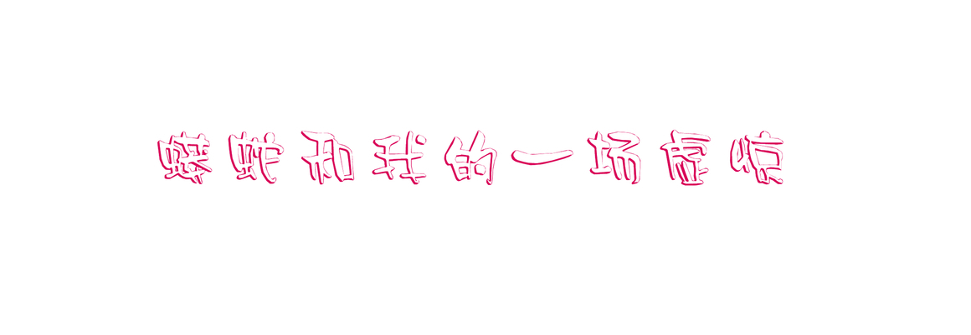
2024-4湖丽衢三地市英语模拟考试
傅嘉
problem---solution +结合《课程标准》阐述“三处衔接一处结尾”

Slide 3
I first met Bo when I volunteered to be a docent(讲解员)at the zoo. It was a summer program our school participated in, where biology students earned extra credit by teaching little kids about some of the animals. I needed to increase my biology grade, so I asked my friend Sue Wang to be my partner. “Melanie, I'll do this with you," she said, "but I'll do the talking. No way will I handle the animals!” That was OK with me.
During the training course, our instructor, Mr. Lindsey came to Sue and me and said, “OK, girls, your animal is a boa(蟒蛇).” I felt myself go cold. “I have to handle a boa?”
That night, I had a nightmare. I was carrying the snake around a classroom, showing the kids, when all of a sudden it started constricting(收紧). It squeezed and squeezed, and I couldn't breathe! I woke up in a sweat, my body rigid.
Next day I told my instructor. “ Sure you can do it,” he said. He slid the door of the snake carrier open. “Now put your elbow in—slowly —and wait for him to crawl on your arm. Good, that's the way.” He wasn't wet or slimy. He was dry and soft! But it was scary! Mr. Lindsey stood beside me. “Relax, Melanie. You need to show him you aren't afraid. He needs to trust you, and you need to trust him.” Yeah, right. He didn't do anything. Awesome! I named him Bo. After a few school visits, I began to really like my boa and was pretty much at ease with him.
Then came the day I will never forget. As usual, I opened the carrier and took him out. After Sue talked about how boas live mostly in rain forests in Central and South America, I walked around the classroom, saying, “Don't be afraid. See, he is nice. You can touch him gently, here, on his back. His name is Bo.”
Most of the kids actually did touch him, and everything went fine until one boy, for some unknown reasons, tapped Bo on the head. I froze.

Slide 4
Read for main ideas
《高中英语课程标准》中，对普通高中英语课程语言技能要求提出的目标：
1.通过阅读能从语篇中提取主要信息和主要观点；
2. 能够理解语篇的要义。

Slide 5
I first met Bo when I volunteered to be a docent(讲解员)at the zoo. It was a summer program our school participated in, where biology students earned extra credit by teaching little kids about some of the animals. I needed to increase my biology grade, so I asked my friend Sue Wang to be my partner. “Melanie, I'll do this with you," she said, "but I'll do the talking. No way will I handle the animals!” That was OK with me.
main idea
Background of the story: why I met Bo

Slide 6
During the training course, our instructor, Mr. Lindsey came to Sue and me and said, “OK, girls, your animal is a boa(蟒蛇).” I felt myself go cold. “I have to handle a boa?”
That night, I had a nightmare. I was carrying the snake around a classroom, showing the kids, when all of a sudden it started constricting(收紧). It squeezed and squeezed, and I couldn't breathe! I woke up in a sweat, my body rigid.
main idea
my nightmare of a boa

Slide 7
Next day I told my instructor. “ Sure you can do it,” he said. He slid the door of the snake carrier open. “Now put your elbow in—slowly —and wait for him to crawl on your arm. Good, that's the way.” He wasn't wet or slimy. He was dry and soft! But it was scary! Mr. Lindsey stood beside me. “Relax, Melanie. You need to show him you aren't afraid. He needs to trust you, and you need to trust him.” Yeah, right. He didn't do anything. Awesome! I named him Bo. After a few school visits, I began to really like my boa and was pretty much at ease with him.
main idea
Trust is the core of our harmonious relationship.

Slide 8
Then came the day I will never forget. As usual, I opened the carrier and took him out. After Sue talked about how boas live mostly in rain forests in Central and South America, I walked around the classroom, saying, “Don't be afraid. See, he is nice. You can touch him gently, here, on his back. His name is Bo.” Most of the kids actually did touch him, and everything went fine until one boy, for some unknown reasons, tapped Bo on the head. I froze.
main idea
my unforgettable experience

Slide 9

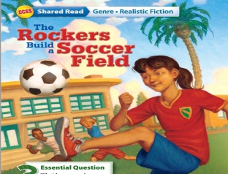

1. 基于语义连贯
理顺叙事元素
深度解读语篇
--摘自 吴俊峰老师的2024年 高考临门一脚读后续写押题

Slide 10
原文本类型探究
梳理原文故事叙事模式，构建“ 问题---解决 ”的叙事模式。
1. 矛盾与冲突1：（conflict – solution 1 )
I need extra credits to increase my biology grade--- volunteered to be a docent at the zoo – my partner Sue --- our agreement --- Sue did the talking vs I handle the animals.
2. 矛盾冲突2： ( conflict– solution 2 )
An unexpected event happened: A boy tapped Bo’s head

Slide 11
3. 矛盾与冲突1 解决后的结果：首尾呼应 （结尾与叙事背景呼应）
The ending result: Sue and I earned our extra credits and I increased my grade as I had expected.
《课程标准》 读后续写的主题意义的探究: 培养学生核心素养。在英语学科中落实立德树人的根本任务。读后续写，将语言的理解与语言的产出紧密结合， 实现语言育人作用。
4. 矛盾冲突2 解决后的结果；确定主题词：升华主题 （结尾与主题升华呼应）
I learned an unforgettable lesson--- respect and trust work wonders in nature/ in the kingdom of wild animals.

Slide 12
Read for clues and echoes
阅读过程中寻找原文伏笔，进行同向顺承或反向表达：

Slide 13
clues | echoes
I first met Bo when I volunteered to be a docent(讲解员)at the zoo. It was a summer program our school participated in, where biology students earned extra credit by teaching little kids about some of the animals. I needed to increase my biology grade, so I asked my friend Sue Wang to be my partner. “Melanie, I'll do this with you," she said, "but I'll do the talking. No way will I handle the animals!” That was OK with me. | The cooperation between Sue and me paid off / was fruitful---I achieved my goal and earned extra credits as I had expected. ( 点题） Sue continued her talking about boas’ living habits and their daily routines.

Slide 14
clues | echoes
That night, I had a nightmare. I was carrying the snake around a classroom, showing the kids, when all of a sudden it started constricting (收紧). It squeezed and squeezed, and I couldn't breathe! I woke up in a sweat, my body rigid. | 3. Still carrying the snake around my arms, I could sense Bo starting constricting. It squeezed and squeezed and I could hardly breathe, my body rigid and cold. (第一段My nightmare came true. )

Slide 15
clues | echoes
“Relax, Melanie. You need to show him you aren't afraid. He needs to trust you, and you need to trust him.” Yeah, right. He didn't do anything. Awesome! I named him Bo. After a few school visits, I began to really like my boa and was pretty much at ease with him. | I showed no sign of fear and total trust to Bo. Meanwhile, I consoled him by touching/ stroking his back gently. 5. He didn’t do anything to me . Awesome! （ 4、5 剧情需要，原文进行再次利用。建议适当改写。） 6. Bo was at ease again in the carrier. ( 危机解除，重新放回蛇笼）

Slide 16
clues | echoes
Then came the day I will never forget. As usual, I opened the carrier and took him out. After Sue talked about how boas live mostly in rain forests in Central and South America, I walked around the classroom, saying, “Don't be afraid. See, he is nice. You can touch him gently, here, on his back. His name is Bo.” Most of the kids actually did touch him, and everything went fine until one boy, for some unknown reasons, tapped Bo on the head. I froze. | 7. I would never forget that day as it taught me how to treat animals---Just respect and trust them and we will live in harmony/ the world will be harmonious. My blood ran cold and I held my breath, rooted to the ground, signaling Sue to take all the kids out of the room in case something terrible should happen.

Slide 17
Sort through details of the story

Slide 18
Analyze the original story
My purpose : to increase my biology grade
My solution : be a volunteer zoo docent and co-work with Sue.
2. My fear of the boa: had a nightmare
Mr. Lindsey’s solution : trust Bo
3. Our unexpected experience in a classroom in a school:
Conflict : a boy tapped Bo
4. Continuation : my real nightmare

Slide 19
本文六要素：
Time： a day
Place: in a classroom in a school
Characters: I ( Melanie) , Bo ( 蟒蛇），Sue ( my friend &partner)
Mr. Lindsey ( my training instructor); kids
(第一个冲突的why/ how / result)
Why: I needed to increase my biology grade.
5. How: ( participated in a school program with my partner Sue)
6. Result: （achieve my goal as I had wished 呼应原文第一段的背景---我的愿望）

Slide 20
本文六要素：
Time： a day
Place: in a classroom in a school
Characters: I ( Melanie) , Bo ( 蟒蛇），Sue ( my friend &partner)
Mr. Lindsey ( my training instructor); kids
(第二个冲突的why/ how / result)
Why: a boy tapped Bo’s head
5. How: (续写内容：My nightmare came true. 危机出现—如何解决）
6. Result: （续写内容：Everything went nice and learn how to treat animals--- respect and trust them.)

Slide 21
Aspects in Continuation
本文以第一人称视角进行叙事， 故事的主角是I, 配角很多，看情
节需要可以在续写的过程中，看情节需要来自如安排配角的出场。
人物多的好处，就是考生可以多角度进行故事的接续，内容会更
加充实，丰富且有创造性；
地点不变：in the classroom; 但第二段首句signaled the kids to come inside , 第一段: all the kids were led/ guided out of the classroom 时间 a day 具体时间无法明确，可以忽略；
本文立意角度： 人类如何与动物相处：尊重并信赖；一般来说，
原文如果有一个角色说了一句比较有哲理的话，这句话一定是主
题的暗示语。考生可以完全借鉴这句话来引领文章的行文方向，
并以此升华主题，体现育人作用。

Slide 22
2. 基于语义连贯
设置问题驱动
合理发展情节
--摘自 吴俊峰老师的2024年 高考临门一脚读后续写押题

Slide 23
续写两段的构思安排：
Para1: My worst nightmare came true!
Scene 1:
How to describe Bo’s response and actions
Scene2:
How did the kids feel?
Scene3:
How did I feel and what did I do ?
What is the proper ending to relate to Para2?

Slide 24
Para2: I closed the carrier and signaled the kids to come inside.
Scene 1:
How did the kids feel? Where was the carrier now?
Scene2:
How did I and Sue feel? What did we do then?
Scene3:
What did the kids learn? What did Sue and I get?
What will be the possible ending ?

Slide 25
3. 基于语义连贯
增强语境关联
促成协同效应
--摘自 吴俊峰老师的2024 年 高考临门一脚读后续写押题

Slide 26
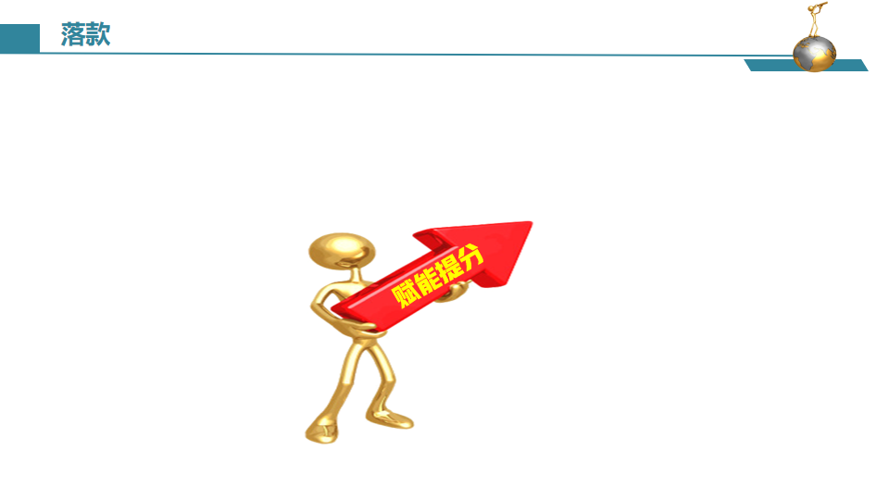


语篇衔接的三个“一定”
根据衔接连贯理论，通过词汇的有效衔接（词汇同现或词汇复现）实现语义连贯和逻辑衔接。
第一段结尾
①一定要有与第二段段首句中的同词或同义词。
②实现无缝衔接
第一、二段开头
①一定要把段首句的名词或动词（尤其是后半句），用在写作开头，实现语义连贯。
②力争高分开头
第二段结尾
①一定要呼应原文中体现主题或伏笔的关键词。
②实现主题升华
--摘自 吴俊峰老师的2024 年 高考临门一脚读后续写押题

Slide 27
Design plots for each paragraph
确定核心词汇：所给段落首句的名词、动词、地点、时间等要读透，并利用所给段落首句的核心词汇进行两段首句的创作，增强与原文的协同性，一致性，确保续写内容与原文故事语义连贯；
附评分标准：第五档：（21—25 分）与所给短文融洽度高，与段落开头衔接合理，内容丰富，有效地使用了语句间连接成分，使所续写短文结构紧凑

Slide 28
结合原文本最后一段定首段Link 1
Para1: My worst nightmare came true!
Link1 A: （核心词: my worst nightmare 起到衔接作用；+常识：现实中蛇受到攻击后的表现)
Bo took quick action to defend himself, sticking out his red forked tongue to detect its attacker, which scared the whole class.

Slide 29
结合原文本最后一段定首段Link 1
Para1: My worst nightmare came true!
Link1B: （核心词: my worst nightmare 起到衔接作用，回扣原文Nightmare )
Still carrying the snake around my arms, I could sense Bo starting constricting. It squeezed and squeezed and I could hardly breathe, my body rigid and cold.

Slide 30
结合原文本最后一段定首段Link 1
Para1: My worst nightmare came true!
Link1 C: （核心词: my worst nightmare 起到衔接作用；+常识：现实中蛇受到攻击后的表现)
Sensing a danger, Bo stuck out his terrifying long red forked tongue, making terrifying noises. All the kids were scared to death!

Slide 31
结合第二段首句定Link2: （句群）
Para1: My worst nightmare came true!
Link2A: (根据第二段所给首句 the carrier，可推知Bo已经被安全放进去。）
Amazingly, Bo released my arms and I put him back in the carrier.
Para2: I closed the carrier and signaled the kids to come inside.

Slide 32
结合第二段首句定Link2: （句群）
Para1: My worst nightmare came true!
Link2B: (根据第二段所给首句 the carrier，可推知Bo已经被安全放进去。）
Gradually, Bo relaxed and loosened and I took the opportunity to put Bo back in the carrier.
Para2: I closed the carrier and signaled the kids to come inside.

Slide 33
结合第二段首句定第二段Link3
Para2: I closed the carrier and signaled the kids to come inside.
Link3A: (以 小孩子为叙事对象：孩子被带进教室，仍是满脸害怕）
Despite the unexpected episode, all the kids, still wearing a scared look on their face, were guided back in by Sue.

Slide 34
结合第二段首句定第二段Link3
Para2: I closed the carrier and signaled the kids to come inside.
Link3B: (以carrier以及里面的Bo为叙事对象）
Bo rested at ease in the carrier as if nothing had happened at all.

Slide 35
结合主题立意或呼应原文设定目标定 Ending
Para2: I closed the carrier and signaled the kids to come inside.
Ending A： (回扣原文第一段的背景---我的愿望+我的感想）
Our cooperative summer programme eventually paid off . As I wished, I increased my biology grade. But what counted to me was that we and animals should respect and trust each other.

Slide 36
结合主题立意或呼应原文设定目标定 Ending
Para2: I closed the carrier and signaled the kids to come inside.
Ending B： ( 升华主旨；人类动物相处之道）
Only if we human beings respect and trust wild animals like Bo can we live in harmony with them.

Slide 37
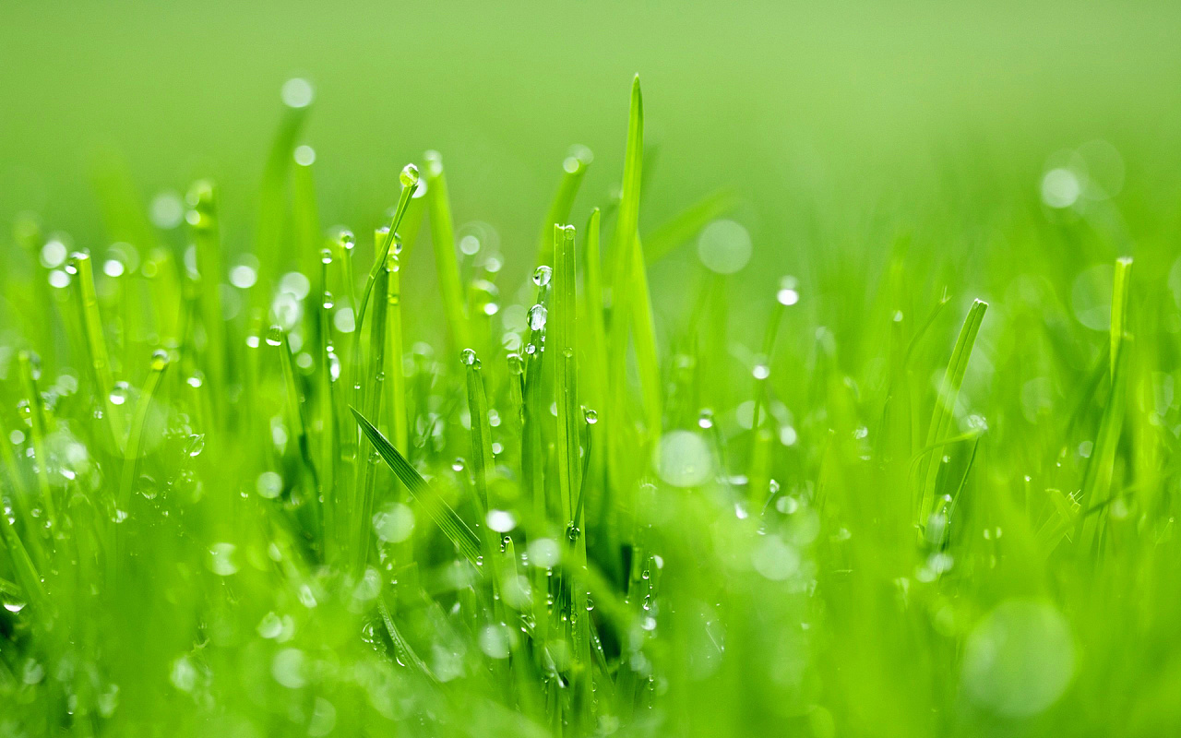
习作欣赏

Slide 38
Para1: My worst nightmare came true! Bo took quick action to defend himself, sticking out his red forked tongue to detect its attacker, which scared the whole class. Panicked and alarmed , Bo began constricting and squeezed my arms. My blood ran cold and I held my breath, rooted to the ground. Mr. Lindsey’s words echoed in my ears, “He needs to trust you, and you need to trust him.” Immediately, I signaled Sue to take all the kids out of the room in case something terrible should happen. I showed no sign of fear and total trust to Bo, consoling/ soothing him by touching/ stroking his back gently. Amazingly, Bo released my arms and I put him back in the carrier.

Slide 39
Para2: I closed the carrier and signaled the kids to come inside.Despite the unexpected episode, all the kids, still wearing a scared look on their face, were guided back in by Sue. Sue and I breathed a sigh of relief , knowing everything had come back to normal. I put the carrier in the center of the classroom and asked the kids to gather around it. Sue continued her detailed narration about boas’ living habits and their habitats. What delighted us most was that they all listened attentively, eager for more knowledge about boas. The boy who tapped Bo’s head just now asked when Bo attacked humans. I took a glance at all the kids and Bo, explaining that Bo would never attack us purposely unless we attacked him. Only if we human beings respect and trust wild animals like Bo can we live in harmony with them.

Slide 40
Para2: I closed the carrier and signaled the kids to come inside. Bo rested at ease in the carrier as if nothing had happened at all. Surrounded by the lovely kids, Bo showed trust to them and lived his routine life. When the kids saw its gentle aspect, their caution and tension gave way to curiosity and eagerness for knowledge. It was time for Sue to continue her work to get kids informed of boa’s living habits and protection. Looking back on the unexpected episode , I could still sense the fear and helplessness inside me. Thanks to the mutual trust between me and Bo, a potential disaster was prevented and I was safe and unharmed. Our cooperative summer programme ended and paid off . As I wished, I increased my biology grade. But what counted to me was that we and animals should respect and trust each other.

