Slide 1


感恩遇见，相互成就，本课件资料仅供您个人参考、教学使用，严禁自行在网络传播，违者依知识产权法追究法律责任。
更多教学资源请关注
公众号：溯恩英语
知识产权声明

Slide 2

The World
March 16th-31st, 2024

Slide 3
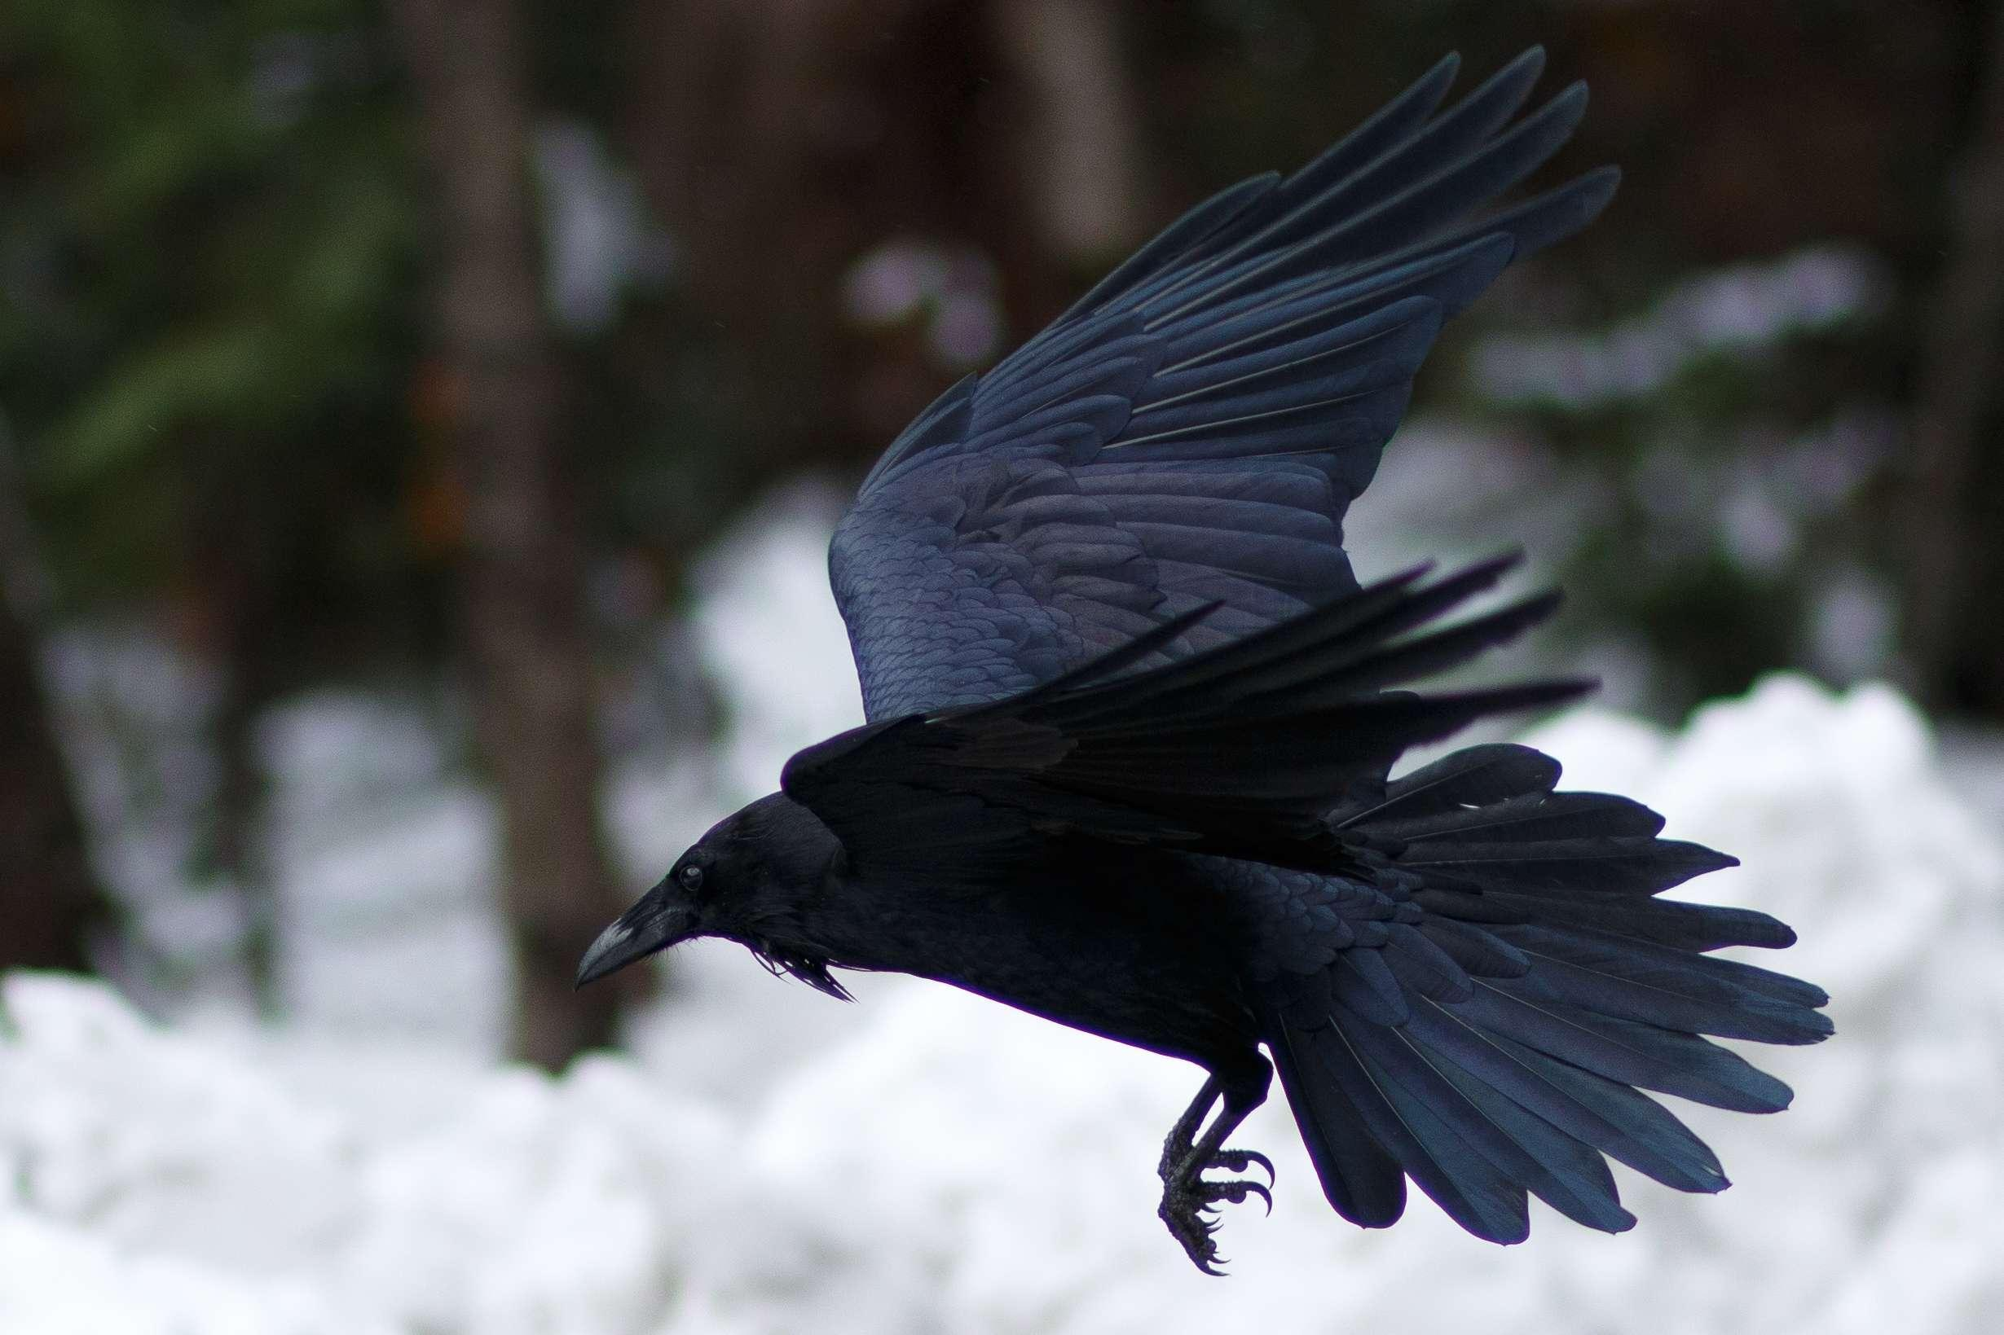
1. Raven’s return
渡鸦的回归

Slide 4
Text Completion
BBC Wildlife ( March 2024 Page 10)
Come March, the breeding season is ___ full swing for several British birds - ravens _______ (include). By now most ravens will be incubating eggs and some pairs, especially in southern England and Wales, will have hungry chicks _______ (feed). Nesting so early in the year is not a problem for such _________ (adapt), omnivorous birds. After all, there’s plenty of carrion to be found.
Once, ravens were more ___ less restricted to hill country and were associated with cliffs, desolate peaks and wilderness, ____ in recent decades, following a welcome decline in persecution, they ____________ (return) to many of their former haunts throughout the lowlands. A few ravens have even started nesting again in the arable __________ (landscape) of East Anglia. The giant crow’s dramatic change in fortune is matched by the comeback of the peregrine, buzzard and ___ number of other much-persecuted birds.
In lowland areas ravens often nest in Scots pines and on pylons, and ___________ (occasion) on tall buildings. Resident pairs perform acrobatic displays above their nest site to strengthen pair bonding and -who knows? - perhaps also out of pure joy.
in
included
to feed
adaptable
or
but
have returned
landscapes
a
occasionally

Slide 5
Vocabulary
1. omnivorous: eating all types of food, especially both plants and meat杂食的
Brown bears are omnivorous, eating anything that they can get their paws on. 棕熊是杂食动物，抓到什么吃什么。
2. desolate: empty and without people, making you feel sad or frightened无人居住的；荒无人烟的；荒凉的
The house stood in a bleak and desolate landscape. 那所房子坐落在萧瑟荒凉的原野上。
Translation
猪是杂食性动物。
Pigs are omnivorous animals.
Translation
这个采矿小镇荒凉而丑陋。
The little mining town was desolate and ugly.

Slide 6
Translation
Nesting so early in the year is not a problem for such adaptable, omnivorous birds. After all, there’s plenty of carrion to be found.
对于这种适应性强的杂食性鸟类来说，这么早筑巢不是问题。毕竟，有很多腐肉等着他们去找。
Once, ravens were more or less restricted to hill country and were associated with cliffs, desolate peaks and wilderness, but in recent decades, following a welcome decline in persecution, they have returned to many of their former haunts throughout the lowlands.
曾经，渡鸦或多或少局限于山地，与悬崖、荒凉的山峰和荒野联系在一起，但近几十年来，随着迫害的减少，它们又回到了许多以前在低地出没的地方。

Slide 7
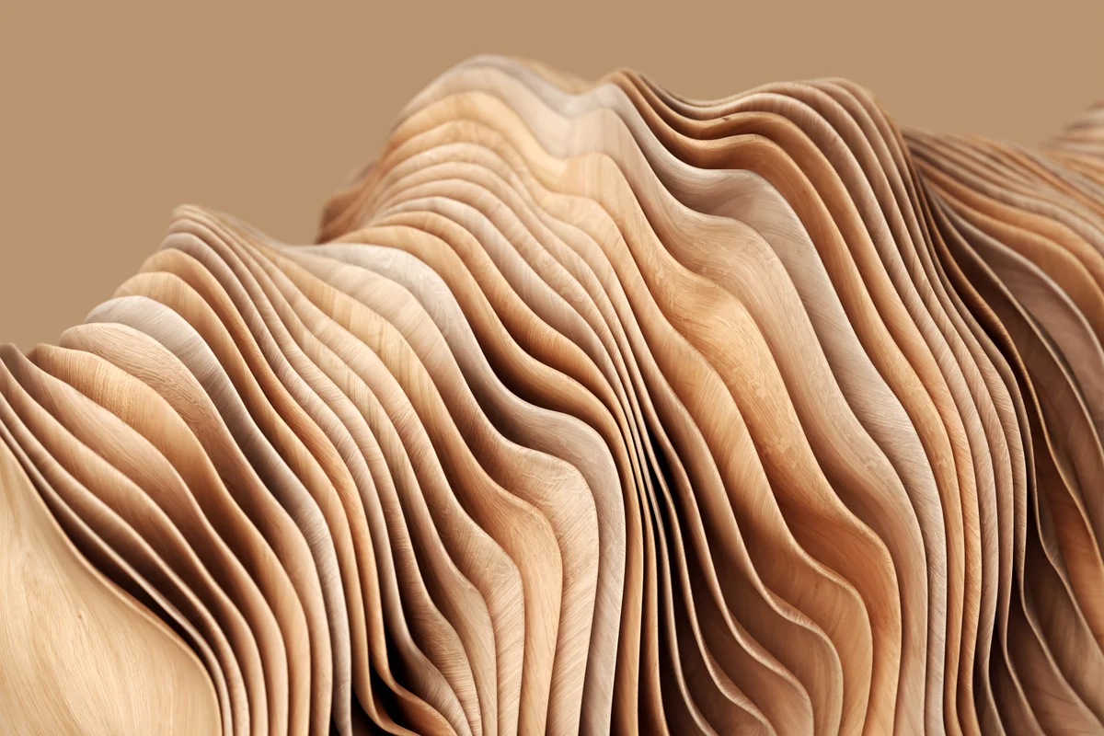
2. Buildings could be 3D printed using ink made of waste wood
建筑可以用废木材制成的墨水进行3D打印

Slide 8
Reading Comprehension
New Scientist ( 23rd March 2024 Page 13)
Recycled wood can be turned into an ink for 3D printing, which could offer a more sustainable way to make furniture or build houses. “Wood has been used for building and structural purposes for centuries,” says Muhammad Rahman at Rice University in Texas. But using it isn’t especially efficient, because cutting wood down to size can result in lots of waste.
To make use of this leftover material, Rahman and his colleagues split it into lignin and cellulose-molecules that are key to the stiff structure of wood-and broke these down to form nanofibres and nanocrystals. They then recombined the cellulose and lignin with water to make a clay-like substance that could be used as an ink. The researchers used this substance for 3D printing by forcing it through a nozzle and building up layers of ink.
To boost the strength of the 3D-printed objects, the team freeze-dried them to remove moisture and then heated them up to 180℃ (356℉) to make the lignin soften and fuse with the cellulose. “We can actually mimic all the visual, textural and olfactory properties of natural wood,” says Rahman. The product was found to be nearly six times as durable as natural balsa wood in compression tests and up to three times as flexible in bending tests.
So far, the researchers have managed to create miniature furniture and honeycomb structures using the ink, but they hope it could eventually be used to build larger objects, such as houses.
“We need to rethink how we can make structures without cutting down trees,” says Rahman. “If we can recycle waste wood using 3D printing instead of conventional manufacturing, that would be a good step forward.”

Slide 9

Reading Comprehension
1. What leads to the inefficiency of wood using in building structures?
A. The poor skills of the carpenters B. The produced leftover material
C. The low quality of the wood D. The insufficiency of funds
2. What’s the main idea of Paragraph 2?
A. The future of 3D printing technology. B. The usage of recycled wood.
C. The process of producing inks. D. The qualities of the researchers.
3. Which of the following can replace the underlined word “mimic”?
A. imitate. B. develop. C. compare D. destroy.

Slide 10
Vocabulary
1. mimic: to look or behave like sth else （外表或行为举止）像，似
The robot was programmed to mimic a series of human movements. 机器人可按程序设计模仿人的各种动作。
2. miniature: very small; much smaller than usual 很小的；微型的；小型的
It looks like a miniature version of James Bond’s car. 它看上去像一辆小型的詹姆斯•邦德的汽车。
Translation
她在学我们办公室里各种人的样子。
She was mimicking the various people in our office.
Translation
我为我侄女的娃娃屋买了一些微型家具。
I bought some miniature furniture for my niece’s doll’s house.

Slide 11
Translation
To make use of this leftover material, Rahman and his colleagues split it into lignin and cellulose-molecules that are key to the stiff structure of wood-and broke these down to form nanofibres and nanocrystals.
为了利用这些剩余的材料，拉赫曼和他的同事们将其分解成木质素和纤维素——这两种分子是木材坚硬结构的关键——并将它们分解成纳米纤维和纳米晶体。
So far, the researchers have managed to create miniature furniture and honeycomb structures using the ink, but they hope it could eventually be used to build larger objects, such as houses.
到目前为止，研究人员已经成功地用这种墨水制造出了微型家具和蜂窝结构，但他们希望这种墨水最终能用于建造更大的物体，比如房子。

Slide 12
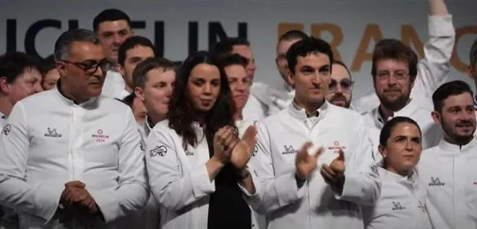
3. Stars do not shine for female chefs, admits Michelin boss 米其林老板承认，女厨师不会得到青睐

Slide 13
Text Completion
The Times (19th March 2024 P31)
The head of the Michelin Guide has bemoaned the absence of women at the top of French cuisine after awarding the coveted three-star rating to another two male ______ (chef).
The guide is widely criticised but remains the most influential in France, _____ its star ratings able to make or break careers. Gwendal Poullennec, the guide’s director, sought to fend off ________ (criticise) over its failure to honour more women in a speech in which he claimed that there were _______ (simple) not enough of them running prestigious restaurant kitchens.
“It is not the first time we ____________ (notice) this,” he said, adding that although there were an increasing number of women working in restaurant kitchens “too few” of them made ___ to the top.
The issue is inflammatory following widespread accusations of sexism and sexual in French restaurants in recent years.
Perhaps aware that the issue would arise, Poullennec introduced a short film at the Michelin
ceremony _________ (show) women chefs at work across France. He said he believed they would rise to senior positions and be in line _____________ (honour) by the guide in years to come.
This year, however, men still ___________ (dominate). All the eight chefs elevated to two stars were men, as were the vast majority of those _____ obtained a single star for the first time.
chefs
with
criticism
simply
have noticed
it
showing
to be honoured
dominated
who

Slide 14
Vocabulary
1. bemoan: to complain or say that you are not happy about sth. 哀怨；悲叹
They sat bemoaning the fact that no one would give them a chance.
他们坐着埋怨别人不肯给他们一个机会。
2. fend off: to protect yourself from difficult questions, criticisms, etc., especially by avoiding them 避开，回避（难题、批评等）
The Federal Reserve began raising rates to fend off inflation.
联邦储备委员会开始提高利率以防止通货膨胀。
Translation
大学和其他研究机构抱怨经费不足。
Universities and other research establishments bemoan their lack of funds.
Translation
她设法避开了关于新增赋税的问题。
She managed to fend off questions about new tax increases.

Slide 15
Vocabulary
3. inflammatory: intended to cause very strong feelings of anger 煽动性的；使人发怒的
These ideas may seem tame today, but they were inflammatory in his time.
这些想法今天看来也许是平淡乏味的，但在他那个时代却是很有煽动的。
4. elevate: to give sb/sth a higher position or rank 提拔，晋升
He elevated many of his friends to powerful positions within the government.
他将许多朋友都提拔到政府部门的要职上。
Translation
煽动性的话更有可能鼓励更多的人参与进来。
Inflammatory words are more likely to encourage more people to participate.
Translation
他被提拔到总裁的职位。
He was elevated to the post of president.

Slide 16
Translation
The head of the Michelin Guide has bemoaned the absence of women at the top of French cuisine after awarding the coveted three-star rating to another two male chefs.
《米其林指南》的主编将令人垂涎的三星评级颁给了另外两名男厨师，对法国烹饪界缺少女性感到遗憾。
Gwendal Poullennec, the guide’s director, sought to fend off criticism over its failure to honour more women in a speech in which he claimed that there were simply not enough of them running prestigious restaurant kitchens.
该指南的负责人Gwendal Poullennec在一次演讲中试图反驳人们对该指南未能表彰更多女性的批评，他声称，经营知名餐厅厨房的女性人数根本不够多。

Slide 17
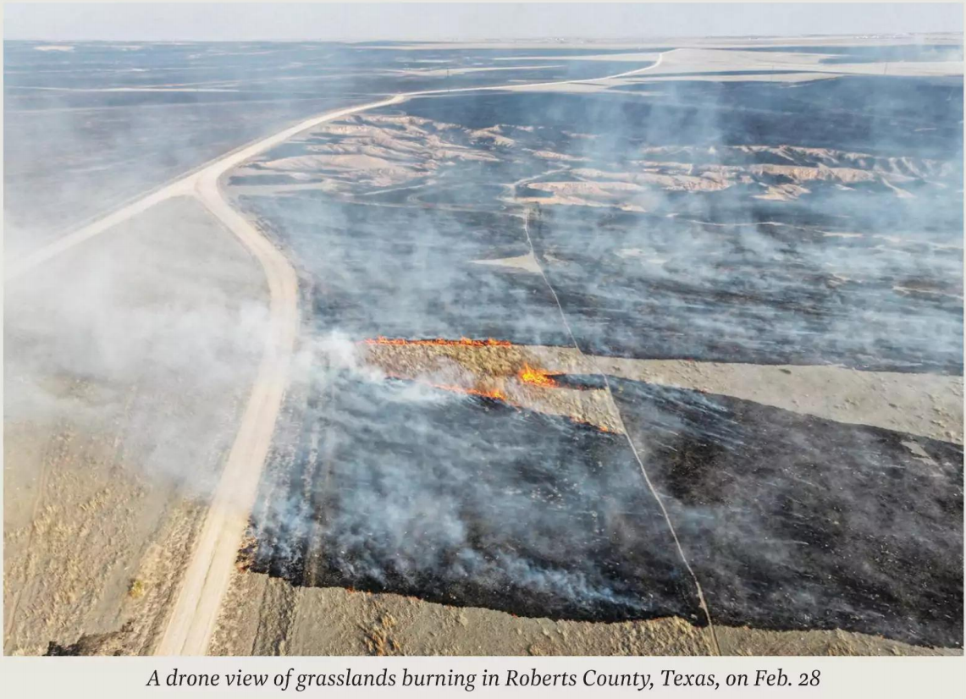
4. Texas’ Scorched Panhandle 德克萨斯州大火

Slide 18
Text Completion
Time (25th March 2024 P13)
The Smokehouse Creek Fire was named for the place it began on Feb. 26, the grasslands lining a tributary to the Canadian River north of Amarillo, Texas. ____ within days, dry winds had blown it into the second largest wildfire in U.S. history—__ galloping, aptly named conflagration that by March 6 had burned 1.1 million acres and caused the ______ (dead) of two people.
Three other wildfires—the Windy Deuce, the Magenta, and the Grape Vine Creek—also raged into the first week of March, ______ (take) in a few days nearly half as many acres as wildfires had burned across the entire nation in all of 2023. As of March 7, only the Magenta had been contained.
Evacuations were ordered across the region, and at least 500 structures were destroyed. But in cattle country, most of the losses were animals—thousands of head ____ (lose) among the millions that graze grasslands that had grown _________ (especial) tall over the past year.
On the other end of the state, President Biden ____ (pay) tribute to first responders during a visit __ the border at Brownsville. “______ disasters strike, there is no red state or blue state where I come from, he said. “There are just communities and families looking for help.” He noted that Texas had received $13 billion in relief funding under his presidency, and that the _________ (frequent) of disasters flowing from extreme weather has ticked up sharply.
But
a
deaths
taking
lost
especially
paid
to
When
frequency

Slide 19
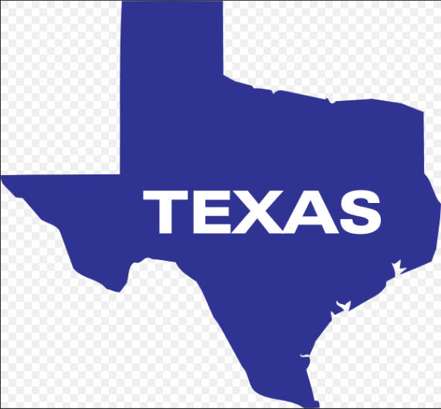
Reading Comprehension
1. What does the underlined word “conflagration” in paragraph 1 mean?
A. A natural disaster. B. A destructive fire.
C. A serious disease. D. A severe drought.
2. Which of the following statements is correct?
A. The Smokehouse Creek Fire is the largest wildfire in America.
B. Three other wildfires had been put out by March 7.
C. Most of the losses were the infrastructure.
D. Biden called for unity during his visit to Brownsville.

Slide 20
Vocabulary
1. apt: suitable or appropriate in the circumstances 恰当的；适当的
The words of this report are as apt today as in 1929.
这份报告的措词用在今天和用在1929年一样贴切。
2. tribute: something that you say, do, or make to show your admiration and respect for someone 致敬；颂词；献礼
I would like to pay tribute to the tireless work done by our volunteers.
我要向我们的志愿者们孜孜不倦的工作表示敬意。
Translation
这不是对我们状况的恰当描述。
This is not an apt description of our condition.
Translation
部长向与大火搏斗的人们致敬。
The minister paid tribute to the people who had fought the big fire.

Slide 21
Translation
But within days, dry winds had blown it into the second largest wildfire in U.S. history— a galloping, aptly named conflagration that by March 6 had burned 1.1 million acres and caused the deaths of two people.
但在几天之内，经干燥的风一吹，它成了美国历史上第二大的野火——一场巧妙命名并极速蔓延的大火，到3月6日已经烧毁了110万英亩的土地，并造成两人死亡。
But in cattle country, most of the losses were animals—thousands of head lost among the millions that graze grasslands that had grown especially tall over the past year.
但在养牛的乡下，损失的大部分是牲畜——数百万头牲畜在过去一年里在长得特别高的草原上放牧，大火致使损失了其中的数千头。

Slide 22

5. CNN News 03/22/2024

Slide 23

Dictation
All right, we begin today in Iceland where a volcano has erupted again.
It’s the fourth time since December a volcano has erupted in southwest Iceland. This time forcing the _________ of the popular tourist destination Blue Lagoon, as well as the nearby town of Grindavik. According to officials who spoke with Iceland’s public broadcaster RUV, this eruption is considered as the most ________ of recent seismic activity. Iceland is one of the most __________________ on the planet. So, despite the ________ dangers, the country is well prepared for these events, utilizing anti-lava barriers and other measures to protect people and critical infrastructure. Our Michael Holmes has the latest for us, and the why, as this latest event is something tourists were hoping to _______.
A siren wails at the world-famous Blue Lagoon Spa in Iceland. The orange plume _________ the night sky means it’s time to evacuate again. For some tourists, this is part of the __________, one of the reasons they came to Iceland: to see its active volcanoes. And there has been a lot of activity lately. This is the fourth time since December that a volcano has erupted in Southwest Iceland, less than an hour from the country’s capital Reykjavik. The fissure is _________ to be roughly three kilometers long and flowing once again towards the town of Grindavik, where _______________ are working to reinforce the town’s ________.
evacuation
powerful
active volcanic areas
potential
witness
lighting up
excitement
estimated
emergency teams
defenses

Slide 24
Vocabulary
1. wail: to make a long high sound 发出长而高的声音；呼啸
Police cars, their sirens wailing, accompanied the lorries.
警车护送着大卡车，一路警笛长鸣。
2. reinforce: to make a structure or material stronger, especially by adding another material to it 加固；使更结实
Eventually, they had to reinforce the walls with exterior beams.
最终，他们不得不通过增加外梁来对墙体进行加固。
Translation
紧闭的窗户外狂风呼啸。
The wind wailed outside the closed windows.
Translation
所有建筑现在都已经加固，以抗地震。
All buildings are now reinforced to withstand earthquakes.

Slide 25
Translation
So, despite the potential dangers, the country is well prepared for these events, utilizing anti-lava barriers and other measures to protect people and critical infrastructure.
因此，尽管有潜在的危险，这个国家已经为这些事件做好了充分的准备，利用防熔岩屏障和其他措施来保护人和关键的基础设施。
A siren wails at the world-famous Blue Lagoon Spa in Iceland. The orange plume lighting up the night sky means it’s time to evacuate again. For some tourists, this is part of the excitement, one of the reasons they came to Iceland: to see its active volcanoes. And there has been a lot of activity lately.
在举世闻名的冰岛蓝湖水疗中心，警报器在鸣叫。橙色的烟柱照亮了夜空，意味着又到了疏散的时候了。对于一些游客来说，这是令人兴奋的一部分，也是他们来冰岛的原因之一：看活火山。而最近火山活动正频繁发生。

