Slide 1

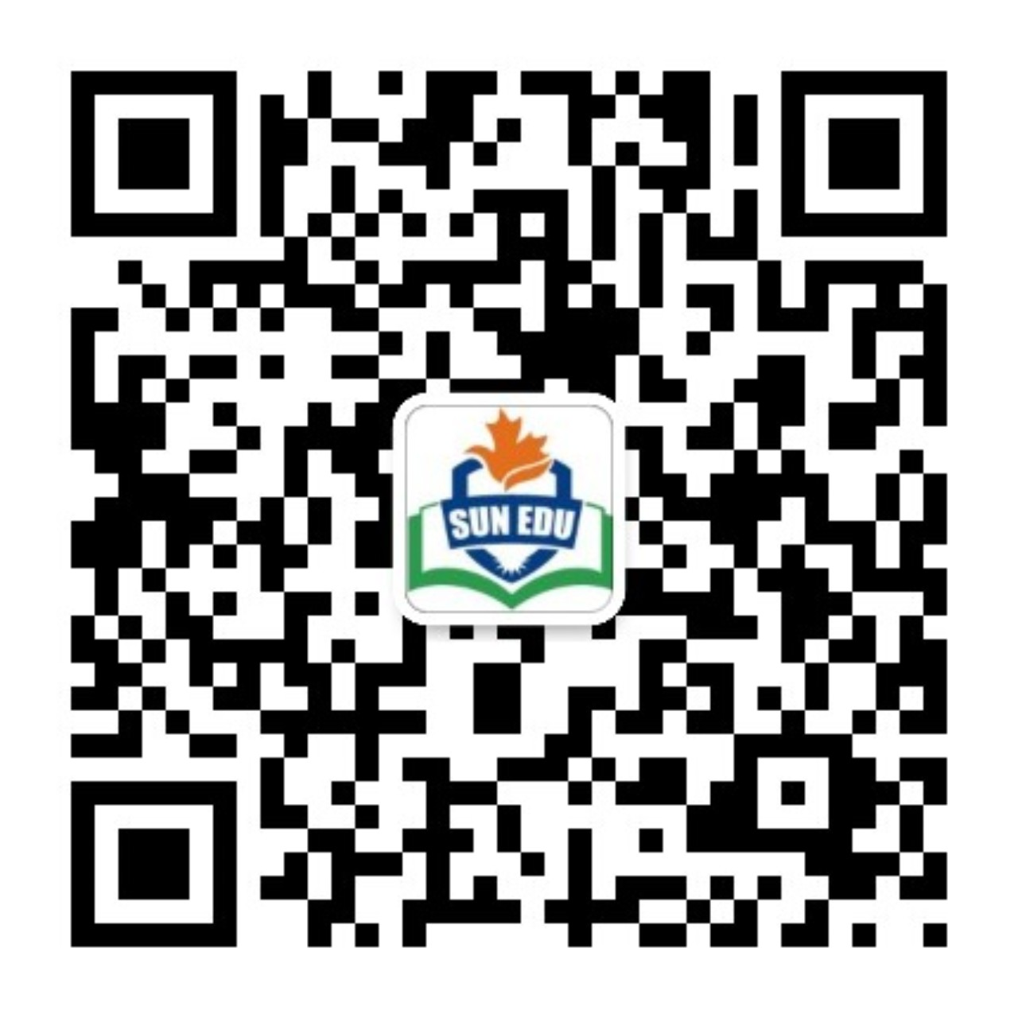
感恩遇见，相互成就，本课件资料仅供您个人参考、教学使用，严禁自行在网络传播，违者依知识产权法追究法律责任。
更多教学资源请关注
公众号：溯恩英语
知识产权声明

Slide 2
P52
1. About a month ago, I was sailing, and towards night I found myself ________(carry) out to sea by a strong wind. The next morning I ____________(spot) by a ship.
carried
was spotted
find + o+ o.c. (doing/ done/ adj /prep)
Even the best writer sometimes find themselves ________ (lose) for
words.
lost
有时候即使最好的作家也会发现自己找不到合适词汇来表达.
smoking
A cook will be immediately fired if he is found __________ (smoke) in the kitchen.
Dusk found a little girl ___________( cry) in the street.
crying

Slide 3
v. spotted, spotted
to see or notice a person or thing, especially suddenly or when it is not easy to do so 注意到；发现
They ____________ (spot) by police as they were entering the bank.
were spotted
Spain is our favorite holiday spot.
spot
a particular area or place地点；场所；处所
His jacket was covered with spots of mud.
a small dirty mark on something
污迹；污渍；脏点

Slide 4
spot v. spotted, spotted
If you spot any mistakes in the article, just mark them with a pencil.
The police spotted him driving a stolen car.
The policewoman spotted that I hadn’t got my seat belt on and signalled me to stop.
spot sb/ sth
spot sb doings th
spot +clause

Slide 5
that
2. It was the ship _______ brought you to England.
It is/ was + 需强调的部分+that +剩余部分
It is/ was + 需强调的人+that/who +剩余部分
Mary met her friend in the street yesterday.
It was Mary who/that met her friend in the street yesterday.
It was her friend who/that Mary met in the street yesterday.
It was in the street that Mary met her friend yesterday.
It was yesterday that Mary met her friend in the street.
Mary did meet her friend in the street yesterday.

Slide 6
manner
以友好的方式/态度
in a friendly manner
以坦率的方式
in a frank manner
以（对方）可以接受的方式/做法
in an acceptable manner
他的彬彬有礼受到了老师的称赞。
His good manners were praised by his teachers.
他一点也不讲礼貌。
He has no manners at all.
Table manners

Slide 7
The past future tense
would do
was/ were going to
was about to do sth
(when sb did sth.)

Slide 8
When my parents went on business trips, my grandparents _________ look after me.
He said he ___________ be there at 8 o’clock and so he will.
Hey, Timmy, I ______________ call you. But now that you are here, I don’t have to.
I _____________ take part in the event, but it was cancelled.
The sky was full of dark clouds. Obviously, it ______________ rain.
Oliver _____________ get the letter when Roderick asked him to.
常见/习惯性动作
would
would
意愿或承诺要做的事
was going to
本来打算的计划，但未能如愿发生虚拟
was going to
was going to
根据某种迹象表明即将发生
was about to

Slide 9
was about to
Li Bai went aboard and _________________ leave when he suddenly heard the stamping sound from the bank. （李白乘舟将欲行，忽闻岸上踏歌声。）
Mrs Thomson ______________ sit down to watch the opera when her phone rang.
I ____________________ turn off the computer when I received an email.
was about to
was about to
…was/were about to do when sth/sb did…
刚要…，突然就在这时…

Slide 10
Ex I: on P85
sort n.
sorted v.
suit n.
suited v.
judges n
judge v
tailored v.
tailor
spot n.
spotted v.
maintain a balance between their income and expenses well 保持收支平衡
tailor v. to make or adapt something for a particular purpose, a particular person, etc.专门制作；定做

Slide 11
Ex II:
by accident
in case 万一
as a matter of fact
in a direct manner
In that case 在那种情况下
pop into one’s mind …被突然想到

Slide 12
Ex 3 on P 86
hesitating, whispered, permission, judged, seeking (seek out 寻找到)
duties patience settled
settle on 选择; 选定

Slide 13
Ex 4 on P 86
1. I was sitting on the stairs outside the opera house, admiring the external appearance of the building and remembering the day I saw a show there many years ago.
2. The author indicates that to some extent the hero and heroine are both responsible for the tragic situation in the end.
3. One of his duties as a producer is to seek the best actors for the roles in the play, including minor roles such as the bank clerk, tailor, hotel manager, waiter and servant.
4. The film tells the story of a young man who bought a small boat to sail around the world and the adventures he had before he went back to his hometown and settled down.
5. Knowing their daughter planned to go to a drama school, they set aside some money every month so that she would not need to apply for student loans for college.
6. The clerk was speechless in amazement when he saw the million-pound note. When he returned to normal, he made a thousand apologies for not being able to break the note.

Slide 14
Discovering useful structures– Activity 1
1. had better, ought to: for advice
2. must, can’t: possibility ;
must: obligation,
can’t: permission
3. would: past future modal
will: polite request,
will: simple future modal
4. may: polite request
may: possibility
might: possibility less likely to happen
5. couldn’t: ability
could: polite request
can’t: possibility

Slide 15
Discovering useful structures– Activity 2
1. One good turn deserves another. 善有善报,以德报德
ought to/should
2. Hope for the best, but prepare for the worst.抱最大希望但做最坏打算.
should/ought to/ had better
3. There is no such thing as a free lunch. 天下没有免费的午餐.
might/may
4. God helps those who help themselves.自助者天助。
mustn’t/shouldn’t/ ought not to
5. Beggars can’t be choosers. 有求于人，无权挑剔。
have to

Slide 16
Discovering useful structures– Activity 3
can’t, ought to/could, must, would, Could/Can, can’t, had better, could/can
Discovering useful structures– Activity 4
1. wouldn’t /weren’t going to give him a loan
2. would/were going to offer him a job
3 would know everything
4. was going to explain why he couldn’t pay the bill
5. wouldn’t hold such a large note
6. was going to give the note back/give back the note.

